Slide 1
CSP571 Data Preparation and Analysis
Lecture 19. Statistical Methods for Data Analysis
Oleksandr Narykov
onarykov@iit.edu

Slide 2
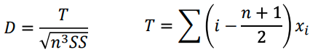
D’Agostino Test
A very powerful test for departures from normality.
First, the data are ordered from smallest to largest or largest to smallest
Based on the D statistic, which gives an upper and lower critical value
where D is the test statistic, SS is the sum of squares of the data and n is the sample size, and i is the order or rank of observation x. The df for this test is n (sample size).

Slide 3
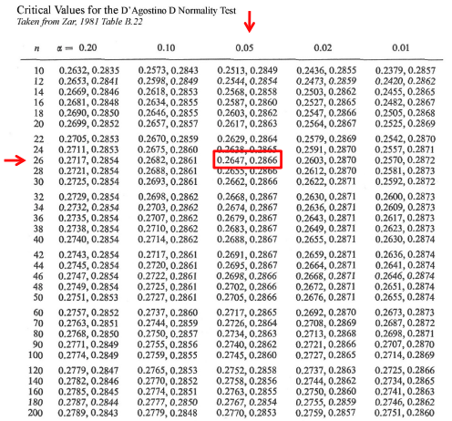
D’Agostino Test
Use the next lower n on the table if the sample size is not listed

Slide 4
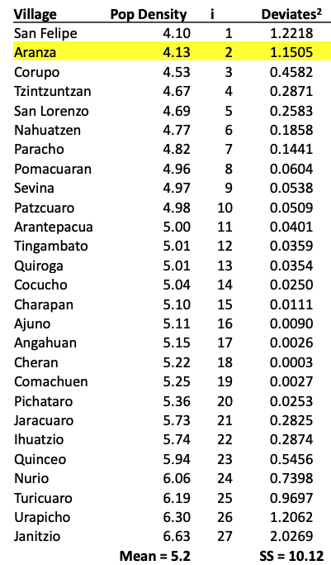
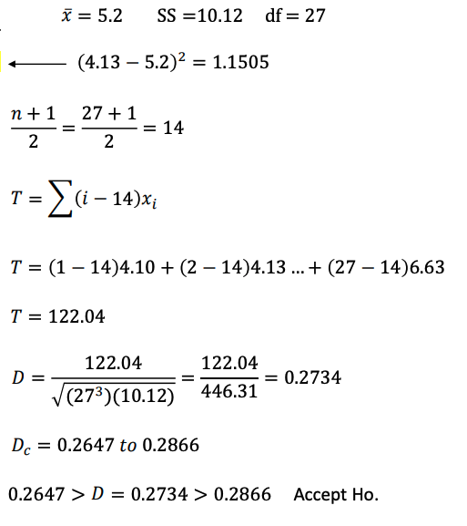
D’Agostino Test

Slide 5
Nonparametric Tests

Slide 6
Parametric vs Nonparametric
Typical parametric tests can only assess continuous data and the results can be significantly affected by outliers.
Conversely, some nonparametric tests can handle ordinal data, ranked data, and not be seriously affected by outliers

Slide 7
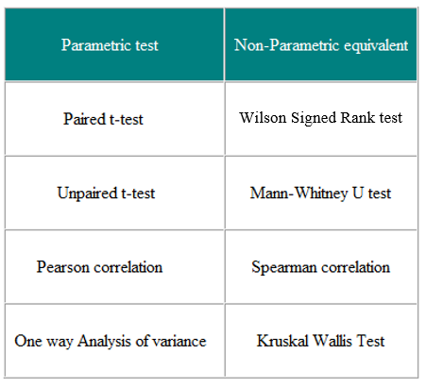
Parametric and Nonparametric Equivalents
Notes:
In the example, only 5 graduate students preferred face-to-face instruction, compared with the expected value of 18.
Forty undergraduate students preferred face-to-face instruction, while the expected value was 27.
Therefore, researchers can conclude not only that there is an association between the variables, but they can also describe the association.
Researchers can conclude that graduate students prefer online instruction, whereas undergraduate students prefer face-to-face instruction.

Slide 8
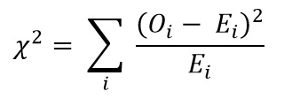
Chi-Square Test
It is calculated by the sum of the squared difference between observed (O) and the expected (E) data (or the deviation, d) divided by the expected data by the following formula:

Slide 9
Chi-Square Test
To determine whether the association between two qualitative variables is statistically significant, researchers must conduct a test of significance called the Chi-Square Test
H0: There is no significant association between variables
H1: There is significant association between variables

Slide 10
Chi-Square Test
It is calculated by the sum of the squared difference between observed (O) and the expected (E) data (or the deviation, d) divided by the expected data by the following formula:

Slide 11
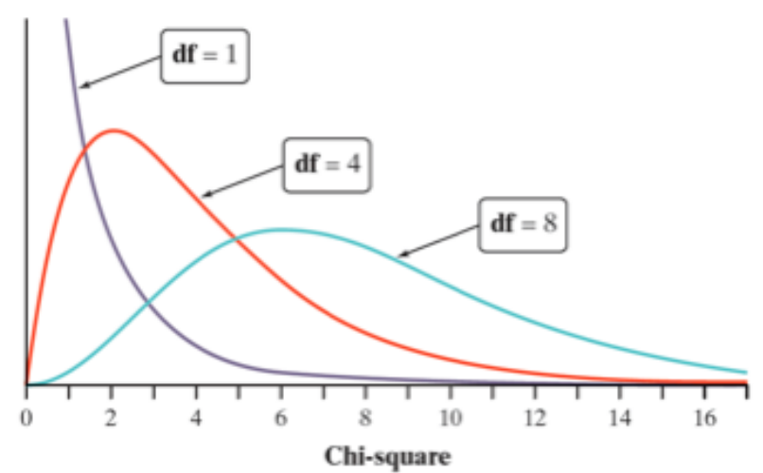
Chi-Square Test
Chi-Squared distributions:

Slide 12
Chi-Square Test
Interpretation
Compare selected percents: which cells occur in very different percentages than the other cells?
Compare observed and expected cell counts: which cells have more or less observations than would be expected if H0 were true?
Look at the terms of the chi-square statistic: which cells contribute the most to the value of chi squared?
Notes:
▪ T tests can be used to determine whether there are significant differences between undergraduate and graduate students or between face-to-face and online instruction.
▪ However, these procedures would be conducted separately by education level and then by instructional preference. This would not reveal an association between the two variables.
▪ Correlation analysis is typically used to measure the association between variables, but correlation can only be used with quantitative variables.
▪ In order to compare categorical variables, the data can be summarized into a table, which lists the options for one variable as the rows and the options for the other variable as the columns. This is called a crosstab because two variables are being tabulated at the same time, and the frequency, or the percentage of individuals in each subcategory, are being counted.

Slide 13
Chi-Square Test Example
Question: Is there an association between students’ preference for online or face-to-face instruction and their education level?
Survey Items:
Are you an undergraduate or graduate student? Undergraduate or Graduate
Which method of instructional delivery do you prefer? Face-to-face or Online
Moore, D. S., Notz, W. I, & Flinger, M. A. (2013). The basic practice of statistics (6th ed.). New York, NY: W. H. Freeman and Company.

Slide 14
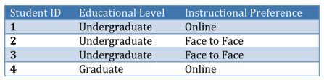

Chi-Square Test Example
Data:

Slide 15
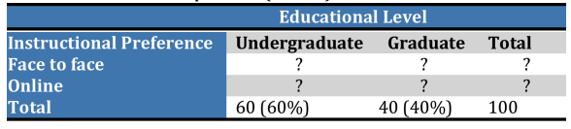
Chi-Square Test Example
Cross-tabulation table
Notes:
▪ T tests can be used to determine whether there are significant differences between undergraduate and graduate students or between face-to-face and online instruction.
▪ However, these procedures would be conducted separately by education level and then by instructional preference. This would not reveal an association between the two variables.
▪ Correlation analysis is typically used to measure the association between variables, but correlation can only be used with quantitative variables.
▪ In order to compare categorical variables, the data can be summarized into a table, which lists the options for one variable as the rows and the options for the other variable as the columns. This is called a crosstab because two variables are being tabulated at the same time, and the frequency, or the percentage of individuals in each subcategory, are being counted.

Slide 16
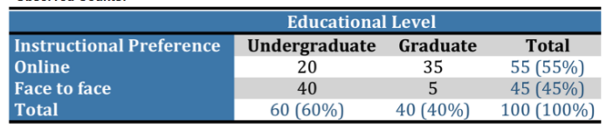
Chi-Square Test Example
Cross-tabulation table
Notes:
▪ T tests can be used to determine whether there are significant differences between undergraduate and graduate students or between face-to-face and online instruction.
▪ However, these procedures would be conducted separately by education level and then by instructional preference. This would not reveal an association between the two variables.
▪ Correlation analysis is typically used to measure the association between variables, but correlation can only be used with quantitative variables.
▪ In order to compare categorical variables, the data can be summarized into a table, which lists the options for one variable as the rows and the options for the other variable as the columns. This is called a crosstab because two variables are being tabulated at the same time, and the frequency, or the percentage of individuals in each subcategory, are being counted.

Slide 17
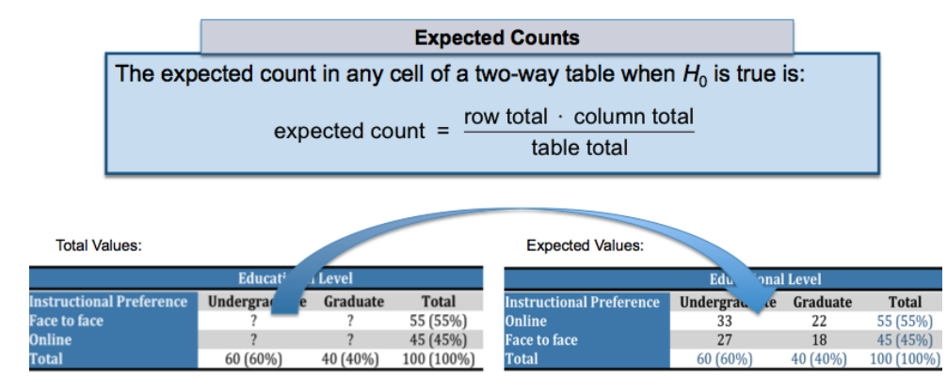
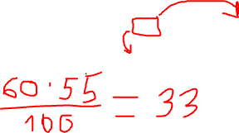
Chi-Square Test Example
Cross-tabulation table
Notes:
▪ T tests can be used to determine whether there are significant differences between undergraduate and graduate students or between face-to-face and online instruction.
▪ However, these procedures would be conducted separately by education level and then by instructional preference. This would not reveal an association between the two variables.
▪ Correlation analysis is typically used to measure the association between variables, but correlation can only be used with quantitative variables.
▪ In order to compare categorical variables, the data can be summarized into a table, which lists the options for one variable as the rows and the options for the other variable as the columns. This is called a crosstab because two variables are being tabulated at the same time, and the frequency, or the percentage of individuals in each subcategory, are being counted.

Slide 18
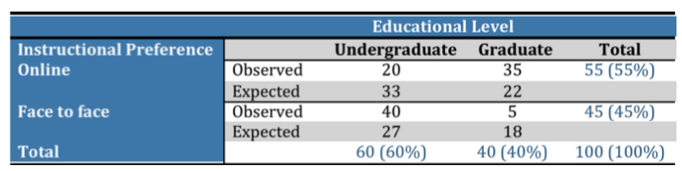

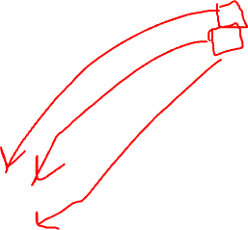
Chi-Square Test Example
Cross-tabulation table
Notes:
▪ T tests can be used to determine whether there are significant differences between undergraduate and graduate students or between face-to-face and online instruction.
▪ However, these procedures would be conducted separately by education level and then by instructional preference. This would not reveal an association between the two variables.
▪ Correlation analysis is typically used to measure the association between variables, but correlation can only be used with quantitative variables.
▪ In order to compare categorical variables, the data can be summarized into a table, which lists the options for one variable as the rows and the options for the other variable as the columns. This is called a crosstab because two variables are being tabulated at the same time, and the frequency, or the percentage of individuals in each subcategory, are being counted.

Slide 19
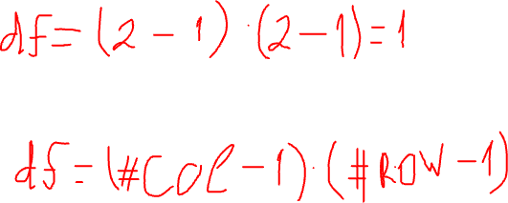
Chi-Square Test Example
Cross-tabulation table
Notes:
▪ T tests can be used to determine whether there are significant differences between undergraduate and graduate students or between face-to-face and online instruction.
▪ However, these procedures would be conducted separately by education level and then by instructional preference. This would not reveal an association between the two variables.
▪ Correlation analysis is typically used to measure the association between variables, but correlation can only be used with quantitative variables.
▪ In order to compare categorical variables, the data can be summarized into a table, which lists the options for one variable as the rows and the options for the other variable as the columns. This is called a crosstab because two variables are being tabulated at the same time, and the frequency, or the percentage of individuals in each subcategory, are being counted.

Slide 20
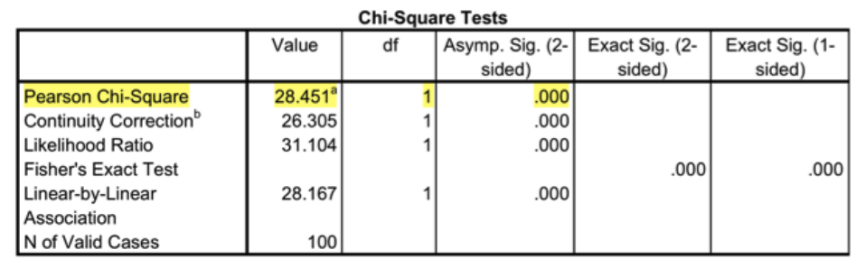
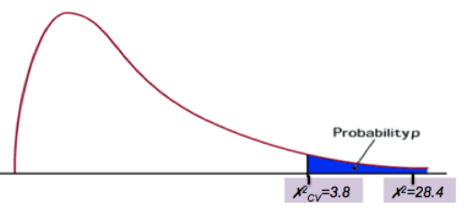
Chi-Square Test Example
Statistical significance
Notes:
▪ T tests can be used to determine whether there are significant differences between undergraduate and graduate students or between face-to-face and online instruction.
▪ However, these procedures would be conducted separately by education level and then by instructional preference. This would not reveal an association between the two variables.
▪ Correlation analysis is typically used to measure the association between variables, but correlation can only be used with quantitative variables.
▪ In order to compare categorical variables, the data can be summarized into a table, which lists the options for one variable as the rows and the options for the other variable as the columns. This is called a crosstab because two variables are being tabulated at the same time, and the frequency, or the percentage of individuals in each subcategory, are being counted.

Slide 21
Chi-Square Test Example
Interpretation
Compare selected percents: which cells occur in very different percentages than the other cells?
Compare observed and expected cell counts: which cells have more or less observations than would be expected if H0 were true?
Look at the terms of the chi-square statistic: which cells contribute the most to the value of chi squared?
Notes:
▪ T tests can be used to determine whether there are significant differences between undergraduate and graduate students or between face-to-face and online instruction.
▪ However, these procedures would be conducted separately by education level and then by instructional preference. This would not reveal an association between the two variables.
▪ Correlation analysis is typically used to measure the association between variables, but correlation can only be used with quantitative variables.
▪ In order to compare categorical variables, the data can be summarized into a table, which lists the options for one variable as the rows and the options for the other variable as the columns. This is called a crosstab because two variables are being tabulated at the same time, and the frequency, or the percentage of individuals in each subcategory, are being counted.

Slide 22
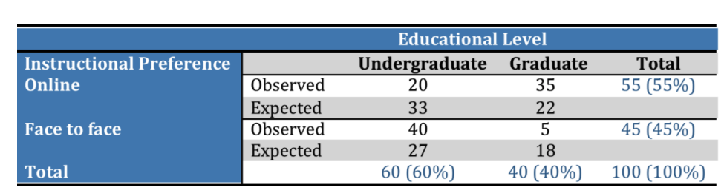
Chi-Square Test Example
Interpretation
Notes:
In the example, only 5 graduate students preferred face-to-face instruction, compared with the expected value of 18.
Forty undergraduate students preferred face-to-face instruction, while the expected value was 27.
Therefore, researchers can conclude not only that there is an association between the variables, but they can also describe the association.
Researchers can conclude that graduate students prefer online instruction, whereas undergraduate students prefer face-to-face instruction.

Slide 23
Chi-Square Test Example
Interpretation
Notes:
In the example, only 5 graduate students preferred face-to-face instruction, compared with the expected value of 18.
Forty undergraduate students preferred face-to-face instruction, while the expected value was 27.
Therefore, researchers can conclude not only that there is an association between the variables, but they can also describe the association.
Researchers can conclude that graduate students prefer online instruction, whereas undergraduate students prefer face-to-face instruction.

Slide 24
The Wilcoxon's Signed Rank Test
Wilcoxon's rank sum test ranks all data points in order, calculates the rank sum of each sample and compares the difference in the rank sums.
For testing whether the differences observed in the values of the quantitative variable between two correlated samples (before and after design ) are statistically different or not
This test corresponds to the paired t test.
Notes:
In the example, only 5 graduate students preferred face-to-face instruction, compared with the expected value of 18.
Forty undergraduate students preferred face-to-face instruction, while the expected value was 27.
Therefore, researchers can conclude not only that there is an association between the variables, but they can also describe the association.
Researchers can conclude that graduate students prefer online instruction, whereas undergraduate students prefer face-to-face instruction.

Slide 25
The Wilcoxon's Signed Rank Test
H₀: There is no difference in the paired values, on average, between the two groups.
H_{1:} There is a difference in the paired values, on average, between the two groups.
Notes:
In the example, only 5 graduate students preferred face-to-face instruction, compared with the expected value of 18.
Forty undergraduate students preferred face-to-face instruction, while the expected value was 27.
Therefore, researchers can conclude not only that there is an association between the variables, but they can also describe the association.
Researchers can conclude that graduate students prefer online instruction, whereas undergraduate students prefer face-to-face instruction.

Slide 26
The Wilcoxon's Signed Rank Test
1. Compute the difference between each group of paired values in the two groups.
2. Rank the difference from smallest, without considering the sign of difference.
3. After giving ranks, the corresponding sign should be attached.
T+ (Sum of ranks of positive sign) and T- (Sum of ranks between negative sign). T is taken as smallest of T+ and T-. Then, Wstat is the smallest value of T- and T+ .
4. Find the W critical value from Wilcoxon’s Signed rank Table .
if Wstat < W_{Critical Value}; Reject H0.
Notes:
In the example, only 5 graduate students preferred face-to-face instruction, compared with the expected value of 18.
Forty undergraduate students preferred face-to-face instruction, while the expected value was 27.
Therefore, researchers can conclude not only that there is an association between the variables, but they can also describe the association.
Researchers can conclude that graduate students prefer online instruction, whereas undergraduate students prefer face-to-face instruction.

Slide 27
The Wilcoxon's Signed Rank Test Example
IQ values of 8 malnourished children of 4 years age before and after giving some nutritious diet for 3 months are given below
Before | 40 | 60 | 55 | 65 | 43 | 70 | 80 | 60
After | 50 | 80 | 50 | 70 | 40 | 60 | 90 | 85
Notes:
In the example, only 5 graduate students preferred face-to-face instruction, compared with the expected value of 18.
Forty undergraduate students preferred face-to-face instruction, while the expected value was 27.
Therefore, researchers can conclude not only that there is an association between the variables, but they can also describe the association.
Researchers can conclude that graduate students prefer online instruction, whereas undergraduate students prefer face-to-face instruction.

Slide 28
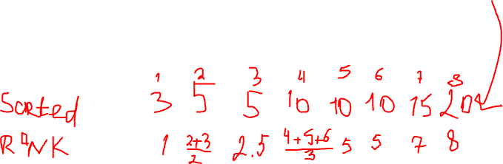
The Wilcoxon's Signed Rank Test Example
Before | 40 | 60 | 55 | 65 | 43 | 70 | 80 | 60
After | 50 | 80 | 50 | 70 | 40 | 60 | 90 | 85
Difference | -10 | -20 | 5 | -5 | 3 | 10 | -10 | -15
Absolute difference | 10 | 20 | 5 | 5 | 3 | 10 | 10 | 15
Rank | 5 | 8 | 2.5 | 2.5 | 1 | 5 | 5 | 7
Notes:
In the example, only 5 graduate students preferred face-to-face instruction, compared with the expected value of 18.
Forty undergraduate students preferred face-to-face instruction, while the expected value was 27.
Therefore, researchers can conclude not only that there is an association between the variables, but they can also describe the association.
Researchers can conclude that graduate students prefer online instruction, whereas undergraduate students prefer face-to-face instruction.

Slide 29
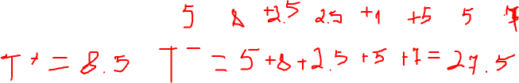
The Wilcoxon's Signed Rank Test Example
Before | 40 | 60 | 55 | 65 | 43 | 70 | 80 | 60
After | 50 | 80 | 50 | 70 | 40 | 60 | 90 | 85
Difference | -10 | -20 | 5 | -5 | 3 | 10 | -10 | -15
Absolute difference | 10 | 20 | 5 | 5 | 3 | 10 | 10 | 15
Rank | 5 | 8 | 2.5 | 2.5 | 1 | 5 | 5 | 7
Notes:
In the example, only 5 graduate students preferred face-to-face instruction, compared with the expected value of 18.
Forty undergraduate students preferred face-to-face instruction, while the expected value was 27.
Therefore, researchers can conclude not only that there is an association between the variables, but they can also describe the association.
Researchers can conclude that graduate students prefer online instruction, whereas undergraduate students prefer face-to-face instruction.

Slide 30
The Wilcoxon's Signed Rank Test Example
T+ = 8.5, T- = 27.5. T = 8.5
Wstat = 8.5, Wcritic = 3
Wstat > W_{Critical Value}; Accept H0.
Notes:
In the example, only 5 graduate students preferred face-to-face instruction, compared with the expected value of 18.
Forty undergraduate students preferred face-to-face instruction, while the expected value was 27.
Therefore, researchers can conclude not only that there is an association between the variables, but they can also describe the association.
Researchers can conclude that graduate students prefer online instruction, whereas undergraduate students prefer face-to-face instruction.

Slide 31
Mann Whitney U Test
For testing whether two independent samples with respect to a quantitative variable come from the same population or not.
Wilcoxon’s Rank Sum test.
It is used to test the null hypothesis that two samples have the same median or, alternatively, whether observations in one sample tend to be larger than observations in the other.
This test is alternative of t test for two independent samples
Notes:
In the example, only 5 graduate students preferred face-to-face instruction, compared with the expected value of 18.
Forty undergraduate students preferred face-to-face instruction, while the expected value was 27.
Therefore, researchers can conclude not only that there is an association between the variables, but they can also describe the association.
Researchers can conclude that graduate students prefer online instruction, whereas undergraduate students prefer face-to-face instruction.

Slide 32
Mann Whitney U Test
H₀: The average values in the two groups are the same
H_{1:} The average values in the two groups are the different
Notes:
In the example, only 5 graduate students preferred face-to-face instruction, compared with the expected value of 18.
Forty undergraduate students preferred face-to-face instruction, while the expected value was 27.
Therefore, researchers can conclude not only that there is an association between the variables, but they can also describe the association.
Researchers can conclude that graduate students prefer online instruction, whereas undergraduate students prefer face-to-face instruction.

Slide 33
Mann Whitney U Test
Let n₁ be the sample size of one group and n2 be the sample size of the second group; rank all the values in the two groups taken together. Tied values should be given same ranks.
The ranksum of each group is taken and U_{stat} is calculated using
U_{stat} = Rank Sum - {n(n +1)/2 }.
Both U₁ and U₂ is calculated and smaller value is taken as U_{stat.} and U_{critical value} is calculated from the Mann- Whitney U test table
If U_{stat} < U_{Critical value}; ; Reject H0.
Notes:
In the example, only 5 graduate students preferred face-to-face instruction, compared with the expected value of 18.
Forty undergraduate students preferred face-to-face instruction, while the expected value was 27.
Therefore, researchers can conclude not only that there is an association between the variables, but they can also describe the association.
Researchers can conclude that graduate students prefer online instruction, whereas undergraduate students prefer face-to-face instruction.

Slide 34
Mann Whitney U Test Example
Treatment A | Treatment B
3 4 2 6 2 5 | 9 7 5 10 6 8
Notes:
In the example, only 5 graduate students preferred face-to-face instruction, compared with the expected value of 18.
Forty undergraduate students preferred face-to-face instruction, while the expected value was 27.
Therefore, researchers can conclude not only that there is an association between the variables, but they can also describe the association.
Researchers can conclude that graduate students prefer online instruction, whereas undergraduate students prefer face-to-face instruction.

Slide 35
Mann Whitney U Test Example
Ranks | 1 | 2 | 3 | 4 | 5 | 6 | 7 | 8 | 9 | 10 | 11 | 12
Values | 2 | 2 | 3 | 4 | 5 | 5 | 6 | 6 | 7 | 8 | 9 | 10
Rank | 1.5 | 1.5 | 3 | 4 | 5.5 | 5.5 | 7.5 | 7.5 | 9 | 10 | 11 | 12
U_{stat} = Rank Sum - {n(n +1)/2 }.
Notes:
In the example, only 5 graduate students preferred face-to-face instruction, compared with the expected value of 18.
Forty undergraduate students preferred face-to-face instruction, while the expected value was 27.
Therefore, researchers can conclude not only that there is an association between the variables, but they can also describe the association.
Researchers can conclude that graduate students prefer online instruction, whereas undergraduate students prefer face-to-face instruction.

Slide 36
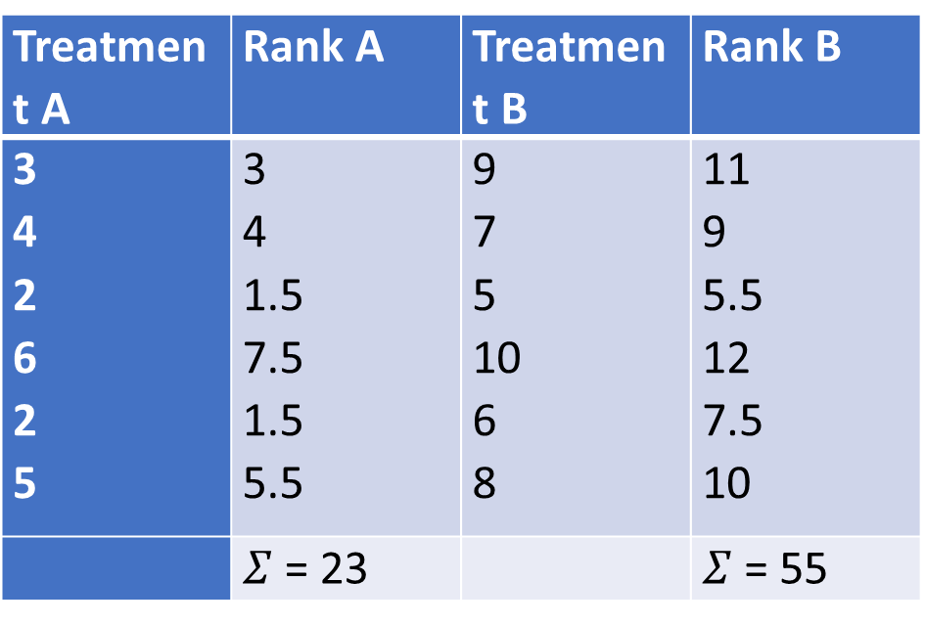
Mann Whitney U Test Example
Notes:
In the example, only 5 graduate students preferred face-to-face instruction, compared with the expected value of 18.
Forty undergraduate students preferred face-to-face instruction, while the expected value was 27.
Therefore, researchers can conclude not only that there is an association between the variables, but they can also describe the association.
Researchers can conclude that graduate students prefer online instruction, whereas undergraduate students prefer face-to-face instruction.

Slide 37

Mann Whitney U Test Example
U_{A} = 23 – 21 = 2, U_{B} = 55- 21 =34
so U_{stat} = 2 (lowest value)
U_{critic} = 5
Ustat < U_{Critical value}; Reject H₀.
Notes:
In the example, only 5 graduate students preferred face-to-face instruction, compared with the expected value of 18.
Forty undergraduate students preferred face-to-face instruction, while the expected value was 27.
Therefore, researchers can conclude not only that there is an association between the variables, but they can also describe the association.
Researchers can conclude that graduate students prefer online instruction, whereas undergraduate students prefer face-to-face instruction.

Slide 38
Kruscal-Wallis Test
The Kruskal–Wallis test is a non-parametric test to analyse the variance.
It is for the comparison among several independent samples.
For testing whether several independent samples of a quantitative variable come from the same population or not
It corresponds to one way analysis of variance in parametric methods.
Notes:
In the example, only 5 graduate students preferred face-to-face instruction, compared with the expected value of 18.
Forty undergraduate students preferred face-to-face instruction, while the expected value was 27.
Therefore, researchers can conclude not only that there is an association between the variables, but they can also describe the association.
Researchers can conclude that graduate students prefer online instruction, whereas undergraduate students prefer face-to-face instruction.

Slide 39
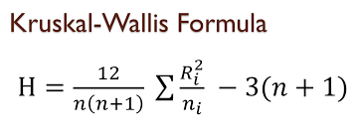
Kruscal-Wallis Test
It analyses if there is any difference in the median values of three or more independent samples.
The data values are ranked in an increasing order, and the rank sums calculated followed by calculation of the test
Where n is the total of sample sizes in all the groups and Ri is the sum of the ranks in the ith group.
Notes:
In the example, only 5 graduate students preferred face-to-face instruction, compared with the expected value of 18.
Forty undergraduate students preferred face-to-face instruction, while the expected value was 27.
Therefore, researchers can conclude not only that there is an association between the variables, but they can also describe the association.
Researchers can conclude that graduate students prefer online instruction, whereas undergraduate students prefer face-to-face instruction.

Slide 40
Kruscal-Wallis Test
H₀: The average values in the different groups are the same
H_{1:} The average values in the different groups are the different
Notes:
In the example, only 5 graduate students preferred face-to-face instruction, compared with the expected value of 18.
Forty undergraduate students preferred face-to-face instruction, while the expected value was 27.
Therefore, researchers can conclude not only that there is an association between the variables, but they can also describe the association.
Researchers can conclude that graduate students prefer online instruction, whereas undergraduate students prefer face-to-face instruction.

Slide 41
Kruscal-Wallis Test Example
Sample 1 | Sample 2 | Sample 3
8 10 9 12 11 13 | 10 9 13 14 9 16 | 13 8 9 13 17 15
Notes:
In the example, only 5 graduate students preferred face-to-face instruction, compared with the expected value of 18.
Forty undergraduate students preferred face-to-face instruction, while the expected value was 27.
Therefore, researchers can conclude not only that there is an association between the variables, but they can also describe the association.
Researchers can conclude that graduate students prefer online instruction, whereas undergraduate students prefer face-to-face instruction.

Slide 42

Kruscal-Wallis Test Example
Rank | 1 | 2 | 3 | 4 | 5 | 6 | 7 | 8 | 9 | 10 | 11 | 12 | 13 | 14 | 15 | 16 | 17 | 18
Values | 8 | 8 | 9 | 9 | 9 | 9 | 10 | 10 | 11 | 12 | 13 | 13 | 13 | 13 | 14 | 15 | 16 | 17
Tied rank | 1.5 | 1.5 | 4.75 | 4.75 | 4.75 | 4.75 | 7.5 | 7.5 | 9 | 10 | 12.5 | 12.5 | 12.5 | 12.5 | 15 | 16 | 17 | 18
Notes:
In the example, only 5 graduate students preferred face-to-face instruction, compared with the expected value of 18.
Forty undergraduate students preferred face-to-face instruction, while the expected value was 27.
Therefore, researchers can conclude not only that there is an association between the variables, but they can also describe the association.
Researchers can conclude that graduate students prefer online instruction, whereas undergraduate students prefer face-to-face instruction.

Slide 43
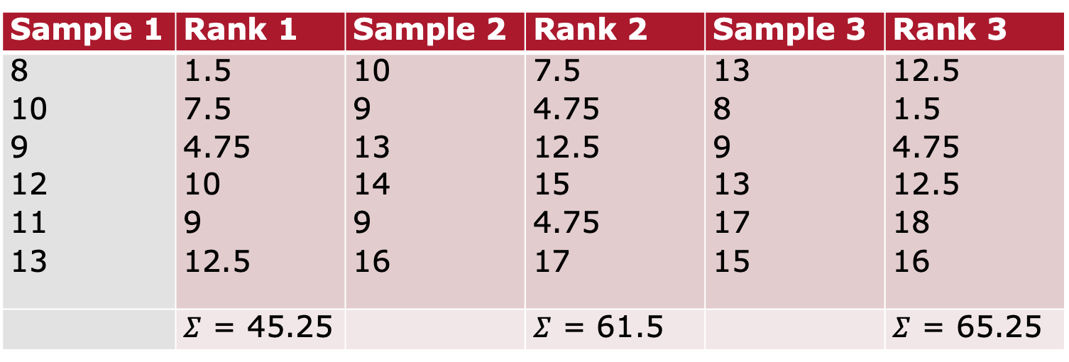
Kruscal-Wallis Test Example
Sample 1 | Rank 1 | Sample 2 | Rank 2 | Sample 3 | Rank 3
8 10 9 12 11 13 | 1.5 7.5 4.75 10 9 12.5 | 10 9 13 14 9 16 | 7.5 4.75 12.5 15 4.75 17 | 13 8 9 13 17 15 | 12.5 1.5 4.75 12.5 18 16
 | $Σ$ = 45.25 |  | $Σ$ = 61.5 |  | $Σ$ = 65.25
Notes:
In the example, only 5 graduate students preferred face-to-face instruction, compared with the expected value of 18.
Forty undergraduate students preferred face-to-face instruction, while the expected value was 27.
Therefore, researchers can conclude not only that there is an association between the variables, but they can also describe the association.
Researchers can conclude that graduate students prefer online instruction, whereas undergraduate students prefer face-to-face instruction.

Slide 44
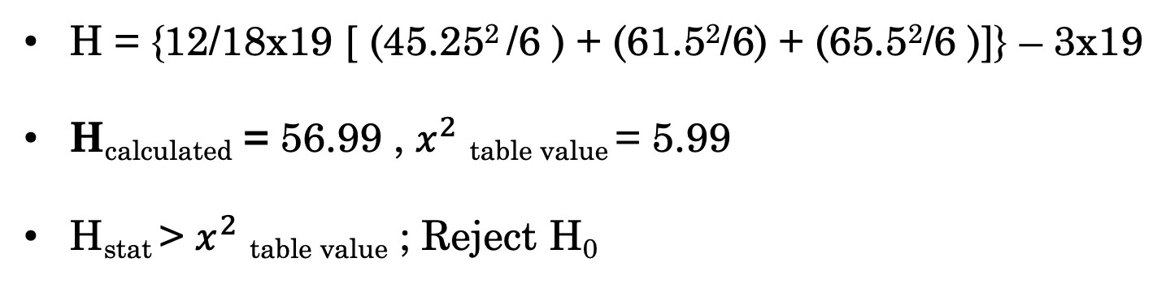

Kruscal-Wallis Test Example
H = {12/18x19 [ (45.25² /6 ) + (61.5²/6) + (65.5²/6 )]} – 3x19
H_{calculated} = 56.99 , $x^{2}$ _{table value} = 5.99
H_{stat} > $x^{2}$ _{table value} ; Reject H₀
Notes:
In the example, only 5 graduate students preferred face-to-face instruction, compared with the expected value of 18.
Forty undergraduate students preferred face-to-face instruction, while the expected value was 27.
Therefore, researchers can conclude not only that there is an association between the variables, but they can also describe the association.
Researchers can conclude that graduate students prefer online instruction, whereas undergraduate students prefer face-to-face instruction.

Slide 45
Kruscal-Wallis Test Example
H₀: The average values in the different groups are the same
H_{1:} The average values in the different groups are the different
Notes:
In the example, only 5 graduate students preferred face-to-face instruction, compared with the expected value of 18.
Forty undergraduate students preferred face-to-face instruction, while the expected value was 27.
Therefore, researchers can conclude not only that there is an association between the variables, but they can also describe the association.
Researchers can conclude that graduate students prefer online instruction, whereas undergraduate students prefer face-to-face instruction.

Slide 46
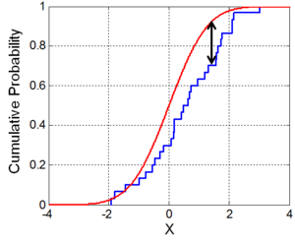
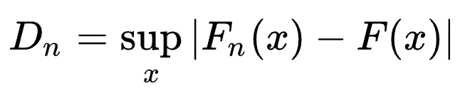


Kolmogorov-Smirnov Test
Nonparametric of the equality of continuous (or discontinuous), one-dimensional probability distributions that can be used to test whether a sample came from a given reference probability distribution (one-sample K–S test), or to test whether two samples came from the same distribution (two-sample K–S test)

