Slide 1
CSP571 Data Preparation and Analysis
Lecture 20. Survival Analysis
Oleksandr Narykov
onarykov@iit.edu
Based on the work of A. Segonds-Pichon, L. Winner

Slide 2
Survival Analysis
Time to event data.
Censoring.
Survivor function – Kaplan-Meier plot.
Log-rank test.
Hazard function and Hazard ratio .

Slide 3
Time-to-Event Data Features
Non-negative values.
Not normally distributed (usually positively skewed).
Event is usually not observed for all individuals during the study.
An observation is censored if an individual does not experience an event during the study.
Censoring time: time from baseline/randomization until the latest date at which the individual is known to be still alive and event-free.

Slide 4
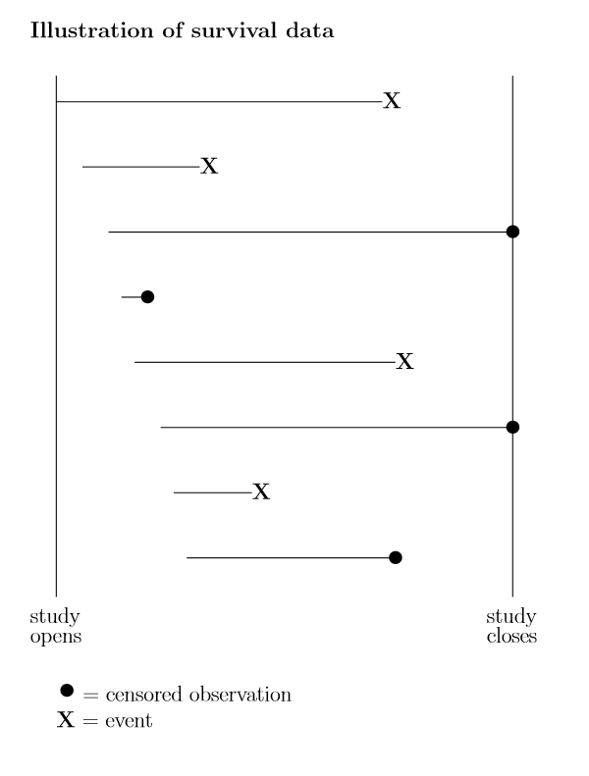
Censoring
Definition: Event of interest not observed for all individuals.
Fixed censoring: event has not occurred when study has ended or data analysis is performed.
Loss to follow-up: individual has been lost to follow-up (e.g. he/she no longer wishes to take part in study).

Slide 5
Censoring
Survival analysis methods make use of information from censored observations.
Assume censoring is non-informative, i.e. if an individual is censored, his/her subsequent risk of the event of interest is unaffected.

Slide 6
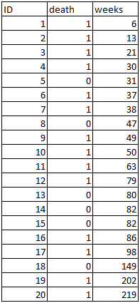

Example
Weeks to death or censoring (*) in 20 adults with recurrent astrocytoma:

Slide 7
Aims of Survival Analysis
To estimate probability of not experiencing event of interest (not dying = “surviving”) over any given time period (e.g. 5 year survival rate).
To compare overall survival experience between different groups of individuals (e.g. between groups in a randomised clinical trial).

Slide 8
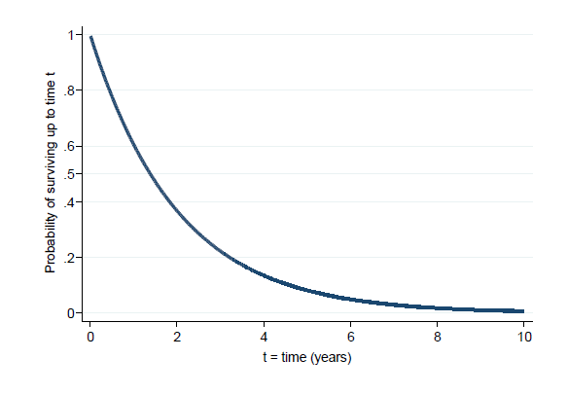
Survival Function
Survivor function: Probability of not experiencing event of interest (“surviving”) up to time t.

Slide 9
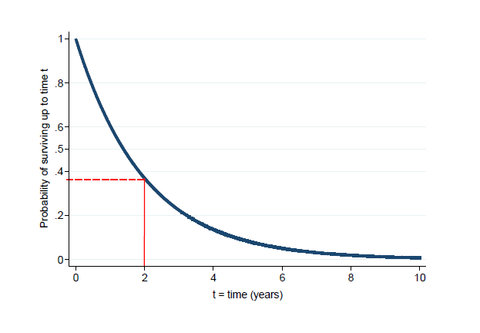
Survival Function
Probability of surviving up to 2 years = 0.37.

Slide 10
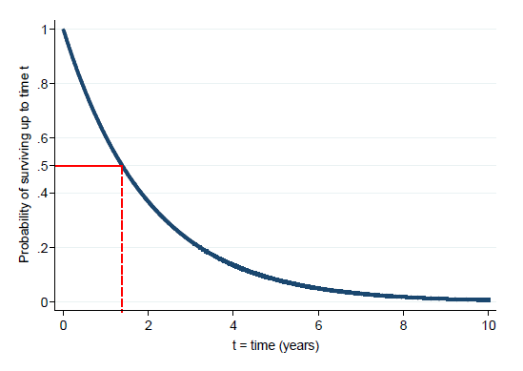
Median Survival Time
It is the time (expressed in months or years) when half the patients are expected to be alive. It means that the chance of surviving beyond that time is 50%
Median survival time = 1.4 years, since the probability of surviving up to 1.4 years is 0.5.

Slide 11
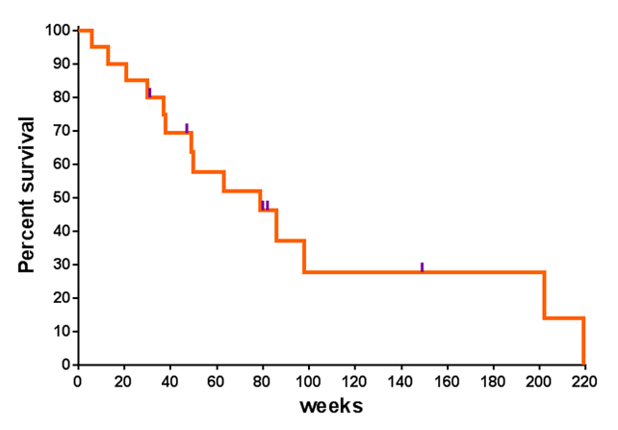
Kaplan-Meier (KM) estimation of survivor function
Ticks indicate censoring occurance

Slide 12

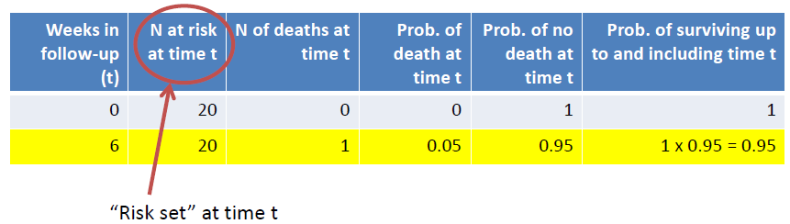
Kaplan-Meier (KM) estimation of survivor function. First death
20 individuals in study at t=0.
First death at t=6 weeks.
No individuals censored before t=6.
Probability of death for each individual: 1/20=0.05
Therefore probability of surviving beyond t=6 is
(1-0.05)=0.95=19/20.
1/20
19/20

Slide 13

Kaplan-Meier (KM) estimation of survivor function. First death
19 individuals in study between t=6 and t=13.
Second death at t=13.
No individuals censored between t=6 and t=13.
Probability of death for each individual: 1/19=0.053
Therefore probability of surviving beyond t=13 is 0.95 x 0.947 =0.90.
with 0.95=(1-(1/20)) and 0.947=(1-(1/19))

Slide 14

Kaplan-Meier (KM) estimation of survivor function. First death
18 individuals in study between t=13 and t=21.
Probability of death for each individual: 1/18=0.056
Probability of surviving beyond t=21 is 0.90 x (1-(1/18)) =0.85.

Slide 15
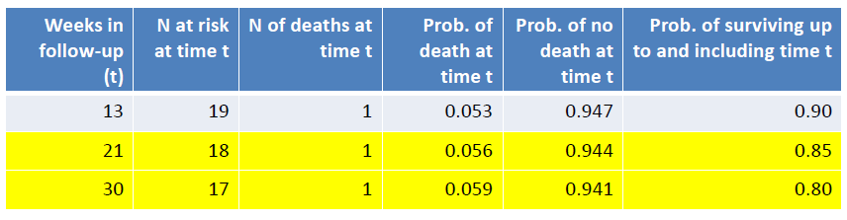
Kaplan-Meier (KM) estimation of survivor function. First death
17 individuals in study between t=21 and t=30.
Probability of death for each individual: 1/17=0.059
Probability of surviving beyond t=30 is 0.85 x (1-(1/17)) =0.80.
1/19=
1/18=
1/17=

Slide 16
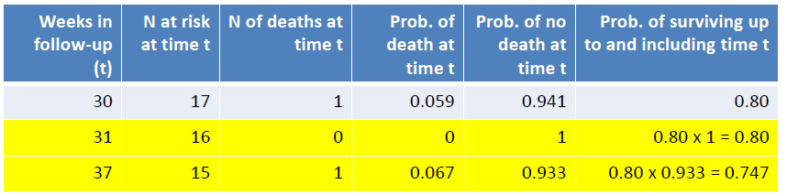
Kaplan-Meier (KM) estimation of survivor function. First death
16 individuals in study between t=30 and t=31.
1 individual censored at t=31.
Probability of surviving beyond t=31 remains at 0.80.
15 individuals in study between t=31 and t=37.
Probability of surviving beyond t=37 is 0.80 x (1-(1/15)) =0.747.
1/15=

Slide 17
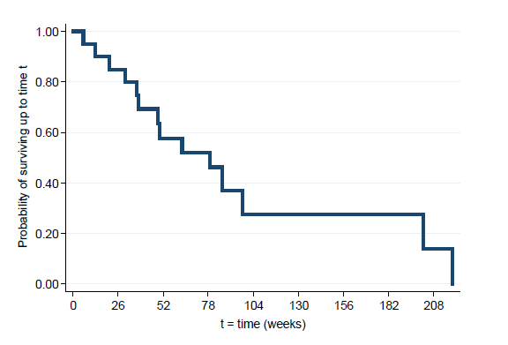
Kaplan-Meier Plots
Continue these calculations until reaching the longest event time.
K-M plot drawn as a step function:
First death: t=6, survival probability=0.95
Second death: t=13, survival probability=0.90
Third death: t=21, survival probability=0.85

Slide 18

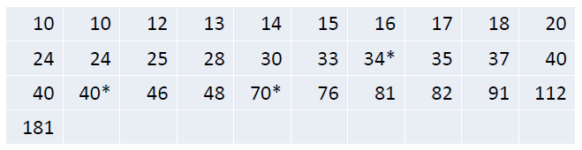
Comparing Two Studies
Weeks to death or censoring (*) in 20 adults with recurrent astrocytoma:
Weeks to death or censoring (*) in 31 adults with recurrent glioblastoma:

Slide 19
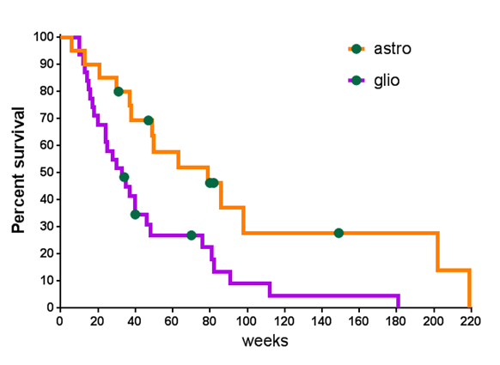
K-M Plots
Survival chances appear better in individuals with astrocytoma than with glioblastoma, but is the difference between groups statistically significant?

Slide 20
Comparing Two Samples
Could compare median survival time, or probability of surviving up to any particular time.
It is better to use a test that compares survivor functions over the whole follow-up period.
Log rank test: tests null hypothesis of no difference between samples in probability of an event (death in this example) at any time point during follow-up.
Log rank test statistic:
Based on calculating expected number of events that would occur under null hypothesis at each event time, and comparing to observed number of events.
Under null hypothesis has a Chi2 distribution with 1 degree of freedom.

Slide 21
Log-Rank Test
Goal: Test whether two groups (treatments) differ wrt population survival functions. Notation:
t_{(i)} ≡ Time of the i^{th} failure time (across groups)
d_{1i} ≡ Number of failures for group 1 at time t_{(i)}
d_{2i} ≡ Number of failures for group 2 at time t_{(i)}
n_{1i} ≡ Number at risk prior for group 1 prior to time t_{(i)}
n_{2i} ≡ Number at risk prior for group 2 prior to time t_{(i)}
Computations:

Slide 22
Log-Rank Test
H₀: Two Survival Functions are Identical
H_{A}: Two Survival Functions Differ
Some software packages conduct this identically as a chi-square test, with test statistic (T_{MH})² which is distributed χ₁² under H₀

Slide 23
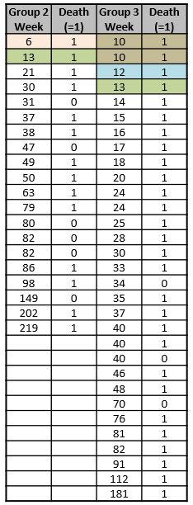
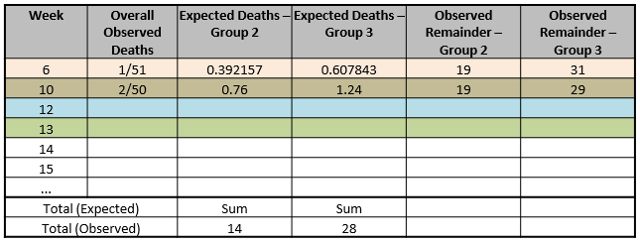



Example
20/51
31/51
Astro
Glio
Astro
(19/50)*2
(31/50)*2
=14 deaths
=28 deaths

Slide 24
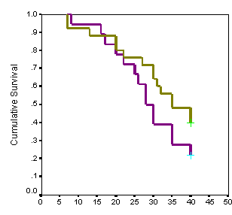
Log-Rank Test
Unlikely to detect a difference between Groups if survivor
functions cross over during follow-up.
Assumes non-informative censoring
Can be extended to compare more than 2 groups.
But
Only provides a p-value, not an estimate of size of difference between groups or a confidence interval.
Estimate of size of difference = Hazard Ratio

Slide 25
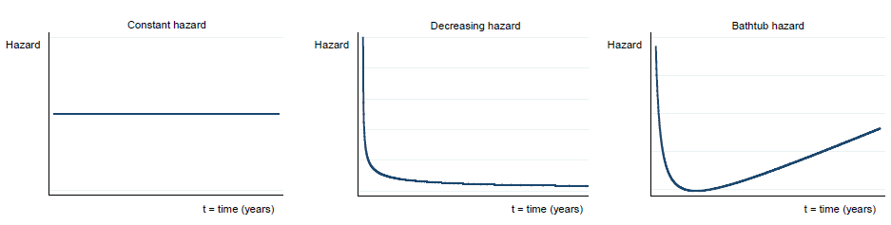
Hazard Function
Hazard is defined as the slope of the survival curve :a measure of how rapidly subjects are dying.
Hazard function describes how hazard varies over time.

Slide 26
Hazard Ratio
Hazards may vary over time, but assume that HR is constant over time.
The hazard ratio is not directly related to the ratio of median survival times.
When comparing 2 groups (a and b):
observed events (deaths) in each group: Oa and Ob,
expected events (deaths) in each group: Ea and Eb,
assuming a null hypothesis of no difference in survival.
HR= (Oa/Ea)/(Ob/Eb)
No assumption is needed about shape of hazard functions or underlying distribution of time to event data.
HR is obtained from Cox regression

Slide 27
Relative Risk Regression - Proportional Hazards (Cox) Model
Goal: Compare two or more groups (treatments), adjusting for other risk factors on survival times (like Multiple regression)
p Explanatory variables (including dummy variables)
Models Relative Risk of the event as function of time and covariates:

Slide 28
Cox Regression
Common assumption: Relative Risk is constant over time. Proportional Hazards
Log-linear Model:
Test for effect of variable x_{i}, adjusting for all other predictors:
H₀: β_{i} = 0 (No association between risk of event and x_{i})
H_{A}: β_{i} ≠ 0 (Association between risk of event and x_{i})

Slide 29
Relative Risk for Individual Factors
Relative Risk for increasing predictor x_{i} by 1 unit, controlling for all other predictors:
95% CI for Relative Risk for Predictor x_{i}:
Compute a 95% CI for β_{i} :
Exponentiate the lower and upper bounds for CI for RR_{i}

Slide 30
Example
Subjects: Patients with multiple myeloma
Treatments (HDM considered less intensive):
High-dose melphalan (HDM)
Thiotepa, Busulfan, Cyclophosphamide (TBC)
Covariates (That were significant in tests):
Durie-Salmon disease stage III at diagnosis (Yes/No)
Having received 3+ previous treatments (Yes/No)
Outcome: Progression-Free Survival Time
186 Subjects (97 on TBC, 89 on HDM)

Slide 31
Example
Variables and Statistical Model:
x₁ = 1 if Patient at Durie-Salmon Stage III, 0 otherwise
x₂ = 1 if Patient has had ≥ 3 previous treatments, 0 otherwise
x₃ = 1 if Patient received HDM, 0 if TBC
Of primary importance is β₃:
β₃ = 0 ⇒ Adjusting for x₁ and x₂, no difference in risk for HDM and TBC
β₃ > 0 ⇒ Adjusting for x₁ and x₂, risk of progression higher for HDM
β₃ < 0 ⇒ Adjusting for x₁ and x₂, risk of progression lower for HDM

Slide 32
Example
Variables and Statistical Model:
x₁ = 1 if Patient at Durie-Salmon Stage III, 0 ow
x₂ = 1 if Patient has had ≥ 3 previos treatments, 0 otherwise
x₃ = 1 if Patient received HDM, 0 if TBC
Of primary importance is β₃:
β₃ = 0 ⇒ Adjusting for x₁ and x₂, no difference in risk for HDM and TBC
β₃ > 0 ⇒ Adjusting for x₁ and x₂, risk of progression higher for HDM
β₃ < 0 ⇒ Adjusting for x₁ and x₂, risk of progression lower for HDM

Slide 33
Example
Conclusions (adjusting for all other factors):
Patients at Durie-Salmon Stage III are at higher risk
Patients who have had ≥ 3 previous treatments at higher risk
Patients receiving HDM at same risk as patients on TBC

Slide 34
Comparing Multiple samples
Issue with plots: cannot compare more than 2 groups directly
As in: does not run post-hoc pairwise comparisons
So how do we do it?
Step 1: All groups comparisons (equivalent omnibus step in ANOVA)
Step 2: Make all pairwise comparisons of interest
Step 3: Apply Bonferroni correction
Example dataset: Lung infection
Mice are infected with Streptococcus pneumoniae
3 groups: Control, treatment 1 and treatment 2

Slide 35
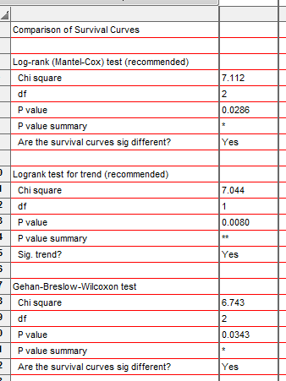
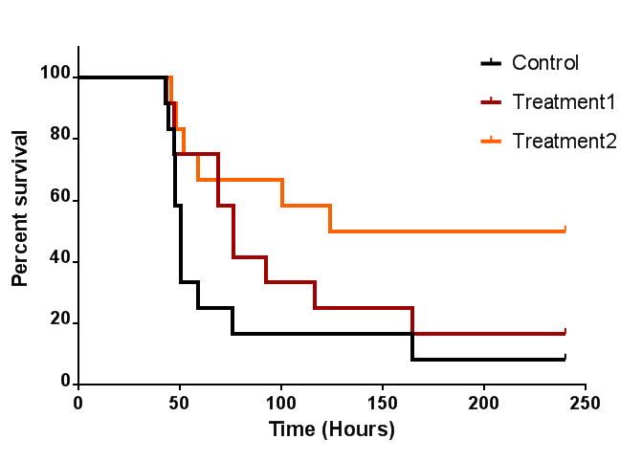
Step 1: All Group Comparison
There is an overall difference in survival between the 3 groups but which group is different from which?

Slide 36
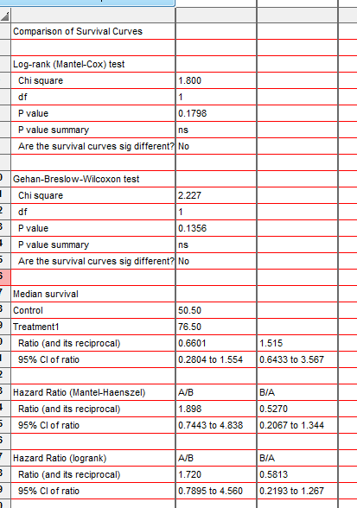
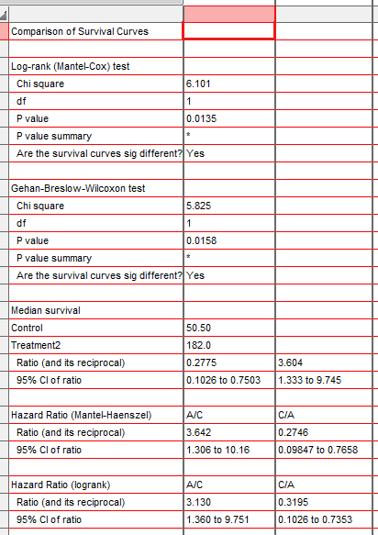
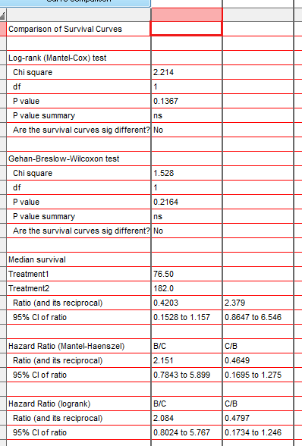
Step 2: Pairwise Comparisons
Step 2: Make all pairwise comparisons of interest
Control vs. T1
Control vs. T2
T1 vs. T2

Slide 37
Step 3: Multiple Testing Correction
Step 3: Apply Bonferroni correction: 0.05/3=0.016 or initial p-values*3
Control vs. T1
Control vs. T2
T1 vs. T2
Adjusted p-value = 0.5394
Adjusted p-value = 0.0405
Adjusted p-value = 0.4101

Slide 38
Step 3: Multiple Testing Correction
At any point in time, hazard of dying in mice with lung infection is:
Almost 2 times higher in the control than in the treatment 1 group (p=0.54)
3.6 times higher in the control than in the treatment 1 group (p=0.04)

