Slide 1
CSP571 Data Preparation and Analysis
Lecture 21. Non-Parametric Regression
Oleksandr Narykov
onarykov@iit.edu
Based on the work of N. Li, E. Fokoué, A. Moore, H. Mahmood

Slide 2
Non-Parametric Regression
The aim of a regression analysis is to produce a reasonable analysis to the unknown response function m, where for n data points ( ), the relationship can be modeled as
Unlike the parametric approach, where the function m is fully described by a finite set of parameters, nonparametric modeling accommodates a very flexible form of the regression curve.
19

Slide 3
Motivation
It provides a versatile method of exploring a general relationship between variables
It gives predictions of observations yet to be made without reference to a fixed parametric model
It provides a tool for finding spurious observations by studying the influence of isolated points
It constitutes a flexible method of substituting for missing values or interpolating between adjacent X-values

Slide 4
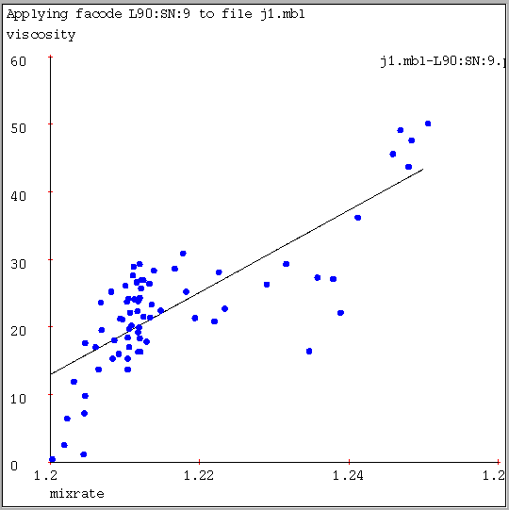
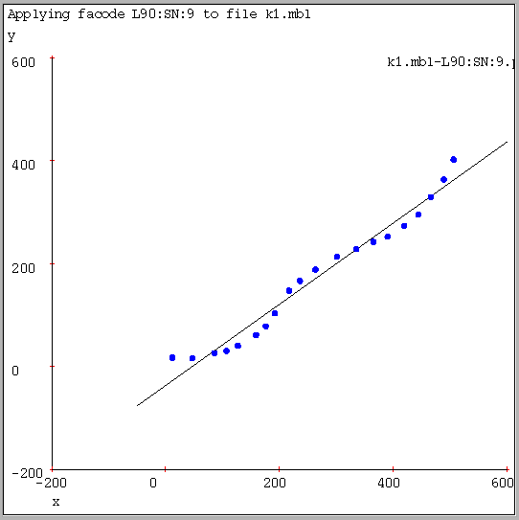
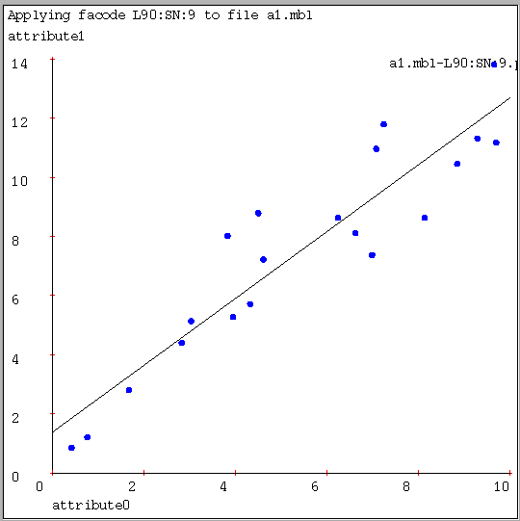
Comparison to Parametric Models
Here, linear regression manages to capture a significant trend in the data, but there is visual evidence of bias. | Here, linear regression appears to have a much better fit, but the bias is very clear. | Here, linear regression may indeed be the right thing.

Slide 5
When To Use
Violations of linearity are extremely serious, especially when you extrapolate beyond the range of the sample data.
How to detect:
Nonlinearity is usually most evident in a plot of residuals versus predicted values.
Use Goodness of fit test.
How to fix:
Use a nonlinear transformation to the dependent and/or independent variables such as a log transformation, square root, or power transformation.
Add another regressors which is a nonlinear function of one of the other variables. For example, if you have regressed Y on X, it may make sense to regress Y on both X and X 2 (i.e., X-squared).
Use non-parametric regression model.

Slide 6
Basic Idea of Smoothing
In the context of nonparametric regression, a smoothing algorithm is a summary of trend in Y as a function of explanatory variables X1, . . . , Xp.
The smoother takes data and returns a function, called a smooth. We focus on scatterplot smooths, for which p = 1. These usually generalize to p = 2 and p = 3, but the curse of dimensionality quickly renders them impractical.
They can be used as building blocks for more sophisticated smoothing algorithms that break down less badly with large p, and we discuss several standard smoothers to illustrate the issues and tradeoffs. Essentially, a smooth just finds an estimate of f in the nonparametric regression function Y = f(x) + ε.

Slide 7
Parametric Model. Kalman Filter
A linear dynamical system
Real-valued variables evolve linearly over time, with some Gaussian noise
Can be considered a specific kind of dynamic Bayesian network where
All variables are continuous
All dependencies are linear Gaussian
Often used for tracking systems, for example tracking airplanes using radar data

Slide 8
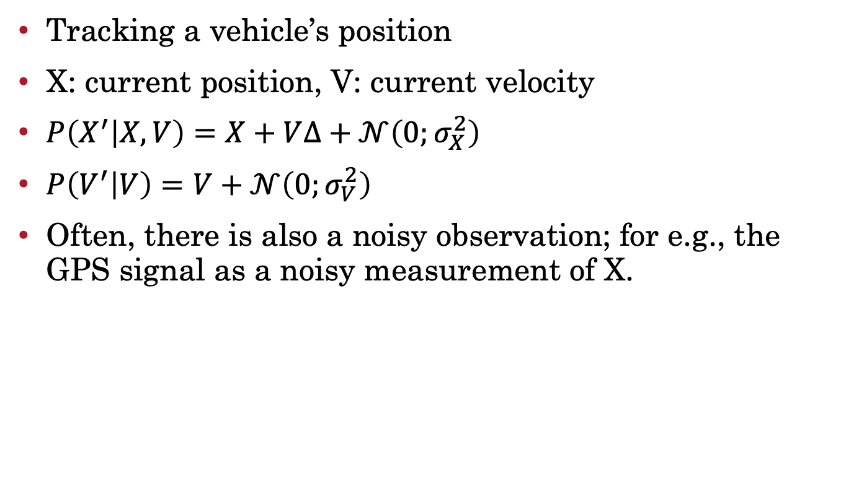
Parametric Model. Kalman Filter
Tracking a vehicle’s position
X: current position, V: current velocity
$P\left(X^{′} | X,V\right)=X+V∆+𝒩\left(0;σ_{X}^{2}\right)$
$P\left(V^{′} | V\right)=V+𝒩\left(0;σ_{V}^{2}\right)$
Often, there is also a noisy observation; for e.g., the GPS signal as a noisy measurement of X.
Notes:
O(t) O(t+1)
^
|
X(t) -> X(t+1)
V(t) |-> V(t+1)

Slide 9
Smoothing
A reasonable approximation to the regression curve m(x) will be the mean of response variables near a point x. This local averaging procedure can be defined as
Every smoothing method to be described is of the form (2).
The amount of averaging is controlled by a smoothing parameter. The choice of smoothing parameter is related to the balances between bias and variance.

Slide 10
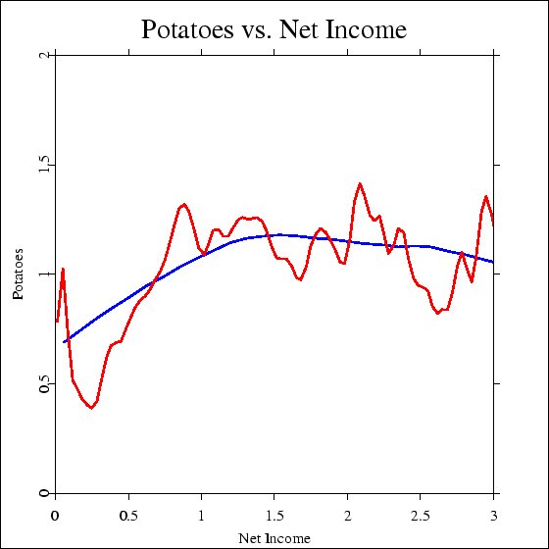
Expenditure of potatoes as a function of net income. h = 0.1, 1.0, n = 7125, year = 1973.

Slide 11
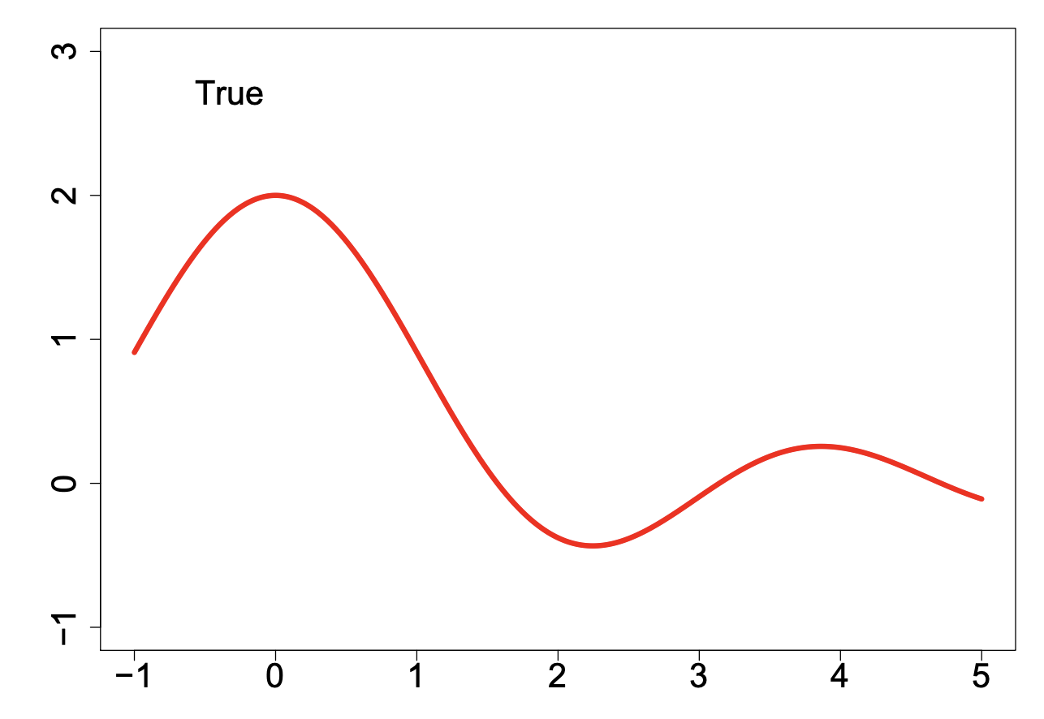
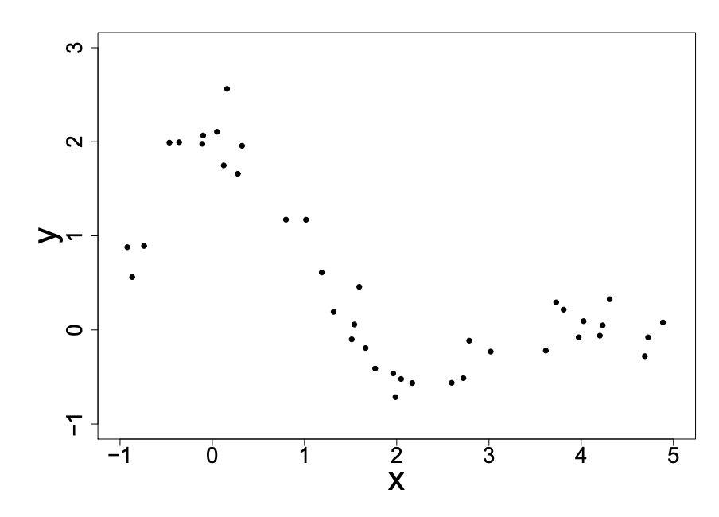
Smoothing
As a running example for the next several sections, assume we have data generated from the following function by adding N(0, 0.25) noise.

Slide 12
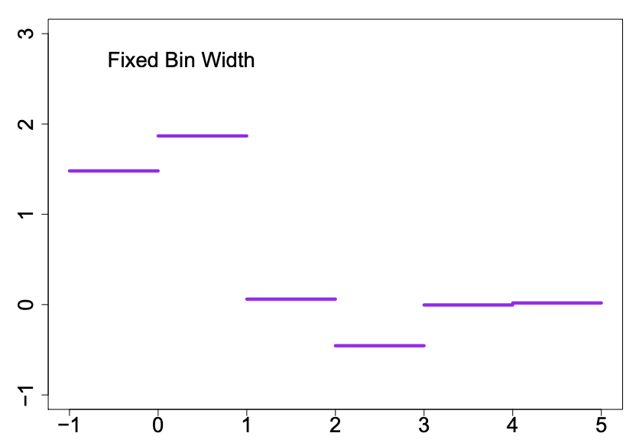
Bin Smoothing
Here one partitions data into disjoint bins; e.g., for p = 1 take {[i, i + 1], i ∈ Z}. Within each bin average the Y values to obtain a smooth that is a step function.

Slide 13
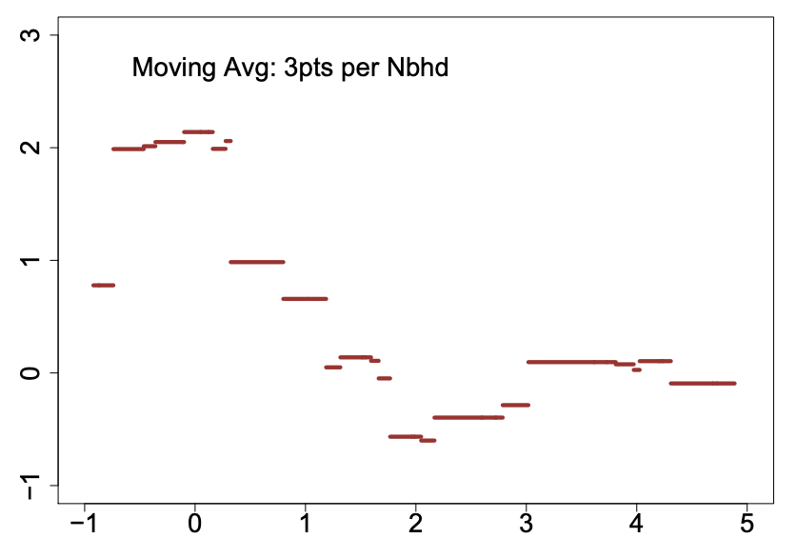
Moving Averages
Moving averages use variable bins containing a fixed number of observations, rather than fixed-width bins with a variable number of observations. They tend to wiggle near the center of the data, but flatten out near the boundary of the data.

Slide 14
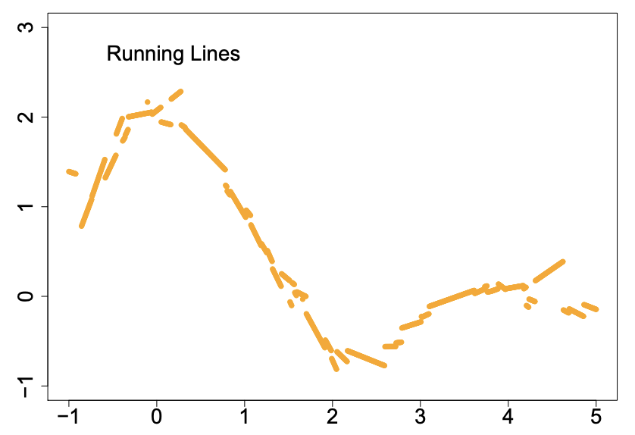
Running Line
This improves on the moving average by fitting a line rather than an average to the data within a variable-width bin. But it still tends to be rough.

Slide 15
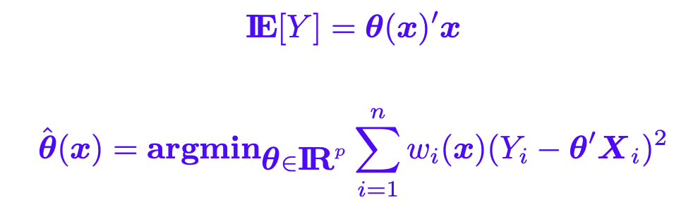
LOESS
LOESS extends the running line smooth by using weighted linear regression inside the variable-width bins. Loess is more computationally intensive, but is often satisfactorily smooth and flexible
It fits model
where

Slide 16
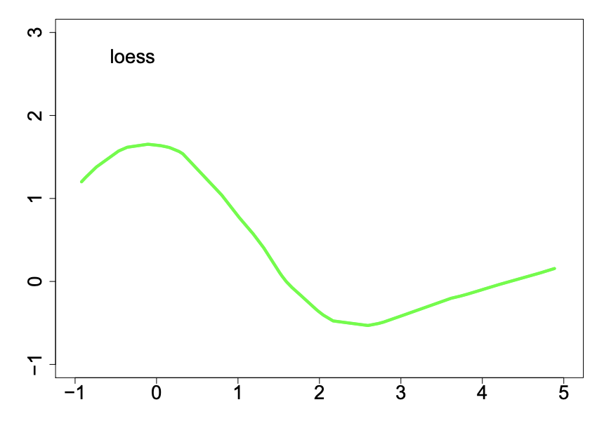
LOESS
LOESS is a consistent estimator, but may be inefficient at finding relatively simple structures in the data. Although not originally intended for high-dimensional regression, LOESS is often used.

Slide 17
Kernel Smoothing
These are much like moving averages except that the average is weighted and the bin-width is fixed.
Kernel smoothers work well and are mathematically tractable. The weights in the average depend upon the kernel K(x).
A kernel is usually symmetric, continuous, nonnegative, and integrates to 1 (e.g., a Gaussian kernel).
The bin-width is set by parameter, also called the bandwidth. This can vary, adapting to information in the data on the roughness of the function.

Slide 18
Kernel Smoothing
Kernel smoothing describes the shape of the weight
function by a density function K with a scale
parameter that adjusts the size and the form of the
weights near x. The kernel K is a continuous, bounded
and symmetric real function which integrates to 1. The weight is defined by
where , and .

Slide 19
Kernel Smoothing
The Nadaraya-Watson estimator is defined by
The mean squared error is
As
we have, under certain conditions,
Where
The bias is increasing whereas the variance is decreasing in h.

Slide 20
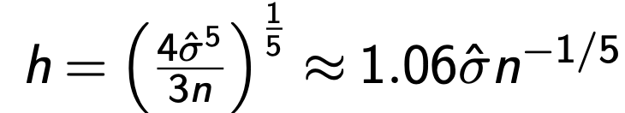
Kernel Smoothing
How to choose the bandwidth?
Rule of thumb: If we use Gaussian then it can be shown that the optimal choice for h is
where σ is the standard deviation of the samples.

Slide 21
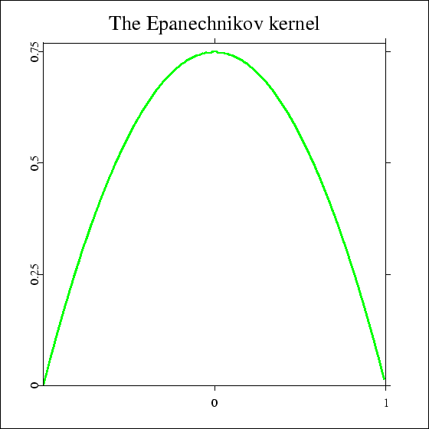
The Epanechnikov kernel K (u) = 0.75(1-u²) I (|u| <= 1 ).

Slide 22
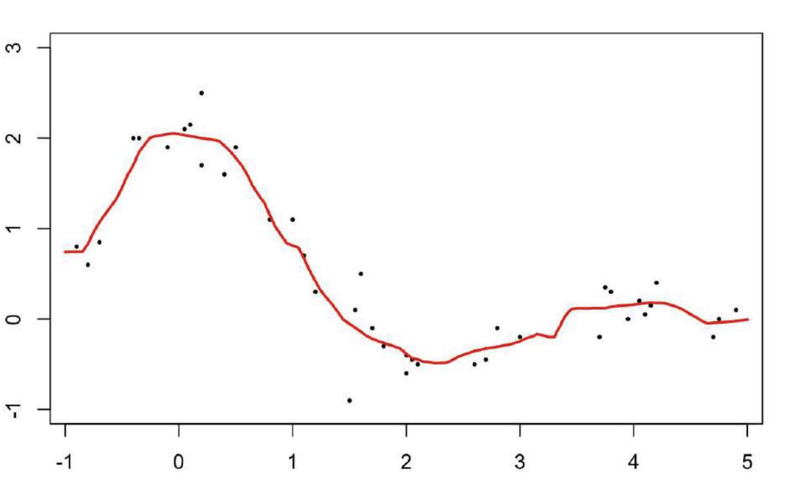
Kernel Smoothing
This improves on the moving average by fitting a line rather than an average to the data within a variable-width bin. But it still tends to be rough.

Slide 23
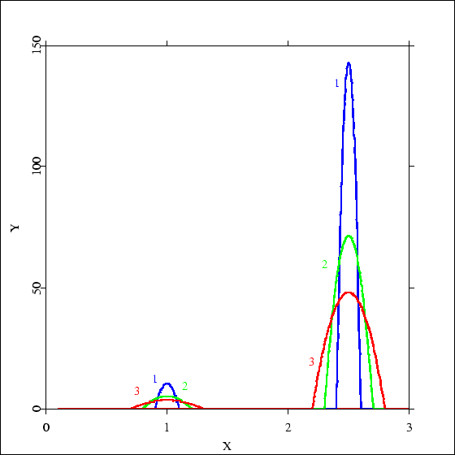
The effective kernel weights for the food versus net income data set. at x = 1 and x = 2.5 for h = 0.1 ( label 1 ), h = 0.2 ( label 2 ), h = 0.3 ( label 3 ) with Epanechnikov kernel.

Slide 24
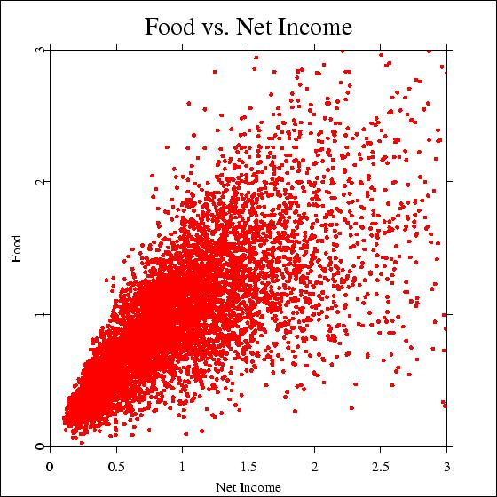

Slide 25
K-Nearest Neighbor Estimates
In k-NN, the neighborhood is defined through those X – variables which are among the k-nearest neighbors of x in Euclidean distance. The k-NN smoother is defined as
where { } i=1, …, n is defined through the set of
Indexes
and

Slide 26
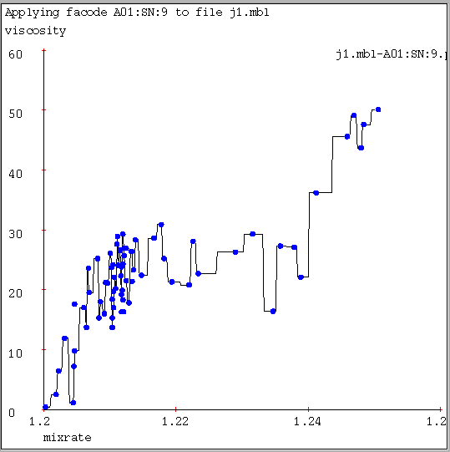
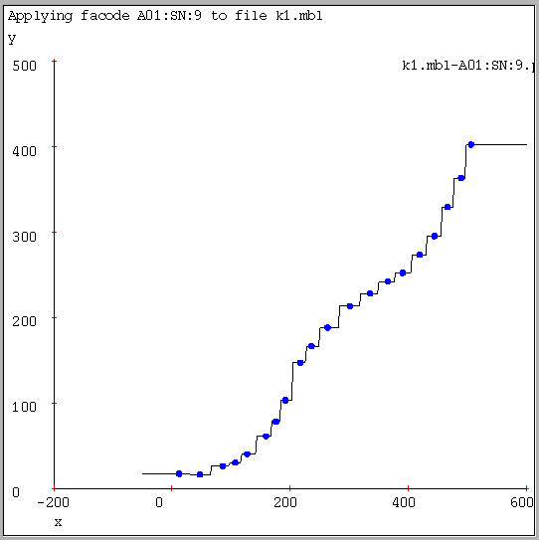
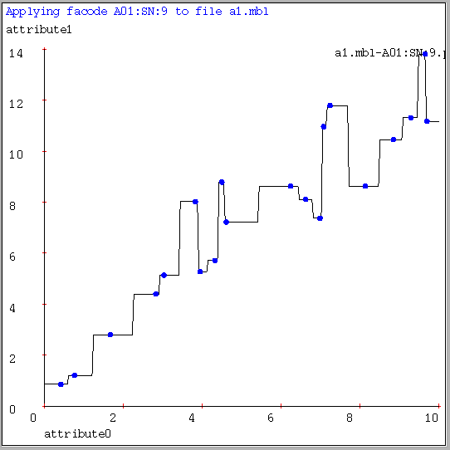
One Nearest Neighbor Example

Slide 27
K-nearest Neighbor Estimates
The smoothing parameter k regulates the degree of smoothness of the estimated curve. It plays a role similar to the bandwidth for kernel smoothers.
The influence of varying k on qualitative features of the estimated curve is similar to that observed for kernel estimation with a uniform kernel.
When k > n, the k - NN smoother then is equal to the average of the response variables. When k = 1, the observations are reproduced at X_{i}, and for an x between two adjacent predictor variables a step function is obtained with a jump in the middle between the two observations.

Slide 28
K-nearest Neighbor Estimates
Let . Bias and variance of the k-NN estimate with weights as in (7) are given by
Note: The trade-off between bias² and variance is thus achieved in an
asymptotic sense by setting k ~ n^{4/5}

Slide 29
K-nearest Neighbor Estimates
In addition to the “uniform” weights, the k-NN weights can be generally thought of as being generated by a kernel function K,
where
and
R is the distance between x and its k-th nearest neighbor.

Slide 30
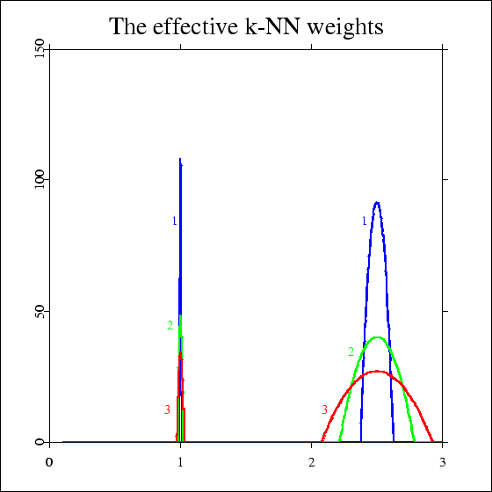
The effective k-NN weights for the food versus net income data set. at x = 1 and x = 2.5 for k = 100 ( label 1 ), k = 200 ( label 2 ), k = 300 ( label 3 ) with Epanechnikov kernel.

Slide 31
K-nearest Neighbor Estimates
Let , and c_{K}, d_{K} be defined as previously, then
Note: The trade-off between bias² and variance is thus achieved in an asymptotic sense by setting k ~ n^{4/5}, like the uniform k-NN weights.

Slide 32
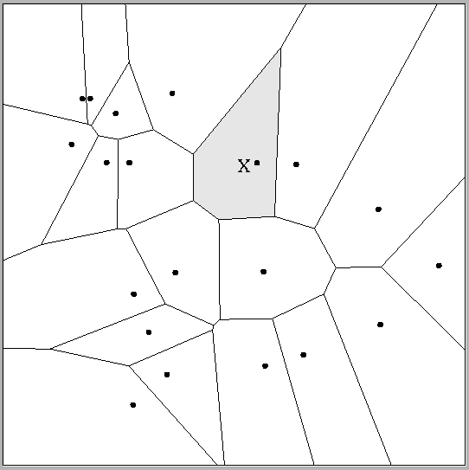
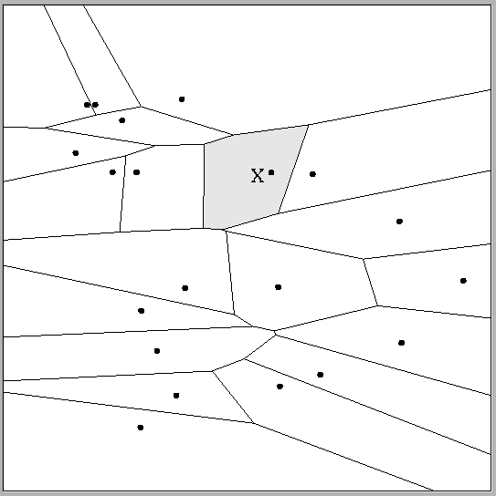
Multivariate Distance Metrics
Suppose the input vectors x1, x2, …xn are two dimensional:
x₁ = ( x₁₁ , x₁₂ ) , x₂ = ( x₂₁ , x₂₂ ) , …x_{N} = ( x_{N1} , x_{N2} ).
One can draw the nearest-neighbor regions in input space.

Slide 33
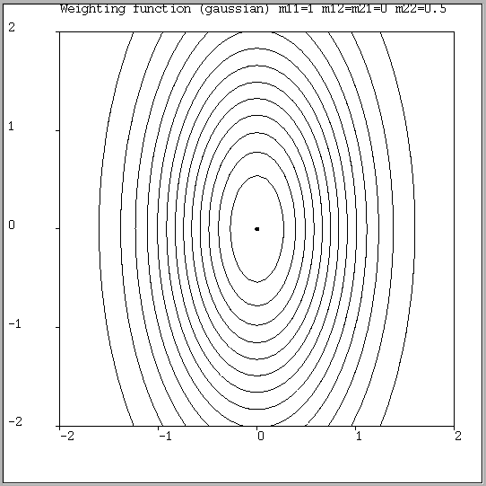
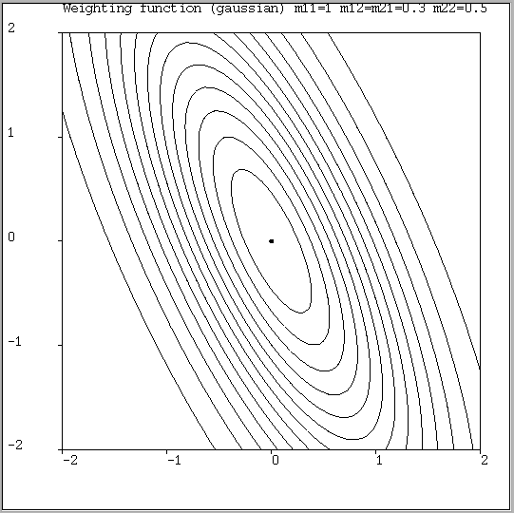
Multivariate Distance Metrics
Scaled Euclidian (L₂)
L₁ norm (absolute)
Mahalanobis
L_{infinity} (max) norm

Slide 34
Spline Smoothing
Spline smoothing quantifies the competition between
• the aim to produce a good fit to the data
• the aim to produce a curve without too much rapid local variation.
The regression curve is obtained by minimizing the penalized sum of squares
where m is twice-differentiable function on [a,b], and λ represents the rate of exchange between residual error and roughness of the curve m.

Slide 35
Spline Smoothing
Smoothing splines are piecewise polynomials, and the pieces are divided at the sample values xi.
The x values that divide the fit into polynomial portions are called knots.
Usually, splines are constrained to be smooth across the knots.
Regression splines have fixed knots that need not depend upon the data. Also, knot selection techniques enable one to find good knots automatically.

Slide 36
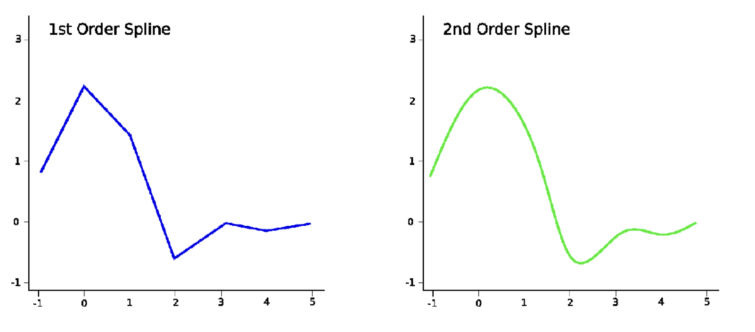
Spline Smoothing
The first order smooth is piecewise linear, and the second order smooth is piecewise quadratic.

Slide 37
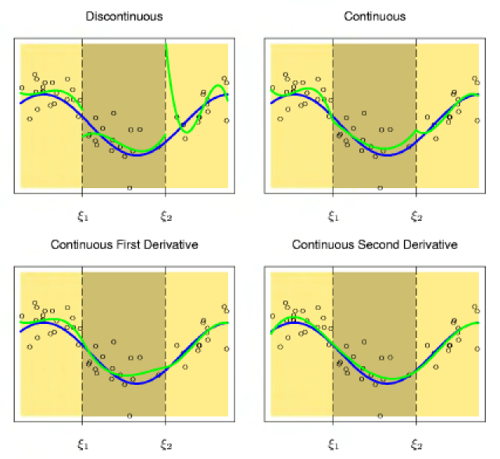
Spline Smoothing

Slide 38
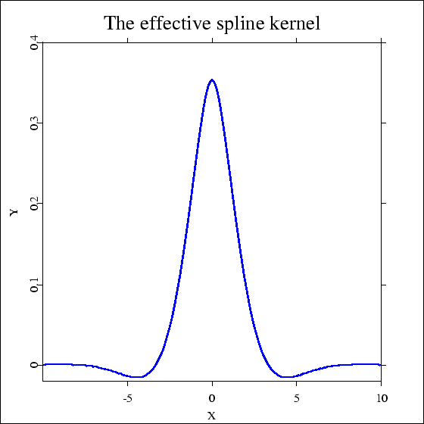
Spline Smoothing
The asymptotic spline kernel function

Slide 39
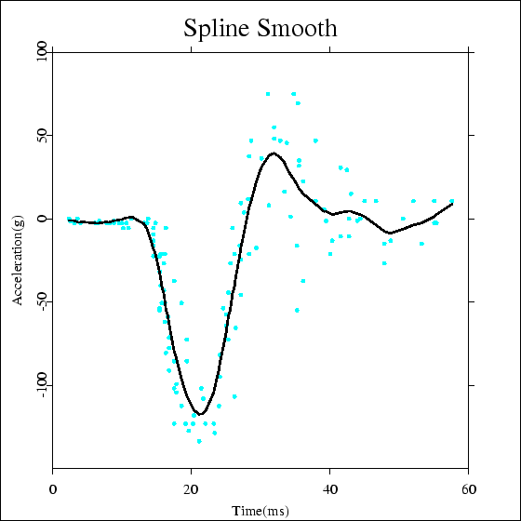
A spline smooth of the Motorcycle data set.

Slide 40
Spline Smoothing
The spline is linear in the Y observations, and there exists weights that
Silverman in 1984 showed for large n, small λ, and X_{i} not too close to the boundary,
where the local bandwith h(X_{i}) satisfies

Slide 41
Spline Smoothing
A variation to (11) is to solve the equivalent problem
under the constraint .
The parameters λ and Δ have similar meanings, and are connected by the relationship
where
and solves (12).

Slide 42
A comparison of kernel, k-NN and spline smoothers
Bias and variance of kernel and k-NN smoother
 | kernel | k-NN
bias
variance

Slide 43
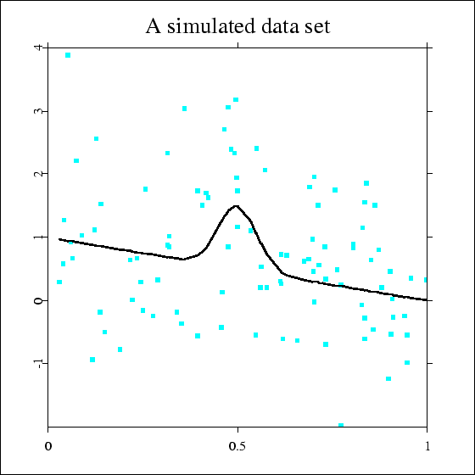
A simulated data set. The raw data n=100 were constructed from
and

Slide 44
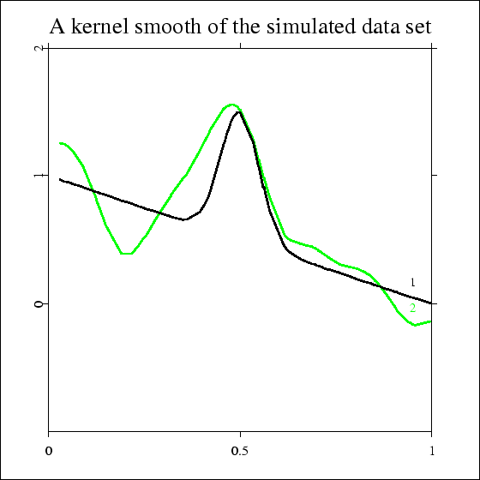
A kernel smooth of the simulated data set. The black line (label 1) denotes the underlying regression curve The green line (label 2) is the Gaussian kernel smooth

Slide 45
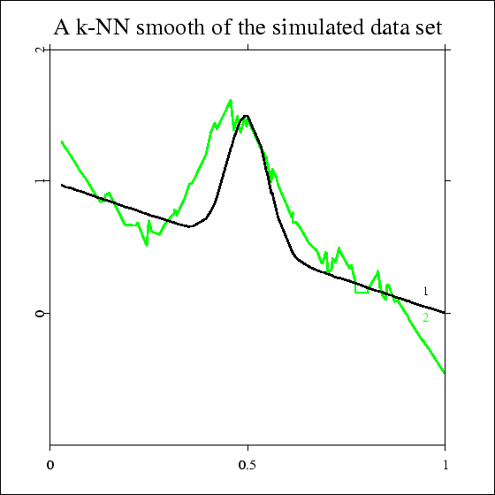
A k-NN kernel smooth of the simulated data set. The black line (label 1) denotes the underlying regression curve. The green line (label 2) is the k-NN smoother

Slide 46
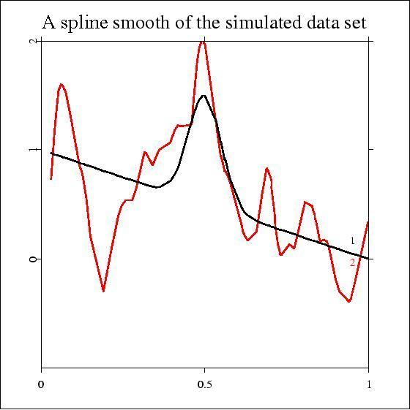
A spline smooth of the simulated data set. The black line (label 1) denotes the underlying regression curve. The green line (label 2) is the spline smoother

Slide 47
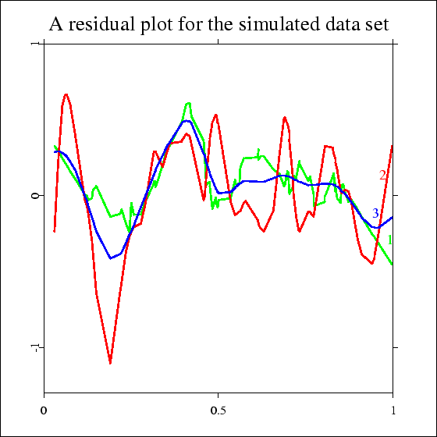
Residual plot of k-NN, kernel and spline smoother for the simulated data set.

Slide 48
Conclusions
Pros:
It is flexible.
Better in fitting the data than parametric regression models.
Cons:
Nonparametric regression requires larger sample sizes than regression based on parametric models because the data must supply the model structure as well as the model estimates.

