Slide 1
APECx MCP Integration
End-to-End Architecture
Synthesis pipeline · 23 MCP tools · 6 ontologies · 504 unit tests
Generated 2026-05-05 · apecx-mcp-integration repo · branch day2-rag-synthesis-agent

Slide 2
Agenda
What this deck covers
• Two lifecycles — backend (offline, periodic) vs. user-facing (online, per-query)
• Backend harmonization pipeline — harvester + dictionary builder
• User-facing query workflow — MCP entry → synthesis → markdown
• Three-tier runtime topology (Tiers 1, 2, 4)
• Synthesis pipeline detail — 5 retrieval branches + LLM
• Trigger-cascade primitive (added 2026-05-05 to nanobrain)
• Mapping & resolution strategy — fast / ancestor / slow / miss
• Ontologies, MCP tool surface, test surface
• Data quality — CI-enforced accuracy floors & harmonization statistics
• Things that will surprise you (silent-failure shapes)
2 / 21

Slide 3
System Purpose
One-paragraph definition
APECx MCP integration takes free-text scientist questions about viral pathogens, vaccines, genes, and genomes and turns them into grounded Markdown answers with inline citations.
It does this by fanning out across local FAISS-indexed knowledge (domain RAG), local VIOLIN/BV-BRC tabular data (substring lookup), live PubMed publications, and the APECx Globus Search index of harvested records — then driving one LLM call to weave the retrieved evidence into a structured response. The system is exposed via the Model Context Protocol (MCP), so it appears as a tool surface inside Claude Desktop and any MCP-compatible client.
3 / 21

Slide 4
Two Lifecycles, One Bridge
Backend vs. user-facing — the central organizing distinction
BACKEND HARMONIZATION
USER-FACING WORKFLOW
• Run periodically (e.g. monthly)
• Two pipelines: harvester (apecx-harvesters) + dictionary builder (this repo)
• Writes Globus Search index + apecx_synonym_dict.sqlite
• Synchronous, batch, NOT on the per-query hot path
• Sources: PubMed, PDB, DataCite, Crossref, OpenAlex, bioRxiv, EMDB, DOI, VIOLIN, BV-BRC, NCBI taxdump
• Per scientist query (~70s wall-clock on Ollama)
• MCP server → synthesize_query → 4 retrieval branches → LLM
• Reads the artifacts the backend wrote — never writes back
• Real-time, async, fail-soft branch failures
• Globus + FAISS + VIOLIN/BV-BRC + PubMed + (synonym dict for fast-path resolution)
Bridge: every artifact the backend writes, the user-facing workflow reads — and never writes to.
4 / 21

Slide 5
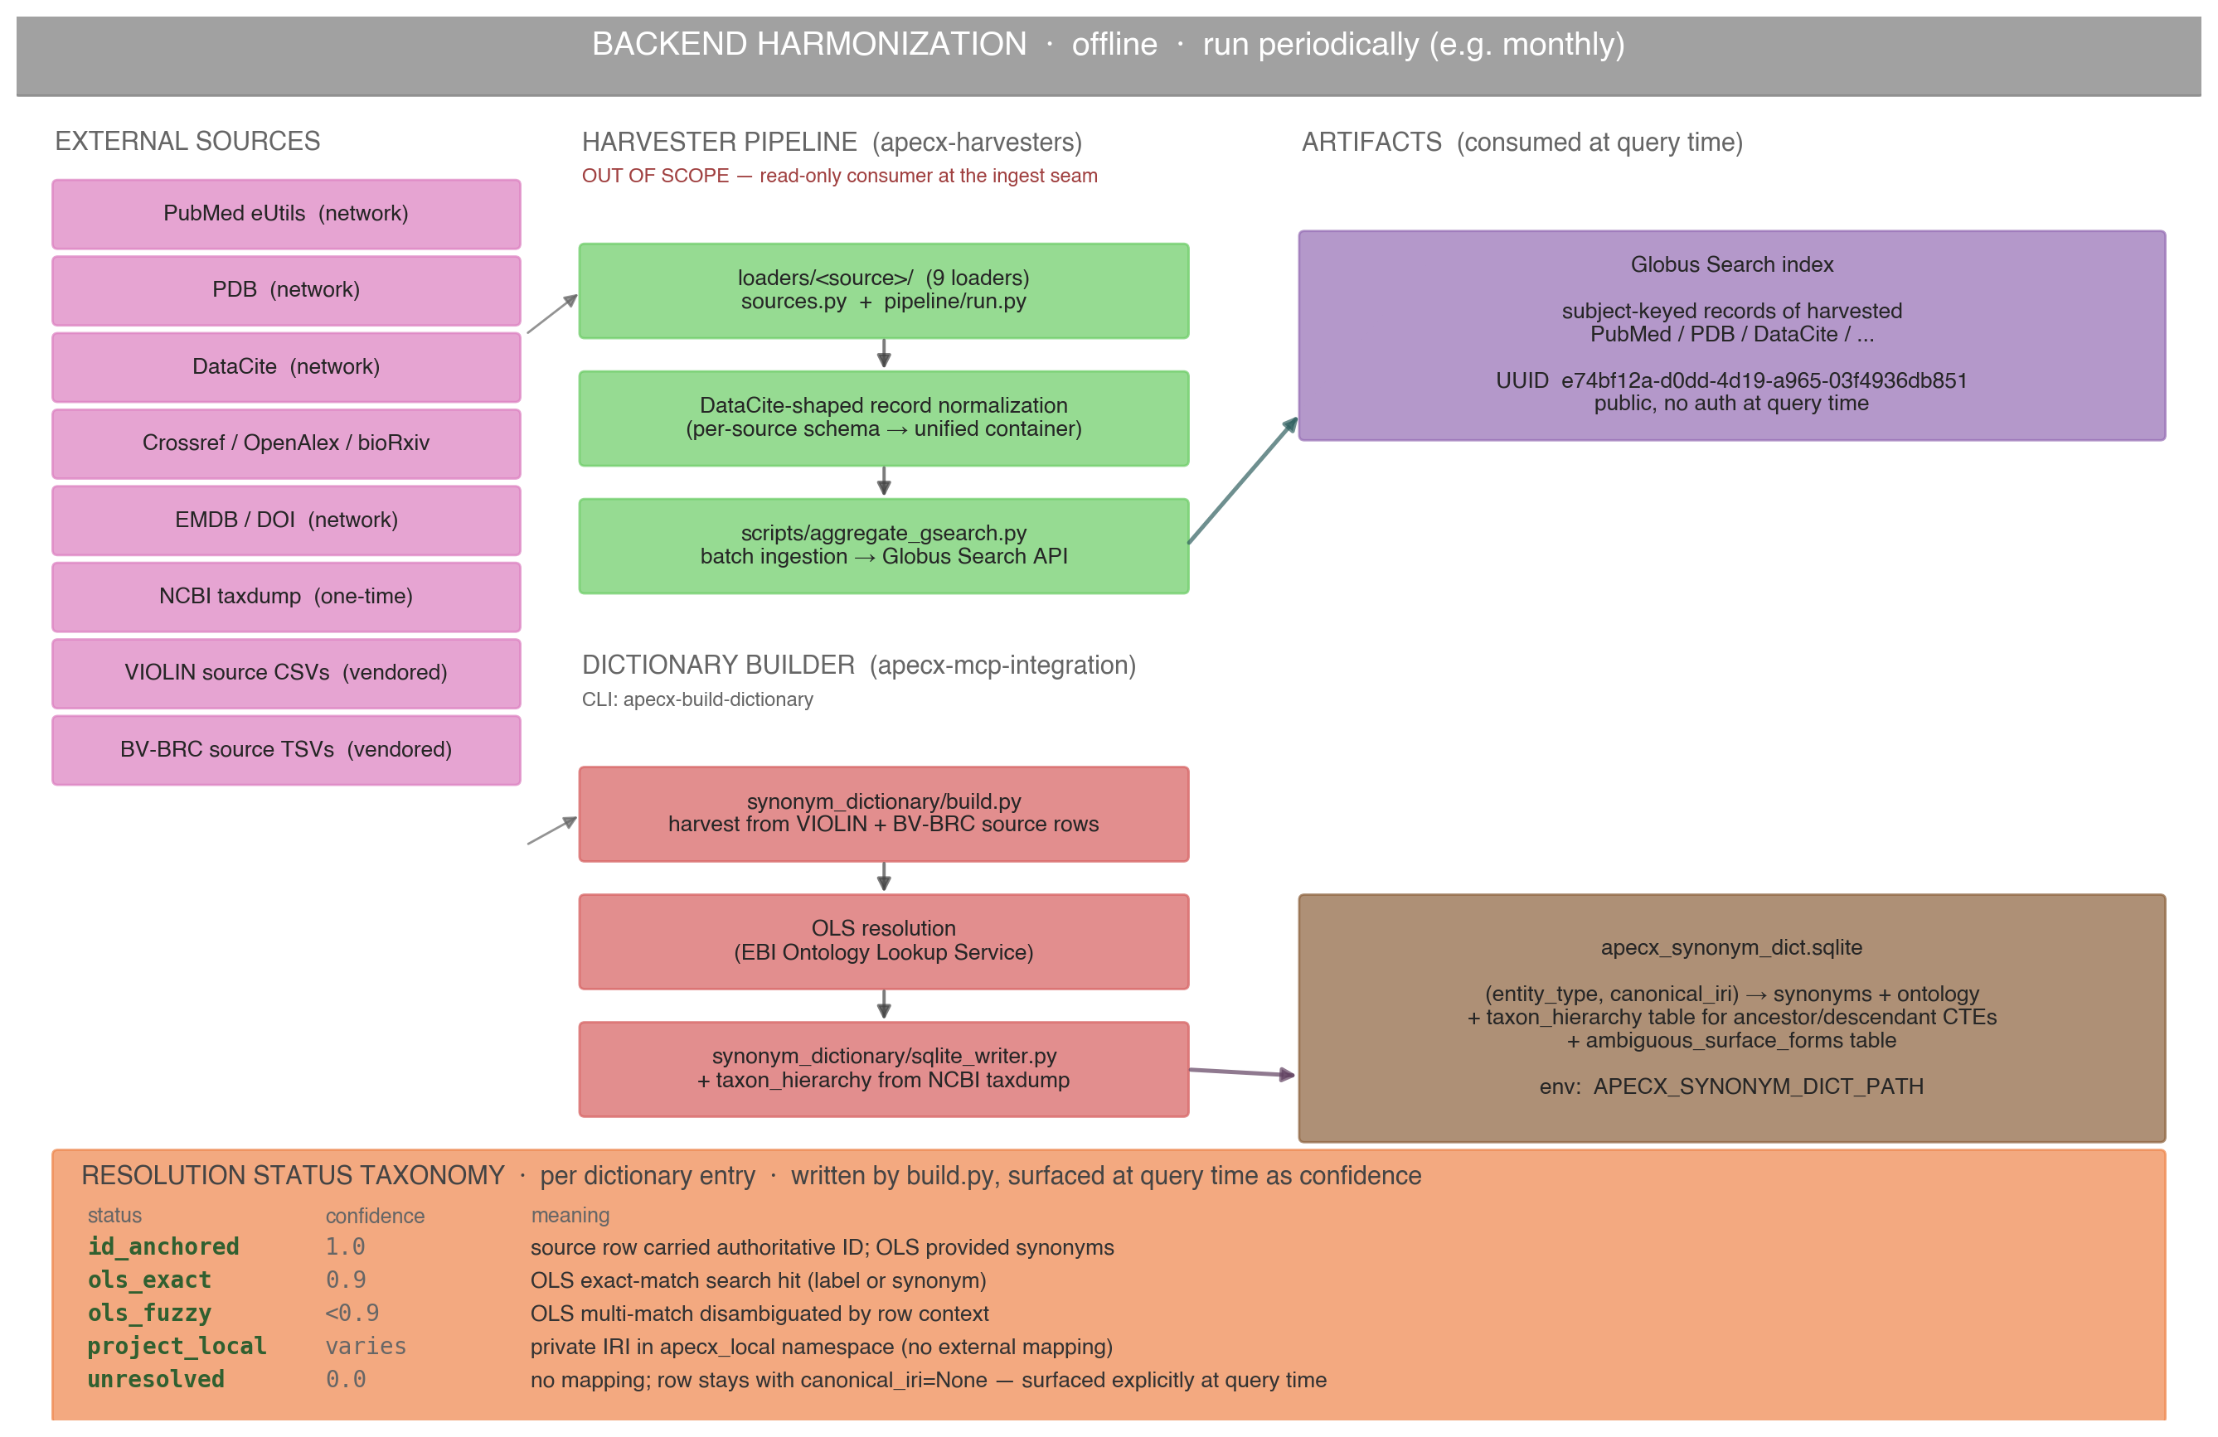
Backend Harmonization Pipeline
Offline · run periodically · harvester (apecx-harvesters) + dictionary builder (this repo)
5 / 21

Slide 6
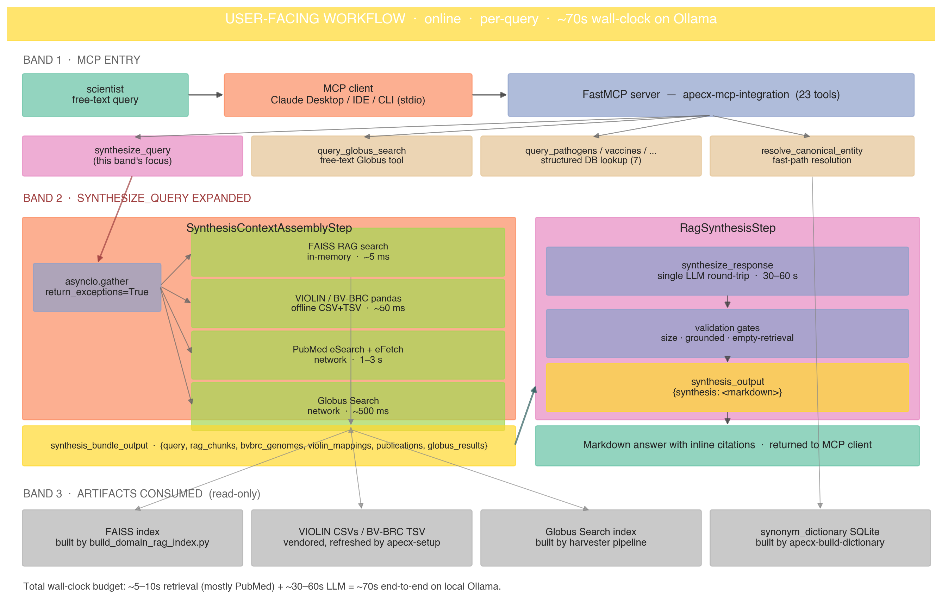
User-Facing Workflow
Online · per-query · ~70s wall-clock · 3 bands (MCP entry → synthesis → artifacts read)
6 / 21

Slide 7
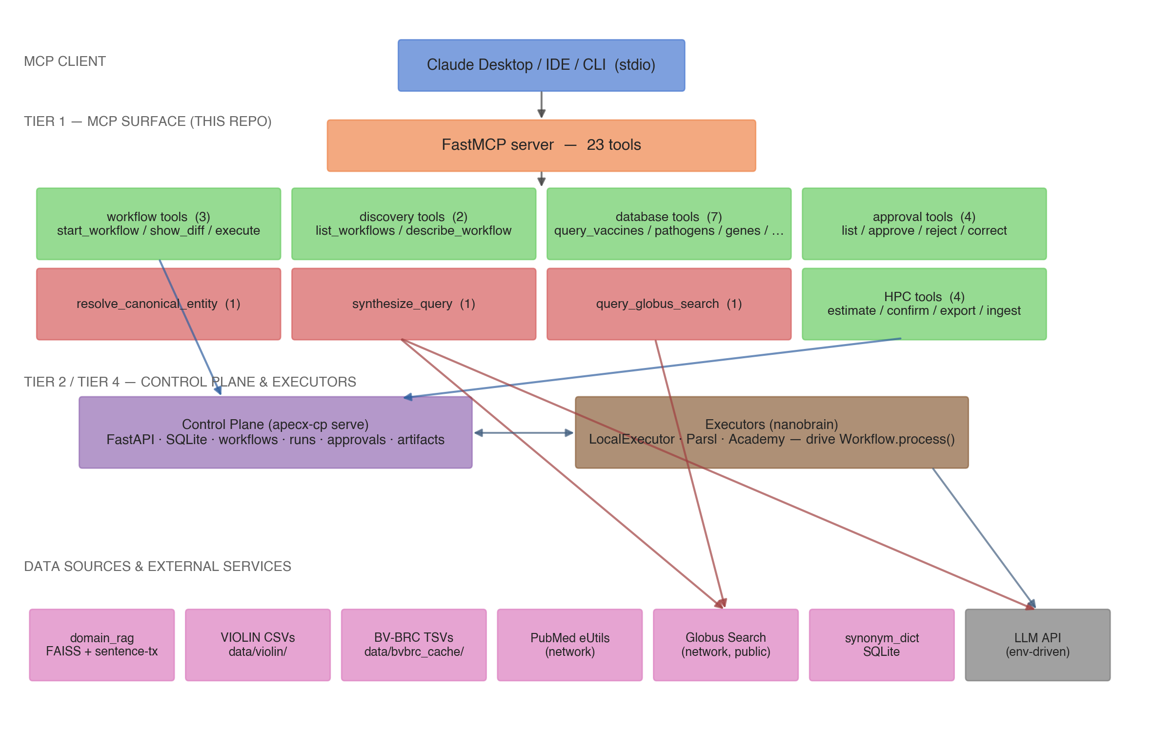
Three-Tier Runtime Topology
Tier 1 (this repo) · Tier 2 (Control Plane) · Tier 4 (Executors)
7 / 21

Slide 8
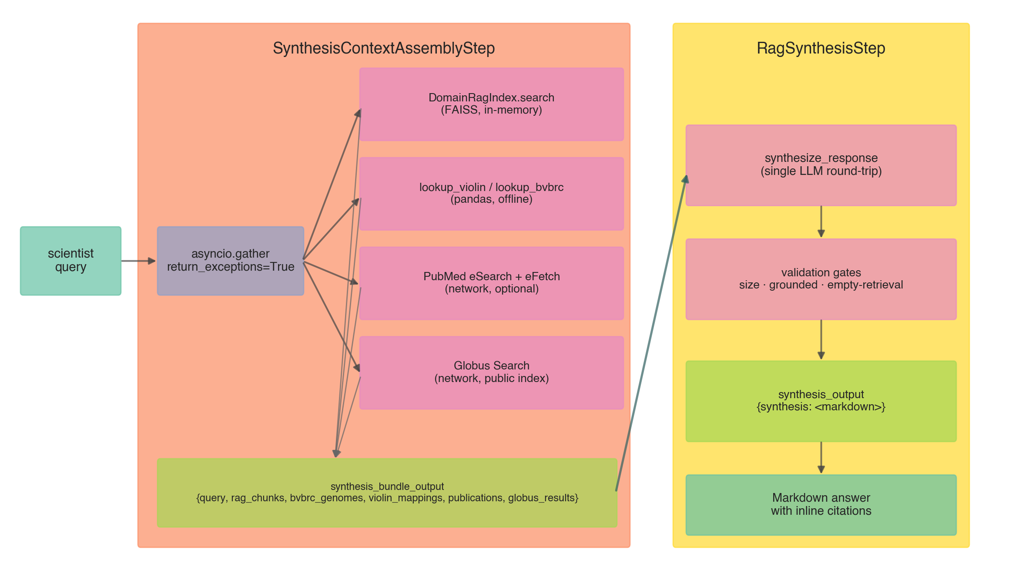
Synthesis Pipeline
5 concurrent retrieval branches → 1 LLM round-trip → grounded Markdown
8 / 21

Slide 9
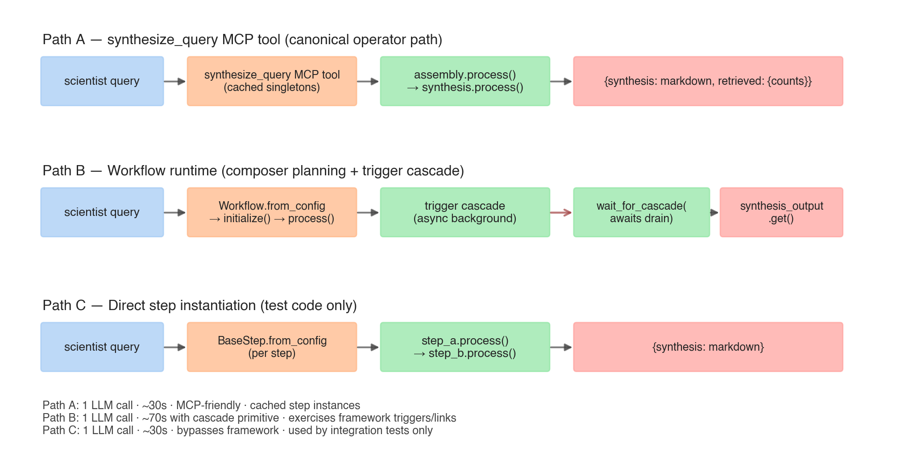
Three Invocation Paths
Pick one based on the calling context
9 / 21

Slide 10
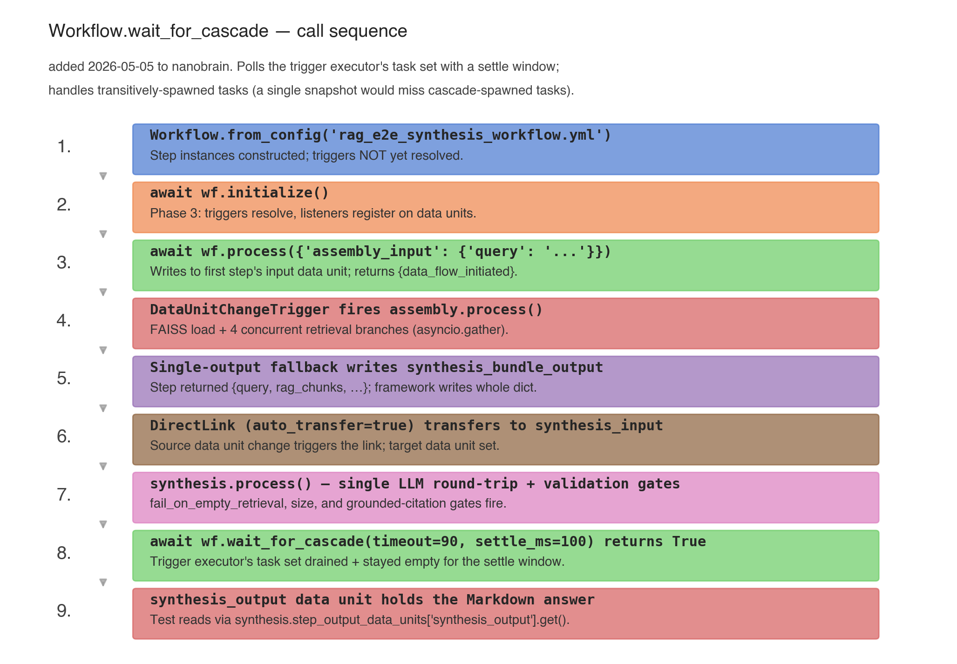
Workflow.wait_for_cascade
Added to nanobrain 2026-05-05 — drains the trigger executor's task set with a settle window
10 / 21

Slide 11
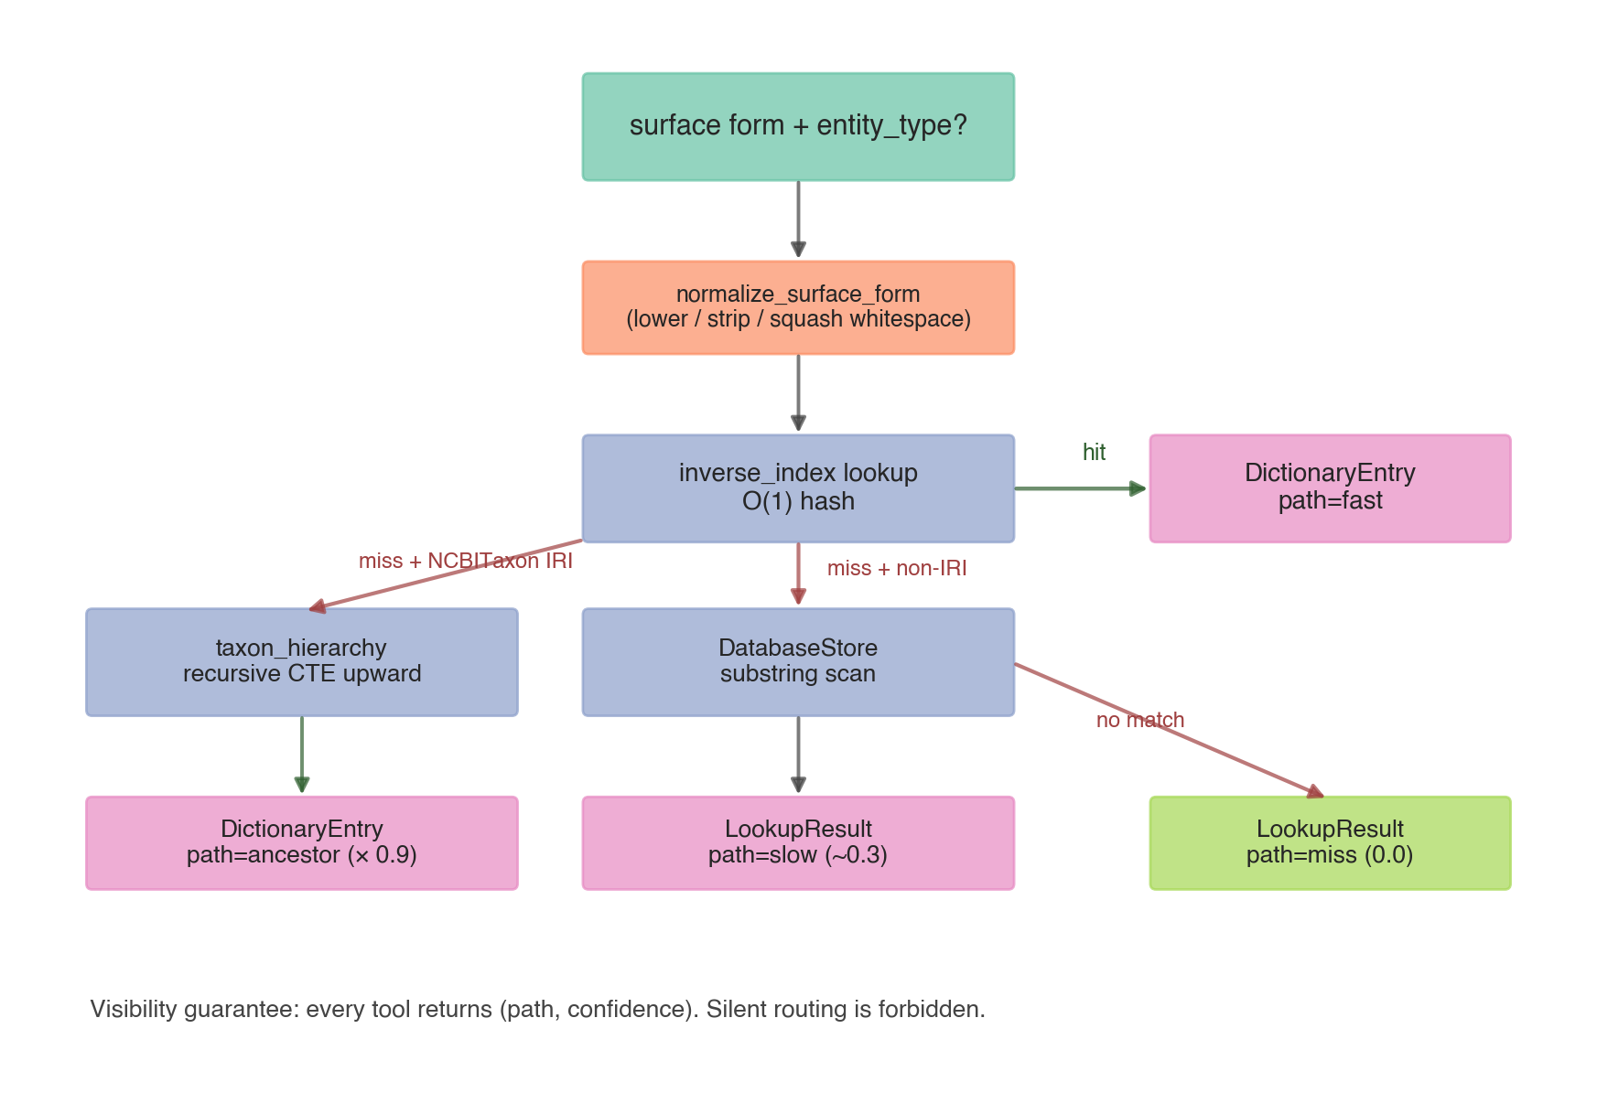
Mapping & Resolution Strategy
fast → ancestor → slow → miss; every result carries (path, confidence)
11 / 21

Slide 12
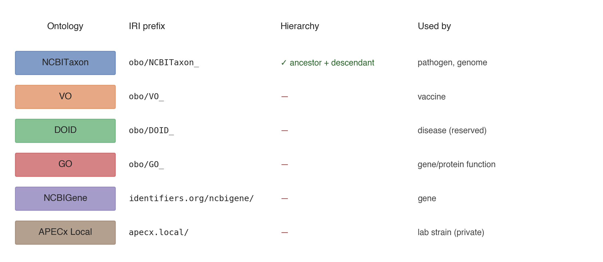
Ontologies
Authoritative sources tracked in DictionaryEntry.ontology
12 / 21

Slide 13
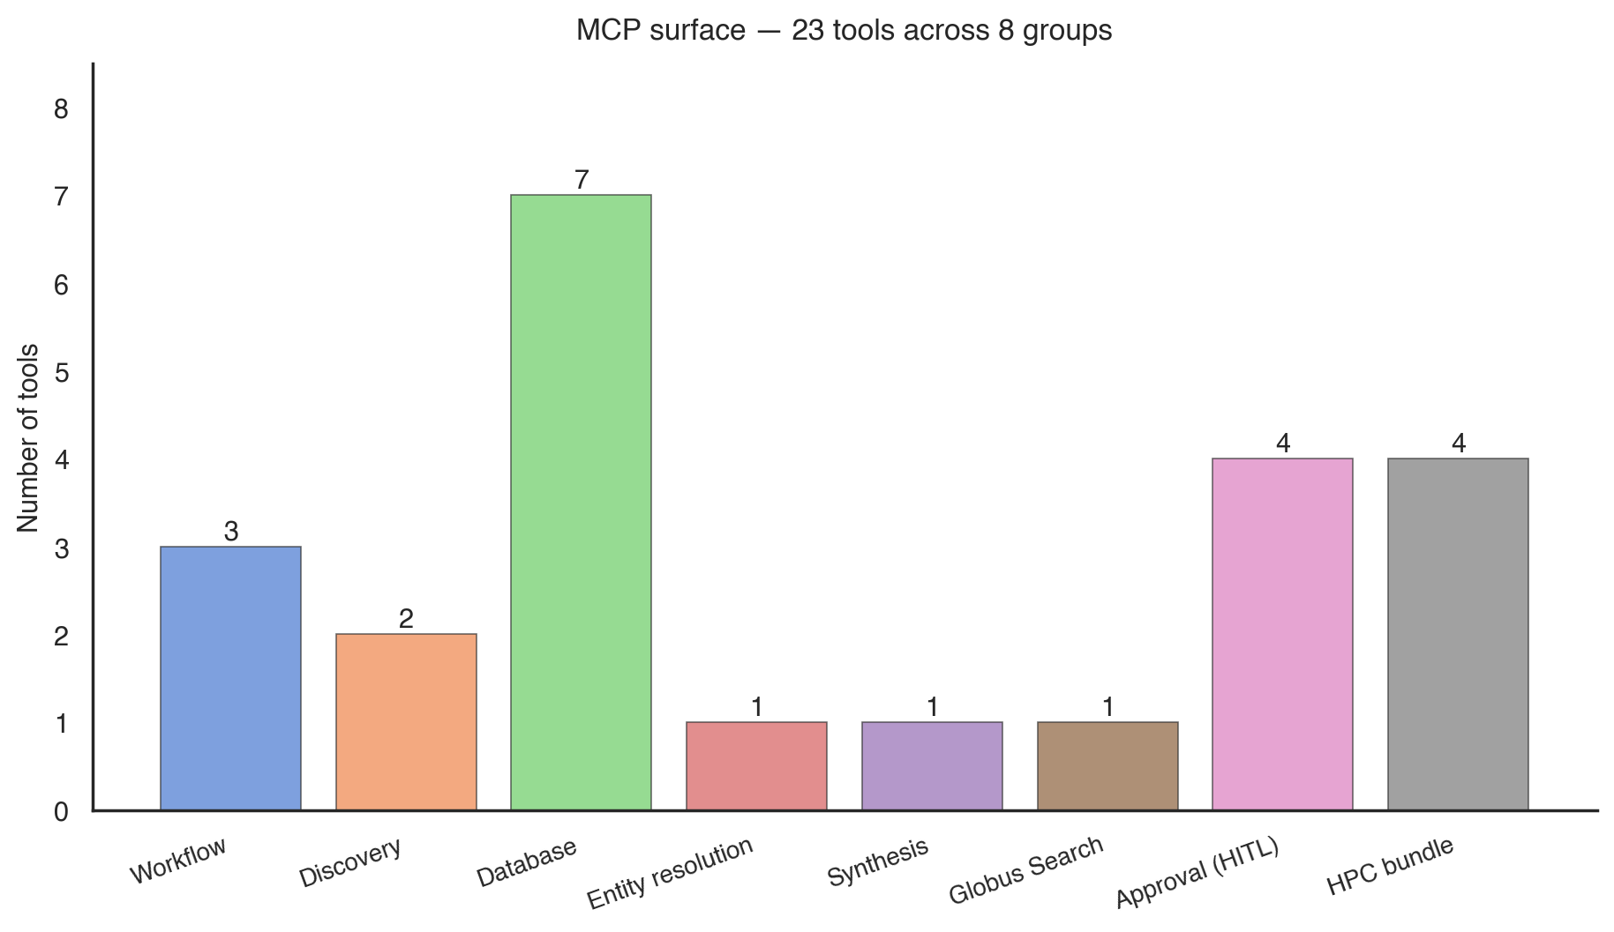
MCP Tool Surface
23 tools across 8 groups
13 / 21

Slide 14
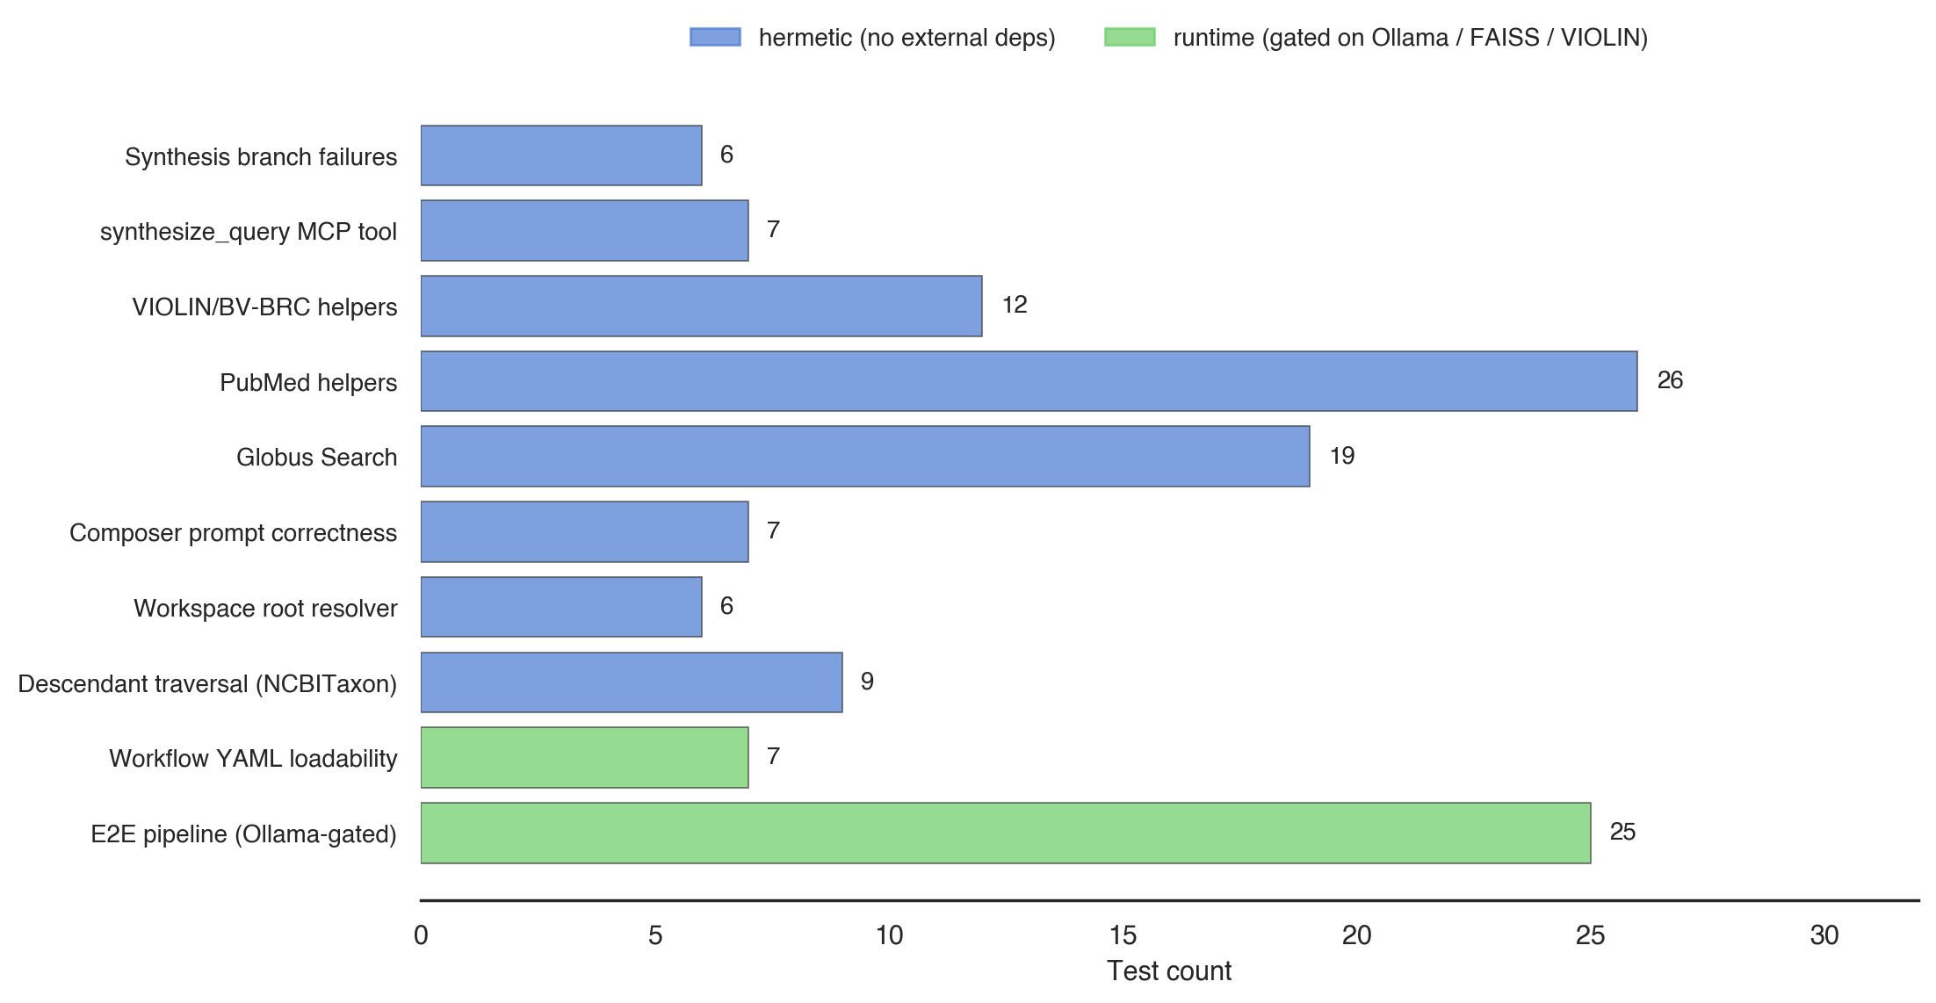
Test Surface
504 unit tests · 7 workflow YAML · 1 cascade runtime — auto-skip when external deps missing
14 / 21

Slide 15
Data Quality Assessment
Three-test pattern · CI-enforced floors · live-OLS gating, no mocks
• AccuracyMetrics — recall + precision + F1 from confusion-matrix counts (correct / incorrect / ground-truth total)
• Three-test pattern: slice baseline (60-row deterministic sample, fast feedback) → full corpus (all 13,238 rows, gated by APECX_SYNONYM_DICT_FULL_CORPUS=1) → probe-batch sampling (50 / 300 spot-checks at the boundary)
• Live OLS gating — APECX_SYNONYM_DICT_LIVE_OLS=1 required; tests auto-skip when the resolver is unreachable rather than mocking it (workspace mocks-only-for-smoke rule)
• Per-class enforcement: Pathogen (R≥0.90, P≥0.95, F1≥0.92), Vaccine (R≥0.75, P≥0.85), Gene (R≥0.65, P≥0.95), Disease (search-only — no recall floor)
• Floors are LOWER BOUNDS, not target observed values — a build that misses any floor fails CI
• Source of truth: tests/integration/test_synonym_accuracy.py (behavior pinned by tests/unit/test_metrics_invariants.py)
15 / 21

Slide 16
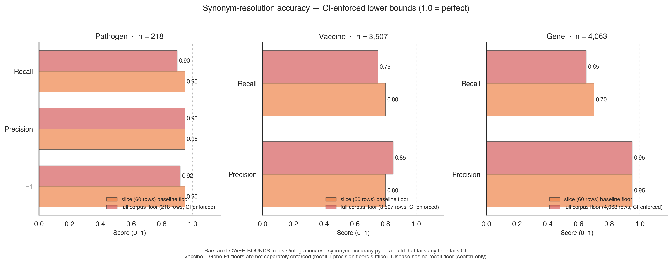
Accuracy Floors per Entity Class
Slice baseline (60 rows) vs. full-corpus floor — both CI-enforced; bars are lower bounds, not observed values
A reading of 0.95 means the test enforces ≥95% — the actual run is at-or-above. Source: tests/integration/test_synonym_accuracy.py.
16 / 21

Slide 17
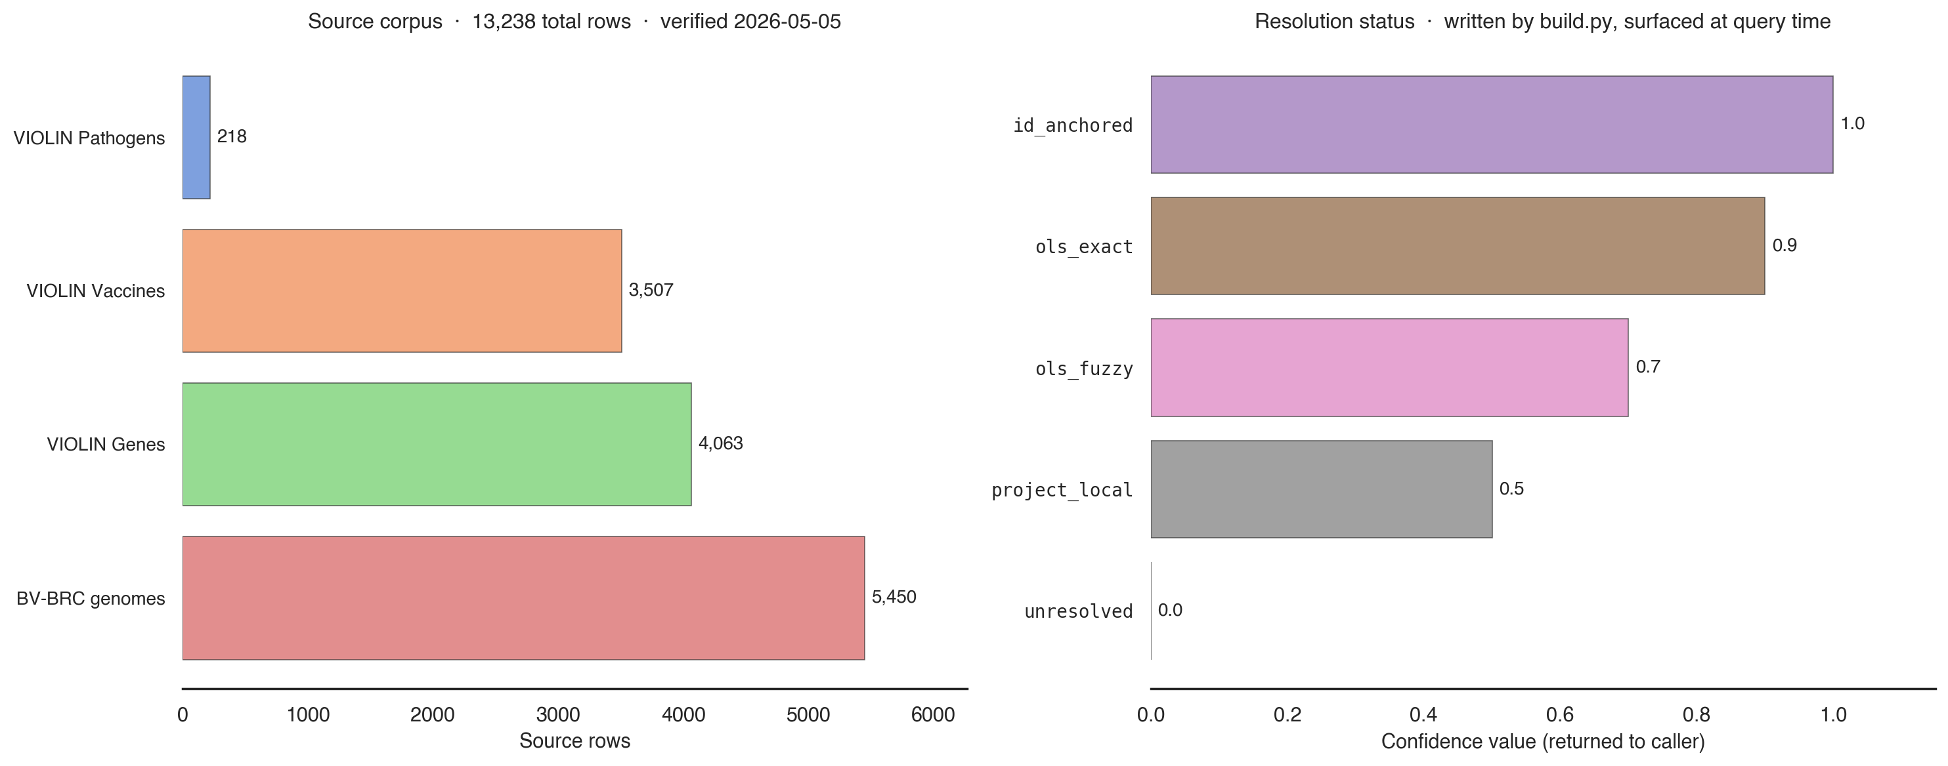
Harmonization Statistics
Source corpus rows · resolution-status confidence · 13,238 total rows verified 2026-05-05
Status taxonomy from synonym_dictionary/enums.py — every resolution result carries (status, confidence) to the caller, so downstream code can filter by quality.
17 / 21

Slide 18
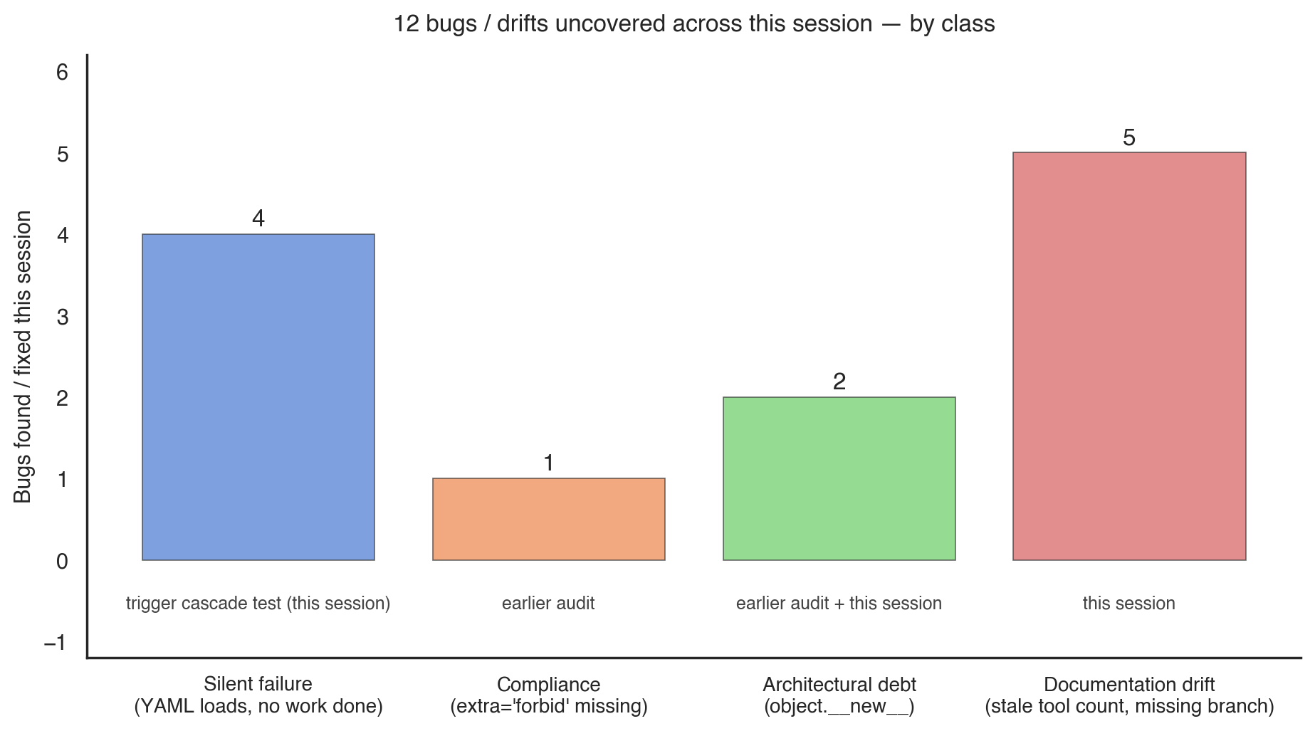
Session Outcome
12 bugs / drifts uncovered, all fixed and pinned by tests
18 / 21

Slide 19
Things That Will Surprise You
Silent-failure shapes you'll hit if you don't know
• Workflow.process(input) is fire-and-forget — use wait_for_cascade to await
• DirectLink defaults to auto_transfer=False — workflow loads, cascade no-ops
• Workflows need workflow-level input_data_units AND step-level data_units
• Trigger inputs are wrapped {unit_name: payload}; direct callers pass raw
• FAISS / sentence_transformers import order is load-bearing on macOS ARM
• Synthesis branch failures degrade gracefully; all-empty raises ValueError
• Globus Search is read-only at the ingest boundary — harvester is offline
• extra='forbid' is mandatory on every step config (silent typo defense)
19 / 21

Slide 20
Failure Contract Per Branch
Branch failures degrade; all-empty raises
Branch | Failure | Effect
Domain RAG | Missing FAISS / corrupted bin | rag_chunks=[], WARNING
VIOLIN / BV-BRC | Missing CSV / wrong column | both bundles=[], WARNING
PubMed | Network / 5xx / timeout | publications=[], WARNING
Globus Search | SDK missing / network / bad UUID | globus_results=[], WARNING
Synthesis LLM | Endpoint down / model rejects | ValueError → MCP {error}
ALL branches empty | fail_on_empty_retrieval gate | ValueError raised
20 / 21

Slide 21
References
Where to read more
• docs/architecture.md — canonical end-to-end map (8 Mermaid diagrams + this content)
• CLAUDE.md — repo-local rules (Python venv, FAISS import order, MCP tool listing)
• ../CLAUDE.md — workspace policy (cross-repo rules, mocks carve-out, harvester boundary)
• docs/figures/*.png — source images for this deck (rerun build_figures.py to regenerate)
• tests/integration/test_rag_e2e_workflow_yaml.py — the cascade test that found the silent-failure bugs
End — questions / discussion
21 / 21

