Slide 1
Housing prices dataset
Тут имена и фамилии

Slide 2
Agenda
01
Data observation
Можно подписать пояснения
02
Preparing data
Encoding, missings, scaling
03
Prediction task
House price prediction
04
Classification task
House quality prediction

Slide 3
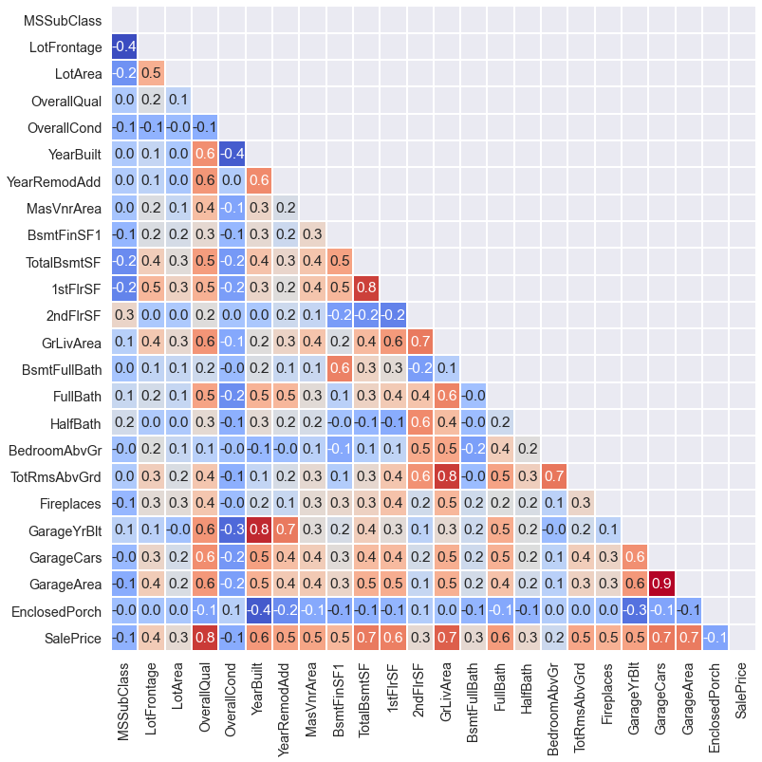
Correlation matrix

Slide 4
Encoding
Adding new features
Splitting
Using one-hot-encoding
If a feature has many zero values
Into train and test samples, test size = 30%
1
3
5
Preparing data for analysis
2
4
Filling NaNs
Scaling
Using simple mean
To get a normal distribution for numeric features

Slide 5
Price prediction task
01
Choosing best parameters
Using GridSearchCV we chose best regularization penalties
02
Choosing best model
Checking for overfitting
Calculating metrics on test sample
03
Придумать заголовок
Looking for the most significant and insignificant features determining the price

Slide 6
Feature’s significance
The most significant features
Here should be scatterplot of y_true and y_score
Proximity to second main road or railroad
Some roof materials (кровля)
Physical locations within Ames city limits
Kitchen quality
Above grade (ground) living area square feet
General shape of property
The most insignificant features
Exterior
Foundation (фундамент)
House and roof style
Type of sale
Paved driveway
Type of heating
Electrical system

Slide 7
Classification task
01
Creating new feature
If OverallQual >= 7:
The house has high quality
Else:
The house has low quality
37% of observations are positive
02
Choosing best parameters
Using GridSearchCV we chose best regularization penalties, best window size for SVM
03
Choosing best model
Checking for overfitting
Calculating metrics on test sample

Slide 8
Classification scores on test sample
Models | Logit | Logit+l1 C=0.62 | Logit+l2 C=0.04 | SVM С=123
Accuracy | 0.89 | 0.88 | 0.89 | 0.88
Precision | 0.91 | 0.87 | 0.91 | 0.89
Recall | 0.81 | 0.82 | 0.81 | 0.79
F1 | 0.86 | 0.84 | 0.85 | 0.84
ROC-AUC | 0.953 | 0.946 | 0.952 | -

Slide 9
Random forest
Но правильный подход это, конечно же, выбирать тьюнинг параметр: глубину дерева или количество соседей через кроссвалидацию… или брать подмножество данных, или как то ещё. Соответственно, надо построить много деревьев и сравнивать их перформанс на разных сэмплах, это и называется ЛЕС.
Павел Павлович Андреянов

Slide 10
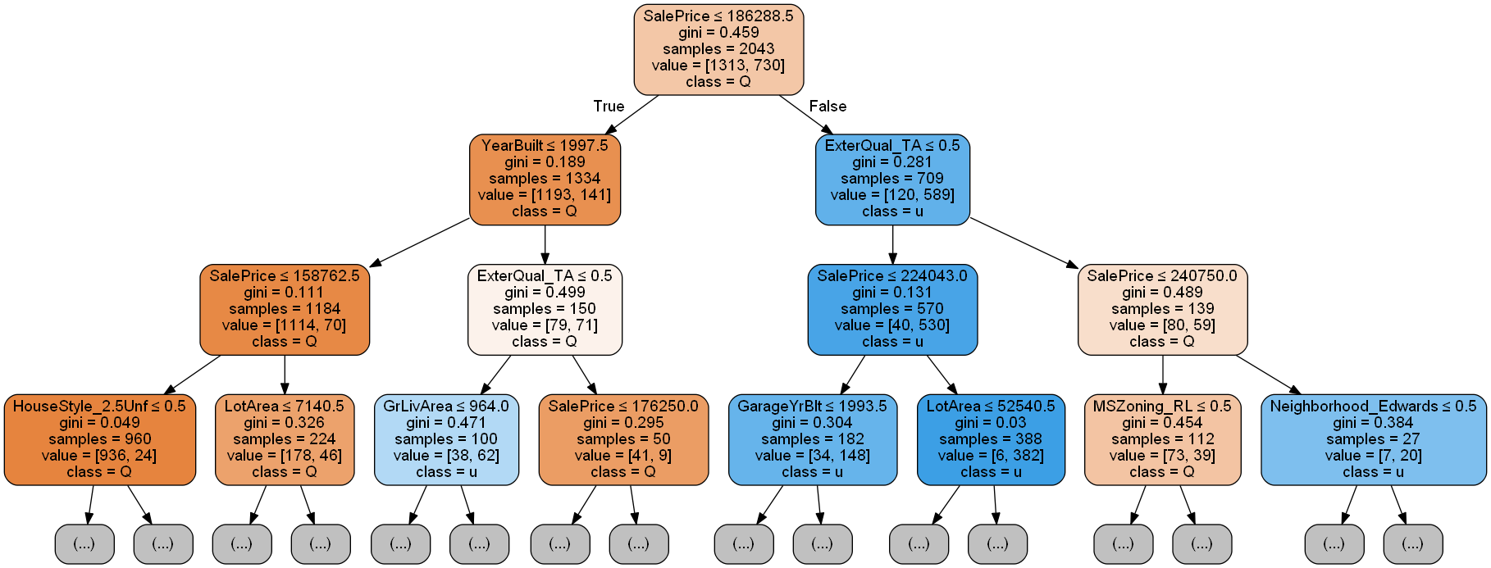
Forest of single trees
Trees with K-fold Cross-Validation: depth as hyperparameter
Why do we need CV in trees?
General characteristics
By using cross validation, we can prevent overfitting and capture nonlinear boundary separating the classes
Forest was trained on f1, guarantee maximum accuracy on depth of 7
Almost 84.5% of variables are insignificant
Sale prices plays more than 64% role, and exterior material quality 9%.
Std is low

Slide 11
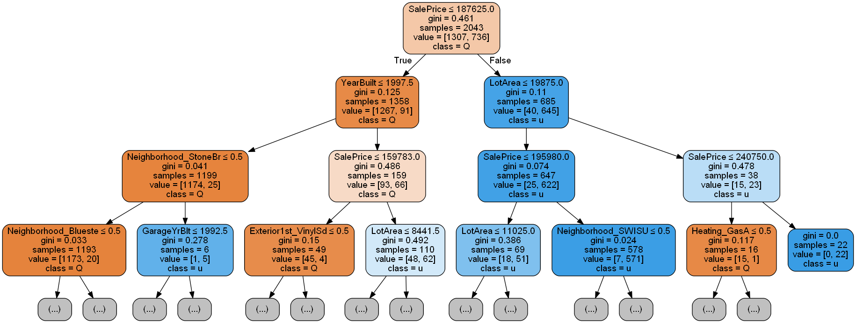
Forest of single trees
Trees with K-fold Cross-Validation: depth and KNN as hyperparameters
Why do we need CV in trees?
General characteristics
By using cross validation, we can prevent overfitting and capture nonlinear boundary separating the classes
Forest was trained on f1, guarantee maximum accuracy on depth of 9 and neighbors of 9
Almost 88% of variables are insignificant
Sale prices plays more than 81% role lot size in a square feet 7%
Std is low

Slide 12
THANK YOU

