Slide 1
MVC Fundamentals
Prezentare Fii Practic

Slide 2
Introduction
Scope
Develop a web application to manage lending books
Use MVC 5 to develop web application
Learn different ways to implement backend of an web application (monolith vs micro services)
Learn how applications are developed in real life

Slide 3
Model view Controller Pattern
Model
(data)
View
(user Interface)
Controller
(applies model to view)

Slide 4
MVC ADvantages
Each component has one responsibility
SRP : Single Responsibility Principle
DRY : Don’t Repeat Yourself
More easily testable
Helps with concurrent development

Slide 5
Model
Business logic and validation of the application’s data domain
Totally independent from the views or the controllers
Model state can be stored in memory, database, XML files

Slide 6
Views
Application’s user interface using data from the model
No interaction with the models or the controllers
Views can be strongly typed
Almost no code

Slide 7
Controller
Handle user interaction
Query the model
Select the right view to render

Slide 8
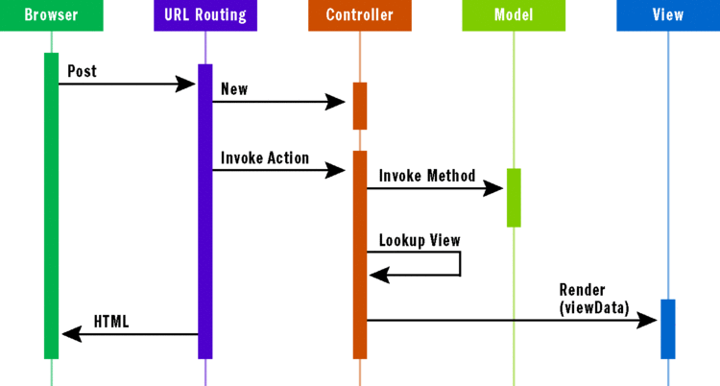
MVC FLOW
https://msdn.microsoft.com/en-us/magazine/dd252940.aspx

Slide 9
Convention over Configuration
Controllers naming
Controllers folder
View naming
A view for each action in controller
View folder
Models folder
Code First Convention over configuration
for models

Slide 10
Demo mvC
Demo – default template
Folder structure
Controller, View, Model
Authentication, Attributes
Razor
Html Helpers

Slide 11
One Common Goal

