Slide 1

Drugs consumption
Python for Data Analysis
ESILV A4
Alexandra CHUVATIN | Axel GUEDJ

Slide 2
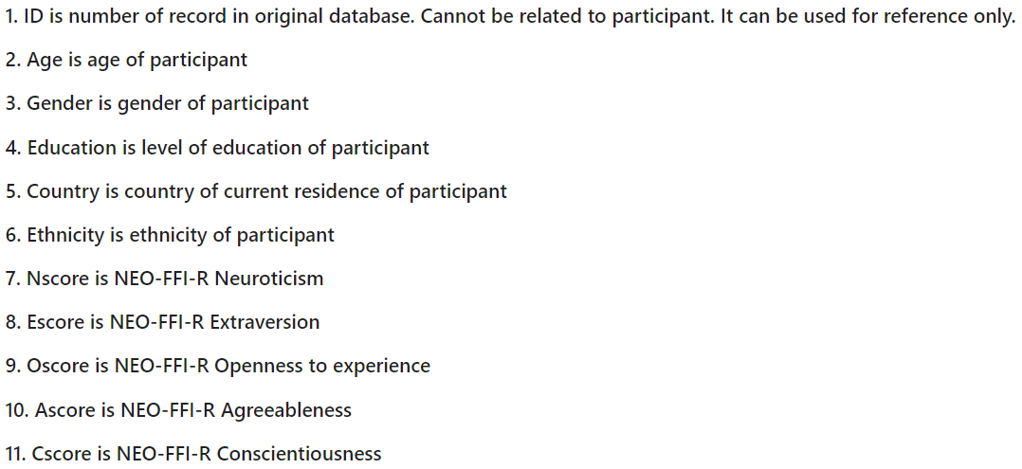
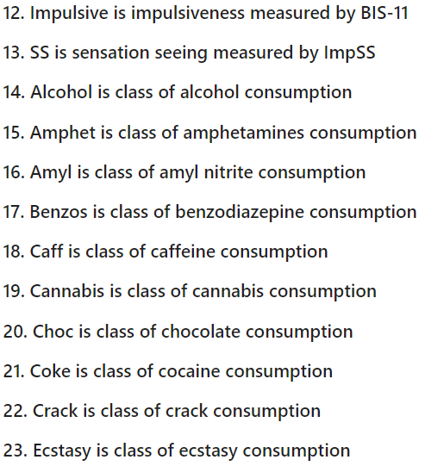
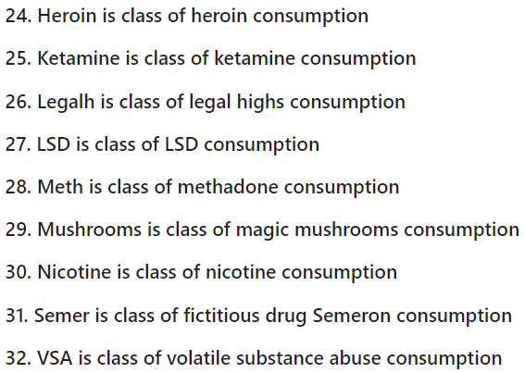
The dataset
Our dataset is about drug consumption. It contains records for 1885 respondants for which 12 attributes are known. Addition to this we have their consumption for 18 legal and illegal drugs.
We do not have missing values.

Slide 3
The Goal
We want to be able to predict whether the person is a user or not of a chosen drug.
To do so, we will look at the data and see which features will help us.
Then, we will class the drugs in categories to help us in our predictions.
Finally, we will do some encoding for the qualitative features.
The last task will be to find the model that predicts the best the usage of each drug class !

Slide 4
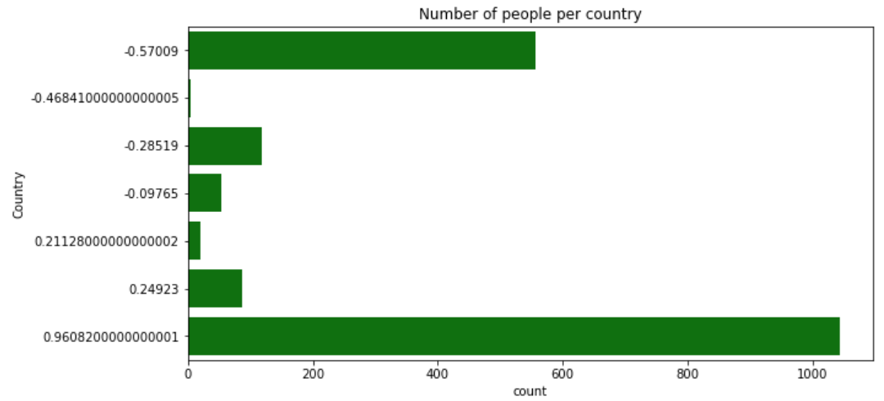
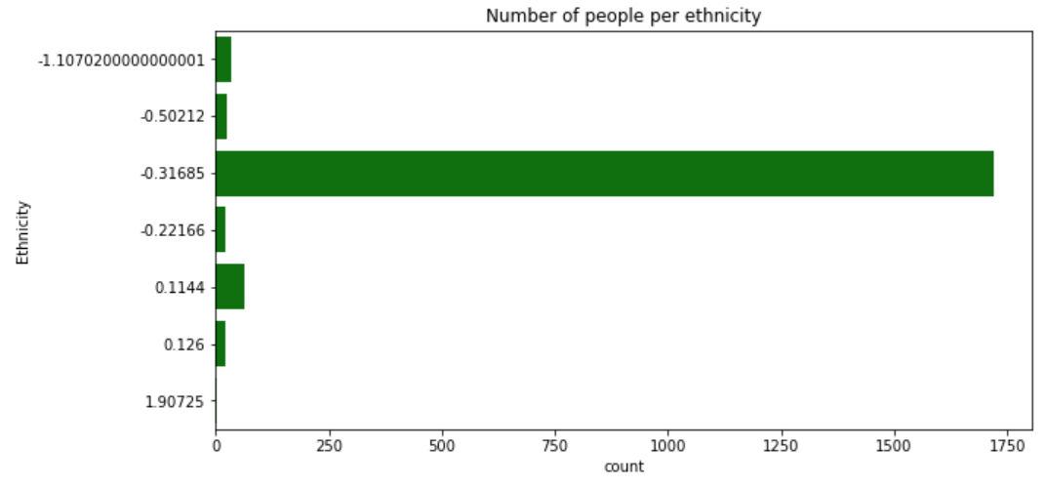
First observations
A good point is that for the gender feature we have 50% of male and 50% of female.
But when we look closer, some features can not help us because of a bad distribution. Thus, we can not use ethnicity and country in our predictions.

Slide 5
Drug users
The first task is to class the participants into 2 groups: “Users” and “Non-Users”. To do so, we decided that a User of a drug is someone that gave one of these answers: ‘Used in last day’ , ‘Used in last week’, ‘Used in last month’. The rest will be Non-User. The goal is to have a one in the dataset if the person is considered as a user and a zero in the other case.
Next, we put the drugs in 3 different classes: Depressants, Stimulants and Psychedelics according to this site: https://www.health.gov.au/health-topics/drugs/about-drugs/types-of-drugs
Unfortunately, we couldn’t class « Choc » and « LegalH » into one of the classes.
NB: first we tried to use the Drug Wheel to class the drugs, but to many of them weren’t part of a class. We also tried to use the distinction between hard and soft drug, but it appeared it wasn’t a good classification for drugs.
Finally, we had only one user of the drug « Semer », so we droped this column because it wasn’t relevent.

Slide 6
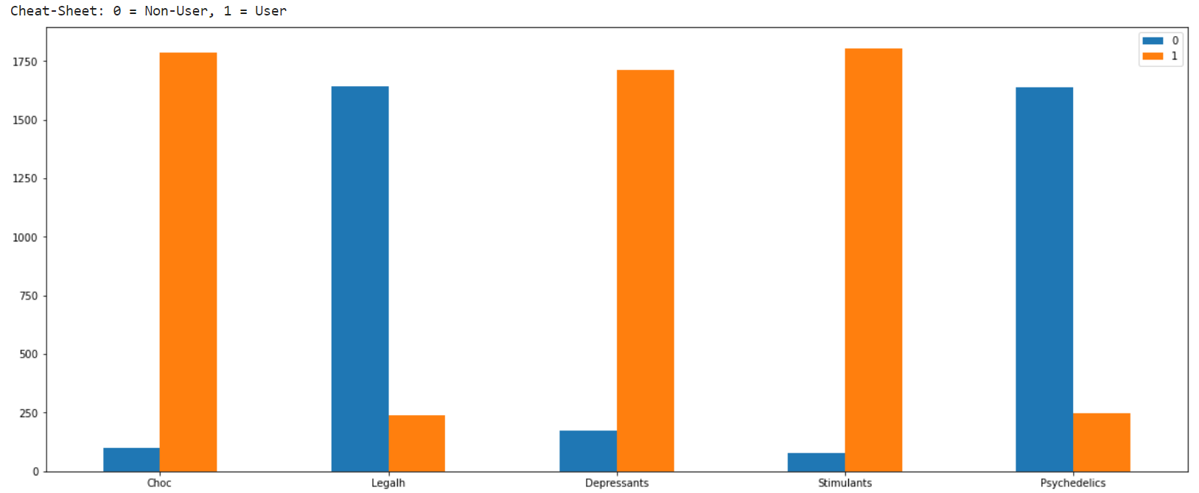
Users vs Non-Users for each drug

Slide 7
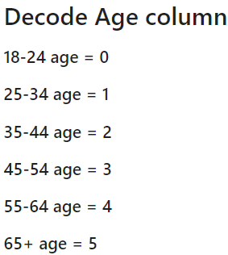
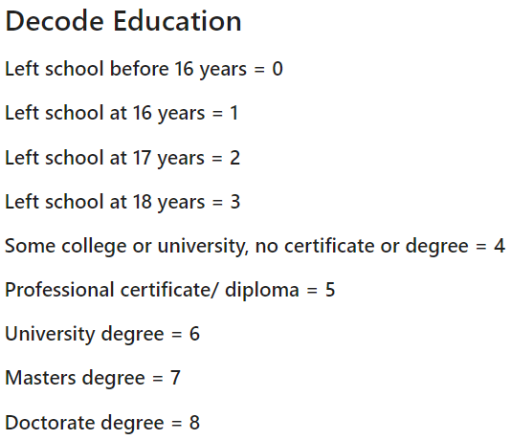
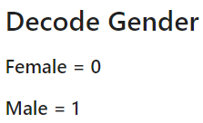
Encoding
The features Age, Gender and Education were already encoded, but we will encode them differently, as seen in class. First we will decode them to easier understand the values.
Then, to encode them, we use the get_dummies() function of the pandas library.
Now, instead of Age (0/1/2/3/4/5) we have Age_0, Age_1, …
Our final columns are:
'Nscore', 'Escore', 'Oscore', 'Ascore', 'Cscore', 'Impulsive', 'SS', 'Education_0', 'Education_1', 'Education_2', 'Education_3', 'Education_4', 'Education_5', 'Education_6', 'Education_7', 'Education_8', 'Age_0', 'Age_1', 'Age_2', 'Age_3', 'Age_4', 'Age_5', 'Education_0', 'Education_1', 'Education_2', 'Education_3', 'Education_4', 'Education_5', 'Education_6', 'Education_7', 'Education_8', 'Age_0', 'Age_1', 'Age_2', 'Age_3', 'Age_4', 'Age_5', 'Gender_0', 'Gender_1’ + the drugs

Slide 8
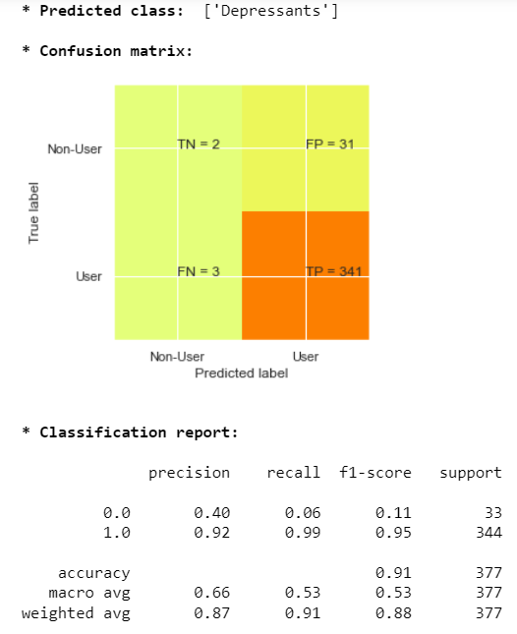
Predictions
Our model will be a classification model because we want to know wether someone is a « User » or a « Non-User ».
After standardizing our data, we tried several algorithms such as SVC, KNN, Decision Tree…
The best model we found is Decision Tree with an accuracy of 0.91 !
To compare our models, we used graphics to compute the confusion matrix, and we showed different scores as the accuracy, the recall…

Slide 9
Flask interface
First, to use our model on our Flask application, we saved it using the library pickle.
Flask helped us creat an internet application thanks to which we can fill some questions about the features we need about a person for our prediction.
Once all the values are wrote, the model we saved with pickle is used to find if the person is a consumer of the chosen drug (1 if yes, 0 if no).
NB: to load localhost:5000, we need to run the file app.py just before (available in ‘predict drugs’ on the github)

Slide 10
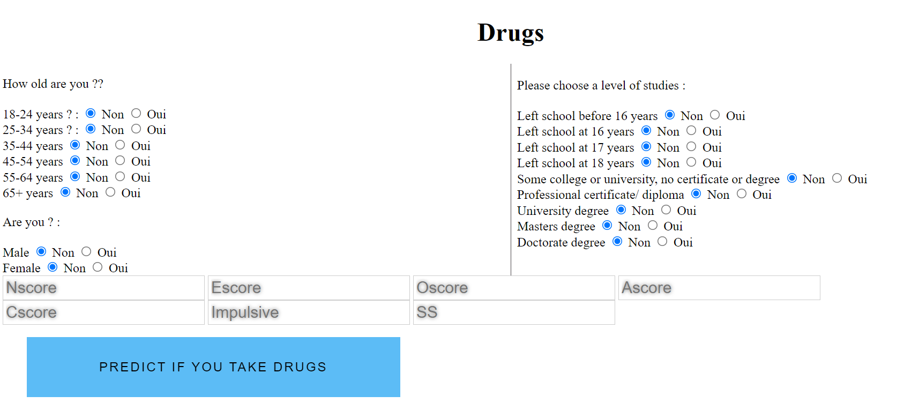

Flask interface
To use the interface, we need to specify the needed questions. (put a ‘yes’ for the category the person belongs to for the age, education and gender).
Push the predict button…
The answer appears just below !
NB: On the flask interface, we predict wether the person will be a Depressant drug consumer or not. To upgrade this, we can add the prediction for all the types of drugs.

