Slide 1
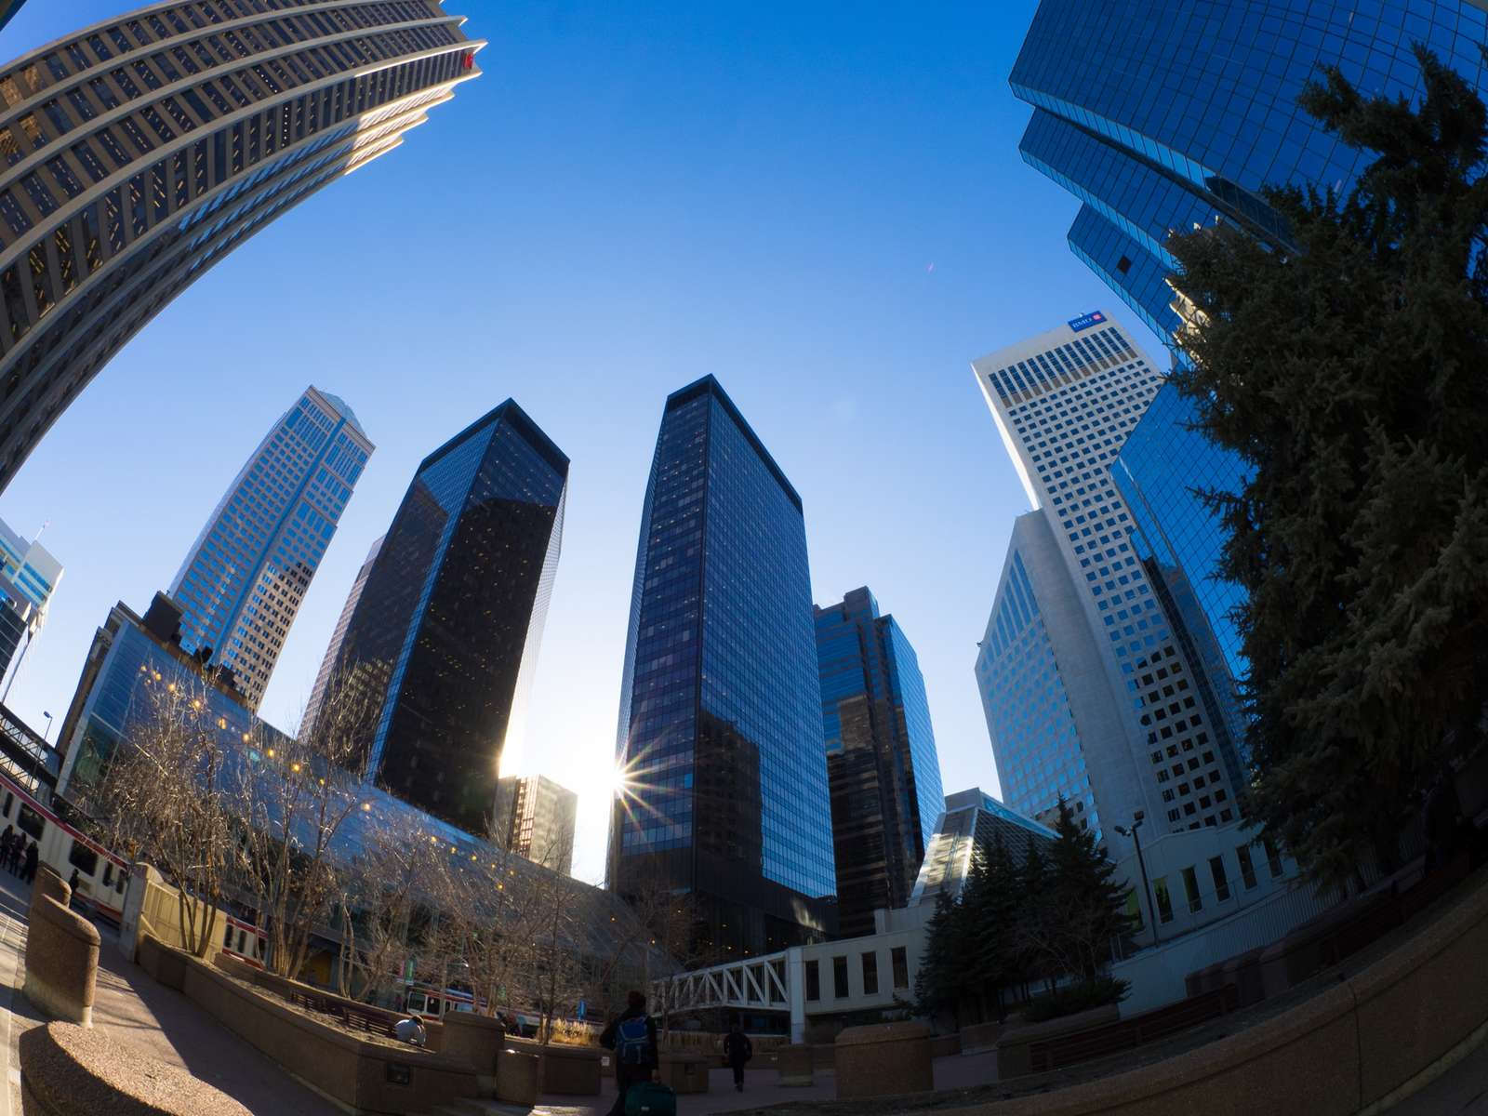
Camera calibration

Slide 2
References
http://szeliski.org/Book/
http://www.cs.cornell.edu/courses/cs5670/2019sp/lectures/lectures.html
http://www.cs.cmu.edu/~16385/

Slide 3
Contents
What is camera calibration?
Camera intrinsics
Camera extrinsics
Full camera matrix
Calibration methods and distortions

Slide 4
What is camera calibration
Geometric camera calibration, also referred to as camera resectioning, estimates the parameters of a lens, image sensor, position and view direction of a perspective camera.
You can use these parameters to correct for lens distortion, measure the size of an object in world units, or determine the location of the camera in the scene. These tasks are used in applications such as machine vision to detect and measure objects. They are also used in robotics, for navigation systems, and 3-D scene reconstruction.
[from: https://www.mathworks.com/help/vision/ug/camera-calibration.html]

Slide 5
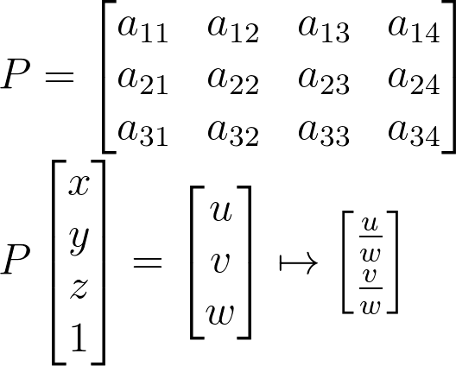
Starting from the end
The camera matrix is a full transformation from 3D objects in the scene to a 2D image with the specific camera parameters:
How many DOFs do we have?
Notes:
\\
P =
\begin{bmatrix}a_{11} & a_{12}&a_{13}&a_{14}
\\ a_{21}&a_{22} &a_{23}&a_{24}
\\a_{31}&a_{32}&a_{33}&a_{34}
\end{bmatrix}
\\
P
\begin{bmatrix}x
\\ y
\\z
\\1
\end{bmatrix}
=
\begin{bmatrix}u
\\ v
\\w
\end{bmatrix}
\mapsto
\begin{bmatrix}\frac{u}{w}
\\ \frac{v}{w}
\end{bmatrix}

Slide 6
Starting from the end
The camera matrix is a full transformation from 3D objects in the scene to a 2D image with the specific camera parameters:
How many DOFs do we have?
11, because in homogenous coordinates the answer is always correct up to a scale.
Notes:
\\
P =
\begin{bmatrix}a_{11} & a_{12}&a_{13}&a_{14}
\\ a_{21}&a_{22} &a_{23}&a_{24}
\\a_{31}&a_{32}&a_{33}&a_{34}
\end{bmatrix}
\\
P
\begin{bmatrix}x
\\ y
\\z
\\1
\end{bmatrix}
=
\begin{bmatrix}u
\\ v
\\w
\end{bmatrix}
\mapsto
\begin{bmatrix}\frac{u}{w}
\\ \frac{v}{w}
\end{bmatrix}

Slide 7
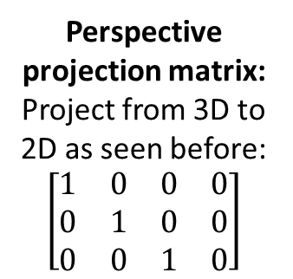
Starting from the end
Intrinsic camera matrix:
estimates the parameters of the lens and image sensor.
Perspective projection matrix:
Project from 3D to 2D as seen before:
$$\left[\begin{matrix}1 & 0 & 0 & 0 \\ 0 & 1 & 0 & 0 \\ 0 & 0 & 1 & 0\end{matrix}\right]$$
extrinsic camera matrix:
estimates the parameters of position and view direction of a camera.
Notes:
P_{3X4} = K_{3X3}[I|0]_{3X4}\Pi_{4X4}

Slide 8
Contents
What is camera calibration?
Camera intrinsics
Camera extrinsics
Full camera matrix
Calibration methods and distortions

Slide 9



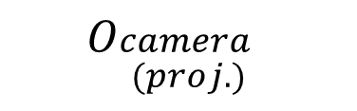
Coordinate systems
There are 3 coordinate systems that are discussed in general: camera, world and image coordinate systems.
world point
image point
$$O_{camera}$$
$$O_{\begin{aligned}camera \\ (proj.)\end{aligned}}$$
$$O_{world}$$
$$O_{image}$$

Slide 10




Recap: perspective projection
Perspective projection (also known as perspective transformation) is a linear projection where three dimensional objects are projected on the image plane.
image plane
$$O_{camera}$$
principal axis
Notes:
\begin{bmatrix}x
\\ y
\\ z
\end{bmatrix}
\begin{bmatrix}u
\\ v
\end{bmatrix}

Slide 11
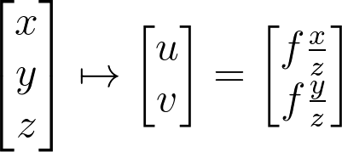
Recap: perspective projection
Using triangle proportions (Thales’ theorem) we can easily conclude that:
image plane
Notes:
\begin{bmatrix}x
\\ y
\\ z
\end{bmatrix}
\mapsto
\begin{bmatrix}u
\\ v
\end{bmatrix}
=
\begin{bmatrix}f\frac{x}{z}
\\ f\frac{y}{z}
\end{bmatrix}

Slide 12
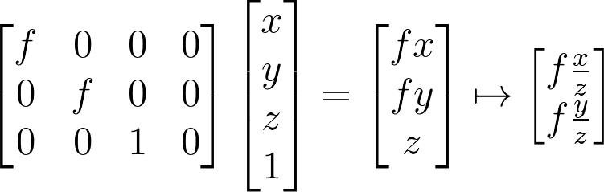

Recap: perspective projection
Let’s use the homogeneous coordinates:
Units of $[m]$
Notes:
\begin{bmatrix}f & 0&0&0
\\ 0&f &0&0
\\0&0&1&0
\end{bmatrix}
\begin{bmatrix}x
\\ y
\\z
\\1
\end{bmatrix}
=
\begin{bmatrix}fx
\\ fy
\\z
\end{bmatrix}
\mapsto
\begin{bmatrix}f\frac{x}{z}
\\ f\frac{y}{z}
\end{bmatrix}

Slide 13
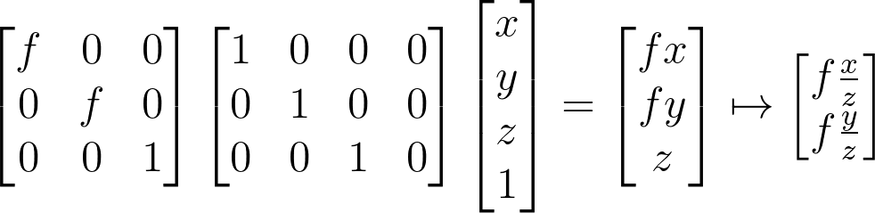
Recap: perspective projection
Let’s split into 2 matrices and use 3D->2D homogenous coordinates:
Intrinsic camera matrix
Perspective projection matrix
Notes:
\begin{bmatrix}f & 0&0
\\ 0&f &0
\\0&0&1
\end{bmatrix}
\begin{bmatrix}1 & 0&0&0
\\ 0&1 &0&0
\\0&0&1&0
\end{bmatrix}
\begin{bmatrix}x
\\ y
\\z
\\1
\end{bmatrix}
=
\begin{bmatrix}fx
\\ fy
\\z
\end{bmatrix}
\mapsto
\begin{bmatrix}f\frac{x}{z}
\\ f\frac{y}{z}
\end{bmatrix}

Slide 14
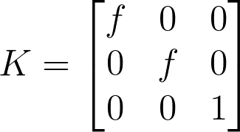
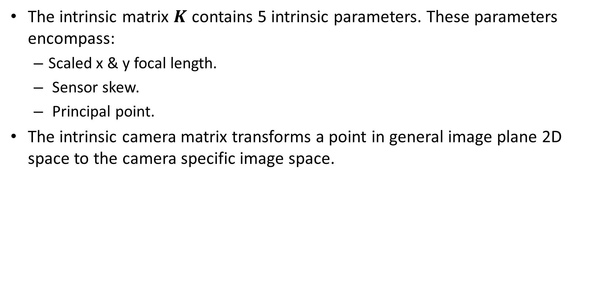
Intrinsic camera matrix
The intrinsic matrix $K$ contains 5 intrinsic parameters. These parameters encompass:
Scaled x & y focal length.
Sensor skew.
Principal point.
The intrinsic camera matrix transforms a point in general image plane 2D space to the camera specific image space.
Notes:
K =
\begin{bmatrix}f & 0&0
\\ 0&f &0
\\0&0&1
\end{bmatrix}

Slide 15
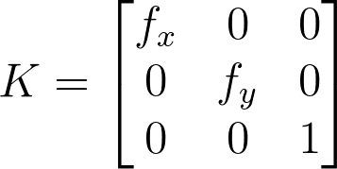
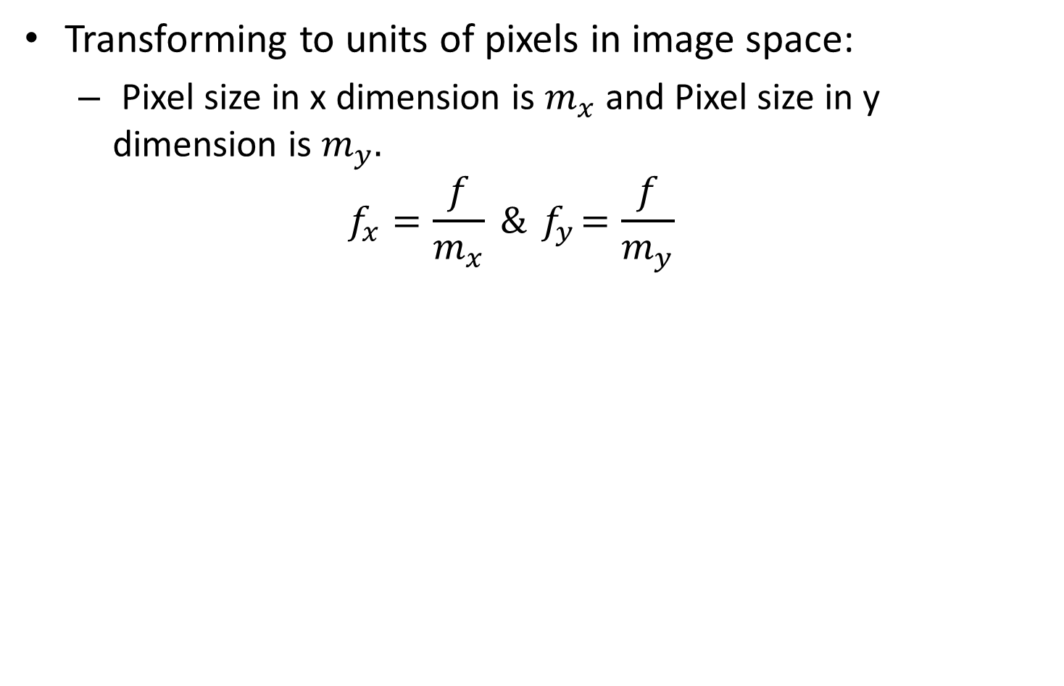
Intrinsic camera matrix
Transforming to units of pixels in image space:
Pixel size in x dimension is $m_{x}$ and Pixel size in y dimension is $m_{y}.$
$$f_{x}=\frac{f}{m_{x}} \&{ f}_{y}=\frac{f}{m_{y}}$$
Notes:
K =
\begin{bmatrix}f_x & 0&0
\\ 0&f_y &0
\\0&0&1
\end{bmatrix}

Slide 16

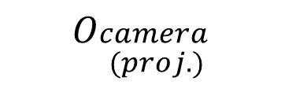
Intrinsic camera matrix
Let’s add the principle point: the offset vector between the projected camera coordinates to the image coordinate [units of pixels].
How to add this to the intrinsic matrix?
image plane
$$O_{\begin{aligned}camera \\ (proj.)\end{aligned}}$$
$$O_{image}$$

Slide 17
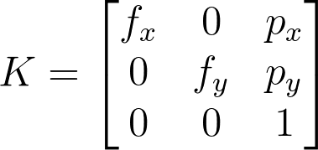
Intrinsic camera matrix
Let’s add the principle point: the offset vector between the projected camera coordinates to the image coordinate [units of pixels].
How to add this to the intrinsic matrix?
image plane
$$O_{\begin{aligned}camera \\ (proj.)\end{aligned}}$$
$$O_{image}$$

Slide 18
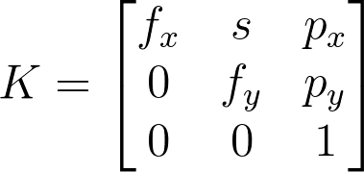
Intrinsic camera matrix
In some camera sensors exist a very small skew which makes the sensor a parallelogram.
Notes:
K =
\begin{bmatrix}f_x & s&p_x
\\ 0&f_y &p_y
\\0&0&1
\end{bmatrix}
==============================
Kx =
\begin{bmatrix}1 & 0&p_x
\\ 0&1 &p_y
\\0&0&1
\end{bmatrix}
\begin{bmatrix}1 & \frac{s}{f_y}&0
\\ 0&1 &0
\\0&0&1
\end{bmatrix}
\begin{bmatrix}f_x & 0&0
\\ 0&f_y &0
\\0&0&1
\end{bmatrix}
x

Slide 19
Contents
What is camera calibration?
Camera intrinsics
Camera extrinsics
Full camera matrix
Calibration methods and distortions

Slide 20
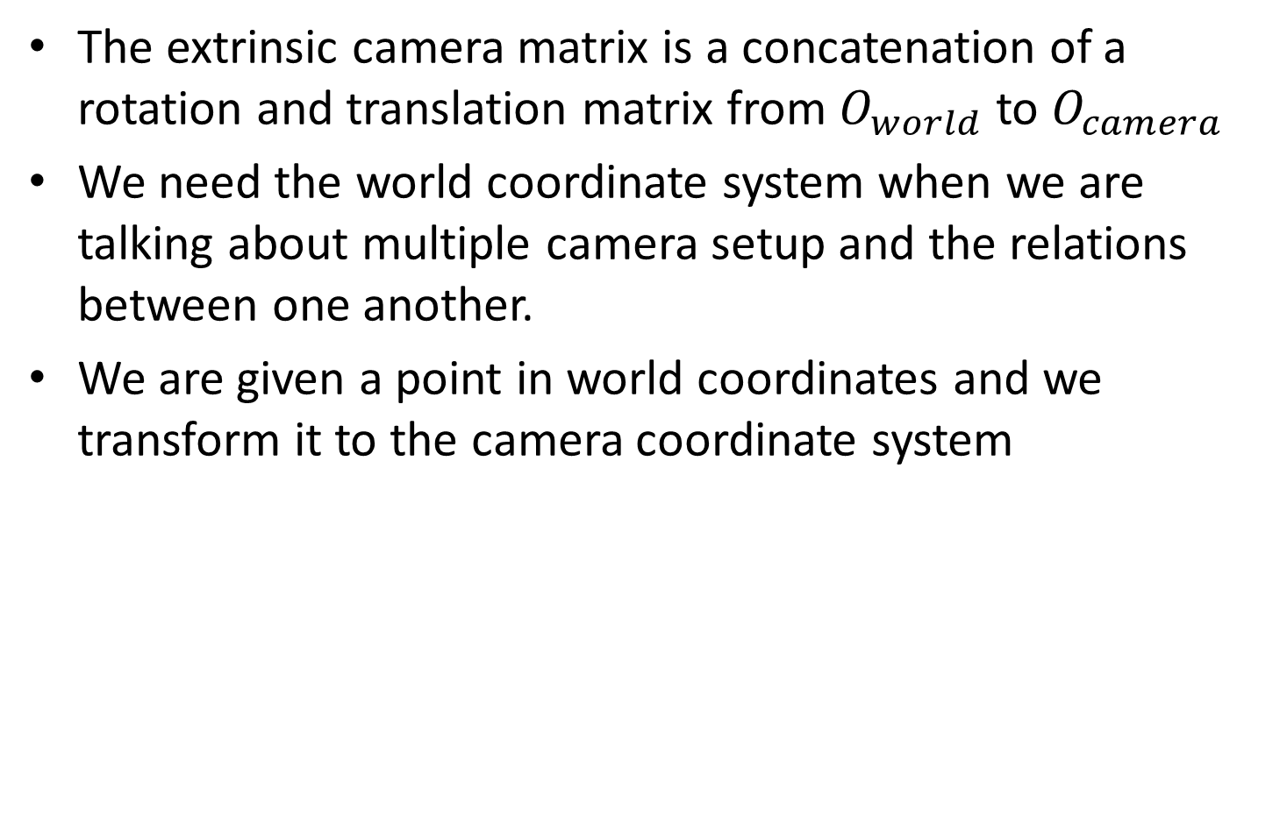
Extrinsic camera matrix
The extrinsic camera matrix is a concatenation of a rotation and translation matrix from $O_{world}$ to $O_{camera}$
We need the world coordinate system when we are talking about multiple camera setup and the relations between one another.
We are given a point in world coordinates and we transform it to the camera coordinate system

Slide 21
Extrinsic camera matrix
We are given a point in world coordinates and we transform it to the camera coordinate system:

Slide 22

Extrinsic camera matrix
$$X_{w}$$
Camera coordinate system
World coordinate system

Slide 23

Extrinsic camera matrix
Camera coordinate system
$$C$$
Translation vector from world to camera
World coordinate system

Slide 24

Extrinsic camera matrix
$$\left(X_{w}−C\right)$$

Slide 25


Extrinsic camera matrix
$$X_{c}=R(X_{w}−C)$$
$$R$$
Rotation matrix from world to camera

Slide 26
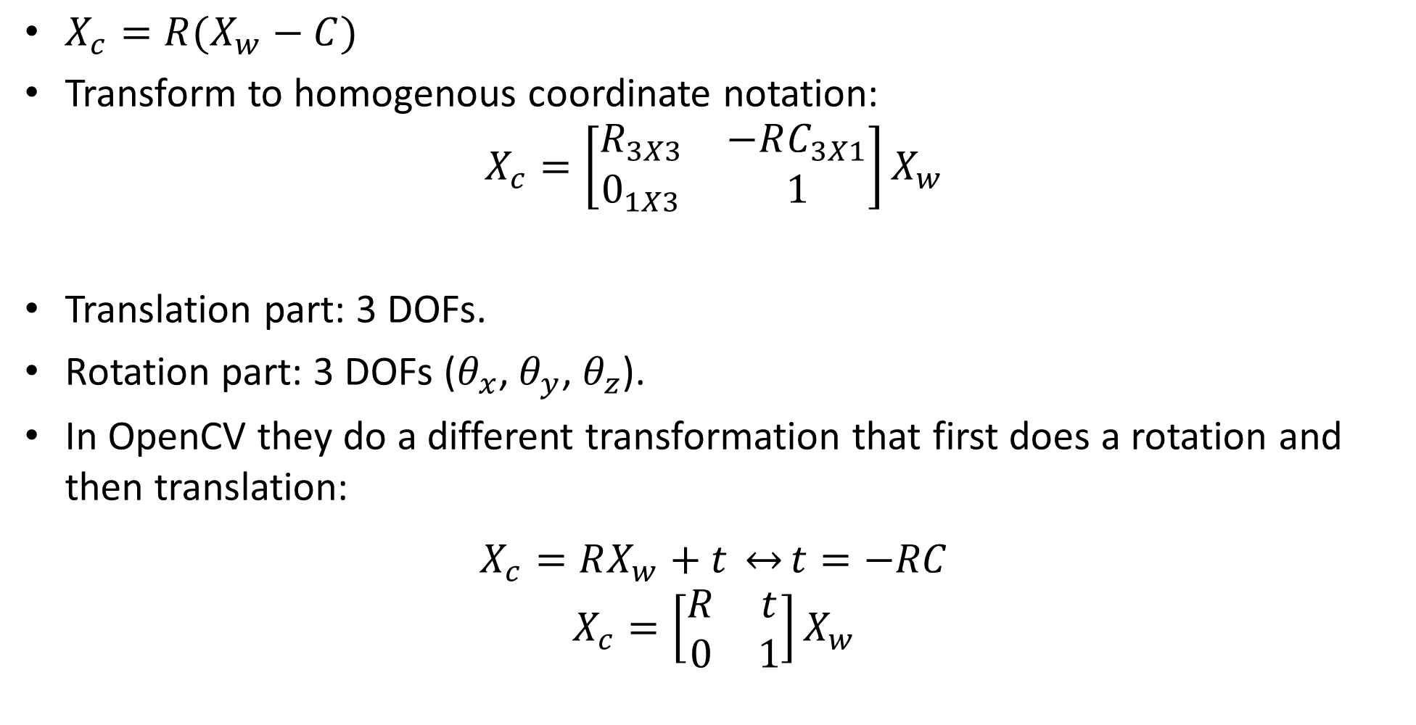
Extrinsic camera matrix
$X_{c}=R(X_{w}−C)$
Transform to homogenous coordinate notation:
$$X_{c}=\left[\begin{matrix}R_{3X3} & −RC_{3X1} \\ 0_{1X3} & 1\end{matrix}\right]X_{w}$$
Translation part: 3 DOFs.
Rotation part: 3 DOFs ($θ_{x}$, $θ_{y}$, $θ_{z}$).
In OpenCV they do a different transformation that first does a rotation and then translation:
$$X_{c}=RX_{w}+t \underset{↔}{}t=−RC$$
$$X_{c}=\left[\begin{matrix}R & t \\ 0 & 1\end{matrix}\right]X_{w}$$

Slide 27
Contents
What is camera calibration?
Camera intrinsics
Camera extrinsics
Full camera matrix
Calibration methods and distortions

Slide 28
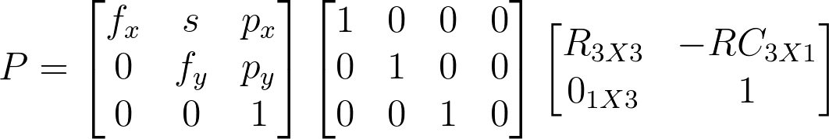
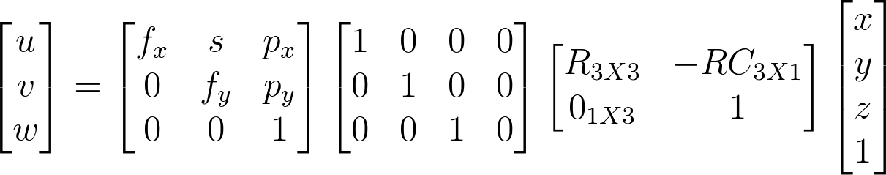
Full camera matrix
Notes:
P =
\begin{bmatrix}f_x & s&p_x
\\ 0&f_y &p_y
\\0&0&1
\end{bmatrix}
\begin{bmatrix}1 & 0&0&0
\\ 0&1 &0&0
\\0&0&1&0
\end{bmatrix}
\begin{bmatrix}R_{3X3} & -RC_{3X1}
\\ 0_{1X3}&1
\end{bmatrix}
=========================================
\begin{bmatrix}u
\\ v
\\w
\end{bmatrix}
=
\begin{bmatrix}f_x & s&p_x
\\ 0&f_y &p_y
\\0&0&1
\end{bmatrix}
\begin{bmatrix}1 & 0&0&0
\\ 0&1 &0&0
\\0&0&1&0
\end{bmatrix}
\begin{bmatrix}R_{3X3} & -RC_{3X1}
\\ 0_{1X3}&1
\end{bmatrix}
\begin{bmatrix}x
\\ y
\\z
\\1
\end{bmatrix}

Slide 29
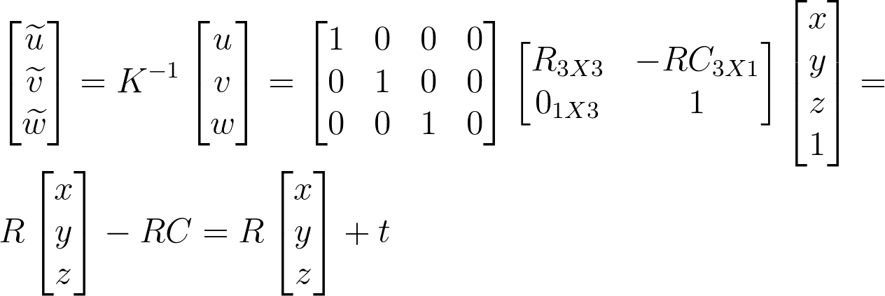
Side note: normalized image coordinates
A projection into 2D where the intrinsic matrix is already embedded at the coordinate given
We will use it when we already know the intrinsic of the camera and just interested in the extrinsic:
Notes:
\\
\begin{bmatrix}\widetilde{u}
\\ \widetilde{v}
\\\widetilde{w}
\end{bmatrix}
=
K^{-1}
\begin{bmatrix}u
\\ v
\\w
\end{bmatrix}
=
\begin{bmatrix}1 & 0&0&0
\\ 0&1 &0&0
\\0&0&1&0
\end{bmatrix}
\begin{bmatrix}R_{3X3} & -RC_{3X1}
\\ 0_{1X3}&1
\end{bmatrix}
\begin{bmatrix}x
\\ y
\\z
\\1
\end{bmatrix}
=
\\
R
\begin{bmatrix}x
\\ y
\\z
\end{bmatrix}
-RC
=
R
\begin{bmatrix}x
\\ y
\\z
\end{bmatrix}
+t

Slide 30
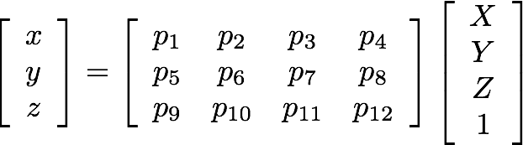
Full camera matrix
Assuming we are given an imaged points and their corresponding 3D points in the real world, camera calibration is the process to find the camera parameters.
We will return to this assumption later.

Slide 31
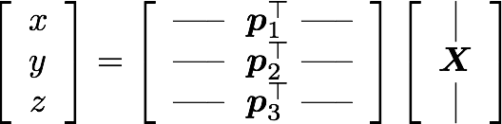


Full camera matrix
Heterogeneous coordinates
(non-linear relation between coordinates)

Slide 32


Full camera matrix
Make them linear with algebraic manipulation…
Now we can setup a system of linear equations with multiple point correspondences

Slide 33
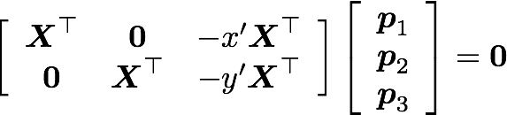
Full camera matrix
Vector of 1X12
In matrix form …

Slide 34
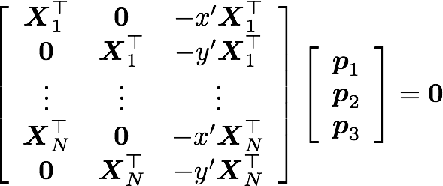
Full camera matrix
In matrix form …
For N points …
How many points do we need to solve this problem?
How do we solve this system?

Slide 35

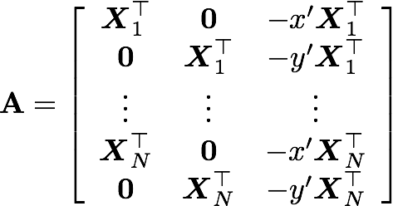
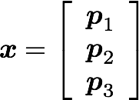
Full camera matrix
We’ve already seen this minimization problem in the curve fitting class- linear TLS.
6 points will give us 12 equations- enough for 11 parameters.

Slide 36
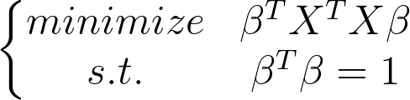
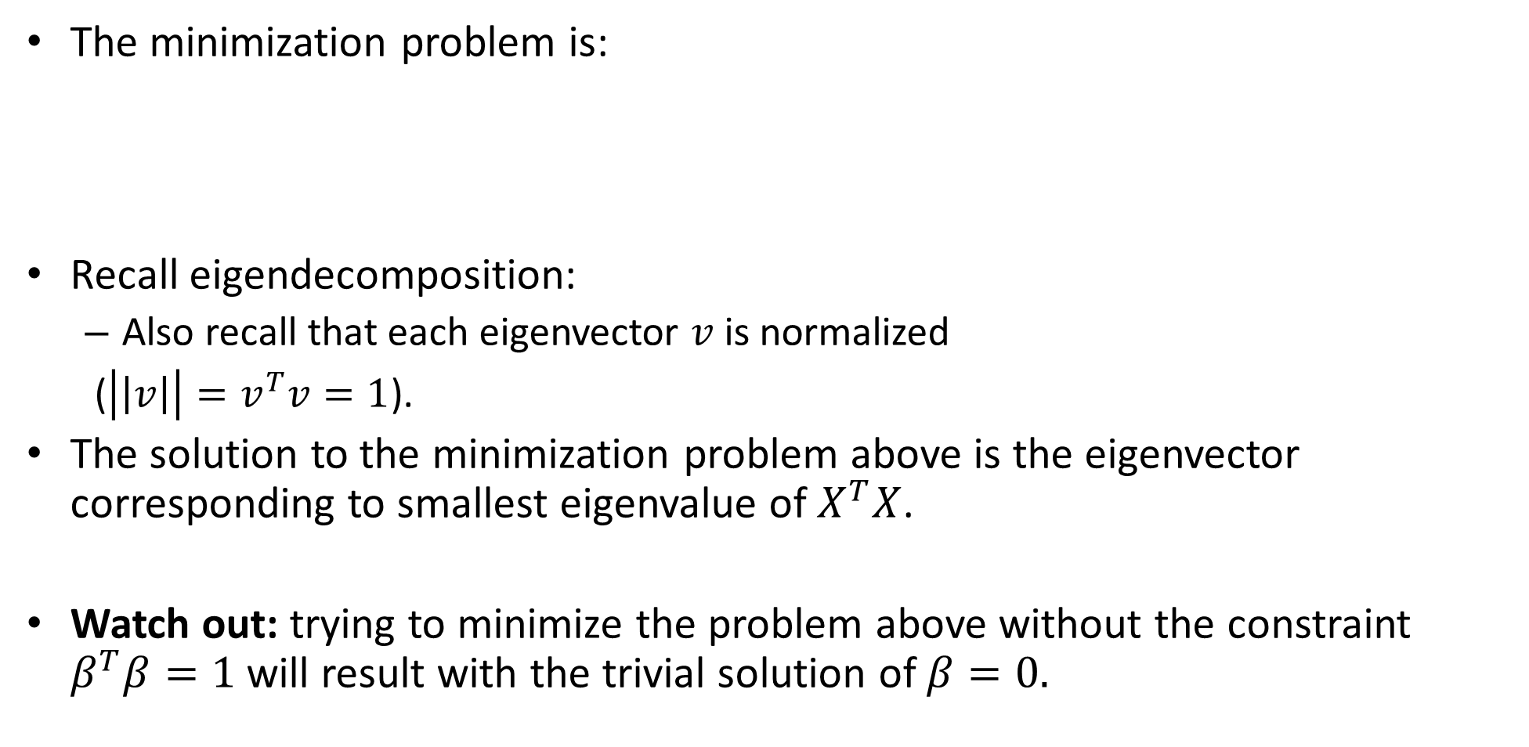
Linear TLS -the minimization problem
The minimization problem is:
Recall eigendecomposition:
Also recall that each eigenvector $v$is normalized
($\left|\left|v\right|\right|=v^{T}v=1$).
The solution to the minimization problem above is the eigenvector corresponding to smallest eigenvalue of $X^{T}X$.
Watch out: trying to minimize the problem above without the constraint $β^{T}β=1$ will result with the trivial solution of $β=0.$
Notes:
Av = \lambda v \mapsto v^TAv = \lambda

Slide 37
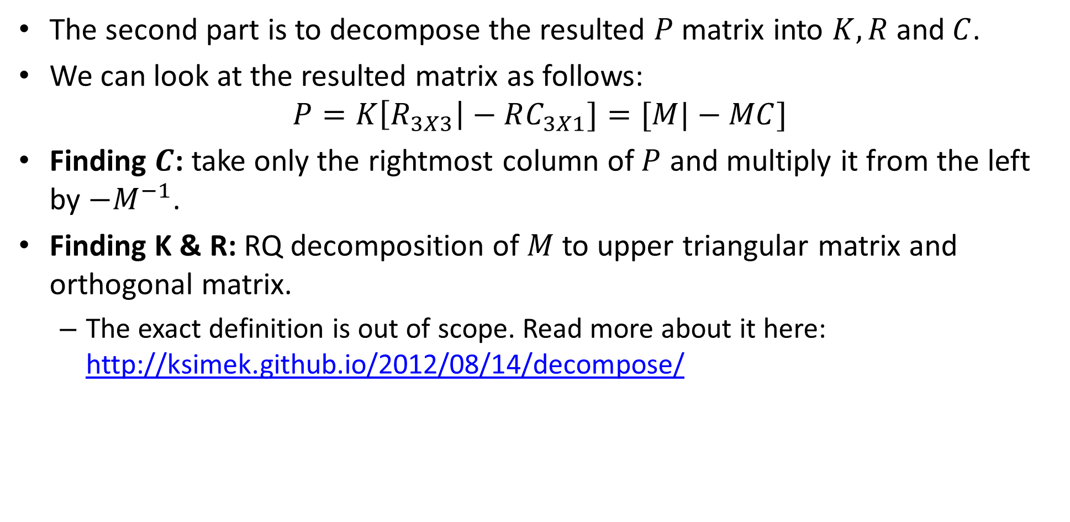
Full camera matrix
The second part is to decompose the resulted $P$matrix into $K, R$and$C$.
We can look at the resulted matrix as follows:
$$P=K\left[R_{3X3}\right|−RC_{3X1}]=[M|−MC]$$
Finding $C$: take only the rightmost column of $P$ and multiply it from the left by $−M^{−1}$.
Finding K & R: RQ decomposition of $M$ to upper triangular matrix and orthogonal matrix.
The exact definition is out of scope. Read more about it here: http://ksimek.github.io/2012/08/14/decompose/

Slide 38
Contents
What is camera calibration?
Camera intrinsics
Camera extrinsics
Full camera matrix
Calibration methods and distortions

Slide 39
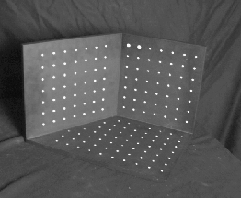
Geometric calibration
Place a known object in the scene:
identify correspondences between image and scene
compute mapping from scene to image
Issues:
must know geometry very accurately
must know 3D->2D correspondence

Slide 40
Geometric calibration
Advantages:
Very simple to formulate.
Analytical solution.
Disadvantages:
Doesn’t model radial/ tangential distortion.
For these reasons, nonlinear methods are preferred.
Define error function E between projected 3D points and image points.
E encompass intrinsics, extrinsics, radial distortion and tangential distortion.
Minimize E using nonlinear optimization techniques.

Slide 41
AR using markers
Compute point correspondents of known marker.
Estimate the pose of the camera.
Project 3D content to image plane using known places of camera and marker.
Examples:
https://www.youtube.com/watch?v=lIHcnwOVKng
https://developers.google.com/ar/develop/c/augmented-images

Slide 42
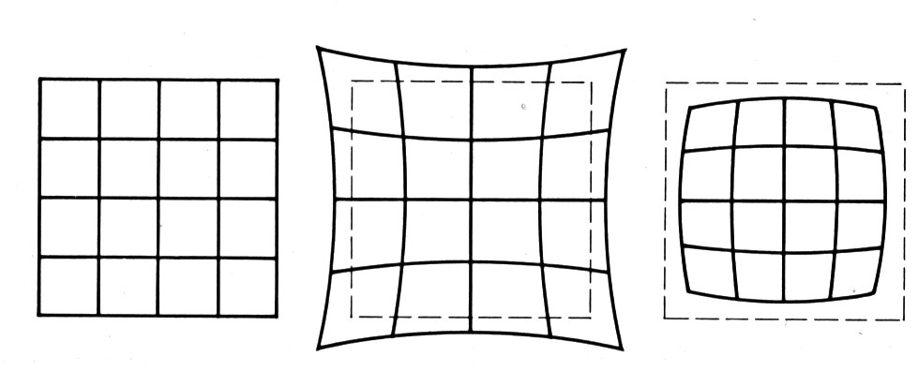
Radial distortion
No distortion
Pin cushion
Barrel
Radial distortion of the image
Caused by imperfect lenses
Deviations are most noticeable for rays that pass through the edge of the lens

Slide 43
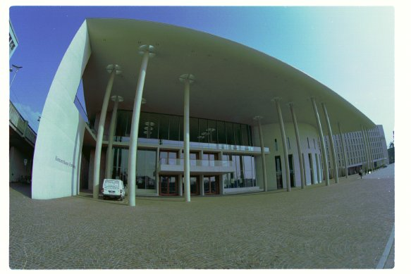
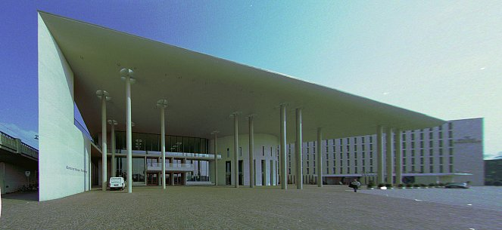
Radial distortion

Slide 44
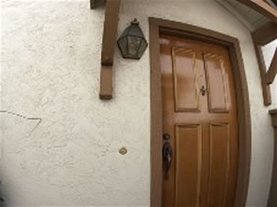
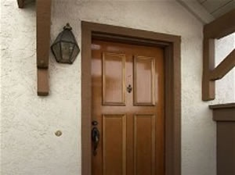
Radial distortion
before
after

Slide 45
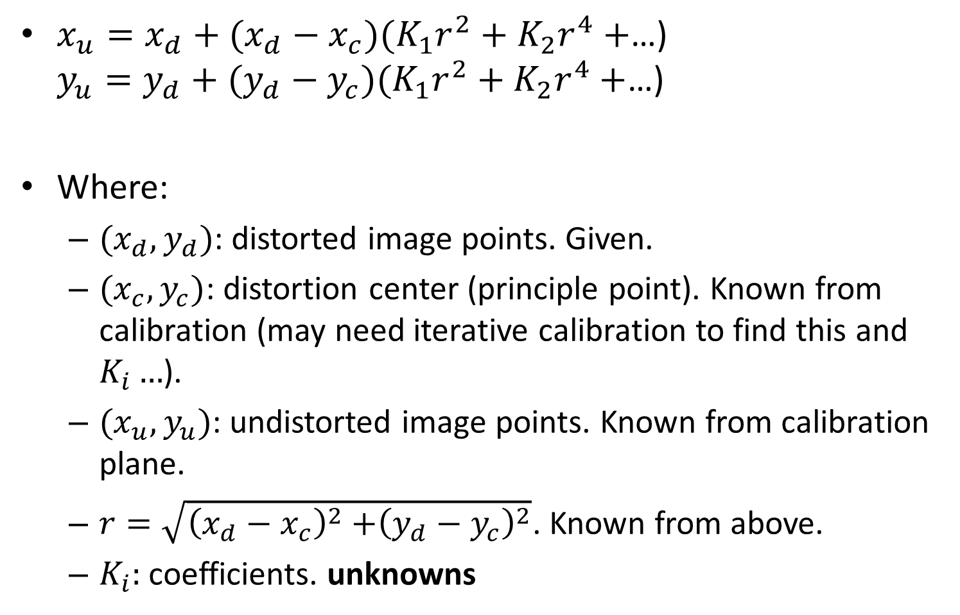
Radial distortion
$x_{u}=x_{d}+(x_{d}−x_{c})(K_{1}r^{2}+K_{2}r^{4}+$…) $y_{u}=y_{d}+(y_{d}−y_{c})(K_{1}r^{2}+K_{2}r^{4}+$…)
Where:
$(x_{d}, y_{d})$: distorted image points. Given.
$(x_{c}, y_{c})$: distortion center (principle point). Known from calibration (may need iterative calibration to find this and $K_{i}…$).
$(x_{u}, y_{u})$: undistorted image points. Known from calibration plane.
$r=\sqrt{{\left(x_{d}−x_{c}\right)}^{2}{+\left(y_{d}−y_{c}\right)}^{2}}$. Known from above.
$K_{i}:$coefficients. unknowns

Slide 46
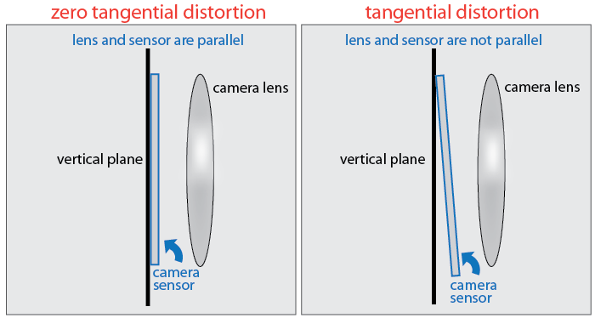
Tangential distortion
Another kind of distortion caused by the camera sensor not being completely parallel to the lens and image plane.

Slide 47
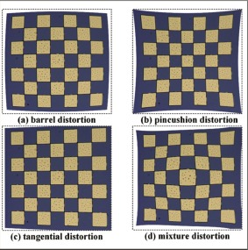
Tangential distortion

Slide 48
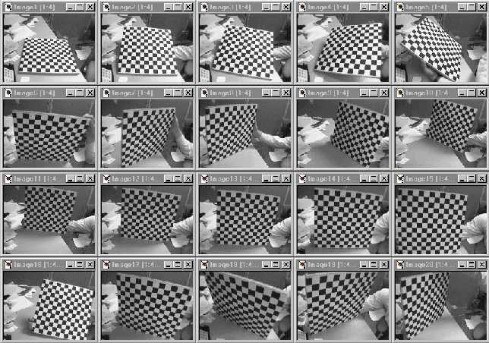
Multi plane calibration
Advantages:
Only requires a plane
Don’t have to know positions/orientations
Disadvantage:
Need to solve non-linear optimization problem.
https://www.microsoft.com/en-us/research/wp-content/uploads/2016/02/tr98-71.pdf

