Slide 1
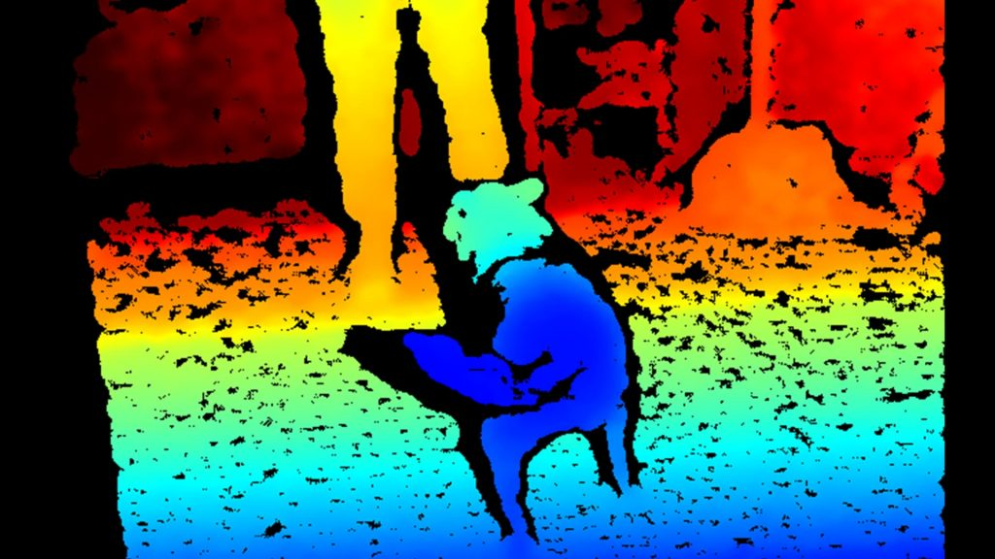
Stereo

Slide 2
References
http://szeliski.org/Book/
http://www.cs.cornell.edu/courses/cs5670/2019sp/lectures/lectures.html
http://www.cs.cmu.edu/~16385/

Slide 3
Epipolar geometry

Slide 4
Structure and motion
 | Structure (3D model of world) | Motion (6 DOFs of cameras) | Measurements
Pose Estimation (camera pose estimation) | known | estimate | 3D to 2D correspondences
Triangulation | estimate | known | 2D to 2D correspondences
3D reconstruction | estimate | estimate | 2D to 2D correspondences

Slide 5
Sfm blablba

Slide 6



The triangulation problem
Given two 2D points in the normalized image coordinate system $(x,x^{′}$) in two different images $(I,I^{′})$ that describes the same point $p$ in 3D space -> find $p$.
Normalized image coordinate system: ${x=K}^{−1}\left[\begin{aligned}u \\ v \\ 1\end{aligned}\right]$
$$I$$
$I$’

Slide 7

Epipolar geometry
We can trace lines from the camera center of each image, through the given 2D point to the 3D point $p$.
Camera center
$$I$$
$I$’

Slide 8
Epipolar geometry
Baseline is a vector that represent the translation between two cameras
Baseline
$$I$$
$I$’

Slide 9



Epipolar geometry
Epipole $e$: projection of $o’$onto $I$.
The place of camera $o′$ in image $I.$
Epipole $e$: projection of $o’$onto $I$
$$I$$
$I$’

Slide 10

Epipolar geometry
Epipolar plane: the plane that is constructed from the 3 points $\left(p,o,o^{′}\right).$
Epipolar plane
$$I$$
$I$’

Slide 11

Epipolar geometry
Epipolar line: intersection of Epipolar plane and image plane.
Epipolar line
(intersection of Epipolar plane and image plane)
$$I$$
$I$’

Slide 12




Epipolar constraint
The epipolar constraint: a point $x$ in image $I$ is mapped onto an epipolar line $l′$ in image $I′$.
This happens since we don’t know $p$ in advance.
$$p^{∗}$$
$$p^{∗∗}$$
$$p^{∗∗∗}$$
$$I$$
$I$’

Slide 13
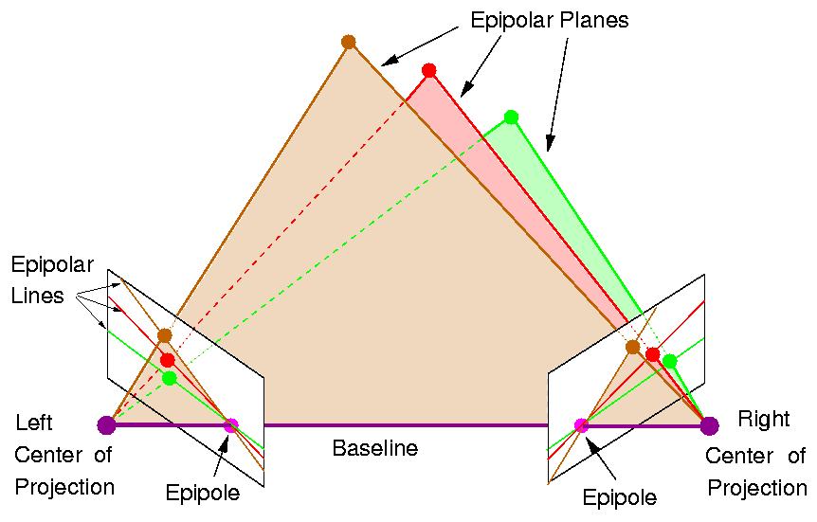
Epipolar geometry
Note: all epipolar lines pass through the epipole.

Slide 14
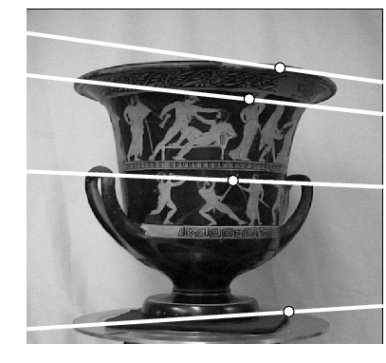
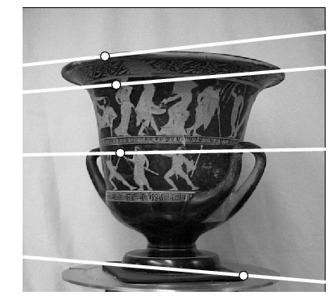
Epipolar geometry
Where is the epipole in this images?

Slide 15
Epipolar geometry
Where is the epipole in this images? The epipole doesn’t have to be inside the image!
here!

Slide 16
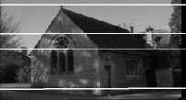
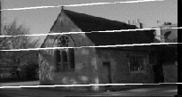
Epipolar geometry
Where is the epipole in this image?

Slide 17
Epipolar geometry
Where is the epipole in this image? The epipolar lines doesn’t converge since the baseline translation is parallel to the image plane!

Slide 18

Epipolar geometry
Even if the image plane $I$ was infinite, you can’t see the place of $o′$.

Slide 19
Essential matrix

Slide 20
Recall: Dot Product
dot product of two orthogonal vectors is zero

Slide 21
Recall: Cross Product
Vector (cross) product takes two vectors and returns a vector perpendicular to both

Slide 22
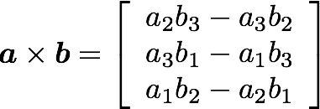
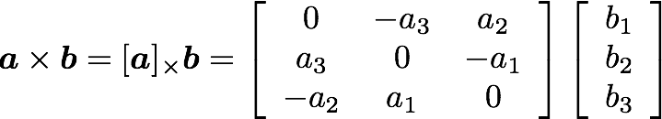
Recall: Cross Product
Can also be written as a matrix multiplication
Skew symmetric

Slide 23





Building the essential matrix
Let’s define the $o$ system as world coordinate system.
*$t$ here is $c$ from camera calibration class

Slide 24
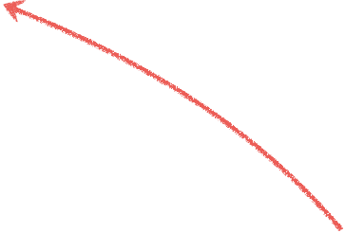
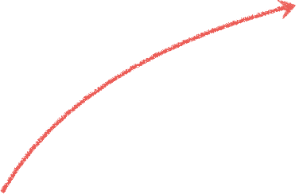


Building the essential matrix
These three vectors are coplanar

Slide 25

Building the essential matrix
These three vectors are coplanar

Slide 26

Building the essential matrix
These three vectors are coplanar

Slide 27

Building the essential matrix
These three vectors are coplanar

Slide 28

Building the essential matrix
These three vectors are coplanar

Slide 29


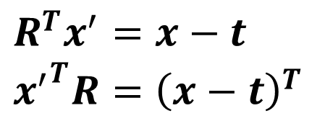
Building the essential matrix
rigid motion
coplanarity
$$R^{T}=R^{−1}$$
$$R^{T}x^{′}=x−t \\ {x^{′}}^{T}R={\left(x−t\right)}^{T}$$

Slide 30
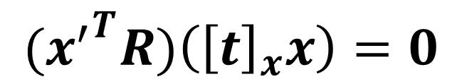
Building the essential matrix
rigid motion
coplanarity
$$R^{T}=R^{−1}$$
$$R^{T}x^{′}=x−t \\ {x^{′}}^{T}R={\left(x−t\right)}^{T}$$
$${{(x}^{′}}^{T}R)\left({\left[t\right]}_{x}x\right)=0$$

Slide 31
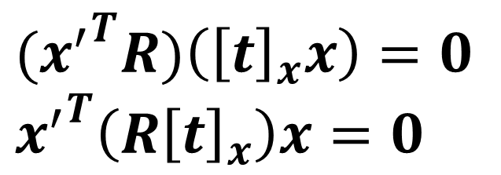
Building the essential matrix
rigid motion
coplanarity
$$R^{T}=R^{−1}$$
$$R^{T}x^{′}=x−t \\ {x^{′}}^{T}R={\left(x−t\right)}^{T}$$
$${{(x}^{′}}^{T}R)\left({\left[t\right]}_{x}x\right)=0 \\ {x^{′}}^{T}\left({R\left[t\right]}_{x}\right)x=0$$

Slide 32

Building the essential matrix
rigid motion
coplanarity
$$R^{T}=R^{−1}$$
$$R^{T}x^{′}=x−t \\ {x^{′}}^{T}R={\left(x−t\right)}^{T}$$
$${{(x}^{′}}^{T}R)\left({\left[t\right]}_{x}x\right)=0 \\ {x^{′}}^{T}\left({R\left[t\right]}_{x}\right)x=0$$

Slide 33

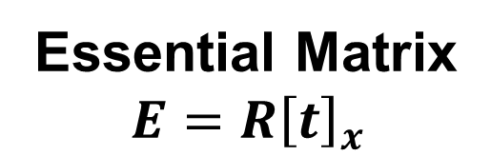
Building the essential matrix
rigid motion
coplanarity
$$R^{T}=R^{−1}$$
$$R^{T}x^{′}=x−t \\ {x^{′}}^{T}R={\left(x−t\right)}^{T}$$
$${{(x}^{′}}^{T}R)\left({\left[t\right]}_{x}x\right)=0 \\ {x^{′}}^{T}\left({R\left[t\right]}_{x}\right)x=0$$
Essential Matrix
$$E={R\left[t\right]}_{x}$$

Slide 34
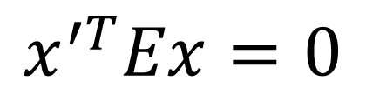
properties of the E matrix
(points in normalized image coordinates)
Essential matrix definition
$$x^{′T}Ex=0$$

Slide 35

Epipolar lines equation
Recall this version of line equation:
$$ax+by+c=0$$
For homogenous vector$x=\left[\begin{aligned}x \\ y \\ 1\end{aligned}\right]$ and $l=\left[\begin{aligned}a \\ b \\ c\end{aligned}\right]$:
$x^{T}l=l^{T}x=0$

Slide 36

Epipolar lines equation
$x^{′T}Ex=x^{′T}l^{′}=0$ $Ex=l^{′}$ is the epipolar line in $I^{′}$ corresponding to $x$.
$x^{′T}Ex=l^{T}x=0$ ${{(x}^{′T}E)}^{T}={l^{T}}^{T}=l$is the epipolar line in $I$corresponding to $x′$.

Slide 37
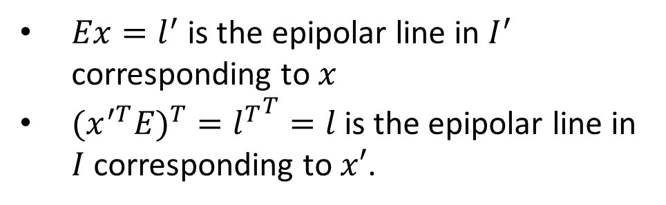
properties of the E matrix
Full proof for the epipolar lines can be found here:
http://www.cs.cornell.edu/courses/cs4670/2015sp/lectures/lec21_stereo_web.pdf
(points in normalized image coordinates)
Essential matrix definition
$$x^{′T}Ex=0$$
$Ex=l^{′}$ is the epipolar line in $I^{′}$ corresponding to $x$
${{(x}^{′T}E)}^{T}={l^{T}}^{T}=l$is the epipolar line in $I$corresponding to $x′$.
Epipolar lines

Slide 38

Epipolar lines equation
$e^{′T}l^{′}=0$ $∀x$s.t. $Ex=l′$, meaning:
$e^{′T}E=0$
$l^{T}e=0 ∀x′$s.t. $x^{′T}E=l^{T}$meaning:
$Ee=0$

Slide 39

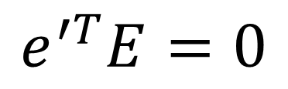
properties of the E matrix
(points in normalized image coordinates)
Essential matrix definition
$$x^{′T}Ex=0$$
$Ex=l^{′}$ is the epipolar line in $I^{′}$ corresponding to $x$
${{(x}^{′T}E)}^{T}={l^{T}}^{T}=l$is the epipolar line in $I$corresponding to $x′$.
Epipolar lines
Epipoles
$$e^{′T}E=0$$
$$Ee=0$$

Slide 40
Fundamental matrix

Slide 41



Fundamental matrix
The Essential matrix operates on image points expressed in
normalized coordinates (points have been aligned (normalized) to camera coordinates)
camera point
image point

Slide 42



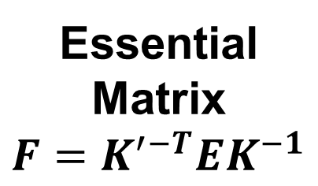
Fundamental matrix
The Essential matrix operates on image points expressed in
normalized coordinates (points have been aligned (normalized) to camera coordinates)
camera point
image point
Writing out the epipolar constraint in terms of image coordinates
Essential Matrix
$$F=K^{′−T}EK^{−1}$$

Slide 43
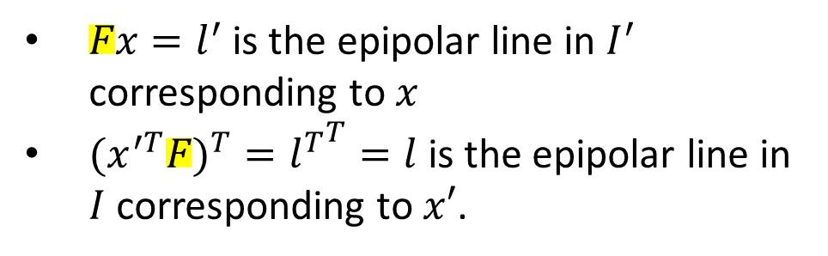


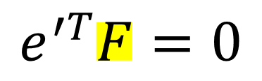
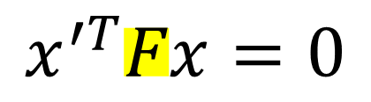
properties of the F matrix
All of the below functions works with $F$ and un-normalized points the same!
(points in un-normalized image coordinates)
Fundamental matrix definition
$$x^{′T}Fx=0$$
$Fx=l^{′}$ is the epipolar line in $I^{′}$ corresponding to $x$
${{(x}^{′T}F)}^{T}={l^{T}}^{T}=l$is the epipolar line in $I$corresponding to $x′$.
Epipolar lines
Epipoles
$$e^{′T}F=0$$
$$Fe=0$$

Slide 44


Estimating F
If we don’t know K₁, K₂, R, or t, can we estimate F for two images?
Yes, given enough correspondences

Slide 45
Estimating F – 8-point algorithm
The fundamental matrix F is defined by
for any pair of matches x and x’ in two images.
Let x=(u,v,1)^{T} and x’=(u’,v’,1)^{T},
each match gives a linear equation

Slide 46
8-point algorithm
Like with homographies, instead of solving , we seek f to minimize , least eigenvector of .

Slide 47
8-point algorithm – Problem?
F should have rank 2
To enforce that F is of rank 2, F is replaced by F’ that minimizes subject to the rank constraint.
This is achieved by SVD. Let , where
, let
then is the solution.

Slide 48
8-point algorithm
Pros: it is linear, easy to implement and fast
Cons: susceptible to noise

Slide 49
Problem with 8-point algorithm
~10000
~10000
~100
~10000
~10000
~100
~100
~100
1
Orders of magnitude difference
between column of data matrix
→ least-squares yields poor results
!

Slide 50
Normalized 8-point algorithm
normalized least squares yields good results
Transform image to ~[-1,1]x[-1,1]
(0,500)
(700,500)
(-1,1)
(1,1)
(0,0)
(0,0)
(700,0)
(-1,-1)
(1,-1)

Slide 51
Normalized 8-point algorithm
Transform input by ,
Call 8-point on to obtain

Slide 52
rectification

Slide 53

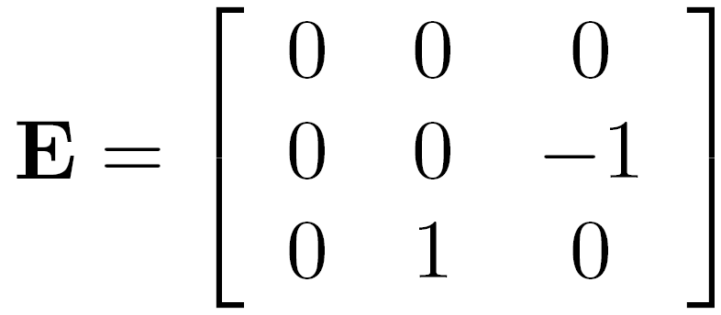
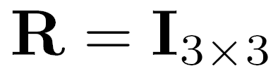
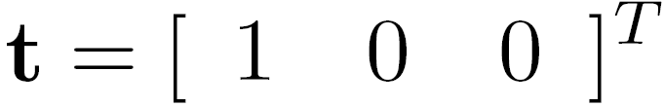
Rectified case

Slide 54
Stereo image rectification
reproject image planes onto a common
plane parallel to the line between optical centers
pixel motion is horizontal after this transformation
two homographies (3x3 transform), one for each input image reprojection
C. Loop and Z. Zhang. Computing Rectifying Homographies for Stereo Vision. IEEE Conf. Computer Vision and Pattern Recognition, 1999.

Slide 55
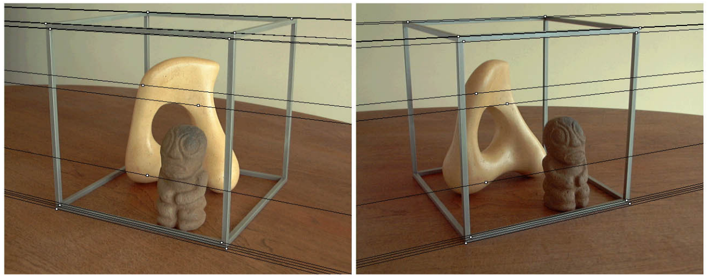
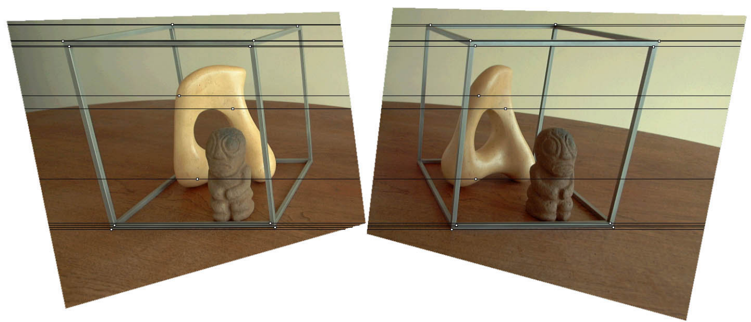
Original stereo pair
After rectification

