Slide 1
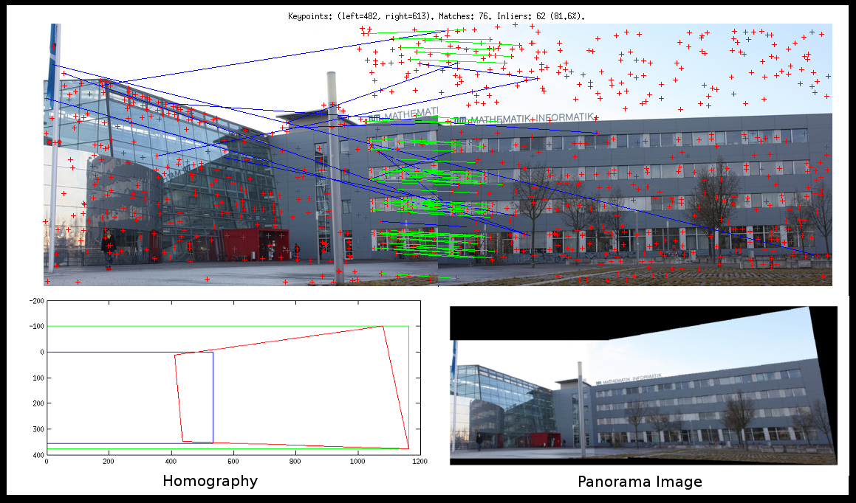
Features

Slide 2
References
http://szeliski.org/Book/
http://www.cs.cornell.edu/courses/cs5670/2019sp/lectures/lectures.html
http://www.cs.cmu.edu/~16385/
https://medium.com/software-incubator/introduction-to-orb-oriented-fast-and-rotated-brief-4220e8ec40cf
https://opencv-python-tutroals.readthedocs.io/en/latest/py_tutorials/py_feature2d/py_table_of_contents_feature2d/py_table_of_contents_feature2d.html
https://towardsdatascience.com/sift-scale-invariant-feature-transform-c7233dc60f37

Slide 3
Feature detection
Talk about harris corner detector?
Feature descriptor and matching
Sift
Talk about orb
Panorama

Slide 4
What is a feature?
There is no universal or exact definition of what constitutes a feature, and the exact definition often depends on the problem or the type of application. Given that, a feature is defined as an "interesting" part of an image.
[from: wikipedia]

Slide 5
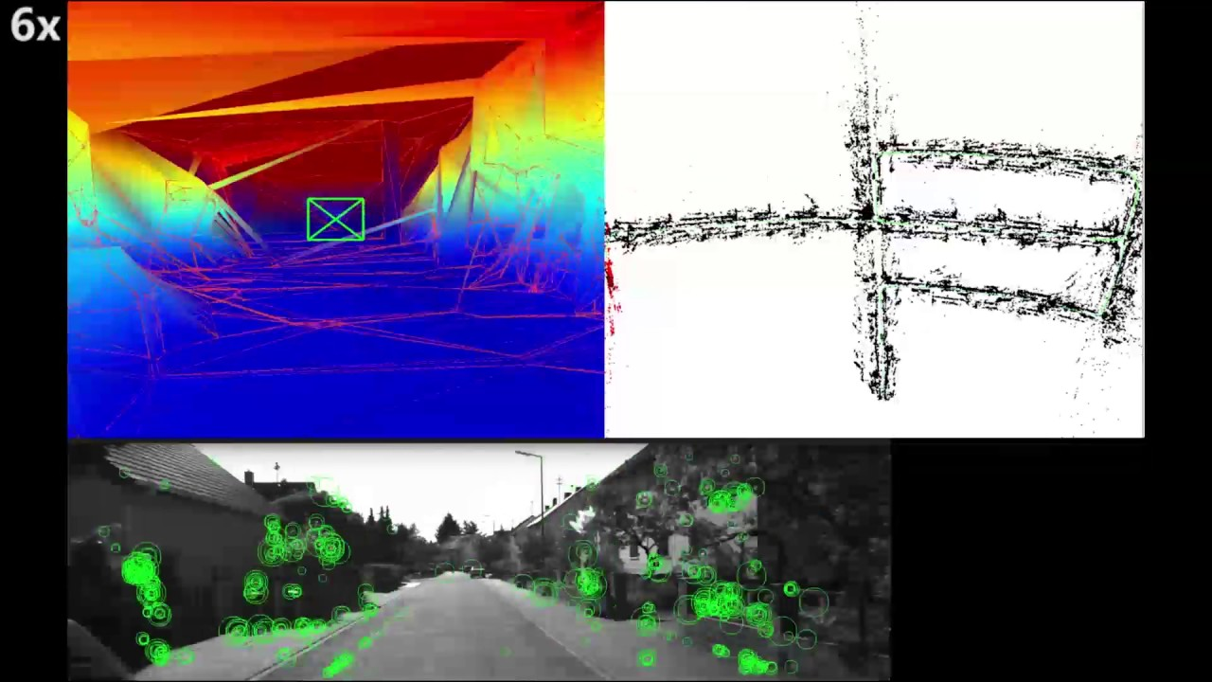
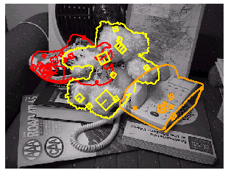
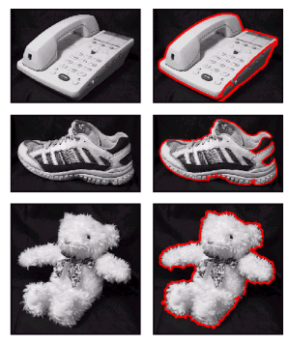
What can we do with features?
Robot navigation
Object recognition
Panorama stitching

Slide 6
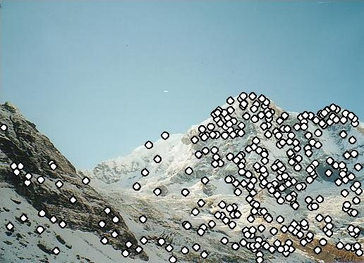
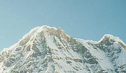

Local features: main components
Detection: Identify the interest points (also called keypoints).
Description: Extract vector feature descriptor surrounding each interest point.
Matching: Determine correspondence between descriptors in two views

Slide 7
detection

Slide 8
Global detection
Template matching

Slide 9
Advantages of local keypoints
Locality:
features are local, so robust to occlusion and clutter
Quantity:
hundreds or thousands in a single image
Distinctiveness:
can differentiate a large database of objects
Efficiency
real-time performance achievable

Slide 10
Local measures of uniqueness
Suppose we only consider a small window of pixels-
How does the window change when you shift it?
Credit: S. Seitz, D. Frolova, D. Simakov
Notes:
High level idea is that corners are good. You want to find windows that contain strong gradients AND gradients oriented in more than one direction

Slide 11
Local measures of uniqueness
Suppose we only consider a small window of pixels-
How does the window change when you shift it?
“flat” region: no change in all directions
“edge”:
no change along the edge direction
“corner”: significant change in all directions

Slide 12
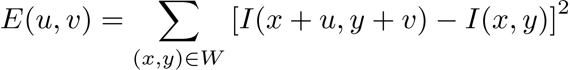
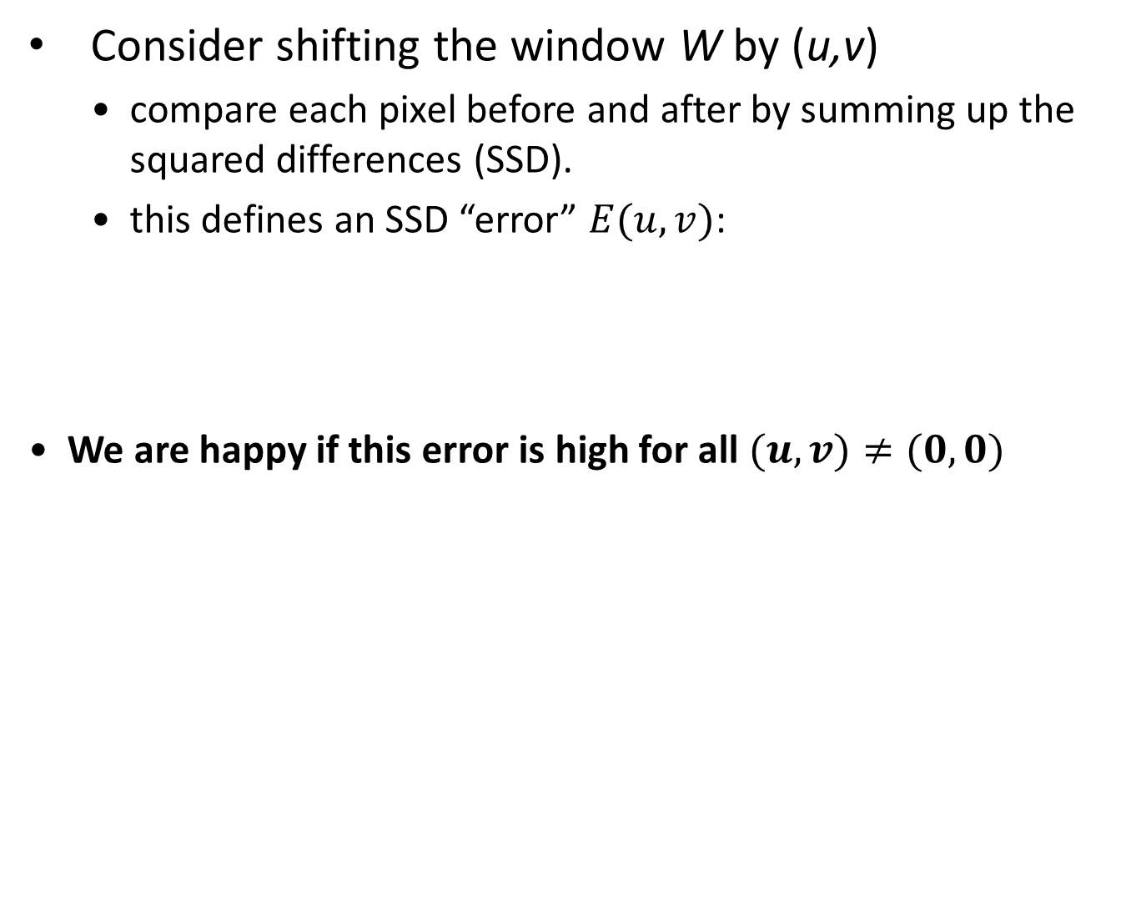
Harris corner detection: the math
Consider shifting the window W by (u,v)
compare each pixel before and after by summing up the squared differences (SSD).
this defines an SSD “error” $E(u,v)$:
We are happy if this error is high for all $(u,v)≠(0,0)$
_{(u,v)}
W

Slide 13
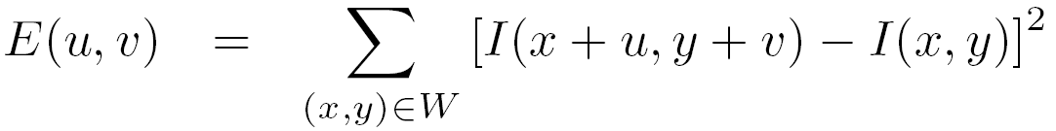
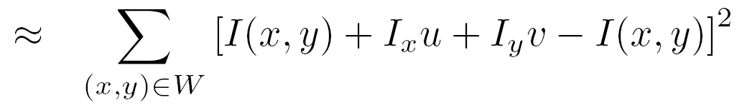
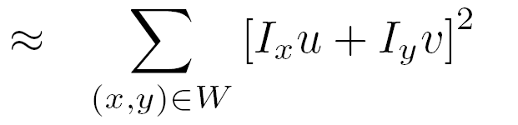

Small motion assumption
Taylor Series expansion of $I$:
If the motion $(u,v)$ is small, then first order approximation is good
Plug it into the SSD error term:

Slide 14
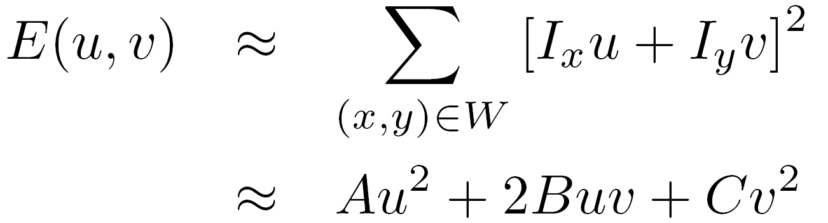
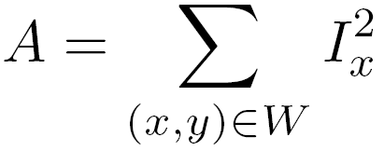
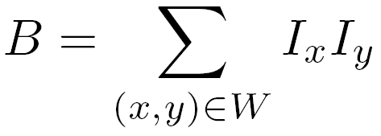
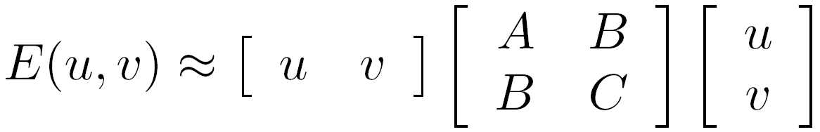
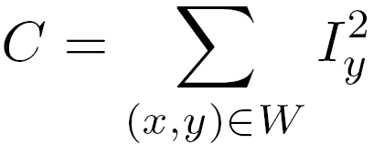

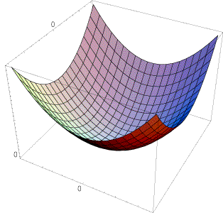
Corner detection: the math
Also called second-moments matrix
E(u,v)
v
u

Slide 15
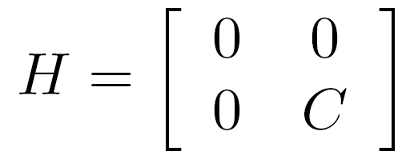
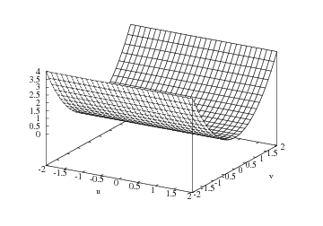

Corner detection: the math
E(u,v)
Horizontal edge:
v
u

Slide 16
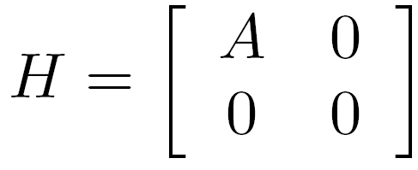
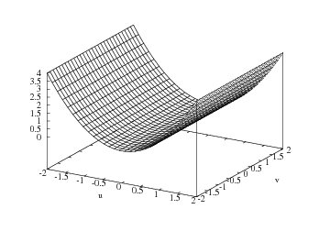

Corner detection: the math
E(u,v)
Vertical edge:
v
u

Slide 17
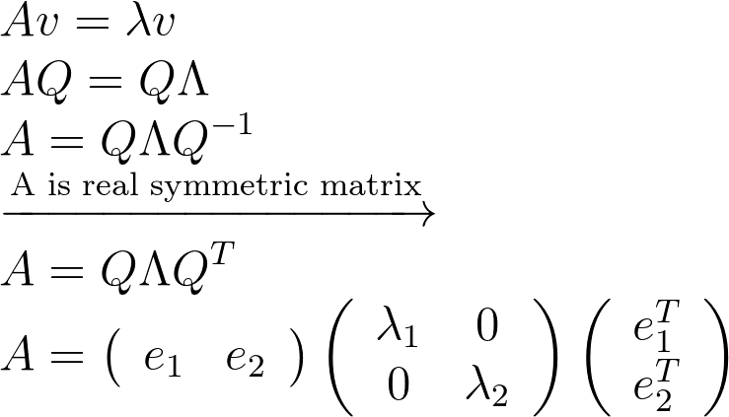
A real symmetric matrix has an eigendecomposition of:
Bonus: eigenvectors are orthonormal if A is real and symmetric.
Notes:
\\
Av = \lambda v
\\
AQ=Q\Lambda
\\
A=Q\Lambda Q^{-1}
\\
\xrightarrow{\text{A is real symmetric matrix}}
\\
A=Q\Lambda Q^{T}
\\
A=\left(\begin{array}{ll}{e_{1}} & {e_{2}}\end{array}\right)\left(\begin{array}{cc}{\lambda_{1}} & {0} \\ {0} & {\lambda_{2}}\end{array}\right)\left(\begin{array}{c}{e_{1}^{T}} \\ {e_{2}^{T}}\end{array}\right)

Slide 18
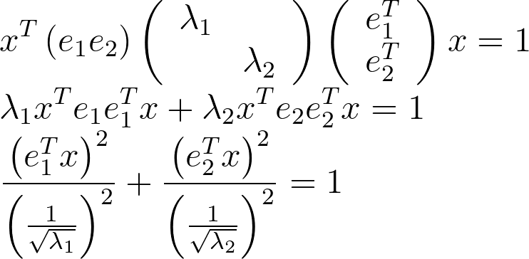
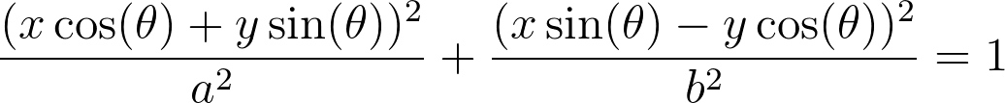

An ellipse can have a matrix form of:
Which is exactly as a rotated ellipse with a center of $\left(0,0\right):$
Notes:
\\
x^{T}\left(e_{1} e_{2}\right)\left(\begin{array}{cc}{\lambda_{1}} \\ {} & {\lambda_{2}}\end{array}\right)\left(\begin{array}{c}{e_{1}^{T}} \\ {e_{2}^{T}}\end{array}\right) x=1
\\
\lambda_{1} x^{T} e_{1} e_{1}^{T} x+\lambda_{2} x^{T} e_{2} e_{2}^{T} x =1
\\
\frac{\left(e_{1}^{T} x\right)^{2}}{\left(\frac{1}{\sqrt{\lambda_{1}}}\right)^{2}}+\frac{\left(e_{2}^{T} x\right)^{2}}{\left(\frac{1}{\sqrt{\lambda_{2}}}\right)^{2}}=1
=============================================
\frac{(x \cos (\theta)+y \sin (\theta))^{2}}{a^2}+\frac{(x \sin (\theta)-y \cos (\theta))^2}{b^{2}}=1

Slide 19
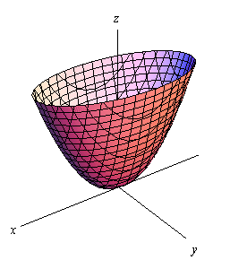



General case
Combining the two equations seen before we can conclude that when taking a cross-section from the error function, we can get an ellipsoid.
$[u v]H\left[\begin{matrix}u \\ v\end{matrix}\right]=\text{const}$
Assume $λ_{1}>λ_{2}$
Remember to subtract the mean of each patch so that the ellipsoid is centered.
direction of $e_{1}$
direction of $e_{2}$
(λ₁)^{-1/2}
(λ₂)^{-1/2}

Slide 20





General case
Eigenvalues and eigenvectors of $H$
$e_{1}$ = direction of largest increase in $E$
$1$= relative increase in direction $e_{1}$
$e_{2}$ = direction of smallest increase in $E$
$2⁡$= relative increase in direction $e_{2}$
$λ larger↔λ^{−\frac{1}{2}} smaller$
$e_{min}$
$e_{max}$
direction of $e_{max}$
direction of $e_{min}$
(λ_{max})^{-1/2}
(λ_{min})^{-1/2}

Slide 21
Interpreting the eigenvalues
λ₂
“Edge” λ₂ >> λ₁
“Corner” λ₁ and λ₂ are large, λ₁ ~ λ₂; E increases in all directions
λ₁ and λ₂ are small; E is almost constant in all directions
“Flat” region
“Edge” λ₁ >> λ₂
λ₁

Slide 22


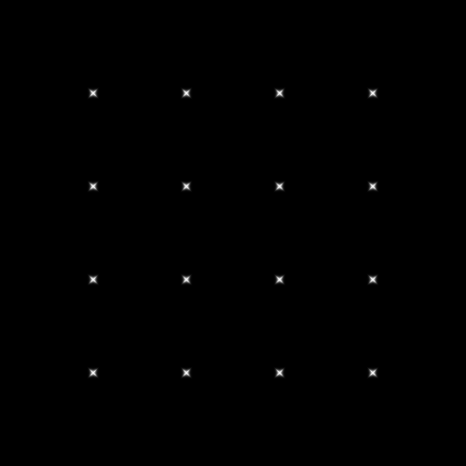



Corner detection: the math

Slide 23
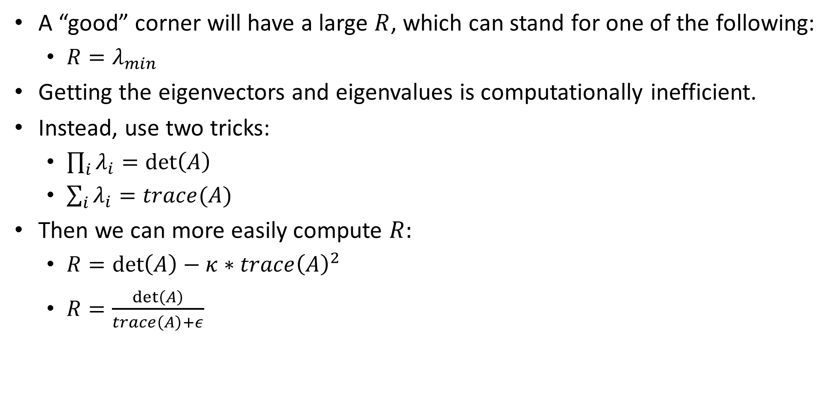
A “good” corner will have a large $R$, which can stand for one of the following:
$R=λ_{min}$
Getting the eigenvectors and eigenvalues is computationally inefficient.
Instead, use two tricks:
$\prod_{i}{λ_{i}}=\det\left(A\right)$
$\sum_{i}{λ_{i}=trace(A)}$
Then we can more easily compute $R:$
$R=\det\left(A\right)−κ∗trace{\left(A\right)}^{2}$
$R=\frac{\det\left(A\right)}{trace\left(A\right)+ε}$

Slide 24
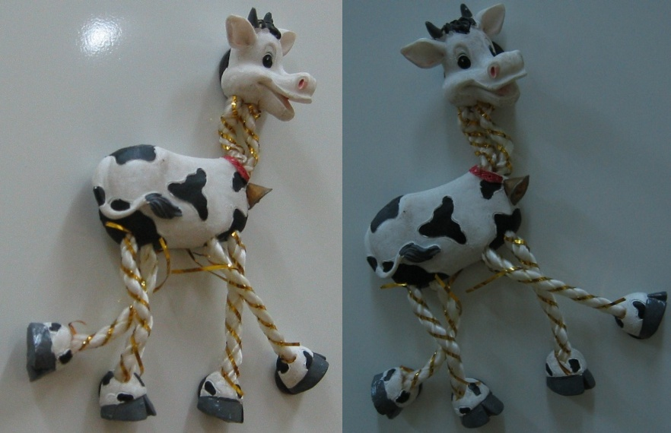
Harris detector example

Slide 25
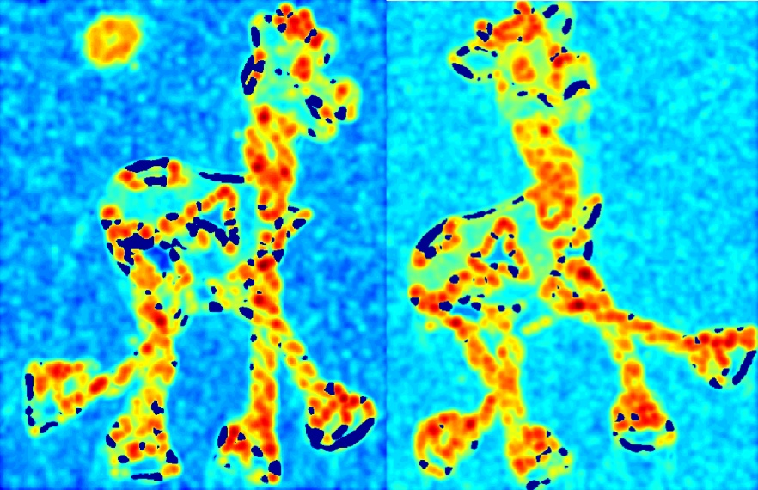
f value (red high, blue low)

Slide 26
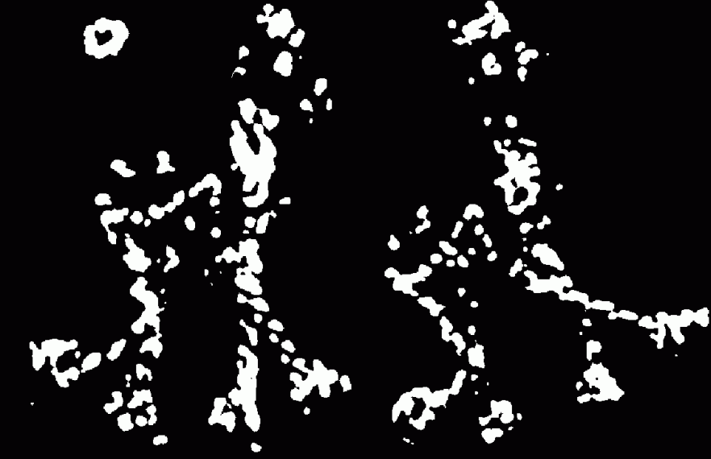
Threshold (f > value)

Slide 27

Find local maxima of f

Slide 28

Harris features (in red)

Slide 29
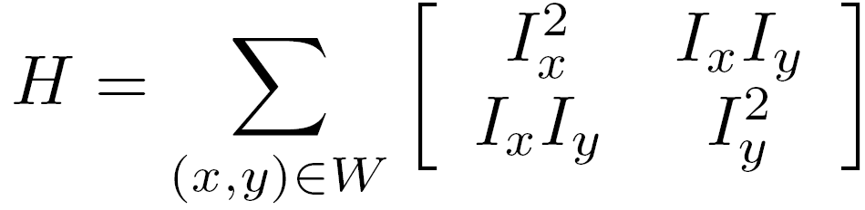
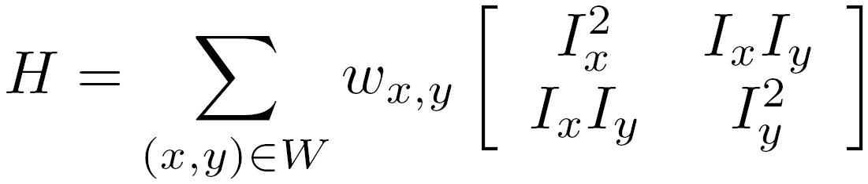

Weighting the derivatives
In practice, using a simple window W doesn’t work too well
Instead, we’ll weight each derivative value based on its distance from the center pixel

Slide 30
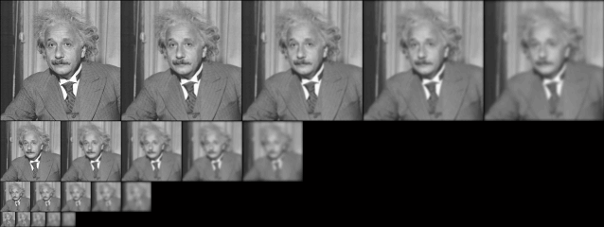
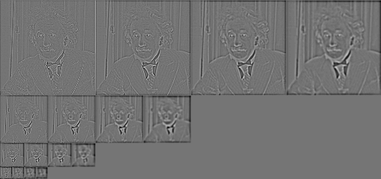
Gaussian
Laplacian

Slide 31
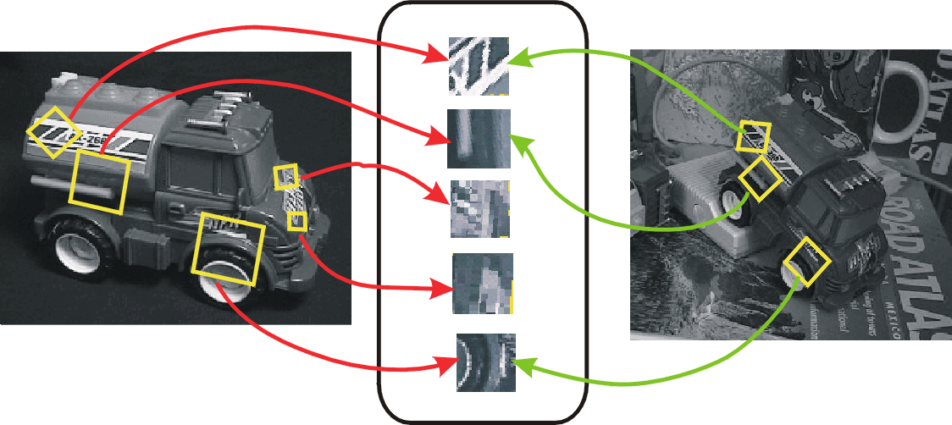
Invariant local features
Find features that are invariant to transformations
geometric invariance: translation, rotation, scale
photometric invariance: brightness, exposure, …
Feature Descriptors

Slide 32
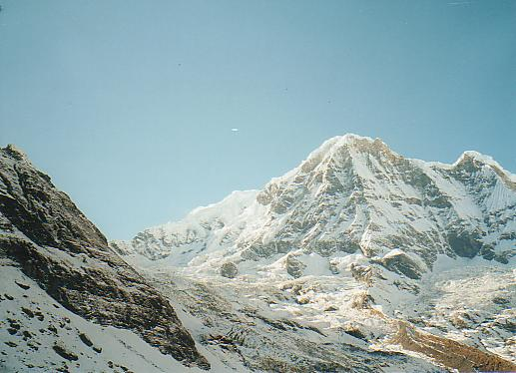
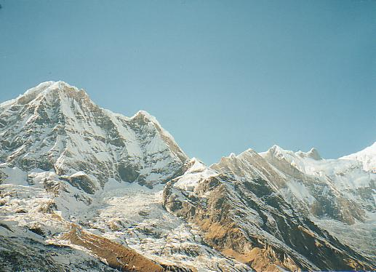
Why extract features?
Motivation: panorama stitching
We have two images – how do we combine them?

Slide 33
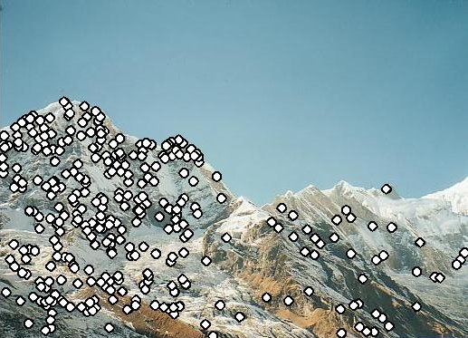
Why extract features?
Motivation: panorama stitching
We have two images – how do we combine them?
Step 1: extract features
Step 2: match features

Slide 34
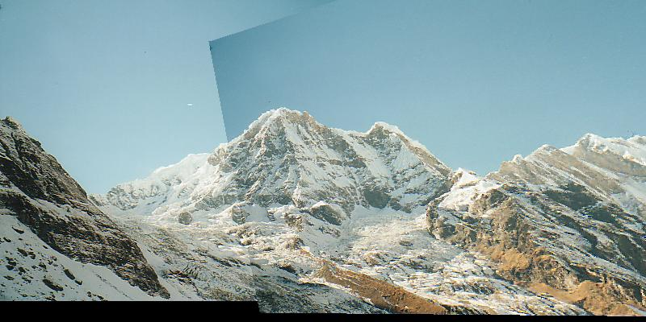
Why extract features?
Motivation: panorama stitching
We have two images – how do we combine them?
Step 1: extract features
Step 2: match features
Step 3: align images

