Slide 1
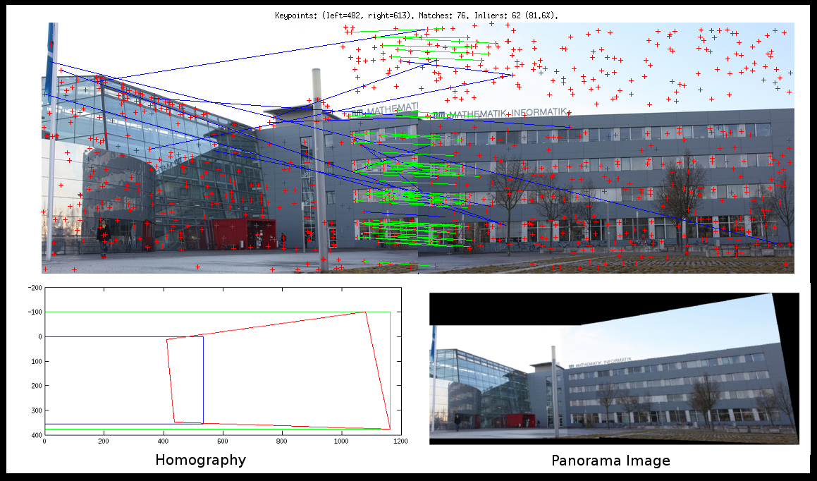
Features

Slide 2
References
http://szeliski.org/Book/
http://www.cs.cornell.edu/courses/cs5670/2019sp/lectures/lectures.html
http://www.cs.cmu.edu/~16385/
https://medium.com/software-incubator/introduction-to-orb-oriented-fast-and-rotated-brief-4220e8ec40cf
https://opencv-python-tutroals.readthedocs.io/en/latest/py_tutorials/py_feature2d/py_table_of_contents_feature2d/py_table_of_contents_feature2d.html
https://towardsdatascience.com/sift-scale-invariant-feature-transform-c7233dc60f37

Slide 3
Feature detection
Talk about harris corner detector?
Feature descriptor and matching
Sift
Talk about orb
Panorama

Slide 4
What is a feature?
There is no universal or exact definition of what constitutes a feature, and the exact definition often depends on the problem or the type of application. Given that, a feature is defined as an "interesting" part of an image.
[from: wikipedia]

Slide 5
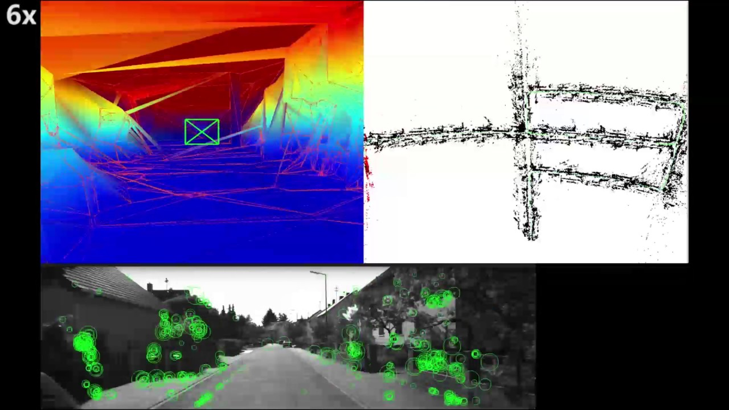
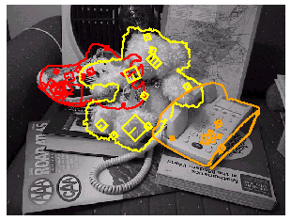
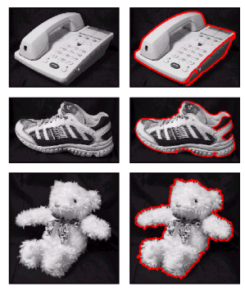
What can we do with features?
Robot navigation
Object recognition
Panorama stitching

Slide 6
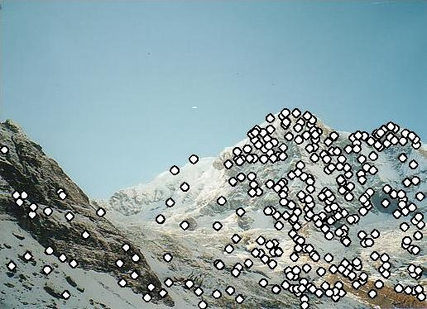
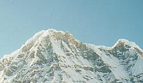

Local features: main components
1. Detection: Identify the interest points (also called keypoints).
2. Description: Extract vector feature descriptor surrounding each interest point.
3. Matching: Determine correspondence between descriptors in two views.

Slide 7
detection

Slide 8
Global detection
Template matching

Slide 9
Advantages of local keypoints
Locality:
features are local, so robust to occlusion and clutter
Quantity:
hundreds or thousands in a single image
Distinctiveness:
can differentiate a large database of objects
Efficiency
real-time performance achievable

Slide 10
Local measures of uniqueness
Suppose we only consider a small window of pixels.
How does the window change when you shift it?
Credit: S. Seitz, D. Frolova, D. Simakov
Notes:
High level idea is that corners are good. You want to find windows that contain strong gradients AND gradients oriented in more than one direction

Slide 11
Local measures of uniqueness
Suppose we only consider a small window of pixels-
How does the window change when you shift it?
“flat” region: no change in all directions
“edge”:
no change along the edge direction
“corner”: significant change in all directions

Slide 12


Harris corner detection: probabilistic interpretation
1. Compute image gradients over a small region
array of x gradients
array of y gradients

Slide 13
Harris corner detection: probabilistic interpretation
1. Compute image gradients over a small region
What does the distribution tell you about the region?

Slide 14
Harris corner detection: probabilistic interpretation
1. Compute image gradients over a small region
distribution reveals edge orientation and magnitude

Slide 15
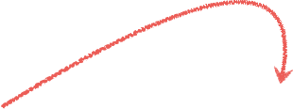

Harris corner detection: probabilistic interpretation
2. Subtract the mean from each image gradient
plot intensities
constant intensity gradient
intensities along the line
subtract mean
plot of image gradients

Slide 16
Harris corner detection: probabilistic interpretation
2. Subtract the mean from each image gradient
plot intensities
constant intensity gradient
intensities along the line
subtract mean
plot of image gradients
data is centered
(‘DC’ offset is removed)

Slide 17
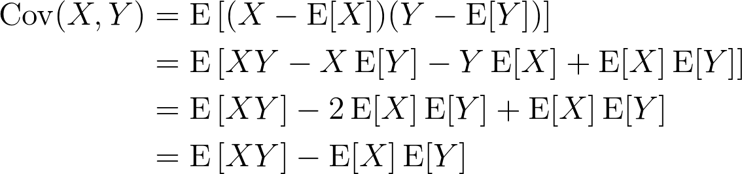

Harris corner detection: probabilistic interpretation
3. Compute the covariance matrix
As you know:
Covariance of two random variables:
Covariance matrix (also known as second moment matrix) of two random vectors:
In our case $X=\left[\begin{aligned}{− I}_{x}− \\ {− I}_{y}−\end{aligned}\right]$ and $μ_{X}=0$due to step 2.
Notes:
\begin{align}
\operatorname{Cov}(X,Y) &= \operatorname{E}\left[(X - \operatorname{E}[X])(Y - \operatorname{E}[Y])\right] \nonumber\\
&= \operatorname{E}\left[XY -X\operatorname{E}[Y] -Y\operatorname{E}[X] + \operatorname{E}[X]\operatorname{E}[Y]\right] \nonumber\\
&= \operatorname{E}\left[XY\right] - 2\operatorname{E}[X]\operatorname{E}[Y] + \operatorname{E}[X]\operatorname{E}[Y] \nonumber\\
&= \operatorname{E}\left[XY\right] -\operatorname{E}[X]\operatorname{E}[Y] \nonumber
\end{align}
=================================
\operatorname{K}_{\mathbf{X}\mathbf{X}} = \operatorname{cov}[\mathbf{X},\mathbf{Y}] = \operatorname{E}[(\mathbf{X}-\mathbf{\mu_X})(\mathbf{Y}-\mathbf{\mu_Y})^{\rm T}]= \operatorname{E}[\mathbf{X} \mathbf{Y}^T] - \mathbf{\mu_X}\mathbf{\mu_Y}^T

Slide 18
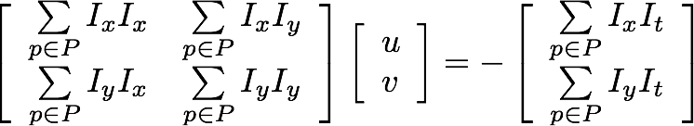
Harris corner detection: probabilistic interpretation
3. Compute the covariance matrix
=sum(
.*
)
array of x gradients
array of y gradients

Slide 19
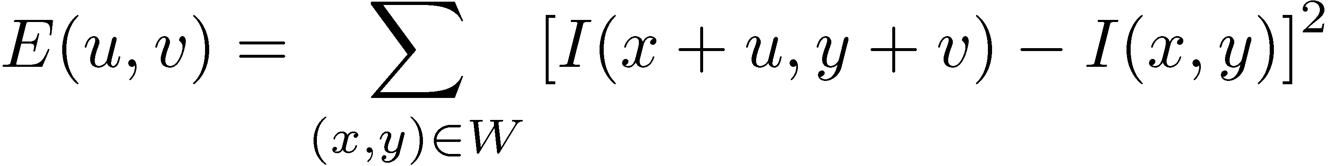
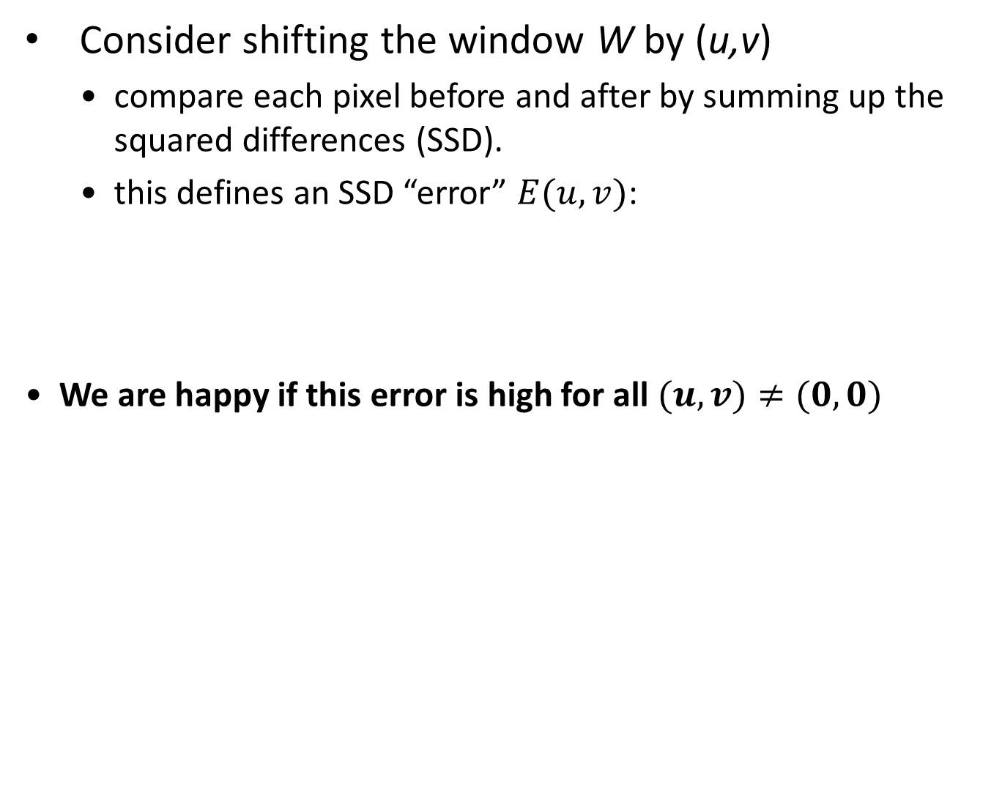
Harris corner detection
Consider shifting the window W by (u,v)
compare each pixel before and after by summing up the squared differences (SSD).
this defines an SSD “error” $E(u,v)$:
We are happy if this error is high for all $(u,v)≠(0,0)$
_{(u,v)}
W

Slide 20
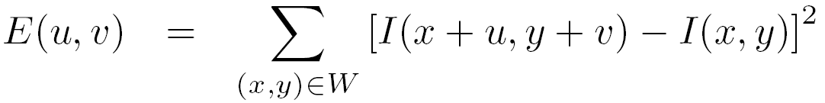
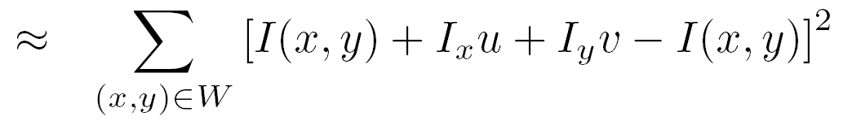
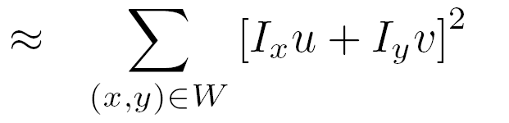

Harris corner detection
Taylor Series expansion of $I$:
If the motion $(u,v)$ is small, then first order approximation is good
Plug it into the SSD error term:

Slide 21
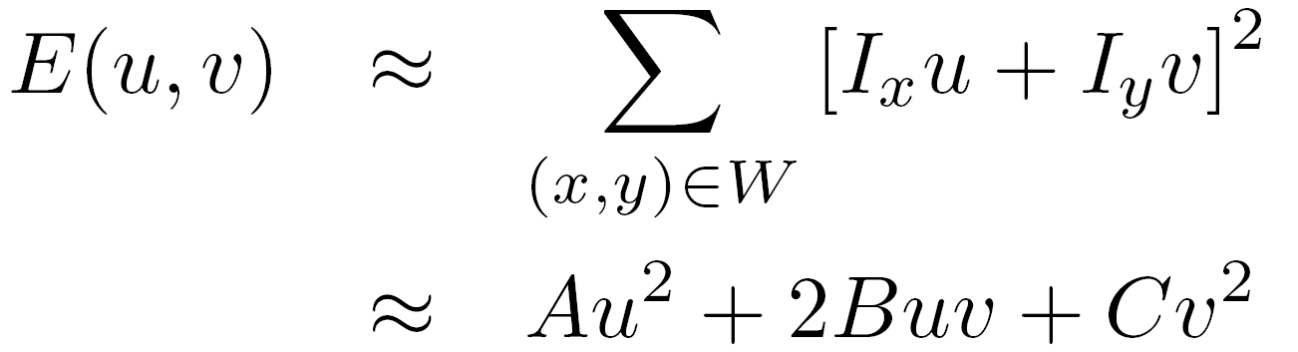
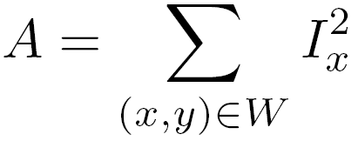
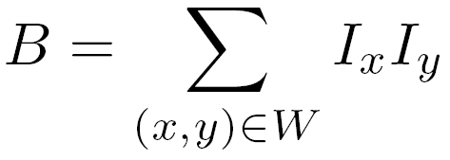
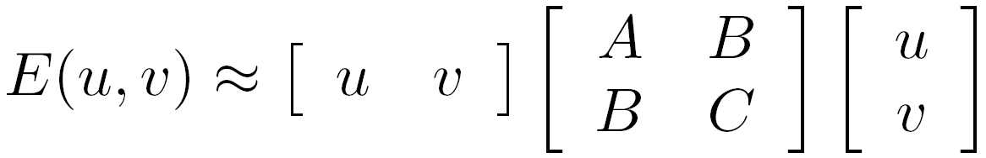
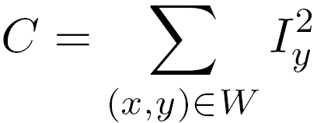

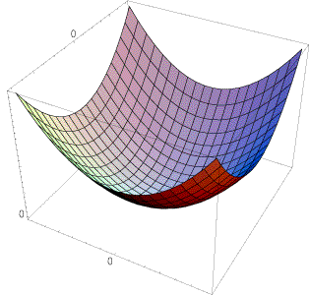
Harris corner detection
Also called second-moments matrix
E(u,v)
v
u

Slide 22
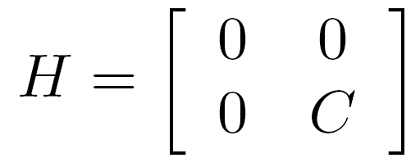
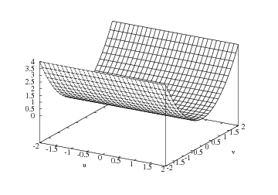

Harris corner detection
E(u,v)
Horizontal edge:
v
u

Slide 23
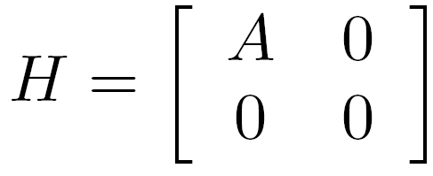
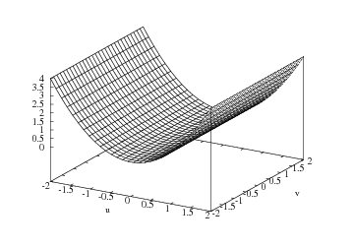

Harris corner detection
E(u,v)
Vertical edge:
v
u

Slide 24
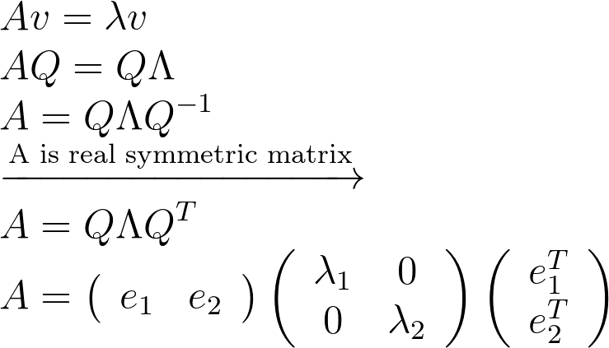
Harris corner detection: probabilistic interpretation
4. Compute the eigendecomposition
A real symmetric matrix has an eigendecomposition of:
Bonus: eigenvectors are orthonormal if A is real and symmetric.
Notes:
\\
Av = \lambda v
\\
AQ=Q\Lambda
\\
A=Q\Lambda Q^{-1}
\\
\xrightarrow{\text{A is real symmetric matrix}}
\\
A=Q\Lambda Q^{T}
\\
A=\left(\begin{array}{ll}{e_{1}} & {e_{2}}\end{array}\right)\left(\begin{array}{cc}{\lambda_{1}} & {0} \\ {0} & {\lambda_{2}}\end{array}\right)\left(\begin{array}{c}{e_{1}^{T}} \\ {e_{2}^{T}}\end{array}\right)

Slide 25
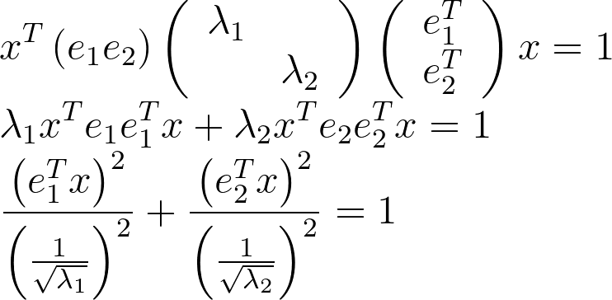
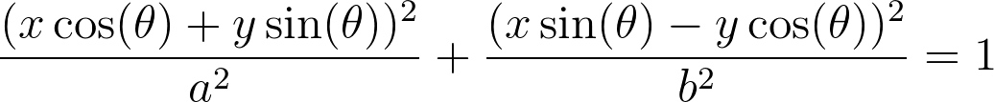

Harris corner detection
An ellipse can have a matrix form of:
Which is exactly as a rotated ellipse with a center of $\left(0,0\right):$
Notes:
\\
x^{T}\left(e_{1} e_{2}\right)\left(\begin{array}{cc}{\lambda_{1}} \\ {} & {\lambda_{2}}\end{array}\right)\left(\begin{array}{c}{e_{1}^{T}} \\ {e_{2}^{T}}\end{array}\right) x=1
\\
\lambda_{1} x^{T} e_{1} e_{1}^{T} x+\lambda_{2} x^{T} e_{2} e_{2}^{T} x =1
\\
\frac{\left(e_{1}^{T} x\right)^{2}}{\left(\frac{1}{\sqrt{\lambda_{1}}}\right)^{2}}+\frac{\left(e_{2}^{T} x\right)^{2}}{\left(\frac{1}{\sqrt{\lambda_{2}}}\right)^{2}}=1
=============================================
\frac{(x \cos (\theta)+y \sin (\theta))^{2}}{a^2}+\frac{(x \sin (\theta)-y \cos (\theta))^2}{b^{2}}=1

Slide 26
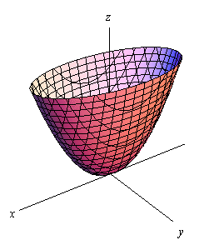



Harris corner detection
Combining the two equations seen before we can conclude that when taking a cross-section from the error function, we can get an ellipsoid.
$[u v]H\left[\begin{matrix}u \\ v\end{matrix}\right]=\text{const}$
Assume $λ_{1}>λ_{2}$
Remember to subtract the mean of each patch so that the ellipsoid is centered.
direction of $e_{max}$
direction of $e_{min}$
(λ_{max})^{-1/2}
(λ_{min})^{-1/2}

Slide 27
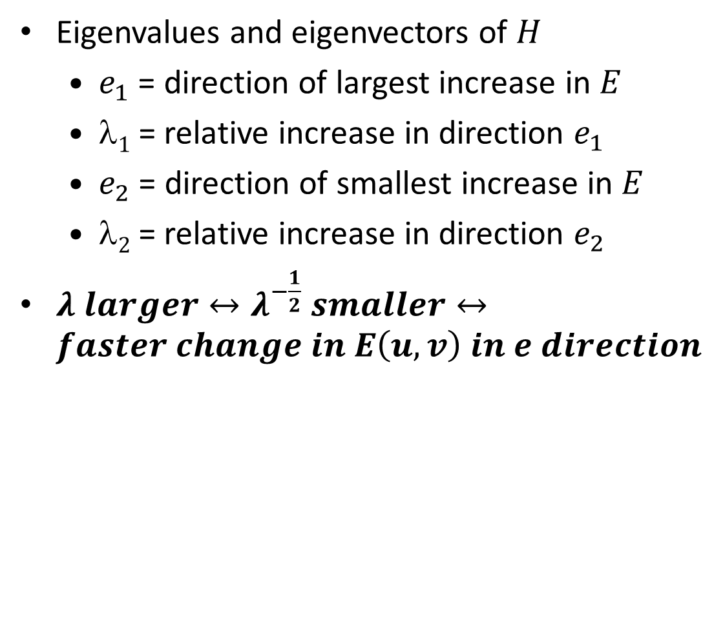


Harris corner detection
Eigenvalues and eigenvectors of $H$
$e_{1}$ = direction of largest increase in $E$
$1$= relative increase in direction $e_{1}$
$e_{2}$ = direction of smallest increase in $E$
$2⁡$= relative increase in direction $e_{2}$
$λ larger↔λ^{−\frac{1}{2}} smaller↔faster change in E\left(u,v\right) in e direction$
$e_{min}$
$e_{max}$
direction of $e_{max}$
direction of $e_{min}$
(λ_{max})^{-1/2}
(λ_{min})^{-1/2}

Slide 28
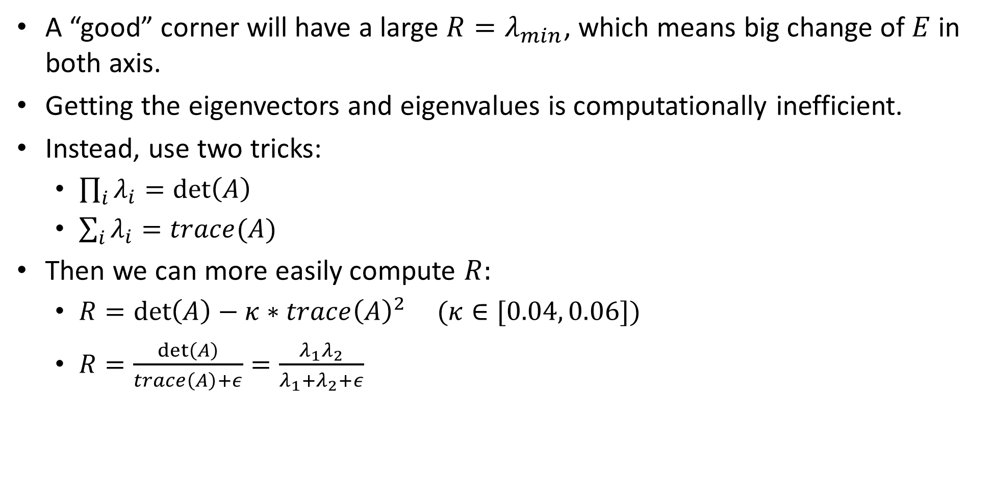
Interpreting the eigenvalues
A “good” corner will have a large $R=λ_{min}$, which means big change of $E$in both axis.
Getting the eigenvectors and eigenvalues is computationally inefficient.
Instead, use two tricks:
$\prod_{i}{λ_{i}}=\det\left(A\right)$
$\sum_{i}{λ_{i}=trace(A)}$
Then we can more easily compute $R:$
$R=\det\left(A\right)−κ∗trace{\left(A\right)}^{2}$ $(κ∈[0.04, 0.06])$
$R=\frac{\det\left(A\right)}{trace\left(A\right)+ε}=\frac{λ_{1}λ_{2}}{λ_{1}+λ_{2}+ε}$

Slide 29
Interpreting the eigenvalues
λ₂
“Edge” λ₂ >> λ₁
“Corner” λ₁ and λ₂ are large, λ₁ ~ λ₂; E increases in all directions
λ₁ and λ₂ are small; E is almost constant in all directions
“Flat” region
“Edge” λ₁ >> λ₂
λ₁

Slide 30


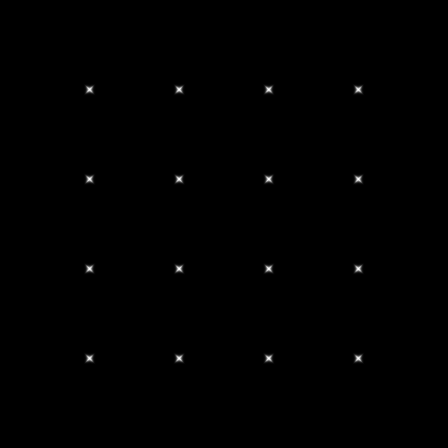




Interpreting the eigenvalues
A binary threshold of pixels above $λ_{max}$ and $λ_{min}$

Slide 31
Harris corner detection
Compute gradients of patch around each pixel.
Subtract the mean from each patch gradient.
Compute the covariance matrix.
Compute eigendecomposition of covariance matrix.
Use eigenvalues to find corners.
This is PCA (principal component analysis). Out of scope but really interesting!

Slide 32
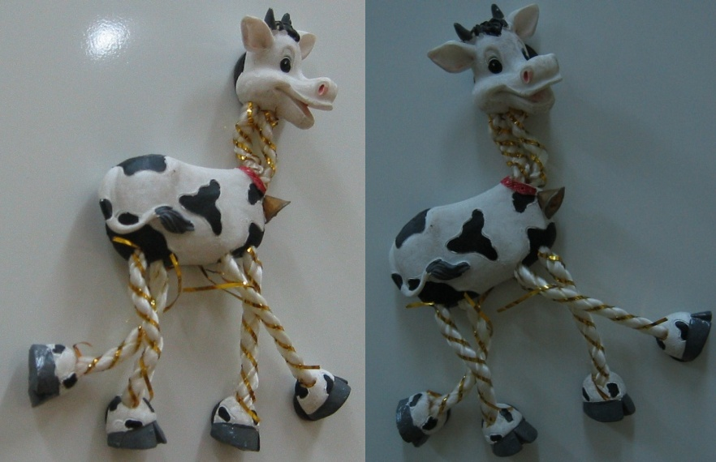
Harris detector example

Slide 33
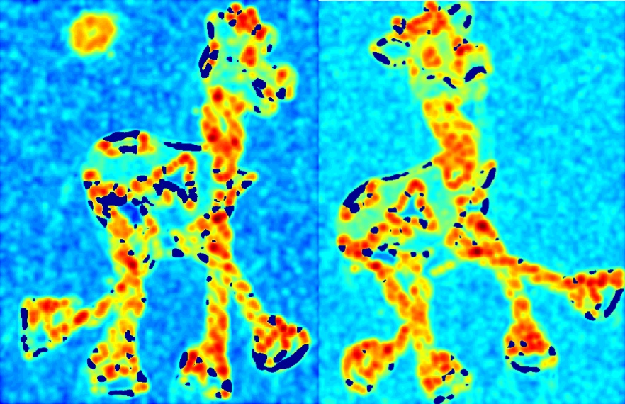
f value (red high, blue low)

Slide 34
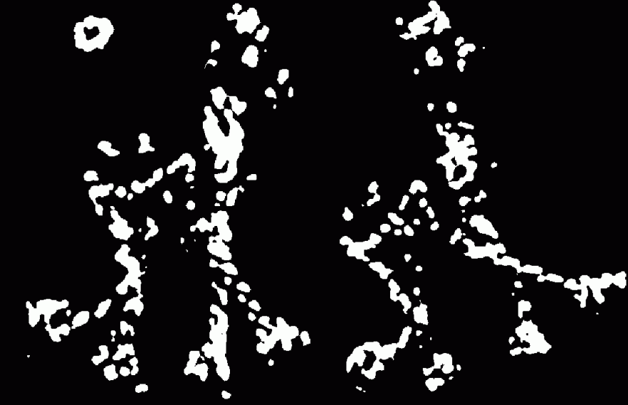
Threshold (f > value)

Slide 35
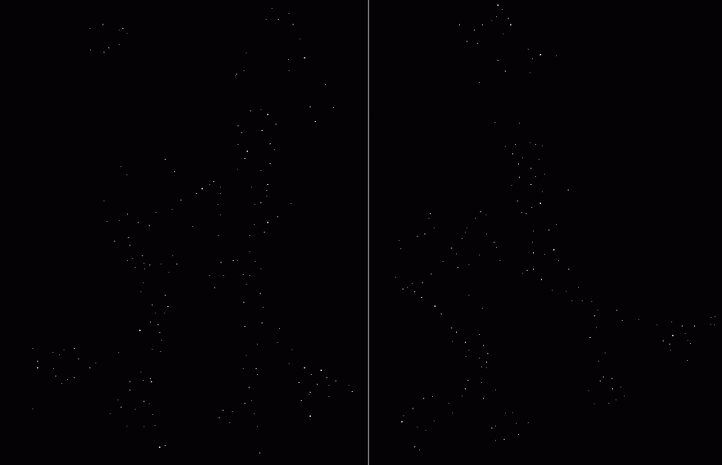
Find local maxima of f

Slide 36

Harris features (in red)

Slide 37
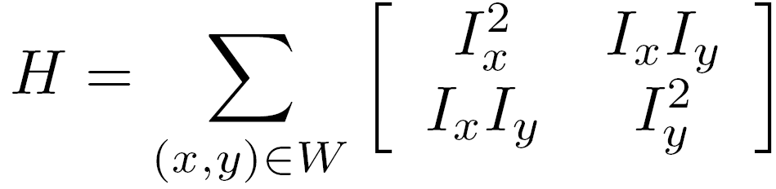
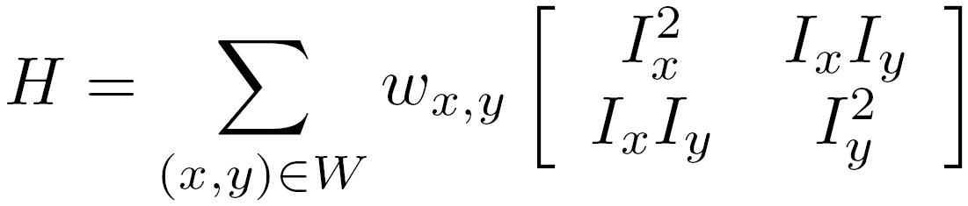

Weighting the derivatives
In practice, using a simple window W doesn’t work too well
Instead, we’ll weight each derivative value based on its distance from the center pixel

Slide 38
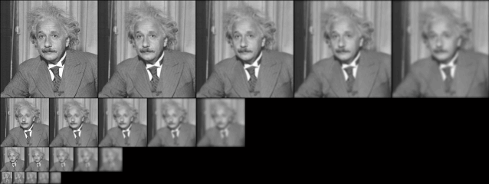
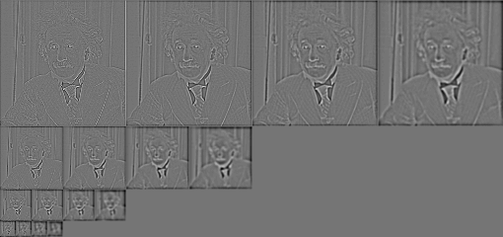
Gaussian
Laplacian

Slide 39
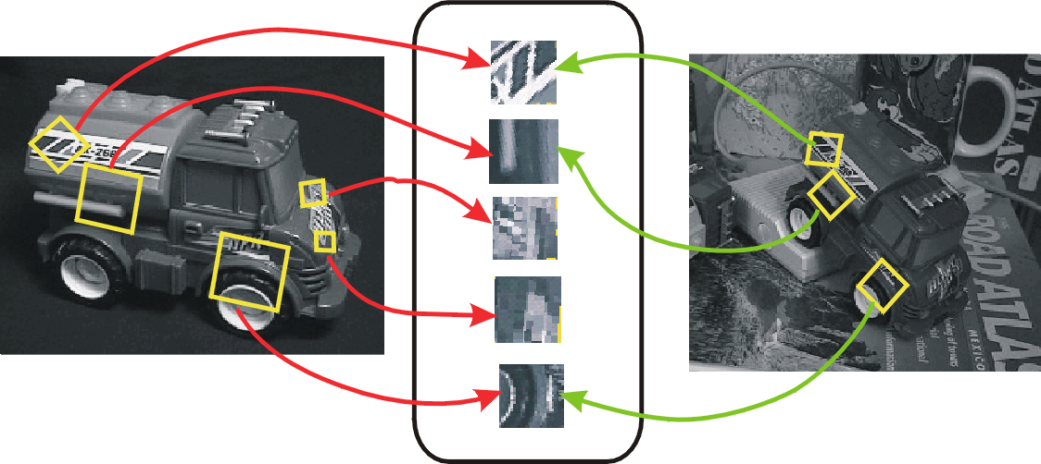
Invariant local features
Find features that are invariant to transformations
geometric invariance: translation, rotation, scale
photometric invariance: brightness, exposure, …
Feature Descriptors

Slide 40
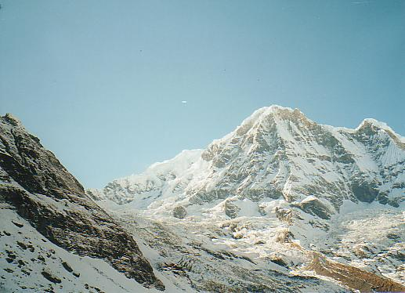
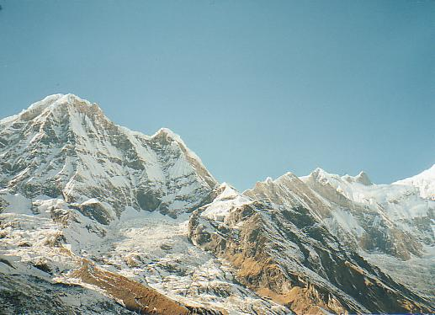
Why extract features?
Motivation: panorama stitching
We have two images – how do we combine them?

Slide 41
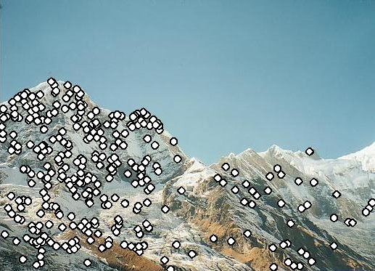
Why extract features?
Motivation: panorama stitching
We have two images – how do we combine them?
Step 1: extract features
Step 2: match features

Slide 42
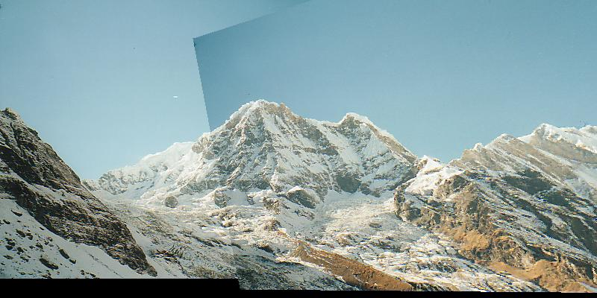
Why extract features?
Motivation: panorama stitching
We have two images – how do we combine them?
Step 1: extract features
Step 2: match features
Step 3: align images

