Slide 1
Features

Slide 2
References
http://szeliski.org/Book/
http://www.cs.cornell.edu/courses/cs5670/2019sp/lectures/lectures.html
http://www.cs.cmu.edu/~16385/
https://medium.com/software-incubator/introduction-to-orb-oriented-fast-and-rotated-brief-4220e8ec40cf
https://opencv-python-tutroals.readthedocs.io/en/latest/py_tutorials/py_feature2d/py_table_of_contents_feature2d/py_table_of_contents_feature2d.html
https://towardsdatascience.com/sift-scale-invariant-feature-transform-c7233dc60f37

Slide 3
Feature detection
Talk about harris corner detector?
Feature descriptor and matching
Sift
Talk about orb
Panorama

Slide 4
What is a feature?
There is no universal or exact definition of what constitutes a feature, and the exact definition often depends on the problem or the type of application. Given that, a feature is defined as an "interesting" part of an image.
[from: wikipedia]

Slide 5
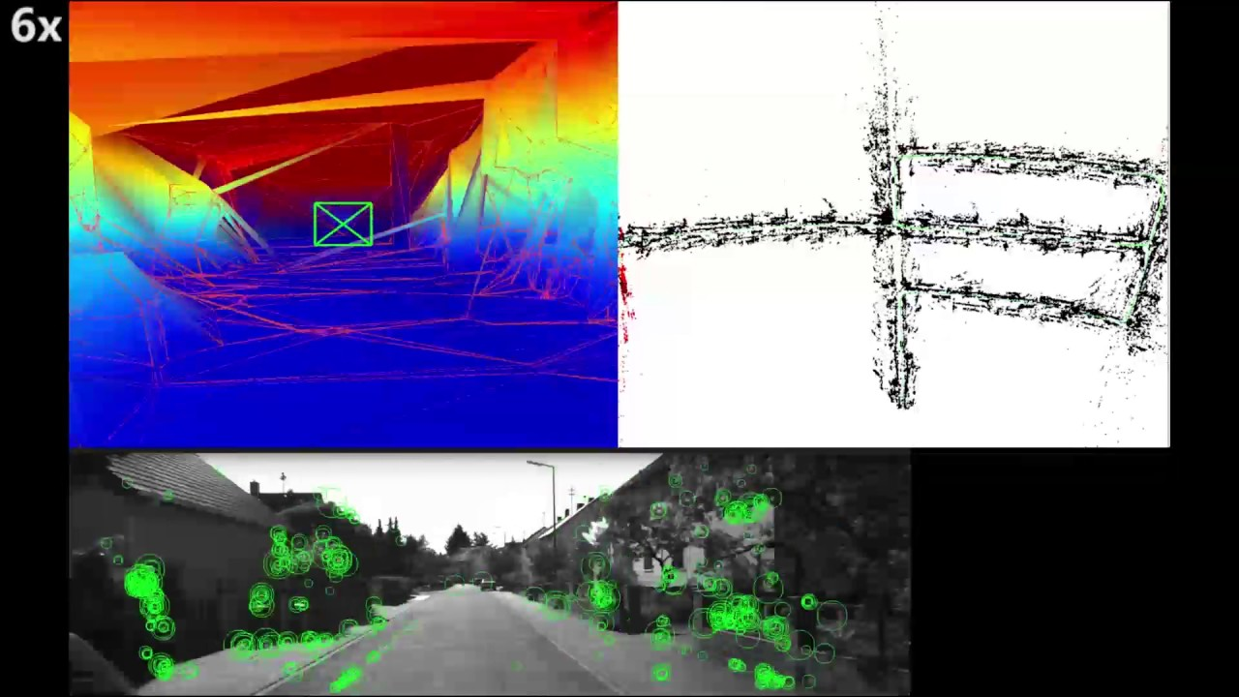
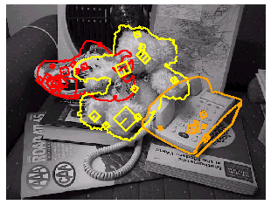
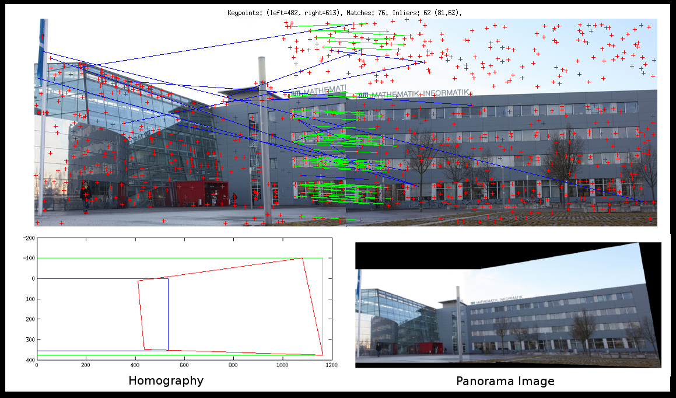
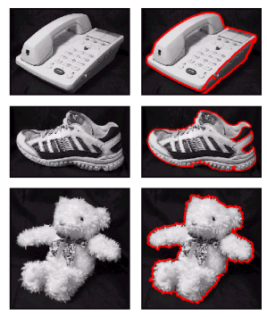
What can we do with features?
Robot navigation
Object recognition
Panorama stitching

Slide 6
Features- 2 main parts
Detector: an algorithm to determine which points of an image are interesting and unique enough to be considered features (also known as keypoints).
Descriptor: once we have keypoints, we need to be able to find matches between two feature sets of two images as fast and as accurate as possible. The descriptor is a feature vector that can be compared to others.

Slide 7
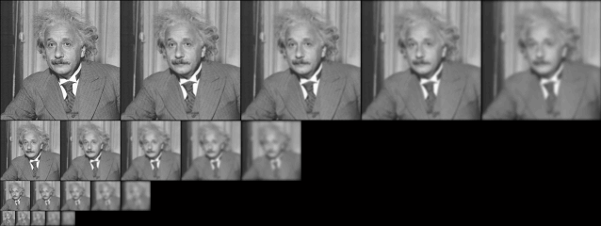
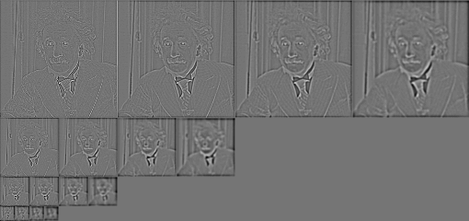
Gaussian
Laplacian

