Slide 1
Variational Inference

Slide 2
Framework –Bayesian Inference
The inputs:
Sample of length n (numbers, categories, vectors, images)
We denote this entity–Evidence
2. An assumption about the probabilistic structure that generates the sample –Hypothesis
Objective : Gain\Update information about the Hypothesis using the Evidence

Slide 3
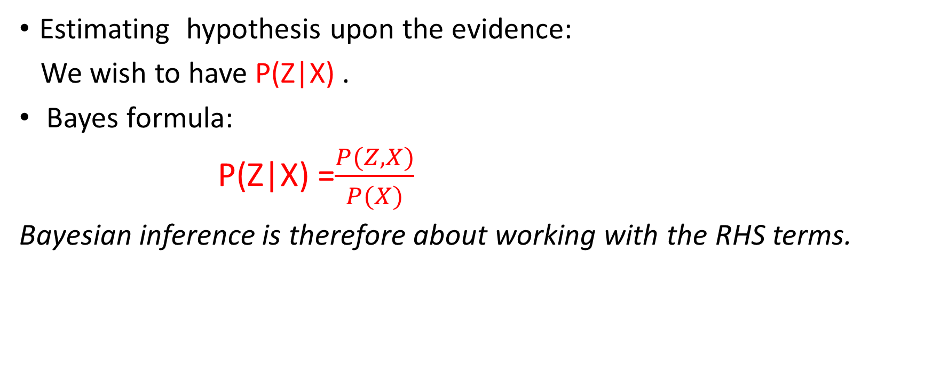
Bayesian Inference- into formulas
Estimating hypothesis upon the evidence:
We wish to have P(Z|X) .
Bayes formula:
P(Z|X) =$\frac{P(Z,X)}{P(X)}$
Bayesian inference is therefore about working with the RHS terms.

Slide 4
RHS terms
Hidden Variables (Hypothesis)(Z)- The variables of the mechanism that generates the sample
(e.g. topics distribution in a corpus or the Gaussians in GMM)
The values are not given
We have the joint distribution P(Z,X) !!!
Observed Data (Evidence) (X)- The sample that we actually have.
We know every value
We may know nothing about its distribution

Slide 5
RHS terms (Cont.)
In some case studies P(X) is intractable or extremely difficult to calculate.
We cannot have Bayes formula.
Variational inference offers a class of algorithms to solve this problem

Slide 6
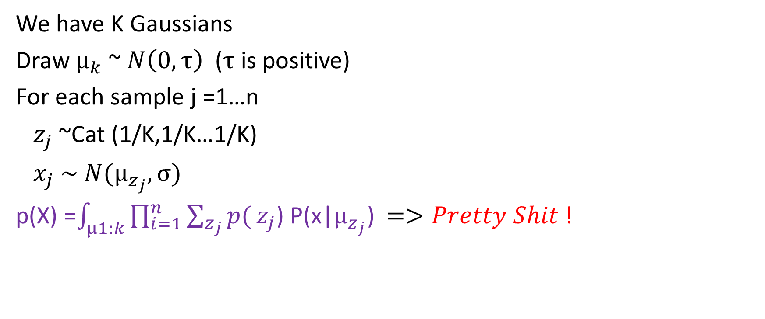
Examples -GMM
We have K Gaussians
Draw $μ_{k}$ ~ $N\left(0,τ\right)$ ($τ$ is positive)
For each sample j =1…n
$z_{j}$ ~Cat (1/K,1/K…1/K)
$x_{j} \sim N(μ_{z_{j}},σ)$
p(X) =$\int_{μ1:k}{\prod_{i=1}^{n}{\sum_{z_{j}}{p(}}z_{j}\text{) }\text{P}\text{(}\text{x}\text{|}μ_{z_{j}}\text{)}}$ $=>Pretty Shit$!

Slide 7
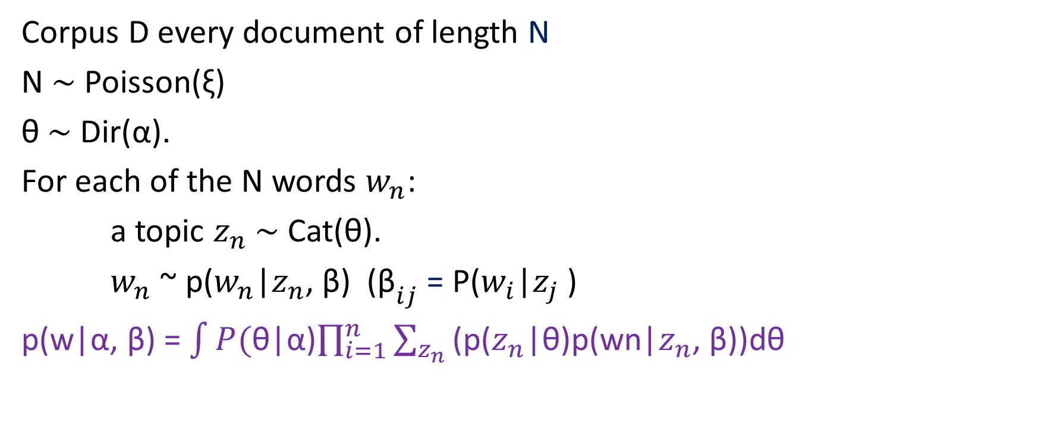
Examples - LDA
Corpus D every document of length N
N ∼ Poisson(ξ)
θ ∼ Dir(α).
For each of the N words $w_{n}$:
a topic $z_{n}$ ∼ Cat(θ).
$w_{n}$ ~ p($w_{n}$|$z_{n}$, β) (${\text{β}}_{ij}$ = P($w_{i}$|$z_{j}$ )
p(w|α, β) = $\int{P(}$θ|α)$\prod_{i=1}^{n}{\sum_{z_{n}}{\text{(}\text{p}\text{(}z_{n}\text{|}\text{θ}\text{)}\text{p}\text{(}\text{wn}\text{|}z_{n}\text{, }\text{β}\text{))}\text{d}\text{θ}}}$

Slide 8
Sampling
The common solution for estimating a distribution is sampling:
MCMC
Gibbs
RBM –(Mostly by Gibbs sampling)
Today we wont talk about these methods!

Slide 9
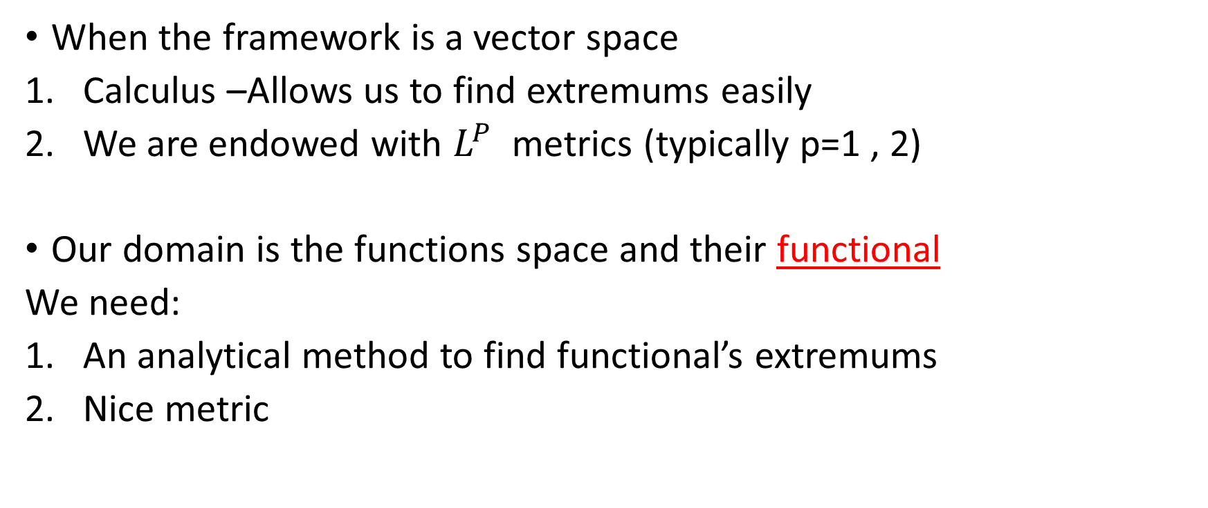
Can we do something analytically?
When the framework is a vector space
Calculus –Allows us to find extremums easily
We are endowed with $L^{P}$ metrics (typically p=1 , 2)
Our domain is the functions space and their functional
We need:
An analytical method to find functional’s extremums
Nice metric

Slide 10
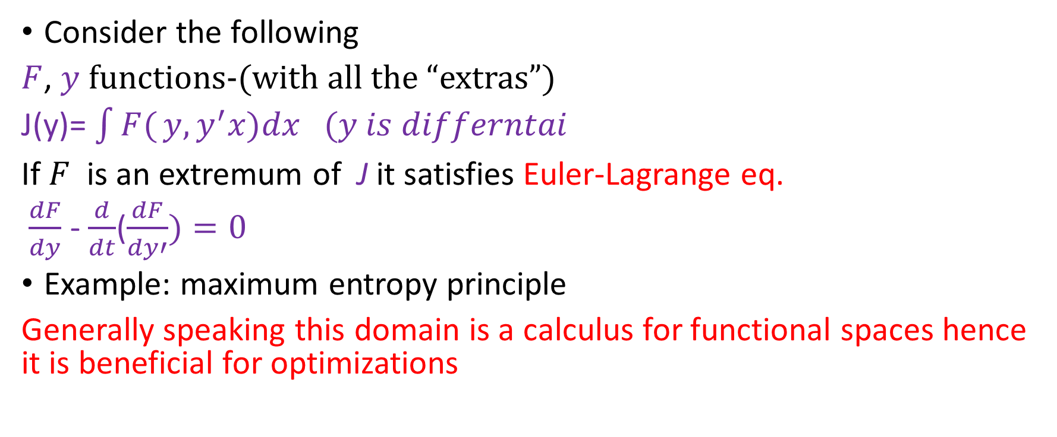
Calculus of Variations
Consider the following
$F$, $y$ functions-(with all the “extras”)
J(y)= $\int{F(}y,y^{′}x)dx (y is differntai$
If $F$ is an extremum of J it satisfies Euler-Lagrange eq.
$\frac{dF}{dy}$ - $\frac{d}{dt}$($\frac{dF}{dy′})=0$
Example: maximum entropy principle
Generally speaking this domain is a calculus for functional spaces hence it is beneficial for optimizations

Slide 11
KL (Kullback-Leibler) Divergence
A metric on distributions
* “On Information and Sufficiency” 1951 (Ann Math Statist)
Properties:
Non-symmetric (It actually measures a relative distance :which dist. P finds the closest)
Concave -> 0 is obtained only for Kl(p,p) (proof by concavity of log an Jensen Lagrange multipliers))
The distance between P(x,y) to p(x) *p(y)=0
Usage:
Cross Entropy = H(p)+ KL(p,q)

Slide 12

PMI (Pointwise Mutual Information)
Let X,Y random variables
PMI(X,Y)= Log[p(X=a, Y=b)/(p(X=a)p(Y=b)]
KL(p(X/Y=a),Q(x)) = $\sum_{x}{P(X=x|Y=a)}$PMI(X=x, Y=a)
What does this term mean?

Slide 13
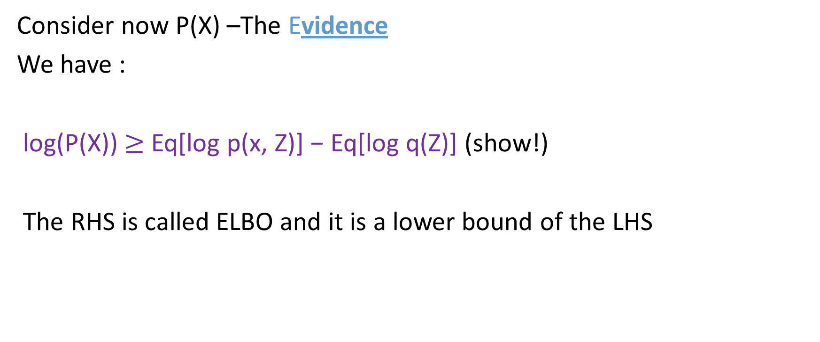
ELBO- Evidence Lower Bound
Consider now P(X) –The Evidence
We have :
log(P(X)) $≥$ Eq[log p(x, Z)] − Eq[log q(Z)] (show!)
The RHS is called ELBO and it is a lower bound of the LHS

Slide 14
Back to KL
Recall that we search for a distribution Q s.t. Q(Z) ~ P(Z|X) :
min(KL(Q(Z)||P(Z|X) )
KL(Q||P(Z|X) )= Log(P(X))- ELBO
=>Log(P(X)) = KL(Q||P(Z|X) ) +ELBO
P is fixed Hence: Maximizing ELBO =>minimizing KL

Slide 15
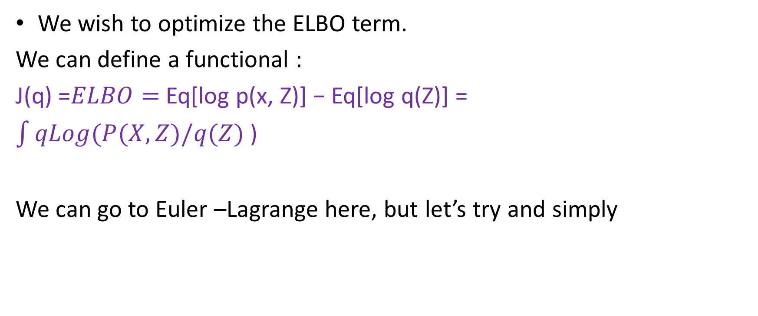
Let’s use Calculus!
We wish to optimize the ELBO term.
We can define a functional :
J(q) =$ELBO=$Eq[log p(x, Z)] − Eq[log q(Z)] =
$\int{qLog(P(X,Z)/q(Z)}$ )
We can go to Euler –Lagrange here, but let’s try and simply

Slide 16
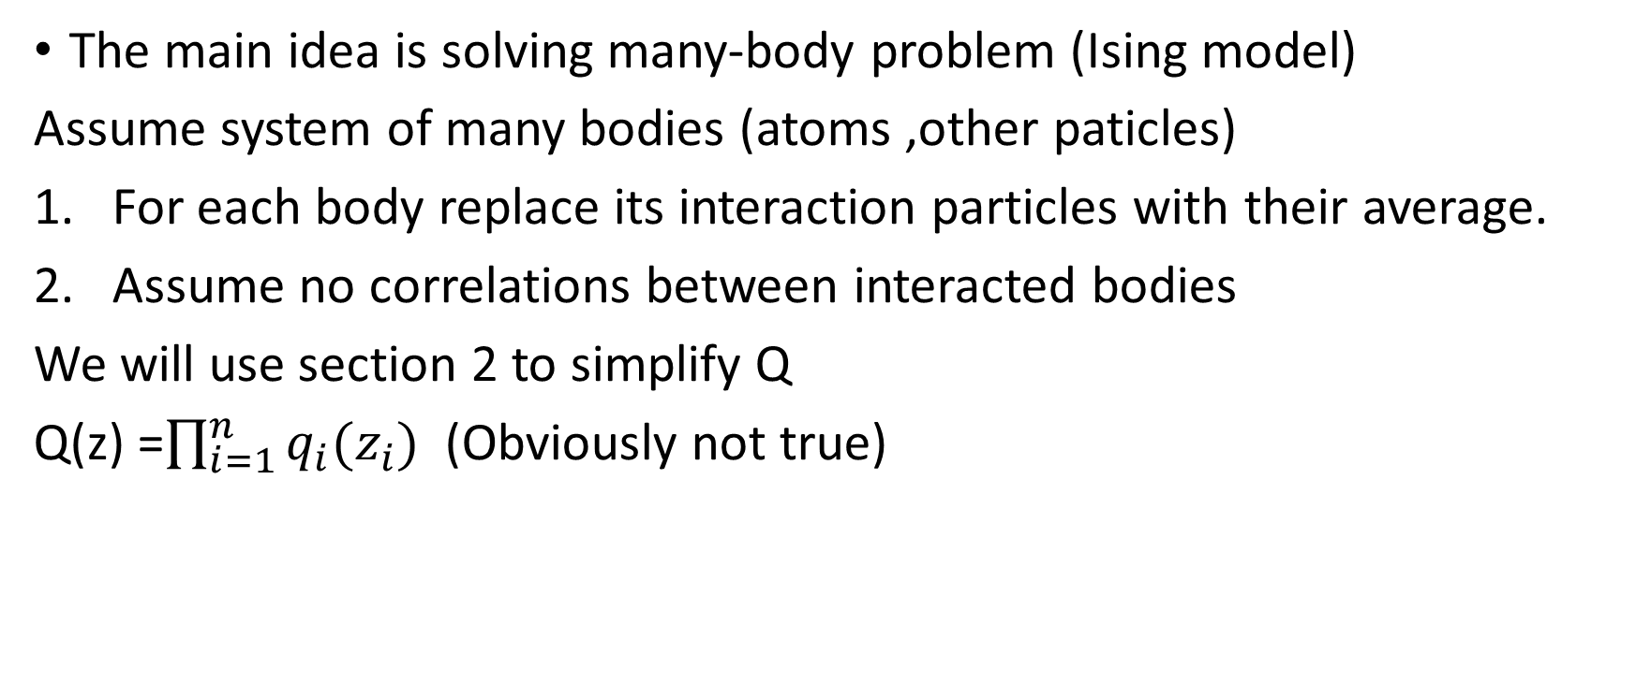
Mean Field Theory-MFT
The main idea is solving many-body problem (Ising model)
Assume system of many bodies (atoms ,other paticles)
For each body replace its interaction particles with their average.
Assume no correlations between interacted bodies
We will use section 2 to simplify Q
Q(z) =$\prod_{i=1}^{n}{q_{i}(z_{i})}$ (Obviously not true)

Slide 17
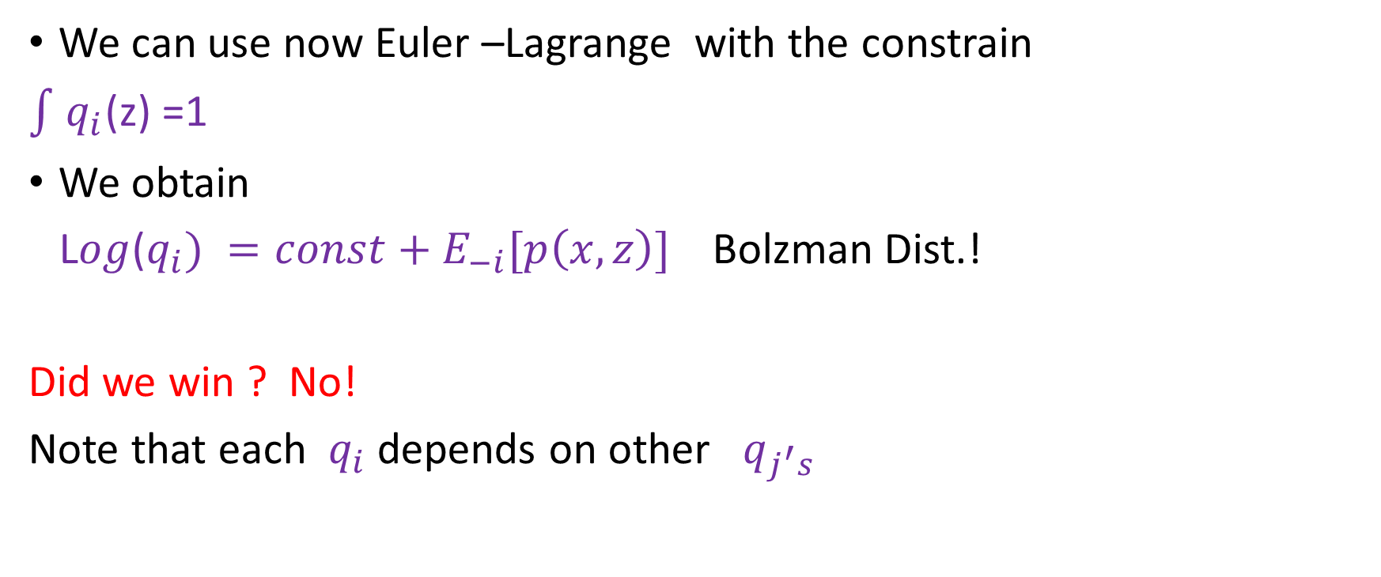
MFT -cont
We can use now Euler –Lagrange with the constrain
$\int{ q_{i}}$(z) =1
We obtain
L$og$($q_{i}) =const+E_{−i}[p\left(x,z\right)]$ Bolzman Dist.!
Did we win ? No!
Note that each $q_{i}$ depends on other $q_{j^{′}s}$

Slide 18

Coordinate Ascent Variational Inference CAVI
An iterative algorithm
Construct a model P(X,Z)
Set sequentially each $q_{i}$ to $E_{−i}[p\left(x,z\right)]$ +constant
As always we do repeat until the q’s converge

Slide 19
Stochastic - VI
CAVI does not work well for big data (update for every item)
Stochastic VI- rather updating the q’s, we calculate the gradient of the ELBO, and optimize its parameters

Slide 20
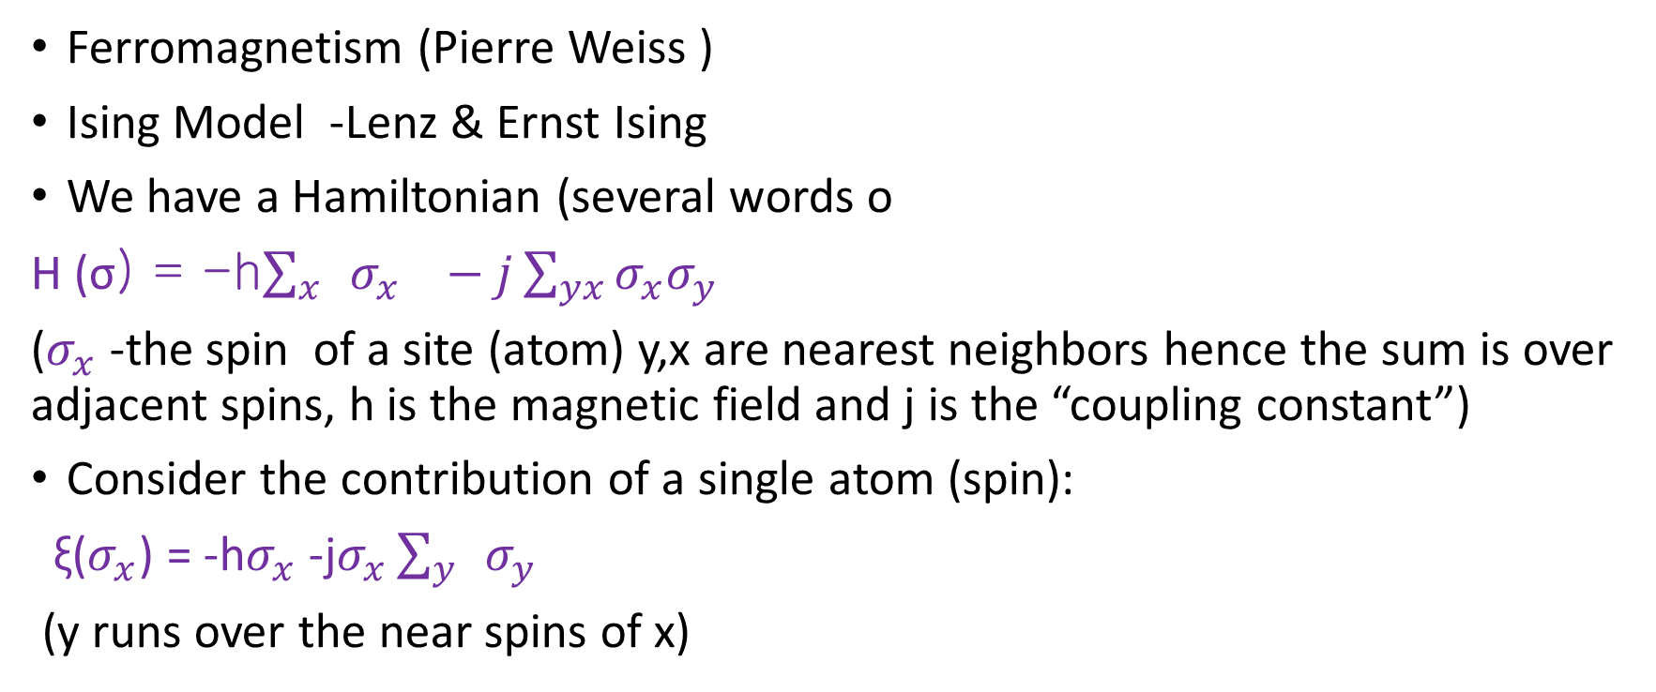
Appendix- Ising Model
Ferromagnetism (Pierre Weiss )
Ising Model -Lenz & Ernst Ising
We have a Hamiltonian (several words o
H (σ) = -h$\sum_{x}{ }σ_{x} −j\sum_{yx}{σ_{x}σ_{y}}$
($σ_{x}$ -the spin of a site (atom) y,x are nearest neighbors hence the sum is over adjacent spins, h is the magnetic field and j is the “coupling constant”)
Consider the contribution of a single atom (spin):
ξ($σ_{x}$) = -h$σ_{x}$ -j$σ_{x}\sum_{y}{ }σ_{y}$
(y runs over the near spins of x)

Slide 21
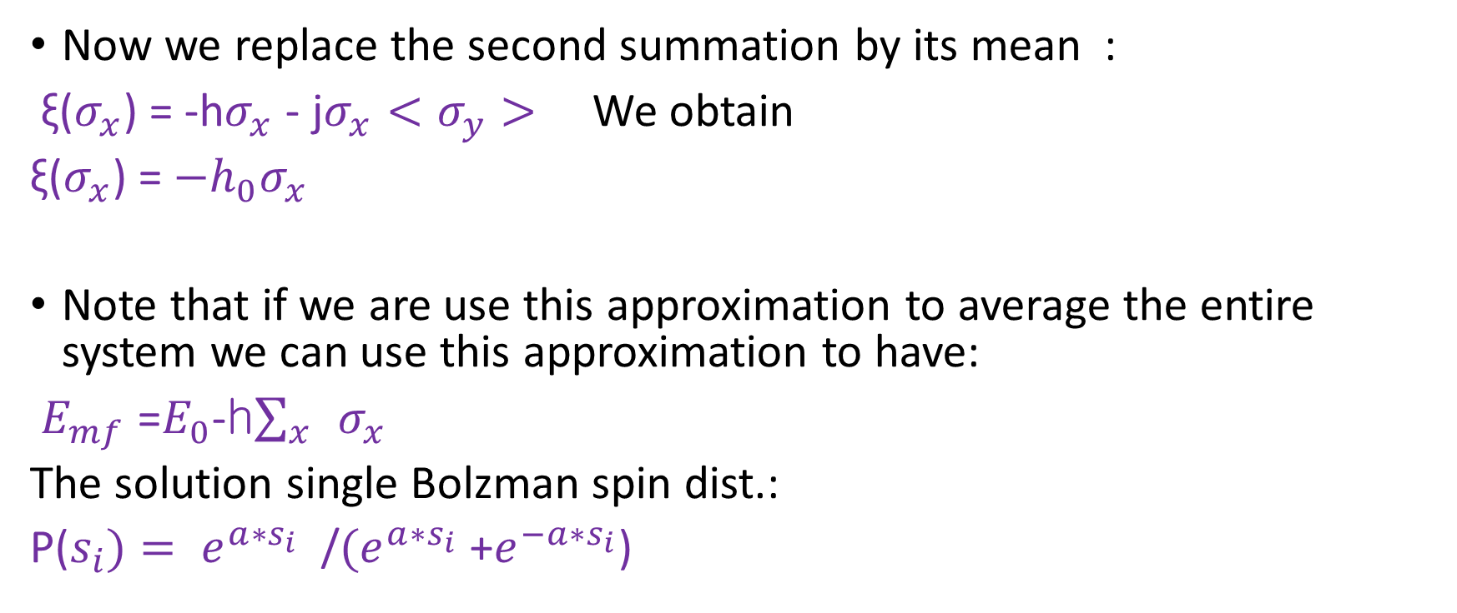
Ising Model(cont.)
Now we replace the second summation by its mean :
ξ($σ_{x}$) = -h$σ_{x}$ - j$σ_{x}<σ_{y}>$ We obtain
ξ($σ_{x}$) = ${−h}_{0}σ_{x}$
Note that if we are use this approximation to average the entire system we can use this approximation to have:
$E_{mf}$ =$E_{0}$-h$\sum_{x}{ }σ_{x}$
The solution single Bolzman spin dist.:
P($s_{i})= e^{a∗s_{i}}$ /${(e}^{a∗s_{i}}$ +$e^{−a∗s_{i}}$)

Slide 22
Remarks
1 Maxwell speeds – The use of independency for “achieving” normal distribution
2 RBM
3 Conditional Random Field (CRF)

