Slide 1
Distracted Driver Detection
Youssef Mroue, David Nassif, Alexandra Oricchio, Vaishall Pradeepkumar

Slide 2

Inspiration
The CDC motor vehicle safety division states that one in five car accidents are caused by the driver being distracted
According to their statistics this is translated to 425,000 injuries and 3,000 deaths every year.
State farm took the initiative and hosted a Kaggle Competition in 2016 in order to detect if a driver were distracted or not from a dashboard camera.

Slide 3

You can also split your content
The Data
State farm provided participants with over 100,000 dashboard photos already divided into test and train folders for us.
We also utilized NHTSA (National Highway Traffic Safety Administration) data to better visualize how big of an issue distracted drivers are. This dataset covered incidents all over the US from 2016 to 2018.

Slide 4
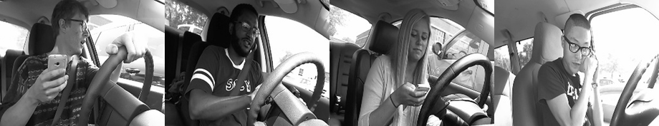
In two or three columns
Our Approach
Having complex image processing involved we resorted to computer vision and built a convolutional neural network model in order to analyze each photo and group them accordingly.
We deployed it to a webpage and gave other people the opportunity to upload a photo or a video and then our model would detect and classify it from there.
Our buckets consist of:
Safe Driving
Texting right hand
Talking on the phone with right hand
Texting left hand
Talking on the phone with left hand
Operating the radio
Drinking
Reaching behind
Hair and makeup
Talking to passenger.

Slide 5
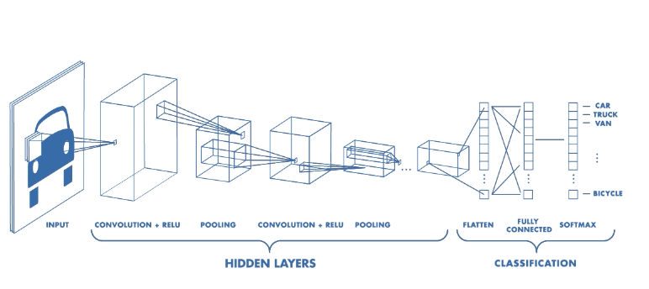
Our Model
Our model features 3 convolutional layers, each with an associated Activation, Pooling, and Dropout layer.
The number of nodes in each layer increases each layer, starting with 32, then 64, and finally 128. It finishes with Flatten, Dense, and a final Activation layer.
After running 100 epochs, our model had trained to an accuracy above 99% on our testing data.

Slide 6

Questions

