Slide 1

Final BootCamp Project
Prediction of Patients with Parkinson Disease.

Slide 2
INTRODUCTION
The dataset was created by Max Little of the University of Oxford, in collaboration with the National Centre for Voice and Speech, Denver, Colorado, which recorded the speech signals.
This dataset is composed of a range of biomedical voice measurements from 31 people, 23 with Parkinson's disease (PD). Each column in the table is a particular voice measure, and each row corresponds to one of 195 voice recordings from these individuals.
In this work we have predicted with 3 different models the patient with and without Parkinson’s. I have used Logistic Regression, the K-NN method, and Naive Bayes Model.

Slide 3
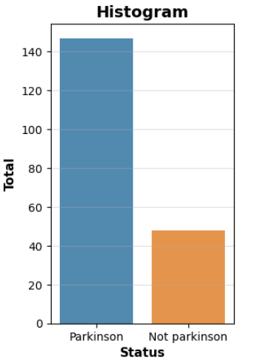
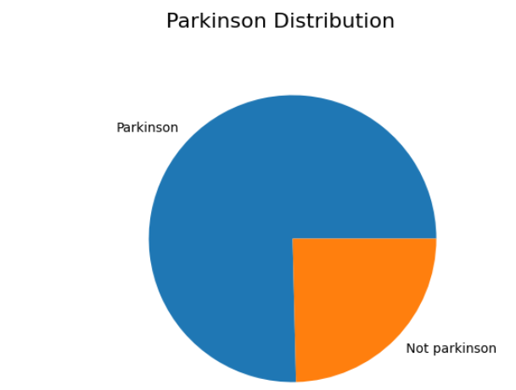
Parkinson distribution

Slide 4
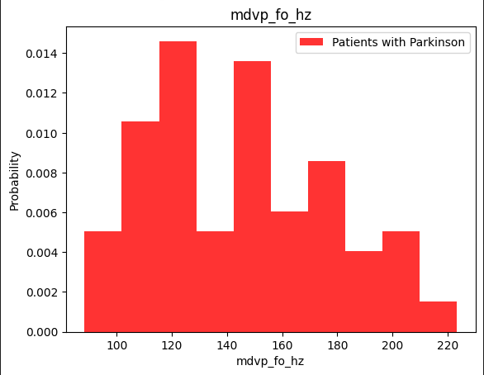
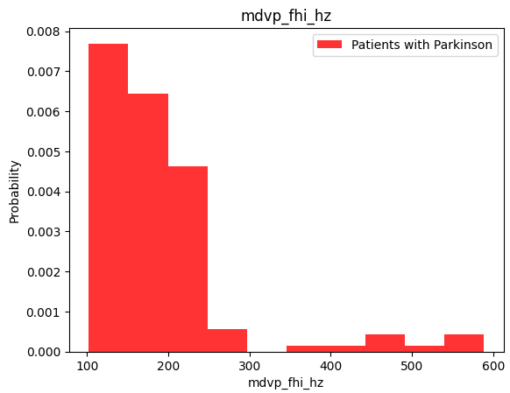
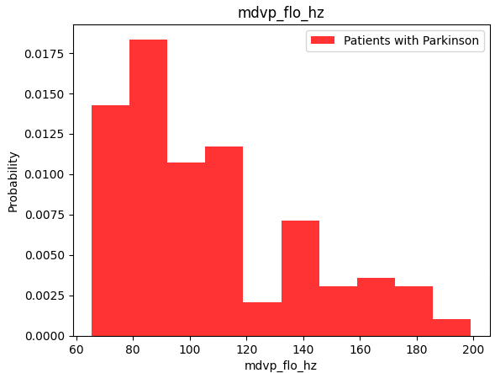
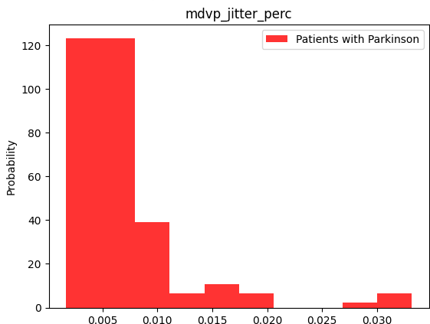
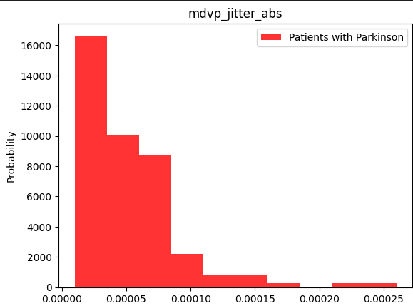
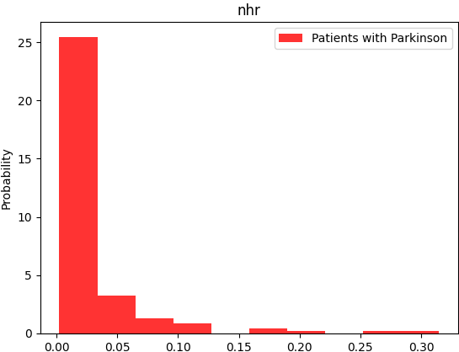
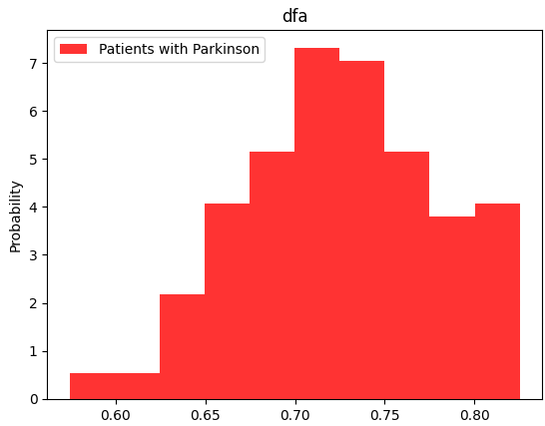
Distribution of different variables for patients with Parkinson
Average vocal fundamental frequency
Maximum vocal fundamental frequency
Minimum vocal fundamental frequency
Measure of variation in fundamental frequency
Measure of variation in fundamental frequency
Signal fractal scaling exponent
Noise to tonal components in the voice

Slide 5
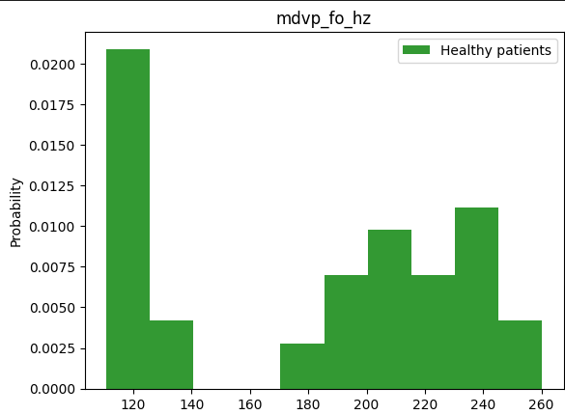
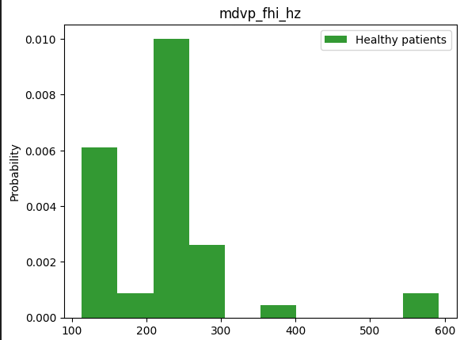
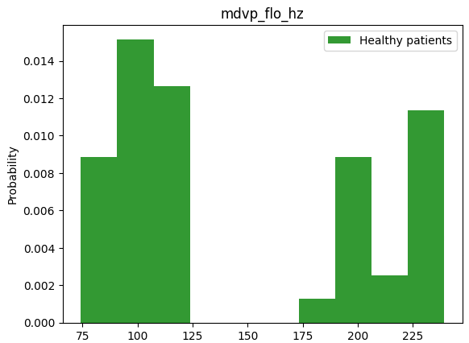
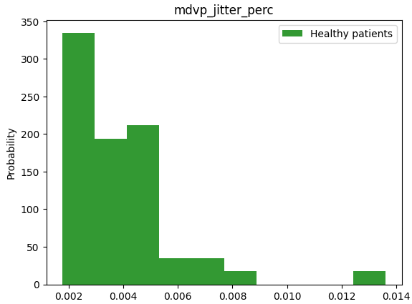
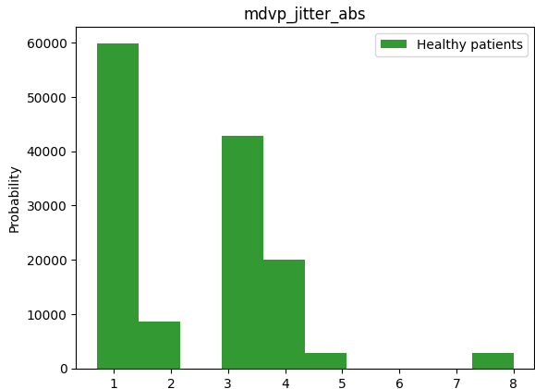
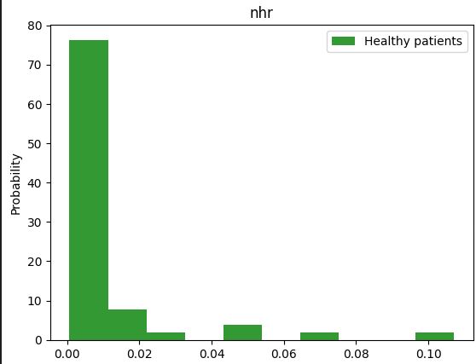
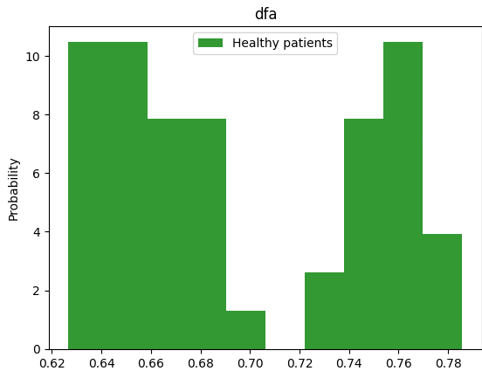
Distribution of different variables for patients Not with Parkinson We can clearly see that different variables increase or decrease drastically with PD.
Average vocal fundamental frequency
Maximum vocal fundamental frequency
Minimum vocal fundamental frequency
Measure of variation in fundamental frequency
Measure of variation in fundamental frequency
Signal fractal scaling exponent
Noise to tonal components in the voice

Slide 6
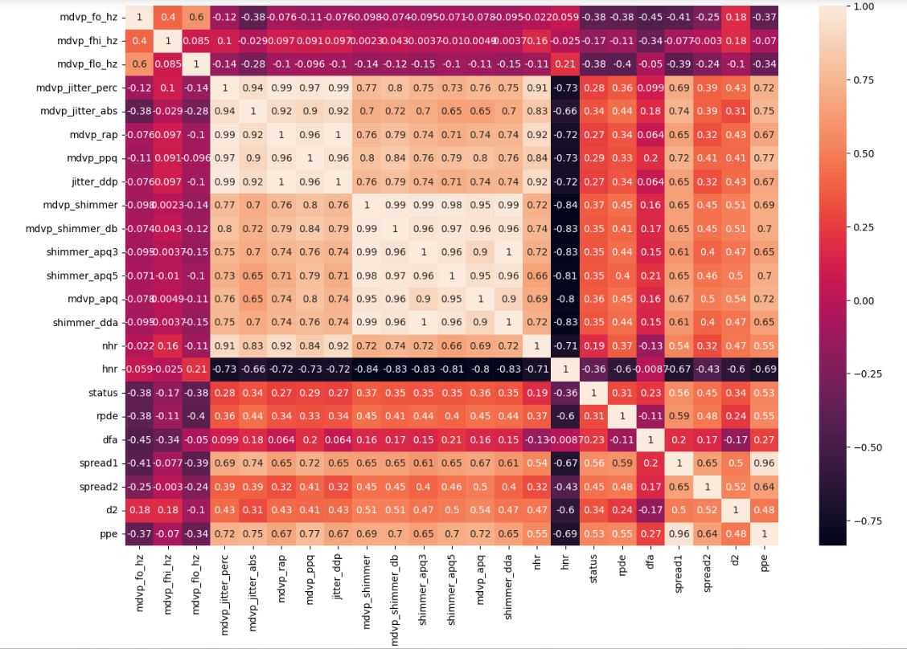
Let’s Check the correlation between variables
From the heatmap we can clearly see that a considerate number of the data are positively correlated.

Slide 7
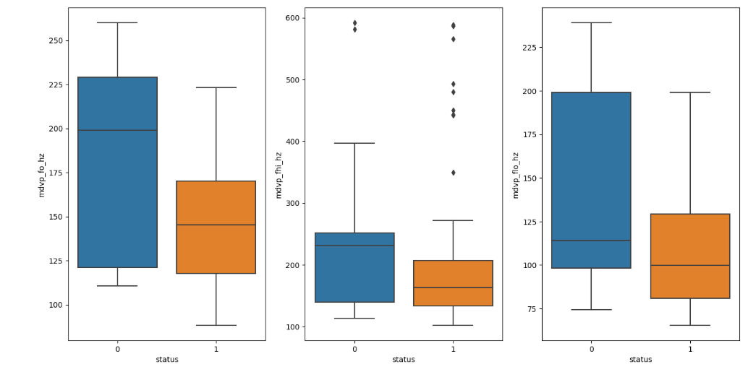
the number of people who have Parkinson’s is a lot higher compared to those who don't. This makes the Variable 'status' which is also the target variable, imbalanced.
BOXPLOT
Vocal frequency and DFA comparison for patients with Parkinson and not.
It is obvious that the range of vocal frequency is higher for people not having Parkinson when comparing to people who have Parkinson.

Slide 8
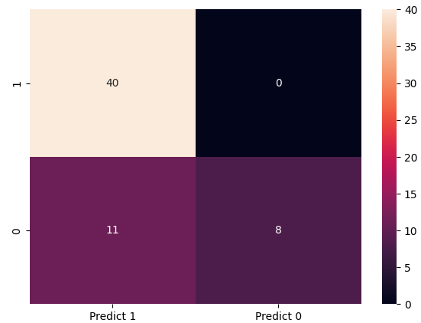
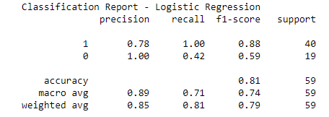
Logistic Regression
Confusion matrix interpretation explanation:
(TP): We correctly predicted the number of patients who have Parkinson, they are: 40
(TN): We did not predict correctly the count patients who do not have Parkinson’s and they didn't have Parkinson they are : 3
(FP): We incorrectly predicted the number of patients who do not have Parkinson but they actually dint have Parkinson and they are: 16
(FN): We incorrectly predicted the number of patients who do not have Parkinson’s but actually had Parkinson and they are: 0
The accuracy of this model is 0.81. The F1 score is 0.88.

Slide 9
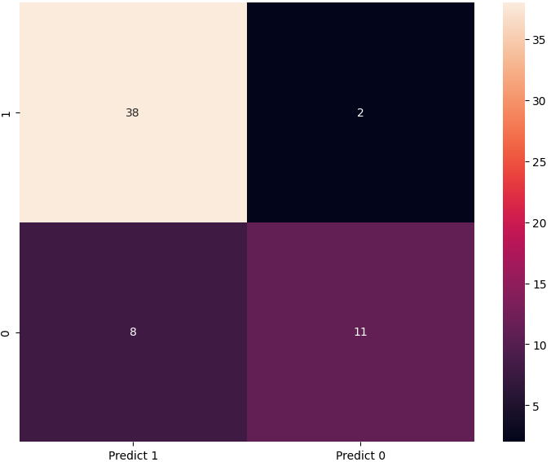
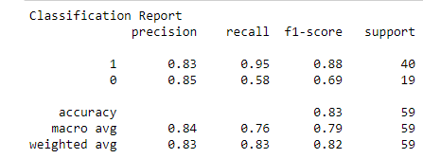
K-Nearest Neighbour
Confusion matrix interpretation explanation:
(TP): We correctly predicted the number of patients who have Parkinson, they are: 38
(TN): We predicted correctly the count of patients who do not have Parkinson’s and they don't have it: 8
(FP): We predicted incorrectly the number of patients who have Parkinson’s and they don't have Parkinson and they are: 11
(FN): We incorrectly predicted the number of patients who do not have Parkinson’s who actually had Parkinson and they are: 2
The accuracy of this model is 0.83. The recall of this model is 0.95.
The F1 score is 0.88.

Slide 10
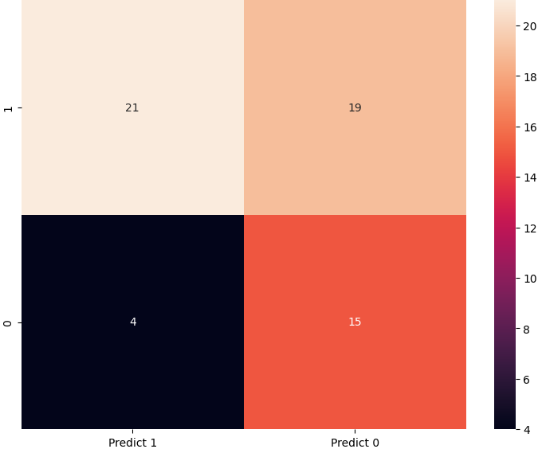
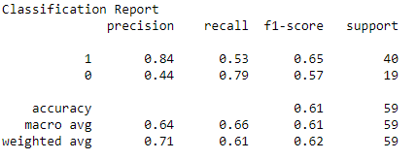
Naive Bayes Model
Confusion matrix interpretation explanation:
(TP): We correctly predicted the number of patients who have Parkinson, they are: 21
(TN): We predicted correctly the count of patients who do not have Parkinson and they don't have it : 15
(FP): We did not predicted correctly the number of patients who have Parkinson and they don't have Parkinson and they are: 4
(FN): We incorrectly predicted the number of patients who do not have Parkinson who actually had parkinson and they are: 19
The accuracy is 0.61.
The recall of this model is 0.53. The F1 score is 0.65.

Slide 11
Conclusion
Taking in consideration all the models the KNN model is the most accurate of all.
Naive Bayes is the least accurate.
Thank you!

