Slide 1
RESOLUTION PROOF METHOD
IN PROPOSITIONAL LOGIC

Slide 2
RESOLUTION PROOF METHOD
It was proposed by J.A. Robinson in 1965 as a proof method for classical logics
Dedicated theorem provers based on resolution:
OTTER, PCPROOVE, AMPHION, Jape
It was easily adapted to nonstandard logics (modal, temporal, many-valued, non-monotonic).
Its basic aim is to check the consistency/inconsistency of a set of clauses.
It is based on syntactic considerations => syntactic method
The validity of a formula is proved by contradiction=>
=> refutation method

Slide 3
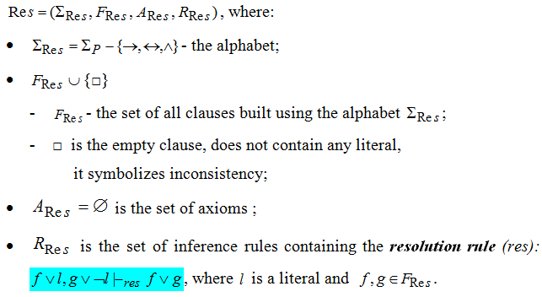
RESOLUTION METHOD
- FORMAL SYSTEM FOR PROPOSITIONAL LOGIC -

Slide 4
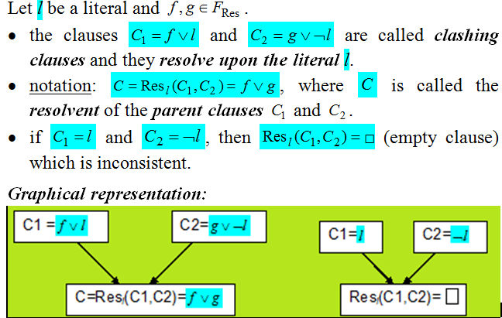
DEFINITIONS

Slide 5
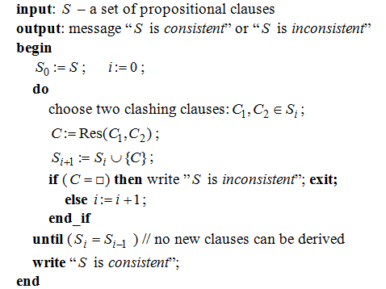
ALGORITHM: PROPOSITIONAL_RESOLUTION

Slide 6
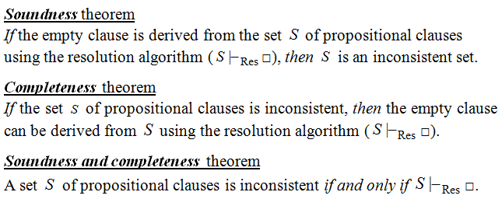
THEOREMS

Slide 7
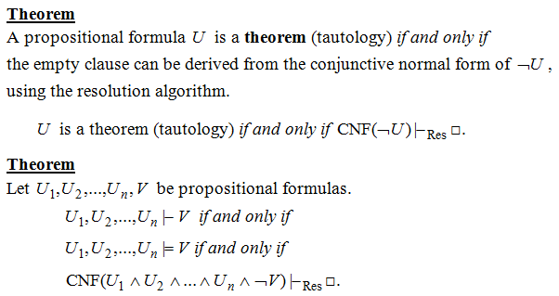
RESOLUTION - A REFUTATION PROOF METHOD

Slide 8
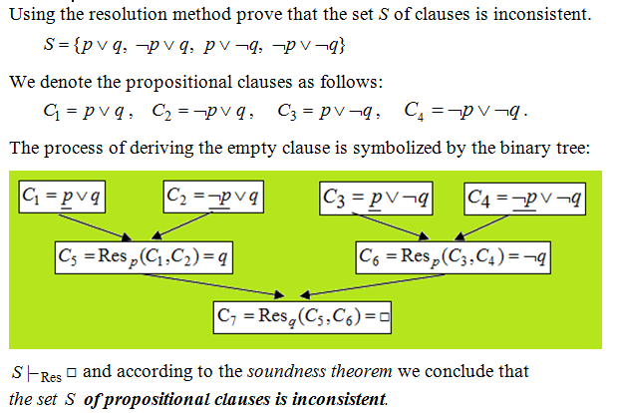
EXAMPLE 1

Slide 9
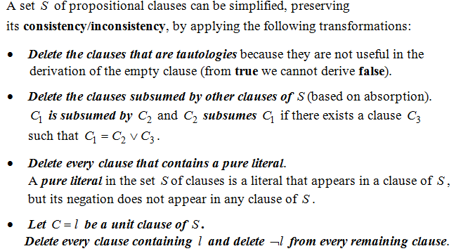
THEOREM
(BASED ON DAVIS-PUTMAN PROCEDURE)

Slide 10
STRATEGIES AND REFINEMENTS OF RESOLUTION
Strategies:
  assure that all the possible clauses to be derived are generated
  they try to avoid the derivation of redundant and irrelevant clauses in order to obtain the empty clause.
  level-saturation strategy, deletion strategy,
  set-of-support strategy
Refinements
  make the resolution process more efficient by imposing restrictions on the clashing clauses
  lock resolution, linear resolution,
  semantic resolution

Slide 11
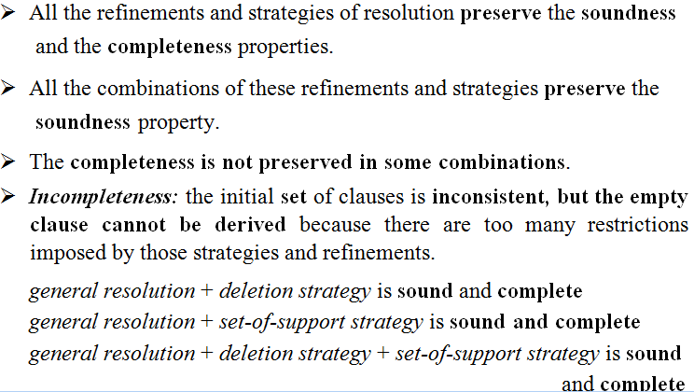
REMARKS

Slide 12
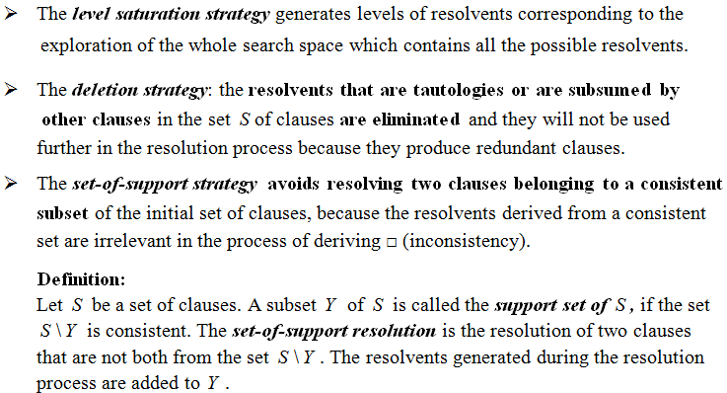
STRATEGIES OF RESOLUTION

Slide 13
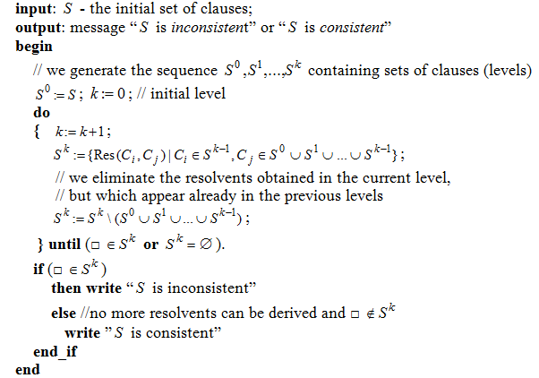
ALGORITHM: LEVEL-SATURATION-STRATEGY

Slide 14
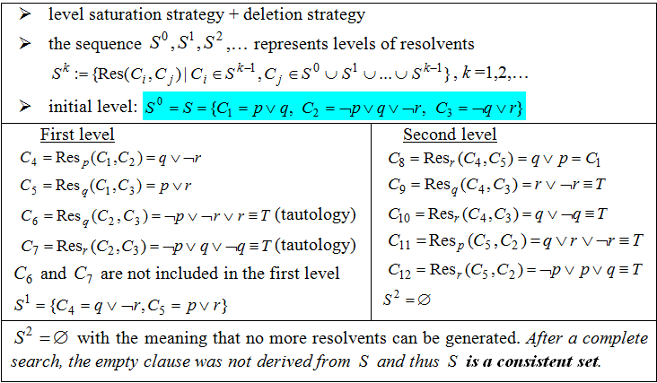
EXAMPLE 2

Slide 15
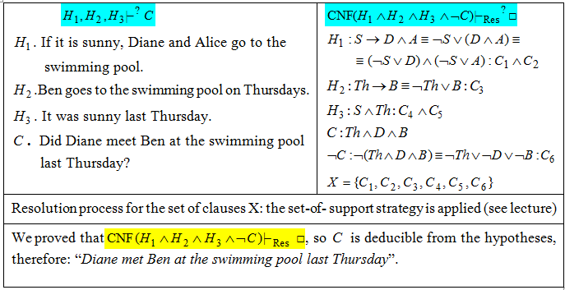
EXAMPLE 3. MODELING REASONING

Slide 16
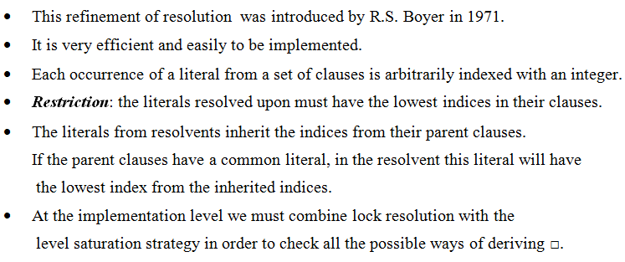
LOCK RESOLUTION

Slide 17
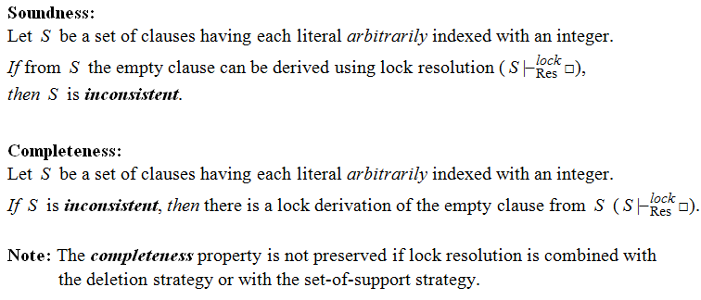
THEOREMS – LOCK RESOLUTION

Slide 18
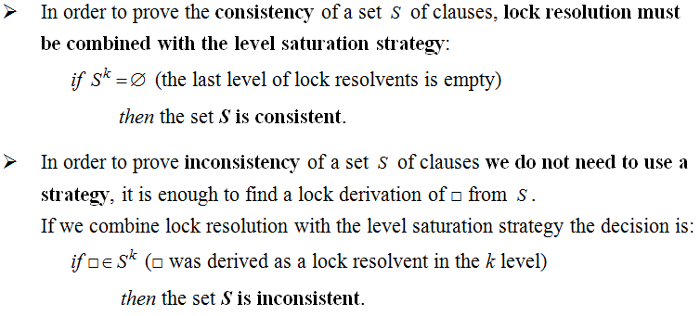
REMARKS

Slide 19
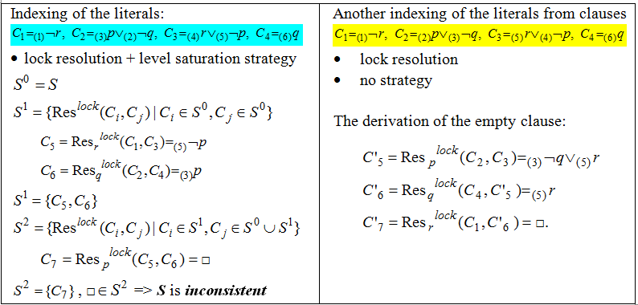
EXAMPLE 4

Slide 20
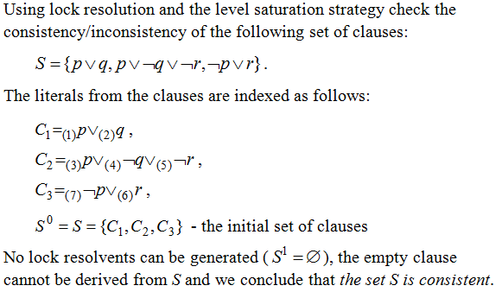
EXAMPLE 5

Slide 21
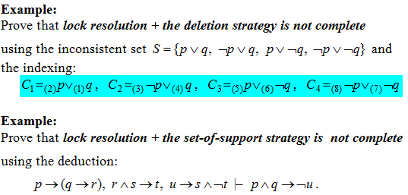
EXAMPLES (HOMEWORK)

Slide 22
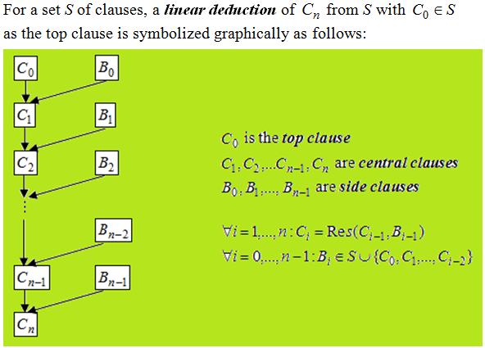
LINEAR RESOLUTION (LOVELAND 1971)

Slide 23
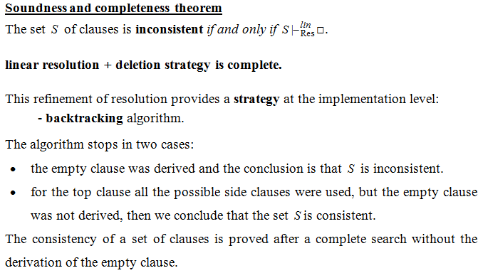
Linear Resolution- THEORETICAL RESULTS

Slide 24
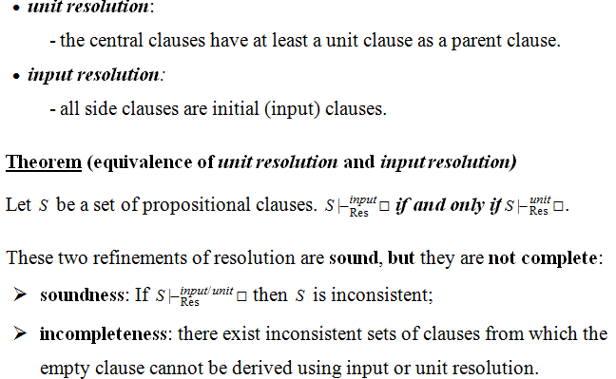
SPECIAL CASES OF LINEAR RESOLUTION

Slide 25
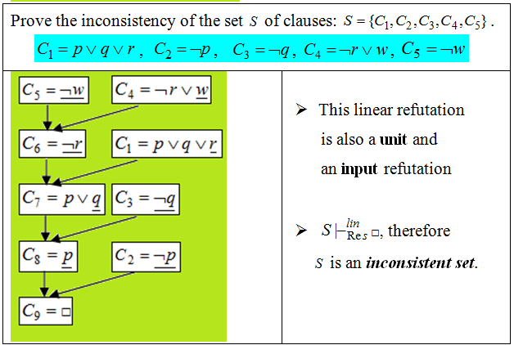
EXAMPLE 6

