Slide 1
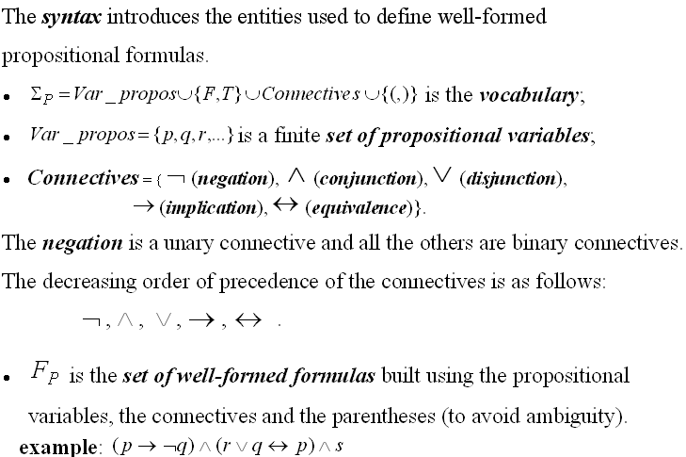
PROPOSITIONAL LOGIC
- SYNTAX-

Slide 2
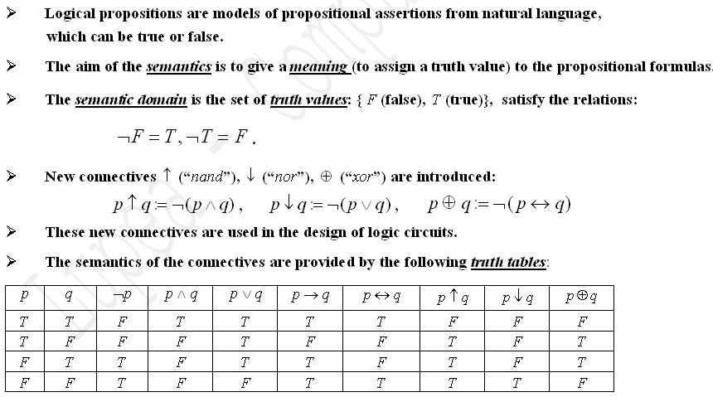
Semantics of propositional logic

Slide 3
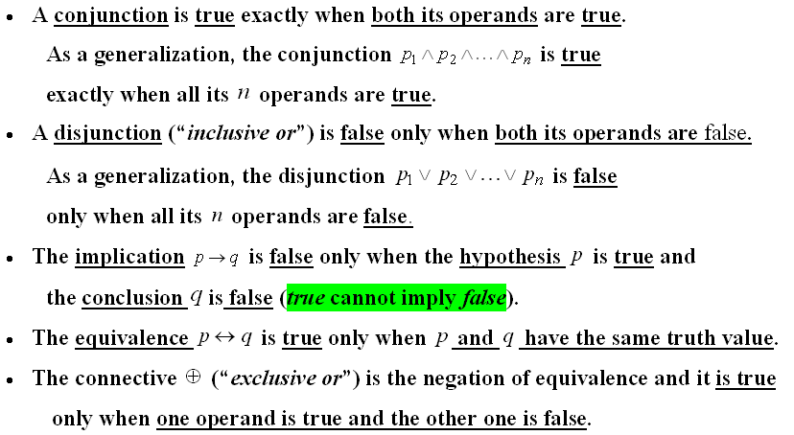
Truth tables

Slide 4
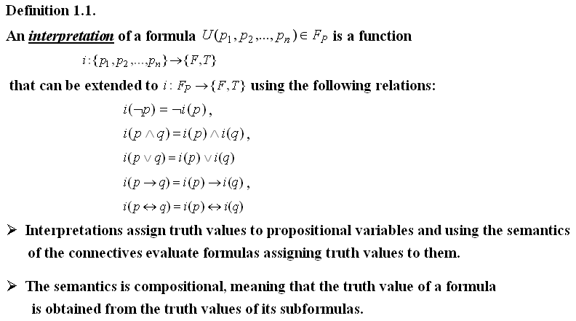
Interpretation of a propositional formula

Slide 5
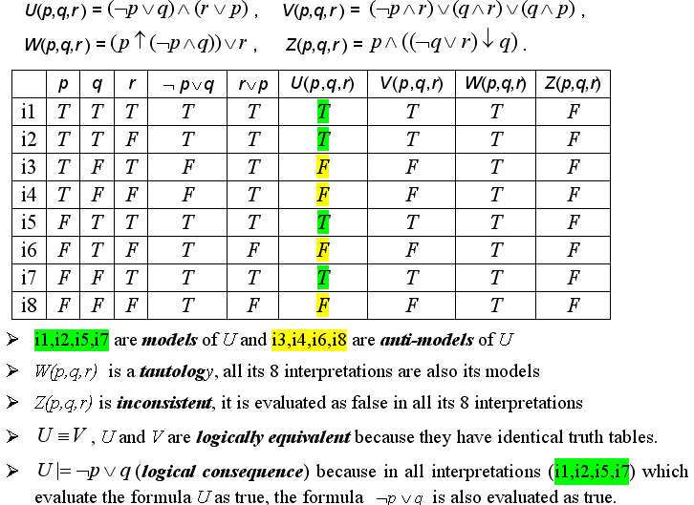
Example 1
Build the truth tables of the formulas:

Slide 6
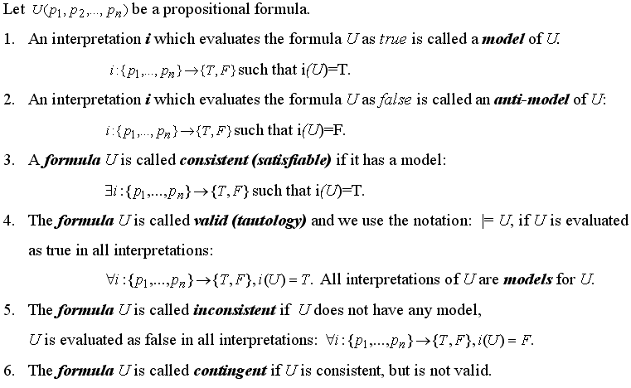
Semantic concepts

Slide 7
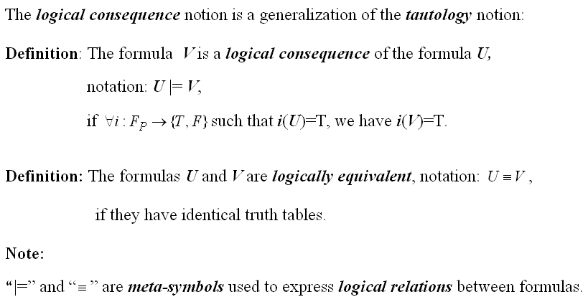
Semantic concepts (contd.)

Slide 8
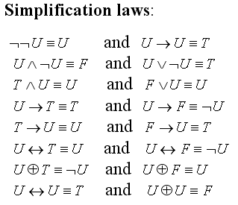
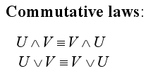
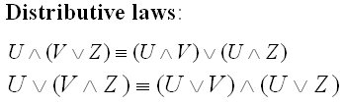
Logical equivalences

Slide 9
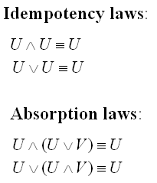
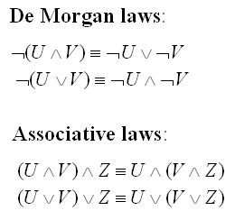
Logical equivalences (contd.)

Slide 10
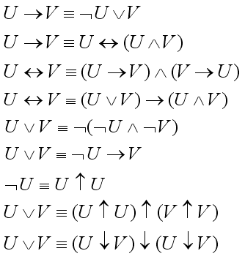
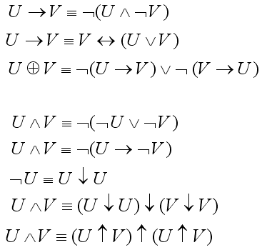
Logical equivalences (contd.)
--- Definitions of the connectives ---

Slide 11
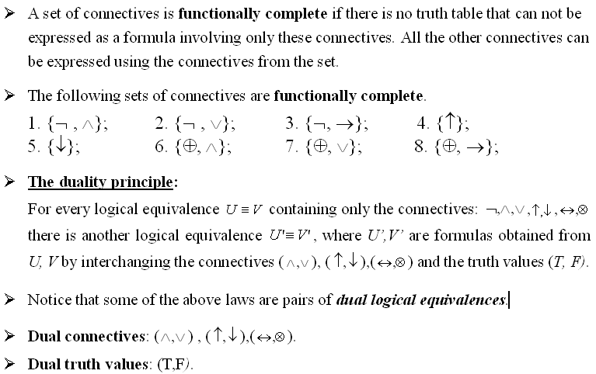

Slide 12
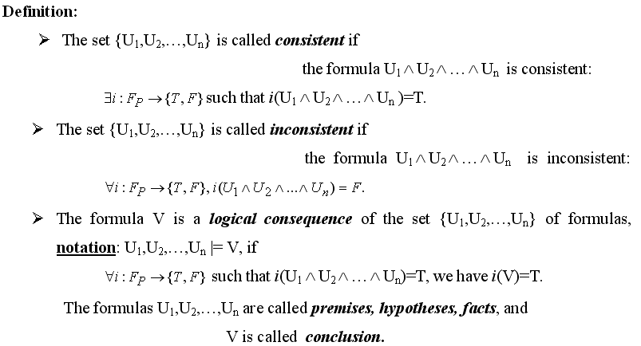
Sets of propositional formulas

Slide 13
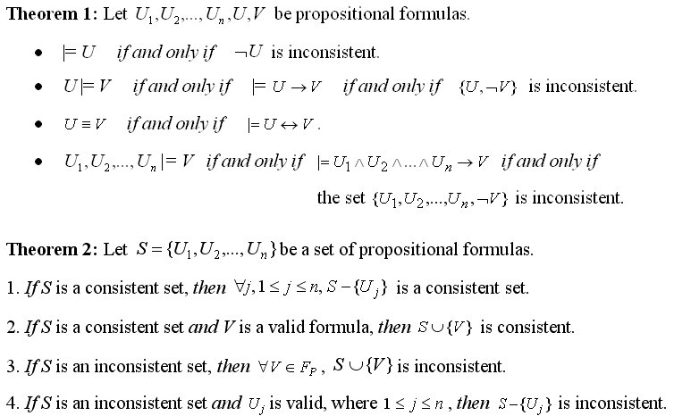
Theorems (semantic results)

Slide 14
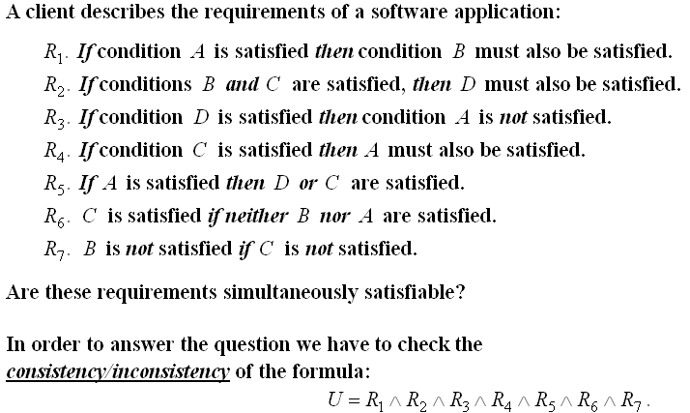
Example

Slide 15
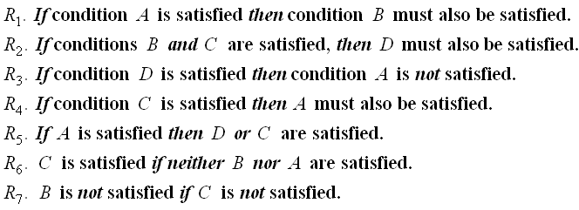
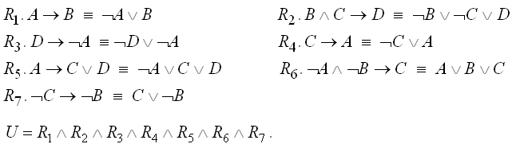
Example (contd.)

Slide 16
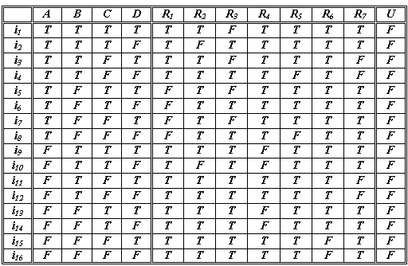
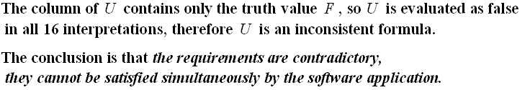
Example (contd.) – Truth table

Slide 17




Stylistic variants in English for logical connectives
A and B Both A and B A, but B A, although B A as well as B A, B A, also B | A or B Either A or B A unless B | If A, then B If A, B A is a sufficient condition for B A is sufficient for B In case A, B Provided that A, then B B provided that A B only on the condition that A B is necessary for A B if A | A if and only if B A is equivalent to B A is necessary and sufficient for B A just in case B

Slide 18




Normal forms - definitions
A literal is a propositional variable or its negation.
A clause is a disjunction of a finite number of literals.
A cube is a conjunction of a finite number of literals.
A formula is in disjunctive normal form (DNF), if it is written as a disjunction of cubes:
A formula is in conjunctive normal form (CNF), if it is written as a conjunction of clauses:

Slide 19
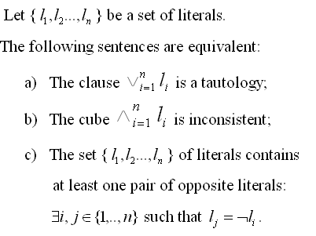
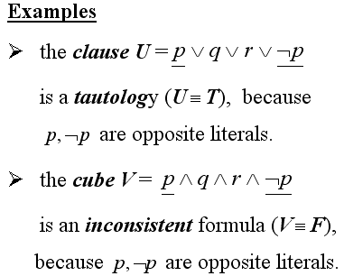
Property

Slide 20
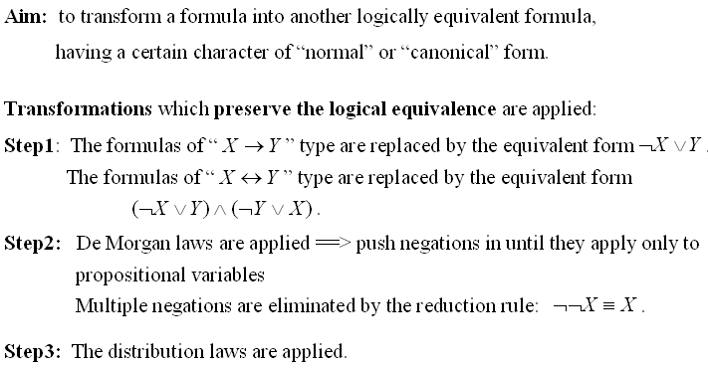
Normalization algorithm

Slide 21
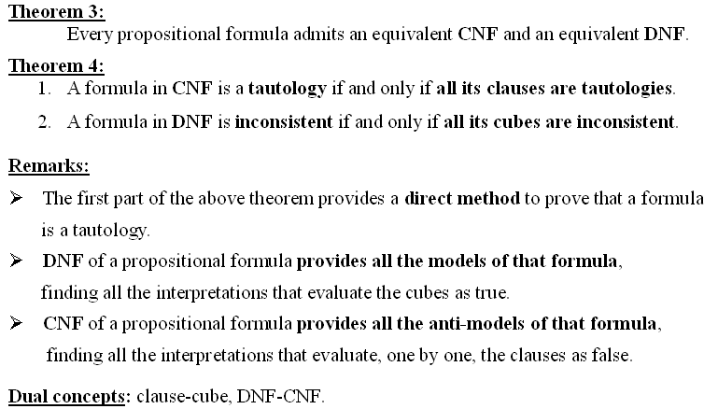
Normal forms - theorems

Slide 22
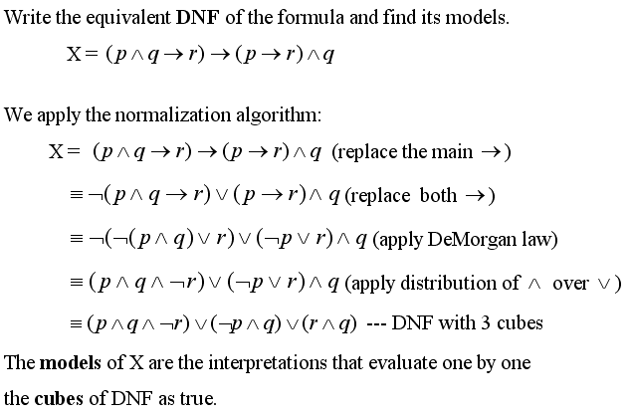
Example

Slide 23
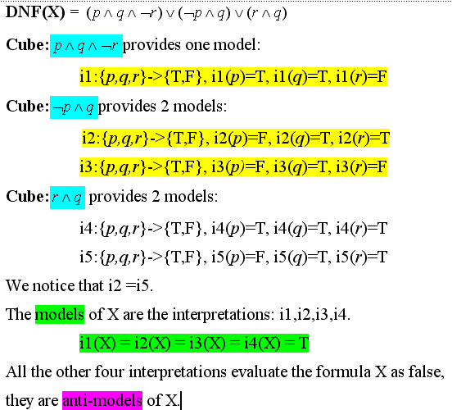
Example – models of a formula

