Slide 1
FIRST-ORDER (PREDICATE) LOGIC

Slide 2
TRANSFORMATION OF NATURAL LANGUAGE SENTENCES
INTO PREDICATE FORMULAS
All Computer Science (CS) students are smart.
There is someone who studies at Babes-Bolyai University (BBU) and is smart.
If x and y are nonnegative integers and x is greater than y, then x² is greater than y² .
In a plane if a line x is parallel to a constant line d then all the lines perpendicular to x are also perpendicular to d.
Every child loves anyone who gives the child any present.

Slide 3
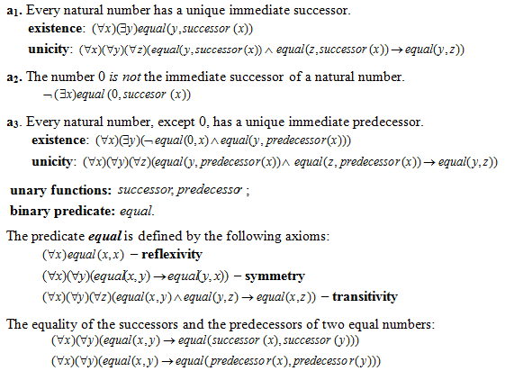
THE AXIOMS THAT DEFINE THE NATURAL NUMBERS

Slide 4
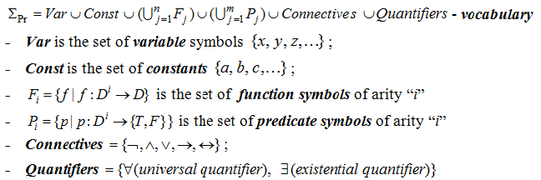
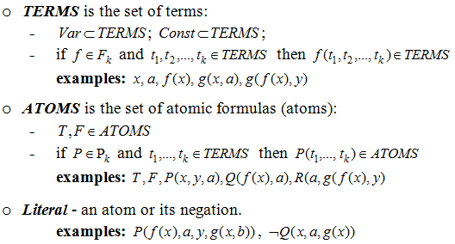
AXIOMATIC (FORMAL) SYSTEM OF PREDICATE LOGIC

Slide 5
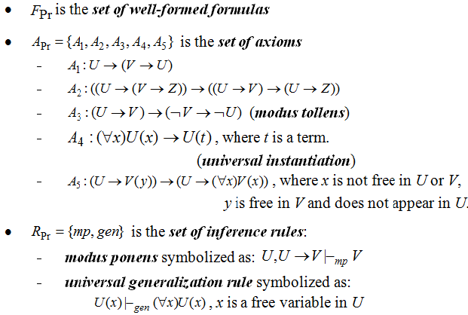
AXIOMATIC SYSTEM (CONTD.)

Slide 6
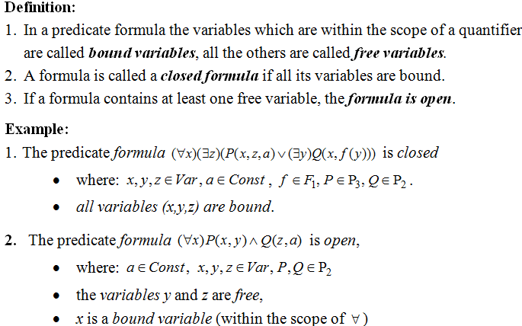
OPEN VERSUS CLOSED FORMULAS

Slide 7
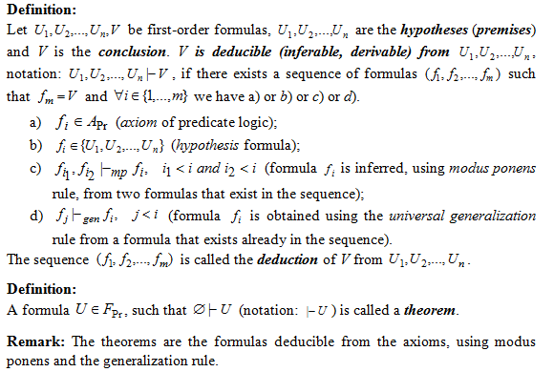
DEDUCTION IN FIRST-ORDER LOGIC

Slide 8
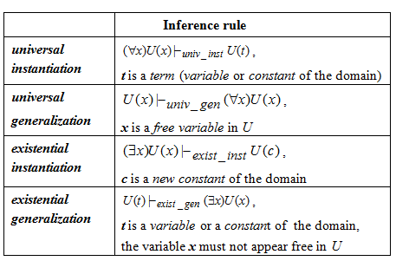
INFERENCE RULES IN FIRST-ORDER LOGIC

Slide 9
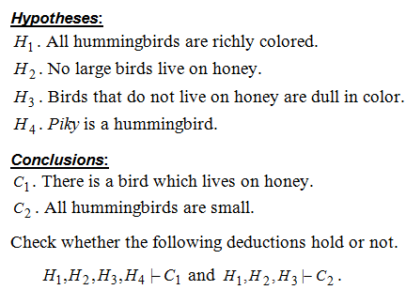
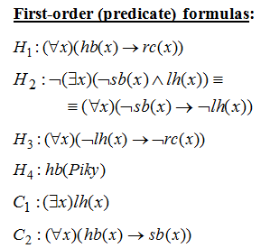
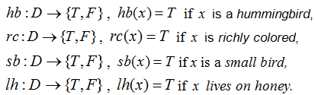

EXAMPLE 1 –MODELING REASONING

Slide 10
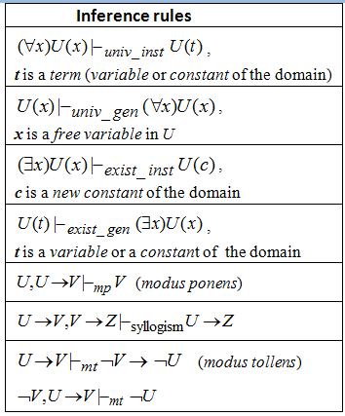
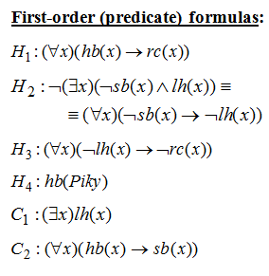
EXAMPLE 1 – BUILDING DEDUCTIONS (LECTURE)

Slide 11
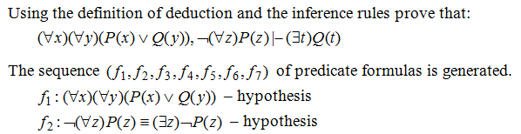
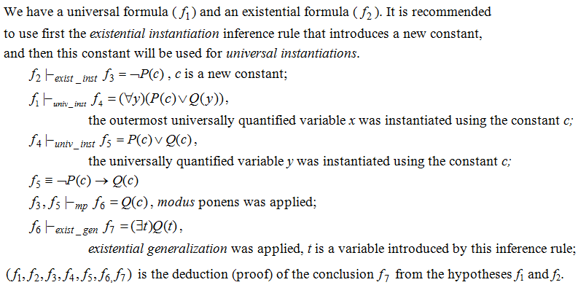
EXAMPLE 2

Slide 12
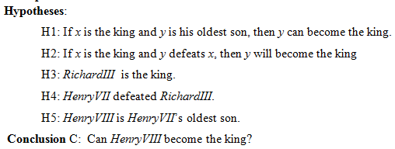
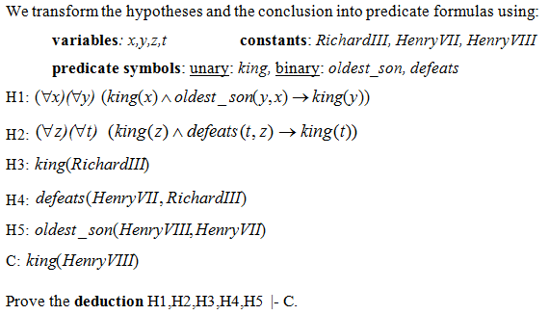
EXAMPLE 3 (HOMEWORK)
SUCCESSION TO THE BRITISH THRONE

Slide 13
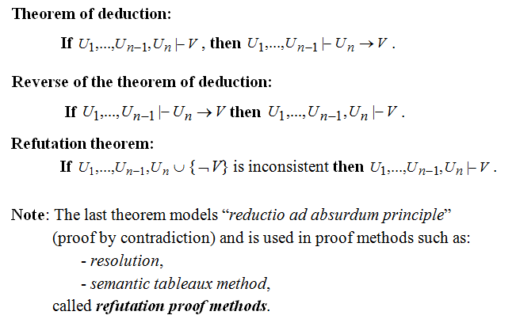
THEOREMS

Slide 14

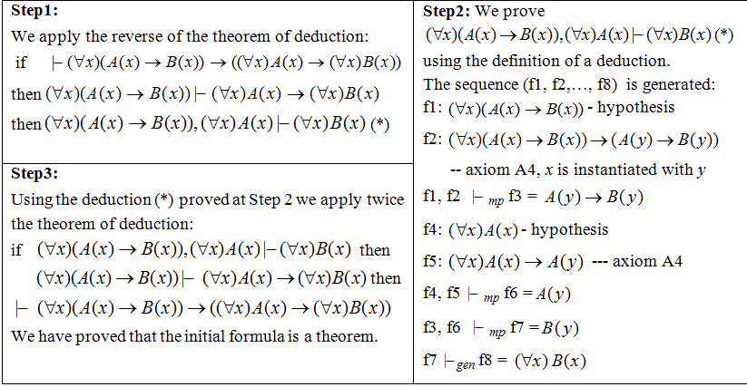

Slide 15
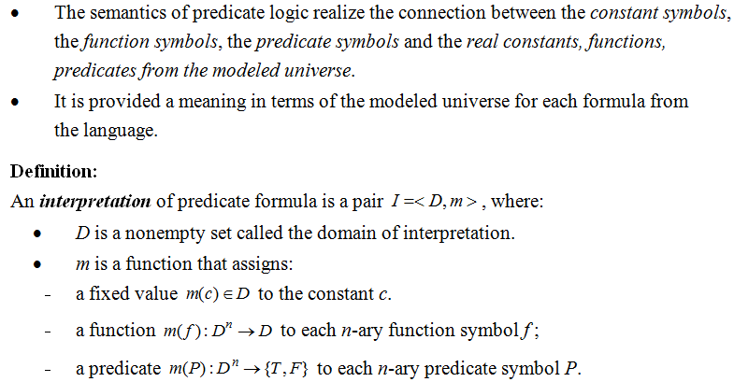
THE SEMANTICS OF FIRST-ORDER LOGIC

Slide 16
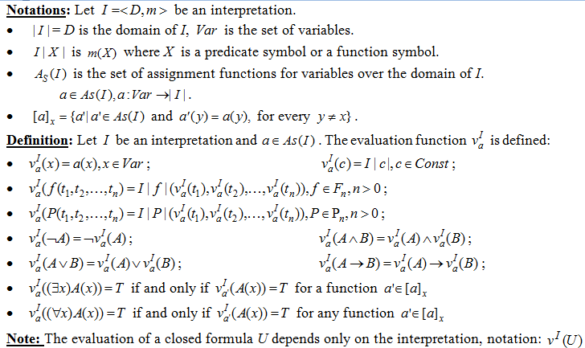

Slide 17
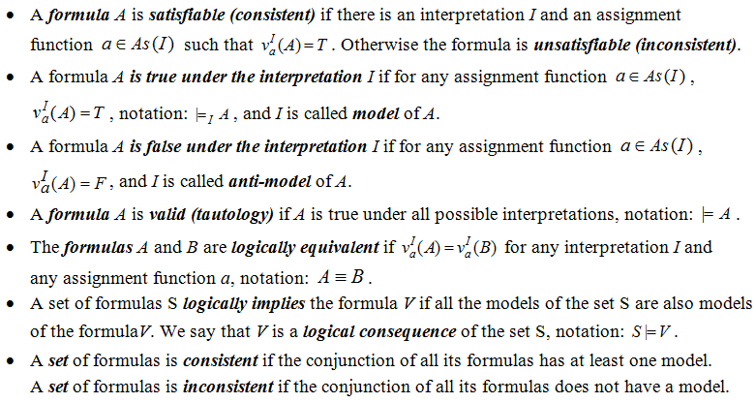
DEFINITIONS (SEMANTIC CONCEPTS)

Slide 18
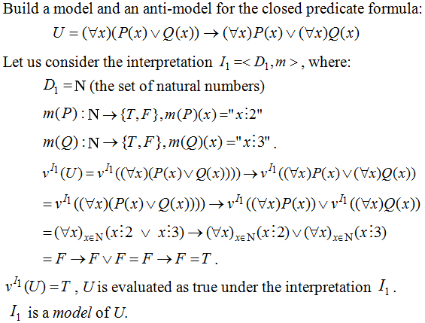
EXAMPLE 5

Slide 19
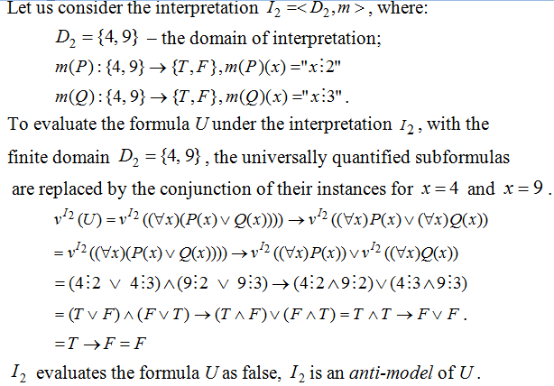
EXAMPLE 5 (CONTD.)

Slide 20
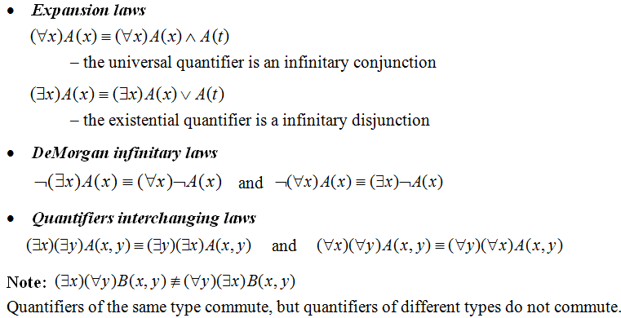
LOGICAL EQUIVALENCES IN PREDICATE LOGIC

Slide 21

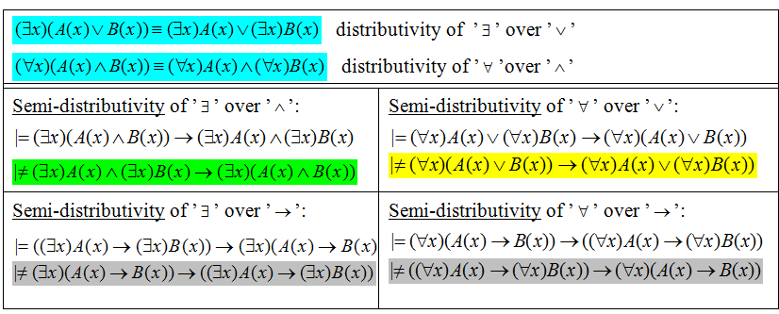

Slide 22
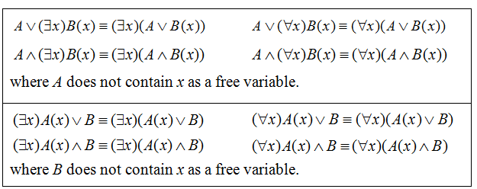
EXTRACTION OF QUANTIFIERS
IN FRONT OF THE FORMULA

Slide 23
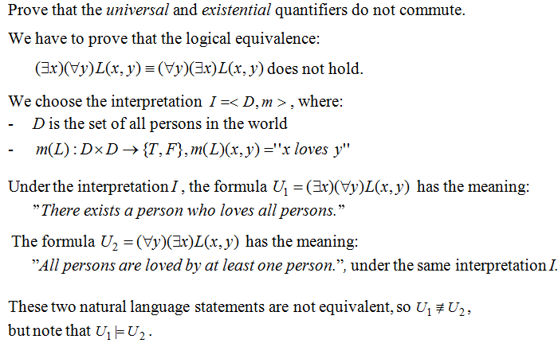
EXAMPLE 6

Slide 24
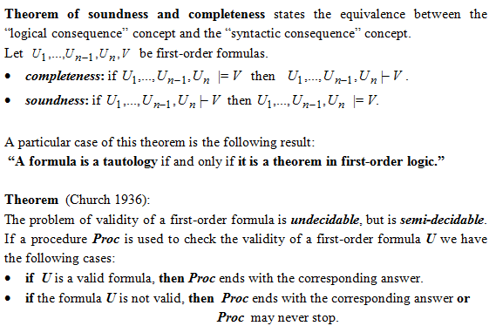
PROPERTIES OF FIRST-ORDER LOGIC:
SOUNDNESS, COMPLETENESS, SEMI-DECIDABILITY

