Slide 1
Cleopatra
Κλεοπᾰ́τρᾱ Φιλοπάτωρ

Slide 2
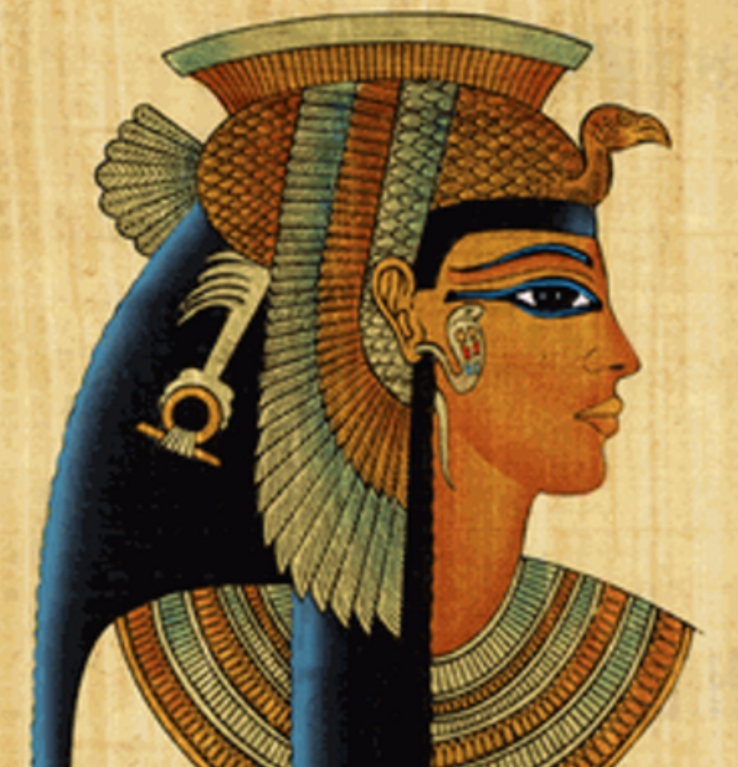
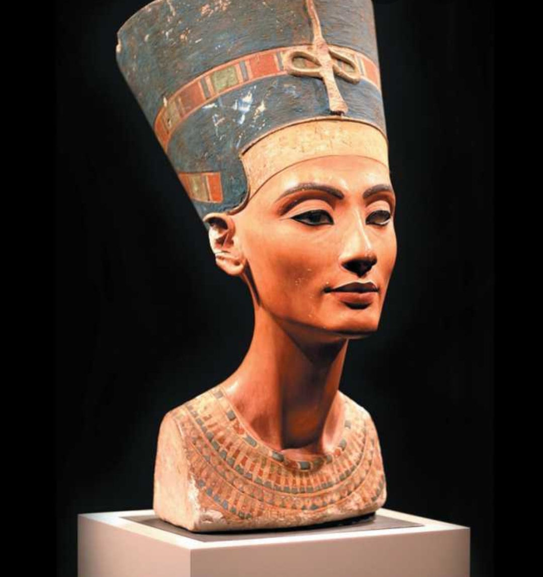
Who was she?

Slide 3
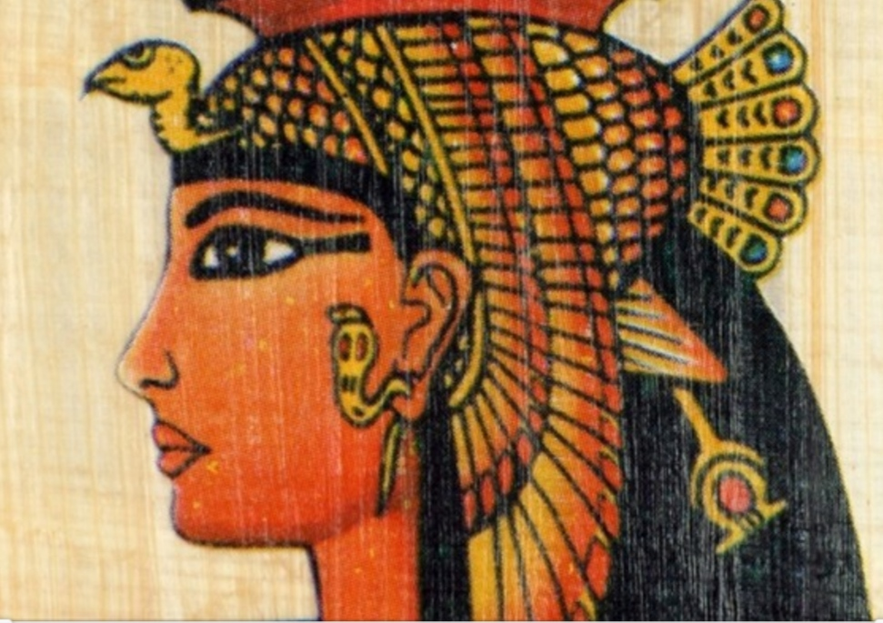
Early childhood

Slide 4
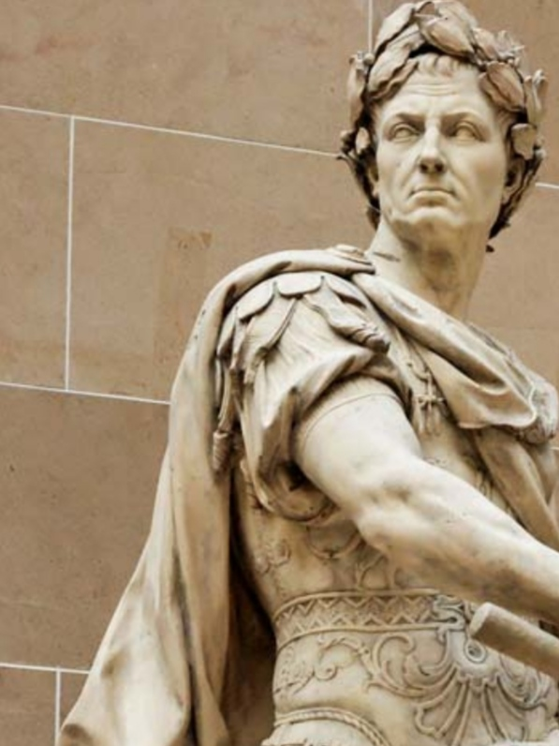
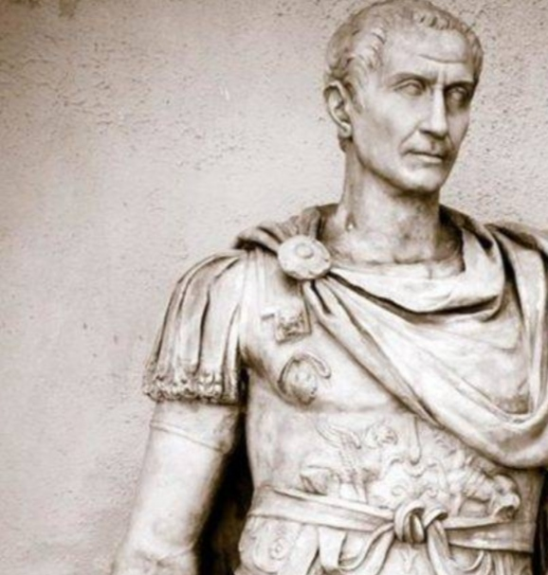
Conflict with Ptolemy and Relationship with Julius Caesar

Slide 5
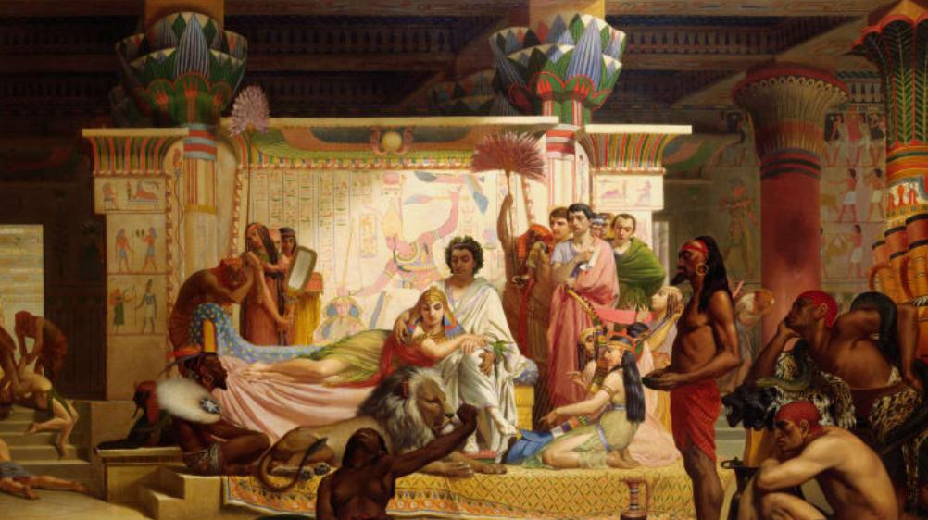
Cleopatra and Mark Anthony

Slide 6
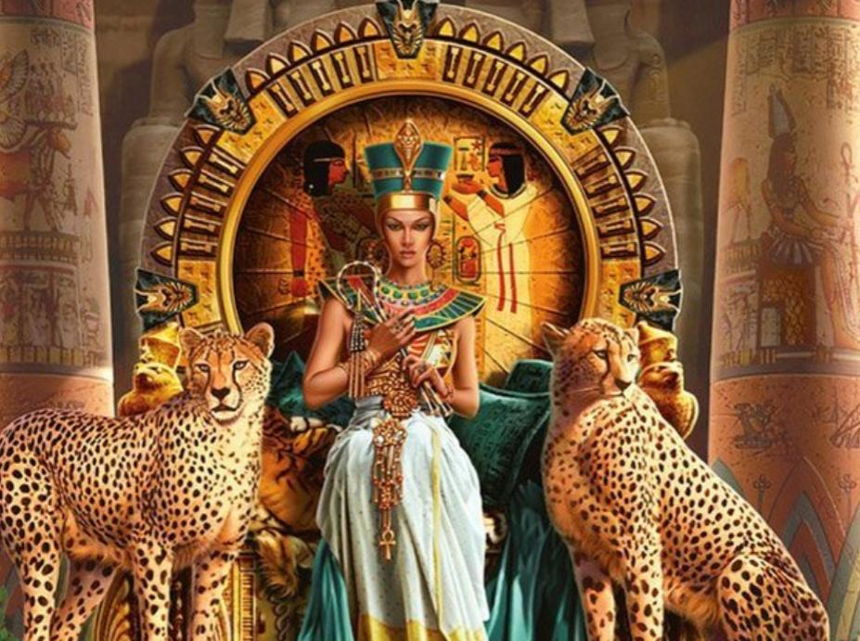

Slide 7
Questions
Who rebelled against Cleopatra?
What did Cleopatra build to meet Mark Anthony?
How did Cleopatra and Mark Anthony die?
How long did Egypt’s independence last?

