Slide 1
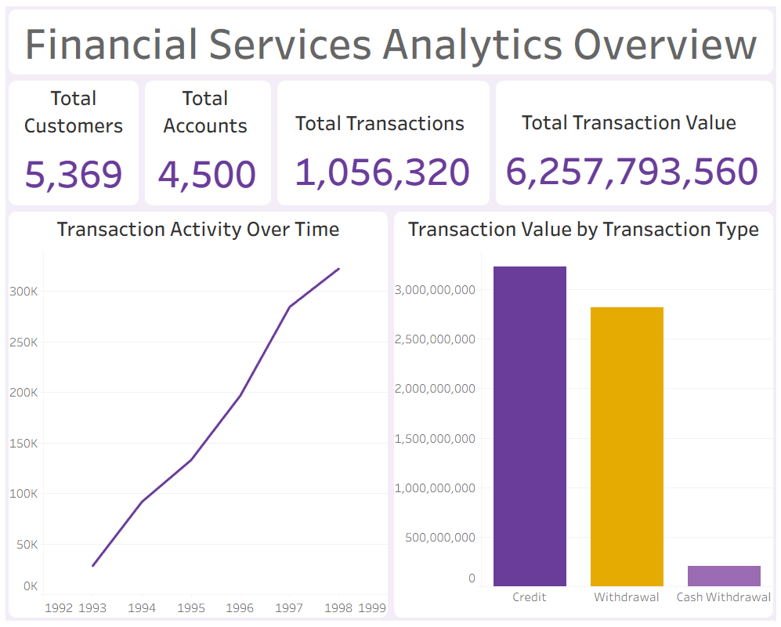

Slide 2




End – to end Data Analytics project using Python, PostgreSQL, Excel, Tableau & Power BI
Customer Insights • Transaction Performance • Risk Indicators
Presented by: Tzanakaki Alexandra
Data Analyst Portfolio | 2026

Slide 3
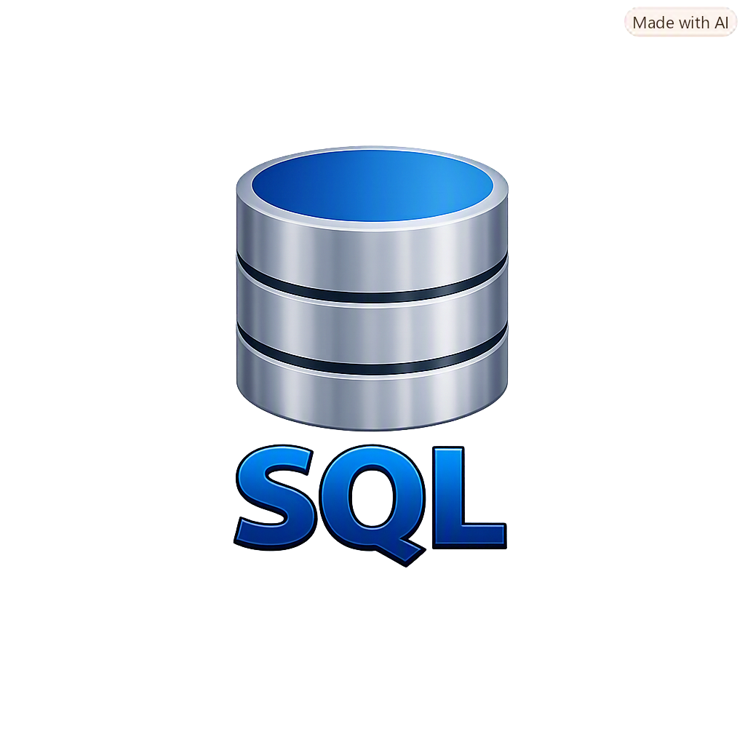
Understanding Customer Behaviour and Financial Activity
End – to end Data Analytics project using Python, PostgreSQL, Excel, Tableau & Power BI
Key business questions
Customer Insights • Transaction Performance • Risk Indicators
Who are the customers and how are they distributed across demographic groups?
Presented by: Tzanakaki Alexandra
Data Analyst Portfolio | 2026
How do transaction volumes and values vary over time?
How are accounts and financial products used?
How transactions exhibit patterns that may require further investigation?

Slide 4
Understanding Customer Behaviour and Financial Activity
Key business questions
Who are the customers and how are they distributed across demographic groups?
How do transaction volumes and values vary over time?
How are accounts and financial products used?
How transactions exhibit patterns that may require further investigation?

Slide 5
Understanding Customer Behaviour and Financial Activity
Key business questions
Who are the customers and how are they distributed across demographic groups?
How do transaction volumes and values vary over time?
How are accounts and financial products used?
How transactions exhibit patterns that may require further investigation?

Slide 6
Understanding Customer Behaviour and Financial Activity
Key business questions
Who are the customers and how are they distributed across demographic groups?
How do transaction volumes and values vary over time?
How are accounts and financial products used?
How transactions exhibit patterns that may require further investigation?

Slide 7
Understanding Customer Behaviour and Financial Activity
Key business questions
Who are the customers and how are they distributed across demographic groups?
How do transaction volumes and values vary over time?
How are accounts and financial products used?
How transactions exhibit patterns that may require further investigation?

Slide 8
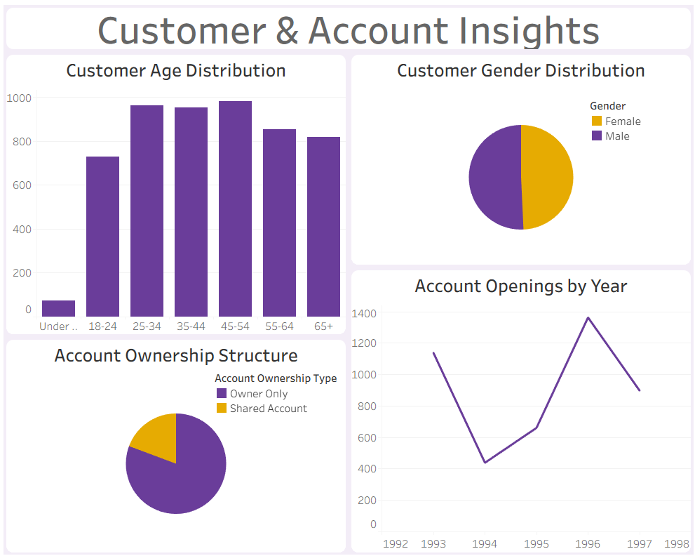
Understanding Customer Behaviour and Financial Activity
From raw data to business insights
Objectives
Key business questions
Who are the customers and how are they distributed across demographic groups?
How do transaction volumes and values vary over time?
How are accounts and financial products used?
How transactions exhibit patterns that may require further investigation?

Slide 9
From raw data to business insights
Objectives
Understand the structure and quality of the source data

Slide 10
Clean, transform and integrate multiple related datasets

Slide 11
Analyse customer demographics and account characteristics

Slide 12
Evaluate transaction activity and financial transaction values

Slide 13
Explore loan and card portfolios

Slide 14
Identify unusual transaction patterns using analytical risk indicators

Slide 15
Develop interactive dashboards to communicate findings

Slide 16
Translate analytical results into practical business recommendations

Slide 17
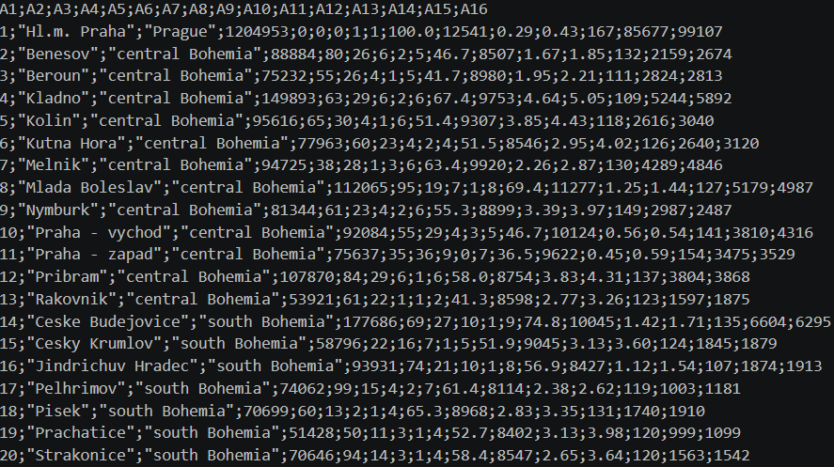
Dataset Overview: A historical financial services dataset
The analysis uses the PKDD ‘99 Czech Bank Dataset, a historical dataset containing financial and customer records from the Czech Republic
Historical period: 1993 - 1998
Customers: 5,369
Accounts: 4,500
Transactions: 1,056,320
Loans: 682
Payment cards: 892
Districts: 77

Slide 18
Dataset Overview: A historical financial services dataset
The analysis uses the PKDD ‘99 Czech Bank Dataset, a historical dataset containing financial and customer records from the Czech Republic
Additional data
Account ownership relationships
Standing orders
Account - opening dates
Transaction categories
Loan characteristics
District – level socioeconomic information

Slide 19
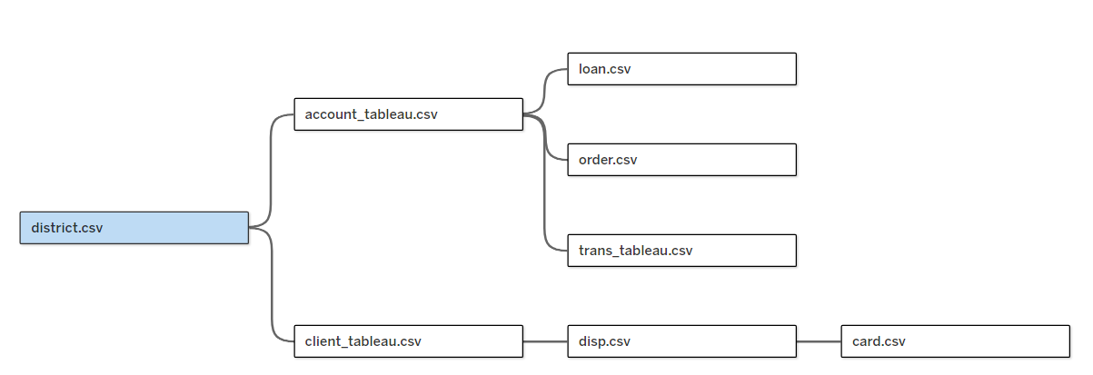
Data architecture
Account
Disposition
Dataset Overview: A historical financial services dataset
Transaction
The analysis uses the PKDD ‘99 Czech Bank Dataset, a historical dataset containing financial and customer records from the Czech Republic
District
Order
Card
Connecting multiple sources into an analytical model
Account ownership relationships
Account - opening dates
Transaction categories
District – level socioeconomic information
Additional data
Standing orders
Loan characteristics

Slide 20
Client
Account
Disposition
Transaction
District
Order
Card
Loan

Slide 21
Key relationships
Client
Account
Disposition
Transaction
Clients are linked to accounts through disposition records
Accounts are linked to transactions, loans and standing orders
Cards are linked to disposition records
Clients are linked to district – level information
District
Order
Card
Loan

Slide 22
Key relationships
Clients are linked to accounts through disposition records
Accounts are linked to transactions, loans and standing orders
Cards are linked to disposition records
Clients are linked to district – level information

Slide 23
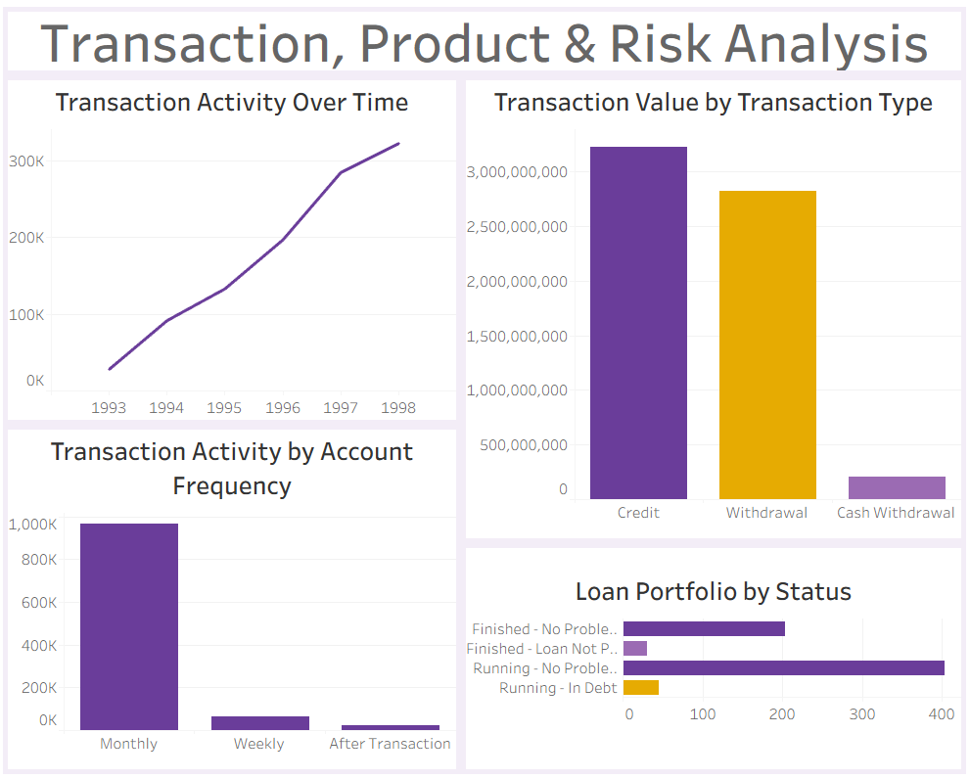
Key relationships
Created consistent analytical categories for reporting and visualization
The preparation stage ensured that the datasets could be used consistently across Python, PostgreSQL, Excel, Tableau and Power BI
Data preparation & quality: Building a reliable analytical foundation
Validated key relationships and record counts
Integrated customer, account, transaction, product and district data
Standardised date and numeric data types
Translated selected transaction, account frequency and loan status labels into English
Reviewed missing values in optional transaction and order attributes
Inspected table structures, column types, missing values and record counts
Clients are linked to accounts through disposition records
Accounts are linked to transactions, loans and standing orders
Cards are linked to disposition records
Clients are linked to district – level information

Slide 24
Data preparation & quality: Building a reliable analytical foundation
Created consistent analytical categories for reporting and visualization
The preparation stage ensured that the datasets could be used consistently across Python, PostgreSQL, Excel, Tableau and Power BI
Validated key relationships and record counts
Inspected table structures, column types, missing values and record counts
Integrated customer, account, transaction, product and district data
Standardised date and numeric data types
Translated selected transaction, account frequency and loan status labels into English
Reviewed missing values in optional transaction and order attributes

Slide 25
Inspected table structures, column types, missing values and record counts
Created consistent analytical categories for reporting and visualization
The preparation stage ensured that the datasets could be used consistently across Python, PostgreSQL, Excel, Tableau and Power BI
Validated key relationships and record counts
Standardised date and numeric data types
Integrated customer, account, transaction, product and district data
Translated selected transaction, account frequency and loan status labels into English
Reviewed missing values in optional transaction and order attributes

Slide 26
Standardised date and numeric data types
Created consistent analytical categories for reporting and visualization
The preparation stage ensured that the datasets could be used consistently across Python, PostgreSQL, Excel, Tableau and Power BI
Validated key relationships and record counts
Translated selected transaction, account frequency and loan status labels into English
Integrated customer, account, transaction, product and district data
Reviewed missing values in optional transaction and order attributes

Slide 27
Translated selected transaction, account frequency and loan status labels into English
Created consistent analytical categories for reporting and visualization
The preparation stage ensured that the datasets could be used consistently across Python, PostgreSQL, Excel, Tableau and Power BI
Validated key relationships and record counts
Reviewed missing values in optional transaction and order attributes
Integrated customer, account, transaction, product and district data

Slide 28
Reviewed missing values in optional transaction and order attributes
Created consistent analytical categories for reporting and visualization
The preparation stage ensured that the datasets could be used consistently across Python, PostgreSQL, Excel, Tableau and Power BI
Validated key relationships and record counts
Integrated customer, account, transaction, product and district data

Slide 29
Integrated customer, account, transaction, product and district data
Created consistent analytical categories for reporting and visualization
The preparation stage ensured that the datasets could be used consistently across Python, PostgreSQL, Excel, Tableau and Power BI
Validated key relationships and record counts

Slide 30
Validated key relationships and record counts
The preparation stage ensured that the datasets could be used consistently across Python, PostgreSQL, Excel, Tableau and Power BI
Created consistent analytical categories for reporting and visualization

Slide 31
Created consistent analytical categories for reporting and visualization
The preparation stage ensured that the datasets could be used consistently across Python, PostgreSQL, Excel, Tableau and Power BI

Slide 32
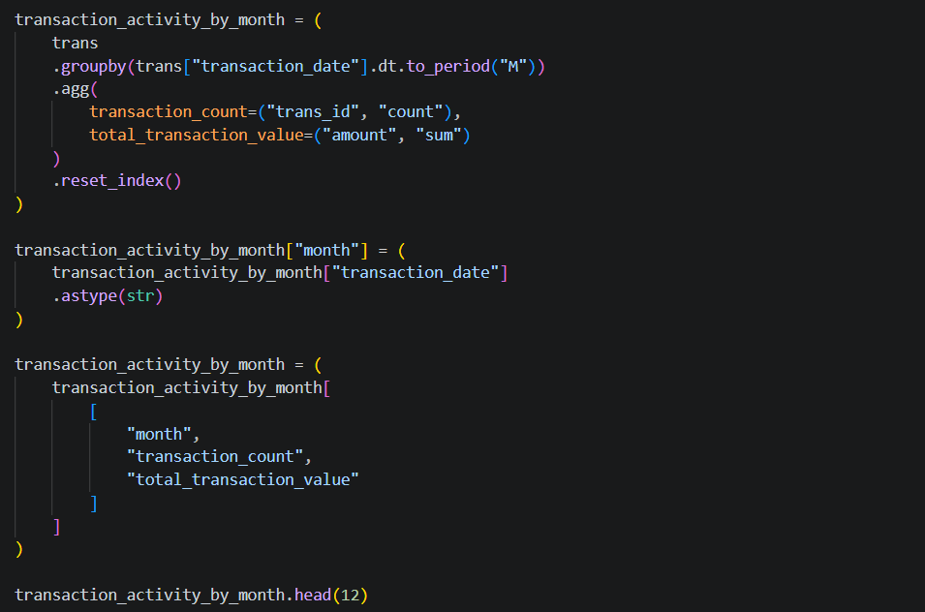
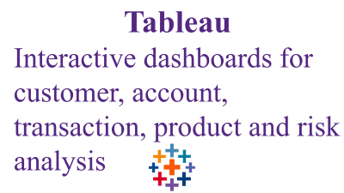
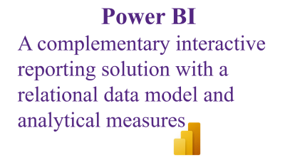
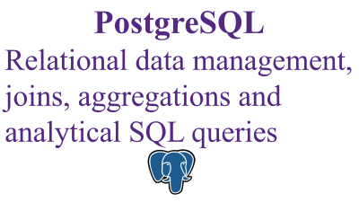
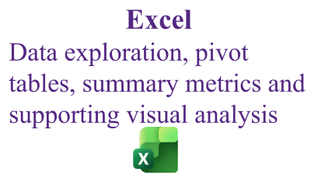




The preparation stage ensured that the datasets could be used consistently across Python, PostgreSQL, Excel, Tableau and Power BI
Analytical methodology: A multi – tool analytics workflow

Slide 33
Python
Initial data understanding, quality checks, exploratory analysis and preparation

Slide 34
PostgreSQL
Relational data management, joins, aggregations and analytical SQL queries

Slide 35
Excel
Data exploration, pivot tables, summary metrics and supporting visual analysis

Slide 36
Tableau
Interactive dashboards for customer, account, transaction, product and risk analysis

Slide 37
Power BI
A complementary interactive reporting solution with a relational data model and analytical measures

Slide 38
Customer demographics: Understanding the Customer Base
The dataset contains 5,369 customers, with a nearly balanced gender distribution and age groups ranging from under 18 to 65 and above.

Slide 39
Account portfolio & ownership: Understanding account structure and growth
The dataset contains 4,500 accounts with different statement and fee frequencies
Key observation: Account openings varied considerably across the observed years, with the highest annual total occurring in 1996.

Slide 40
Transaction performance: Measuring financial activity
The transaction dataset contains 1,056,320 records covering 1993 - 1998
The total recorded transaction value is approximately 6.26 billion in the dataset’s original monetary units
Key observation: Transaction activity increased across the observed years, reaching 322,277 transactions in 1998.

Slide 41
Transaction patterns & account usage: Exploring how accounts are used
The analysis compares transaction activity and value across account - frequency categories
Transaction records are also examined by transaction type, operation and transaction - purpose category.

Slide 42
Loan & card portfolio: Reviewing financial product usage
The dataset includes 682 loans and 892 payment cards
Loan - status and card - type distributions provide a starting point for portfolio monitoring and product analysis.

Slide 43
Risk & anomaly indicators: Identifying transactions for further investigation
The project uses rule - based indicators to flag unusual transaction patterns that may warrant further review
Important limitation: A negative balance or a large transaction does not, by itself, establish fraudulent activity. The indicators are analytical flags, not confirmed fraud cases.

Slide 44
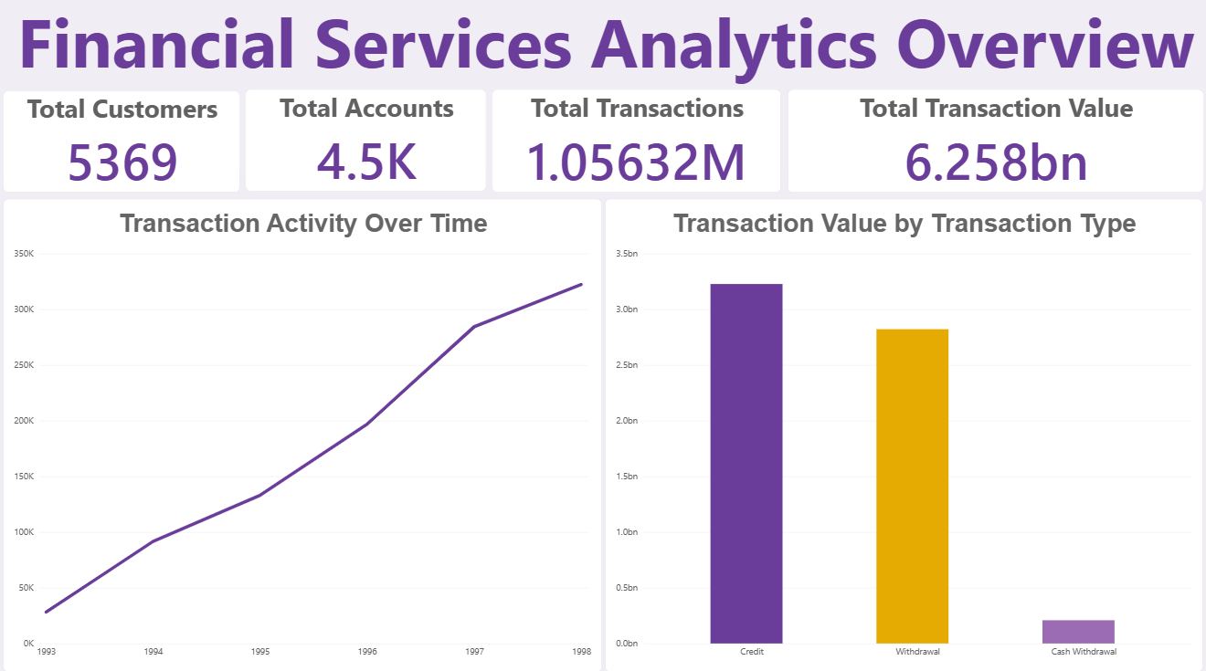
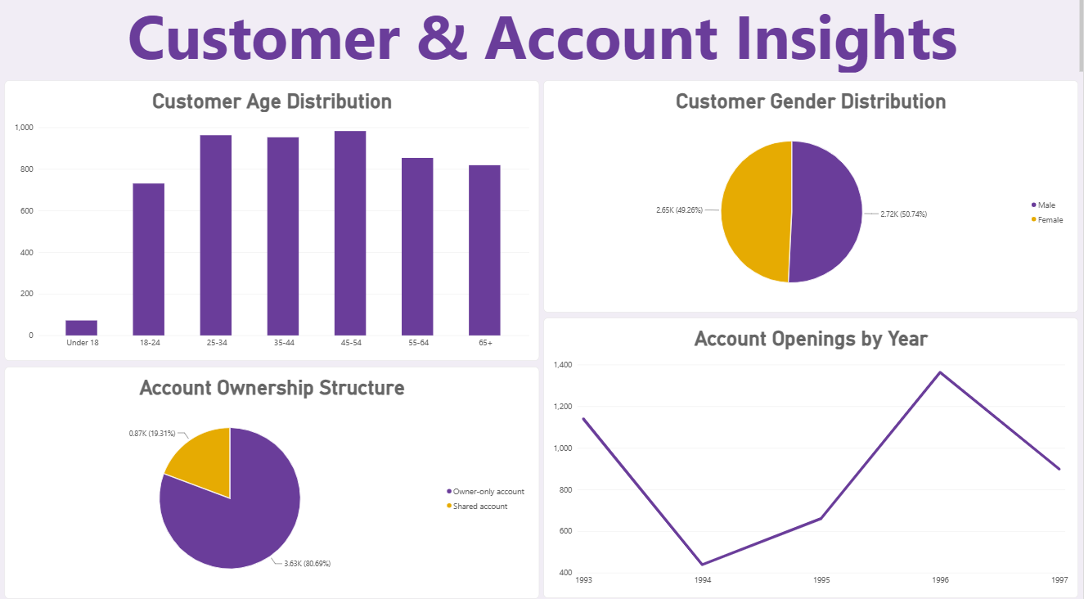
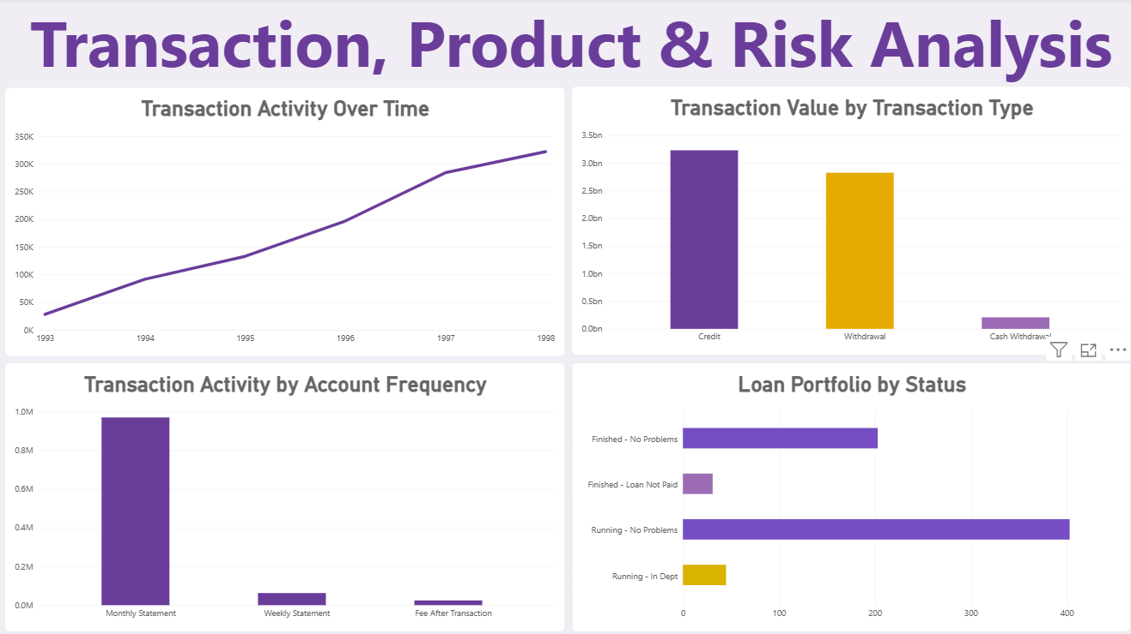
Dashboards and business recommendations: Turning analysis into action through interactive Tableau & Power BI dashboards
Financial Services Analytics Overview
Customer & Account Insights
Transaction, Product & Risk Analysis

Slide 45
Dashboards and business recommendations: Turning analysis into action through interactive Tableau & Power BI dashboards
Financial Services Analytics Overview
Customer & Account Insights
Transaction, Product & Risk Analysis

Slide 46
Dashboards and business recommendations: Turning analysis into action through interactive Tableau & Power BI dashboards
Customer & Account Insights
Financial Services Analytics Overview
Transaction, Product & Risk Analysis

Slide 47
Dashboards and business recommendations: Turning analysis into action through interactive Tableau & Power BI dashboards
Transaction, Product & Risk Analysis
Financial Services Analytics Overview
Customer & Account Insights

Slide 48
Dashboards and business recommendations: Turning analysis into action through interactive Tableau & Power BI dashboards
Transaction, Product & Risk Analysis
Key conclusions & findings
Financial Services Analytics Overview
Customer & Account Insights

Slide 49
Key conclusions & findings
2,724 male customers
2,645 female customers

Slide 50
Key conclusions & findings
2,724 male customers
2,645 female customers
4,500 accounts
3,631 owner - only
869 shared accounts

Slide 51
Key conclusions & findings
2,724 male customers
2,645 female customers
1.05 million transactions
4,500 accounts
3,631 owner - only
869 shared accounts

Slide 52
Key conclusions & findings
2,724 male customers
2,645 female customers
1.05 million transactions
4,500 accounts
3,631 owner - only
869 shared accounts
1,363 new accounts in 1996

Slide 53
Key conclusions & findings
2,724 male customers
2,645 female customers
682 recorded loans
403 running with no issues
203 finished with no issues
1.05 million transactions
4,500 accounts
3,631 owner - only
869 shared accounts
1,363 new accounts in 1996

Slide 54
Key conclusions & findings
2,724 male customers
2,645 female customers
682 recorded loans
403 running with no issues
203 finished with no issues
1.05 million transactions
4,500 accounts
3,631 owner - only
869 shared accounts
2,999 transactions with negative balances
10,564 large transactions
1,363 new accounts in 1996

Slide 55
Key conclusions & findings
2,724 male customers
2,645 female customers
682 recorded loans
403 running with no issues
203 finished with no issues
1.05 million transactions
Possible next steps
4,500 accounts
3,631 owner - only
869 shared accounts
2,999 transactions with negative balances
10,564 large transactions
1,363 new accounts in 1996

Slide 56
Key conclusions & findings
Monitor transaction activity and values over time to identify material changes
Monitor loan - status distributions as part of portfolio reporting
2,724 male customers
2,645 female customers
682 recorded loans
403 running with no issues
203 finished with no issues
1.05 million transactions
Investigate transactions flagged by risk indicators using additional context and appropriate review procedures
Use customer and age – group analysis to support customer segmentation
Possible next steps
4,500 accounts
3,631 owner - only
869 shared accounts
2,999 transactions with negative balances
10,564 large transactions
1,363 new accounts in 1996
Review account ownership and usage patterns when evaluating service needs
Maintain consistent data definitions and quality checks across reporting tools

Slide 57
Monitor transaction activity and values over time to identify material changes
Monitor loan - status distributions as part of portfolio reporting
Tzanakaki Alexandra
Data & Business Analyst
alexandratzanakakii@gmail.com
LinkedIn
Career objective:
Seeking full – time opportunities in Data & Business Analytics to leverage analytical skills and drive data-informed decisions
Project repository:
Explore the full data analysis, code, and insights on GitHub
Investigate transactions flagged by risk indicators using additional context and appropriate review procedures
Use customer and age – group analysis to support customer segmentation
Possible next steps
Thank you for your time!
Any questions?
Review account ownership and usage patterns when evaluating service needs
Maintain consistent data definitions and quality checks across reporting tools

