Slide 1
Boolean Algebra & Boolean Functions
Viorel alexandra
Group 917

Slide 2
Problem statement
Exercise 8
Using Moisil’s method simplify the following Boolean functions of 3 variables:
8. f₈(x₁,x₂,x₃)= m₀ ∨ m₃ ∨ m₄ ∨ m₆ ∨ m₇

Slide 3
Theoretical results
Moisil’s simplification method:
The initial Boolean function is transformed into its equivalent disjunctive canonical form (DCF).
The set of maximal monoms are calculated using one of the following methods: Veitch-Karnaugh diagrams or Quine’s method.
Moisil’s method uses propositional logic to obtain the simplified forms from the set of maximal monoms.
- The disjunctive canonical form (DCF) is the disjunction of the minterms corresponding to the values 1 of the function.

Slide 4
f₈(x₁,x₂,x₃)= m₀ ∨ m₃ ∨ m₄ ∨ m₆ ∨ m₇
f₈ is given in disjunctive canonical form (DCF)
Now, we need to find the support of f, and then the set of maximal monoms using Quine’s method.
The truth table of f₈
x₁ | x₂ | x₃ | f₈(x₁,x₂,x₃)
0 | 0 | 0 | 1
0 | 0 | 1 | 0
0 | 1 | 0 | 0
0 | 1 | 1 | 1
1 | 0 | 0 | 1
1 | 0 | 1 | 0
1 | 1 | 0 | 1
1 | 1 | 1 | 1
The support of f₈ is:
S_{f8} = {(0, 0, 0), (0, 1, 1), (1, 0, 0), (1, 1, 0), (1, 1, 1)}
The ascending order (with respect to the number of “1” values in each triple) of the elements of the support of f is:
S_{f8} = {(0, 0, 0), (1, 0, 0), (0, 1, 1), (1, 1, 0), (1, 1, 1)}

Slide 5
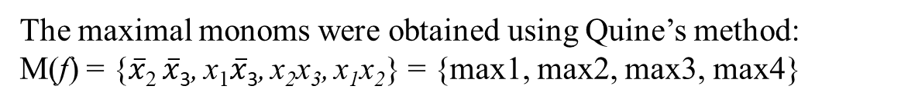
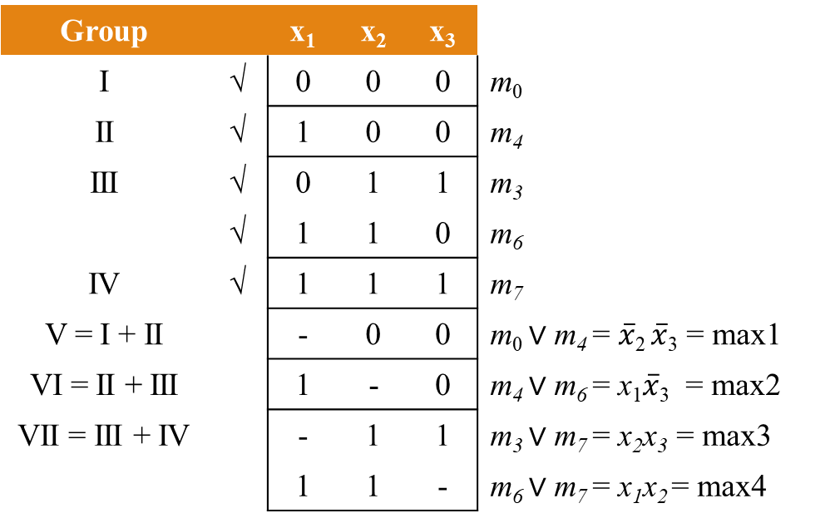
The factorization process:
S_{f8} = {(0, 0, 0), (1, 0, 0), (0, 1, 1), (1, 1, 0), (1, 1, 1)}
Group |  | x₁ | x₂ | x₃
I | √ | 0 | 0 | 0 | m₀
II | √ | 1 | 0 | 0 | m₄
III | √ | 0 | 1 | 1 | m₃
 | √ | 1 | 1 | 0 | m₆
IV | √ | 1 | 1 | 1 | m₇
V = I + II |  | - | 0 | 0 | m₀ ∨ m₄ = $\overline{x}$₂ $\overline{x}$₃ = max1
VI = II + III |  | 1 | - | 0 | m₄ ∨ m₆ = x₁$\overline{x}$₃ = max2
VII = III + IV |  | - | 1 | 1 | m₃ ∨ m₇ = x₂x₃ = max3
 |  | 1 | 1 | - | m₆ ∨ m₇ = x₁x₂ = max4
Representation
Simple factorizations
The maximal monoms were obtained using Quine’s method:
M(f) = {$\overline{x}$₂ $\overline{x}$₃, x₁$\overline{x}$₃, x₂x₃, x₁x₂} = {max1, max2, max3, max4}

Slide 6
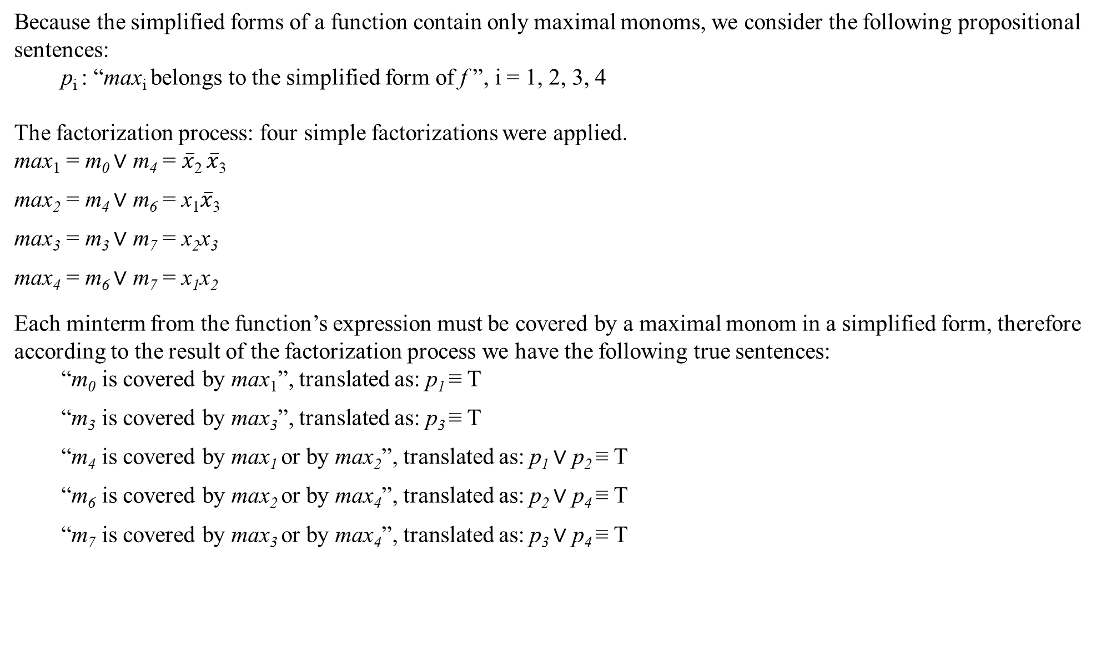
Because the simplified forms of a function contain only maximal monoms, we consider the following propositional sentences:
p_{i} : “max_{i} belongs to the simplified form of f ”, i = 1, 2, 3, 4
The factorization process: four simple factorizations were applied.
max₁ = m₀ ∨ m₄ = $\overline{x}$₂ $\overline{x}$₃
max₂ = m₄ ∨ m₆ = x₁$\overline{x}$₃
max₃ = m₃ ∨ m₇ = x₂x₃
max₄ = m₆ ∨ m₇ = x₁x₂
Each minterm from the function’s expression must be covered by a maximal monom in a simplified form, therefore according to the result of the factorization process we have the following true sentences:
“m₀ is covered by max₁”, translated as: p₁ ≡ T
“m₃ is covered by max₃”, translated as: p₃ ≡ T
“m₄ is covered by max₁ or by max₂”, translated as: p₁ ∨ p₂ ≡ T
“m₆ is covered by max₂ or by max₄”, translated as: p₂ ∨ p₄ ≡ T
“m₇ is covered by max₃ or by max₄”, translated as: p₃ ∨ p₄ ≡ T

Slide 7
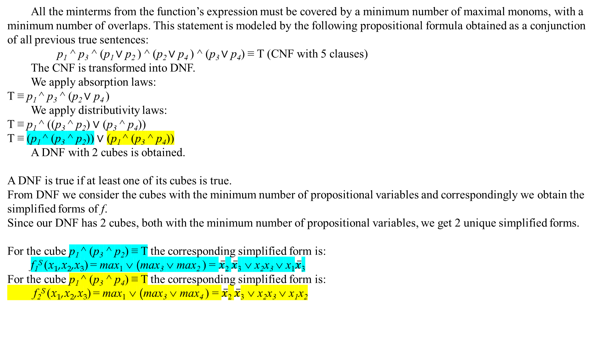
All the minterms from the function’s expression must be covered by a minimum number of maximal monoms, with a minimum number of overlaps. This statement is modeled by the following propositional formula obtained as a conjunction of all previous true sentences:
p₁ ^ p₃ ^ (p₁ ∨ p₂ ) ^ (p₂ ∨ p₄ ) ^ (p₃ ∨ p₄) ≡ T (CNF with 5 clauses)
The CNF is transformed into DNF.
We apply absorption laws:
T ≡ p₁ ^ p₃ ^ (p₂ ∨ p₄ )
We apply distributivity laws:
T ≡ p₁ ^ ((p₃ ^ p₂) ∨ (p₃ ^ p₄))
T ≡ (p₁ ^ (p₃ ^ p₂)) ∨ (p₁ ^ (p₃ ^ p₄))
A DNF with 2 cubes is obtained.
A DNF is true if at least one of its cubes is true.
From DNF we consider the cubes with the minimum number of propositional variables and correspondingly we obtain the simplified forms of f.
Since our DNF has 2 cubes, both with the minimum number of propositional variables, we get 2 unique simplified forms.
For the cube p₁ ^ (p₃ ^ p₂) ≡ T the corresponding simplified form is:
f₁^{S} (x₁,x₂,x₃) = max₁ ∨ (max₃ ∨ max₂ ) = $\overline{x}$₂ $\overline{x}$₃ ∨ x₂x₃ ∨ x₁$\overline{x}$₃
For the cube p₁ ^ (p₃ ^ p₄) ≡ T the corresponding simplified form is:
f₂^{S} (x₁,x₂,x₃) = max₁ ∨ (max₃ ∨ max₄ ) = $\overline{x}$₂ $\overline{x}$₃ ∨ x₂x₃ ∨ x₁x₂

