Slide 1
Problem statement
Exercise 5
Using the semantic tableaux method, prove the following properties in predicate logic:
7. ‘∀’ is distributive over ‘∧’
⊨ (∀x)(A(x) ∧ B(x)) ↔ (∀x)A(x) ∧ (∀x)B(x)

Slide 2
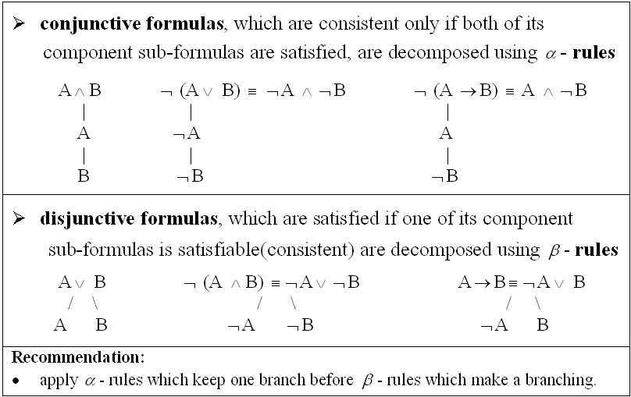
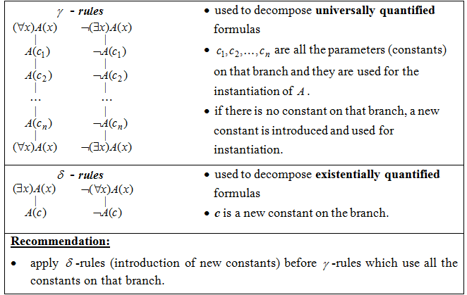
Theoretical results
Decomposition rules for propositional formulas
A branch of the semantic tableau is called closed (marked by ⨂ ) if it contains a formula and its negation.
A branch of the semantic tableau is called complete if it is closed or all the formulas on that branch are already decomposed.
A semantic tableau is called closed if all its branches are closed.
A formula is inconsistent if and only if its semantic tableau is closed.
Decomposition rules for predicate formulas

Slide 3
⊨ (∀x)(A(x) ∧ B(x)) ↔ (∀x)A(x) ∧ (∀x)B(x) if and only if
⊨U1 and ⊨U2 where:
U1 = (∀x)(A(x) ∧ B(x)) → ((∀x)A(x) ∧ (∀x)B(x)) and
U2 = ((∀x)A(x) ∧ (∀x)B(x)) → (∀x)(A(x) ∧ B(x)).
We shall prove that U1 is a tautology and U2 is also a tautology building the semantic tableaux of ¬ U1 and ¬ U2.
The following theoretic result is used:
⊨U if and only if ¬U has a closed semantic tableau.

Slide 4
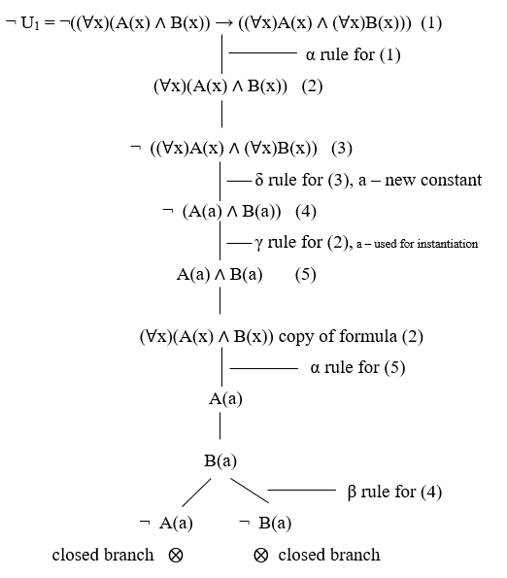
The semantic tableaux of ¬ U1 is complete and closed, with two closed branches containing pairs of opposite literals: (A(a), ¬ A(a)) and (B(a), ¬ B(a)), therefore ¬ U1 is inconsistent and U1 is valid (tautology).

Slide 5
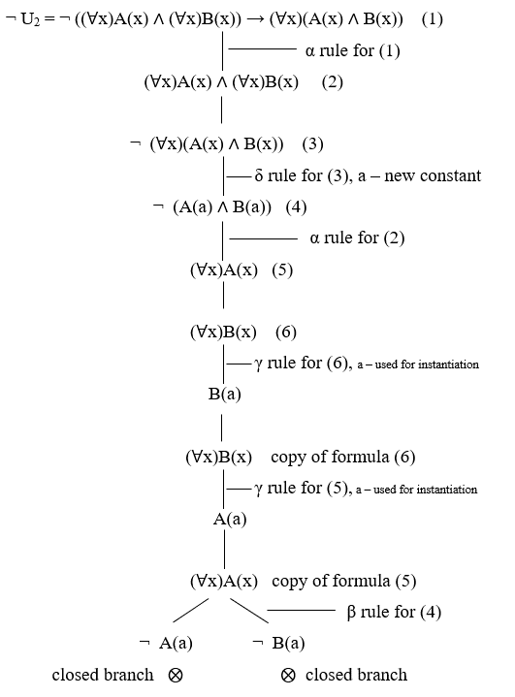
The semantic tableaux of ¬ U2 is complete and closed, with two closed branches containing pairs of opposite literals: (A(a), ¬ A(a)) and (B(a), ¬ B(a)), therefore ¬ U2 is inconsistent and U2 is valid (tautology).

Slide 6
Conclusions
We proved that ⊨U1 and ⊨U2 because both ¬U1 and ¬U2 have a closed semantic tableaux, so the universal quantifier is distributive over conjunction.

