Slide 1
Customer Request Handling Automation

Slide 2
The Automation in brief
This automated system is designed to improve the efficiency of handling customer service requests.
The automation involves reading emails from Outlook, extracting and processing customer data from Excel attachments, intercepting received emails, and drafting response emails.

Slide 3
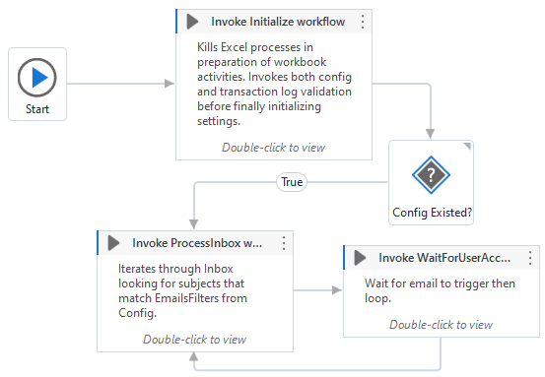
Automation Structure
3 States
Initialization
Transaction Processing
Waiting
Important Components
Config file
Transaction Log

Slide 4
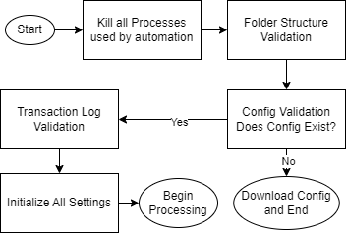
Walkthrough– State 1: Initialization
Kill all processes - Closes instances of Excel, ensuring clean start
Folder Structure Validation – Ensures all required folders exist
Config Validation – Ensures Config file exists
Transaction Log Validation – Ensures Transaction Log exists
Initialize All Settings – Extracts settings for automation from Config file and turning them into a Dictionary

Slide 5
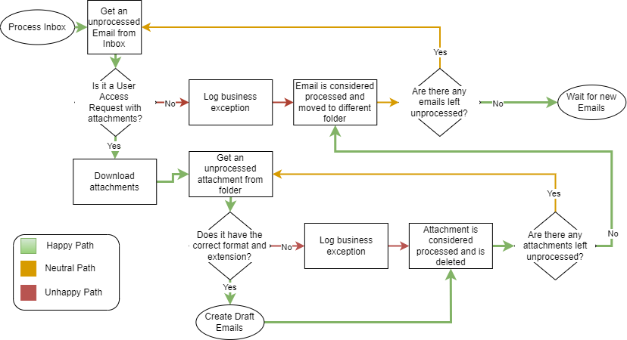
Walkthrough – State 2: Transaction Processing
2 Nested Loops

Slide 6
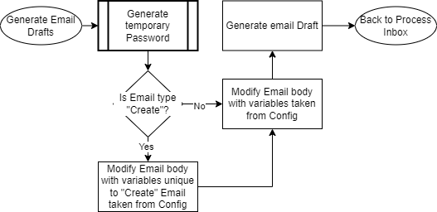
Walkthrough – State 2: Transaction Processing Create Email Drafts
Generate Temporary Password – Using parameters taken from Config file
ex: Minimums characters and password size

Slide 7
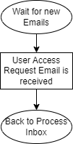
Walkthrough – State 3: Waiting
Idle – Program remains in background until an email is received
Email received – When an email is received it is checked against Config file subject-line filter to determine if it’s a user access request
Loop – When email is confirmed to be a user access request

Slide 8
Automation Sample Runs & Deeper Dive Into Auxiliary Files
Run automation as if first run
Look into Config file
Look at sample Emails in Outlook
Run automation
Look at Email Drafts
Look at Transaction Log and compare with sample Emails used

Slide 9
My biggest Hurdles
.Net Programming language syntax
Unfamiliarity with UiPath activities

Slide 10
Lessons Learned
Focus on a minimum viable product before implementing additional features.
Collaboration leads to new ideas and improvements.
Excel automation is finicky.

Slide 11
Questions?
Thanks for taking the time to listen to my presentation.
Feel free to ask questions.

