Slide 1
Image analysis and pattern recognition Special project
Team 28
Alexandre Levy
Pauline Treyvaud
Sayid Derder

Slide 2
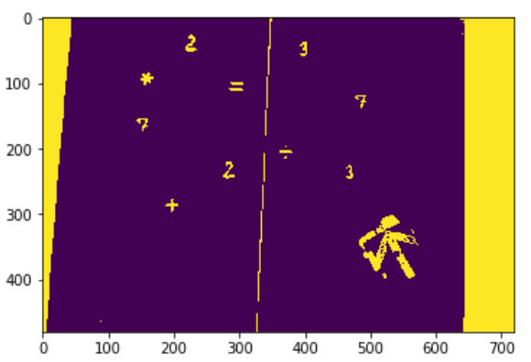
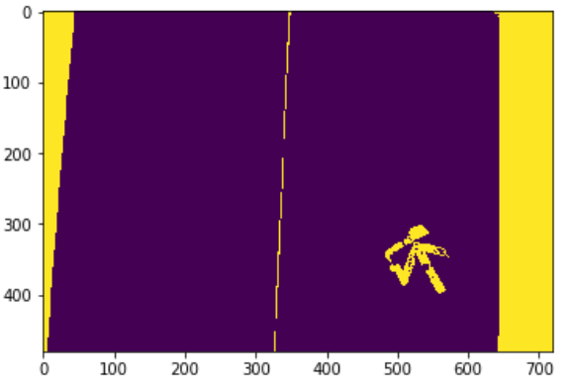
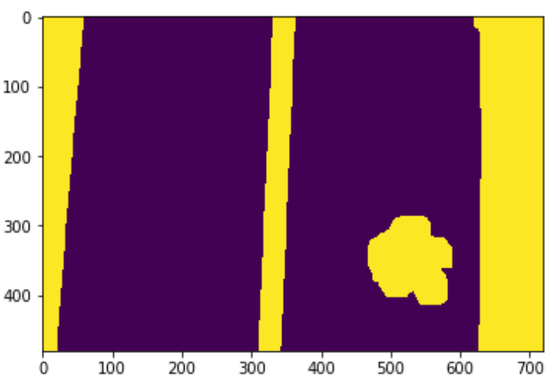
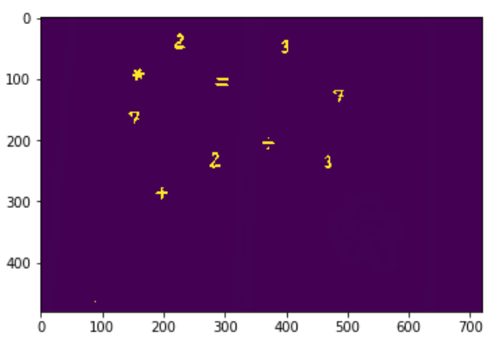
Preprocessing
Goal: isolate symboles and the arrow from the background
Convert first frame of video to HSV
Threshold the image such that we can see nicely the numbers and operators
Open to suppress the operator and digits (keep arrow, borders of table, etc). Dilate the resulting image
Substract 3) to 2) in order to keep only the numbers and operators
5) Open and close to clean perfectly image

Slide 3

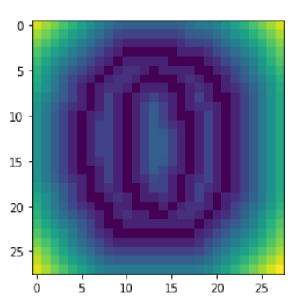
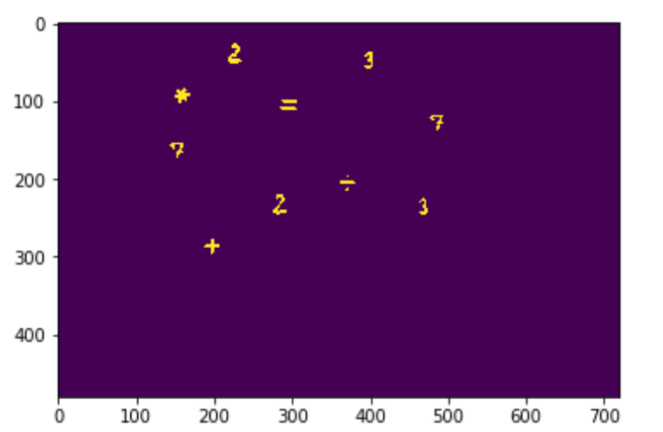
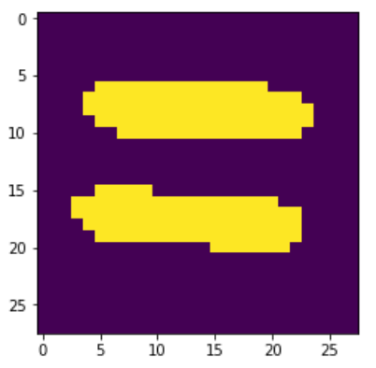
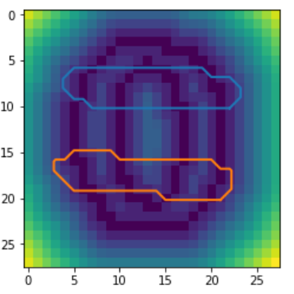
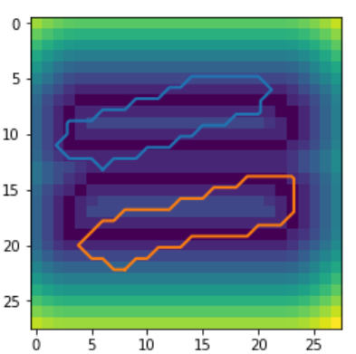
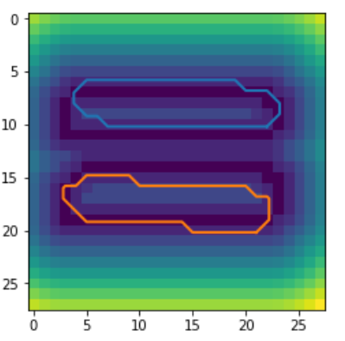
Distance map and contour method
1) Create a database of distance maps for each digit and operator
Reference image Distance map to contours
→
28 x 28 pixels
2) For each object found in the video, create a 28 x 28 pixels images centered on the object
3) Translate the image by a translation vector t
4) Rotate the image by α degrees
5) Compare the contours of the rotated object with all the distance maps: sum the values of the distance map at the coordonates of the contours (score)
Repeat from 3) for all translation vectors and all rotations
6) Attributes label according to the lowest score and contours specificity (concentricity, number of contours)
IT’S A MATCH!

Slide 4
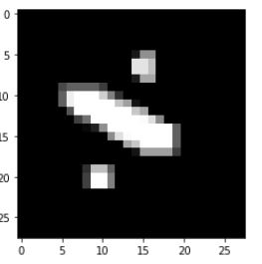
CNN
1)We train a cnn classifier with mnist datatset and png operators shifted and scaled (all size 28X28)
2) For each object found in the first frame, create a 28 x 28 pixels images centered on the object
3)We the then put each image in our classifier and if we dont get a sufficient result of matching we rotate the image until we get a sufficient result of matching
Isolated operator to analyze(28x28)

Slide 5
Pros and cons
Distance Maps and contours specificity:
+ Easy to understand, exploit simple concept
+ Works well on known images
+ Robust to orientation
Not necessarly robust to variance
Not robust to scaling
CNN:
+ Robust to scaling, orientation and translation
+ Robust to variance
+ Can be used for different applications
Hard to tune for perfect results
Complicated to implement from scratch

