Slide 1
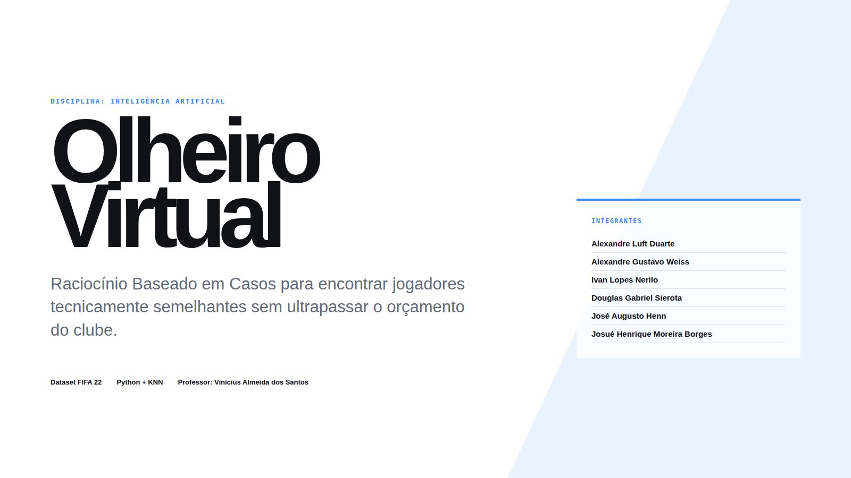
Notes:
[Sources]
- /home/henn/Documents/GitHub/easportsrbc/apresentacao/Olheiro_Virtual_Apresentacao.html
- /home/henn/Documents/GitHub/easportsrbc/rbc/config.py
- /home/henn/Documents/GitHub/easportsrbc/rbc/similaridade.py

Slide 2
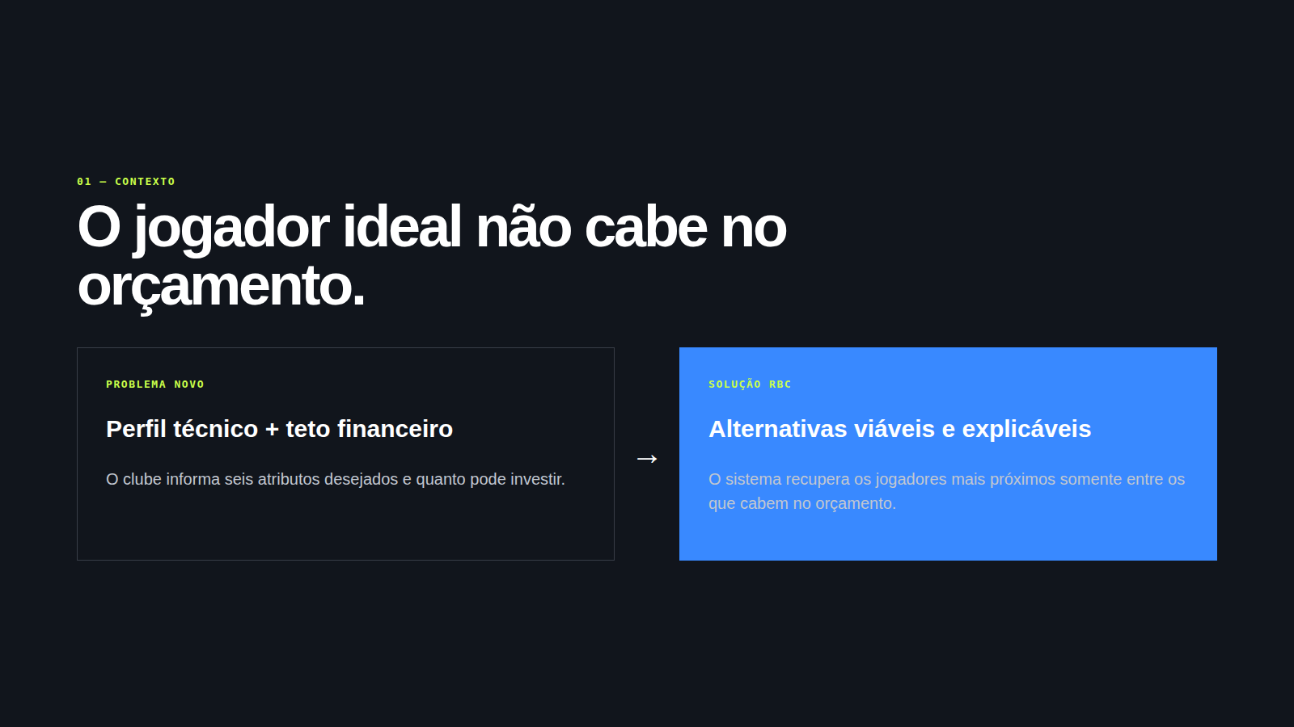
Notes:
[Sources]
- /home/henn/Documents/GitHub/easportsrbc/apresentacao/Olheiro_Virtual_Apresentacao.html
- /home/henn/Documents/GitHub/easportsrbc/rbc/config.py
- /home/henn/Documents/GitHub/easportsrbc/rbc/similaridade.py

Slide 3
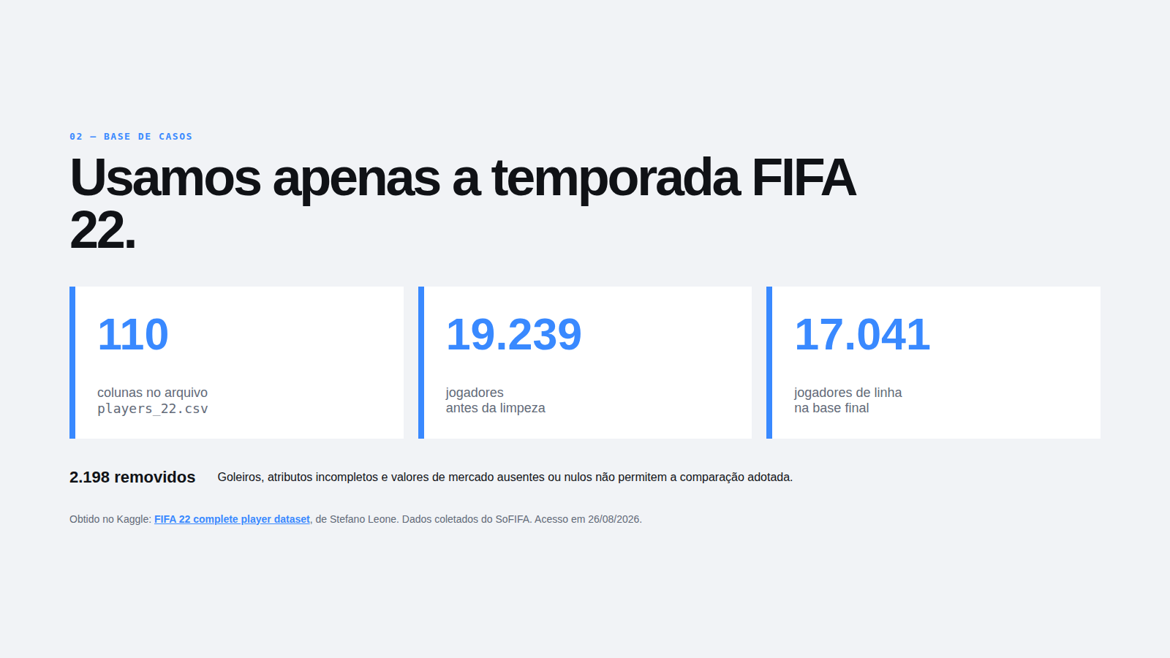
Notes:
[Sources]
- /home/henn/Documents/GitHub/easportsrbc/apresentacao/Olheiro_Virtual_Apresentacao.html
- /home/henn/Documents/GitHub/easportsrbc/rbc/config.py
- /home/henn/Documents/GitHub/easportsrbc/rbc/similaridade.py
- https://www.kaggle.com/datasets/stefanoleone992/fifa-22-complete-player-dataset

Slide 4
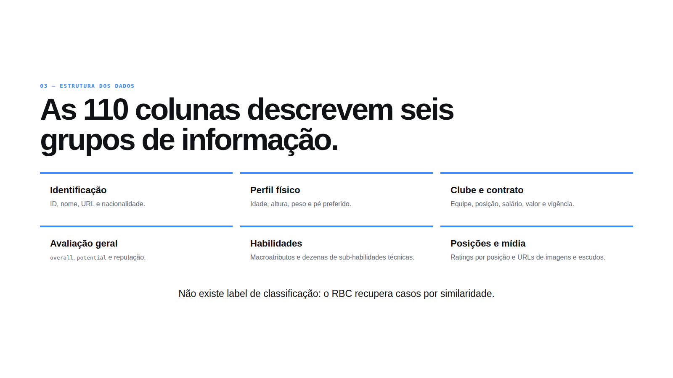
Notes:
[Sources]
- /home/henn/Documents/GitHub/easportsrbc/apresentacao/Olheiro_Virtual_Apresentacao.html
- /home/henn/Documents/GitHub/easportsrbc/rbc/config.py
- /home/henn/Documents/GitHub/easportsrbc/rbc/similaridade.py

Slide 5
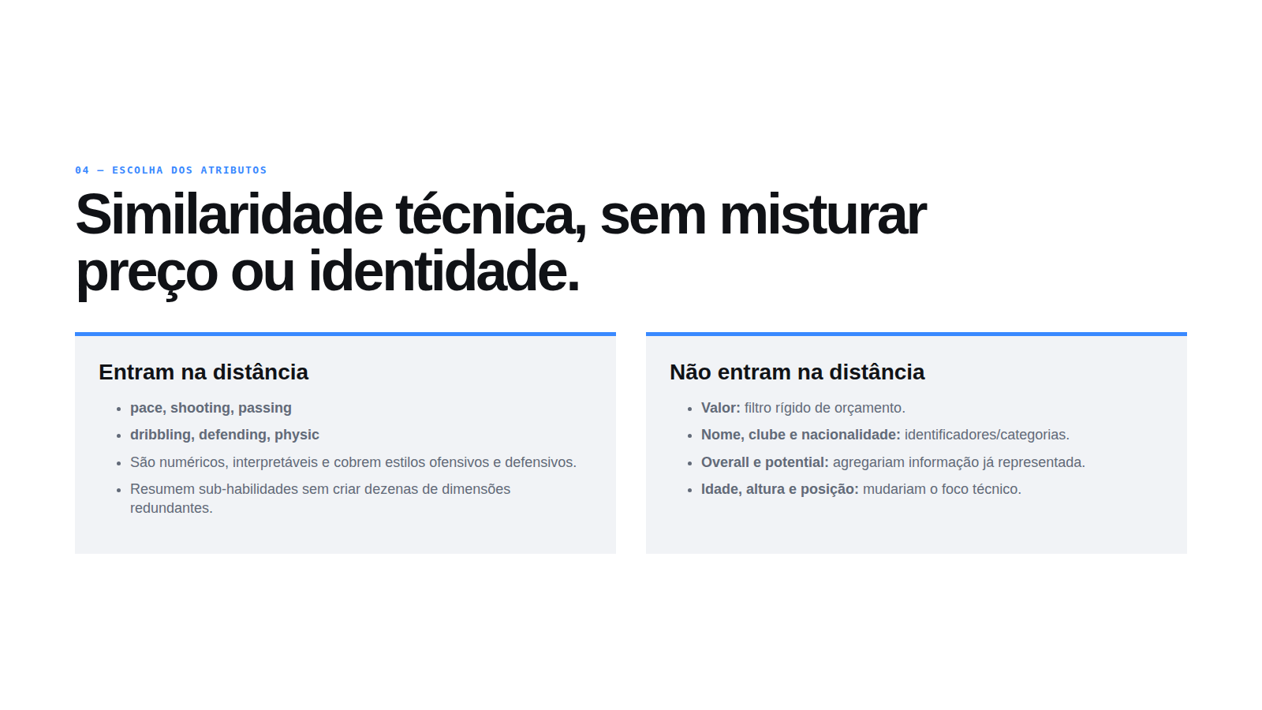
Notes:
[Sources]
- /home/henn/Documents/GitHub/easportsrbc/apresentacao/Olheiro_Virtual_Apresentacao.html
- /home/henn/Documents/GitHub/easportsrbc/rbc/config.py
- /home/henn/Documents/GitHub/easportsrbc/rbc/similaridade.py

Slide 6
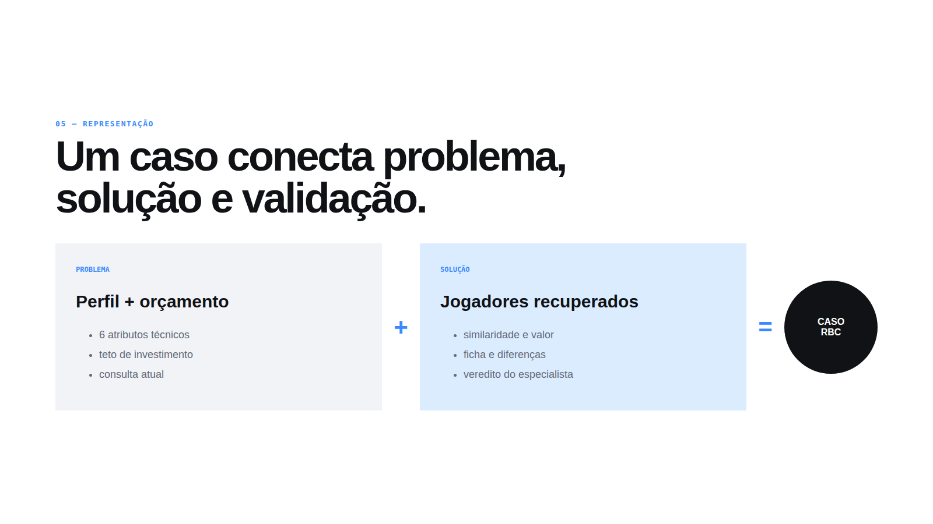
Notes:
[Sources]
- /home/henn/Documents/GitHub/easportsrbc/apresentacao/Olheiro_Virtual_Apresentacao.html
- /home/henn/Documents/GitHub/easportsrbc/rbc/config.py
- /home/henn/Documents/GitHub/easportsrbc/rbc/similaridade.py

Slide 7
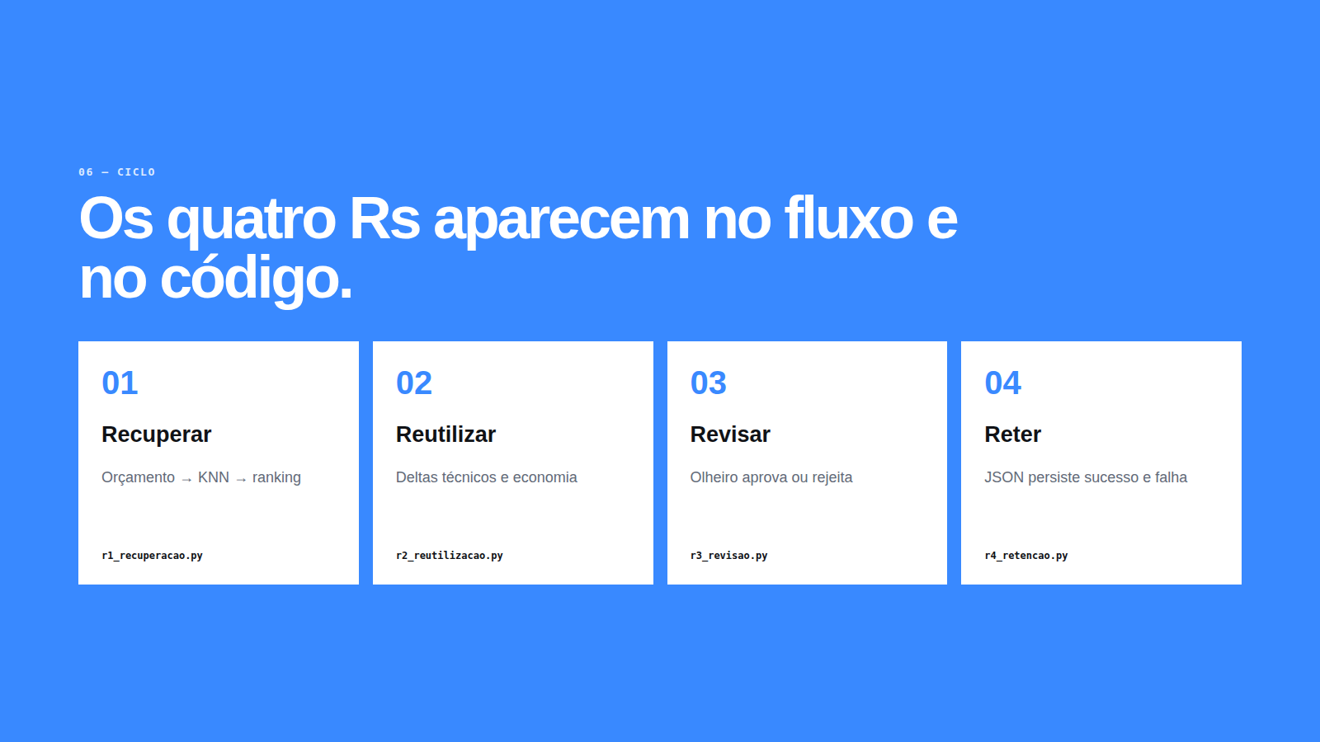
Notes:
[Sources]
- /home/henn/Documents/GitHub/easportsrbc/apresentacao/Olheiro_Virtual_Apresentacao.html
- /home/henn/Documents/GitHub/easportsrbc/rbc/config.py
- /home/henn/Documents/GitHub/easportsrbc/rbc/similaridade.py

Slide 8
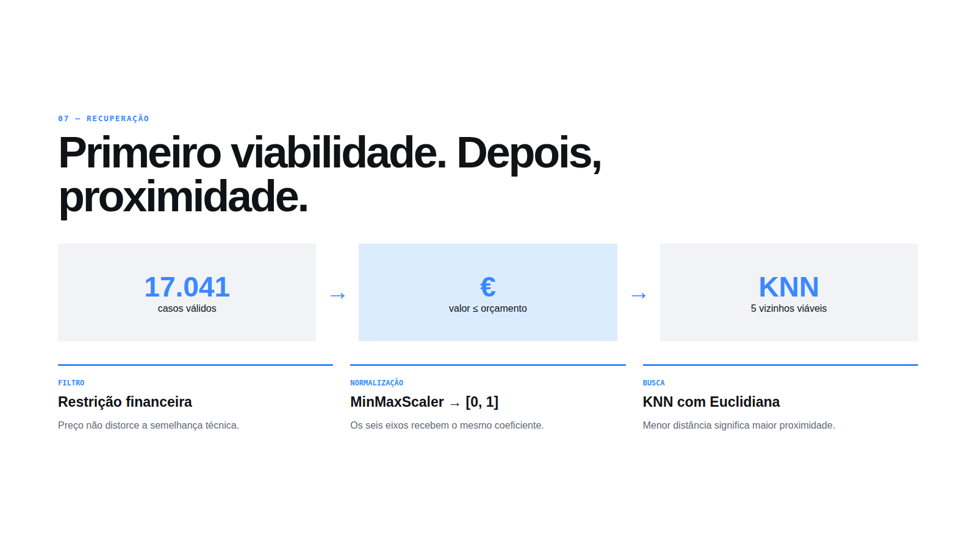
Notes:
[Sources]
- /home/henn/Documents/GitHub/easportsrbc/apresentacao/Olheiro_Virtual_Apresentacao.html
- /home/henn/Documents/GitHub/easportsrbc/rbc/config.py
- /home/henn/Documents/GitHub/easportsrbc/rbc/similaridade.py

Slide 9
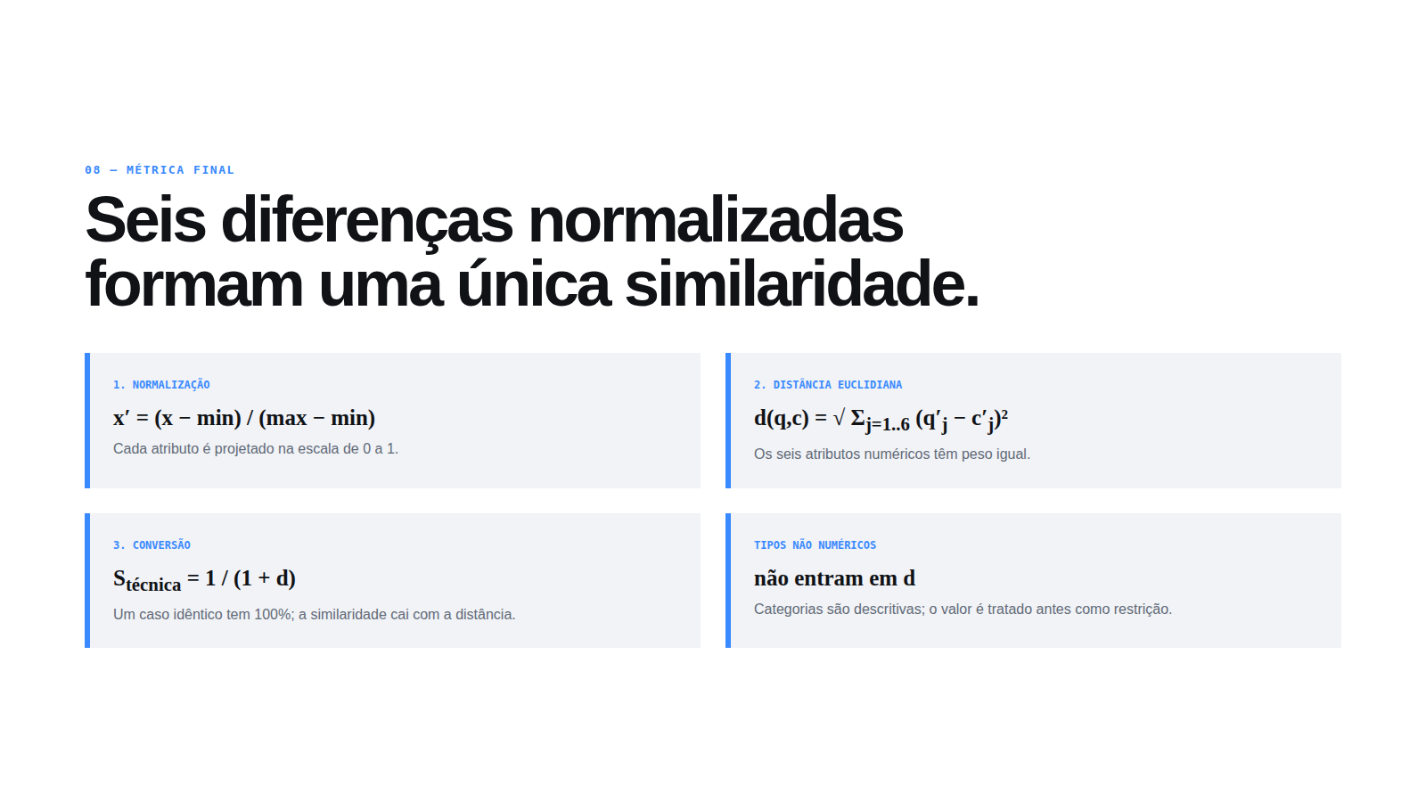
Notes:
[Sources]
- /home/henn/Documents/GitHub/easportsrbc/apresentacao/Olheiro_Virtual_Apresentacao.html
- /home/henn/Documents/GitHub/easportsrbc/rbc/config.py
- /home/henn/Documents/GitHub/easportsrbc/rbc/similaridade.py

Slide 10
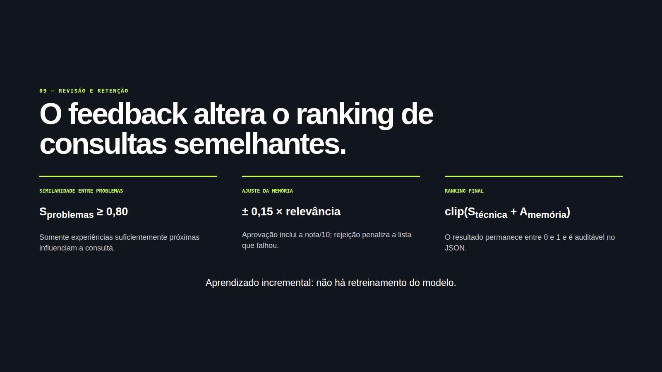
Notes:
[Sources]
- /home/henn/Documents/GitHub/easportsrbc/apresentacao/Olheiro_Virtual_Apresentacao.html
- /home/henn/Documents/GitHub/easportsrbc/rbc/config.py
- /home/henn/Documents/GitHub/easportsrbc/rbc/similaridade.py
- /home/henn/Documents/GitHub/easportsrbc/rbc/ciclo/r4_retencao.py

Slide 11
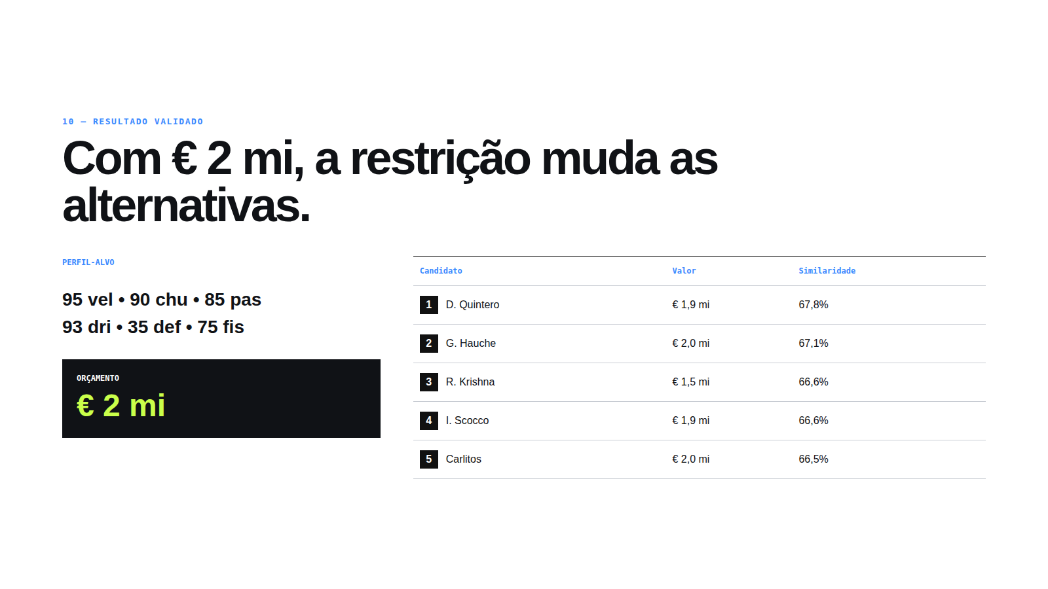
Notes:
[Sources]
- /home/henn/Documents/GitHub/easportsrbc/apresentacao/Olheiro_Virtual_Apresentacao.html
- /home/henn/Documents/GitHub/easportsrbc/rbc/config.py
- /home/henn/Documents/GitHub/easportsrbc/rbc/similaridade.py
- /home/henn/Documents/GitHub/easportsrbc/data/players_22.csv

Slide 12
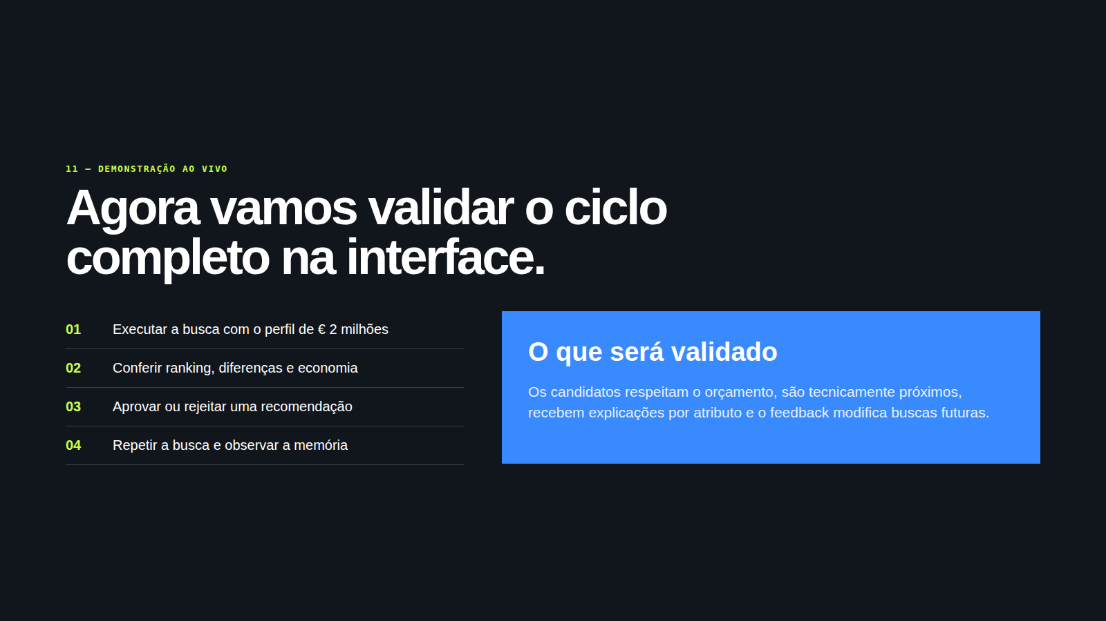
Notes:
[Sources]
- /home/henn/Documents/GitHub/easportsrbc/apresentacao/Olheiro_Virtual_Apresentacao.html
- /home/henn/Documents/GitHub/easportsrbc/rbc/config.py
- /home/henn/Documents/GitHub/easportsrbc/rbc/similaridade.py

