Slide 1
Projet Data Stream
Sentiment analysis of reviews of the top 10 box office films
Alexandre Gommez
Matthieu Denis
Narjes Haouala

Slide 2
Sommaire
01
Présentation du projet
Étudier les critiques des 10 films les plus populaires du box-office et les classer automatiquement en temps réel.
02
Méthode
Utiliser les méthodes de data stream pour collecter les données du site imdb et implémenter un modèle NLP pour la catégorisation
03
Résultats
Classification des avis des utilisateurs, limites et amélioration

Slide 3

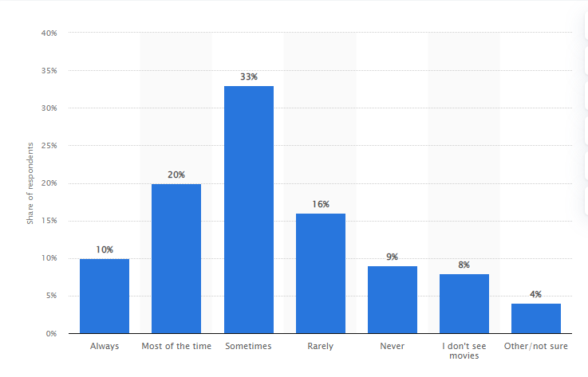
Problématique
Grand nombre d’avis en ligne sur les différents produits et services
21,4 milliards de dollars, c'est le montant total des recettes du cinéma mondial pour l'année 2021
La plupart des adultes se basent sur les critiques avant de regarder un film ( >50%)
Les avis des cinéphiles peuvent varier à chaque instant selon l’actualité et les évènements mondiaux.
Part des adultes qui lisent des critiques avant de regarder un film aux États-Unis, en août 2018.
Notes:
Avec le développement rapide du commerce électronique, de plus en plus d'avis en ligne sur les produits et les services sont créés, ce qui constitue une source d'information importante pour les vendeurs et les clients.
La recherche sur l'exploration des sentiments et des opinions pour l'analyse des avis en ligne a attiré de plus en plus d'attention parce qu'une telle étude permet de tirer parti des informations des avis en ligne pour un impact économique potentiel.
En effet, plus que 21,4 milliards de dollars, est dépensé dans le cinéma mondial pour l'année 2021
De plus, cette figure montre que la plupart des adultes regardent les avis sur internet (et principalement sur imdb puisqu’il s’agit du site le plus populaire et le plus « trusted » ) avant de voir le film ….
Finalement, les avis des cinéphiles peuvent varier fréquemment selon les évènements mondiaux, par exemple, au début de la pandémie, le film pandémie apparu en 2016 est devenu très populaire.
Source pour les stats https://www.statista.com/statistics/

Slide 4
Méthode
Traiter les flux de données en temps réel à partir du l’API de imdb en utilisant Kafka
Ingest data
Filter movies
Select comments
Implémenter un modèle NLP pour classifier les avis des utilisateurs de imdb
Préparer la data
Tokenize
Normalise
Remove noise
Determine Word Density
Essayer plusieurs modèles
Sélectionner un modèle final selon une métrique bien déterminée: accuracy
Classifier en temps réel les avis posté sur imdb

Slide 5
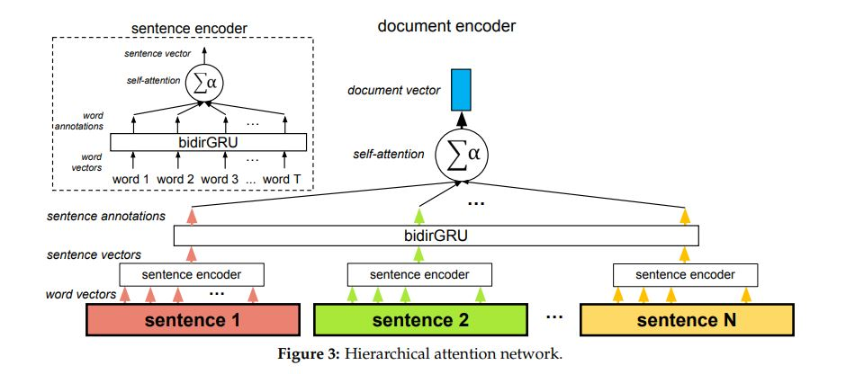
Modèle retenu: Hierarchical attention network
Notes:
Le plus grand avantage de Naive bayes est sa rapidité, par conséquent il est très pratique pour avoir des prédictions temps réel
Une des améliorations majeures qui peut être incorporée à mesure que nous avançons dans ce projet est de fusionner les mots ayant des significations similaires avant de former les classificateurs . Un autre point d'amélioration amélioration peut être de modéliser ce problème comme un problème de classification multi-classes càd classer les sentiments de l'évaluateur de façon plus que binaire comme "Heureux", "Ennuyé", "Effrayé",

Slide 6
Exemples de classifications
Review: “ RATED 10/10 Language: Telugu Media Partner: Zee5 Source: Nil HIGHLY RECOMMENDEDMovie starts with two hero introductions, that itself like full meals satisfaction...Really the trailer shown the 30% of the movie it has much more action blocks and goosebumps moments in the movie... its real double treat and mass moments also doubled with dual heroes... Naattu song is the cherry on top, whole theatre goes mad on this one... the interval block action sequence is real jaw dropping one, even though we can guess this one, but cant guess the scale...Second half starts with bit slow flashback, but it picks up to the paek immediately. Second half has more sentiments and more screen space for RC. RC outshines NTR in lot of places... All the action blocks are gravity defying but enjoyable.... After credit Janta song has cameo from Rajamouli. When the movie ends it was like completing the festival celebration....Exceeding expectations in all aspects....”
Review for the movie: RRR (Rise Roar Revolt)
From: m-ramanan
Good review

Slide 7
Exemples de classifications
Review: “ "The Batman" is an Action - Drama movie in which we watch Batman trying to protect the citizens of Gotham from the Riddler, a sadistic serial killer who murders some politicians of the city.I have to admit that I did not have high expectations from this movie but I happily surprised by it. It was different than the previous Batman movies, a bit darker and the action scenes were also captured from a different aspect. The plot of the movie was interesting and contained plenty of suspense but it also contained some very slow scenes that they could be sorter. The interpretation of Robert Pattinson who played as Bruce Wayne was good and he made the difference. Some other interpretations that have to be mentioned were Zoë Kravitz's who played as Selina Kyle, Jeffrey Wright's who played as Lt. James Gordon, Andy Serkis' who played as Alfred and Paul Dano's who played as The Riddler. Finally, I have to say that "The Batman" is a nice action movie and I highly recommend everyone to watch it.”
Review for the movie: The Batman
From: Thanos_Alfie
Good review
Grade from the model: 0.9972432851791382

Slide 8
Limites de la classification
Review: “Well Rob Pattinson is no Christine Bale and it was smart that Pattinson did a different version for The Batman. There was no Christine Bale the playboy millionaire character side of Batman which made the movie less fun. Regrettably, there was not much humor in The Batman, but The Batman took a much darker serious role! Thankful, that woke Hollywood did not ruin another Super hero movie with forcing the current woke flavor characters, or storyline, which creates another disjointed and boring film. Hollywood did not create another formulated good guy meets bad guy with super power duel ending either. The Batman is sorta anti woke. Themes like everyone is not what people formulate them as. Batman is not the only one with dark secrets. Even the most noble have burred mistakes and pasts. The truth is mixed with lies and what we want to believe. The themes create sub stories which slowly unravel and keep the enthralled in what will be revealed next. The Batman character is built up rage, which turns dark. The Batman/Wayne character and story meld into one, while every character think that they are the true victim and Wayne had it easy. The plot twist, I never saw coming, was the Riddler is just a angry tech guy, very human, delusional, and frail. I will not call this the best Batman, but compared to todays trash superhero movie The Batman is a solid movie. 8 stars.”
Review for the movie: The Batman
From: mm-39
Bad review
Grade from the model: 0.014468331821262836

Slide 9
Quelques avis peuvent créer des confusions
Review: “I liked the movie. There were some ridiculous scenes in the movie, but overall I liked the movie. I watched the movie in Baku (Azerbaijan) 28 Mall, Cinema Plus and the movie theater was good. There was no problem on screen, light and sound. The movie was long, it could have been a little short because the endings of the movie were a bit boring. Music and specially the main score was good. The acting was great, Robert Pattison, Zoe Kravitz, Paul Dano, Colin Farrell, Jeffrey Wright, John Turturo all did well. I was happy when I heard that Robert Pattion will be the Batman, because he is such a good actor. Please forget about the "vampire" thing. Matt Reeves did a great job. Gotham City was great. Bruce Wayne turned out to be exactly what I wanted.I really liked this movie.I did not like Alfred.In my opinion Best Batman, not best Bruce Wayne, not Best Batman movie but overall very good movie.”
Review for the movie: The Batman
From: jack_o_hasanov_imdb
Bad review
Grade from the model: 0.4467065632343292

Slide 10
Demo

Slide 11
Conclusion
Critique et limites:
Le modèle considère uniquement le début des avis
Le sarcasme
Quelques avis peuvent créer des confusions
Améliorations possibles:
Fusionner les mots ayant des significations similaires avant de former les classificateurs
Modéliser ce problème comme un problème de classification multi-classes càd classer les sentiments des utilisateurs de façon plus que binaire comme "Heureux", "Ennuyé", "Effrayé« …

