Slide 1
Improving Bias Correction Standards by Quantifying its Effects on Treatment Outcomes Alexandre Abraham – Implicity Andres Hoyos Idrobo – Rakuten

Slide 2
Problem context
Estimating a treatment effect on retrospective observational studies:
With a selection bias on populations
That we want to solve using Propensity Score Matching
When performing Average Treatment Effect after selection bias correction:
Between 30% and 48% of studies do not report the method use to correct the bias [1, 4, 13, 21, 23]
Between 17% and 48% of studies do not assess basic validation after correction [1, 13, 21, 23]
Applying PSM is complex and hard to report

Slide 3
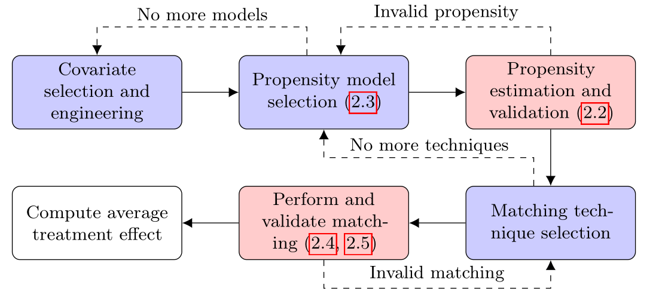
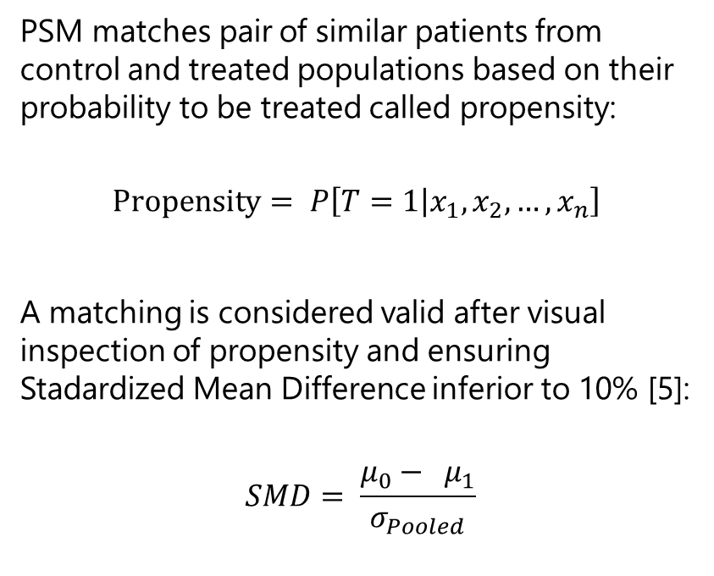
PSM complete pipeline
PSM matches pair of similar patients from control and treated populations based on their probability to be treated called propensity:
$$\text{Propensity}= P\left[T=1 | x_{1}, x_{2}, …, x_{n}\right]$$
A matching is considered valid after visual inspection of propensity and ensuring Stadardized Mean Difference inferior to 10% [5]:
$$SMD= \frac{μ_{0}− μ_{1}}{σ_{Pooled}}$$

Slide 4
Patient matching
Paring can happen in different ways depending on the method:
0.12
0.15
0.36
0.42
0.67
0.14
0.18
0.31
0.39
0.69
0.12
0.15
0.36
0.42
0.67
0.14
0.18
0.31
0.39
0.69
Both pairing seem valid, is there a better one?
As an external auditor, would you be aware of the practitioner’s choice?
In our experiments, at least 10 methods with different ATE were considered valid for each task.

Slide 5
Our propositions
SMD is too permissive, it does not allow to pin point the best method.
We redefine the bias correction validation. All matching must be run and we select the best ones.
To perform this, we automated the whole pipeline.
There is no ground truth in bias correction experiments.
We propose a benchmark with generated datasets featuring a give number of confounders.
SMD already does a good job validating feature balancing. In order to filter more, we need another criterion.
We hypothetize that it may be possible to select methods based on the outcome correction rather than features.

Slide 6
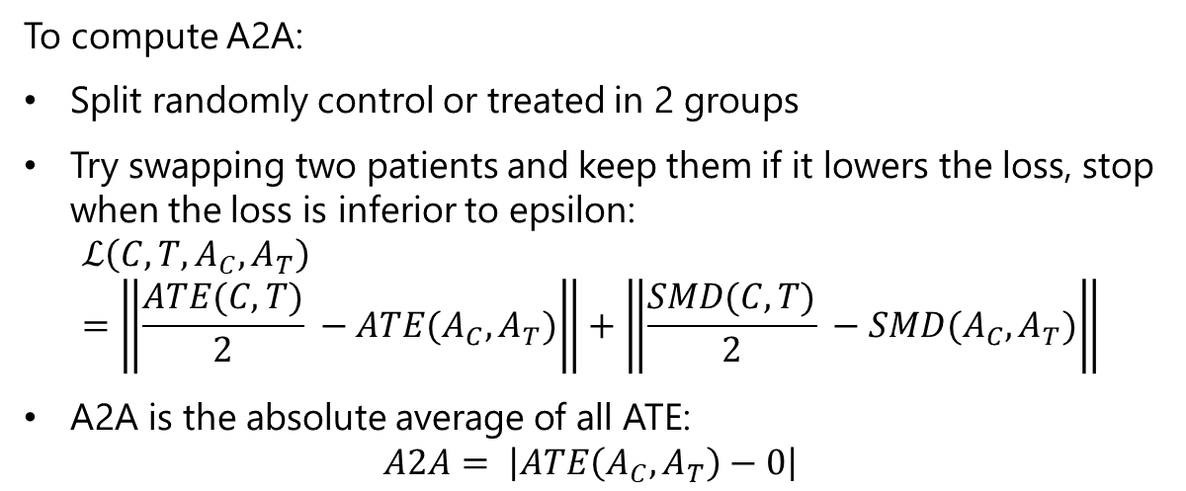
The A2A metric
The fundamental idea behind A2A is that:
Any split patients coming form control or treated has a true ATE of zero
A split having characteristics similar to the reference problem can tell us about the capacity of a bias correction technique to retrieve true ATE.
To compute A2A:
Split randomly control or treated in 2 groups
Try swapping two patients and keep them if it lowers the loss, stop when the loss is inferior to epsilon:
$$ℒ\left(C,T,A_{C}, A_{T}\right)=\left\|\frac{ATE(C, T)}{2} −ATE(A_{C}, A_{T})\right\|+\left\|\frac{SMD(C, T)}{2} −SMD(A_{C}, A_{T})\right\|$$
A2A is the absolute average of all ATE: $A2A= \left|ATE\left(A_{C}, A_{T}\right)−0\right|$

Slide 7
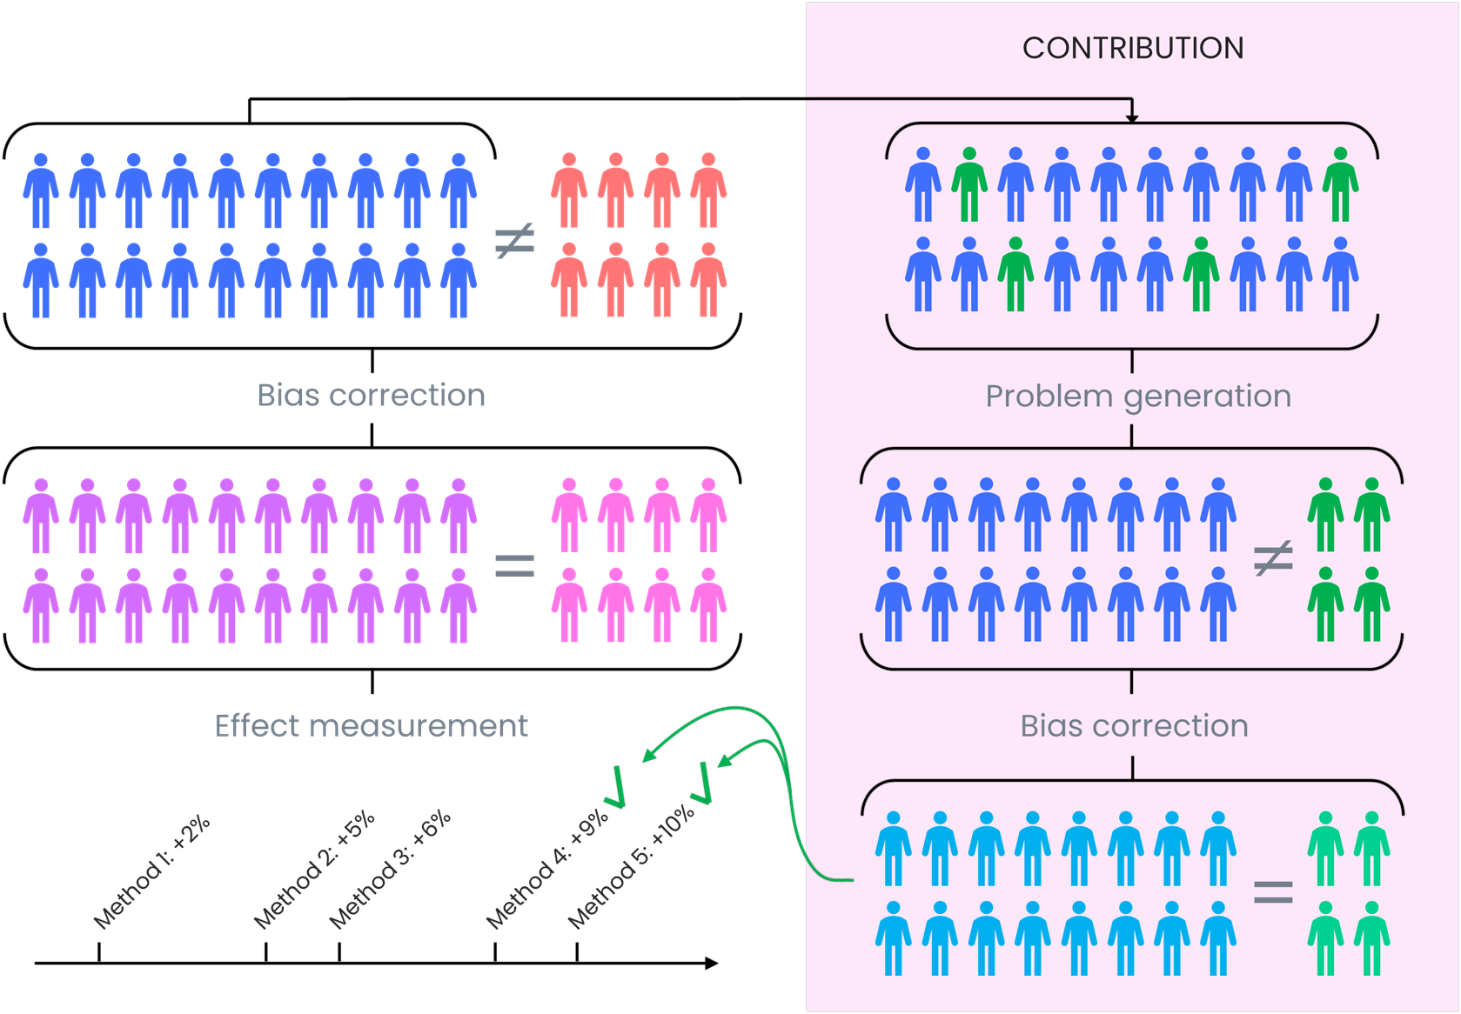
A2A: A visual aid

Slide 8
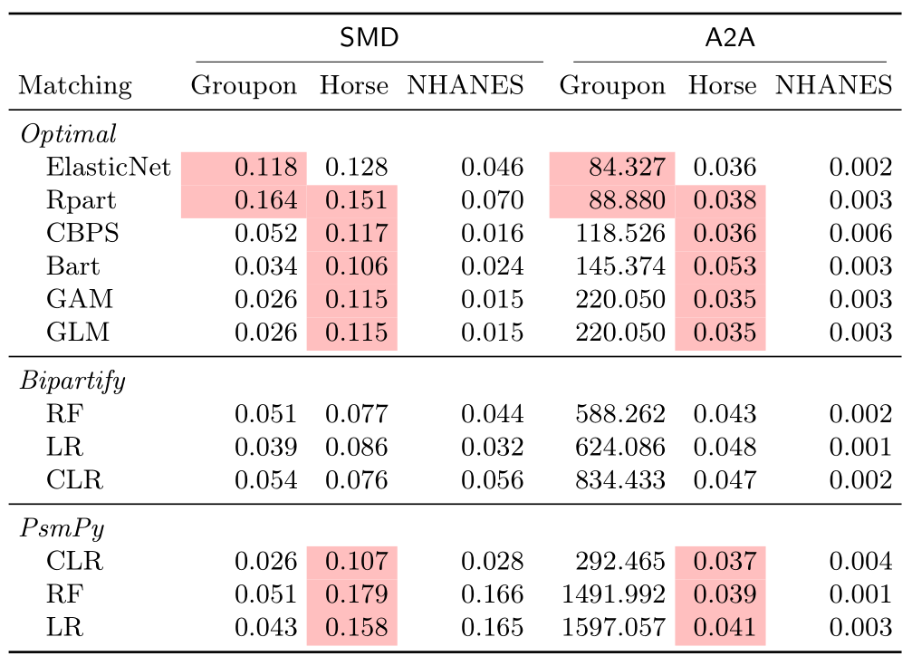
A2A and SMD

Slide 9
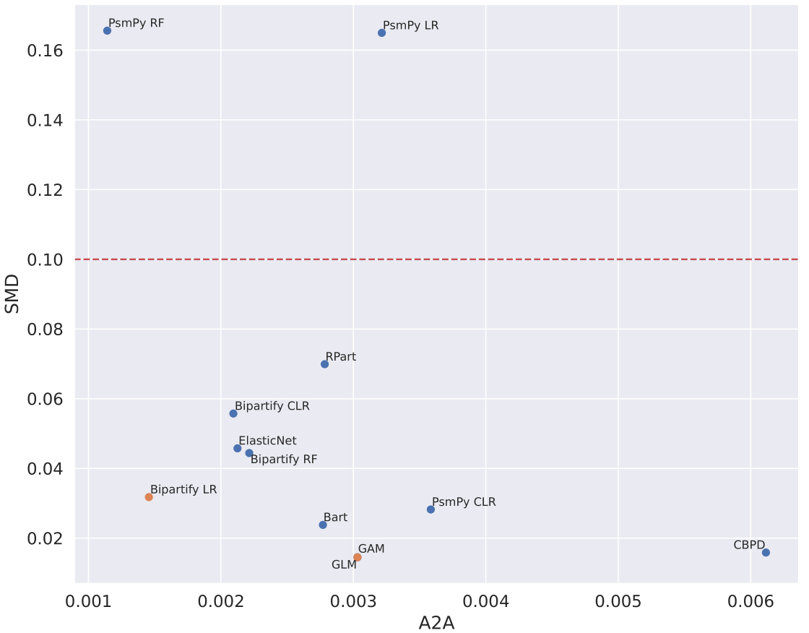
Combining SMD and A2A
SMD×A2A: Use DBScan to cluster the points and keep the group with best A2A.
Pareto: Keep the Pareto front of the methods
Min A2A/SMD: keep only the method with minimum value.

Slide 10
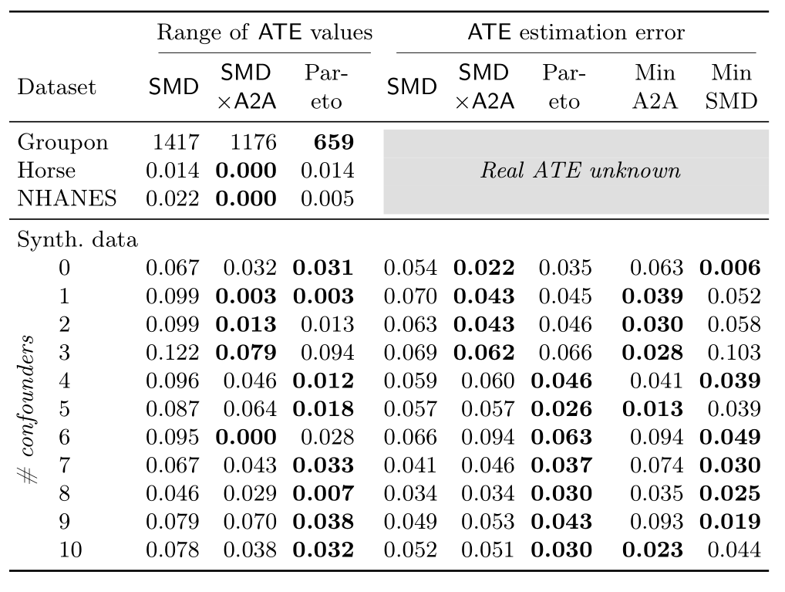
Results
A2A reduces the range of predicted values.
The methods selected are more accurate
SMD×A2A works better when the number of confounders is low
In general, when there are confounders, SMD is better
Prediction range is decreased on real datasets

Slide 11
Conclusion
SMD should be taken carefully if the number of confounders is low.
A2A allows for accurate selection of bias correction models and reduces ATE prediction range at the cost of an extended PSM procedure
More importantly, bias correction methods seem to behave on artificial tasks as they do on real ones, paving ways for other uses
More work is required to turn this metric into an absolute one such as SMD, if this is possible and extend it to other bias correction methods.
Presentation template: Microsoft LGBTQIA pride month

Slide 12
Questions & answers

Slide 13

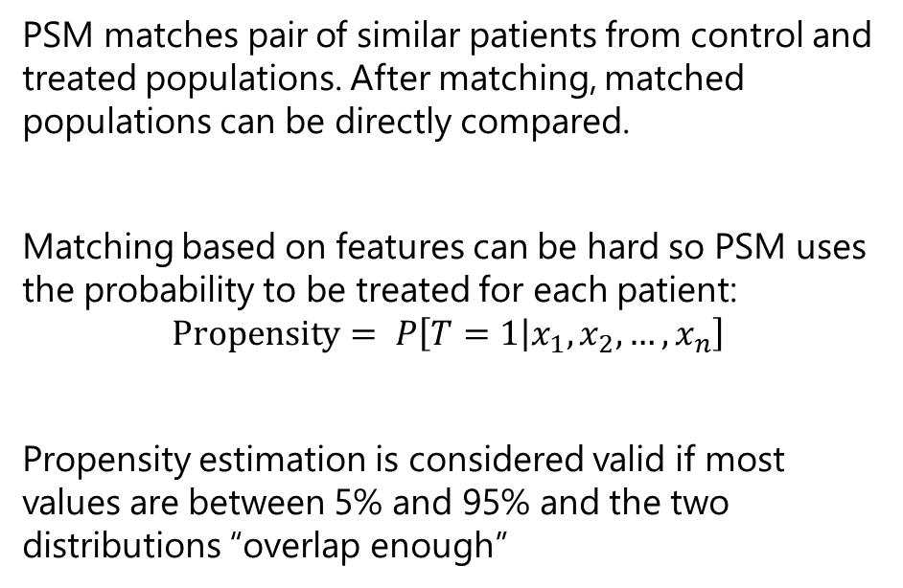
A fast introduction to Propensity Score Matching
Control
PSM matches pair of similar patients from control and treated populations. After matching, matched populations can be directly compared.
Matching based on features can be hard so PSM uses the probability to be treated for each patient:
$$\text{Propensity}= P\left[T=1 | x_{1}, x_{2}, …, x_{n}\right]$$
Propensity estimation is considered valid if most values are between 5% and 95% and the two distributions “overlap enough”
Treated
Distribution
20%
40%
60%
80%
Probability to be selected

