Slide 1



Dreadful Frailties in Propensity Score Matching and How to Fix Them. Alexandre Abraham Andrés Hoyos Idrobo
Published under the title “Improving Bias Correction Standards by Quantifying its Effects on Treatment Outcomes”

Slide 2


Alex, I need you to estimate the effect of our treatment on past data, with selection bias, so that we can justify that we save lives to French Health authorities.
Credits: « The expert » short comedy sketch
I can do absolutely anything, I’m an engineer!

Slide 3
Selection bias correction
A gentle introduction to propensity score matching

Slide 4
Measuring bias
Selection bias is measured as a difference in population probability to be selected for study, also called propensity.
ge
ender
omorb
4

Slide 5

Controls
Measuring bias
Selection bias is measured as a difference in population probability to be selected for study, also called propensity.
Treated
ge
ender
omorb
Standardized Mean Difference
$$\text{Cohen}\text{′}\text{s} \text{D}= \frac{|μ_{\text{C}}−μ_{\text{T}}|}{σ_{pooled}}$$
5

Slide 6
Measuring bias
Selection bias is measured as a difference in population probability to be selected for study, also called propensity.
ge
ender
omorb
$$\hat{\text{PS}}\left(\text{x}\right)=ℙ\left[T=1\right| ]+ε$$
6

Slide 7

Measuring bias
Selection bias is measured as a difference in population probability to be selected for study, also called propensity.
Control
Treated
Distribution
$$\hat{\text{PS}}\left(\text{x}\right)=ℙ\left[T=1\right| x_{1},x_{2}, x_{3},…]+ε$$
20%
40%
60%
80%
Probability to be selected
Rosenbaum, P.R., Rubin, D.B.: The central role of the propensity score in observational studies for causal effects, 1983
7

Slide 8


Correcting bias
Controls
Propensity score matching
Treated
Control
Treated
Distribution
20%
40%
60%
80%
Probability to be selected
8

Slide 9
Correcting bias
Controls
Propensity score matching
Treated
Control
Treated
Distribution
20%
40%
60%
80%
Probability to be selected
9

Slide 10
Correcting bias
Controls
Propensity score matching
Treated
Control
Treated
Distribution
20%
40%
60%
80%
Probability to be selected
10

Slide 11
Patient matching
Paring can happen in different ways depending on the method:
0.12
0.15
0.36
0.42
0.67
0.14
0.18
0.32
0.39
0.69
0.12
0.15
0.36
0.42
0.67
0.14
0.18
0.32
0.39
0.69
Both pairing seem valid, is there a better one?
Would the estimated Average Treatment Effect (ATE) be the same?

Slide 12
Selection bias correction
Practice makes perfect

Slide 13
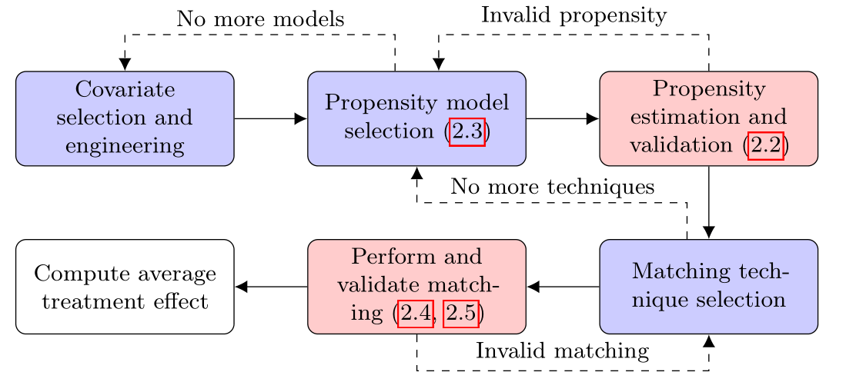
PSM complete pipeline
Li, M.: Using the propensity score method to estimate causal effects: A review and practical guide., 2013

Slide 14
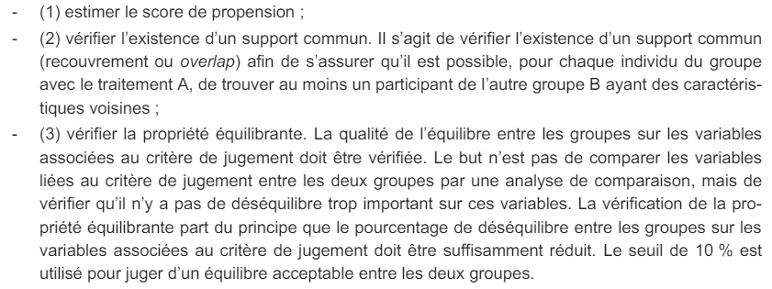
French HAS requirements
Translation and summary:
Estimate the propensity score - Calculate the likelihood of each individual receiving the treatment. No indication about the method to use.
Check for common support - Ensure each treated individual has a counterpart in the control group with similar characteristics. No quantitative criterion.
Check the balancing property - Verify that the groups are balanced on key variables, with an acceptable imbalance threshold of 10%. This threshold is very lenient.

Slide 15
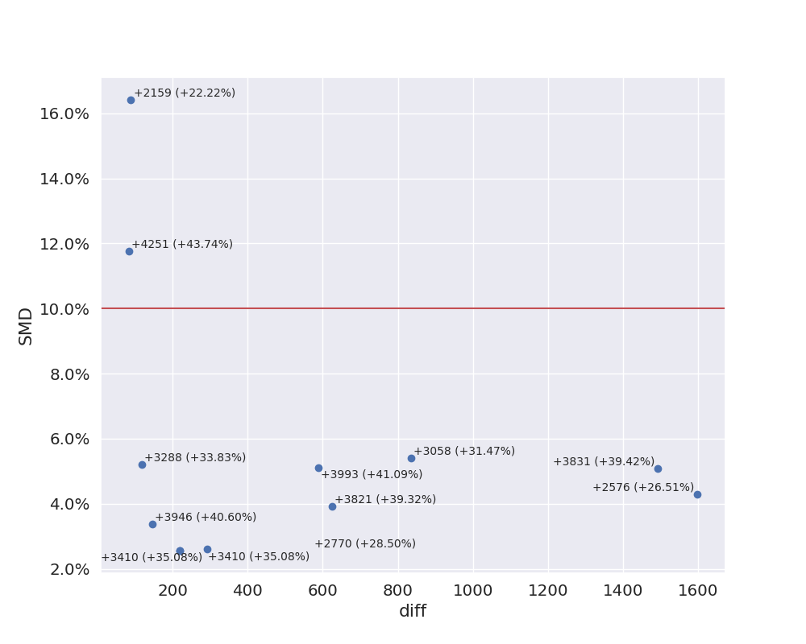

Compute all the things!
Dataset: Groupon Reference value: 9270

Slide 16
Crafting a new validation metric
Can we validate the treatment correction?

Slide 17


Can we validate treatment correction?
Feature balance
Common support
propensity features
$$\hat{\text{PS}}\left(\text{x}\right)=f(x_{1}, x_{2}, x_{3}, x_{4}, x_{5}, x_{6}, …)$$
outcome features
Feature balance
Nothing
yet

Slide 18
Artificial cases
Selection bias
Reference SMD
Reference ATE
Controls
Treated
18

Slide 19
Artificial cases
Selection bias
Reference SMD
Reference ATE
Controls
Artificial SMD
Artificial ATE
19

Slide 20
Artificial cases
Selection bias
Reference SMD
Reference ATE
Controls
Artificial SMD
Artificial ATE
20

Slide 21
The A2A metric
Fundamental idea
Any split patients in homogeneous population has ATE=0
A method good on an artificial task resembling the reference one has good chances to perform on the ref
We compute A2A by:
Automating all vérifications in the PSM pipeline:
50% overlap of propensity distributions
SMD below 10%
Creating 100 artificial tasks using hill climbing clustering
Running a bias correction method on them
Measuring the absolute mean deviation from 0

Slide 22
Combining SMD and A2A
SMD
A2A

Slide 23
Combining SMD and A2A
Pareto front
SMD×A2A
SMD
A2A

Slide 24
Synthetic dataset with various # of confounders
10
9
4
8
3
7
2
6
1
5
0

Slide 25
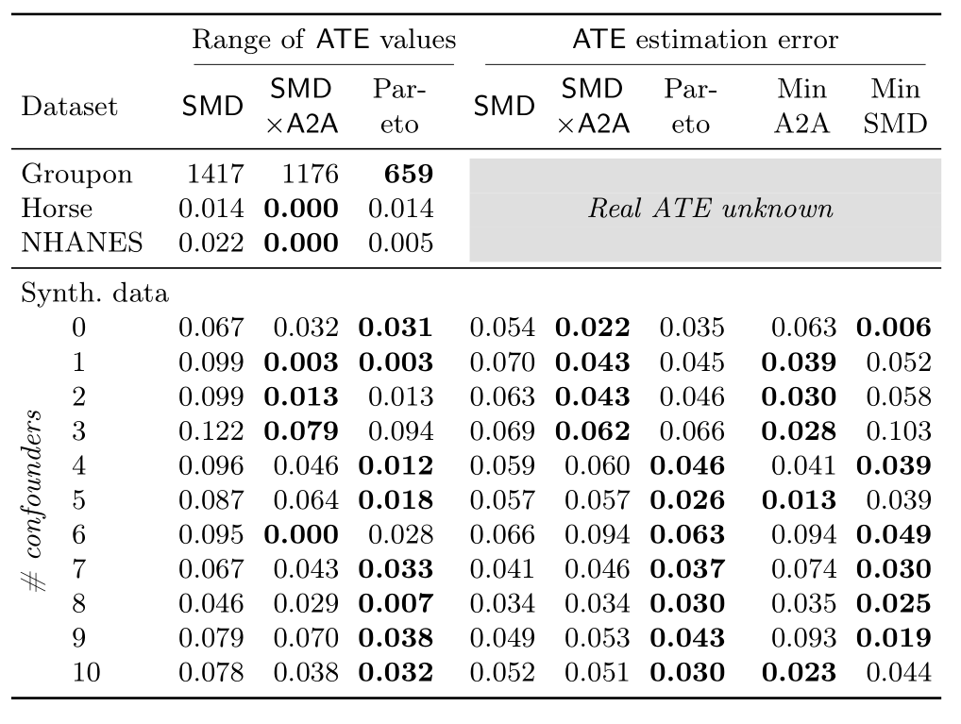
Results
A2A reduces the range of predicted values.
The methods selected are more accurate
SMD×A2A works better when the number of confounders is low
In general, when there are confounders, SMD is better
Prediction range is decreased on real datasets

Slide 26
Conclusion
We have introduced a new metric allowing to better select bias correction methods.
It still has some flaws:
It requires to runs all possible methods
It is ordinal
But it also offers promising perspectives:
It can be extended to other methods than matching
It can already be used in real cases (meetup next month!)
Available as a research package at: https://www.github.com/AlexandreAbraham/popmatch

Slide 27

This research is a hobby
You (yes, you!) can help research on your free time:
Researchers: we need you to provide ideas and supervision
Participants: come and join a project!
You can have a meaningful impact on the world
Publishing a paper (1 to 2 years) is shorter than having a scikit-learn PR accepted (10 years) and half the rate of burn-outs.
Together, we are stronger:
Create work dynamics through a meet-up, manage conflicts
Get sponsorship to attend conferences

Slide 28
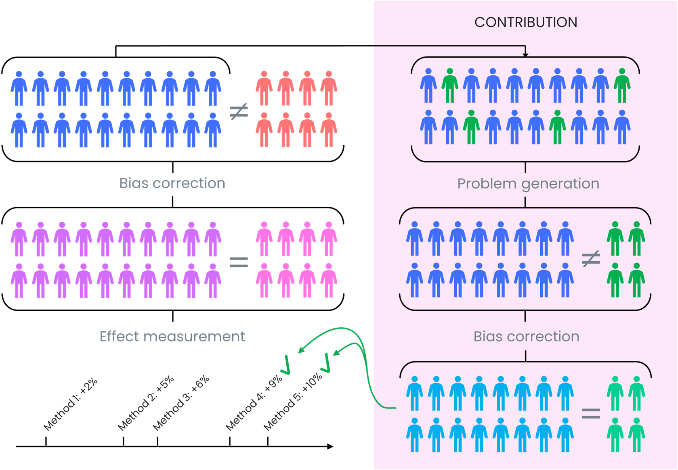
Questions & answers
Slides credit: LGBTQIA Pride month template by Microsoft

Slide 29
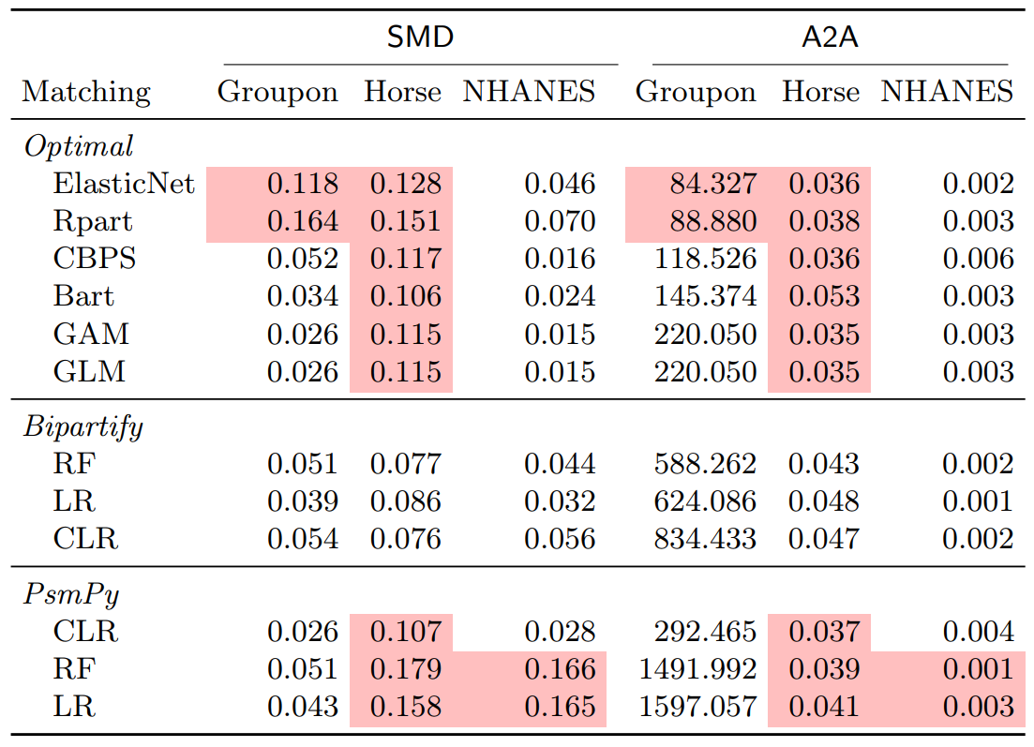
A2A and SMD

