Slide 1

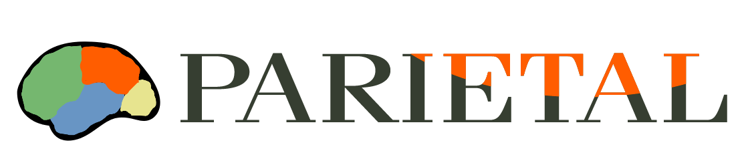


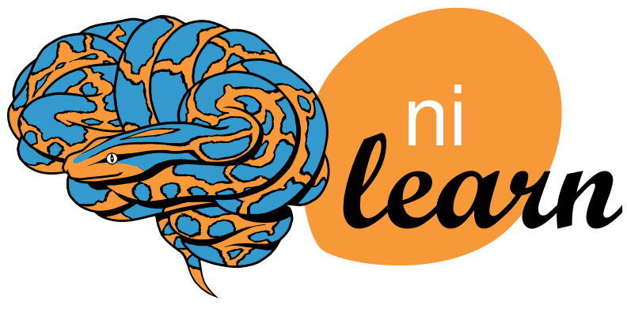
Nilearn : neuroimaging for scikit-learn
Alexandre Abraham^{1,2}, Fabian Pedregosa^{1,2}, Michael Eickenberg^{1,2}, Philippe Gervais^{1,2}, Alexandre Gramfort^{1,2,3}, Bertrand Thirion^{1,2}, and Gaël Varoquaux^{1,2}
COMING SOON
nilearn.github.io
¹ Parietal Team, INRIA Saclay, France ² CEA, DSV, I²BM, Neurospin, Gif-Sur-Yvette, France ³ Institut Mines-Telecom, Telecom ParisTech, CNRS LTCI, Paris, France
▸ Improves code quality and readability thanks to versatile objects
▸ Makes your scripts distributable with automatic data fetching
▸ Provides detailed examples usable on your data, using scikit-learn
▸ Implements state of the art algorithms like Searchlight or CanICA
Features
Data preparation
▸ SearchLight
▸ Multi-subject PCA and ICA
▸ Signal extraction and preparation
▸ Harnest scikit-learn: SVM, sparse
regression, sparse inverse covariance...
All fast and scalable
Detrending
Removes linear
trend over voxels'
time series
Normalization
Sets time series
variance to 1
Confounds
removal
Regress out
spurious noise
Frequency
filtering
Remove scanner
drifts
Masking
Discard
uninformative
voxels
Application: Miyawaki 2008
Encoding stimuli and decoding brain activity
▸ Highlighted pixels are same in both settings
▸ Encoding and decoding match: they highlight a relationship between the same pixel and voxels

