Slide 1
IBM Watson Studio
IBM Cloud / Watson and Cloud Platform / © 2018 IBM Corporation

Slide 2
Agenda
Watson Studio – Offering Overview
Use Cases
Demonstration
Q&A
IBM Cloud / Watson and Cloud Platform / © 2018 IBM Corporation

Slide 3
Steps for your AI journey
Prove
Adopt
Scale
Prove that AI Computing can positively impact your business with an Initial Use Case
Adopt an AI approach and understand how it will change the organization’s ways of working
Scale AI Computing Solutions across the Enterprise
IBM Cloud / Watson and Cloud Platform / © 2018 IBM Corporation

Slide 4
What do we aim for in a Banking Business?
IBM Cloud / Watson and Cloud Platform / © 2018 IBM Corporation

Slide 5
Business Goals:
Customer Satisfaction
IBM Cloud / Watson and Cloud Platform / © 2018 IBM Corporation

Slide 6
Business Goals:
Optimize Spending
IBM Cloud / Watson and Cloud Platform / © 2018 IBM Corporation

Slide 7
Business Goals:
Detect and Prevent Fraud
IBM Cloud / Watson and Cloud Platform / © 2018 IBM Corporation

Slide 8
Business Goals:
Compliance
IBM Cloud / Watson and Cloud Platform / © 2018 IBM Corporation

Slide 9
Why are enterprises struggling to capture the value of AI?
Data
Data resides in silos & difficult to access
Unstructured and external data wasn’t considered
Governance
If the data isn’t secure, self-service isn’t a reality
Challenge understanding data lineage and getting to a system of truth
Skills
Data Science skills are in low supply and high demand
Nurturing new data professionals is challenging
Tools & Infrastructure
Need an environment that enables a “fail fast” approach
Discrete tools present barriers to productivity
IBM Cloud / Watson and Cloud Platform / © 2018 IBM Corporation

Slide 10




Watson Studio
Built for AI teams – enabling team productivity and collaboration
Tanya
Domain Expert
Mike
Data Scientist
Ed
Data Engineer
Deb
The Developer
Her Job:
To transfer knowledge to Watson for a successful user experience.
His Job:
Transform data into knowledge for solving business problems.
His Job:
Architects how data is organized and ensures operability
Her Job:
Builds AI application that meet the requirements of the business.
What she does:
Range of domain knowledge and uses that to teach Watson and develop a custom models
As Tanya gains more experience she optimizes her knowledge to teach Watson to design better end-user experiences.
What he does:
Runs experiments to build custom models that solve business problems.
Use techniques such as Machine Learning or Deep Learning and works with Tanya to validate success of trained models.
What he does:
Builds data infrastructure and ETL pipelines. Works with Spark, Hadoop, and HDFS.
Works with data scientist to transform research models into production quality systems.
What she does:
Starts PoCs which includes gathering content, dialog building and model training
Focus is on app building for the team or company to use. Will handle ML Ops as needed
Sometimes known as:
Subject matter expert, content strategist.
Sometimes known as:
ML/DL engineer, Modeler, Data Miner
Sometimes known as:
Data infrastructure engineer
Sometimes known as:
Front-end, back-end, full stack, mobile or low-code developer

Slide 11
Watson Studio
Supporting the end-to-end AI workflow
Connect & Access Data
Search and Find Relevant Data
Prepare Data for Analysis
Build and Train ML/DL Models
Deploy Models
Monitor, Analyze and Manage
Connect and discover content from multiple data sources in the cloud or on premises. Bring structured and unstructured data to one toolkit.
Find data (structured, unstructured) and AI assets (e.g., ML/DL models, notebooks, Watson Data Kits) in the Knowledge Catalog with intelligent search and giving the right access to the right users.
Clean and prepare your data with Data Refinery, a tool to create data preparation pipelines visually.
Use popular open source libraries to prepare unstructured data.
Democratize the creation of ML and DL models. Design your AI models programmatically or visually with the most popular open source and IBM ML/DL frameworks or leverage transfer learning on pre-trained models using Watson tools to adapt to your business domain. Train at scale on GPUs and distributed compute
Deploy your models easily and have them scale automatically for online, batch or streaming use cases
Monitor the performance of the models in production and trigger automatic retraining and redeployment of models. Build Enterprise Trust with Bias Detection, Mitigation Model Robustness and Testing Service Model Security.
IBM Cloud / Watson and Cloud Platform / © 2018 IBM Corporation

Slide 12



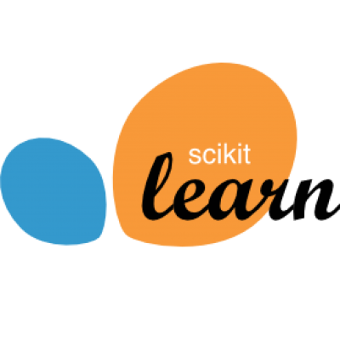




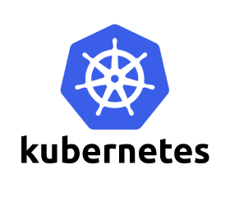
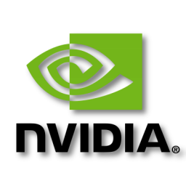
Watson Studio
Comprehensive set of tools for the end-to-end AI workflow
Create, collaborate, deploy, and monitor
Best of breed open source & IBM tools
Code (R, Python or Scala) and no-code/visual modeling tools
Authoring Tools
Data Refinery
Model Builder
Watson API Tools
Machine Learning Runtimes
Deep Learning Runtimes
Most popular open source frameworks
IBM best-in-class frameworks
Cloud Infrastructure as a Service
Fully managed service
Container-based resource management
Elastic pay as you go CPU/GPU power
Model Lifecycle Management
IBM Cloud / Watson and Cloud Platform / © 2018 IBM Corporation

Slide 13
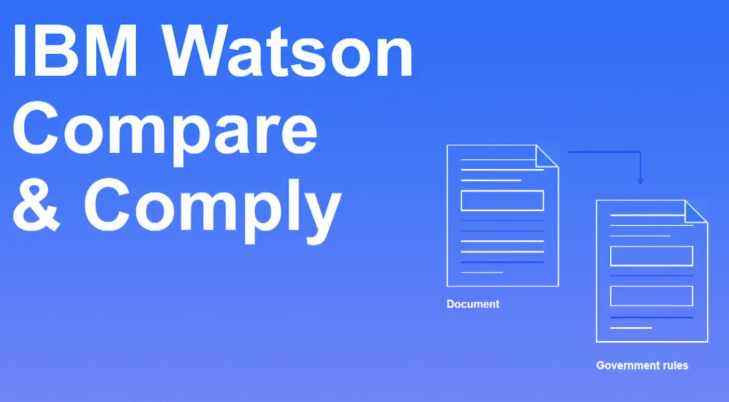
IBM Cloud / Watson and Cloud Platform / © 2018 IBM Corporation

Slide 14
A large retail bank
Several institutional clients at the bank have raised the same issue: they are not being billed properly for banking services.
That sounds like a simple question to resolve, but for the bank, it’s actually quite time-consuming to locate the right set of discrepancies among payment terms in a variety of committed contracts and then reconcile those against their clients’ internal billing systems.
The bank could hire outside counsel to perform thousands of contact reviews and then record their analysis into a normalized repository of the terms, and then update their billing systems.
Instead, they’re applying Watson’s semantic understanding to extract the payment terms in the contracts and proceed.
IBM Cloud / Watson and Cloud Platform / © 2018 IBM Corporation

Slide 15

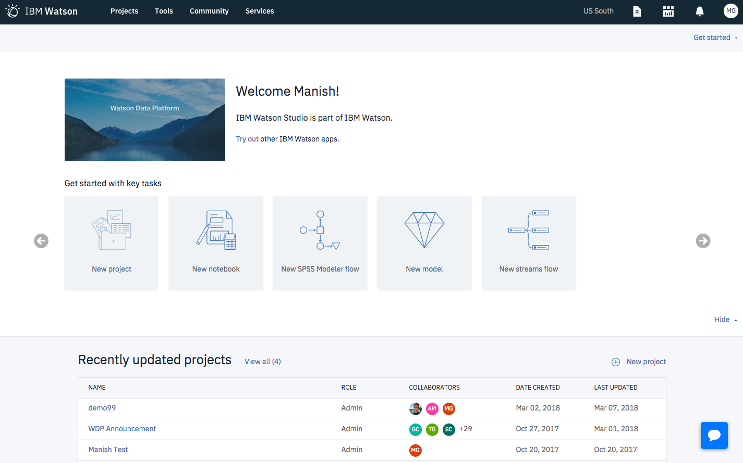
Demo
IBM Cloud / Watson and Cloud Platform / © 2018 IBM Corporation

