Slide 1
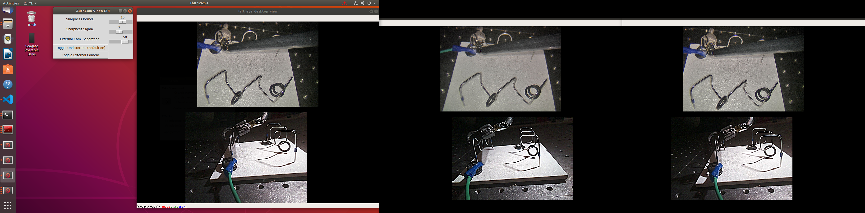

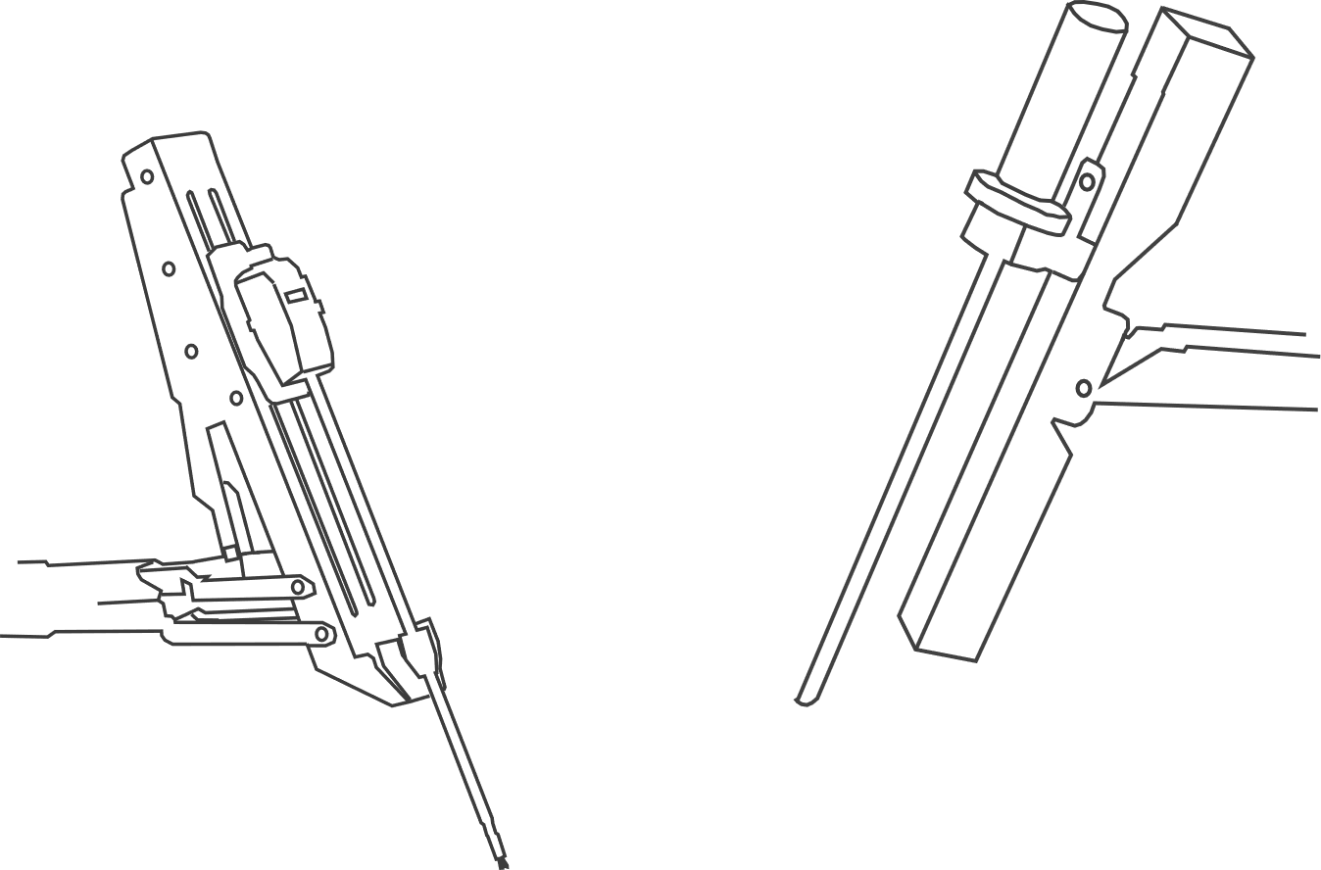
a)
UI
Disparity
Adjust
b)
PC 2
Video to Console
HDMI
DeckLink Capture Card
PCIe
Video Processing
Ethernet
Autocam Video
ECM Video
Ethernet
PC 1
ECM
Kinematics & Motion Commands
Autocam Controller
FireWire
Autocam

