Slide 1

Multithreading
Game Server Programming

Slide 2
Multithreading
1 | Programs & Processes
2 | Threads
3 | When do we need
multithreaded programming?
4 | What is a thread?
5 | Things to consider when
handing threads
6 | Critical sections and mutexes
7 | Deadlocks
8 | Rules for locking order
9 | Parallelism & serial
bottlenecks
10 | Single-threaded game server
11 | Multi-threaded game server
12 | Atomic operation
source: Game Server Programming Textbook, Gilbut, 2019

Slide 3
1.1 | Programs & Processes
Program: A chunk of data containing a set of instructions , executed on a computer
Process: A state in which a program is active
Loading: Loading the code and data in a program into process memory
In Winedows, you can check the programs that are executed in this way with the Task Manager
Program
Process
code
code
heap
execution
data
data
stack
Fig. 1-1 Programs are on disk, processes are in RAM

Slide 4
1.1 | Programs & Processes
Multiprocessing: Multiple processes running
Process 1
Process 2
code
heap
code
heap
data
stack
data
stack
Fig. 1-3 multiprocessing

Slide 5
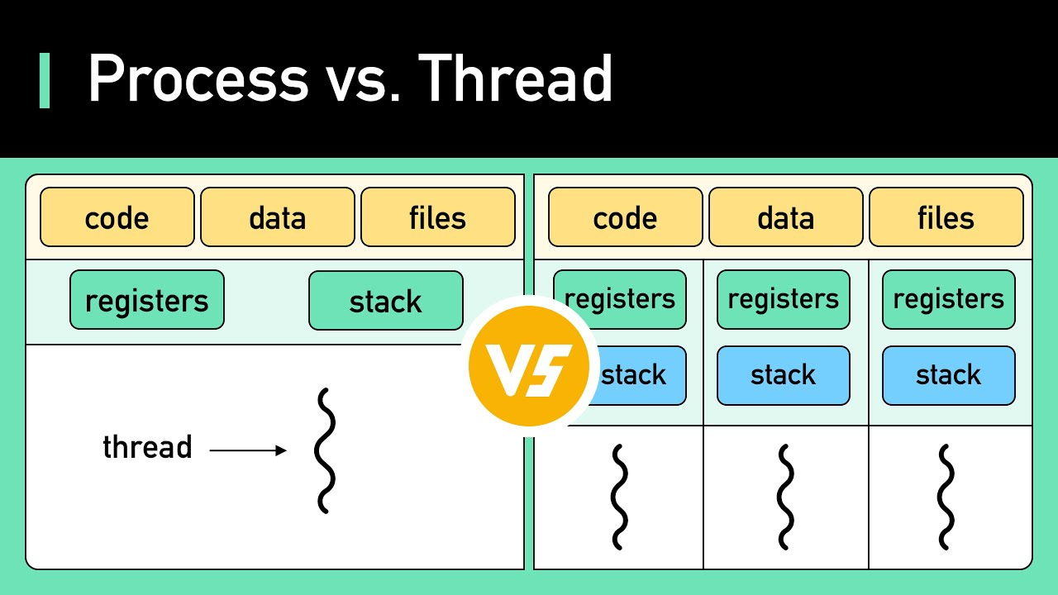
1.2 | Thread
Most commonly used Oses provide a functionality called threads.
Difference between threads and processes
There are multiple threads in a process
Threads are the flow of a program!
Threads in a process can share the memory space in the process
Each thread has a stack. This means that local variables of functions executed in each thread managed by each thread.
heap
heap
Fig. 1-4 Process and Threads

Slide 6
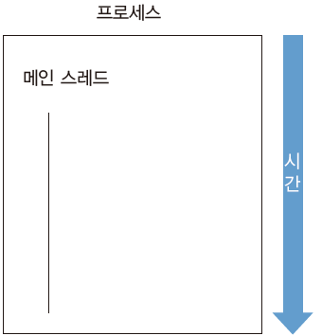
1.2 | Thread
“When you run a program, a process is created. Inside that process, there is a single thread, and the program runs inside that thread.”
Single-threaded program: A program that runs only one program at a time.
Single-threaded model: A program designed and implemented to operate with only a single thread.
Process
Main thread
The thread that exists by default (main thread),
the one that has been running the program so far
Time
Fig. 1-5 Single thread

Slide 7
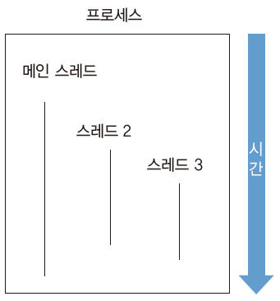
1.2 | Thread
Multithreaded model or multithreading: Having multiple threads handle multiple tasks simultaneously
Process
void main()
{
t2 = CreateThread(Thread2Proc);
}
void Thread2Proc()
{
t3 = CreateThread(Thread3Proc);
}
void Thread3Proc()
{
...
}
Main thread
Thread 2
Time
Thread 3
Fig. 1-6 Multithreading

Slide 8
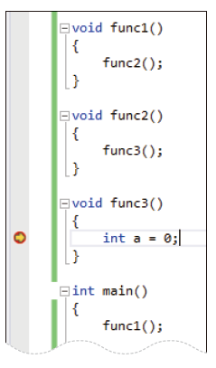
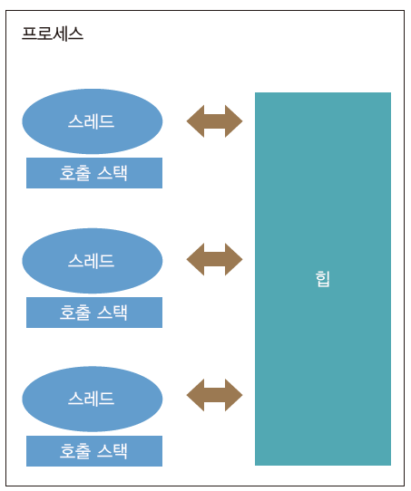
1.2 | Thread
Checking the call stack using the debugger (when using Visual Studio)
Fig. 1-8 Debugger call stack
Process
Thread
Call stack
Thread
heap
Call stack
Fig. 1-7 Debugging in Visual Studio
Fig. 1-9 Relationship among
threads, call stack, and heap
Thread
Call stack
*exCallStack

Slide 9
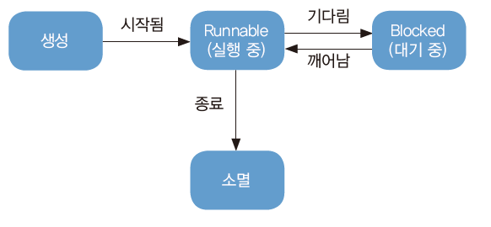
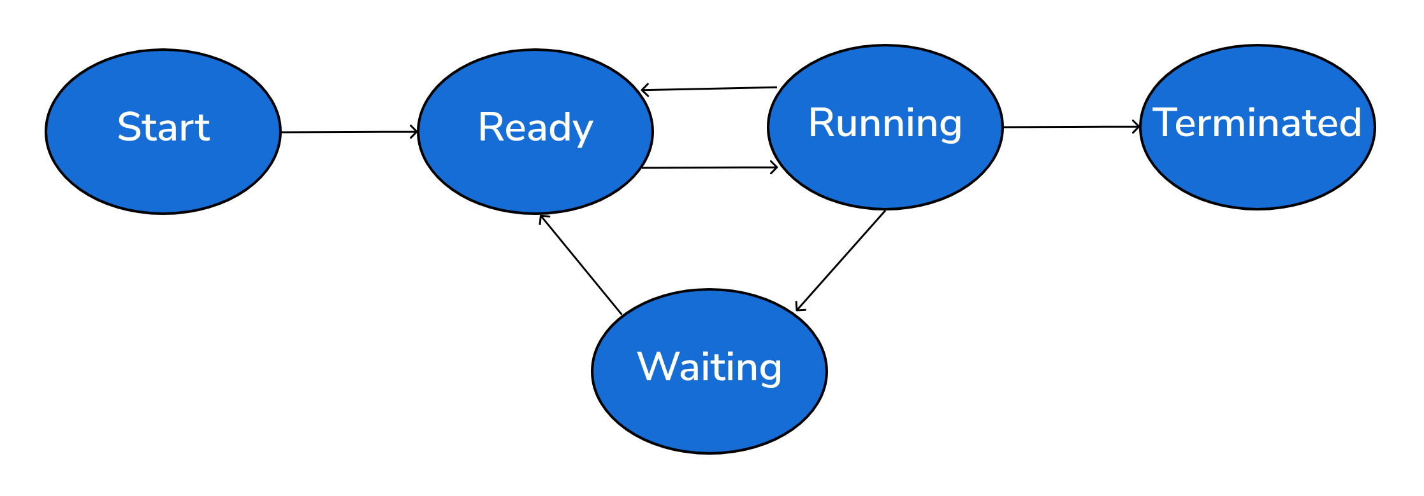
1.2 | Thread
Example of main thread and another thread running concurrently
void main()
{
// ➊ start main thread
t1 = CreatThread(ThreadProc, 123);
// ➋ Dealing with long-term tasks
// ...
// ➌ Wait until t1 thread terminates
t1.Join();
// ➍ End of main()
}
ThreadProc(int)
{
// ➎ Dealing with long-term tasks
// ...
// ➏ End of ThreadProc()
}
No one knows which of ➋ and ➎ will be executed first!
Fig. 1-10 Life of a thread

Slide 10
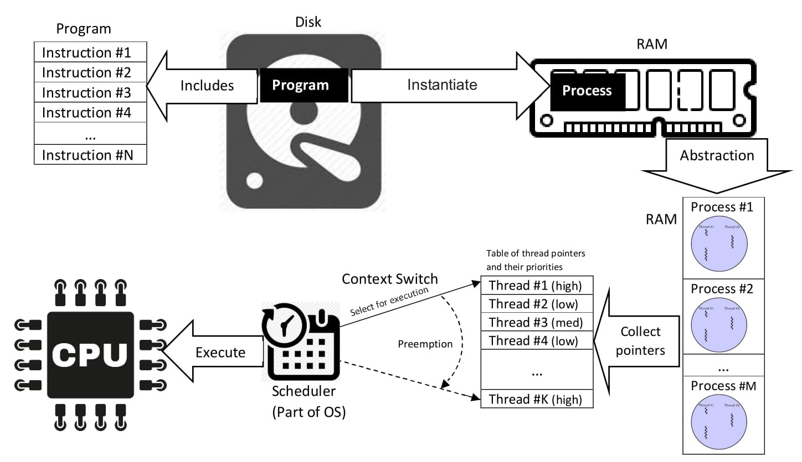
1.2 | Program journey to Execution
https://upload.wikimedia.org/wikipedia/commons/2/25/Concepts-_Program_vs._Process_vs._Thread.jpg

Slide 11
1.3 | When should we need multithreaded programming?
Typical situations where multi-threaded programming is required
1. When you need to do one long-running task and
several quick-running tasks at the same time
2. When you need to do other short tasks while
performing a long process
3. When you need to utilize all the CPUs on the device

Slide 12



1.3 | When should we need multithreaded programming?
1.3.1 When you need to do one long-term task and several quick-to-finish tasks at the same time
-When loading in a game program
Fig. 1-11 Graphical representation of
loading situation
Fig. 1-12 Animation to relieve
the tedious loading time
(<Street Fighter 5>)
Fig.1-13 Minigame to enjoy
while loading

Slide 13
1.3 | When should we need multithreaded programming?
When not multithreading
When multithreading
LoadScene()
{
Render();
LoadScene();
Render();
LoadModel();
Render();
LoadTexture();
Render();
LoadAnimation();
Render();
LoadSound();
}
bool isStillLoading; // global variable
Thread1
{
isStillLoading = true;
while (isStillLoading)
{
FrameMove();
Render();
}
}
Thread2
{
LoadScene();
LoadModel();
LoadTexture();
LoadAnimation();
LoadSound();
isStillLoading = false;
}
Messy code
Temporary frame rate drops when loading large files
Frame rate is uneven when loading and rendering files in parts, and the code becomes messier
Perform rendering continuously
Loading data required for the game from disk, and changing a specific variable when loading is complete. Thread1 repeatedly renders the loading screen until this variable is changed.
Rendering: The process of visually representing data. Mainly used to display graphics, images, videos, etc. on the screen.

Slide 14
1.3 | When should we need multithreaded programming?
1.3.2 When you need to do other short tasks while doing some long processing.
- When accessing a disk to read or write player information.
The time it takes to write player information to disk is about 1/10,000th of a second → A huge waste of time for commercial game servers.
To utilize a very long time of 1/10,000 second
You need to do multithreading or asynchronous programming!
Disks are mechanical devices made up of motors, so they work much slower than electronic circuits.
First-person shooter (FPS) games process 30 requests per second for one client. If 10,000 of these clients connect to the server, 30 * 10,000 = 300,000 processings are required per second.
→ In the worst case, the server that should process 300,000 requests can only process 10,000 requests per second.

Slide 15
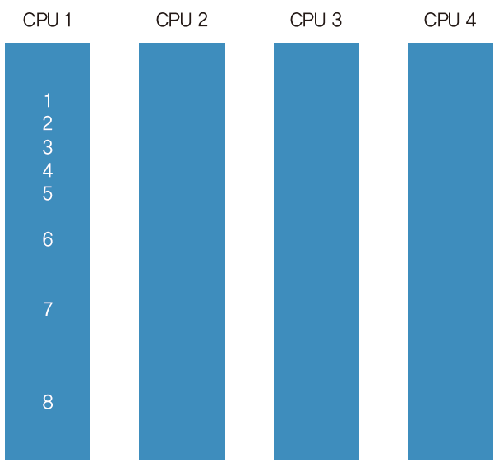
1.3 | When should we need multithreaded programming?
1.3.3 When you need to utilize all the CPUs on your device
Experiment: Program to find and print prime numbers (integers that are not divisible by any number other than 1 and itself, such as 2, 3, 5, and 7)
Demo: prime_number
- Program execution: Displays the time taken to calculate the prime number.
Took 3920 milliseconds.
- Run after changing MaxCount to a much larger number
Fig. 1-14 the entire CPU cannot be used
Fig. 1-15 The unfortunate situation where calculations are processed with only one CPU (core)
Task Manager (Ctr+shift+esc) > Performance
*prime_number

Slide 16
1.3 | When should we need multithreaded programming?
-solving the issue
Create a global variable num.
Each thread gets one value from num. Determine if the value is a prime number.
If it is a prime number, put the found number in the array primes.
Once all threads have finished their work, print out the prime numbers.
*Demo: prime_number_errorneous
- Expressing in code
int num = 1;
Array<int> primes;
main()
{
Array<Thread> threads;
for (i = 0; i < 4; i++)
threads.Add(BeginThread(ThreadProc));
for (i = 0; i < 4; i++)
{
threads.waitForExit();
}
printNumbers(primes);
}
TreadProc()
{
while (num <= 1000000)
{
if (Isprime(num)) primes.Add(num);
num++;
}
}

Slide 17
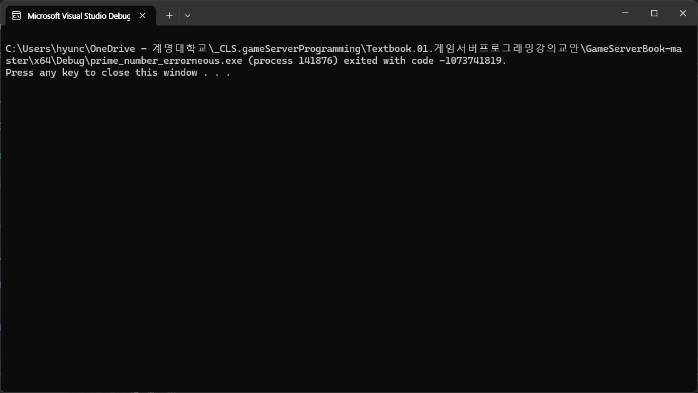
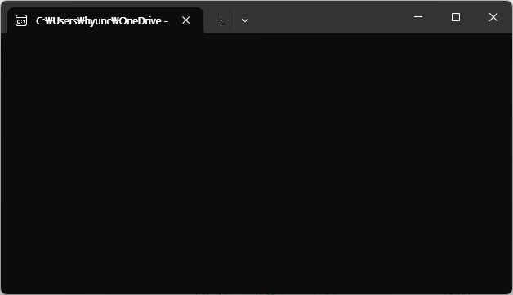
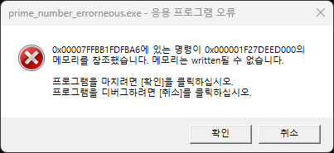
1.3 | When should we need multithreaded programming?
-Multi-thread programming attempted without any plan…
Notes:
기다린다?!?

Slide 18
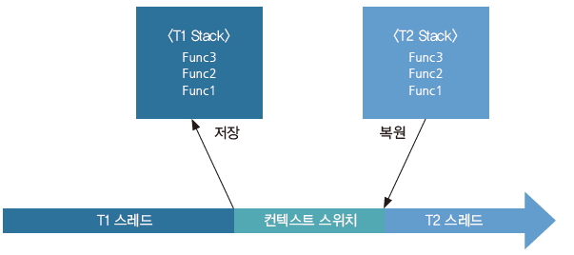
1.4 | Thread and context switch
When told to “do two things at the same time”
- Computers work by going back and forth
- Context switch: The process of executing another thread while stopping execution of each thread
- If the context switch interval is too frequent: The time spent executing T1 and T2 is much less, so it is inefficient
- If the context switch is as few as possible: If context switch takes 1 second, then the animation during loading can only be executed once per second!
- If the number of threads is more than the number of CPUs: The context switch must occur within a CPU
- If the number of threads that are actually runnable is less than the number of CPUs, there is no problem
- The context switch is performed in machine language instruction units.
save
save
restore
Thread T1
Context Switching
Thread T2
Fig. 1-19 Context Switching

Slide 19
1.5 | Things to keep in mind when handling threads
When two threads access one value simultaneously
x += y;
int x = 2
# Thread 1
x += 3
# Thread 2
x += 4
# Expected value
x is 9
What we want
Wrong result!
- Context switches occur randomly
x = 2
# Thread 1
t1 = x // t1 = 2
t1 = t1 + 3 // t1 = 5
x = t1 // x = 5
# Thread 2
t2 = x // t2 = 5
t2 = t2 + 4 // t2 = 9
x = t2 // x = 9
x = 2
# Thread 1
t1 = x // t1 = 2
t1 = t1 + 3 // t1 = 5
# Thread 2
t2 = x // t2 = 2
t2 = t2 + 4 // t2 = 6
x = t2 // x = 6
# Thread 1
x = t1 // x = 5 !!!
When compile the code into machine language,
t1 = x
t1 = t1 + 3
x = t1

Slide 20
1.5 | Things to keep in mind when handling threads
Find out what went wrong in the program that calculates prime numbers previously
  Multiple threads access the Array<int> array object simultaneously
  (member variable: pointer, size of array).
  When there is not enough space, reallocate memory
  (often change the value of the pointer variable).
  The following properties are not satisfied
    Atomicity: Either change both variables or neither
    Consistency: Both variables always maintain a consistent state
main()
{
Array<Thread> threads;
for (i = 0; i < 4; i++)
threads.Add(BeginThread(ThreadProc));
for (i = 0; i < 4; i++)
{
threads.waitForExit();
}
printNumbers(primes);
}
int num = 1;
Array<int> primes;
TreadProc()
{
while (num <= 1000000) {
if (Isprime(num)) primes.Add(num);
num++;
}
}

Slide 21
1.5 | Things to keep in mind when handling threads
Find out what went wrong in the program that calculates prime numbers
Only one 4-byte integer data space is required to store the information called -num, but more than one data space is required to store the information called Array<int> primes.
Array<int> has a pointer variable that points to the array object and the size of the array as a member variable. The array object would have been allocated from the memory heap, and the memory heap is handled by the runtime library of the currently running process.
If two threads call the Add() function of Array<int> at the same time, multiple threads will change the Array<int> variables, and then the other thread will access the array while only one of the two variables has changed.
During this process, the pointer variable pointing to the array may temporarily point to a wrong value, for example, memory that has already been freed from the heap: data race condition occurs.
Atomicity: While accessing the two member variables, other threads must not access them. –
Consistency: The two variables of Array<int> always maintain a consistent state.
Therefore, a synchronization technique is required:
- Special measures to maintain atomicity and consistency, representative examples are critical sections, mutexes (mutual exclusion), and locking techniques.
A critical section is a part of code area where shared resources (like variables, memory, or files) are accessed by multiple threads simultaneously, and might causing problems.

Slide 22
1.6 | Critical Sections and Mutexes
One of several ways to resolve a race condition
“While a thread is using some information X, prevent other threads from accessing X!”
To be more precise…
“Other threads will wait until the current thread has finished using X before accessing it!”

Slide 23
1.6 | Critical Sections and Mutexes
Mutex: expressing it in code
Explicitly call lock and unlock
Mutex: Short for MUTual EXclusion.
std::mutex mx; // ➊
mx.lock(); // ➋
read(x); // ➌
write(y); // ➍
sum(x); // ➎
mx.unlock(); // ➏
1. Create a mutex MX that protects X, Y.
2. Before accessing X, Y, the thread asks MX to “gain the right to use it.”
3. The thread accesses X, Y.
4. After accessing it, it asks MX to “release the right to use it.”
How to use
a mutex
// C# code example
object mx = new object();
lock(mx)
{
read(x);
write(y);
sum(x);
}
// C++ code example
std::mutex mx;
{
std::lock_guard<std::mutex> lock(mx);
read(x);
write(y);
sum(x);
}

Slide 24
1.6 | Critical Sections and Mutexes
Fig. 1-24 Multithreaded implementation of a program to find prime numbers
ThreadProc()
{
while (1)
{
int n;
lock(num_critSec)
{
n = num;
num++;
if (num > 1000000)
break;
}
if (IsPrime(n))
{
lock(primes_critSec)
{ primes.Add(n); }
}
}
}
main()
{
List<Thread> threads;
for (i = 0; i < 4; i++)
{
threads.Add(
new Thread(ThreadProc);
}
for (i = 0; i < 4; i++)
{
threads.Join();
}
}
int num = 1;
CriticalSection num_critSec;
Array<int> primes;
CriticalSection primes_critSec;
*Demo: prime_number_multithreaded
- Running the program gives the following results – it runs much faster than the previous case.
Took 1358 milliseconds.

Slide 25
1.6 | Critical Sections and Mutexes
Measure CPU usage after greatly increasing MaxCount
Execution time when there is one thread: 3900 milliseconds
Execution time when there are four threads: 1300 milliseconds
→ Why is it actually only 3 times faster?
Fig. 1-25 Checking CPU usage

Slide 26
1.6 | Critical Sections and Mutexes
Main loop of the thread
In the ➊, ➋ section, a lock is applied, and
a situation occurs where other threads
switch to a waiting state.
However, the operation for calculating
prime numbers requires much more
calculations than this section.
➊, ➋ can also be a reason for unsatisfactory performance,
but the proportion is not large.
// Main function for each thread
// Loop if we can get a value.
while (true)
{
int n;
{
lock_guard<recursive_mutex> num_lock(num_mutex);
n = num;
num++;
}
if (n >= MaxCount)
break;
if (IsPrimeNumber(n))
{
lock_guard<recursive_mutex> primes_lock(primes_mutex);
primes.push_back(n);
}
}
// ➊
// ➋
Even if you have a lot of CPUs,
we can't use 100% of
their performance.

Slide 27
1.6 | Critical Sections and Mutexes
If you divide the mutex too finely,
Rather, the program performance is lowered → because the process of accessing the mutex itself is heavy.
The program becomes very complex, especially deadlock problems easily occur.
Code having too small critical section
class Player
{
CriticalSection m_positionCritSec;
Vector3 m_position; // ➊
CriticalSection m_nameCritSec;
string m_name; // ➋
CriticalSection m_hpCritSec;
int m_hp; // ➌
}
It is recommended to divide the mutex range appropriately.
It is recommended to divide the lock units for parts that are
advantageous when operated simultaneously
(multiple CPUs in parallel).
And not to divide the lock units for
parts that do not significantly affect performance .
The above code must access in order to avoid deadlock. It is difficult to handle increasing rules.

Slide 28

1.7 | Deadlock
Deadlock
A situation where two threads are waiting for each other
Thread 1 is waiting for Thread 2 to finish what it was doing,
but Thread 2 is actually waiting for Thread 1 to finish what it was doing
→ In this case, both threads are stuck forever
int a;
int b;
Fig. 1-26 Deadlock in reality
Thread1()
{
lock(a)
{
a++;
lock(b)
{
b++;
}
}
}
Thread2()
{
lock(b)
{
b++;
lock(a)
{
a++;
}
}
}
Wait forever
Fig. 1-27 If the program is executed in this order, a deadlock occurs.

Slide 29
1.7 | Deadlock
What happens when a deadlock occurs on a game server?
1. CPU usage is significantly low or 0%, regardless of the number of concurrent users
2. Clients cannot use the server, for example, they cannot log in or send a request and do not receive a response.
How to use CRITICAL_SECTION
Critical section creation is done with InitializeCriticalSectionEx. At this time, a CRITICAL_SECTION object is created.
Critical section removal is done with DeleteCriticalSection.
Critical section locking is done with EnterCriticalSection.
Critical section unlocking is done with LeaveCriticalSection.
Deadlock occured
t1 done.
t1 done.
t1 done.
t1 done.
t1 done.
t1 done.
t1 done.
t1 done.
t1 done.
t1 done.
t1 done.
t1 done.
(stop…)
*Demo: deadlock-example

Slide 30
1.8 | Rules for locking order
To prevent deadlock when using multiple mutexes:
First, draw the locking order of each mutex as a graph.
Then, when locking, you should check the locking order graph to see if there is anything locked in reverse.
-The unlock order does not affect deadlock.
Locking order of mutexes A, B, and C
A → B → C // ➊
When locking in the order of A → B → C
(does not cause deadlock)
When locking in the order of A → B
(does not cause deadlock)
When only B and C are locked (does not cause deadlock)
lock(B) // lock B
unlock(B) // unlock B
lock(C) // lock C
// Since B has already been unlocked, only C is locked.
unlock(C) // unlock C
lock(A)
lock(B)
lock(C)
unlock(C)
unlock(B)
unlock(A)
lock(A)
lock(B)
unlock(B)
unlock(A)
When locking in the order of B → C
(does not cause deadlock)
When locking in the order of A → C (does not cause deadlock)
lock(A)
lock(C)
unlock(C)
unlock(A)
lock(B)
lock(C)

Slide 31
1.8 | Rules for locking order
A → B → C // ➊
When locking in the order of B → A (causing deadlock)
When locking in the order of C→A (causing deadlock)
lock(B)
lock(A)
unlock(A)
unlock(B)
lock(C)
lock(A)
unlock(A)
unlock(C)
recursive mutex
Handles a thread locking a mutex repeatedly multiple times smoothly.
lock(M) // Acquired a lock.
lock(M) // lock again.
unlock(M) // Unlock once. But there’s still one more to go.
unlock(M) // Unlock twice. Only then is the unlocking actually done.

Slide 32
1.8 | Rules for locking order
recursive mutex
A → B → C → B → A
A → C → B → C → A
lock(A) // ➊
lock(B) // ➋
lock(C) // ➌
lock(B) // ➍
lock(A) // ➎
unlock(C) // ➏
unlock(B) // ➐
unlock(A) // ➑
lock(A) // ➊
Lock(C) // ➋
lock(B) // ➌
lock(C) // ➍
lock(A) // ➎
unlock(C) // ➏
unlock(B) // ➐
unlock(A) // ➑
safe
First lock, keep the lock order
Safe since no backwards
Deadlock occur (break B → C)
Safe with recursive locking
Since locking that is already locked,
we can ignore the lock order graph.
All is safe, but deadlock occurs because of one line of code in ➌
“To avoid deadlock, locking order must be preserved (not reversed).”

Slide 33
1.9 | Parallelism and Serial Bottlenecks
Parallelism and Serial Bottlenecks
Parallelism: Multiple CPUs execute each thread's calculations to increase simultaneous processing.
Serial bottleneck: A phenomenon in which a program is designed to run in parallel, but only one CPU actually does the calculation.
What each thread of the prime number program does
1. Lock num.
2. Get a value from num.
3. Unlock num.
4. Determine if num is prime.
5. If it is, lock primes.
6. Insert a prime number into primes.
7. Unlock primes
lock(num)
n = num
num++
unlock(num)
IsPrimeNumber(n)
lock(primes)
primes.add(n)
unlock(primes)
Fig. 1-35 What a thread does over time

Slide 34
1.9 | Parallelism and Serial Bottlenecks
Fig. 1-36 A situation where everyone is playing except one CPU.
CPU 0
idle!
IsPrimeNumber(n)
idle!
CPU 1
idle!
IsPrimeNumber(n)
idle!
CPU 2
lock(num)
n = num
num++
unlock(num)
IsPrimeNumber(n)
lock(primes)
primes.add(n)
unlock(primes)
CPU 0~98
Fig. 1-36 A situation where only one
CPU is working and the other 99 are idle.
idle!
idle!
CPU 99

Slide 35
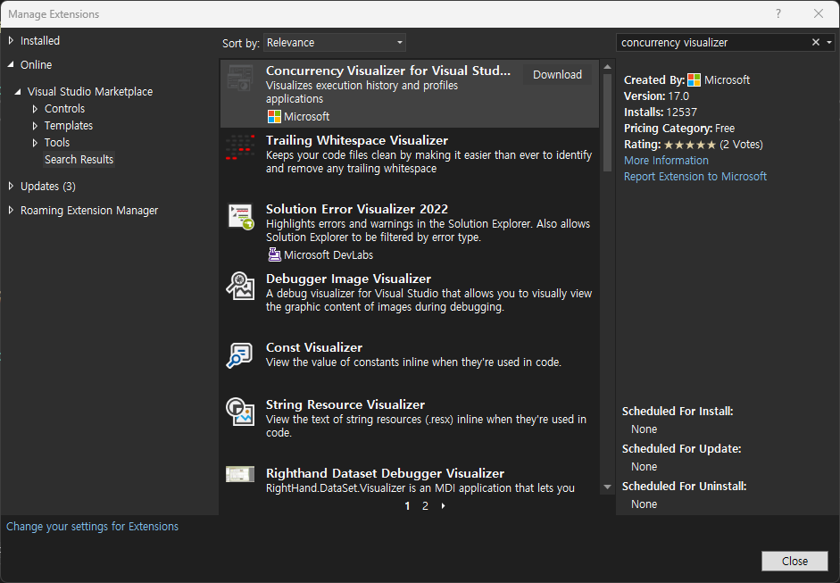
1.9 | Parallelism and Serial Bottlenecks
Reduce the curse of the Amdahl’s Law
Amdahl’s Law or Amdahl’s Curse: The phenomenon where the more CPUs there are, the lower the overall processing efficiency.
To reduce the curse of the Amdahl’s Law , the section where serial bottleneck occurs must be minimized.
Fig. 1-38 Installing Concurrency Visualizer (Extensions on menu)
Analyze > Concurrency Visualizer > Launch new process … , demo…

Slide 36
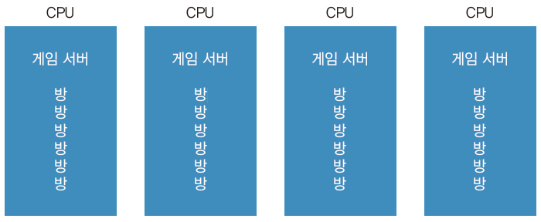
1.10 | Single threaded game server
When running a single-threaded server, it is common to launch as many processes as there are CPUs.
If there are as many threads or processes as the number of rooms, the number of context switches between threads or processes increases.
2. Therefore, even if it is a server that handles the same number of concurrent users, the number of concurrent users that can actually be handled is greatly reduced.
Game server
Game server
Game server
Game server
Room
Room
Room
Room
Room
Room
Room
Room
Room
Room
Room
Room
Room
Room
Room
Room
Room
Room
Room
Room
Room
Room
Room
Room
Room
Room
Room
Room
Room
Room
Room
Room
Fig. 1-42 Single-threaded, multi-process
*Room: A space where one or more players gather to play together. Also called a game room or multiplayer session.

Slide 37
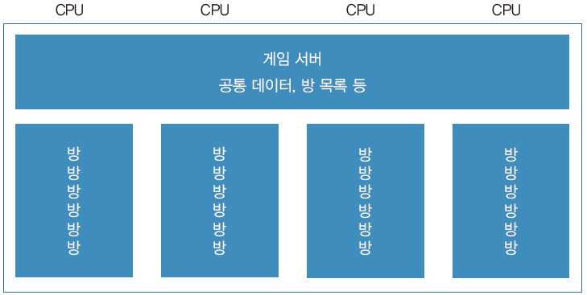
1.11 | Multi-threaded game server
When developing a server with multi-threading
1. When it is difficult to launch many server processes. For example, when the game information (map data, etc.) that needs to be loaded per process is very large (especially MMO game servers)
2. When a single server process performs so many operations that it requires the computational power of multiple CPUs
3. When co-routines or asynchronous functions cannot be used and device time is used
4. When only one server instance should be placed per server device
5. When different rooms need to access the same memory space
Game server
When creating a multi-threaded game server, the main thing to watch out for is serial bottlenecks and deadlocks. Especially when accessing files, performance degradation often occurs when accessing them with mutexes locked.
Sharing data, List of rooms, etc.
Room
Room
Room
Room
Room
Room
Room
Room
Room
Room
Room
Room
Room
Room
Room
Room
Room
Room
Room
Room
Room
Room
Room
Room
Room
Room
Room
Room
Room
Room
Room
Room
Fig. 1-43 Model of a game server that operates in multithreading in one process

Slide 38
1.12 | Atomic operation
atomic operation
It means that multiple threads can safely access it without a mutex or critical section lock.
Atomic operations are a hardware feature, and most compilers provide atomic operations.
Atomic operations ensure that when multiple threads access a 32-bit or 64-bit variable type, only one thread will process it.
Adding values ​​with atomicity
Swapping values ​​with atomicity
Conditional swapping values ​​with atomicity
We don't know what value the variable has, but we can add a specific value to that variable and get the result of that variable.
volatile int a = 0;
Declaring variable
int r = AtomicAdd(&a, 3);
“We don’t know what’s in a, but we’re going to add 3 to it. What we want is for a to have exactly the value 3 added to it. And we want to know what a is, after it’s been added.”
int r = AtomicExchange(&a, 10);
The variable values ​​and the values ​​I want are swapped. The past value of a is filled into r, and 10 is entered into a.
int r = AtomicCompareExchange(&a, 10, 100);
“Change a to 100 only if a contains 10”

Slide 39
//EoF

