Slide 1
Layer 3 Internet Protocol (IP)
Game Server Programming

Slide 2
Contents
Overview
Datagram
Fragmentation
Checksum
Layer3 Demo

Slide 3
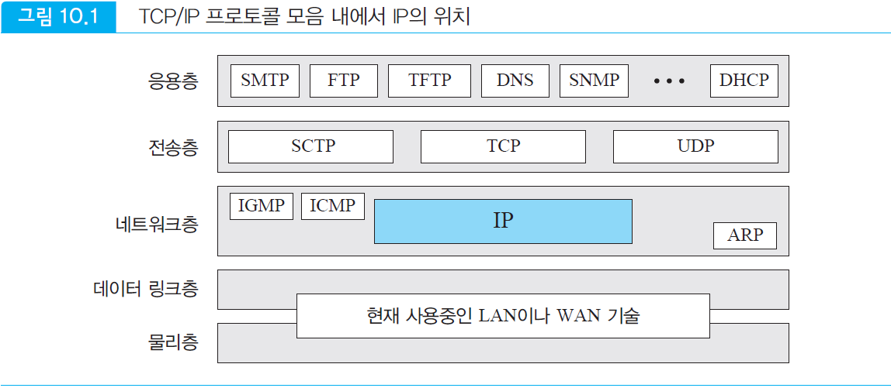
Internet Protocol
Transport mechanism used by the TCP/IP protocol
A connectionless protocol
Designed for packet-switched networks that use the datagram method
Providing unreliable and best-effort delivery service
Fig.1 IP's position within the TCP/IP suite
Application
Transport
Network
Data Link
LAN and WAN Technologies
Physical

Slide 4
Layer3 Outline
Unreliable
Does not guarantee that IP datagrams will successfully reach their destination
Connectionless
Does not maintain state information for transmitted datagrams
Addressing
Specifies the address of a node connected to each network to specify the destination to which data will be transmitted
Route setting
The main function of IP is to set the optimal path to transmit packets using the destination address

Slide 5
Datagram
The packet of the IP layer is called a datagram
A variable-length packet consisting of a header part and data part
Header is 20 upto 60 bytes
Contains information necessary for routing and delivery
Header is displayed in 4-byte units

Slide 6
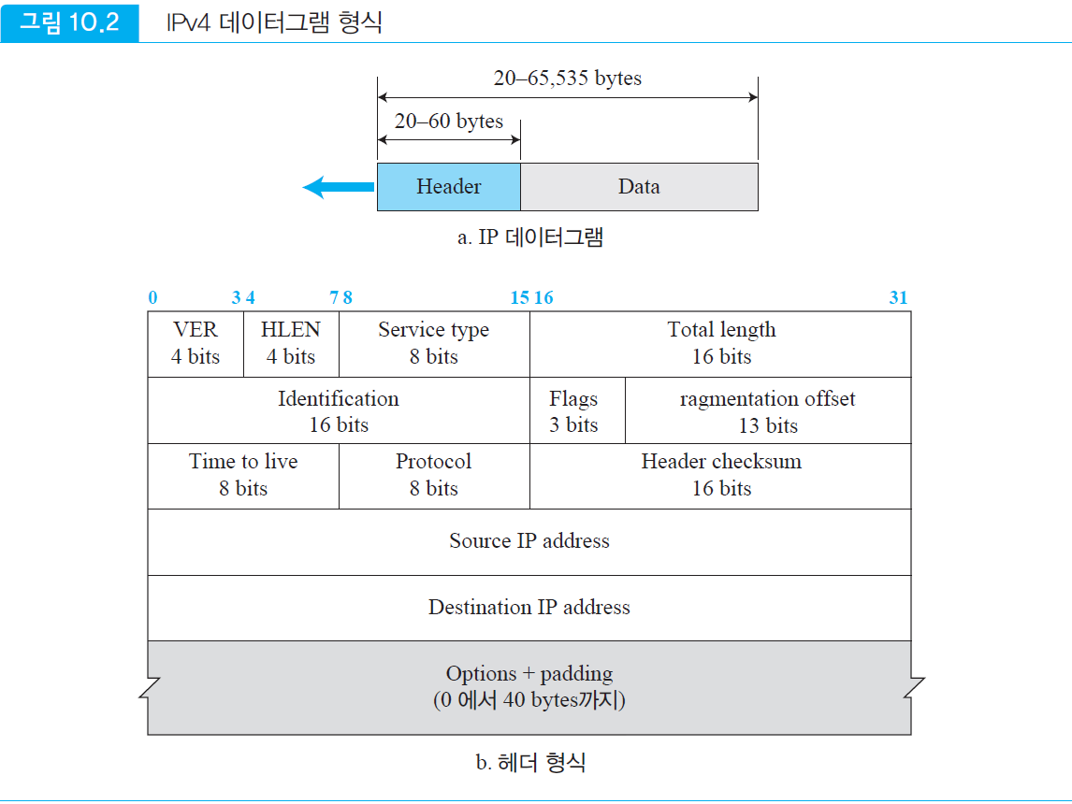
Fig.2 IPv4 datagram format
a. IP datagram
(0 – 40 bytes)
b. Header format

Slide 7
Datagram
Fields in the header
Version (VER)
Consists of 4 bits
Indicates the version of the IP protocol
Header length (HLEN)
4 bits
Indicates the total length of the datagram header in 4-byte units
Length of the header including options
Header without options is 20 bytes, indicated as 0101
5 * 4 = 20
Up to 60 bytes if options are added
15 * 4 = 60
(0 – 40 bytes)

Slide 8
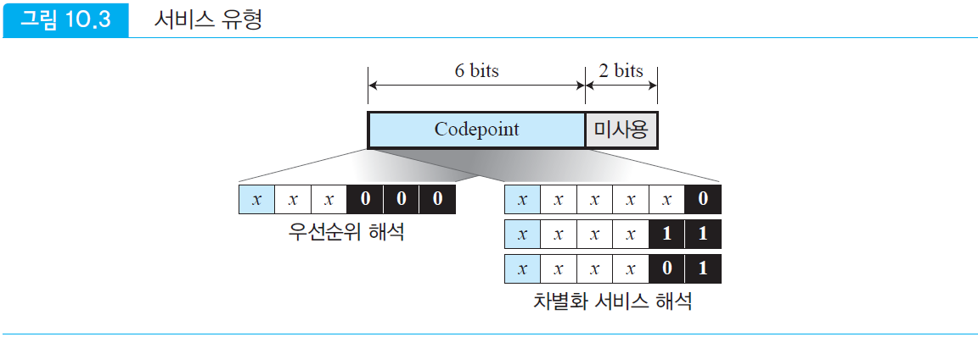
Datagram
TOS^{Type-Of-Service}
Consists of 8 bits
Defines how datagrams should be processed
IEFT modifies the meaning of service types, initially called TOS (Type Of Service) and now called the Differentiated Services set
6 bits are the codepoint subfield and 2 bits are unused
Fig.3 Type of Service
unused
< IETF
Priority Interpretation
< Local
< temporary
Interpretation of differentiated services
IETF | Internet Engineering Task Force

Slide 9
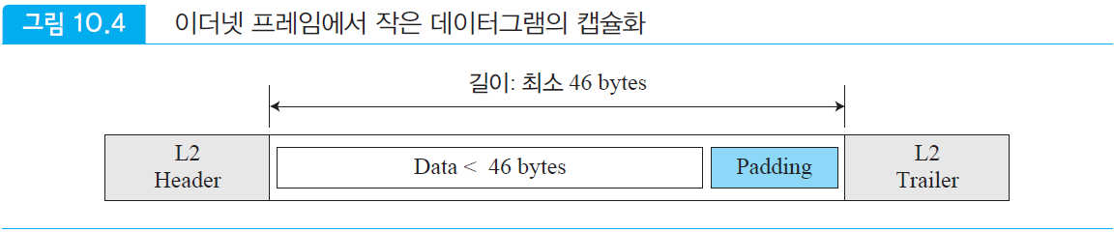
Datagram
Total Length
Consists of 16 bits
Total length of IP datagram including header and data
Total length of IP datagram expressed in bytes
Up to 65,535 bytes
Data length = total length – header length
(0 – 40 bytes)
Fig.4 Encapsulation of small datagrams in Ethernet frames
Minimum length is 46bytes

Slide 10
Datagram
Identification
16 bits
This field is used for fragmentation
Uniquely identifies each datagram sent by the host
When fragmentation occurs, the flags field and fragmentation offset are used
The fragmented packets have the same identifier.
Flags
3 bits
Used for fragmentation
Fragmentation offset
13 bits
When combining fragmented pieces into one datagram, indicates the relative position in the entire datagram
(0 – 40 bytes)

Slide 11
Datagram
Time to live
Consists of 8 bits
Limits the lifetime of a datagram by setting an upper limit on the number of routers (Hop count) that the datagram can pass through
Datagrams have a limited lifetime while being transmitted over the Internet
This field is designed to perform a timestamp function
It is decremented by each router visited, and if the value of this field becomes 0, the datagram is discarded
Default is 64, Windows OS 128
(0 – 40 bytes)

Slide 12
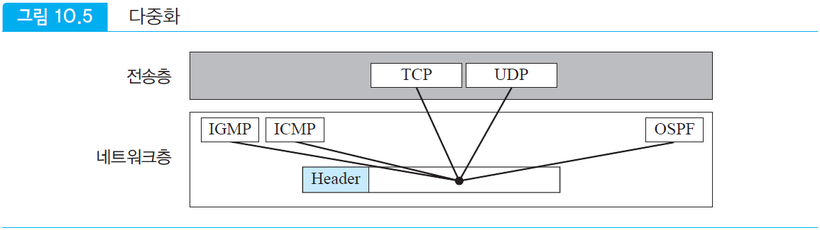
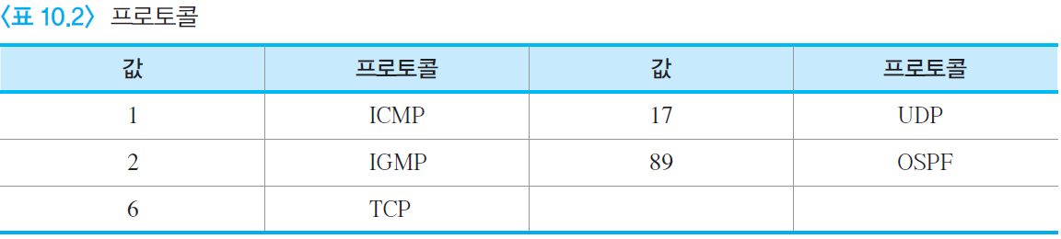
Protocol
Composed of 8 bits
Defines upper layer protocols that use the services of the IP layer
Encapsulates several types of upper layer protocols such as TCP, UDP, ICMP, and IGMP
Fig.5 Protocol field
Transport
Network
Some protocol values
Value
Protocol
Value
Protocol

Slide 13
Datagram
Checksum
16 bits
Checksum for error detection
Source address
32 bits
Defines the IP address of the source
This value must not change while the IP datagram is transmitted from the source to the destination
Destination address
32 bits
IP address of the final destination
This value must not change while the IP datagram is transmitted from the source to the destination
(0 – 40 bytes)

Slide 14
IP Datagram .
(0 – 40 bytes)
Q.1
What if an IP packet with the first 8 bits is received below?
A:
The receiver discards the packet. There is an error in this packet.
The leftmost 4 bits (0100) indicate the version.
The next 4 bits (0010) indicate the header length.
This means 4 x 2 = 8 bytes.
The minimum number of bytes in the header is 20 bytes.
It is considered to have been corrupted during transmission.
01000010

Slide 15
IP Datagram .
(0 – 40 bytes)
Q.2
The value of HLEN in an IP packet is 1000₂ in binary. How many options bytes are there in this packet?
A:
The HLEN value is 8, and the total number of bytes in the header is 4 x 8 or 32 bytes.
The first 20 bytes are the basic header, and 12 bytes are options.

Slide 16
IP Datagram .
(0 – 40 bytes)
Q.3
In an IP packet, the HLEN value is 5₁₆ and the total length field value is 0028₁₆. How many bytes of data does this packet carry?
A
The HLEN value is 5₁₆ and the total number of bytes in the header is 4 x 5 or 20 bytes (no options)
The total length is 0028₁₆ is 00101000₂, which is 40 bytes
The data is 20 bytes
Total length 40 bytes - Header length 20 bytes

Slide 17
IP Datagram .
(0 – 40 bytes)
Q.4
If the following IP packet is received, how many hops can this packet travel before it is discarded? And what upper layer protocol data is this packet carrying?
A
The TTL field is the 9th byte, 01. This means that the packet can travel only one hop.
The protocol field is the 10th byte, 02. This means that the upper layer protocol is IGMP.
45000028000100000102 . . .

Slide 18
Fragmentation
Fragmentation
The frame format and size are different depending on the protocol used by the network.
The maximum transmission length transmitted in each network is called MTU^{Maximum Transfer Unit}
Sending by dividing according to the MTU length is called fragmentation
Fields related to fragmentation and reassembly
Identification 16 bits
Flag 3 bits
Fragmentation offset 13 bits

Slide 19
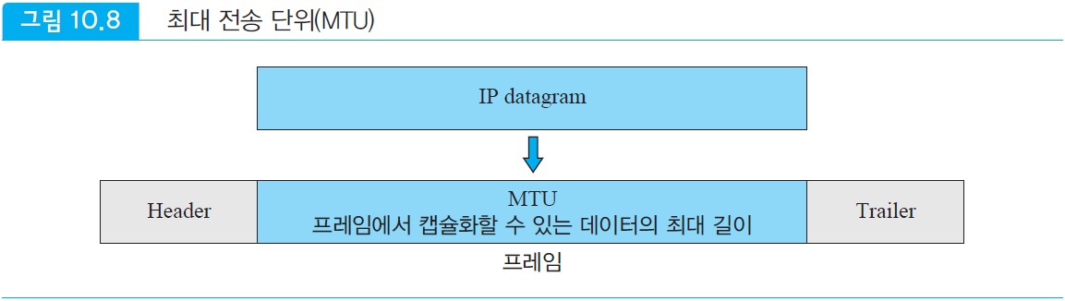
Fragmentation
MTU^{Maxmum Transfer Unit}
One of the fields defined in the format of the frame
When a datagram is encapsulated in a frame, the size of the datagram must be less than this maximum size.
Fig.6 MTU^{Maxmum Transfer Unit}
MTU: The maximum length of data that can be encapsulated in a frame
Frame

Slide 20
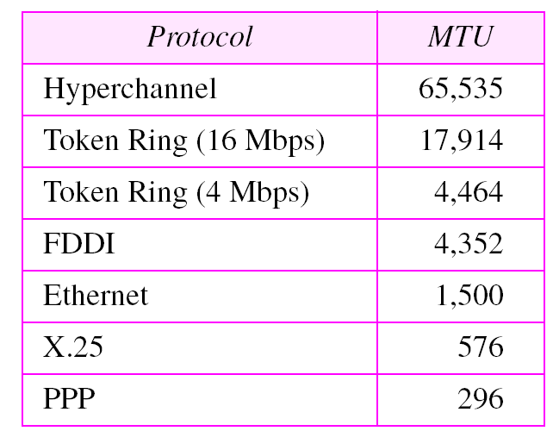
Fragmentation
MTU of different networks in byte

Slide 21
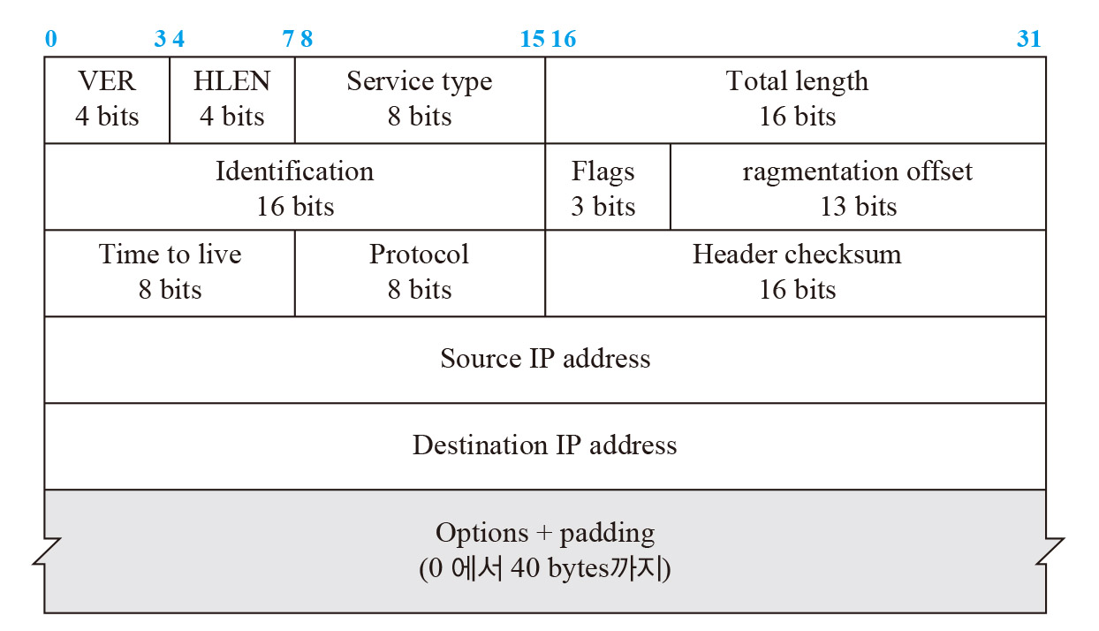
Fragmentation
Fields related to fragmentation
Identifier: Fragments have the same identifier value, 16 bits
Flag: 3 bit field
Fragmentation Offset: 13 bit field, relative position of fragment in the entire datagram (in 8-byte units)
(0 – 40 bytes)

Slide 22
Fragmentation
Identification
Consists of 16 bits
Uniquely identifies a datagram from a source host
The combination of the identifier and the source IP address uniquely identifies the datagram when it leaves the source host
To ensure this uniqueness, the IP protocol uses a counter that utilizes a positive integer to label the datagram
The identifier is used to reassemble the datagram at the destination

Slide 23
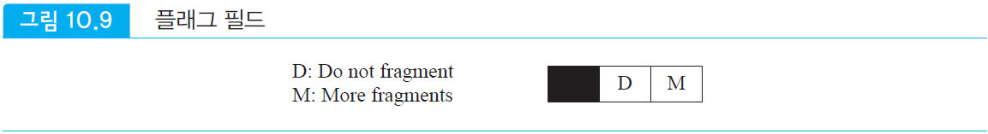
Fragmentation
Flag
3 bits
First bit: unused
Second bit: do not fragment
If this value is 1, the datagram should not be fragmented
If fragmentation is required and this bit is set, the datagram cannot be delivered over the network, so the datagram is discarded and an ICMP error message is sent to the source host
Third bit: more fragment
If this value is 1, the datagram is not the last fragment
Fig.7 Flag field

Slide 24
Fragmentation
Fragmentation offset
13 bits
Indicates the relative position of a fragment within the entire datagram
Offset of data within the original datagram, calculated in 8-byte units
The number of the first byte of each fragment must be divisible by 8

Slide 25
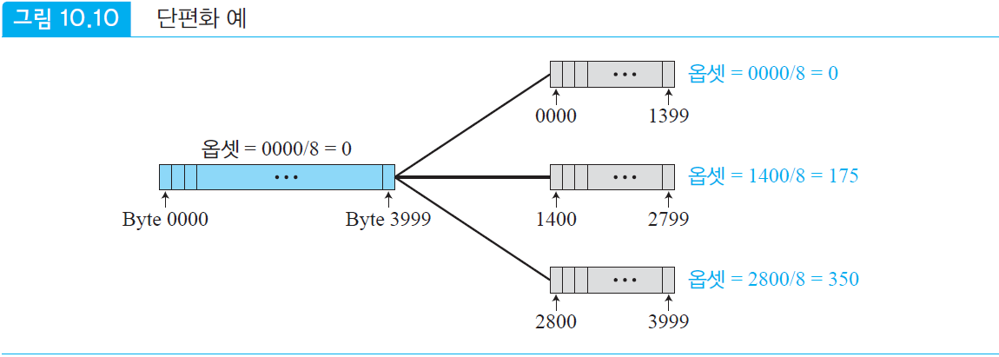
Fragmentation
Fragmentation Example
If a 4,000 byte datagram is divided into 3 fragments:
1st frag.: 0 ~ 1,399, Frag. Offset: 0/8= 0
2nd frag.: 1,400 ~ 2,799, Frag. Offset : 1,400/8 = 175
3rd frag.: 2,800 ~ 3,999, Frag. Offset : 2,800/8 = 350
Fig.8 Fragmentation Offset field example
Off
set
Offset
Off
set
Off
set

Slide 26
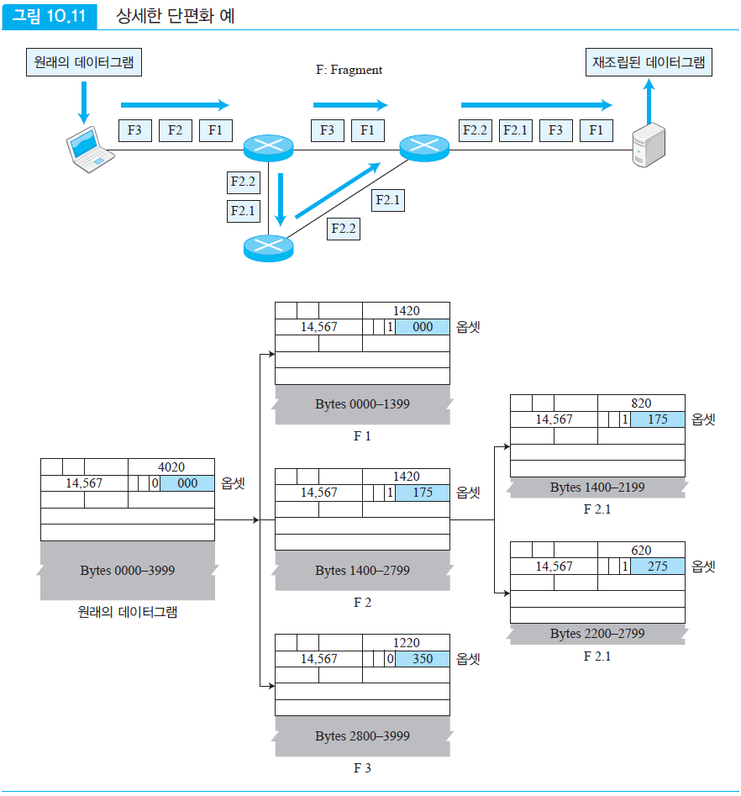
Fig.9 Detailed Fragmentation Example
Original Datagram
Reassembled Datagram
Off
set
Off
set
Off
set
Off
set
Off
set
Original Datagram
Off
set

Slide 27
Fragmentation
Q.5
A packet arrives with the M bit of the flag field set to 0. Is this the first fragment, middle fragment, or last fragment? Also, can we tell if the packet is fragmented?
A
If the M bit is 0, it means there are no more fragments. The fragment is the last fragment.
However, we cannot tell if the original packet was fragmented.
A packet that is not fragmented is considered the last fragment.

Slide 28
Fragmentation
Q.6
A packet with an M bit value of 1 has arrived. Is this the first fragment, middle fragment, or last fragment? Can we tell if the packet is fragmented?
A:
If the M bit is 1, it means there is at least one more fragment.
This fragment can be the first fragment, middle fragment, but not the last fragment. To know the exact fragment, we need to know the fragment offset value.

Slide 29
Fragmentation
Q. 7
A packet arrived with an M bit value of 1 and a fragment offset value of 0. Is this packet the first fragment, middle fragment, or last fragment?
A
Since the M bit is 1, it is either the first fragment or the middle fragment.
Since the offset value is 0, it is the first fragment.

Slide 30
Option
(0 – 40 bytes)
Optional field
The header consists of a fixed part (20Bytes) and a variable part
The variable part is optional. The maximum length is 40 bytes.
The options are used to test or debug the network.

Slide 31
Check sum
Check sum
Error detection method, used by most TCP/IP protocols
Protects against errors that may occur during the transmission of a packet
A checksum is calculated by the sender and transmitted with the packet
The receiver repeats the same calculation for the entire packet containing the checksum
If the result is satisfactory, the packet is accepted, otherwise it is discarded

Slide 32
Check sum
Computing the Sender's Checksum
At the sender, the packet is divided into n-bit pieces (normally n is 16)
These pieces are added together using 1's complement arithmetic to produce an n-bit result
The 1's complement of the sum is the checksum

Slide 33
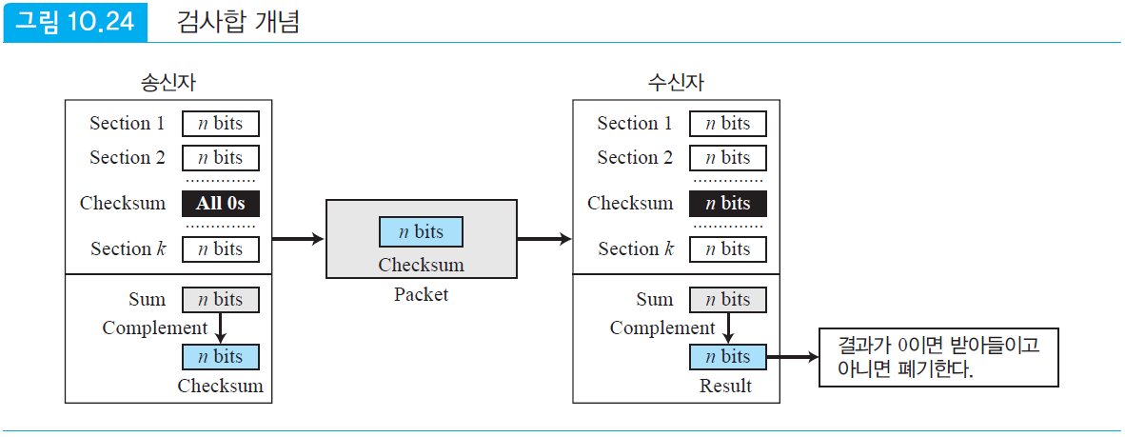
Check sum
Receiver's checksum calculation
The receiver divides the received packet into k pieces and adds them all together
Then it calculates the 1's complement of this sum
If the result is 0, it accepts the packet, otherwise it rejects it
Fig.9 Check sum concept
Sender
Receiver
If the result is 0, accept otherwise discard.

Slide 34
Check sum
Checksum of IP packet
Set checksum field to 0
Then divide all headers into 16-bit pieces and sum them
Complement this result and insert it into checksum field
Why checksum includes only header and not data
All upper layer protocols that encapsulate data in an IP datagram have a checksum that includes the entire packet, so the checksum of an IP datagram does not need to check the encapsulated data
The header of an IP packet can change every time it visits a router, while the data does not, so the checksum should be calculated only for the parts that change
If data is included, each router must recalculate the checksum for the entire packet, which results in a lot of processing time

Slide 35
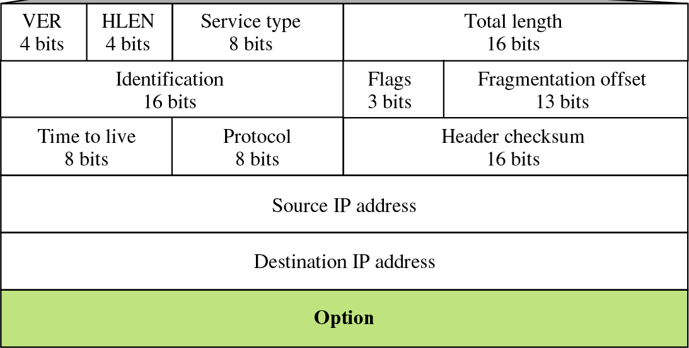
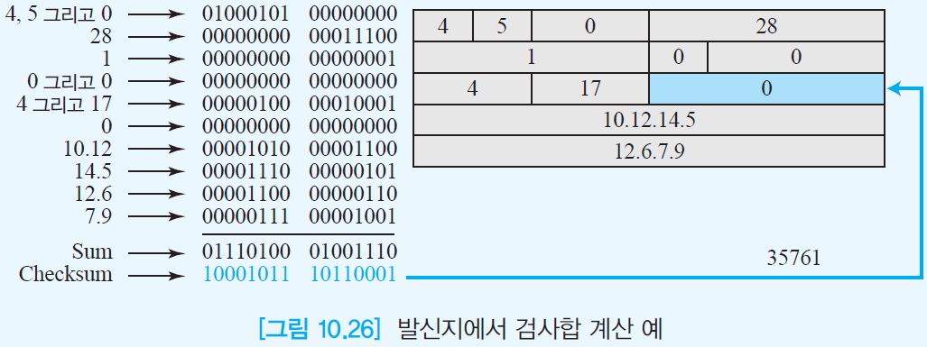
Example
and
and
and
Fig.10 Example of calculating checksum at the sender

Slide 36
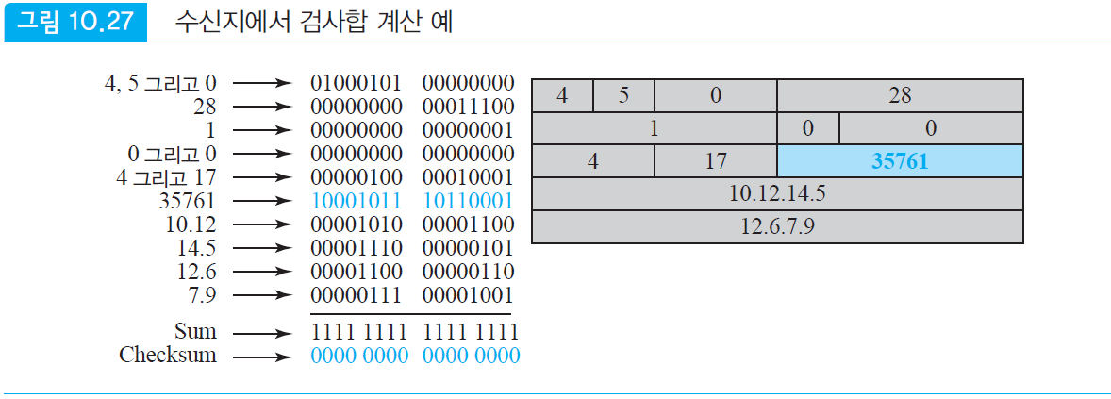
Check sum
Example
Fig.11 Example of calculating checksum at the receiver
and
35761
and
and

Slide 37
Layer 3 Demo
Objective:
Understand how to manipulate IP addresses and subnets in C#.
Learn how to establish basic communication using the network layer.
Implement a simple ping utility using ICMP to demonstrate Layer 3 functionality

Slide 38
Demo1. IP Address Manipulation
First, demonstrate how to work with IP addresses, including converting between different forms (dotted decimal, binary, etc.), calculating subnets, and comparing IP ranges.
Key Points:
IPAddress.Parse for converting string to IPAddress.
Bitwise operations to calculate the network address.
Convert IP to binary for deeper understanding.
Notes:
using System;
using System.Net;
class NetworkLayerExample
{
static void Main(string[] args)
{
string ipString = "192.168.1.10";
string subnetMask = "255.255.255.0";
// Convert the IP string to an IPAddress object
IPAddress ip = IPAddress.Parse(ipString);
IPAddress mask = IPAddress.Parse(subnetMask);
Console.WriteLine($"IP Address: {ip}");
Console.WriteLine($"Subnet Mask: {mask}");
// Convert IP to binary format
Console.WriteLine($"Binary IP: {ConvertToBinary(ip)}");
Console.WriteLine($"Binary Mask: {ConvertToBinary(mask)}");
// Demonstrate subnet calculation (network address)
IPAddress networkAddress = CalculateNetworkAddress(ip, mask);
Console.WriteLine($"Network Address: {networkAddress}");
}
static string ConvertToBinary(IPAddress ip)
{
byte[] bytes = ip.GetAddressBytes();
string binaryString = string.Join(".", Array.ConvertAll(bytes, b => Convert.ToString(b, 2).PadLeft(8, '0')));
return binaryString;
}
static IPAddress CalculateNetworkAddress(IPAddress ip, IPAddress mask)
{
byte[] ipBytes = ip.GetAddressBytes();
byte[] maskBytes = mask.GetAddressBytes();
byte[] networkBytes = new byte[ipBytes.Length];
for (int i = 0; i < ipBytes.Length; i++)
{
networkBytes[i] = (byte)(ipBytes[i] & maskBytes[i]);
}
return new IPAddress(networkBytes);
}
}

Slide 39
Demo2. Communication at Layer 3
Sockets allow communication over the network using IP addresses, which belong to the network layer (Layer 3). Here’s how to send and receive simple messages using sockets.
Key Points:
Using Socket for basic communication over TCP (Layer 4), which is routed via the network layer (Layer 3).
Server listens on any IP (IPAddress.Any) and a specific port.
Client connects to server using Socket.Connect().
Notes:
using System;
using System.Net;
using System.Net.Sockets;
using System.Text;
class SocketExample
{
static void Main(string[] args)
{
Console.WriteLine("Server or Client? (S/C)");
char role = Console.ReadLine().ToUpper()[0];
if (role == 'S')
{
StartServer();
}
else
{
StartClient();
}
}
static void StartServer()
{
IPEndPoint localEndPoint = new IPEndPoint(IPAddress.Any, 8080);
Socket listener = new Socket(AddressFamily.InterNetwork, SocketType.Stream, ProtocolType.Tcp);
listener.Bind(localEndPoint);
listener.Listen(10);
Console.WriteLine("Server listening...");
Socket clientSocket = listener.Accept();
Console.WriteLine("Client connected.");
byte[] bytes = new byte[1024];
int numBytes = clientSocket.Receive(bytes);
Console.WriteLine("Received: " + Encoding.ASCII.GetString(bytes, 0, numBytes));
clientSocket.Close();
listener.Close();
}
static void StartClient()
{
IPEndPoint remoteEndPoint = new IPEndPoint(IPAddress.Parse("127.0.0.1"), 8080);
Socket sender = new Socket(AddressFamily.InterNetwork, SocketType.Stream, ProtocolType.Tcp);
try
{
sender.Connect(remoteEndPoint);
Console.WriteLine("Connected to server.");
byte[] msg = Encoding.ASCII.GetBytes("Hello from Client");
sender.Send(msg);
sender.Close();
}
catch (Exception e)
{
Console.WriteLine(e.ToString());
}
}
}

Slide 40
Demo3. ICMP Ping Utility
To interact more directly with Layer 3, we can create a simple ping utility that uses ICMPInternet Control Message Protocol to check the reachability of a host. This leverages the network layer's routing functionality.
Key Points:
Ping class from System.Net.NetworkInformation for sending ICMP requests.
This demonstrates Layer 3 reachability, showing network routing mechanisms in action.
Notes:
using System;
using System.Net.NetworkInformation;
class PingExample
{
static void Main(string[] args)
{
Console.Write("Enter IP address or host to ping: ");
string address = Console.ReadLine();
Ping pingSender = new Ping();
PingReply reply = pingSender.Send(address);
if (reply.Status == IPStatus.Success)
{
Console.WriteLine($"Ping to {address} successful.");
Console.WriteLine($"Roundtrip time: {reply.RoundtripTime} ms");
Console.WriteLine($"TTL (Time to Live): {reply.Options.Ttl}");
Console.WriteLine($"Buffer size: {reply.Buffer.Length}");
}
else
{
Console.WriteLine($"Ping to {address} failed: {reply.Status}");
}
}
}

Slide 41
Key takeaways from Demos
IP Address Handling: Understanding IP addresses and subnetting using bitwise operations is fundamental for Layer 3 understanding.
Socket Programming: Communicating using sockets illustrates how Layer 3 enables devices to exchange data across different networks.
ICMP and Reachability: Demonstrating ping provides a practical Layer 3 tool to check connectivity between hosts.
This demos introduce students to practical aspects of the network layer, allowing them to understand how routing and communication are structured in real-world networking applications.

Slide 42
EoF

