Slide 1
Layer 4. Transport Layer (UDP)
Game Server Programming
Notes:
https://slideplayer.com/slide/14519191/

Slide 2
Contents
Transport Layer Overview
UDP Service
User Datagram
Demo. Checking Header Field
UDP Application

Slide 3
Transport Layer
Located between the network layer and the application layer
Obligated to provide services to the application layer
Receives services from the network layer

Slide 4
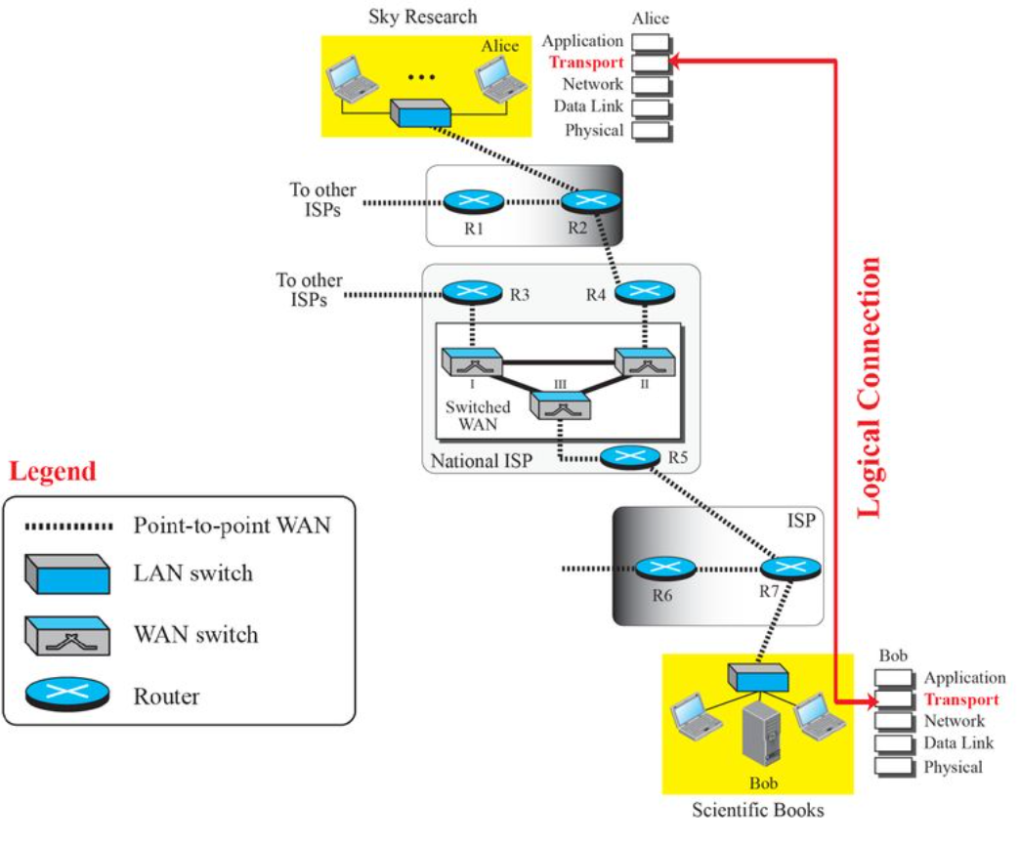
Logical connection of the transport layer

Slide 5
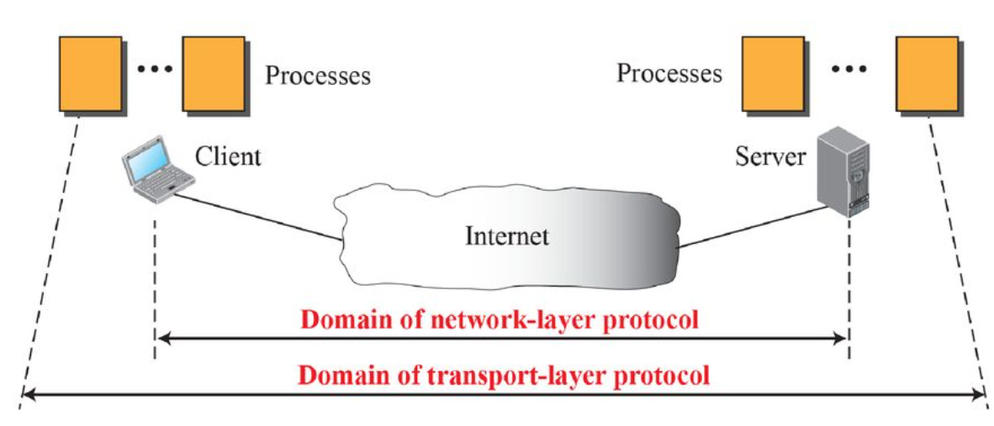
Transport Layer Service
Provides process-to-process communication
A process^{running program} is an application layer entity that uses transport layer services
Responsible for delivering messages to the appropriate process

Slide 6
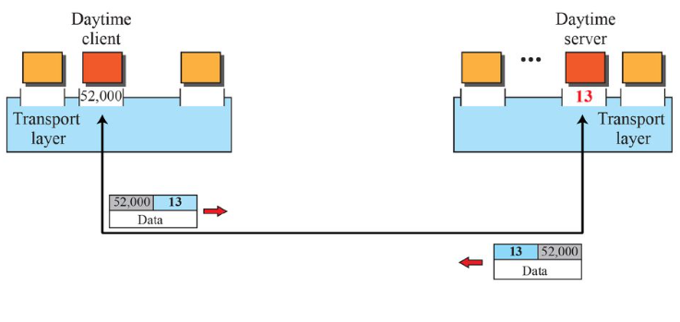
The Role of Port Numbers in Process Communication
Local host and remote host: IP address
Process: Port number
Port number range: Integer between 0 and 65,535
Well-known port number
Ephemeral port number
* daytime service (port# 13): A simple protocol that allows a server to communicate the current date and time to a client. Defined in RFC 867, and used primarily for testing and debugging purposes.

Slide 7
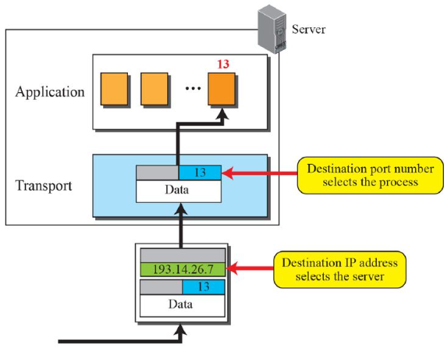
IP addresses vs port numbers

Slide 8
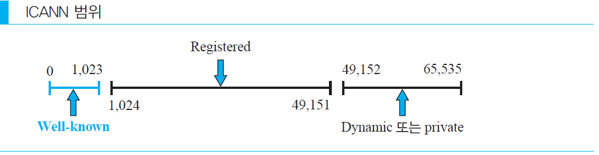
Transport Layer Service
ICANN ranges Internet Corporation for Assigned Names and Numbers
Well-known port: 0 ~ 1,023
Ex> http:80, ssh:22
Registered port: 1,024 ~ 49,151
Ex> MySQL:3306, RDP:3389
Dynamic port: 49,152 ~ 65,535
ranges
or
*ICANN: A non-profit international organization that coordinates DNS management, IP address allocation, and protocol parameter allocation.

Slide 9
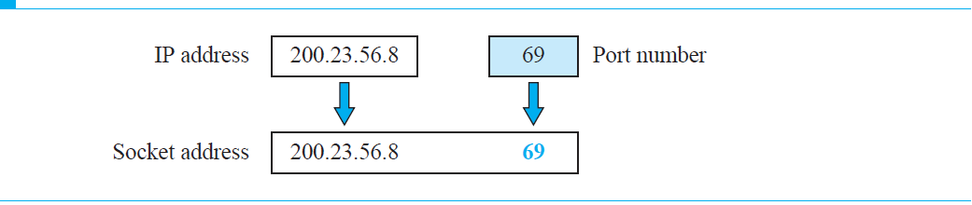
Transport Layer Service
Socket address (end point)
Addresses required to create a connection at each endpoint

Slide 10
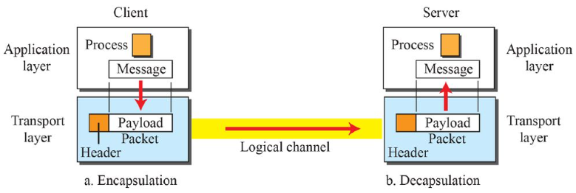
Transport Layer Service
Encapsulation and Decapsulation

Slide 11
Transport Layer Service
Connectionless and connection-oriented services
Connectionless service
Messages are divided into small pieces that can be transmitted and sent
Each piece is considered an independent unit
It’s okay when the data arrives out of order
UDP
Connection-oriented service
First, a logical connection is established between the server and the client
After data exchange is complete, the connection is released
TCP

Slide 12
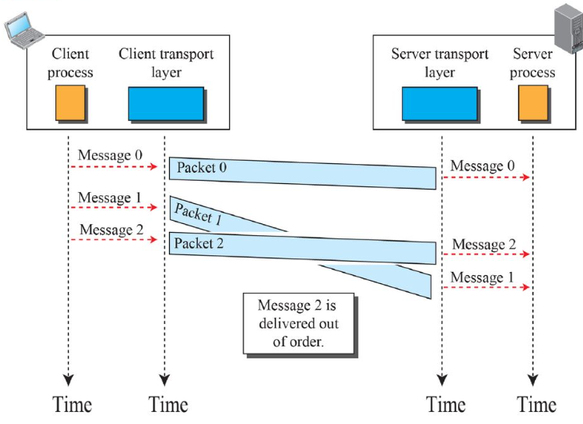
Transport Layer Service
Connectionless service

Slide 13
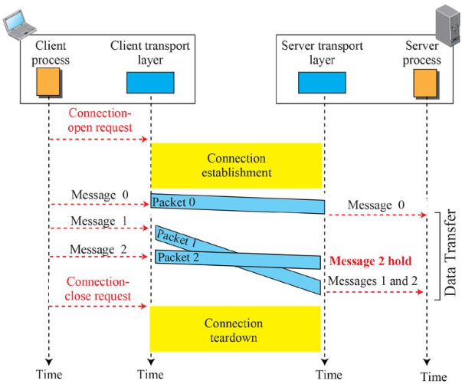
Connection-oriented servcie

Slide 14
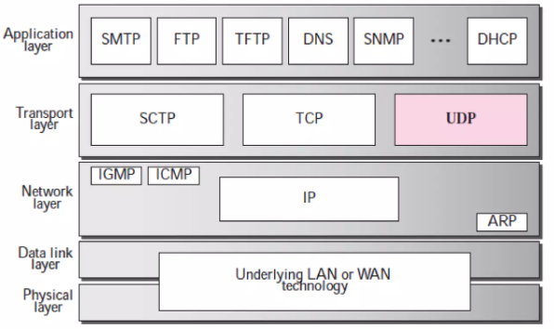
UDP overview
Position of UDP in the TCP/IP protocol suite

Slide 15
UDP overview
The UDP transport protocol's mission
Create process-to-process communication: using port numbers
Perform minimal error control mechanisms
Receive data units from processes and provide unreliable delivery
A connectionless, unreliable transport protocol
A simple protocol that uses minimal overhead

Slide 16
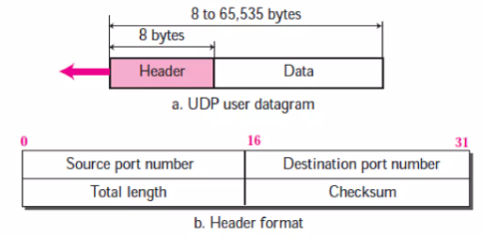
User datagram format
8-byte fixed-size header
Source port number
Port number used by a process running on the source host
Destination port number
Port number used by a process running on the destination host
Length: Total length of header plus data
Checksum: Used for error detection

Slide 17
User Datagram Protocol
Example 1
Here is a dump of the UDP header in hexadecimal format.
What is the source port number?
What is the destination port number?
What is the total length of the user datagram?
How long is the data?
Is the data being sent from client to server or vice versa?
What is the client process?

Slide 18
UDP .
a. The source port number is the first four hexadecimal digits (CB84₁₆), which is 52,100 in decimal.
b. The destination port number is the second four hexadecimal digits (000D₁₆), which is 13 in decimal.
c. The third four hexadecimal digits (001C₁₆) represent the total length of the UDP packet, which is 28 bytes.
d. The length of the data is the total length of the packet minus the length of the header, which is 28 - 8 = 20 bytes.
e. Since the destination port number is 13 (a well-known port), the packet was sent from the client to the server.
f. The client process is Daytime.

Slide 19
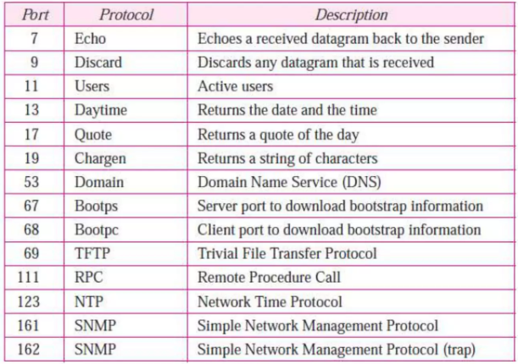
Well-Known Ports used with UDP

Slide 20
Demo. Check UDP packet contents
Since the UDP header is usually handled automatically by the IP stack, classes such as UdpClient used in high-level network programming do not directly expose the UDP header to the programmer.
Therefore, in high-level socket programming, you cannot see the UDP header and IP header.
However, in low-level network programming, you can check the entire packet including the UDP and IP headers.
Raw Socket: You can control all packets at the IP level.
To use a raw socket in C#, use the Socket class to create a socket with SocketType.Raw.
Operating system privileges may be required (administrator privileges).

Slide 21
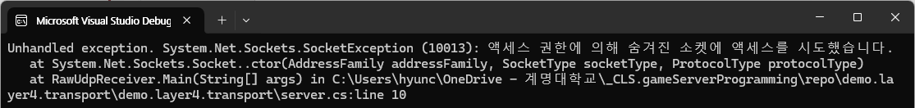
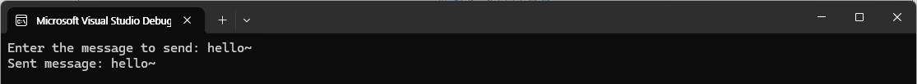
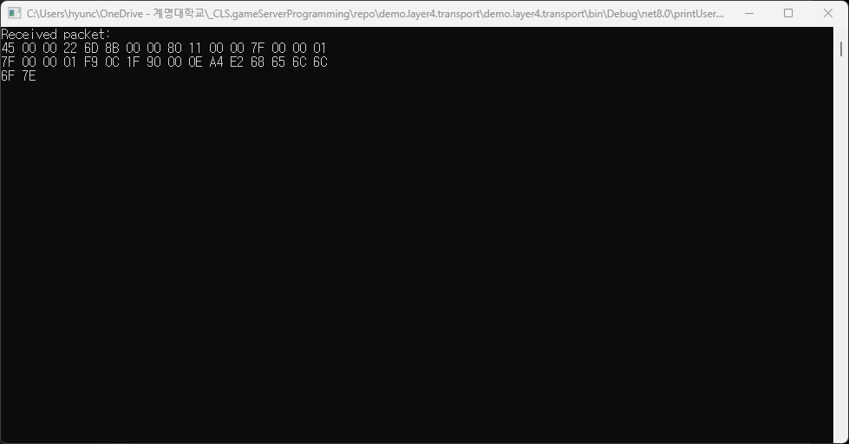
Notes:
//Server.cs //////////////////////////////////////////
using System;
using System.Net;
using System.Net.Sockets;
using System.Text;
class RawUdpReceiver
{
public static void Main(string[] args)
{
Socket rawSocket = new Socket(AddressFamily.InterNetwork, SocketType.Raw, ProtocolType.IP);
rawSocket.Bind(new IPEndPoint(IPAddress.Parse("127.0.0.1"), 8080));
// IP 헤더 포함 수신
rawSocket.SetSocketOption(SocketOptionLevel.IP, SocketOptionName.HeaderIncluded, true);
byte[] buffer = new byte[65535];
// 수신 대기
while (true)
{
int receivedLength = rawSocket.Receive(buffer);
Console.WriteLine("Received packet:");
// 전체 패킷을 16진수로 출력 (IP + UDP 헤더 포함)
for (int i = 0; i < receivedLength; i++)
{
Console.Write(buffer[i].ToString("X2") + " ");
if ((i + 1) % 16 == 0)
Console.WriteLine();
}
Console.WriteLine();
}
}
}
//Client.cs //////////////////////////////////////////
using System;
using System.Net;
using System.Net.Sockets;
using System.Text;
class UdpClientSender
{
public static void Main(string[] args)
{
UdpClient udpClient = new UdpClient();
string serverIp = "127.0.0.1"; // 서버 IP (로컬)
int serverPort = 8080; // 서버 포트
// 전송할 메시지 설정
Console.Write("Enter the message to send: ");
string message = Console.ReadLine();
byte[] messageBytes = Encoding.UTF8.GetBytes(message);
// 서버로 패킷 전송
udpClient.Send(messageBytes, messageBytes.Length, serverIp, serverPort);
Console.WriteLine($"Sent message: {message}");
udpClient.Close();
}
}

Slide 22
IP header .
(45):4: IPv4 , Header Length (5 * 4 = 20 bytes)
Service type (00): General
Total Length (00 22): 34Bytes (IP Header + UDP Header + Data)
ID (6D 8B): Identification (unique identification value of the transmitted packet)
Flags and Offset (00 00): Unsegmented packet (flag 0)
TTL (Time to Live) (80): 128
Protocol (11): UDP (0x11 = 17, indicating UDP)
Header Checksum (00 00)
Source IP (7F 00 00 01): 127.0.0.1(localhost)
Destination IP (7F 00 00 01): 127.0.0.1 (localhost)

Slide 23
UDP header ..
Source port (F9 0C): Hexadecimal = 63756
Port Destination port (1F 90): Hexadecimal = 8080
Port UDP length (00 0E): Hexadecimal 000E = 14 bytes (UDP header + data length)
Checksum (A4 E2): Checksum value
Data field
68 65 6C 6C 6F 7E → "hello~"

Slide 24
UDP Application
Typical applications
Suitable for processes that require simple request-response communication and do not require flow and error control
Suitable for processes that have internal flow and error control (e.g. TFTP)
Transport protocol suitable for multicasting
Used for management processes such as SNMP Simple Network Management Protocol
Used for route update protocols such as RIP Requesting Information Protocol
Used for real-time applications

Slide 25
UDP Application
Suppose you are downloading a very large document file over the Internet.
You need to use a transport layer that provides reliable service.
That is, you do not want parts of the file to be lost or corrupted when you open it.
The delay between the delivery of parts of the file is not a significant issue.
You simply wait for the entire file to be constructed before you can view it.
In this case, UDP is not a suitable transport layer.

Slide 26
EoF

