Slide 1
Layer 4. Transport Layer (TCP)
Game Server Programming

Slide 2
Contents
TCP Service
TCP Features
Segments
TCP Connections
TCP Windows
Flow, Error, Congestion control
TCP application Demo

Slide 3
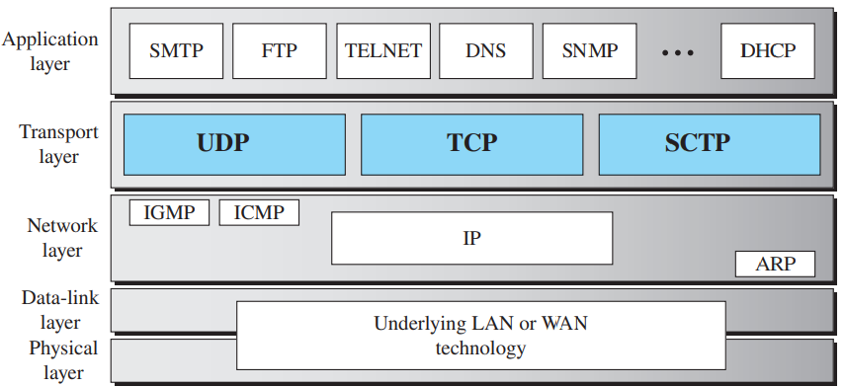
Position of transport-layer protocols in the TCP/IP protocol suite

Slide 4
TCP Services
Process-to-process communication
Stream delivery service
Full-duplex communication
Multiplexing and demultiplexing
Connected service
Reliability service

Slide 5
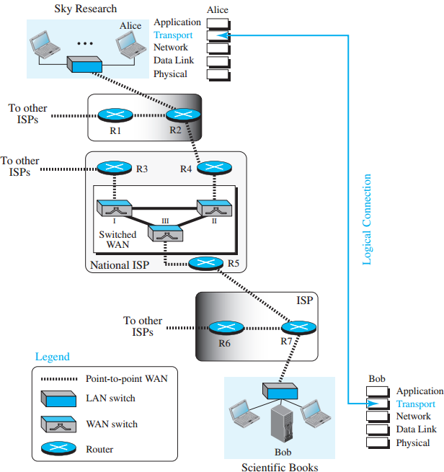
Transport layer service
Process to process communication

Slide 6
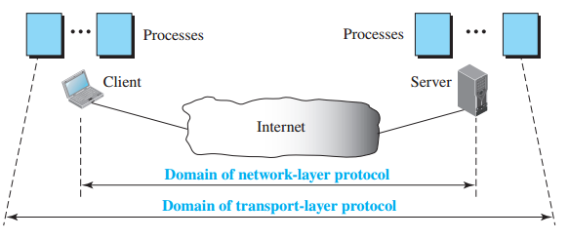
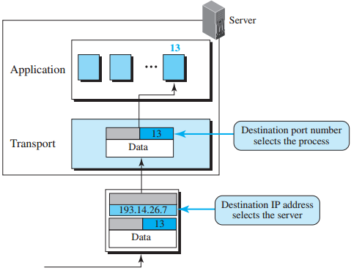
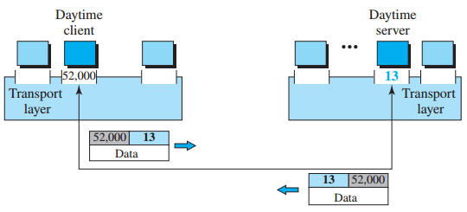
Domain of services in layer 3 and 4

Slide 7
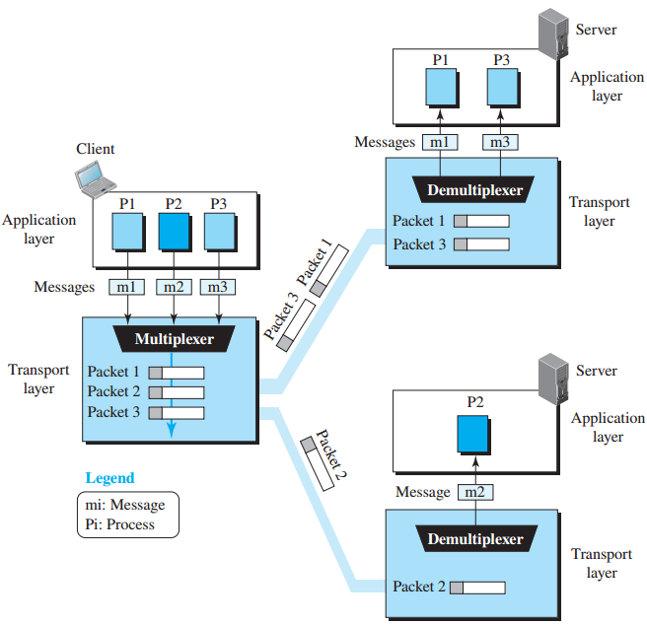
Multiplexing and Demultiplexing
Multitplexing
Receiving information from multiple sources
Demultiplexing
Transmitting information to multiple destinations

Slide 8
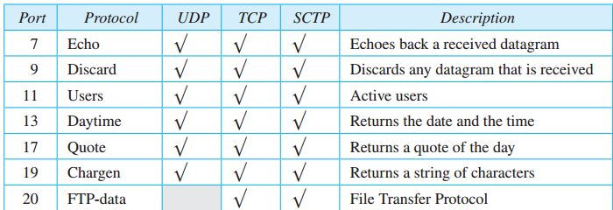
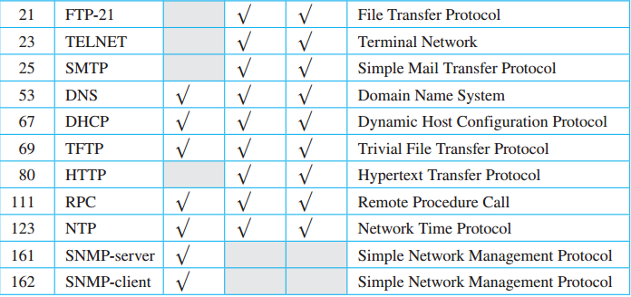
Some of the well known ports

Slide 9
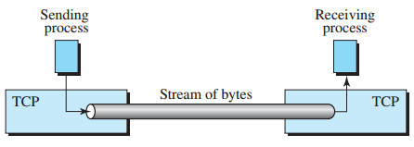
TCP Services
Stream Delivery Service
TCP is a stream-based protocol
Sends and receives data in the form of a byte stream
Two processes are connected by a virtual tube
The sending process creates (writes) a byte stream
The receiving process consumes (reads) a byte stream

Slide 10
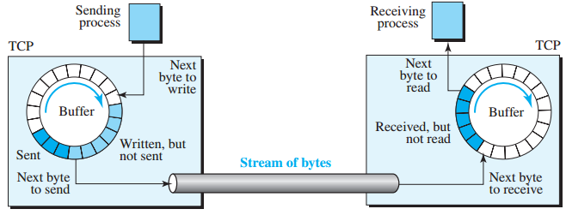
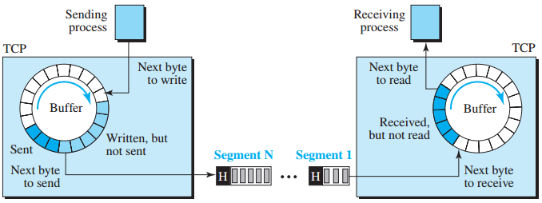
TCP Services
Transmit Buffer and Receive Buffer
A buffer is needed when transmission and reception are not performed at the same speed.
A series of bytes are grouped into a packet called a segment and transmitted to the IP layer.

Slide 11

TCP Services
Full-duplex communication
Simultaneous bidirectional transmission
Piggybacking that sends acknowledgement for both transmitted and received data
Multiplexing and demultiplexing
The transmitter performs multiplexing, and the receiver performs demultiplexing
Connection-oriented service
TCP is a connection-oriented protocol
Virtual connection, not a physical connection
Proceeds in the order of request→acceptance→data exchange→release
Reliable service
Uses acknowledgement mechanism

Slide 12
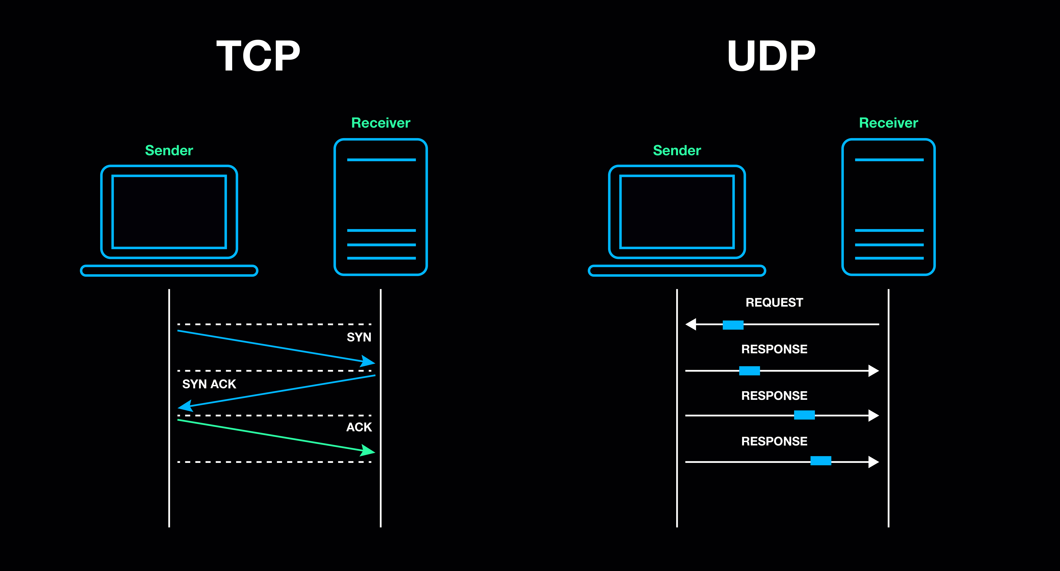
TCP features
Numbering System
Flow Control
Error Control
Congestion Control

Slide 13
TCP features
Numbering System
Byte Number
Numbering every data byte
Transmission Sequence Number
Assigning a sequence number to the first byte in a segment
Acknowledgement Number
Number of the next byte received

Slide 14
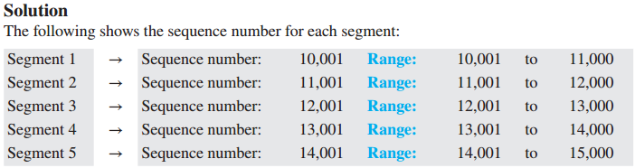
TCP features
Ex. 1
Suppose a TCP connection is transferring a file of 5000 bytes. The first byte is numbered 10,001.
What are the sequence numbers for each segment if data are sent in five segments, each carrying 1000 bytes?

Slide 15
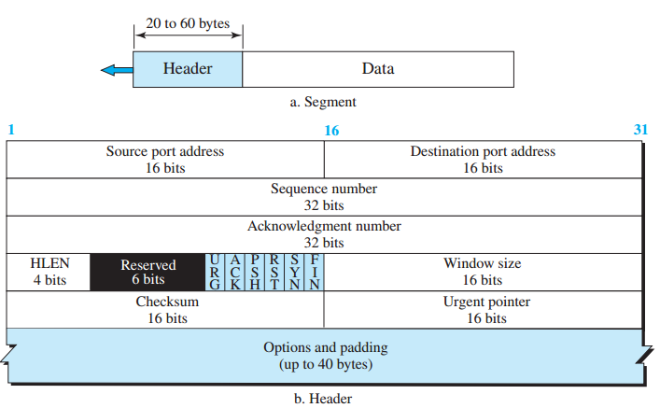
TCP segment format

Slide 16
Segment
Each field
Source port address: Port number of the sending host application
Destination port address: Port number of the receiving host application
Sequence number: Number assigned to the first byte of data included in the segment
Acknowledgement number: Number of bytes to be received from the other node
Header length: 4-byte word value of the TCP header length
Reserved

Slide 17
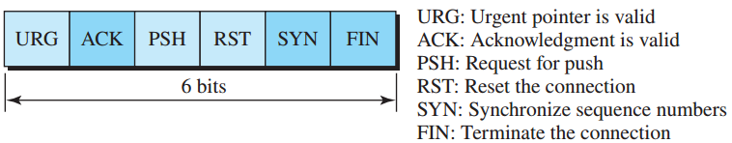
Segment .
Control field: Control or flag

Slide 18
Window size: The maximum size of data that can be received at one time by the receiver (maximum: 2¹⁶-1).
Since the speed at which data is consumed varies depending on the situation, the amount of free space varies from time to time, so the receiver continuously notifies the sender of the window size.
Checksum: Error control
Urgent pointer: Urgent data
defines a value that must be added to the sequence number
Option: Option information

Slide 19
TCP Connection
Connection-oriented protocol
Establishes a virtual path between the source and destination
All segments are transmitted through the virtual path
By using a single virtual path, it is possible to handle not only retransmission of damaged or lost frames, but also acknowledgements, etc.

Slide 20
TCP Connection
TCP connection Establishment
Three-way handshake
Connection between client and server applications
Client starts (active open)
Client sends SYN segment with SYN flag set to 1
Server sends segment with SYN and ACK flags set to 1
Simple ACK segment sent
Server starts (passive open)
Notifies its TCP that it is ready to accept connections
Simultaneous opens
SYN flooding attack:
when one or more malicious attackers send a large number of SYN segments to a server

Slide 21
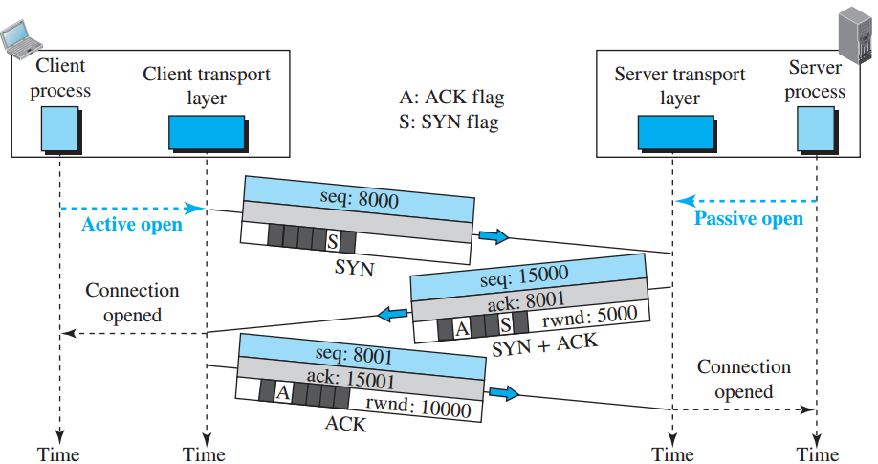
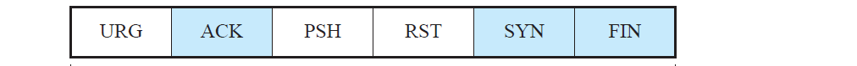
Connection established using three-way handshaking
Notes:
ISN: Initial sequence number

Slide 22
TCP Connection
Bidirectional data transfer
Simultaneous transmission of data and acknowledgment (piggyback)
Pushing data
Setting the push bit to request a push action
Does not wait until the window is full
Urgent data
Setting the URG bit to 1 to indicate urgency
The receiving application determines what action to take on the receiving side, rather than providing priority

Slide 23
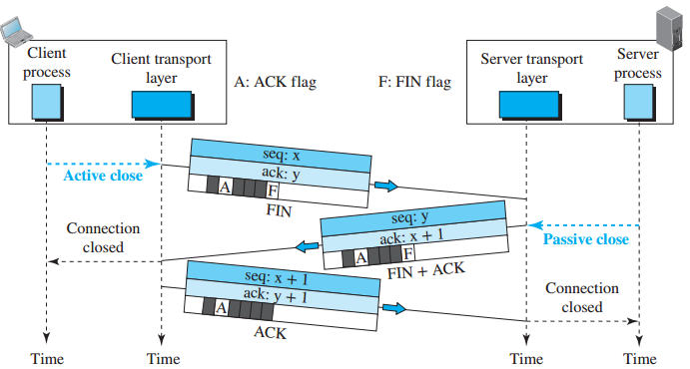
Connection termination using three-way handshaking

Slide 24
TCP Connection
Half-close
One side can end data transmission while receiving data
Either side can request
Occurs when the server starts processing after receiving all data (e.g. sort)

Slide 25
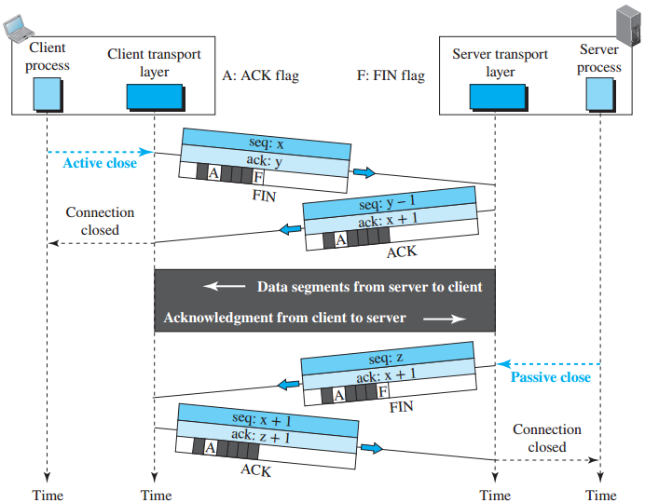
Half-Close

Slide 26
TCP window
A control mechanism in the Transmission Control Protocol (TCP) that governs the flow of data between a sender and receiver.
determines how much data can be sent without waiting for an acknowledgment (ACK) from the receiver.
Two windows are used for each direction of data transmission
Send window and Receive window
Four windows are required for two-way communication

Slide 27
Transmission control
TCP has an algorithm that controls the amount of data transmitted depending on the network status.
The basis of flow control is the window that acts as a buffer at each of the sending and receiving ends.
Each host's TCP session has a sending window and a receiving window.
Sliding window protocol
TCP uses a sliding window protocol, meaning the window size dynamically adjusts as data is acknowledged by the receiver.
When the receiver processes and acknowledges part of the data in the window, the window “slides” forward, allowing the sender to send more data.
This process enables a continuous flow of data while maintaining flow control.
Notes:
https://sw-test.tistory.com/18

Slide 28
Send window
The window size is set to the smaller value between the congestion window on the sender side and the reception window on the reception side:
Transmission window = Min(congestion window, reception window free size)
The congestion window is a window that controls the amount of data transmitted by adjusting the window size according to the network congestion situation in TCP.
The congestion window is affected by the concept of slow start and TCP retransmission.
Slow start is when the number of segments that can be sent before receiving an ACK from the other party, doubled from 1 to 2, 4, and 8.
Since the network quality is unknown at the beginning of the connection, sending a large number of segments from the beginning can cause loss, so the transmission amount is gradually increased.

Slide 29
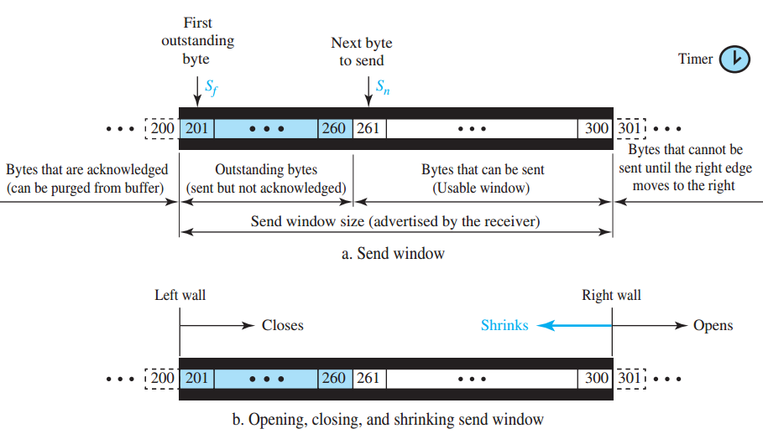
Send window in TCP

Slide 30
Receive Window
The role of the receiving buffer in a TCP connection
If the sending side does not know the current window size of the receiving side, if too many segments are sent and the receiving window size is exceeded, a loss occurs
To prevent this problem and control data transmission efficiently, the TCP protocol header includes the current receiving window free available size and notifies the other party.

Slide 31
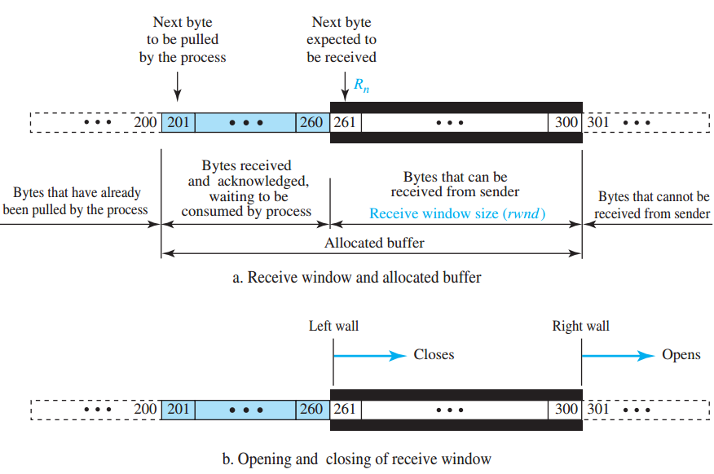
Receive window in TCP

Slide 32
Silly Window Syndrome
In TCP flow control that occurs when data is sent in very small segments, leading to inefficient use of network resources and reduced overall throughput.
It can occur on both the sending and receiving sides of a TCP connection.
Receiver-side SWS: Occurs when the receiving application reads data from the TCP buffer slowly.
Sender-side SWS: Occurs when the sender’s application sends data slowly or in small chunks. If the sender immediately transmits each small chunk, the network can become flooded with tiny packets, which is inefficient and increases overhead.
Solutions:
preventing the sender from sending small packets by holding back data until enough has accumulated to fill a packet
preventing the receiver from advertising new window sizes until the buffer has enough free space to avoid tiny segments.

Slide 33
Congestion control
Occurs when a router receives packets faster than it can process them
Packets are lost, and the destination cannot send an acknowledgment packet
TCP assumes that the cause of a lost segment is congestion on the network.
Recovery through retransmission…
If the cause of a lost segment is congestion, retransmitting the segment will make the problem worse rather than eliminating it.

Slide 34
Congestion control
Congestion control principles
Slow start: exponential growth
Congestion avoidance: additive growth
Congestion detection: exponential decline

Slide 35
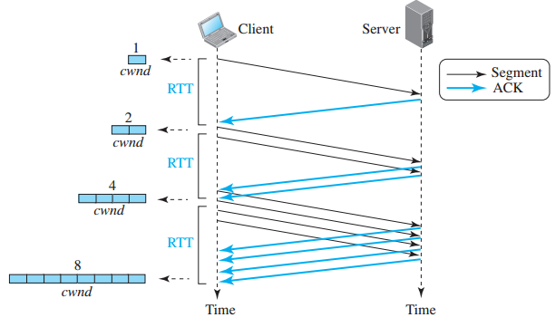
Slow start: exponential growth
Set a threshold (half of the maximum window size)
Increase by one MSS for every acknowledgment until the threshold is reached
Algorithm starts slowly, but grows exponentially
Maximum Segment Size (MSS): In the context of TCP, MSS is the largest segment of data that a device is willing to receive in a single TCP packet.
Threshold initial value: When a TCP connection starts, the threshold is often set to a large value (sometimes the size of the TCP receive window or the maximum segment size of the network path) or a pre-configured default value by the operating system. The goal is to quickly probe the network to find its available capacity.

Slide 36
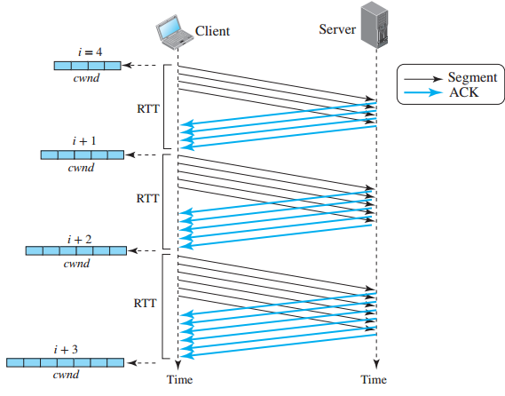
Congestion avoidance: additive increase
When the size of the congestion window reaches the slow start threshold, the slow start phase ends and the congestion avoidance phase begins.
Each time a segment is acknowledged, the congestion window value increases by 1.

Slide 37
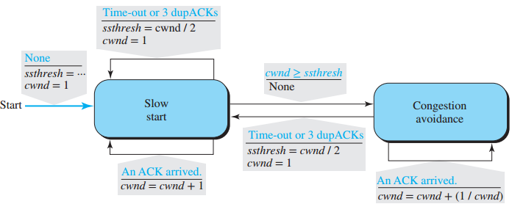
Congestion Detection: Exponential Decrease
consider congestion, a segment needs to be retransmitted.
When the RTO^{Retransmission Time-Out} timer expires
When three duplicate ACKs are received
Do a slow start by reducing the threshold to half the current window size

Slide 38
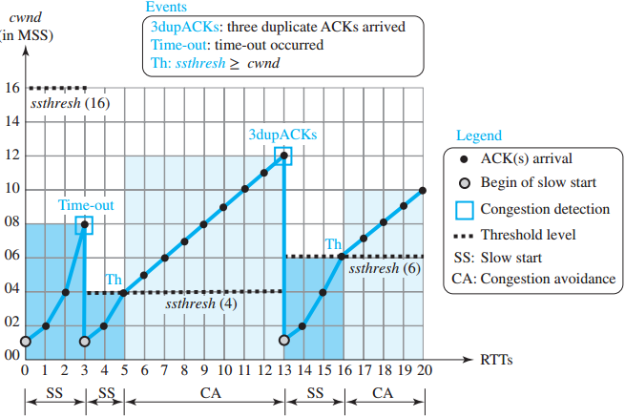
Example of TCP (Taho)

Slide 39
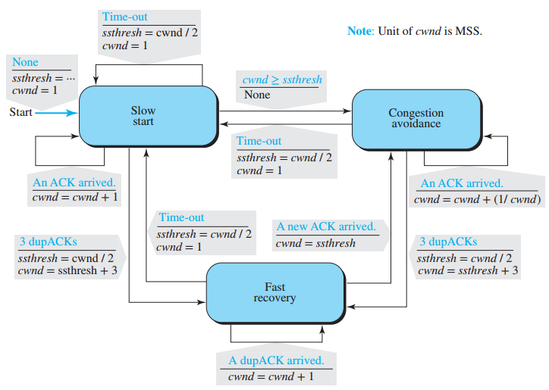
FSM for TCP (Reno)

Slide 40
TCP Demo
Demo1. echo server-client
This echo server and client code demonstrates how basic TCP communication works. When a client sends a message to the server, the server returns the received message back to the client. This demonstrates the two-way communication of a TCP connection and the stream-based way of sending and receiving data.
Demo2. file transfer server-client
An example of a method of reliably transmitting data using TCP. The client connects to the server and transmits data from a file, and the server receives the data and stores it as a file. Data is transmitted and received sequentially by utilizing the reliable connection characteristic of TCP, and data is processed at each stage using file streams and network streams.
Notes:
///////////////////////////////////////////echo server
using System;
using System.Net;
using System.Net.Sockets;
using System.Text;
class TcpEchoServer
{
static void Main(string[] args)
{
//TcpListener는 서버 측에서 클라이언트의 연결 요청을 기다리는 역할
//IPAddress.Any: 서버가 네트워크 인터페이스에 상관없이 모든 IP 주소에서 연결
//9000: TCP 포트 번호
TcpListener listener = new TcpListener(IPAddress.Any, 9000);
listener.Start();
Console.WriteLine("Server started...");
while (true)
{
// 서버는 클라이언트가 연결을 요청할 때까지 무한히 기다림
//AcceptTcpClient()는 클라이언트의 연결 요청을 수락하고,
//클라이언트와의 통신을 위한 TcpClient 객체를 반환
TcpClient client = listener.AcceptTcpClient();
//NetworkStream은 TCP 연결을 통해 클라이언트와 데이터를 주고받기 위한 스트림.
//클라이언트와의 데이터 송수신 작업은 이 스트림을 통해 이루어진다.
NetworkStream stream = client.GetStream();
byte[] buffer = new byte[1024];
//bytesRead: 클라이언트로부터 실제로 읽은 데이터의 크기(바이트 수)
int bytesRead = stream.Read(buffer, 0, buffer.Length);
//Encoding.ASCII.GetString(): 바이트 배열을 문자열로 변환하는 메서드
string receivedMessage = Encoding.ASCII.GetString(buffer, 0, bytesRead);
Console.WriteLine("Received: " + receivedMessage);
// Echo back the message
//buffer 배열의 처음부터 bytesRead만큼의 데이터를 클라이언트로 보냄
stream.Write(buffer, 0, bytesRead);
client.Close();
}
}
}
///////////////////////////////////////////echo client
using System;
using System.Net.Sockets;
using System.Text;
class TcpEchoClient
{
static void Main(string[] args)
{
TcpClient client = new TcpClient("127.0.0.1", 9000);
//클라이언트는 서버와 데이터를 주고받기 위한 NetworkStream을 생성.
//클라이언트와 서버는 이 스트림을 통해 통신
NetworkStream stream = client.GetStream();
string message = "Hello, Server!"; //클라이언트는 서버로 보낼 메시지를 작성
byte[] data = Encoding.ASCII.GetBytes(message);//문자열을 바이트 배열로 변환
// Send the message
stream.Write(data, 0, data.Length);
// Receive the echoed message
//클라이언트는 서버로부터 에코된 데이터를 읽기 위해 stream.Read()를 호출.
//서버에서 보내온 데이터를 buffer 배열에 저장하고, 읽은 바이트 수를 반환
byte[] buffer = new byte[1024];
int bytesRead = stream.Read(buffer, 0, buffer.Length);
string receivedMessage = Encoding.ASCII.GetString(buffer, 0, bytesRead);
Console.WriteLine("Received from server: " + receivedMessage);
client.Close();
}
}
///////////////////////////////////////////file server
using System;
using System.IO;
using System.Net;
using System.Net.Sockets;
class FileReceiver
{
static void Main(string[] args)
{
TcpListener listener = new TcpListener(IPAddress.Any, 9000);
listener.Start();
Console.WriteLine("Server is ready to receive file...");
while (true)
{
//listener.AcceptTcpClient(): 클라이언트가 연결을 요청하면 서버는 이 메서드를 통해 연결수락하고,
// 클라이언트와 통신할 수 있는 TcpClient 객체 생성
using (TcpClient client = listener.AcceptTcpClient())
//client.GetStream(): 서버는 클라이언트와 데이터를 주고받기 위해
// NetworkStream 객체 생성
using (NetworkStream stream = client.GetStream())
//new FileStream("received_file.txt", FileMode.Create): 서버는 클라이언트로부터 전송받을
// 파일을 저장하기 위해 파일 스트림 생성
// FileMode.Create는 파일이 존재하지 않을 경우 새 파일을 만들고, 존재할 경우 덮어쓴다
using (FileStream fileStream = new FileStream("received_file.txt", FileMode.Create))
{
//데이터 전송을 위한 버퍼를 생성. 한 번에 1024바이트씩 데이터를 처리
byte[] buffer = new byte[1024];
int bytesRead;
//stream.Read: 클라이언트가 보낸 데이터를 buffer에 저장하며,
// 읽은 데이터의 크기(바이트)를 반환
while ((bytesRead = stream.Read(buffer, 0, buffer.Length)) > 0)
{
//클라이언트가 보낸 데이터를 파일 쓴다
fileStream.Write(buffer, 0, bytesRead);
}
//반복문을 통해 클라이언트가 보낸 데이터를
//모두 파일에 기록할 때까지 계속 읽음
}
Console.WriteLine("File received.");
}
}
}
///////////////////////////////////////////file client
using System;
using System.IO;
using System.Net.Sockets;
class FileSender
{
static void Main(string[] args)
{
TcpClient client = new TcpClient("127.0.0.1", 9000);
// 클라이언트는 서버와 데이터를 주고받기 위한 NetworkStream 객체 생성
NetworkStream stream = client.GetStream();
//전송할 파일을 읽기 모드 오픈. 파일이 존재해야만 파일을 열 수 있음
using (FileStream fileStream = new FileStream("file_to_send.txt", FileMode.Open))
{
byte[] buffer = new byte[1024];//파일 데이터를 저장할 버퍼 생성
int bytesRead;
//파일의 데이터를 buffer에 읽어 들임
while ((bytesRead = fileStream.Read(buffer, 0, buffer.Length)) > 0)
{
//읽어온 파일 데이터를 서버로 전송
stream.Write(buffer, 0, bytesRead);
}//파일 전체가 서버에 전송될 때까지 계속 반복
}
Console.WriteLine("File sent.");
client.Close();
}
}

Slide 41
EoF

