Slide 1
Mobile App Projet
Alexandre DELAFOSSE
Simon ROCHE
Cameron CELERIER DIT LORMONT

Slide 2
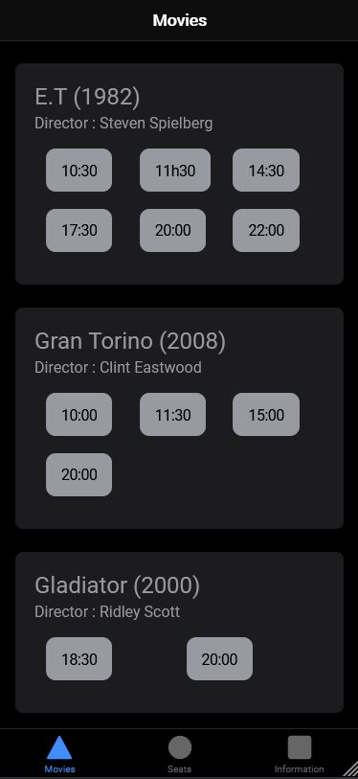
Home Page
We set up severals movies for the app
so the user can choose what he wants

Slide 3
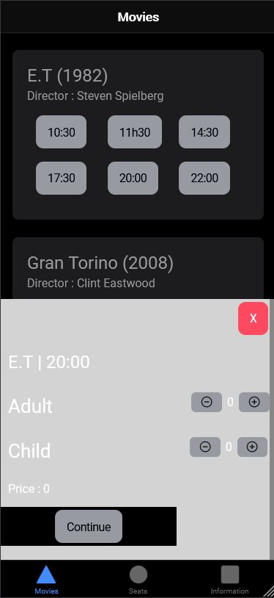
Home Page
When we click on a schedule
we can choose how many people we will be and see the price and then go to the seating page

Slide 4
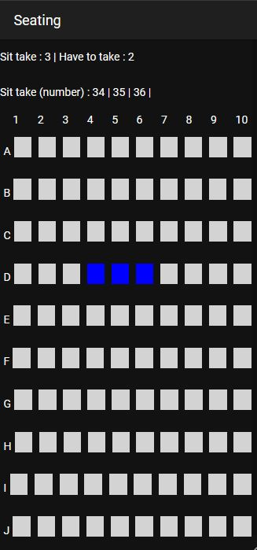
Seating Page
On this page, we have a 100 seats
that we can choose

Slide 5
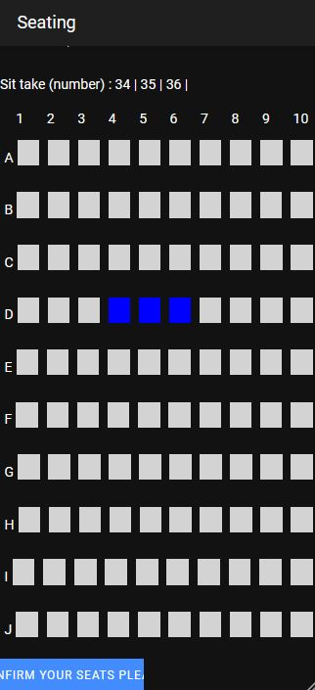
Seating Page
Then, you can go in the Booking page

Slide 6
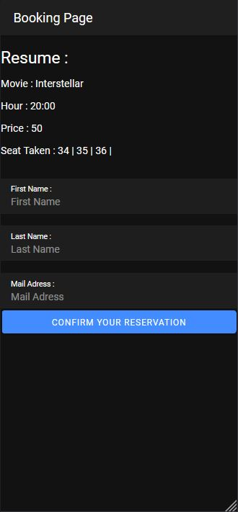
Booking Page
On this page, we can put our information to pay

Slide 7
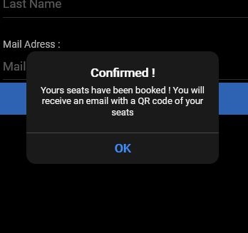
Booking Page
Once you have filled in your information, you can click on the button and you just bought your places !

Slide 8
Things we have to fix/done
We also have to make the seats adjacent when we want to select them

