Slide 1
Mobile App Projet
Alexandre DELAFOSSE
Simon ROCHE
Cameron CELERIER DIT LORMONT

Slide 2
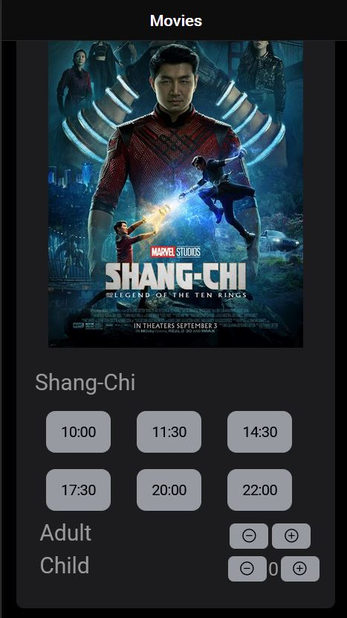
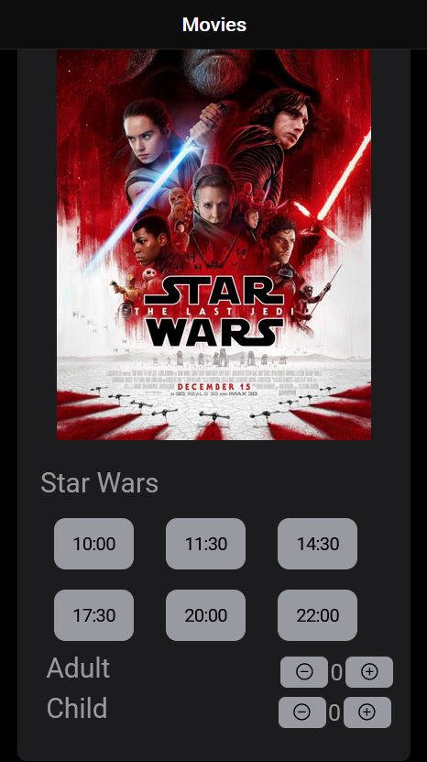
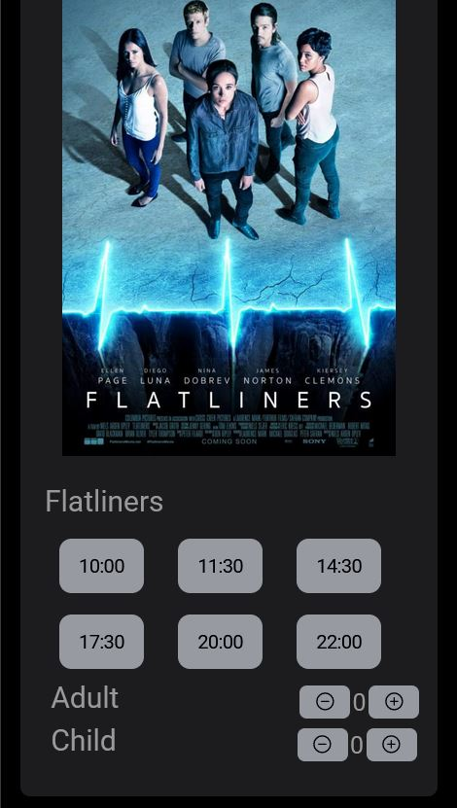
Home Page
We set up 3 movie for the app so the user can choose what he wants

Slide 3
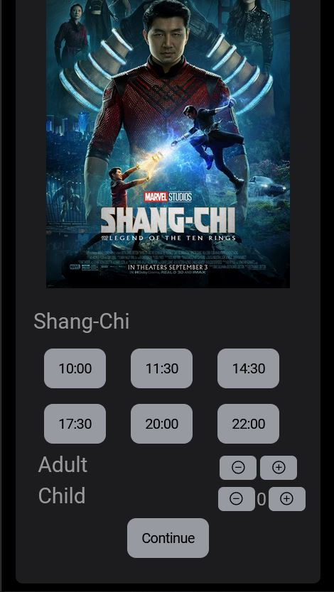
Home Page
When we click on a schedule we can go on the seating page

Slide 4
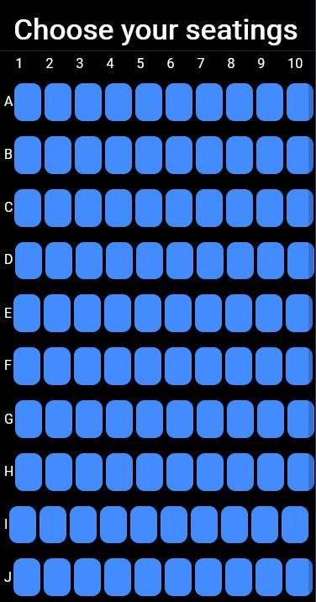
Seating Page
On this page, we have a 100 seats that we can choose

Slide 5
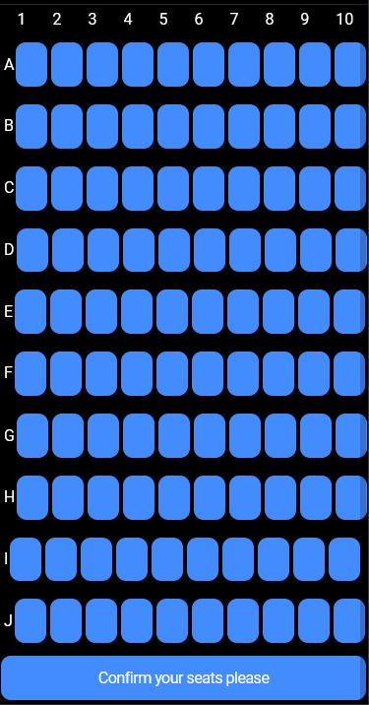
Seating Page
When we choosed our seats we can go directly on the Booking Page

Slide 6
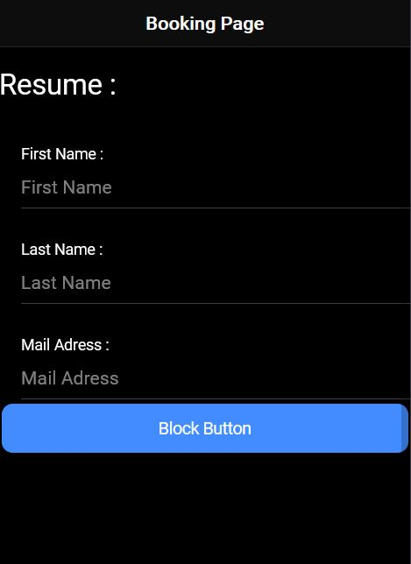
Booking Page
On this page, we can put our information to pay

Slide 7
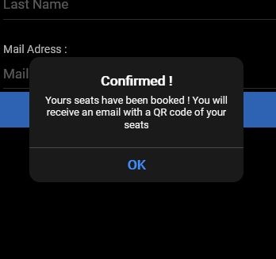
Booking Page
Once you have filled in your information, you can click on the button and you just bought your places !

Slide 8
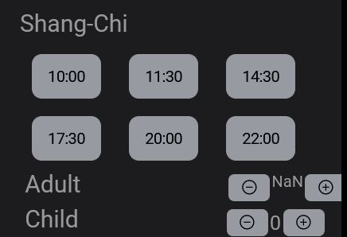
Things we have to fix/done
On the Home Page, we have to fix the incrementation when we want to select the number of person
We also have to make the seats adjacent

