Slide 1

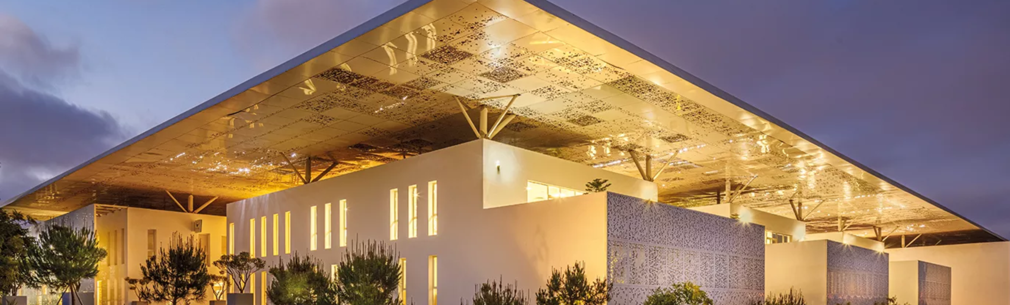
Modern NLP
Based on Deep Learning and Language models.
Day 1 Morning
Alexandre Gazagnes

Slide 2
1st Day
Morning (~ 2h)
ML – IA – NLP – A gentle introduction
Python, Anaconda, Juypter, Git, Github : All the tools you need
Python & Strings 101 – A very small remainder
Afternoon (~ 4h)
ML 101 – A very first implementation
Text Processing – From words to vectors
Basic and Advanced NLP techniques
Alexandre Gazagnes
Alexandre Gazagnes

Slide 3
First … Let’s Talk !
Alexandre Gazagnes

Slide 4
About You and Me
Alexandre Gazagnes

Slide 5
Any Business ideas, techs projects to bring in ?
Achille & Felic => Chat Bot
Kewin => trading bot using Twitter
=>We need to find a new project
=>We need to find a new project
=>We need to find a new project
Alexandre Gazagnes
Alexandre Gazagnes

Slide 6
10 richest vs 10 biggest companies
https://en.wikipedia.org/wiki/The_World%27s_Billionaires
https://en.wikipedia.org/wiki/List_of_public_corporations_by_market_capitalization
Alexandre Gazagnes
Alexandre Gazagnes

Slide 7
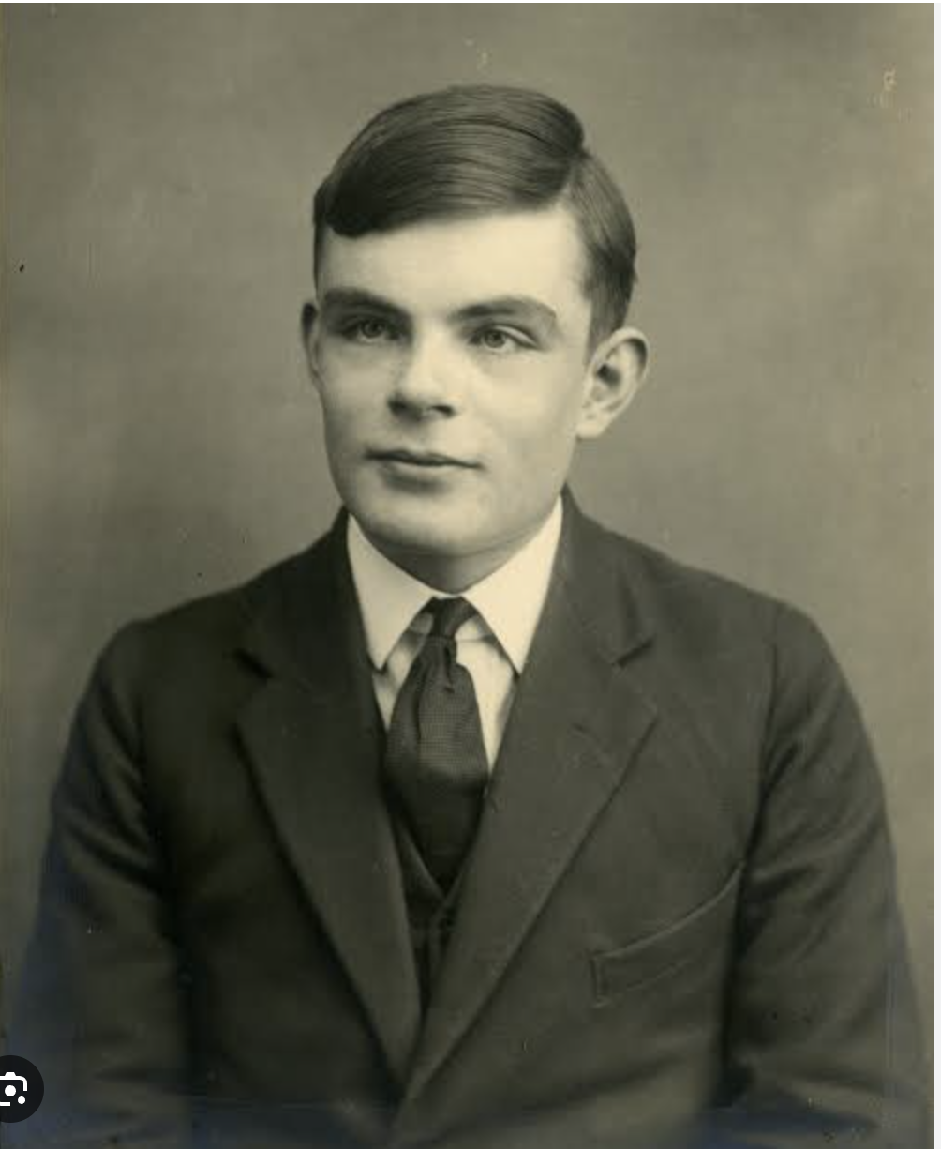
Who is this guy ?
My great great great grandfather
Just a random guy
Alan Turing
Nobody, He was created by some random AI tool
Alexandre Gazagnes
Alexandre Gazagnes

Slide 8
About Tech. Culture & Knowledge
AI
Machine Learning
Data Science
Deep learning
NLP
GPT
Robotics
Supervized
Reinforcement Learning
Skynet
Alphago
Deep Blue
Alexandre Gazagnes
Alexandre Gazagnes
Alexandre Gazagnes

Slide 9
Tools

Slide 10
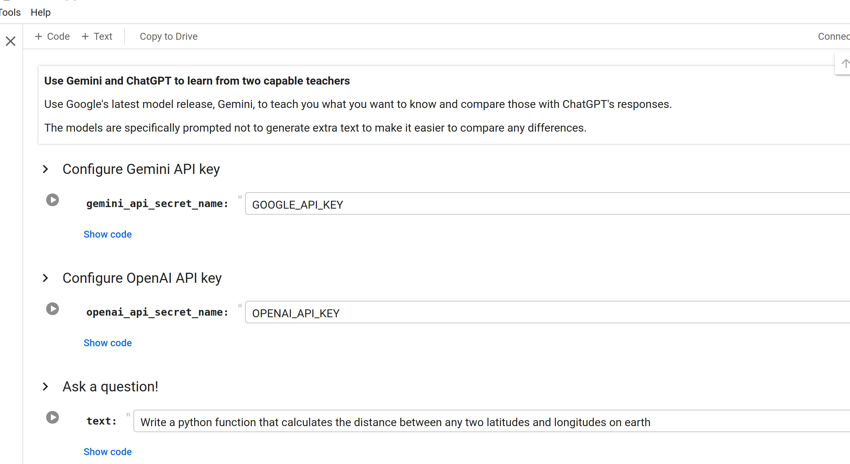
Google Colab
Alexandre Gazagnes
Alexandre Gazagnes

Slide 11
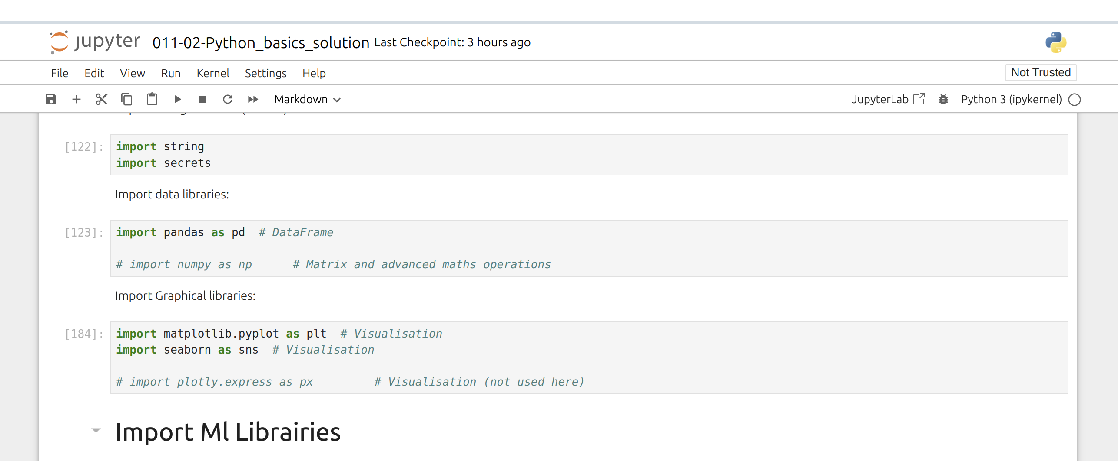
Anaconda & JupyterLab
Alexandre Gazagnes
Alexandre Gazagnes

Slide 12
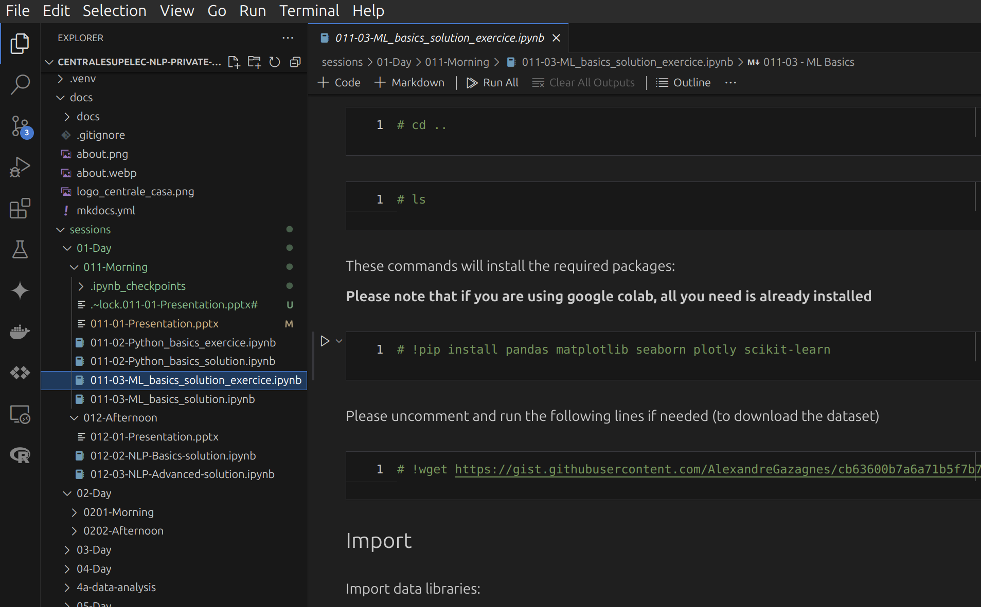
VS Code & PyCharm (most advanced users)
Alexandre Gazagnes
Alexandre Gazagnes

Slide 13
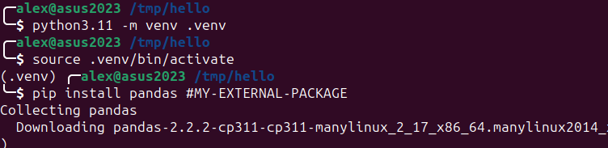
Creating .venv with virtualenv / venv + pip *
* => Better : https://python-poetry.org
Alexandre Gazagnes
Alexandre Gazagnes

Slide 14
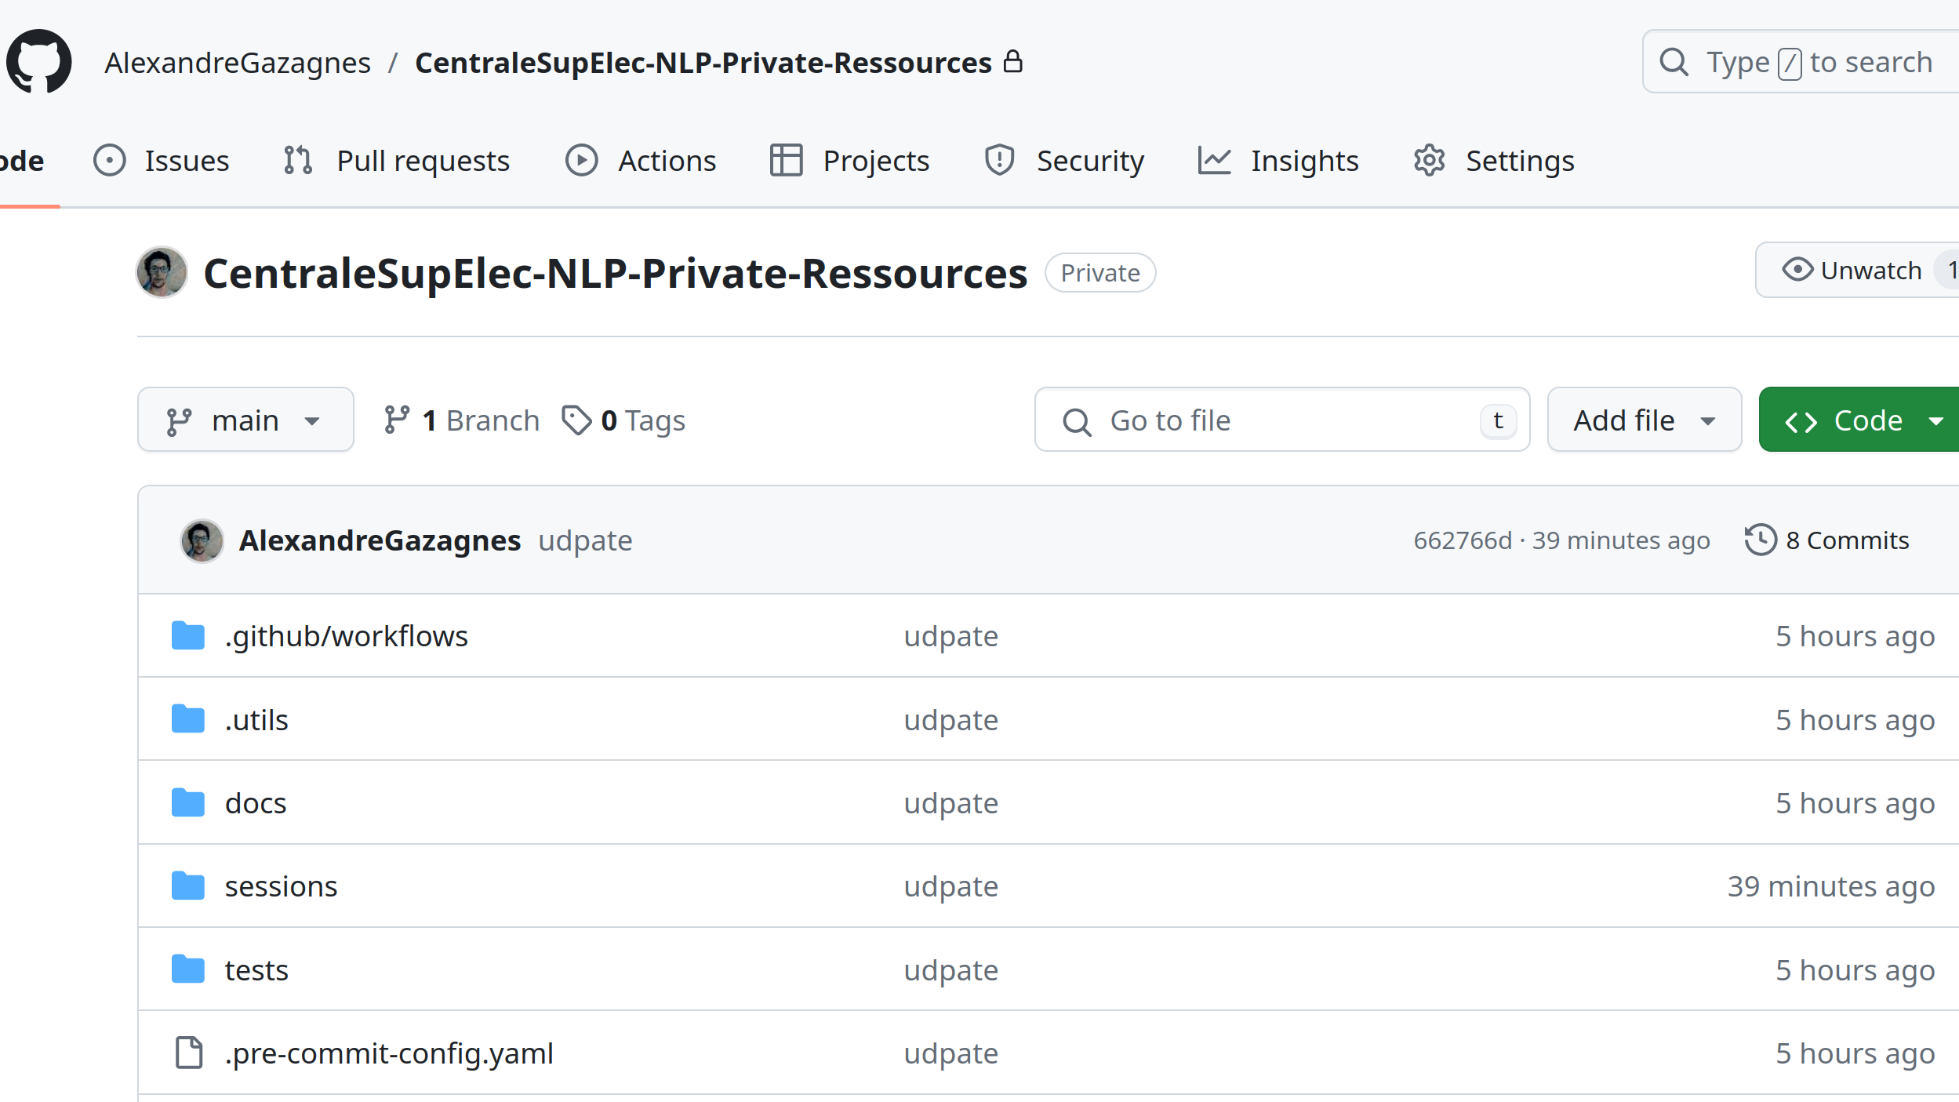
Git & GitHub
Alexandre Gazagnes
Alexandre Gazagnes

Slide 15
Python & Strings – 101

Slide 16
Practice !

