Slide 1

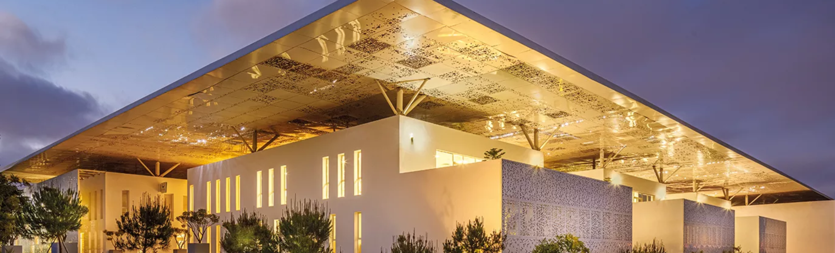
Modern NLP
Based on Deep Learning and Language models.
Day 1 Morning
Alexandre Gazagnes

Slide 2
1st Day
Morning (~ 2h)
ML – IA – NLP – A gentle introduction
Python, Anaconda, Juypter, Git, Github : All the tools you need
Python 101 – A very small remainder
Afternoon (~ 4h)
ML 101 – A very first implementation
Text Processing – From words to vectors
Basic and Advanced NLP techniques
Alexandre Gazagnes
Alexandre Gazagnes

Slide 3
First … Let’s Talk !
Alexandre Gazagnes

Slide 4
About You and Me
Alexandre Gazagnes

Slide 5
About Tech. Knowledge
AI
Machine Learning
Data Science
Deep learning
NLP
GPT
Robotics
Supervized
Reinforcement Learning
Skynet
Alphago
Deep Blue
Alexandre Gazagnes
Alexandre Gazagnes
Alexandre Gazagnes

Slide 6
Any Business ideas, techs projects to bring in ?
.
.
.
.
Alexandre Gazagnes
Alexandre Gazagnes

Slide 7
10 richest vs 10 biggest companies
https://en.wikipedia.org/wiki/The_World%27s_Billionaires
https://en.wikipedia.org/wiki/List_of_public_corporations_by_market_capitalization
Alexandre Gazagnes
Alexandre Gazagnes

Slide 8
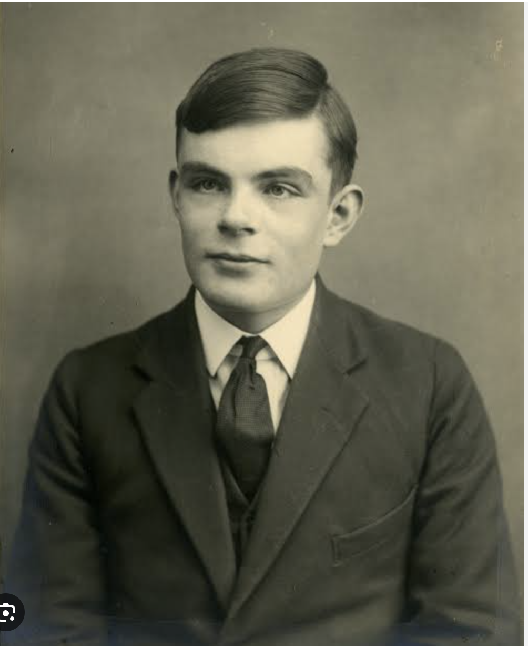
Who is this guy ?
My great great great grandfather
Just a random guy
Alan Turing
Nobody, He was created by some random AI tool
Alexandre Gazagnes
Alexandre Gazagnes

Slide 9
Tools

Slide 10
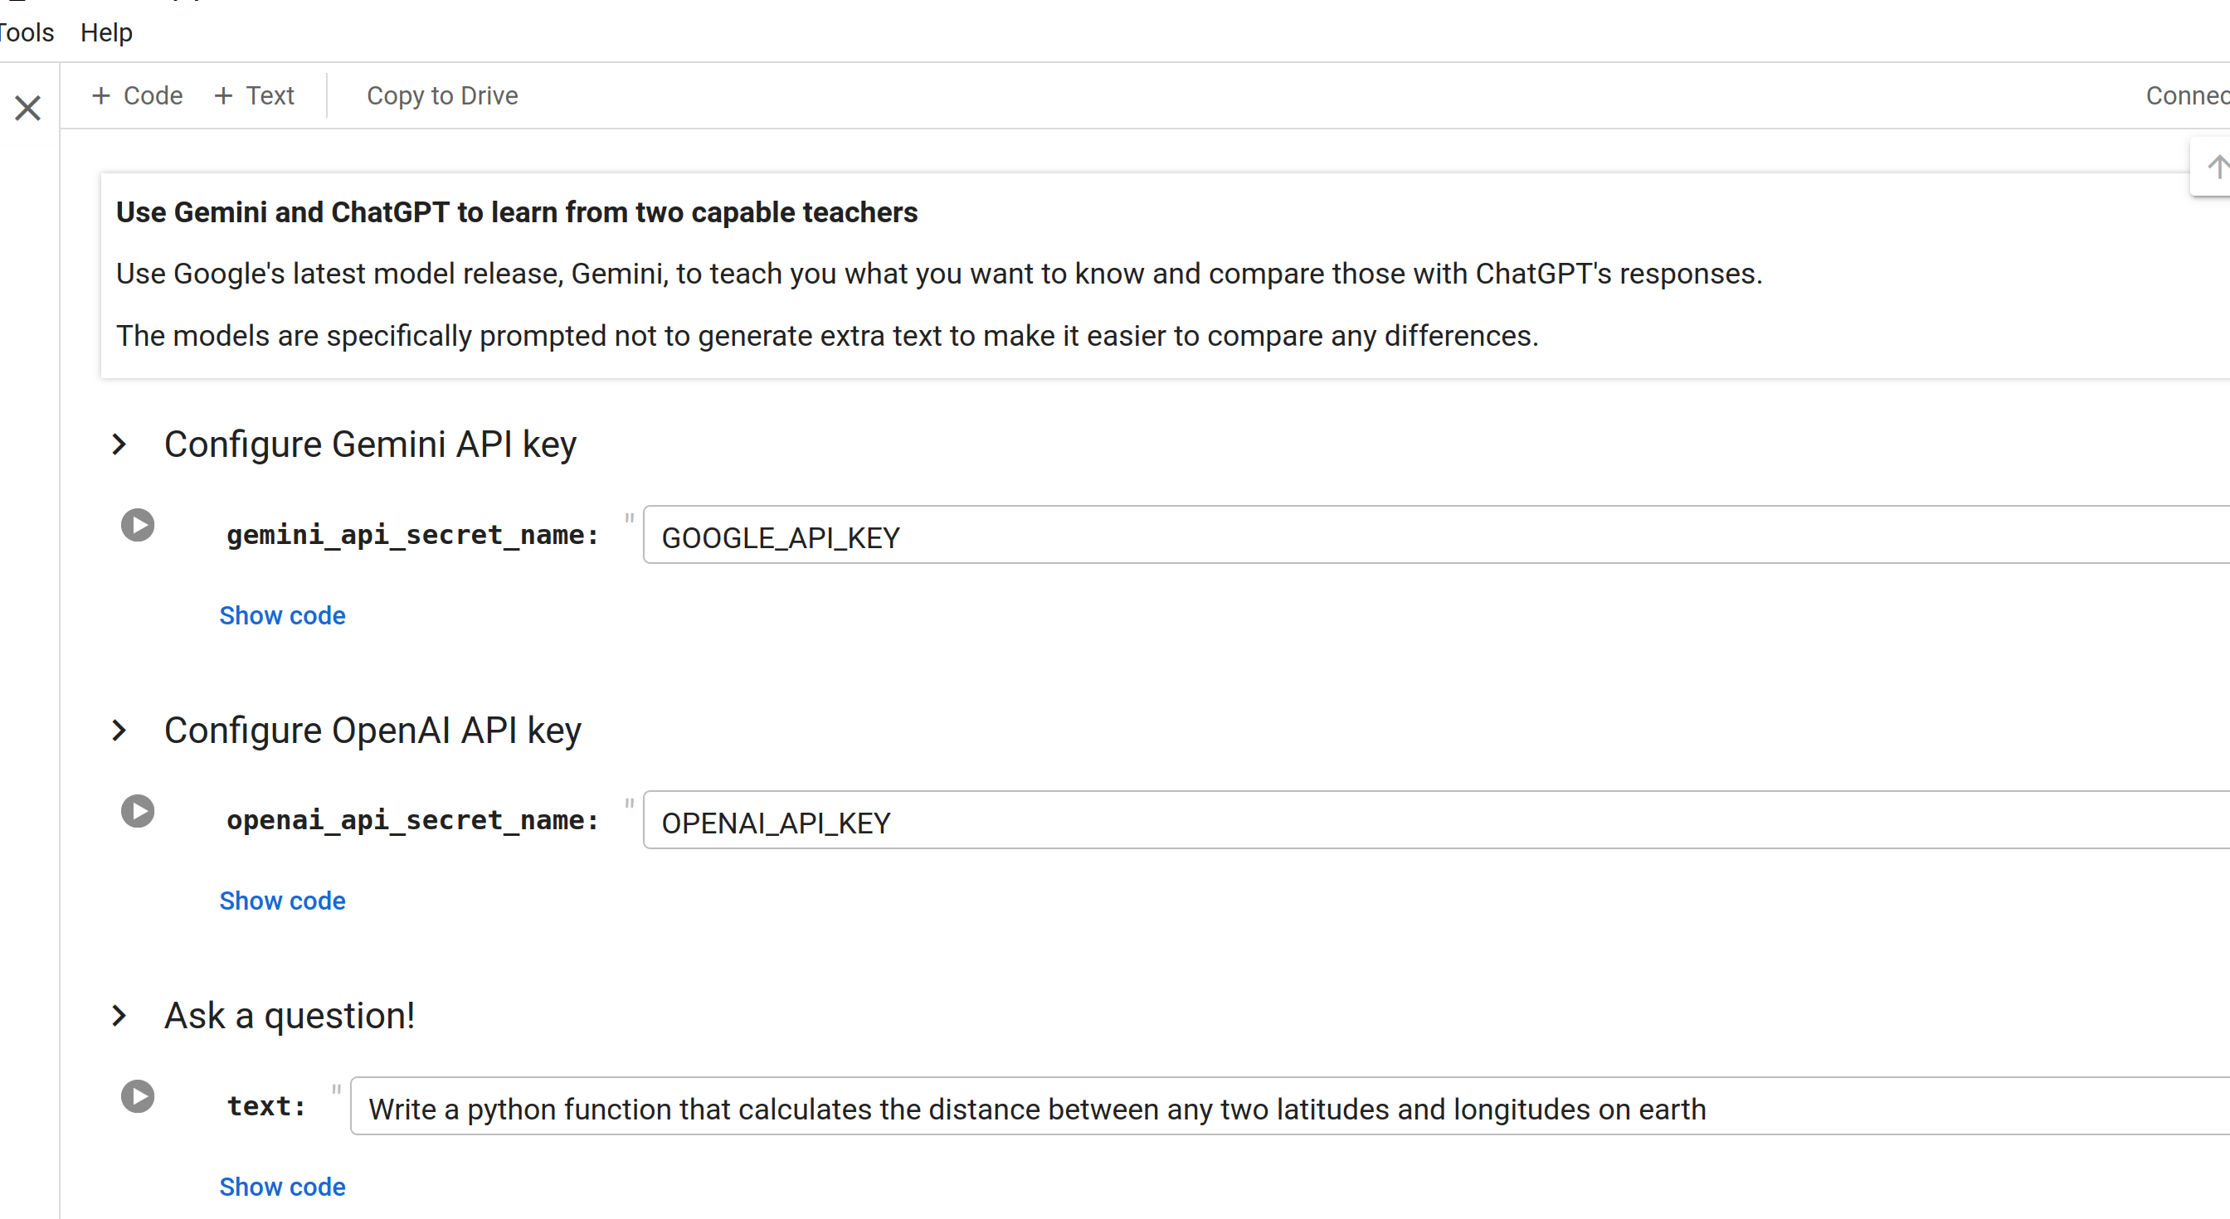
Google Colab
Alexandre Gazagnes
Alexandre Gazagnes

Slide 11
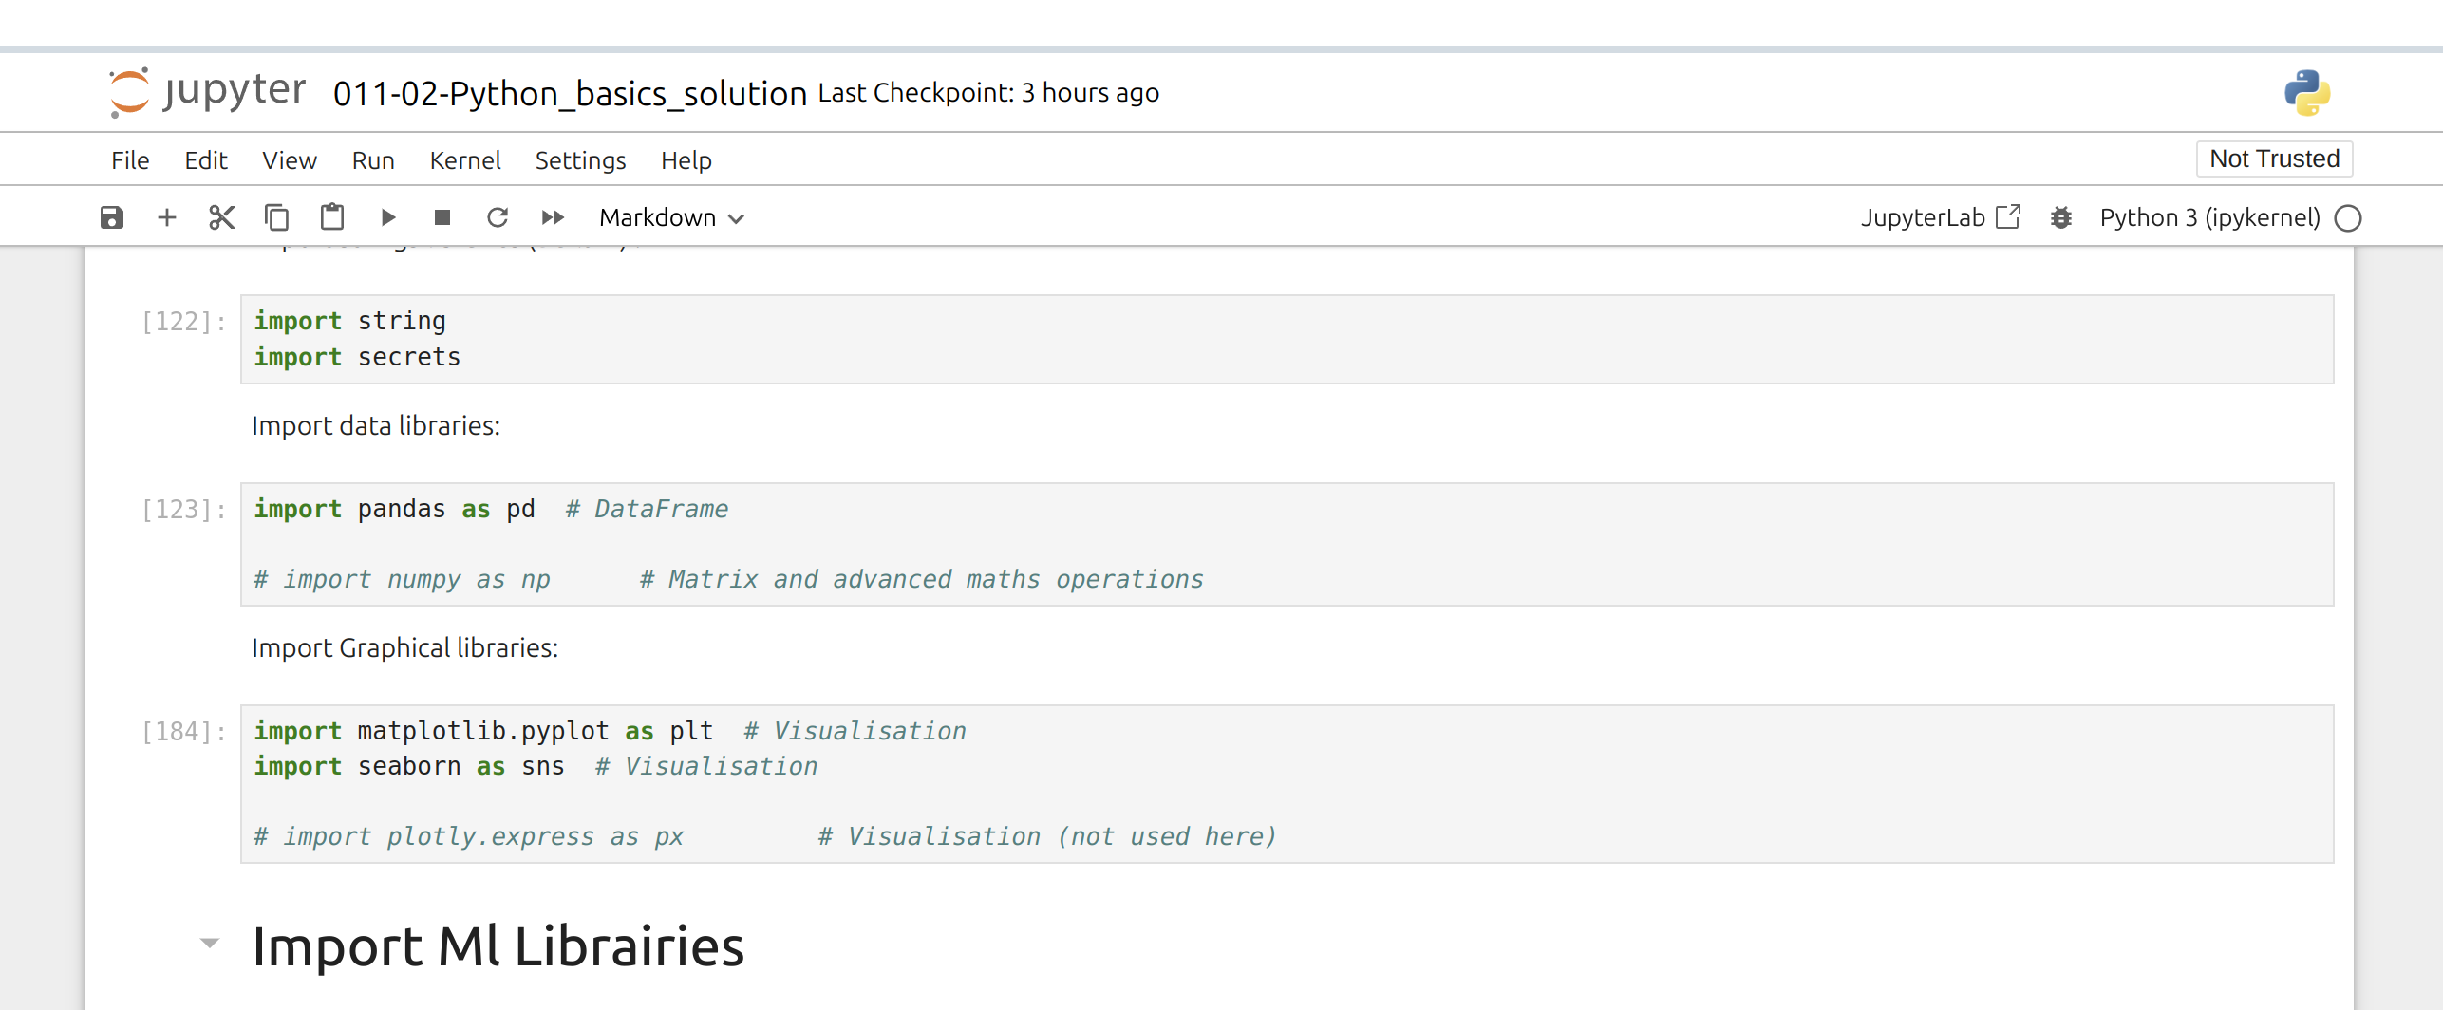
Anaconda & JupyterLab
Alexandre Gazagnes
Alexandre Gazagnes

Slide 12
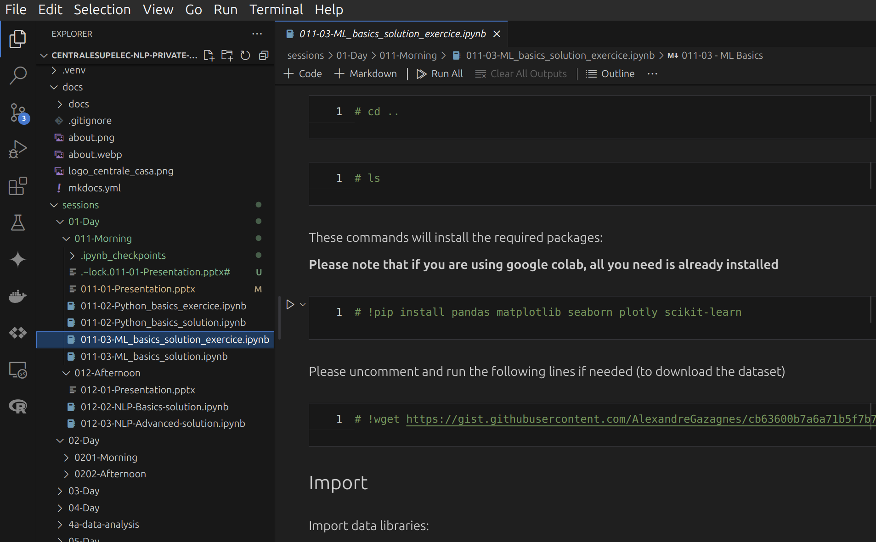
VS Code & PyCharm (most advanced users)
Alexandre Gazagnes
Alexandre Gazagnes

Slide 13
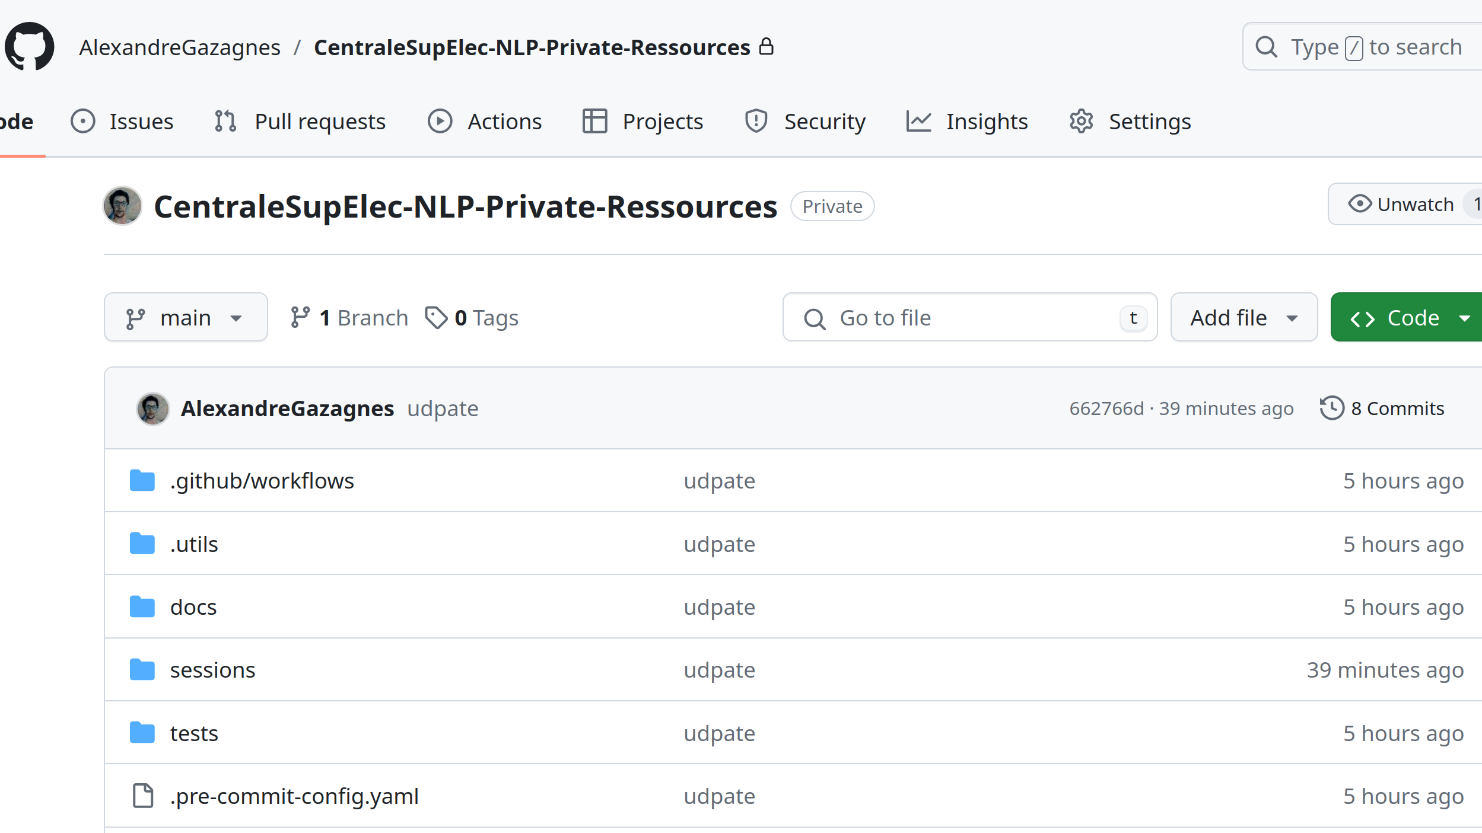
Git & GitHub
Alexandre Gazagnes
Alexandre Gazagnes

Slide 14
Python – 101

Slide 15
Practice !

Slide 16
ML - 101

Slide 17
Practice !

