Slide 1
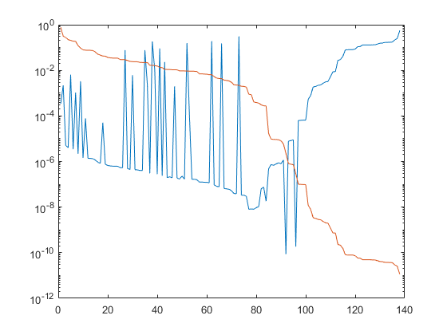
adlittle.mps

Slide 2
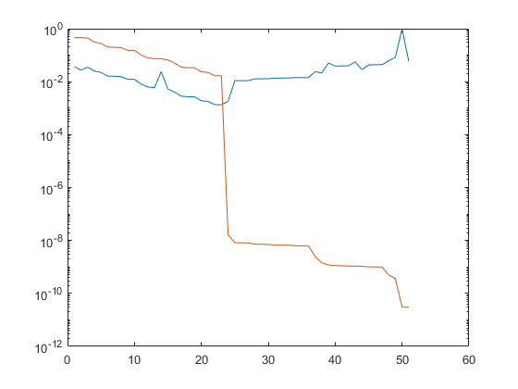
afiro.mps

Slide 3
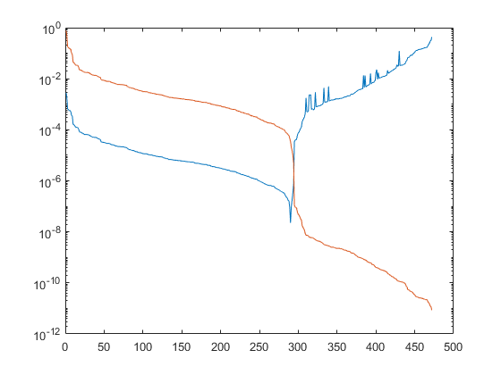
bandm.mps

Slide 4
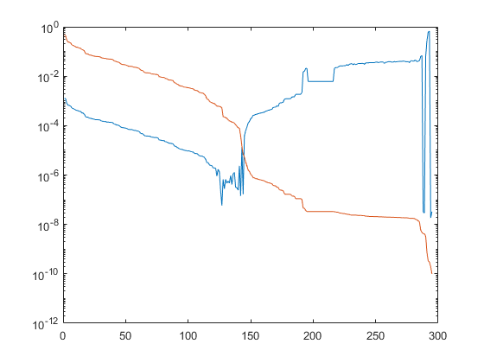
beaconfd.mps

Slide 5
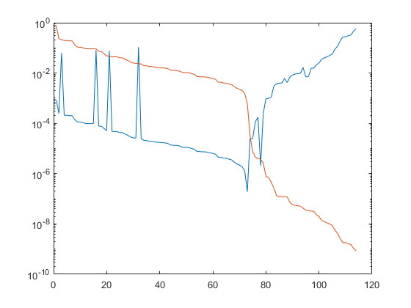
blend.mps

Slide 6
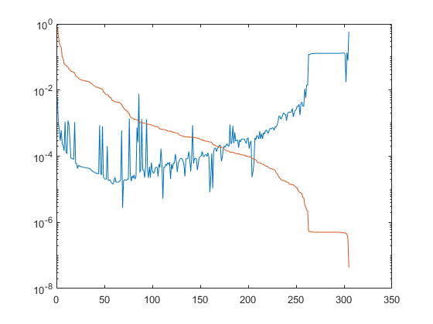
boeing2.mps

Slide 7
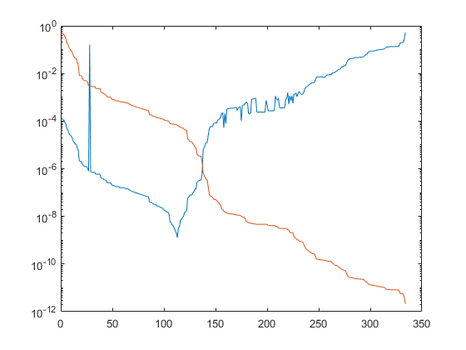
bore3d.mps

Slide 8
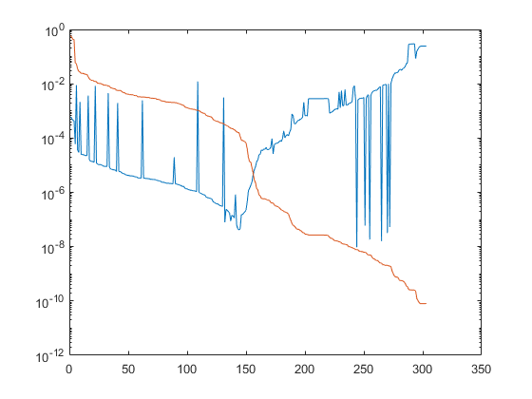
brandy.mps

Slide 9
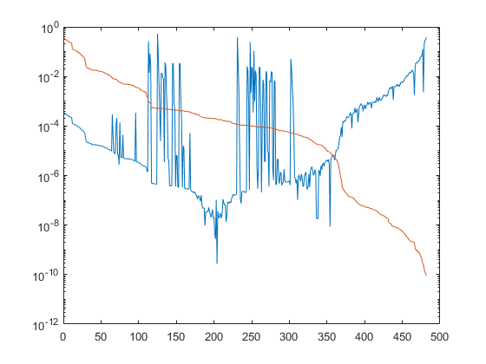
capri.mps

Slide 10
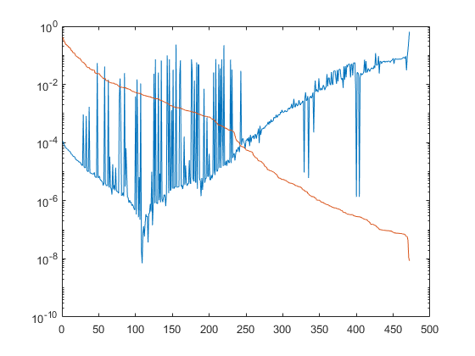
e226.mps

Slide 11
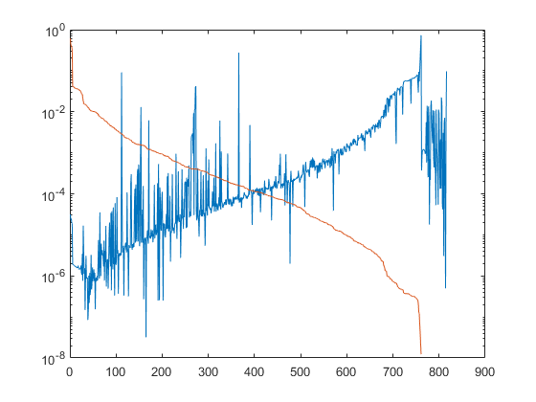
etamacro.mps

Slide 12
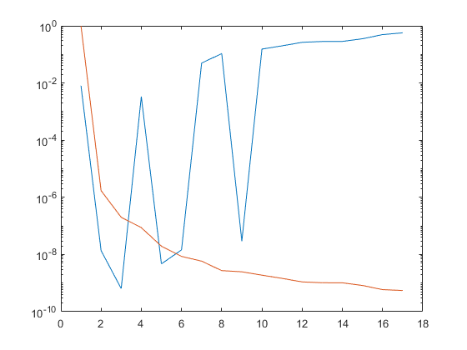
farm.mps

Slide 13
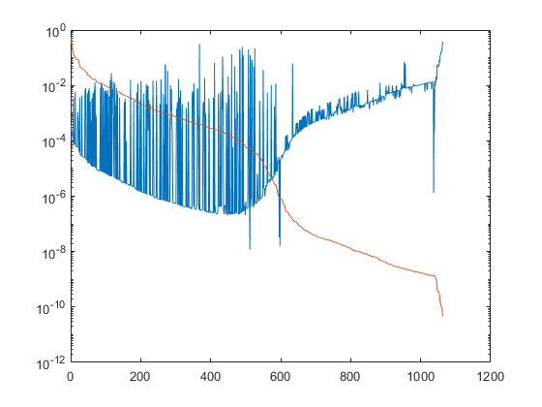
finnis.mps

Slide 14
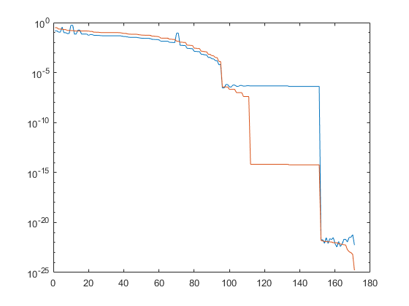
gams10a.mps

Slide 15
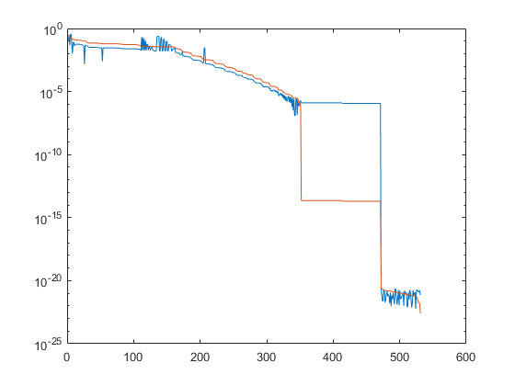
gams30a.mps

Slide 16
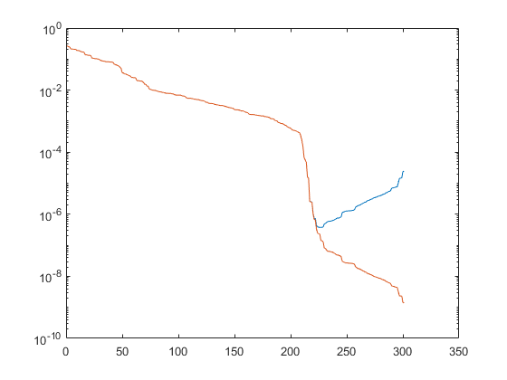
grow7.mps

Slide 17
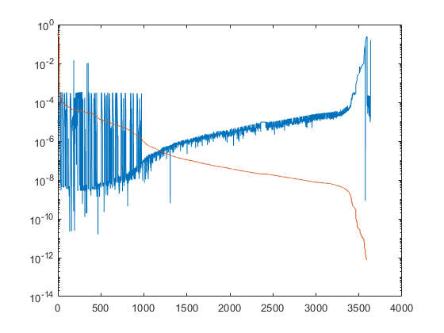
iiasa.mps

Slide 18
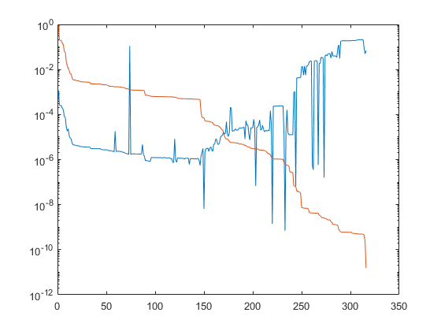
israel.mps

Slide 19
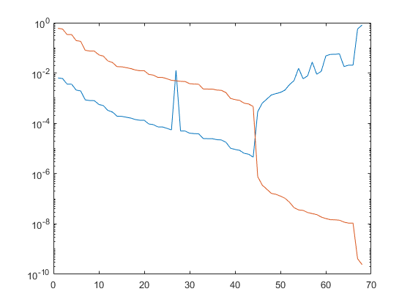
kb2.mps

Slide 20
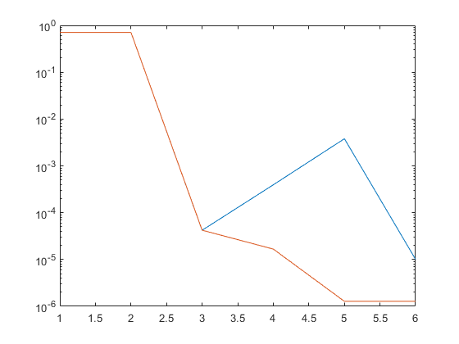
kleemin3.mps

Slide 21
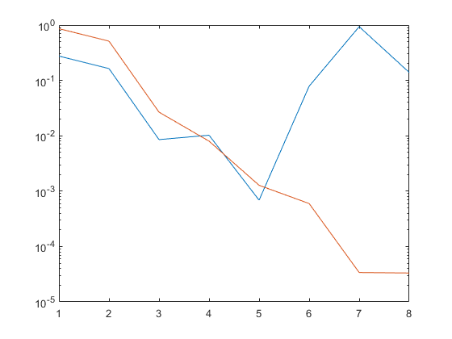
kleemin4.mps

Slide 22
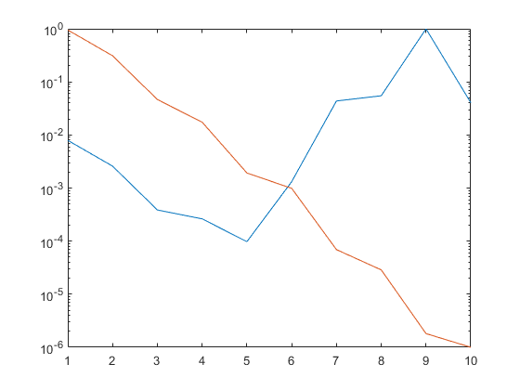
kleemin5.mps

Slide 23
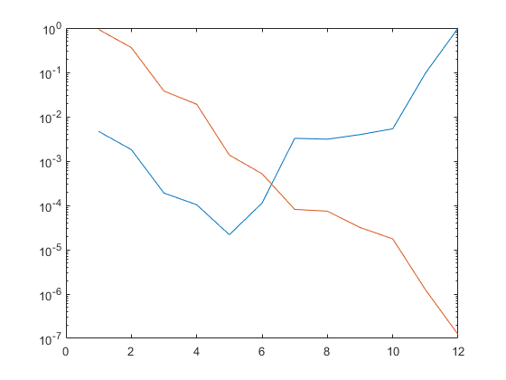
kleemin6.mps

Slide 24
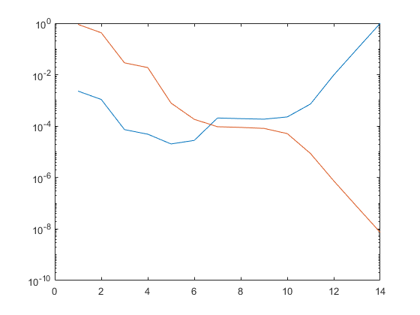
kleemin7.mps

Slide 25
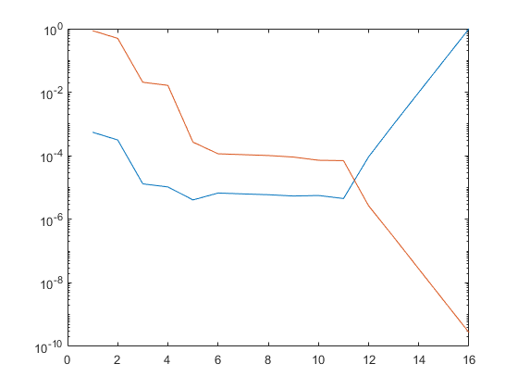
kleemin8.mps

Slide 26
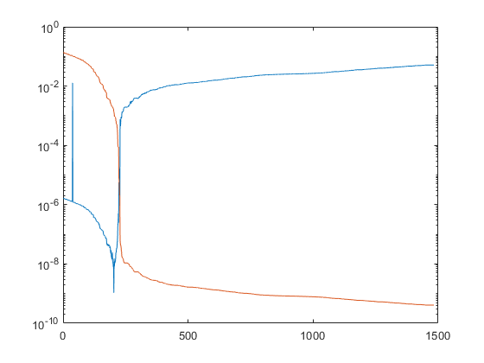
l9.mps

Slide 27
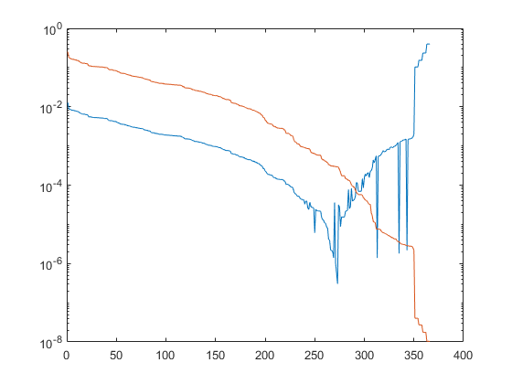
lotfi.mps

Slide 28
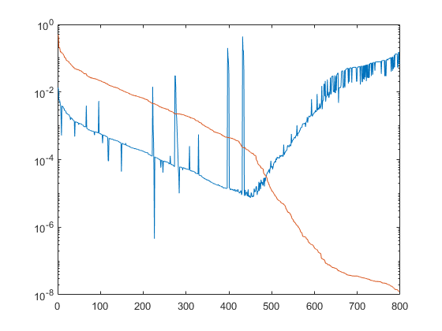
model1.mps

Slide 29
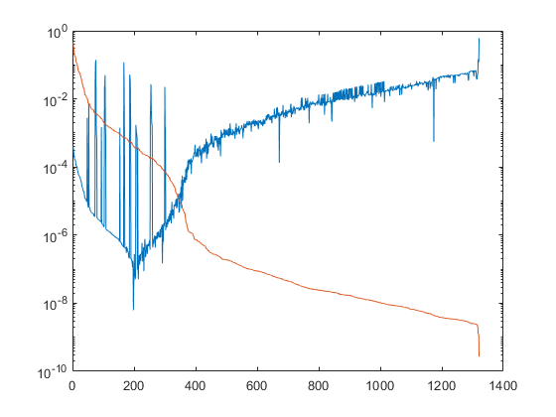
model2.mps

Slide 30
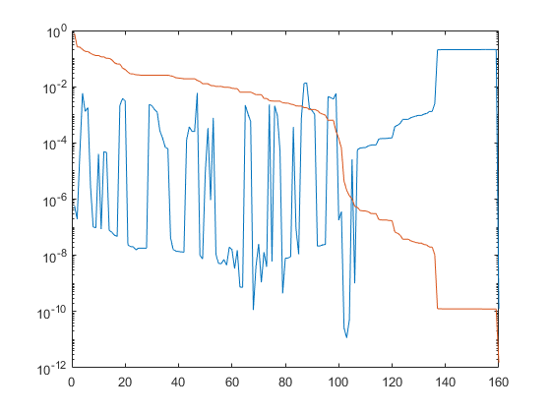
multi.mps

Slide 31
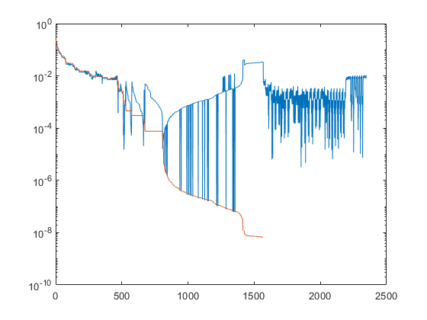
nemsafm.mps

Slide 32
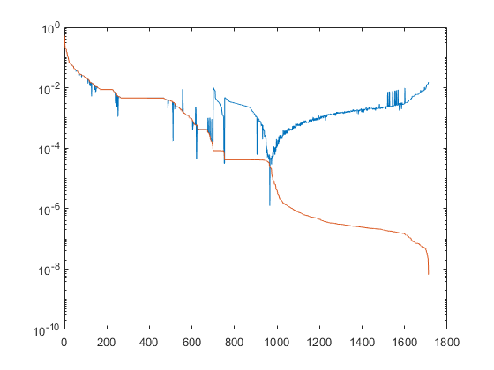
nemscem.mps

Slide 33
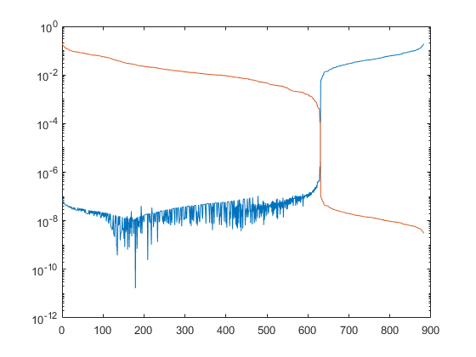
nsic1.mps

Slide 34
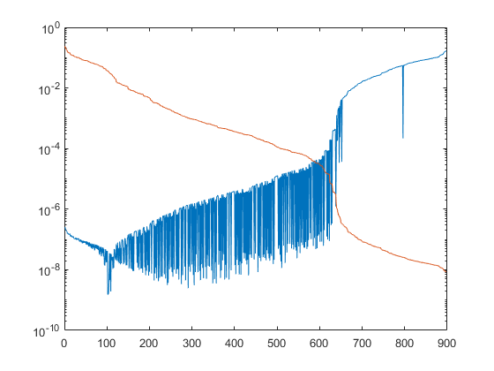
nsic2.mps

Slide 35
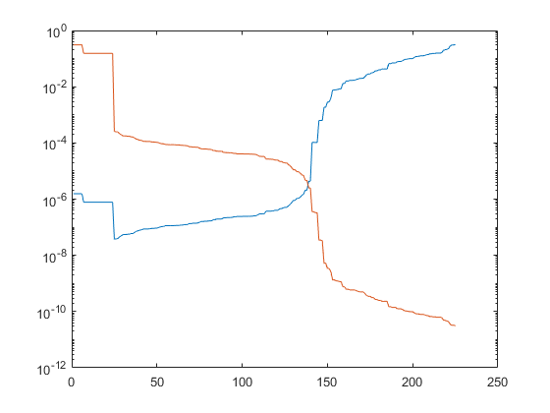
nug05.mps

Slide 36
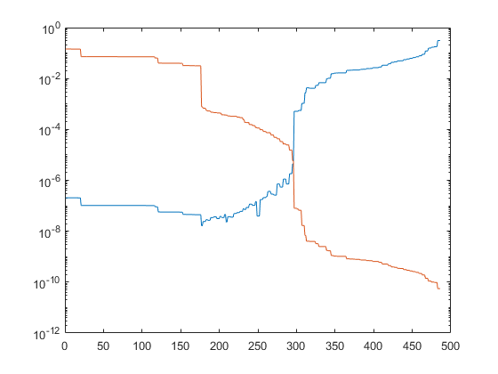
nug06.mps

Slide 37
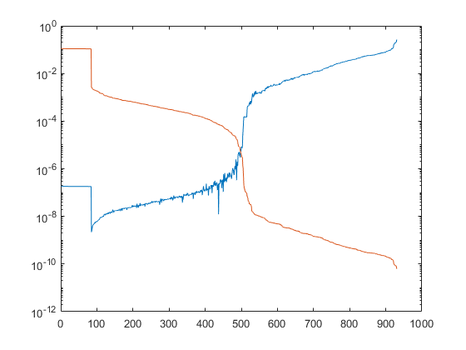
nug07.mps

Slide 38
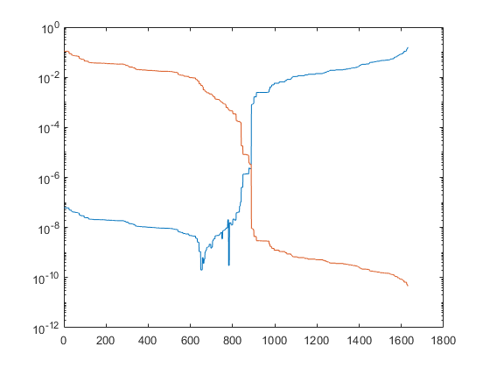
nug08.mps

Slide 39
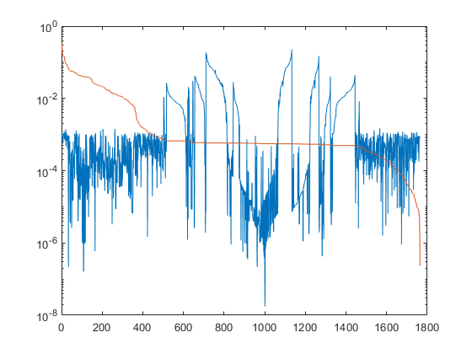
orna1.mps

Slide 40
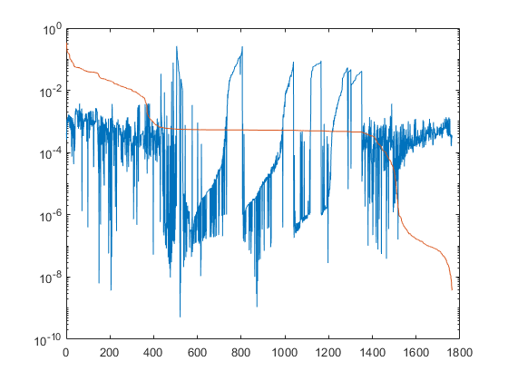
orna4.mps

Slide 41
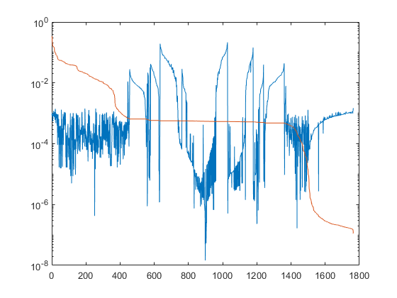
orna7.mps

Slide 42
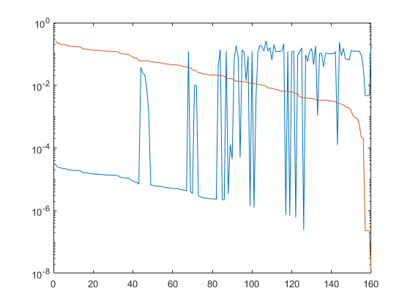
orswq2.mps

Slide 43
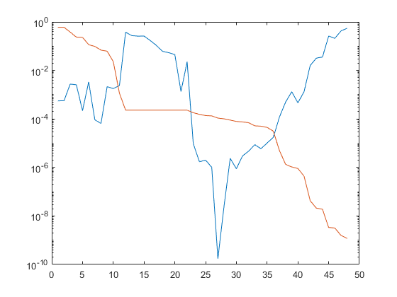
p0033.mps

Slide 44
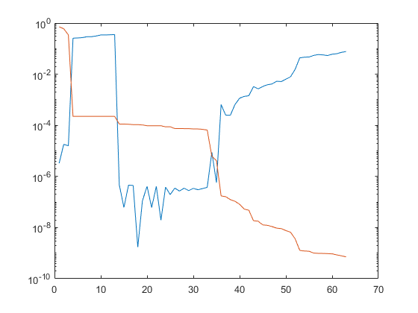
p0040.mps

Slide 45
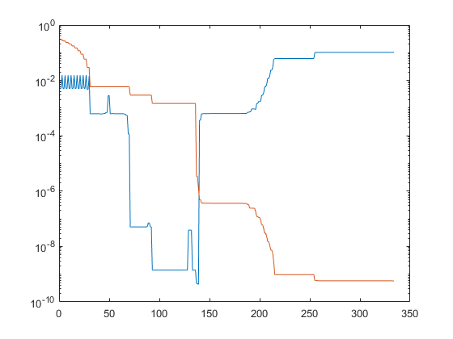
p0201.mps

Slide 46
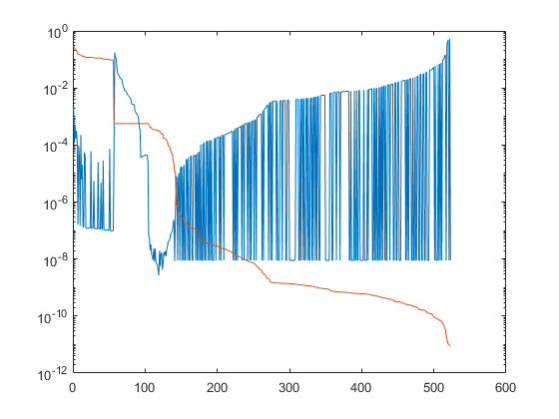
p0282.mps

Slide 47
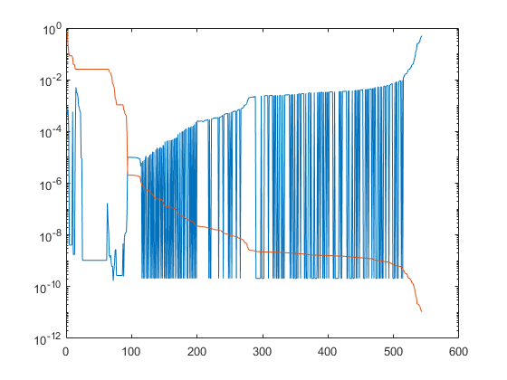
p0291.mps

Slide 48
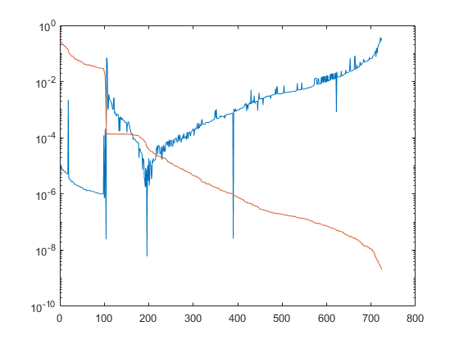
p0548.mps

Slide 49
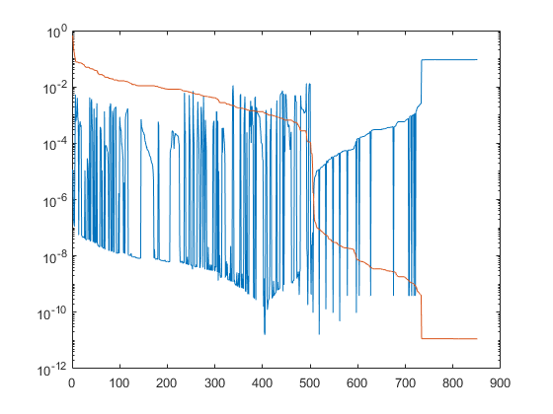
p19.mps

Slide 50
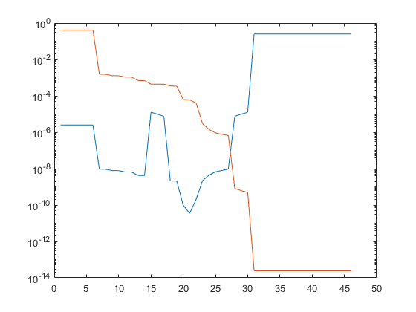
problem.mps

Slide 51

qiulp.mps

Slide 52

recipe.mps

Slide 53

refine.mps

Slide 54

rosen7.mps

Slide 55

sc105.mps

Slide 56

sc205.mps

Slide 57

sc50a.mps

Slide 58

sc50b.mps

Slide 59

scagr25.mps

Slide 60

scagr7.mps

Slide 61

scfxm1.mps

Slide 62

scorpion.mps

Slide 63

scsd1.mps

Slide 64

sctap1.mps

Slide 65

share1b.mps

Slide 66

share2b.mps

Slide 67

small000.mps

Slide 68

small001.mps

Slide 69

small002.mps

Slide 70

small003.mps

Slide 71

small004.mps

Slide 72

small005.mps

Slide 73

small006.mps

Slide 74

small007.mps

Slide 75

small008.mps

Slide 76

small009.mps

Slide 77

small010.mps

Slide 78

small011.mps

Slide 79

small012.mps

Slide 80

small013.mps

Slide 81

small014.mps

Slide 82

small015.mps

Slide 83

small016.mps

Slide 84

standata.mps

Slide 85

standgub.mps

Slide 86

standmps.mps

Slide 87

stocfor1.mps

Slide 88

vtp-base.mps

Slide 89

zed.mps

