Slide 1
Memristor-based computing
By Alexandre Hertzog {ahertzog@inf.ufrgs.br}
With Oliver Bringmann, Thomas Schweizer, Johannes Maximilian Kühn, Markus Dobler, Christoph Gerum, Axel Braun

Slide 2
Context
Von Neumann Architecture (1/2)
Processors must access memory to handle data;
Caches speed up processing by forming memory layers;
  Closer to the processor, the faster.
Hard-disks provide means for longer data longevity and bigger storage.

Slide 3
Context
Von Neumann Architecture (2/2)
What if the memory actually computed results, instead of just storing them?
What if that memory could also work as permanent storage?

Slide 4
Memristor Overview (1/3)
Memristor = memory resistor;
Analog component that stores current;
Can be reset by applying negative current;
Stores current (charge) indefinitely.

Slide 5
Memristor Overview (2/3)
Pulse: digital-like voltage input (square wave);
  Runtime defined;
  Unspecified height and length.
Base: amount of pulses required so that a memristor changes state;
  Runtime defined;
  Considering the same pulse length and height.

Slide 6
Memristor Overview (3/3)
Read: apply N pulses until the memristor changes state;
Auto-resetting: unnatural behavior;
  Forced by a feedback mechanism from its output to its input;

Slide 7
Memristor Math – ADD write (1/2)
For example 3 + 4 on base 10;
  Input 3 pulses to MR[1];
  Input 4 pulses to MR[1];
  Read MR[1] = 3;
  Result = base (which is 10) – 3 = 7

Slide 8

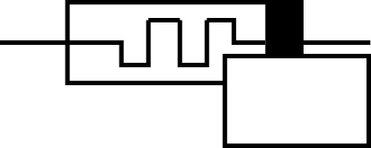
Memristor Math – ADD write (2/2)
3x
0/10
-----------------------------------------------
4x
3/10
-----------------------------------------------
7/10

Slide 9
Memristor Math – ADD read
N pulses until it changes (N=3)
7/10
-----------------------------------------------
0/10
Voltage spike!

Slide 10
Memristor math – ADD read (2/2)
We got N=3 for the previous operation;
With base=10;
Result=10-3=7;

Slide 11
Memristor Math – SUB write (1/2)
For example 7-3 on base 10;
  Input 7 pulses to MR[1];
  Input 3 pulses to MR[2];
  Apply M pulses to MR[1] and MR[2] until MR[1] changes;
  Result N = read from MR[2]

Slide 12
Memristor Math – SUB write (2/2)
7x
0/10
0/10
3x
3/10
0/10
-----------------------------------------------
M=3
0/10
7/10
M=3
3/10
3/10

Slide 13
Memristor Math – SUB read (1/2)
0/10
0/10
N=4
3/10
6/10
-----------------------------------------------
0/10
0/10
3/10
0/10

Slide 14
Memristor Math – SUB read (2/2)
Since the last N is 4, 7-3=4.

Slide 15
Some Considerations...
The bigger the base, greater the read latency may be!
  If MR[1] has a value of 3b10, it takes 7 cycles to read its value;
  If MR[2] has a value of 3b50, it takes 47 cycles to read its value;
Read operation is destructive!

Slide 16
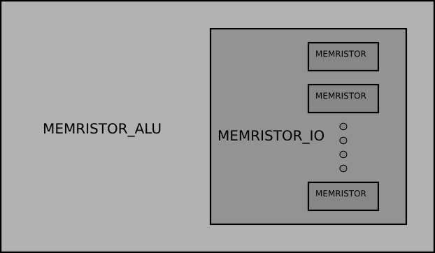
Overall Architecture

Slide 17
Memristor Arithmetic Logic Unit (MEMRISTOR_ALU)
Allowed operations: ADD, SUB, MUL, DIV, FAC;
  Performed by using specific combinations of read/writes of determined bases to given memristors.
AND, OR, NAND, NOR, XOR can be deduced from above operations;
Same for comparison operations.

Slide 18
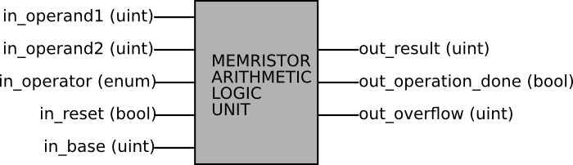
MEMRISTOR_ALU Architecture

Slide 19
Memristor Array (MEMRISTOR_IO)
Static number of addressable memristors;
Manages memristors input/output;
  Makes pulses, monitors resistances.
Overflow mechanism;
  The amount of times a memristor reseted.
Addresses, write data and read data received/sent serially;
  Addresses paired with data.
Read destroys data in the memory.

Slide 20
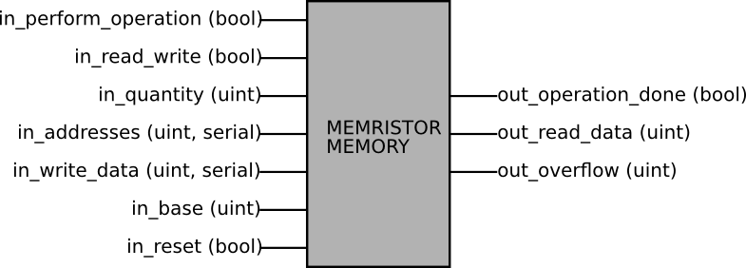
memristor_io architecture

Slide 21
Processor and DRAM recap

Slide 22
Processor and memory latencies (1)
Processor: i7-3960X:
  Clock: 3.8GHz;
  Caches: 6x 32kB / 6x 256kB / 15MB.
Memory: 4x DDR3-1600:
  Latencies: 9-9-9-26;
  Real clock: 800MHz;
  CAS latency: 11.25ns.

Slide 23
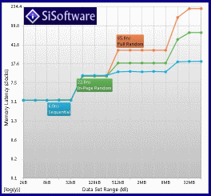
Processor and memory latencies (2) [3]
L1 cache:
  4 cycles;
L2 cache:
  11 cycles;
L3 cache:
  14 to 38 cycles;
DRAM:
  18 to 230 cycles.

Slide 24
Latencies: addition
Operation | Base | Split | Read-write cycles | Total (per mr)
1+4 | 16 | 1+4 | w2 w8 r22 | 32
25+48 | 16 | (1,9)+(3,0) | (w2 w6 r24) (w2 w2 r14) | (32) (18)
25+48 | 10 | (2,5)+(4,8) | (w2 w8 r6) (w2 w16 r14) | (16) (32)
25+48 | 5 | (1,0,0)+(1,4,3) | (w2 w2 r6) (w2 w8 r2) (w2 w6 r4) | (10) (12) (12)
8+7 | 16 | 8+7 | w2 w14 r2 | 18
8+7 | 5 | (1,3)+(1,2) | (w2 w2 r4) (w2 w4 r10) | (8) (16)
87+78 | 16 | (5,7)+(4,14) | (w2 w8 r12) (w2 w28 r22) | (22) (52)
87+78 | 10 | (8,7)+(7,8) | (w2 w14 r8) (w2 w16 r10) | (24) (28)
87+78 | 5 | (3,2,2)+(3,0,3) | (w2 w6 r8) (w2 w2 r4) (w2 w6 r10) | (16) (8) (18)

Slide 25
Latencies: subtraction
Operation | Base | Split | Read-write cycles | Total (per mr)
5-2 | 16 | 5-2 | w3 rw22 r6 | 31
19-15 | 16 | (1,3)+(0,15) | (w3 rw32 r32) (w3 rw26 r8) | (67) (37)
19-15 | 10 | (1,9)-(1,5) | (w3 rw18 r20) (w3 rw2 r8) | (41) (13)
19-15 | 5 | (3,4)-(3,0) | (w3 rw4 r10) (w3 rw2 r8) | (17) (13)
15-7 | 16 | 15-7 | w3 rw2 r16 | 21
9-9 | 16 | 9-9 | w3 rw14 r32 | 49
52-18 | 16 | (3,4)-(1,2) | (w3 rw26 r4) (w3 rw24 r4) | (33) (31)
25-12 | 16 | (1,9)-(0,12) | (w3 rw32 r32) (w3 rw14 r26) | (67) (43)
25-12 | 15 | (1,10)-(0,12) | (w3 rw30 r30) (w3 rw10 r26) | (63) (39)
25-12 | 10 | (2,5)+(1,2) | (w3 rw16 r2) (w3 rw10 r6) | (21) (19)
73-69 | 16 | (4,9)-(4,5) | (w3 rw24 r32) (w3 rw14 r8) | (59) (25)
15-25 | 15 | (0,15)-(1,9) | (w3 rw32 r30) (w3 rw2 r12) | (65) (17)

Slide 26
Memristor vs DRAM
Memristor | DRAM
Analog: extremely high speeds | Digital: low speeds
Inconsistent timings | Strict timings
Can be used to perform operations | Only stores the data
Needs to be renewed after every read (opt) | Needs to be renewed after some cycles
Stores data if power goes out | Looses data upon power outage
Asynchronous | Synchronous
100nm for each cell [3] | 48nm cells
Only uses power when pulses are applied | Uses power frequently by recharging
Some non-related power comparisons can be seen in [4];

Slide 27
Appendix
There was no comparison of the memristor “processor” and the i7 due to complexity reasons;
On smaller data sets, processor + cache combo is faster cycle-wise in every case than a memristor-based memory.

Slide 28
Enhancing speed: Multi-base operations
On larger bases, read and write operations can have a big latency;
  Base-100 operations may take 10x more time than base-10 ones.
Multi-based operations can split large operands into many memristors of smaller bases;
Done in software.

Slide 29
What is software?
In this context, software is an arbitrary set of instructions passed to the ALU;
Instructions are hard-coded in the upper level of the simulation.

Slide 30
Multi-base examples (1)
ADD:
  153b10 + 78b10 = (100+0) + (50+70) + (3+8)
  = 100 + (20 + 1 overflow) + (1 + 1 overflow)
  = 100 + (20 + 100) + (1 + 10) = 231
SUB:
  137b10 - 65b10 = (100-0) + (30-60) + (7-5)
  = 100 + (70 + 1 overflow) + 2
  = 100 + (70 - 100) + 2 = 72

Slide 31
Multi-base examples (2)
MUL: uses bit-shift principle;
  op1 is inputted to A with base-op2;
  Overflows are inputted to a greater-base memristor.
Example:
  16*10 (load 16 on A with base-10) = 6*10^1 + 1 overflow
  = 6*10^1 + 1*10^2
  = 160

Slide 32
Memristor (1)
Resistive component that accumulates voltage;
After accumulating approximately 1V, it changes state;
  From a high-resistance state to a low-resistance state.
Analog entity.

Slide 33
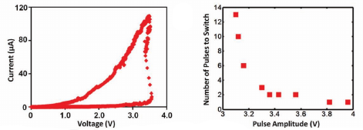
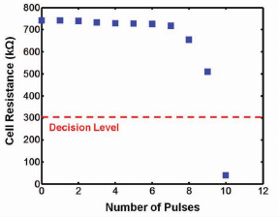
Memristor (2) [1]

Slide 34
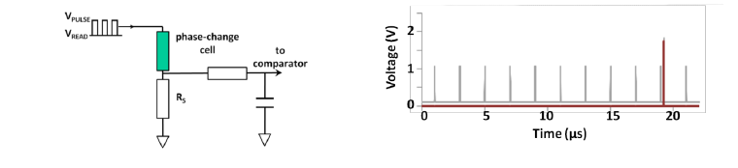
Memristor to digital [2]
Since memristors are analog entities, they must be adapted to use with digital circuits;
Self-resetting behavior is achieved by feeding back the comparator output;
Base is the total amount of pulses it requires to reset.

Slide 35
Memristor representation in SystemC
Two main processes:
  Accumulation process: reads from input, accumulates, outputs;
  Reset process: check “saved” energy, resets.
Internal clock;
  Simulates an analog component.

Slide 36
References
[1] Beyond von-Neumann Computing with Nanoscale Phase-Change Memory Devices
  By C. David Wright, Peiman Hosseini and Jorge A. Vazquez Diosdado
[2] Novel Applications Possibilities for Phase-Change Materials and Devices
  By C. David Wright, Yat-Yin Au, Mustafa M Aziz, Harish Bhaskaran, Rosie Cobley, Gerardo Rodriguez-Hernandez, Peiman Hosseini, Wolfram H P Pernice and Lei Wang
[3] http://www.sisoftware.net/?d=qa&f=ben_mem_latency
[4] mrFPGA: A Novel FPGA Architecture with Memristor-Based Reconfiguration
  Jason Cong & Bingjun Xiao

Slide 37
Thanks for listening!
Questions?

