Slide 1

An introduction to MVVM with Caliburn Micro for Delphi
DAPUG fall 2015
Jeroen Wiert Pluimers
jeroen@pluimers.com
http://wiert.me

Slide 2
The third object
Making the UI lighter.

Slide 3


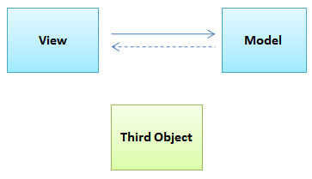
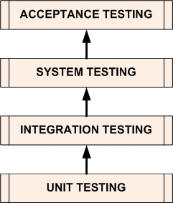
The 3rd object
All to often, applications are like these:
or, if you are lucky
Adding a 3rd object makes sense.
It all comes down to `Separation of Concerns`:
Cutting business logic away from your UI
Swapping your UI (VCL, FireMonkey, Mobile, Web, …)
Making it easier to test UI
Pictures: http://paulstovell.com/blog/third-object
Notes:
http://paulstovell.com/blog/third-object
http://en.wikipedia.org/wiki/Software_testing#Testing_levels
http://softwaretestingfundamentals.com/software-testing-levels/
http://softwaretestingfundamentals.com/unit-testing/
http://softwaretestingfundamentals.com/integration-testing/
http://softwaretestingfundamentals.com/system-testing/
http://softwaretestingfundamentals.com/acceptance-testing/

Slide 4
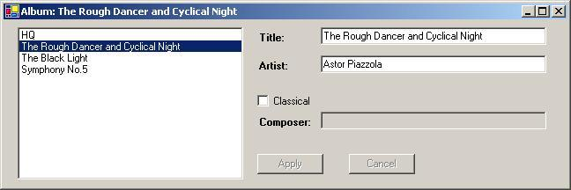
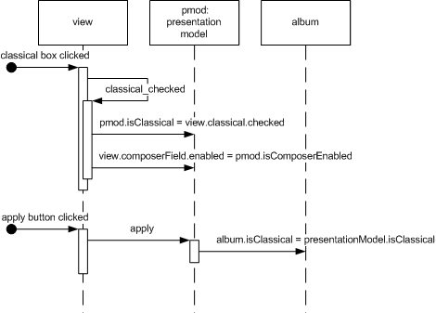
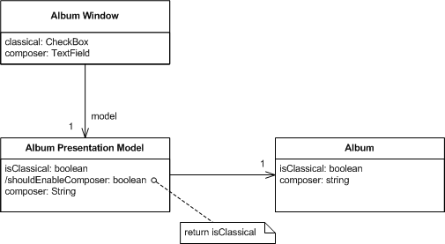
Martin Fowler: Presentation Model
2004; Martin Fowler’s article “Presentation Model”
http://martinfowler.com/eaaDev/PresentationModel.html
Notes:
http://martinfowler.com/eaaDev/presentationModel/cutClass.gif
http://martinfowler.com/eaaDev/presentationModel/cutSeq.gif

Slide 5
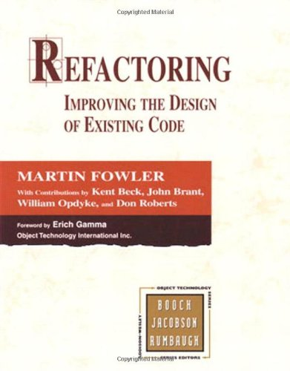


Martin Fowler: Refactoring Book
1999: Really, really, important Refactoring book
with a common vocabulary about recipes for improving existing code.
http://en.wikipedia.org/wiki/Code_refactoring
Refactoring: Improving the Design of Existing Code
Site:
http://www.refactoring.com/
http://www.refactoring.com/catalog/
Wiki:
http://c2.com/cgi/wiki?RefactoringImprovingTheDesignOfExistingCode
1999: Hardcover
http://www.amazon.com/Refactoring-Improving-Design-Existing-Code/dp/0201485672
2012: Kindle
http://www.amazon.com/Refactoring-Improving-Existing-Addison-Wesley-Technology-ebook/dp/B007WTFWJ6
Martin Fowler
http://en.wikipedia.org/wiki/Martin_Fowler
Notes:
http://ecx.images-amazon.com/images/I/41gNhHqNwGL.jpg
http://ecx.images-amazon.com/images/I/41t5CdRUNaL.jpg

Slide 6
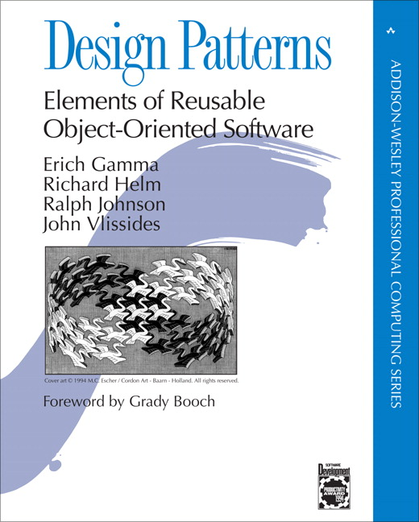
MVVM is about Patterns
2004: The reference on Patterns
with a common vocabulary about recipes for developing new code.
http://en.wikipedia.org/wiki/Design_pattern_(computer_science)
Design Patterns: “Elements of Reusable Object-Oriented Software”
http://en.wikipedia.org/wiki/Design_Patterns
Written by “the Gang of Four”:
http://c2.com/cgi/wiki?GangOfFour
Erich Gamma
Richard Helm
Ralph Johnson
John Vlissides
Martin Fowler on it: http://martinfowler.com/bliki/GangOfFour.html‎
In my view the Gang of Four is the best book ever written on object-oriented design - possibly of any style of design. This book has been enormously influential
The 3rd object is “just” a (relatively) new way of using patterns.
Notes:
http://www-fp.pearsonhighered.com/assets/hip/images/bigcovers/0201633612.jpg

Slide 7
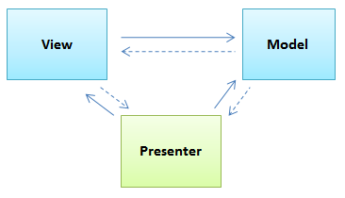
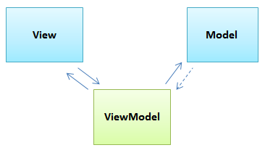

3rd object: adds code
The term "View model" is a major cause of confusion in understanding the pattern when compared to the more widely implemented MVC or MVP patterns. The role of the controller or presenter of the other patterns has been substituted with the framework binder (e.g.,XAML) and view model as mediator and/or converter of the model to the binder.
http://en.wikipedia.org/wiki/Model_View_ViewModel#cite_ref-10

Slide 8
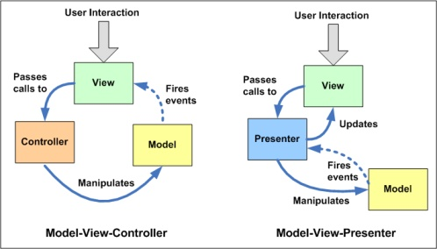
MVC, MVP, MVVM
MVC is like a circle
MVP is multi-way
MVVM is like MVP,
with automated M-V and V-VM bindings to allow real UI designers to work on the V
VM like P is close to the V, but testable
Further reading
http://en.wikipedia.org/wiki/Model_View_ViewModel
http://joel.inpointform.net/software-development/mvvm-vs-mvp-vs-mvc-the-differences-explained/
http://nirajrules.wordpress.com/2009/07/18/mvc-vs-mvp-vs-mvvm/
http://alexander.lds.lg.ua/2010/05/mvvm-model-view-view-model-design-pattern-for-net-windows-forms-winforms/
http://blogs.msdn.com/b/johngossman/archive/2005/10/08/478683.aspx
Notes:
Picture: http://joel.inpointform.net/software-development/mvvm-vs-mvp-vs-mvc-the-differences-explained/

Slide 9
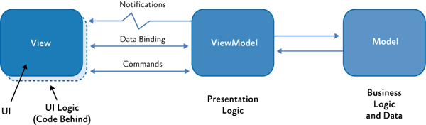
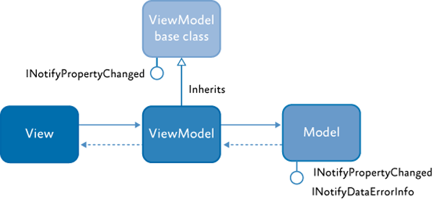
Platforms with MVVM
.NET
Caliburn http://caliburn.codeplex.com / http://caliburnmicro.codeplex.com
PRISM http://msdn.microsoft.com/en-us/library/gg430869
MvvmCross https://github.com/MvvmCross
JavaScript:
KnockoutJS http://knockoutjs.com
AngularJS http://angularjs.org
Java:
AndroidBinding https://github.com/gueei/AndroidBinding
ZK http://www.zkoss.org
Bambi https://github.com/S73417H/bambi-mvvm
Cocoa: the View Controller in the Cocoa Design Patterns
Notes:
Picture: http://msdn.microsoft.com/en-us/library/gg430869
http://en.wikipedia.org/wiki/KnockoutJS
http://en.wikipedia.org/wiki/ZK_(framework)
https://developer.apple.com/legacy/library/documentation/Cocoa/Conceptual/CocoaFundamentals/CocoaDesignPatterns/CocoaDesignPatterns.html
http://msdn.microsoft.com/en-us/library/gg405484.aspx

Slide 10
MVVM goals
Write as little code as possible by using
"Program to an 'interface', not an 'implementation'."
(Gang of Four 1995:18)
"Favor 'object composition' over 'class inheritance'."
(Gang of Four 1995:20)
A structured 3-layer approach
The `Caliburn for Delphi` framework
allows the examples of this session to work
implements MVVM, and a lot more
is very similar to the C# Caliburn / Caliburn.Micro frameworks http://channel9.msdn.com/Events/MIX/MIX10/EX15 https://github.com/bryanhunter/CaliburnMicroTalk
is written by Stefan Glienke (of DSharp) http://stackoverflow.com/users/587106/stefan-glienke and enhanced by Marko Vončina http://www.linkedin.com/pub/marko-vončina/85/741/895
Notes:
http://en.wikipedia.org/wiki/Design_Patterns
http://www.slideshare.net/bryanhunter/caliburnmicro

Slide 11
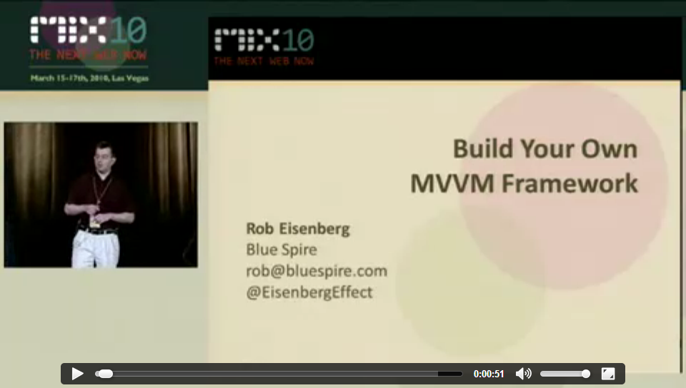
The start of Caliburn Micro
Notes:
http://devlicio.us/blogs/rob_eisenberg/archive/2010/03/16/build-your-own-mvvm-framework-is-online.aspx
http://channel9.msdn.com/Events/MIX/MIX10/EX15

Slide 12
Caliburn for Delphi features and fundamentals
Features:
MVVM (Model-View-ViewModel)
Convention over Configuration
Event Aggregator (publish-subscribe)
Coroutines
Conductors and Screens
Bootstrapper
Fundamentals
Interfaces
Attributes
Generics
We will cover some of these here, starting with MVVM.

Slide 13
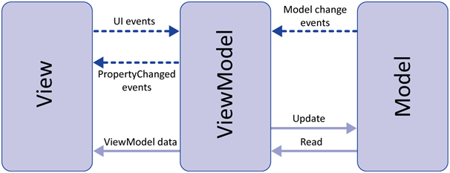
Global structure
View
What the user sees
Are dumb
Model
The data
Model and ViewModel
are testable
ViewModel
Glue between View and Model:
actions/bindings of the View
bindings on the model
contains most code
http://stackoverflow.com/questions/5421874/basic-concepts-of-mvvm-what-should-a-viewmodel-do
Notes:
http://msdn.microsoft.com/en-us/library/ff798384.aspx
http://stackoverflow.com/questions/5421874/basic-concepts-of-mvvm-what-should-a-viewmodel-do

Slide 14
Global structure
Everything in your application starts with the View/ViewModel combo
Even the main Window is a View (and has a ViewModel)
Those are usually named either of these
ShellView/ShellViewModel
AppView / AppViewModel
It is up to the ViewModel how to do the Model
So we will concentrate on the View and ViewModel:

Slide 15
The Delphi picture
V
View
V
V
V
Form/Frame implementing View Interface
Class implementing ViewModel Interface
Anything
Data- Action- Events / Binding Binding / Notification Events / Commands
DataContext
VM
ViewModel
VM
VM
VM
Data- Action- Events / Binding / Binding / Notification Code Code
Class
Web Connection
Database
…
M
Model
M
M
M

Slide 16
MindScape AppView demo the MVVM basics
1. Project setup 2. Binding Properties and Actions

Slide 17
MindScape AppView Part A: getting started
http://www.mindscapehq.com/blog/index.php/2012/01/12/caliburn-micro-part-1-getting-started/

Slide 18
Example: MindScape AppView – part A; 1;2;3/…
Create VCL project with these units and forms:
AppViewForm
(VCL Form `TAppView` with name `AppView`)
AppInterfaces
(interface `IAppViewModel`
AppViewModel
(class `TAppViewModel` implementing `IAppViewModel`)
Change these paths:
Either in the Project Search Path (which I like most)
Or in the Delphi Library Path:
..\..\Source\PresentationModel;..\..\Source\Validation;..\..\External\DSharp\Aspects;..\..\External\DSharp\Bindings;..\..\External\DSharp\Collections;..\..\External\DSharp\ComponentModel;..\..\External\DSharp\Core;..\..\External\DSharp\DelphiWebScript;..\..\External\DSharp\DevExpress;..\..\External\DSharp\Interception;..\..\External\DSharp\Logging;..\..\External\DSharp\Testing;..\..\External\DSharp\Windows;$(Spring)\Source\Base;$(Spring)\Source\Base\Collections;$(Spring)\Source\Base\Reflection;$(Spring)\Source\Core\Container;$(Spring)\Source\Core\Services
Add conditional defines
To DEBUG
CodeSite;DEBUG
Notes:
$(DSharp)\Source\Aspects;$(DSharp)\Source\Bindings;$(DSharp)\Source\Collections;$(DSharp)\Source\ComponentModel;$(DSharp)\Source\Core;$(DSharp)\Source\Logging;$(DSharp)\Source\PresentationModel;$(DSharp)\Source\Validation;$(DSharp)\Source\Windows;$(Spring4D)\Source\Base;$(Spring4D)\Source\Base\Collections;$(Spring4D)\Source\Core\Container;$(Spring4D)\Source\Base\Reflection;$(Spring4D)\Source\Core\Services
CodeSite;DEBUG

Slide 19
Example: MindScape AppView – Part A; 4;5/…
Chang AppView unit to have
an `initialization` section and
no more `var AppView: TAppView`
like this:
unit AppViewForm;
interface
uses
Windows, Messages, SysUtils, Variants, Classes, Graphics,
Controls, Forms, Dialogs, DSharp.Bindings.VCLControls;
type
TAppView = class(TForm)
end;
implementation
{$R *.dfm}
initialization
TAppView.ClassName;
end.
Change AppViewModel unit to
An initialization section
unit AppViewModel;
interface
uses
AppInterfaces,
DSharp.PresentationModel;
type
TAppViewModel = class(TScreen, IAppViewModel)
end;
implementation
initialization
TAppViewModel.ClassName;
end.
Notes:
Note the AppInterfaces needs [InheritedExport] on the interface, otherwise you get this error:
---------------------------
Debugger Exception Notification
---------------------------
Project MindScape_AppViewVCL_Step01.exe raised exception class EResolveException with message 'No component was registered for the service type: IAppViewModel.'.
---------------------------
Break Continue Help
---------------------------
---------------------------
Unexpected Memory Leak
---------------------------
An unexpected memory leak has occurred. The unexpected small block leaks are:
21 - 28 bytes: EResolveException x 1
141 - 148 bytes: UnicodeString x 1
---------------------------
OK
---------------------------

Slide 20
Example: MindScape AppView – Part A; 6/…
Change main program to
Include DSharp units
Start using the IAppViewModel or TAppViewModel
program MindScape_AppViewVCL;
uses
{$ifdef CodeSite}
DSharp.Logging.CodeSite,
{$endif CodeSite}
DSharp.PresentationModel.VCLApplication,
Forms,
AppViewForm in 'AppViewForm.pas' {AppView},
AppViewModel in 'AppViewModel.pas',
AppInterfaces in 'AppInterfaces.pas';
{$R *.res}
begin
Application.Initialize;
Application.MainFormOnTaskbar := True;
ReportMemoryLeaksOnShutdown := True;
{$ifdef DEBUG}
Application.WithDebugLogger();
{$endif DEBUG}
{$ifdef CodeSite}
Application.WithLogger<TCodeSiteLog>;
{$endif CodeSite}
Application.Start<IAppViewModel>();
// Application.Start<TAppViewModel>();
end.

Slide 21
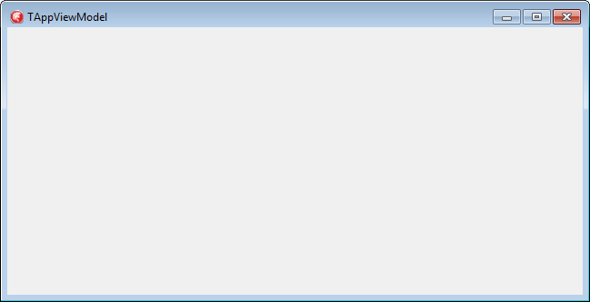
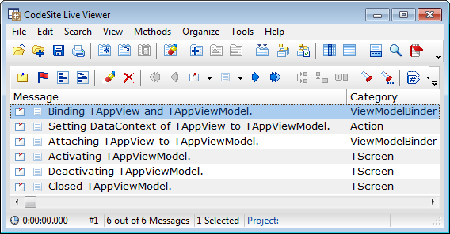
Example: MindScape AppView – Part A; 7/…
Run & observe…
Caption = TAppViewModel
a

Slide 22
MindScape AppView Part B: binding Count property/control
http://www.mindscapehq.com/blog/index.php/2012/01/16/caliburn-micro-part-2-data-binding-and-events/

Slide 23
Example: MindScape AppView – part B; 1/…
Modify the AppViewModel
Add a Count property, with FCount backing field and SetCount method having a NotifyOfPropertyChange call:
unit AppViewModel;
...
type
TAppViewModel = class(TScreen, IAppViewModel)
strict private
FCount: Integer;
strict protected
procedure SetCount(const Value: Integer); virtual;
public
property Count: Integer read FCount write SetCount;
end;
...
procedure TAppViewModel.SetCount(const Value: Integer);
begin
if FCount <> Value then
begin
FCount := Value;
NotifyOfPropertyChange('Count');
end;
end;
...
end.

Slide 24
Example: MindScape AppView – part B; 2/…
Modify the AppView
Add a TEdit control with name Count:
unit AppViewForm;
...
DSharp.Bindings.VCLControls, StdCtrls;
type
TAppView = class(TForm)
Count: TEdit;
end;
...
end.

Slide 25
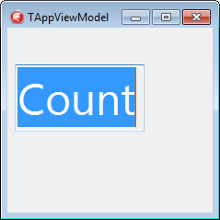
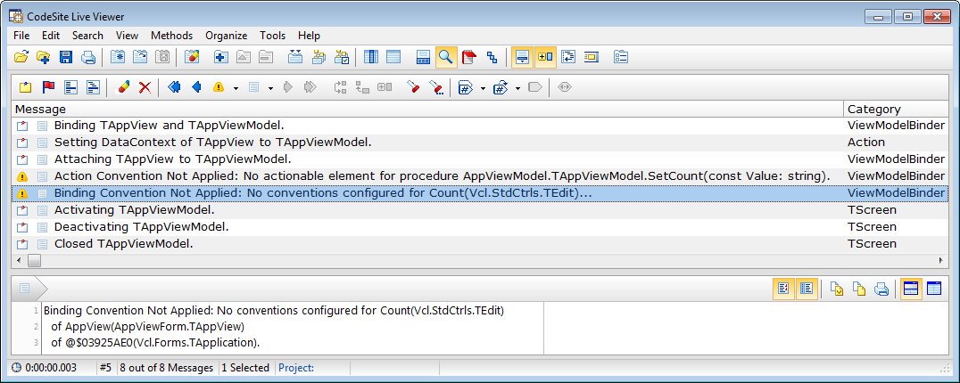
Example: MindScape AppView – part B; 3/…
Run
It fails to show the content of the Count property!
The Count element (TEdit component) could not be bound to the ViewModel.
a

Slide 26
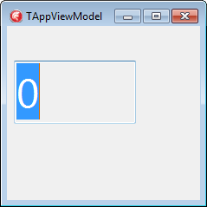
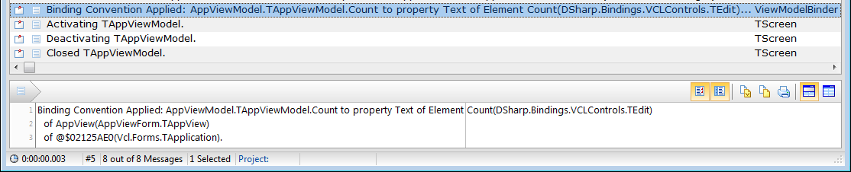
Example: MindScape AppView – part B; 4;5/…
Modify the AppView
Make sure that DSharp.Bindings.VCLControls is at the end of the uses list:
Controls, Forms, Dialogs, StdCtrls, DSharp.Bindings.VCLControls;
Run
The unit DSharp.Bindings.VCLControls manages the binding

Slide 27
Example: MindScape AppView – part B; 6/…
Modify the AppViewModel
Add two consts, two functions and two methods for Incrementing/Decrementing Count:
unit AppViewModel;
...
type
TAppViewModel = class(TScreen, IAppViewModel)
...
public
const MinimumCount = -10;
const MaximumCount = +10;
function CanDecrementCount(): Boolean; virtual;
function CanIncrementCount(): Boolean; virtual;
procedure DecrementCount(); virtual;
procedure IncrementCount(); virtual;
end;
...
function TAppViewModel.CanDecrementCount: Boolean;
begin
Result := Count > MinimumCount;
end;
function TAppViewModel.CanIncrementCount: Boolean;
begin
Result := Count < MinimumCount;
end;
procedure TAppViewModel.DecrementCount;
begin
Count := Count - 1;
end;
procedure TAppViewModel.IncrementCount;
begin
Count := Count + 1;
end;
...
end.

Slide 28
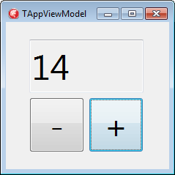
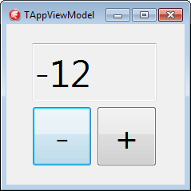
Example: MindScape AppView – part B; 7;8/…
Modify the AppView
Add a two TButtons and name them line this:
unit AppViewForm;
...
type
TAppView = class(TForm)
Count: TEdit;
IncrementCount: TButton;
DecrementCount: TButton;
end;
...
end.
Run
Observe you can increment and decrement too far

Slide 29
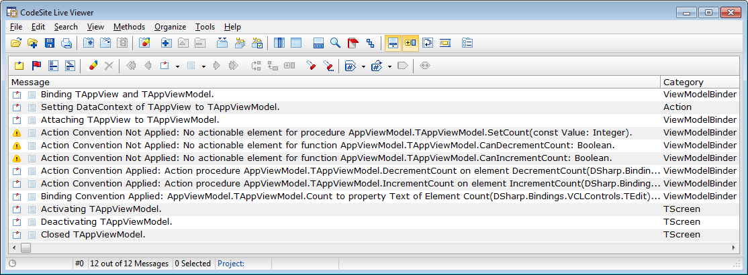
Example: MindScape AppView – part B; 9;10/…
Observe the CodeSite log:
Modify the AppViewModel:
Refactor the CanDecrementCount/CanIncrementCount functions into properties; change the implementation of SetCount:
unit AppViewModel;
...
strict protected
function GetCanDecrementCount(): Boolean; virtual;
function GetCanIncrementCount(): Boolean; virtual;
...
public
...
property CanDecrementCount: Boolean read GetCanDecrementCount;
property CanIncrementCount: Boolean read GetCanIncrementCount;
end;
...
function TAppViewModel.GetCanDecrementCount(): Boolean;
begin
Result := Count > MinimumCount;
end;
function TAppViewModel.GetCanIncrementCount(): Boolean;
begin
Result := Count < MinimumCount;
end;
procedure TAppViewModel.SetCount(const Value: Integer);
begin
if FCount <> Value then
begin
FCount := Value;
NotifyOfPropertyChange('Count');
NotifyOfPropertyChange('CanDecrementCount');
NotifyOfPropertyChange('CanIncrementCount');
end;
end;
...
end.

Slide 30
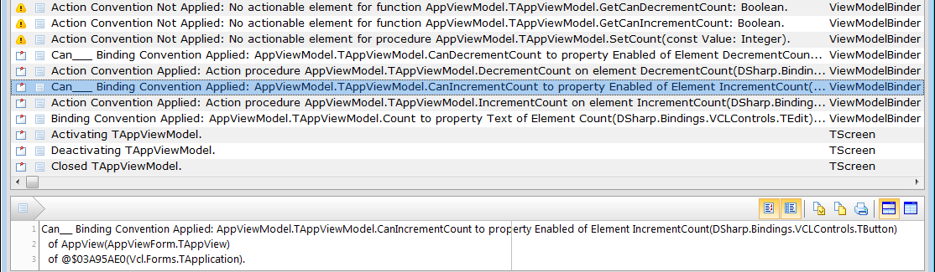
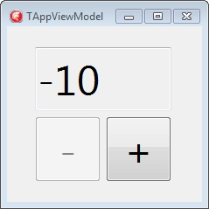
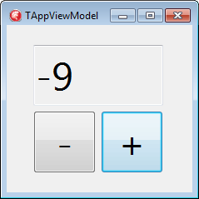
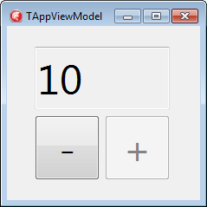
Example: MindScape AppView – part B; 11/…
Run and observe

Slide 31
MindScape AppView Part C: events but no action parameters
http://www.mindscapehq.com/blog/index.php/2012/01/24/caliburn-micro-part-3-more-about-events-and-parameters/

Slide 32
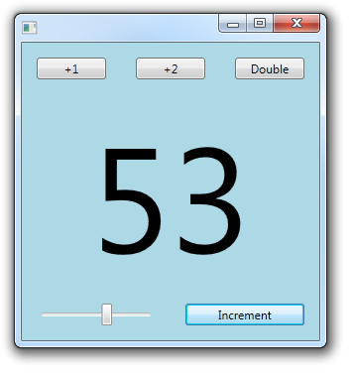
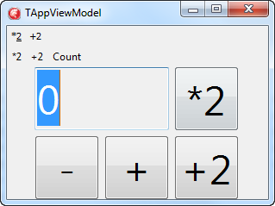
Example: MindScape AppView – part C
MindScape uses Events with parameters for the next example
They pass these increment values:
2
Count
Increment
We don’t, as those expressions add code to the UI.
Code you cannot debug.
Lets start with
*2
+2

Slide 33
Example: MindScape AppView – part C; 1/…
TAppViewModel = class(TScreen, IAppViewModel)
strict protected
function GetCanIncrementCountBy2(): Boolean; virtual;
function GetCanMultiplyCountBy2(): Boolean; virtual;
public
procedure IncrementCountBy2(); virtual;
procedure MultiplyCountBy2(); virtual;
property CanIncrementCountBy2: Boolean read GetCanIncrementCountBy2;
property CanMultiplyCountBy2: Boolean read GetCanMultiplyCountBy2;
end;
...
function TAppViewModel.GetCanIncrementCountBy2(): Boolean;
begin
Result := Count + 1 < MaximumCount;
end;
function TAppViewModel.GetCanMultiplyCountBy2(): Boolean;
begin
Result := (Count * 2 <= MaximumCount) and (Count * 2 >= MinimumCount);
end;
procedure TAppViewModel.IncrementCountBy2();
begin
Count := Count + 2;
end;
procedure TAppViewModel.MultiplyCountBy2();
begin
Count := Count * 2;
end;
procedure TAppViewModel.SetCount(const Value: Integer);
begin
... NotifyOfPropertyChange('CanIncrementCountBy2');
NotifyOfPropertyChange('CanMultiplyCountBy2'); ...
end;

Slide 34
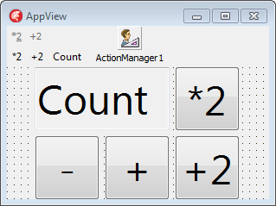
Example: MindScape AppView – part C; 2/…
Modify the AppView
Add TActionManager, Actions + bindings, ActionToolBar, ActionMenuBar, Buttons, MenuItems, uses list:
unit AppViewForm;
...
uses
... Vcl.ActnMan, Vcl.ActnCtrls, System.Actions,
Vcl.ActnList, Vcl.PlatformDefaultStyleActnCtrls,
DSharp.PresentationModel,
DSharp.Bindings.VCLControls;
type
TAppView = class(TForm)
...
ActionManager1: TActionManager;
[Binding('OnExecute', '{Binding IncrementCountBy2}')]
[Binding('Enabled', '{Binding CanIncrementCountBy2}')]
IncrementByTwo: TAction;
[Binding('OnExecute', '{Binding MultiplyCountBy2}')]
[Binding('Enabled', '{Binding CanMultiplyCountBy2}')]
MultipyByTwo: TAction;
ActionToolBar1: TActionToolBar;
ActionMainMenuBar1: TActionMainMenuBar;
Button1: TButton;
Button2: TButton;
end;
...
end.

Slide 35
Example: MindScape AppView – part C; 3/…
Common mistakes
Compiler errors
[dcc32 Warning] AppViewForm.pas(19): W1025 Unsupported language feature: 'custom attribute'
Solution: In the View, add the unit DSharp.PresentationModel to the uses list.
Exception:
Problem: Project MindScape_AppViewVCL.exe raised exception
class EAssertionFailed with message 'Source is not assigned! (C:\Users\developer\Versioned\Caliburn4D\Source\PresentationModel\DSharp.PresentationModel.InitializeComponent.pas, line 302)'.
Solution: issue in unit DSharp.PresentationModel.VCLFramework
Method TPresentationFramework.DoGetParent could not find a Parent (this happened for TActions and is resolved now).
Explicit bindings have no effect (but give no errors or warnings):
Problem: typing errors in the Binding Expression, giving no match for:
ViewModel
Properties on the ViewModel
Methods on the ViewModel
Paths in sub-Components on the ViewModel
Solution:
Fix the typing errors
Have the Caliburn team investigate into logging expression issues.

Slide 36
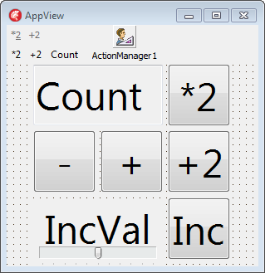
Example: MindScape AppView – part C; 4/…
Before adding the “Increment” with “TrackBar” functionality
Lets observe a few things:
The UI has no code, but bindings
Automatic bindings
Manual bindings through attributes
Bindings can be from
Events to Methods
Properties to Properties
For the “Increment” functionality, we want to hold those observations.

Slide 37
Example: MindScape AppView – part C; 5/…
Modify the unit AppViewModel;
TAppViewModel = class(TScreen, IAppViewModel)
strict private
FIncrementValue: Integer;
strict protected
function GetCanIncrementCountByIncrementValue (): Boolean; virtual;
procedure SetIncrementValue(const Value: Integer); virtual;
public
procedure IncrementCountByIncrementValue(); virtual;
property CanIncrementCountByIncrementValue: Boolean read GetCanIncrementCountByIncrementValue;
property IncrementValue: Integer read FIncrementValue write SetIncrementValue;
end;
...
function TAppViewModel.GetCanIncrementCountByIncrementValue(): Boolean;
begin
Result := (Count + IncrementValue >= MinimumCount) and
(Count + IncrementValue <= MaximumCount);
end;
procedure TAppViewModel.IncrementCountByIncrementValue();
begin
Count := Count + IncrementValue;
end;
procedure TAppViewModel.SetCount(const Value: Integer);
begin
...
NotifyOfPropertyChange('CanIncrementWithValue');
end;
procedure TAppViewModel.SetIncrementValue(const Value: Integer);
begin
if FIncrementValue <> Value then
begin
FIncrementValue := Value;
NotifyOfPropertyChange('IncrementValue');
NotifyOfPropertyChange('CanIncrementWithValue');
end;
end;

Slide 38
Example: MindScape AppView – part C; 6/…
Modify the AppView
Add a TTrackBar, TLabel and TButton:
unit AppViewForm;
...
TAppView = class(TForm)
IncrementValue: TTrackBar;
[Binding('Caption', '{Binding IncrementValue}')]
IncVal: TLabel;
IncrementCountByIncrementValue: TButton;
end;
...
end.

Slide 39
MindScape AppView Intermezzo I: adding a Model

Slide 40
Example: MindScape AppView – Intermezzo I; 1/…
The Model could be anything, but since we use Caliburn…
unit AppInterfaces;
interface
...
const
MinimumCount = -10;
MaximumCount = +10;
type
[InheritedExport]
IAppModel = interface
['{DD3AABF1-140F-4F78-85E3-2E332218F8AE}']
function GetCount(): Integer;
function GetIncrementValue(): Integer;
procedure SetCount(const Value: Integer);
procedure SetIncrementValue(const Value: Integer);
property Count: Integer read GetCount write SetCount;
property IncrementValue: Integer read GetIncrementValue write SetIncrementValue;
end;
...
end.

Slide 41
Example: MindScape AppView – Intermezzo I; 2/…
Add the AppModel unit interface
unit AppModel;
interface
uses
AppInterfaces, IniFiles;
type
TAppModel = class(TInterfacedObject, IAppModel)
strict private
FCount: Integer;
FIncrementValue: Integer;
const
SAppModel = 'AppModel';
SCount = 'Count';
SIncrementValue = 'IncrementValue';
protected
function CreateIniFile(): TIniFile; virtual;
function GetCount(): Integer; virtual;
function GetIncrementValue(): Integer; virtual;
function GetIniFileName(): string; virtual;
procedure SetCount(const Value: Integer); virtual;
procedure SetIncrementValue(const Value: Integer); virtual;
public
constructor Create();
destructor Destroy(); override;
property Count: Integer read GetCount write SetCount;
property IncrementValue: Integer read GetIncrementValue write SetIncrementValue;
property IniFileName: string read GetIniFileName;
end;

Slide 42
Example: MindScape AppView – Intermezzo I; 3/…
Add the AppModel implementation part 1: INI file persistence.
...
uses
SysUtils;
constructor TAppModel.Create();
var
IniFile: TIniFile;
begin
inherited;
IniFile := CreateIniFile();
try
Count := IniFile.ReadInteger(SAppModel, SCount, 0);
IncrementValue := IniFile.ReadInteger(SAppModel, SIncrementValue, 0);
finally
IniFile.Free();
end;
end;
destructor TAppModel.Destroy();
var
IniFile: TIniFile;
begin
IniFile := CreateIniFile();
try
IniFile.WriteInteger(SAppModel, SCount, Count);
IniFile.WriteInteger(SAppModel, SIncrementValue, IncrementValue);
finally
IniFile.Free();
end;
inherited;
end;
function TAppModel.CreateIniFile(): TIniFile;
begin
Result := TIniFile.Create(IniFileName);
end;

Slide 43
Example: MindScape AppView – Intermezzo I; 4/…
Add the AppModel implementation part 2: property logic
...
function TAppModel.GetCount(): Integer;
begin
Result := FCount;
end;
function TAppModel.GetIncrementValue(): Integer;
begin
Result := FIncrementValue;
end;
function TAppModel.GetIniFileName(): string;
begin
Result := ChangeFileExt(ParamStr(0), '.ini');
end;
procedure TAppModel.SetCount(const Value: Integer);
begin
if FCount <> Value then
begin
if (Value < MinimumCount) or (Value > MaximumCount) then
raise ERangeError.CreateFmt('Count value %d out of range %d..%d', [Value, MinimumCount, MaximumCount]);
FCount := Value;
end;
end;
procedure TAppModel.SetIncrementValue(const Value: Integer);
begin
FIncrementValue := Value;
end;
end.

Slide 44
Example: MindScape AppView – Intermezzo I; 5/…
Modify the AppViewModel to use the AppModel
Replace all Count/IncrementValue with AppModel.Count/AppModel.IncrementValue:
uses
AppInterfaces, ...
type
TAppViewModel = class(TScreen, IAppViewModel)
strict private
FAppModel: IAppModel;
strict protected
property AppModel: IAppModel read FAppModel;
public
constructor Create(const AAppModel: IAppModel);
end;
...
constructor TAppViewModel.Create(const AAppModel: IAppModel);
begin
inherited Create();
FAppModel := AAppModel;
end;
function TAppViewModel.GetCount(): Integer;
begin
Result := AppModel.Count;
end;
function TAppViewModel.GetIncrementValue(): Integer;
begin
Result := AppModel.IncrementValue;
end;
procedure TAppViewModel.SetCount(const Value: Integer);
begin
... AppModel.Count := Value;
...
end;
procedure TAppViewModel.SetIncrementValue(const Value: Integer);
begin
... AppModel.IncrementValue := Value;
...
end;

Slide 45
Example: MindScape AppView – Intermezzo I; 6;7/…
Run
Boom!
Project MindScape_AppViewVCL.exe raised exception class $C0000005 with message 'access violation at 0x00ac607a: read of address 0x00000000'.
function TAppViewModel.GetCount(): Integer;
begin
Result := AppModel.Count;
end;
You try to use AppModel, but it is nil as the new Constructor did not get called
Reason 1: forgetting the [InheritedExport]
type
[InheritedExport]
IAppModel = interface
['{DD3AABF1-140F-4F78-85E3-2E332218F8AE}']
Reason 2: forgetting to register the class RTTI
unit AppModel;
...
initialization
TAppModel.ClassName;
end.

Slide 46
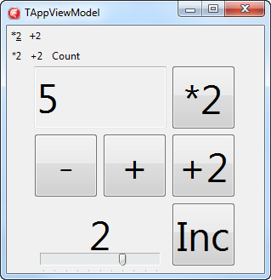
Example: MindScape AppView – Intermezzo I; 8/…
Run
It works!
It loads initial values like before
Each time you run again, Cound/IncrementValue are restored to what they were

Slide 47
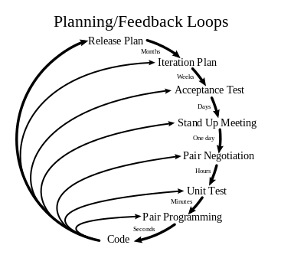
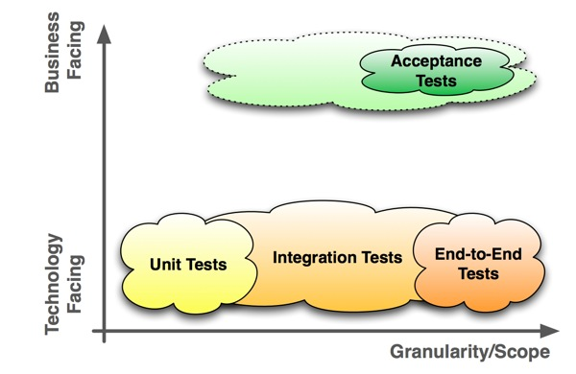
MindScape AppView Intermezzo II: unit testing
http://en.wikipedia.org/wiki/Extreme_programming
Notes:
http://upload.wikimedia.org/wikipedia/commons/thumb/8/84/Extreme_Programming.svg/367px-Extreme_Programming.svg.png
http://en.wikipedia.org/wiki/File:Extreme_Programming.svg
http://blog.jonasbandi.net/2010/09/acceptance-vs-integration-tests.html
http://blog.jonasbandi.net/2010/02/agile-testing-quadrants.html

Slide 48
Example: MindScape AppView – Intermezzo II; 1/…
Add a Unit Test project
Add the AppModel to it
Add the AppViewModel to it
Generate TTestCase for AppModel
Generate TTestCase for AppViewModel
Be creative in your test writing

Slide 49
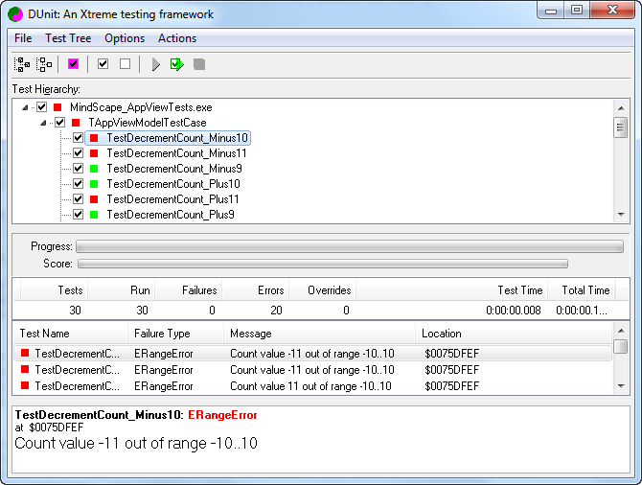
Example: MindScape AppView – Intermezzo II; 2/…
Run the tests, clean bugs, rinse, repeat…

Slide 50
MindScape Color demo beyond the MVVM basics
1. Events

Slide 51
MindScape Color Part A: getting started
http://www.mindscapehq.com/blog/index.php/2012/02/01/caliburn-micro-part-4-the-event-aggregator/

Slide 52
Demo: Color
Color has:
Two Models
ShellViewModel (compareable to AppViewModel in the first demo)
ColorViewModel (handles selection and display of colors)
Two Views
ShellView (comparable to AppView in the first demo)
ColorView (new view showing a color)
Displays ColorView inside ShellView
Uses Events to communicate

Slide 53
Example: MindScape Color – part C; 1..3/…
Start like AppView, but use ShellView/ShellViewModel in stead of AppView/AppViewModel
Add a ColorModel/ColorViewModel
Make sure you have these interfaces
unit Interfaces;
interface
uses
DSharp.PresentationModel;
type
[InheritedExport]
IColorViewModel = interface
['{BCF3E6B6-2684-4D04-99D7-B2E05400A6C4}']
end;
[InheritedExport]
IShellViewModel = interface
['{04C6473A-7E92-4ED1-B9A1-2B07D65277DC}']
end;
...
end.

Slide 54
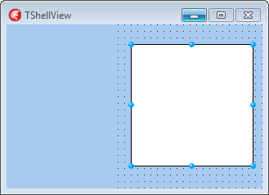
Example: MindScape Color – part C; 4/…
Make your ShellView’s
TPanel refer to the ColorModel
TShape’s Brush.Color refer to Color
unit ShellViewForm;
interface
...
uses
...
DSharp.PresentationModel,DSharp.Bindings.VCLControls;
type
TShellView = class(TForm)
ColorModel: TPanel;
[Binding('Brush.Color', '{Binding Color}')]
Shape1: TShape;
end;
...
initialization
TShellView.ClassName;
end.

Slide 55

Example: MindScape Color – part C; 5/…
Make your ColorView have
3 RadioButtons for Red/Green/Blue
unit ColorViewFrame;
interface
uses
Windows, Messages,
SysUtils, Variants, Classes,
Graphics, Controls, Forms, Dialogs, StdCtrls,
DSharp.PresentationModel,
DSharp.Bindings.VCLControls;
type
TColorView = class(TFrame)
Red: TRadioButton;
Green: TRadioButton;
Blue: TRadioButton;
end;
implementation
{$R *.dfm}
initialization
TColorView.ClassName;
end.

Slide 56
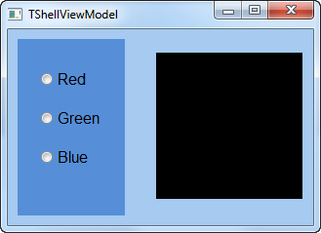
Example: MindScape Color – part C; 6/…
The goal is to
Host the ColorView in the ShellView
Let the ShellViewModel accept events/messages about color changes in the ColorViewModel
Change Brush.Color of the TShape to the Color in the ShellViewModel
Have no code in the ColorView or ShellView

Slide 57
Example: MindScape Color – part C; 7/…
Create a ColorViewModel like this:
unit ColorViewModel;
interface
uses
Graphics, Interfaces, DSharp.PresentationModel, DSharp.PresentationModel.EventAggregator;
type
TColorViewModel = class(TScreen, IColorViewModel)
private
FEvents: IEventAggregator;
public
constructor Create(const Events: IEventAggregator);
procedure Red;
procedure Green;
procedure Blue;
end;
implementation
uses
ColorEvent;
constructor TColorViewModel.Create(const Events: IEventAggregator);
begin
inherited Create();
FEvents := Events;
end;
procedure TColorViewModel.Red;
begin
FEvents.Publish(TColorEvent.Create(clRed));
end;
...
initialization
TColorViewModel.ClassName;
end.

Slide 58
Example: MindScape Color – part C; 8/…
Create a ShellViewModel interface like this:
unit ShellViewModel;
interface
uses
Classes, SysUtils, Graphics,
DSharp.PresentationModel,
DSharp.PresentationModel.EventAggregator,
Interfaces, ColorEvent;
type
TShellViewModel = class(TScreen, IShellViewModel, IHandle<TColorEvent>)
strict private
FColor: TColor;
FColorModel: IColorViewModel;
procedure SetColor(const Value: TColor);
public
/// This constructor is called by the Dependency Injection container with
/// parameters already created for you.
constructor Create(const ColorModel: IColorViewModel;
const Events: IEventAggregator);
/// Implements IHandle<TColorEvent>.
/// This method is called after a TColorEvent message is published from
/// somewhere else in the application.
procedure Handle(AMessage: TColorEvent);
/// This property is for changing the color of the rectangle.
property Color: TColor read FColor write SetColor;
property ColorModel: IColorViewModel read FColorModel;
end;

Slide 59
Example: MindScape Color – part C; 9/…
Create a ShellViewModel like this:
implementation
constructor TShellViewModel.Create(const ColorModel: IColorViewModel; const Events: IEventAggregator);
begin
inherited Create();
FColorModel := ColorModel;
// Get the event aggregator through the constructor and
// subscribe this ColorViewModel so it can listen for ColorEvent messages.
Events.Subscribe(Self);
end;
procedure TShellViewModel.Handle(AMessage: TColorEvent);
begin
Color := AMessage.Color;
end;
procedure TShellViewModel.SetColor(const Value: TColor);
begin
FColor := Value;
NotifyOfPropertyChange('Color');
end;
initialization
TShellViewModel.ClassName;
end.

Slide 60
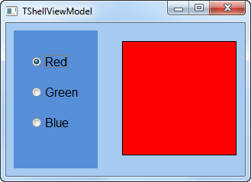
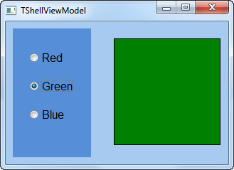
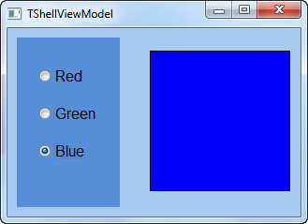
Example: MindScape Color – part C; 10/…
Run.

Slide 61
Q&A break
After that: more in depth demos and framework insight

Slide 62
DataContext / OnDataContextChanged
DataContext / OnDataContextChanged
unit DSharp.Core.Extensions;
...
type
TComponentHelper = class helper for TComponent
...
public
procedure ClearValue(Prop: TDependencyProperty);
function GetValue(Prop: TDependencyProperty): TValue;
procedure SetValue(Prop: TDependencyProperty; const Value: TValue);
property DataContext: TObject
read GetDataContext write SetDataContext;
property IsComponentInitialized: Boolean
read GetIsComponentInitialized
write SetIsComponentInitialized;
property OnDataContextChanged: IEvent<TPropertyChangedEvent>
read GetOnDataContextChanged;
end;

Slide 63
DependencyProperty
DependencyProperty
Property that is not part of the object instance
Through a `helper` can be accessed like it is part of that instance
Has built-in binding support
Delphi uses something similar for the
TFlowPanel
Adds a `ControlIndex` property to all controls on the panel
TGridPanel
Adds these properties to all controls on the panel
Column
Row
ColumnSpan
RowSpan

Slide 64
Binding through notifications
NotifyOfPropertyChange from ViewModel to View:
procedure TShellViewModel.SetColor(const Value: TColor);
begin
FColor := Value;
NotifyOfPropertyChange('Color');
end;
Inside Caliburn, it gets translated to a DoPropertyChanged running on the UI thread by `TPropertyChangedBase.NotifyOfPropertyChange`
From View to ViewModel:
unit DSharp.Bindings.VCLControls has interceptor classes:
procedure TEdit.Change;
begin
inherited;
NotifyPropertyChanged.DoPropertyChanged('Text');
end;

Slide 65
Demos
AppView VCL
AppView DUnit
Color
HowToOpenDialog
IoC http://caliburnmicro.codeplex.com/wikipage?title=The%20Service%20Locator&referringTitle=Documentation
WindowManager http://caliburnmicro.codeplex.com/wikipage?title=The%20Window%20Manager&referringTitle=Documentation
EventAggregatorSample
SimpleDependencyProperty

Slide 66
Current state of affairs
- workable alpha state - beta release aimed in Spring 2014

Slide 67
Downloads
https://bitbucket.org/jeroenp/conferences

Slide 68
Caliburn / Caliburn.Micro references
Start at http://caliburnmicro.codeplex.com/documentation
Mindscape intro:
http://www.mindscapehq.com/blog/index.php/2012/01/12/caliburn-micro-part-1-getting-started/
http://www.mindscapehq.com/blog/index.php/2012/1/16/caliburn-micro-part-2-data-binding-and-events/
http://www.mindscapehq.com/blog/index.php/2012/01/24/caliburn-micro-part-3-more-about-events-and-parameters/
http://www.mindscapehq.com/blog/index.php/2012/02/01/caliburn-micro-part-4-the-event-aggregator/
http://www.mindscapehq.com/blog/index.php/2012/03/13/caliburn-micro-part-5-the-window-manager/
http://www.mindscapehq.com/blog/index.php/2013/09/11/caliburn-micro-part-6-introduction-to-screens-and-conductors/
Lots of references and articles:
http://karlshifflett.wordpress.com/archive/mvvm/
Caliburn Micro and Windows RT
http://www.terrymarshall.com.au/Blog/tabid/162/tagid/37/Caliburn-Micro.aspx
Caliburn Micro and Windows Phone 8
http://wp.qmatteoq.com/first-steps-with-caliburn-micro-in-windows-phone-8-the-complete-series/

Slide 69
Cross platform…
GitHub Halp App: Minimizing Platform-specific code with MvvM
Slides
http://www.slideshare.net/Xamarin/git-hub-halp-app-minimizing-platformspecific-code-with-mvvm-by-justin-spahrsummers
Video
http://xamarin.com/evolve/2013#session-zm59b5yptf

Slide 70
The end… Actually: Questions & Answers
Jeroen Wiert Pluimers
jeroen@pluimers.com
http://wiert.me
https://bitbucket.org/jeroenp/conferences

Slide 71
Conventions
Properties with same names in View and Model are automatically bound together
Handle method in ViewModel can handle events from the Model
Bindings
ViewModel.DisplayName -> View.Caption
ViewModel and View will be automatically instantiated

Slide 72
View Conventions
View
Content
ApplyConventions
Context
IsGenerated
IsLoaded
IsScopeRoot
Model
ViewAware
PreviouslyAttached
ViewModelBinder: DependencyProperty
ConventionsApplied

Slide 73
Property / Action (event) Conventions
Many of them; a few examples in the form class / property / event
TEdit / Text / OnChanged
…
In either FMXConventionManager or VCLConventionManager:
class procedure ConventionManagerHelper.Initialize;
Specials
Any: Can+PropertyName / Enabled / nil
Enabled -> Enabled; Enabled -> IsEnabled
Visible -> Visible; Visible -> IsVisible
List/Item bindings:
Singularize name; then prefix with Active/Selected/Current

Slide 74
Default event filter
Events that by default are not hooked:
AfterConstruction, Assign,
BeforeDestruction,
ClassType, CleanupInstance,
DefaultHandler, DestroyComponents, Destroying, Dispatch,
Equals, ExecuteAction,
FieldAddress, FindComponent, Free, FreeInstance, FreeNotification, FreeOnRelease,
GetEnumerator, GetHashCode, GetInterface, GetNamePath, GetParentComponent,
HasParent,
InsertComponent, IsImplementorOf,
NotifyOfPropertyChange,
RaisePropertyChangedEventImmediately, ReferenceInterface, RemoveComponent, RemoveFreeNotification,
SafeCallException, SafeCallException, SetSubComponent,
ToString,
UpdateAction

Slide 75
Name transformation Conventions
Transformations
FNameTransformer.AddRule('Model$', '');
FNameTransformer.AddRule('ViewModel$', 'View');
FNameTransformer.AddRule('ViewModel$', 'ViewForm');
FNameTransformer.AddRule('ViewModel$', 'ViewFrame');
FNameTransformer.AddRule('ViewModel$', 'Form');
FNameTransformer.AddRule('ViewModel$', 'Frame');
http://caliburnmicro.codeplex.com/wikipage?title=View%2fViewModel%20Naming%20Conventions&referringTitle=Documentation
http://caliburnmicro.codeplex.com/wikipage?title=Handling%20Custom%20Conventions&referringTitle=Documentation
http://caliburnmicro.codeplex.com/wikipage?title=Using%20the%20NameTransformer&referringTitle=Documentation
Notes:
http://caliburnmicro.codeplex.com/wikipage?title=View%2fViewModel%20Naming%20Conventions&referringTitle=Documentation

Slide 76
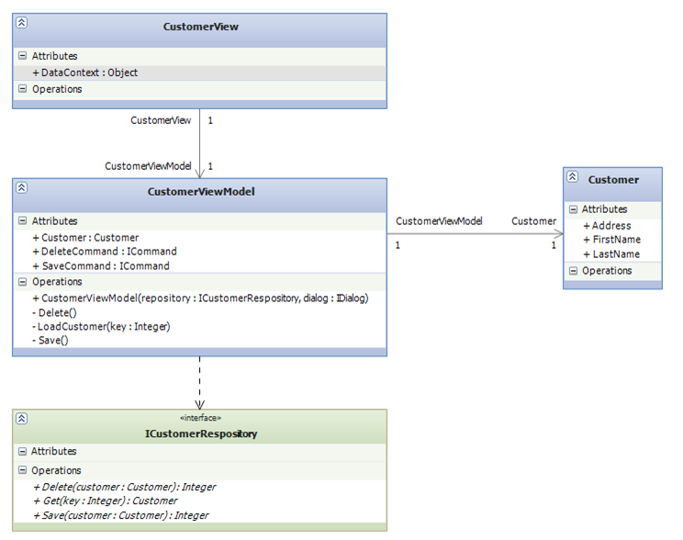
Notes:
http://blogs.msdn.com/b/kashiffl/archive/2010/11/14/mvvm-technical-description.aspx

Slide 77
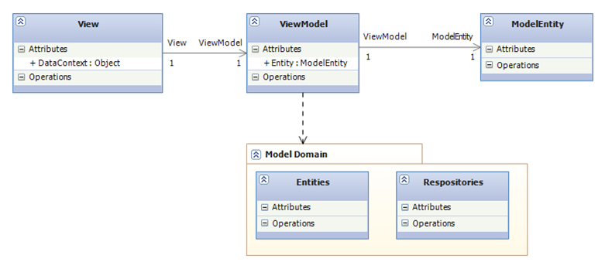

Slide 78
Passing events around in your code
Color demo
Further reading http://www.mindscapehq.com/blog/index.php/2012/02/01/caliburn-micro-part-4-the-event-aggregator/

Slide 79
DependencyProperties
Best reference so far: http://www.wpftutorial.net/dependencyproperties.html

