Slide 1



Operational research for urban solar development
“PV failure detection based on operational time series”
05/12/2023 - Morning
Alexandre Mathieu

Slide 2
Agenda
Curriculum
PV performance model steps

Slide 3
Curriculum
Plan
Day | Time | Duration | Content
Monday 27/11/2023 | 9h45-11h15 12h30-14h | 1h30 + 1h30 | 50% Lecture / 50 % Hands-on
Tuesday 05/12/2023 | 8h-9h30 9h45-11h15 | 1h30 + 1h30 | 50% Lecture / 50 % Hands-on
Thursday 07/12/2023 | 8h-11h 12h45-15h45 | 6h | 25% Lecture / 75 % Project
Monday 11/11/2023 | 8h-11h 12h30-15h30 | 6h | 10% Lecture / 90 % Project
Friday 22/12/2023 | 8h-9h30 | 1h30 | 100 % Project
Today

Slide 4
Curriculum
Plan
Day | Time | Duration | Content
Monday 27/11/2023 | 9h45-11h15 12h30-14h | 1h30 + 1h30 | 50% Lecture / 50 % Hands-on
Tuesday 05/12/2023 | 8h-9h30 9h45-11h15 | 1h30 + 1h30 | 50% Lecture / 50 % Hands-on
Thursday 07/12/2023 | 8h-11h 12h45-15h45 | 6h | 25% Lecture / 75 % Project
Monday 11/11/2023 | 8h-11h 12h30-15h30 | 6h | 10% Lecture / 90 % Project
Friday 22/12/2023 | 8h-9h30 | 1h30 | 100 % Project
For next time. Make groups of 2 for the project.
Today

Slide 5
Agenda
Curriculum
PV performance model steps

Slide 6

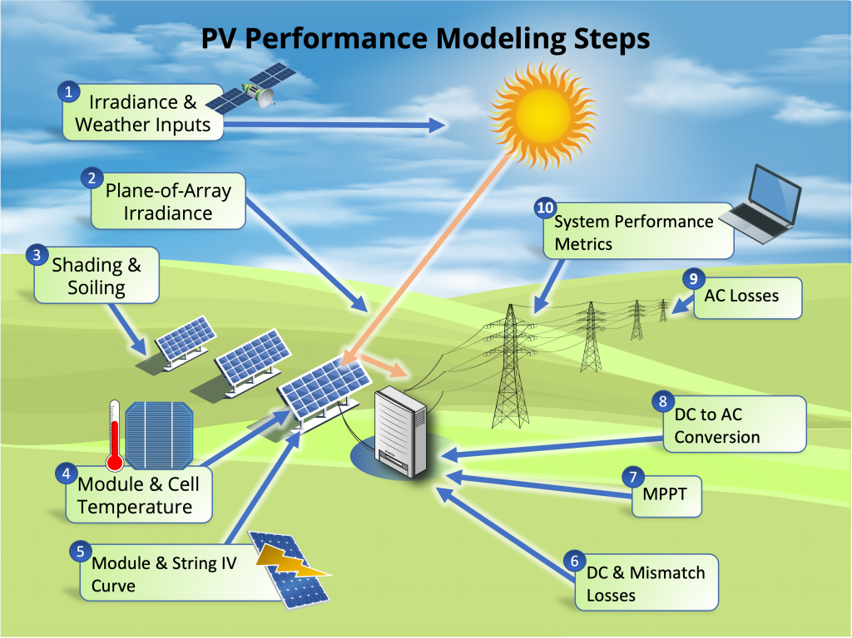
Modeling steps
27/11/2023
*image from: PVSC48 python tutorial

Slide 7
Modeling steps
27/11/2023
Today
*image from: PVSC48 python tutorial

Slide 8
Modeling steps
Notebook recap 27/11/2023
The notebook is now corrected and can be read online: https://github.com/AlexandreHugoMathieu/pvfault_detection_solar_academy/blob/master/notebooks/python_intro_poa.ipynb

Slide 9
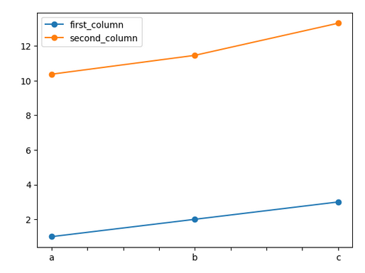
Modeling steps
import numpy as np # import to your python instance the package “numpy” and rename it “np” (helpful for math calculations)
import pandas as pd # import to your python instance the package “pandas” (helpful for data structure and calculations)
ts = pd.Series([1, 2,3], index=['a','b','c']) # Initiate a pandas serie into variable “ts”
ts2 = ts + ts/2 + np.cos(ts) + np.pi # Make calculate with “ts” and store it into “ts2”
print(ts2) # print serie ts
ts.plot(marker="o") # Make a plot of ts with “o” (circle) marker
df = pd.DataFrame() # Initiate an empty dataframe into variable “df”
df["first_column"] = ts # Store “ts” serie in a column labeled “first_column”
df["second_column"] = ts2 * 2 # Store “ts2” serie in another column labeled “second_column”
df.plot(marker="o") # Make a plot of df with “o” (circle) marker
df.loc[“a”, :] # Select the entire row with “a” as index
df.loc[“a”, “first_column”] # Select the value with “a” as index and “first_column” as column
ts
a | 1
b | 2
c | 3
index
values
Notebook recap 27/11/2023
Python commands 1/2
df
a | 1 | 2
b | 2 | 4
c | 3 | 6
index
Pvlib ref *William F. Holmgren, Clifford W. Hansen, and Mark A. Mikofski. “pvlib python: a python package for modeling solar energy systems.” Journal of Open Source Software, 3(29), 884, (2018). https://doi.org/10.21105/joss.00884

Slide 10
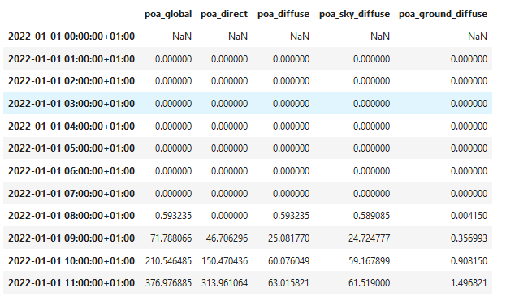
Modeling steps
####### Calculate POA, the lazy way #######
from pvlib.irradiance import get_total_irradiance # import the function “get_total_irradiance from pvlib”
# On another note, pvlib* is a very useful package for PV modeling with plenty of convenient functions, do not hesitate to look it up on the web
beta = 20 # tilt [°]
azimuth = 180 # azimuth [°]
rho = 0.2 # albedo
solar_position = pd.read_csv("solarpos_data.csv") # Import the data file "solarpos_data.csv“ which contains the sun path (azimuth and elevation) with datetime index
weather_data = pd.read_csv("sat_data.csv", index_col=0) # Import the data file “sat_data.csv“ which irradiance (dni, ghi, dhi) with datetime index
data = get_total_irradiance(beta, azimuth, solar_position["zenith"], solar_position["azimuth"], weather_data["dni"], weather_data["ghi"], weather_data["dhi"], albedo=rho) # Directly apply the isotropic models
print(data.head(12)) # Show the first 12 lines of the DataFrame
values
Notebook recap 27/11/2023
Python commands 2/2
Pvlib ref *William F. Holmgren, Clifford W. Hansen, and Mark A. Mikofski. “pvlib python: a python package for modeling solar energy systems.” Journal of Open Source Software, 3(29), 884, (2018). https://doi.org/10.21105/joss.00884

Slide 11

Modeling steps
3. Shading / Terrain horizon mask
PVGIS: Website/Online Tool to estimate power production:
Enables to extract the horizon mask with a Digital Surface Model (DSM).
Go to: https://re.jrc.ec.europa.eu/pvg_tools/en/
Time for some hands-on exercises,
Again !

Slide 12
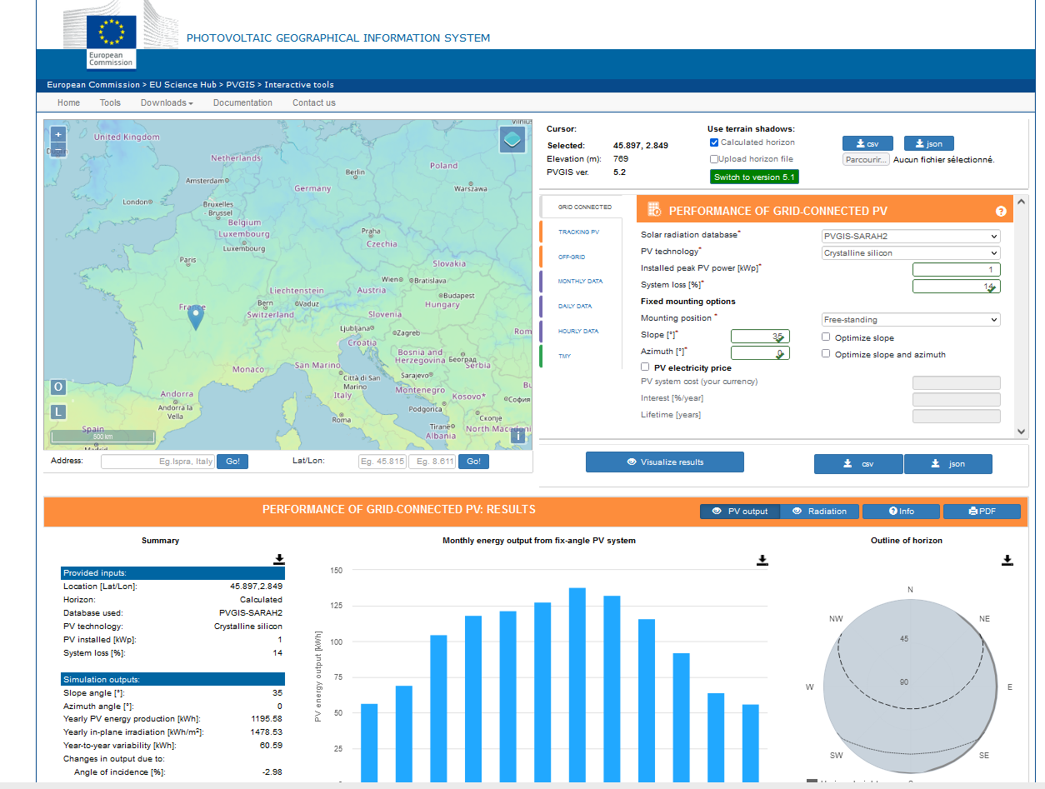
Modeling steps
3. Shading / Terrain horizon mask
PVGIS: Website/Online Tool to estimate power production: https://re.jrc.ec.europa.eu/pvg_tools/en/
Enables to extract the horizon mask with a Digital Surface Model (DSM).
Instructions:
Generate a simulation on PVGIS
Click on the map on Grenoble and select the « Grid connected tab »
Vizualize
Extract the horizon file in csv format
2. Follow the instructions on the jupyter notebook and calculate the modified POA on one year. https://github.com/AlexandreHugoMathieu/pvfault_detection_solar_academy/blob/master/notebooks/python_intro2_horizon_mask.ipynb
Notes:
Show function
Create function to get the API horizon mask
How many hours is the direct component blocked ?

