Slide 1



Operational research for urban solar development
“PV failure detection based on operational time series”
11/12/2023
Alexandre Mathieu

Slide 2
Curriculum
Plan
Day | Time | Duration | Content
Monday 27/11/2023 | 9h45-11h15 12h30-14h | 1h30 + 1h30 | 50% Lecture / 50 % Hands-on
Tuesday 05/12/2023 | 8h-9h30 9h45-11h15 | 1h30 + 1h30 | 50% Lecture / 50 % Hands-on
Thursday 07/12/2023 | 8h-11h 12h45-15h45 | 6h | 25% Lecture / 75 % Project
Monday 11/12/2023 | 8h-11h 12h30-15h30 | 6h | 10% Lecture / 90 % Project
Friday 22/12/2023 | 8h-9h30 | 1h30 | 100 % Project
Today

Slide 3
Modeling steps
Notebook DC Power estimation 07/12/2023
The notebook is now corrected and can be read online: https://github.com/AlexandreHugoMathieu/pvfault_detection_solar_academy/blob/master/notebooks/dc_power_estimation.ipynb

Slide 4
Agenda
PV « expected » losses

Slide 5
PV « expected » losses
Module temperature losses
Non-optimal irradiance collection (light, reflection, known shading)
Non-optimal array production extraction (example: mismatch)
Natural system ageing
Joule losses in the cables
Inverter losses
Bun, L., 2011. Détection et localisation de défauts dans un système photovoltaïque (Theses). Université de Grenoble.
Notes:
- Non-optimal extraction of energy production: mismatch between modules in terms of nominal power, which induces imbalances, and very generally, the operational system adapts to the weakest module.
- Losses by temperature: + It is hot, - the module is efficient. Example (order of magnitude) on a crystal module, a temperature rise of 30° corresponds to a loss of 10%
Collection of non-optimal irradiance: Effects of reflection, spectral and shading due to elements surrounding the installation
Losses due to aging: Natural loss: encapsulant which turns brown, micro cracks in the cells, resistance of the wiring which increases…
Losses in cables due to resistance. Efficiency losses in the conversion between DC and AC.

Slide 6
Agenda
PV Failure

Slide 7
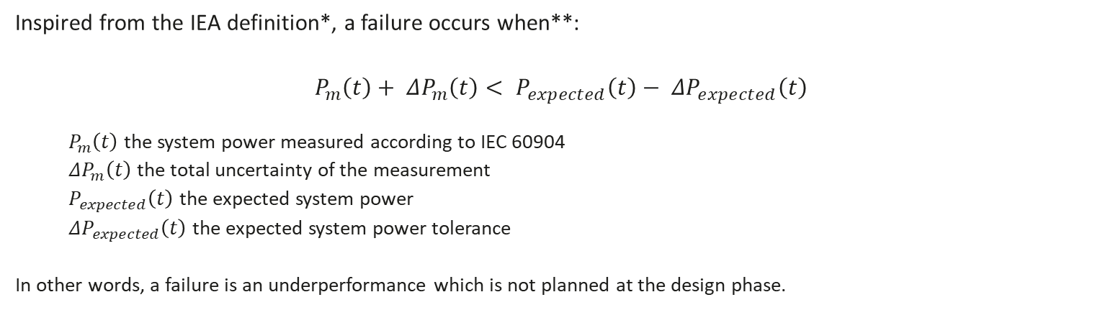
PV failure definition
Inspired from the IEA definition*, a failure occurs when**:
$$P_{m}\left(t\right)+ ΔP_{m}\left(t\right)< P_{expected}\left(t\right)− ΔP_{expected}\left(t\right)$$
$P_{m}\left(t\right)$ the system power measured according to IEC 60904
$ΔP_{m}\left(t\right)$ the total uncertainty of the measurement
$P_{expected}\left(t\right)$ the expected system power
$ΔP_{expected}\left(t\right)$ the expected system power tolerance
In other words, a failure is an underperformance which is not planned at the design phase.
*M. Köntges et al., “Review of Failures of Photovoltaic Modules,” IEA PVPS T13, IEA-PVPS T13-01:2014, 2014.
***A. Mathieu, G. Fraisse, M. Thebault, S. Thebault, S. Boddaert, and L. Gaillard, ‘Failure Risk Analysis of Photovoltaic Systems Based on Literature Review’, presented at the Eurosun 2022, Kassel, Germany, Sep. 2022.

Slide 8
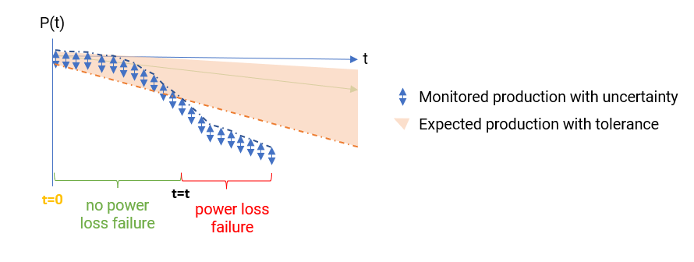
PV failure definition
Inspired from the IEA definition*, a failure occurs when**:
$$P_{m}\left(t\right)+ ΔP_{m}\left(t\right)< P_{expected}\left(t\right)− ΔP_{expected}\left(t\right)$$
$P_{m}\left(t\right)$ the system power measured according to IEC 60904
$ΔP_{m}\left(t\right)$ the total uncertainty of the measurement
$P_{expected}\left(t\right)$ the expected system power
$ΔP_{expected}\left(t\right)$ the expected system power tolerance
In other words, a failure is an underperformance which is not planned at the design phase.
*M. Köntges et al., “Review of Failures of Photovoltaic Modules,” IEA PVPS T13, IEA-PVPS T13-01:2014, 2014.
***A. Mathieu, G. Fraisse, M. Thebault, S. Thebault, S. Boddaert, and L. Gaillard, ‘Failure Risk Analysis of Photovoltaic Systems Based on Literature Review’, presented at the Eurosun 2022, Kassel, Germany, Sep. 2022.

Slide 9
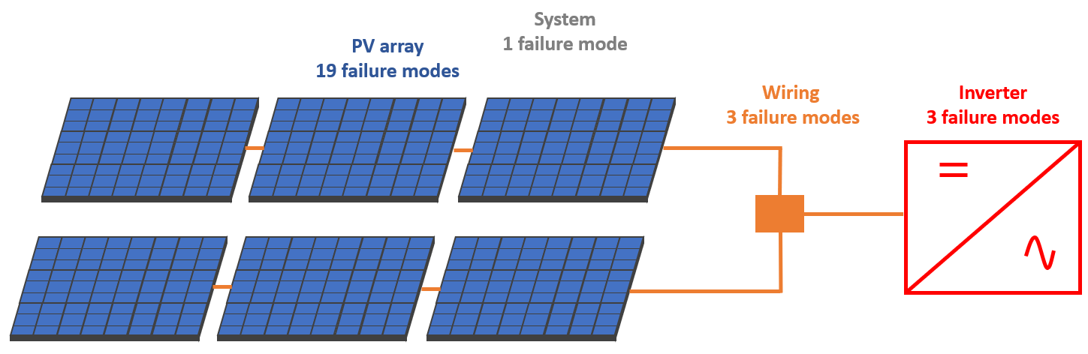
Failures
One list of failures… Total: 26
*A. Mathieu, G. Fraisse, M. Thebault, S. Thebault, S. Boddaert, and L. Gaillard, ‘Failure Risk Analysis of Photovoltaic Systems Based on Literature Review’, presented at the Eurosun 2022, Kassel, Germany, Sep. 2022.

Slide 10
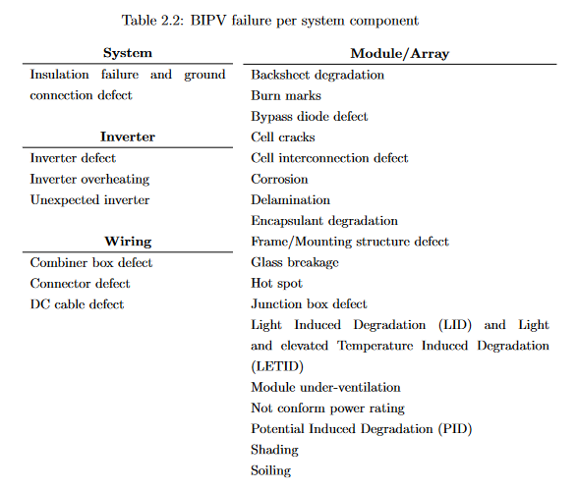
Failures
derating
One list of failures… Total: 26
*A. Mathieu, G. Fraisse, M. Thebault, S. Thebault, S. Boddaert, and L. Gaillard, ‘Failure Risk Analysis of Photovoltaic Systems Based on Literature Review’, presented at the Eurosun 2022, Kassel, Germany, Sep. 2022.

Slide 11
Failures
One list of failure…
The 12 most critical according to *
*A. Mathieu, G. Fraisse, M. Thebault, S. Thebault, S. Boddaert, and L. Gaillard, ‘Failure Risk Analysis of Photovoltaic Systems Based on Literature Review’, presented at the Eurosun 2022, Kassel, Germany, Sep. 2022.

Slide 12
Agenda
Common PV Failures

Slide 13
Shading
Shading refers to the obstruction of sunlight on the PV array.

Slide 14
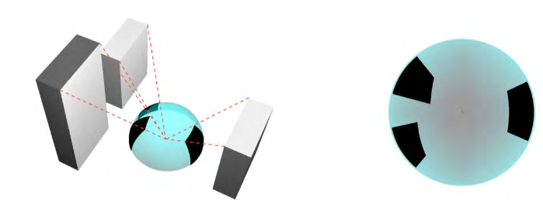
Shading / Full shading
Shading refers to the obstruction of sunlight on the PV array.
One example
Image: “Measuring sky view factor of urban canyons using hacked Gopro hemispheric video processing”, December 2015, Conference, Melbourne, Australia, White et Kimm

Slide 15
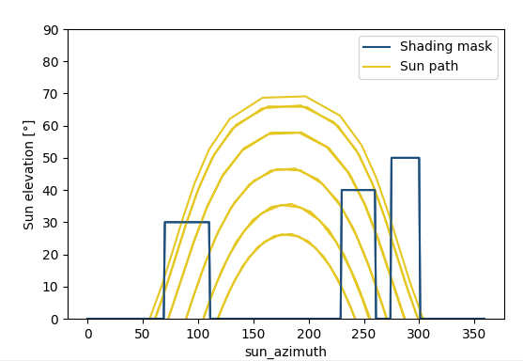
Shading / Full shading
Shading refers to the obstruction of sunlight on the PV array.
One example
*Process illustration, assumptions made on the building masks.
Image: “Measuring sky view factor of urban canyons using hacked Gopro hemispheric video processing”, December 2015, Conference, Melbourne, Australia, White et Kimm

Slide 16
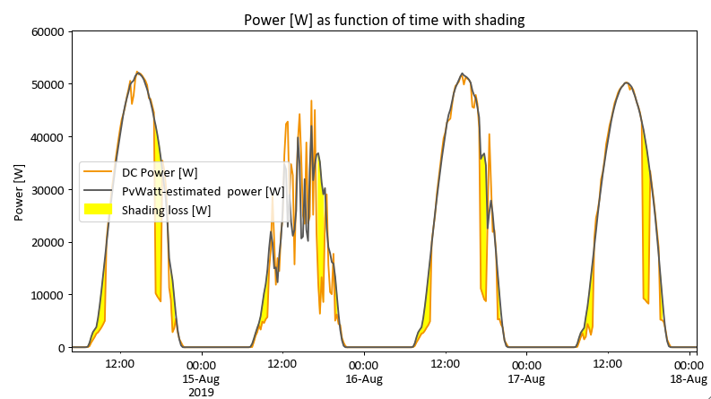
Shading / Full shading
Shading refers to the obstruction of sunlight on the PV array.
One example
*Process illustration, assumptions made on the building masks.
Image: “Measuring sky view factor of urban canyons using hacked Gopro hemispheric video processing”, December 2015, Conference, Melbourne, Australia, White et Kimm
Signature

Slide 17
Shading / Full shading
Shading refers to the obstruction of sunlight on the PV array.
One example
*Process illustration, assumptions made on the building masks.
Image: “Measuring sky view factor of urban canyons using hacked Gopro hemispheric video processing”, December 2015, Conference, Melbourne, Australia, White et Kimm
Signature
Detection Hints:
Temporal cycle
Correlated with the sun position
(Low sun horizons have higher chances of getting shaded.)
Decrease in the same order of magnitude as the POA-direct component ratio out of POA-global
Sudden drops/increase

Slide 18
Inverter clipping
« Inverter clipping » occurs when the generated DC power exceeds the inverter limit.
Then, the inverter caps the generated DC power by moving the operating point to reduce the DC production and fit within the inverter input limits.

Slide 19
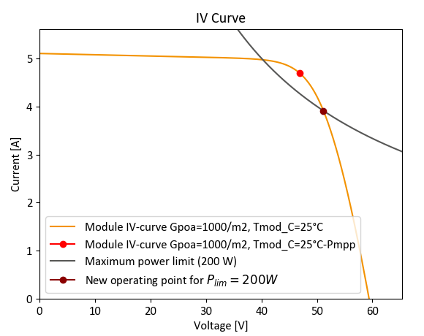
Inverter clipping
« Inverter clipping » occurs when the generated DC power exceeds the inverter limit.
Then, the inverter caps the generated DC power by moving the operating point to reduce the DC production and fit within the inverter input limits.
Example where the inverter increases the tension to reduce the DC power.

Slide 20
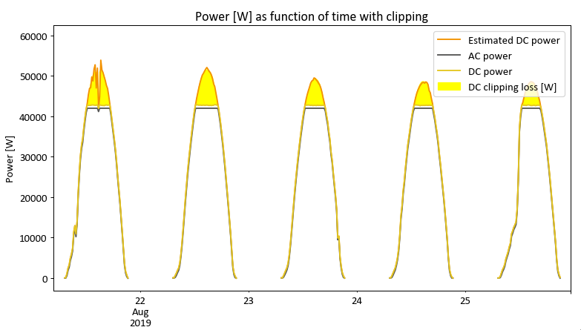
Inverter clipping
« Inverter clipping » occurs when the generated DC power exceeds the inverter limit.
Then, the inverter caps the generated DC power by moving the operating point to reduce the DC production and fit within the inverter input limits.
Signature
Example where the inverter increases the tension to reduce the DC power.

Slide 21
Inverter clipping
« Inverter clipping » occurs when the generated DC power exceeds the inverter limit.
Then, the inverter caps the generated DC power by moving the operating point to reduce the DC production and fit within the inverter input limits.
Signature
Example where the inverter increases the tension to reduce the DC power.
Detection Hints:
Clipping threshold is generally fixed
Occurs at high sunny conditions
Slope = 0 W/m2/h

Slide 22
Module short-circuit
A module short-circuit occurs when the current does not flow through its cells but through another path (such as the bypass diodes).

Slide 23
Module short-circuit
A module short-circuit occurs when the current does not flow through its cells but through another path (such as the bypass diodes).
Potential causes:
Improper manufacturing (soldering error, bus bar misalignment…)
Faulty bypass diodes in short-circuit position
Improper installation (connection error, damaged connectors…)
Situations where the PV module is « intentionally » bypassed thanks to the bypass diodes:
Damaged cells (from hailing, lightning…)
Electrical insulation defect due to moisture ingress
Shading with hotspots
Advanced aging with severe mismatch

Slide 24
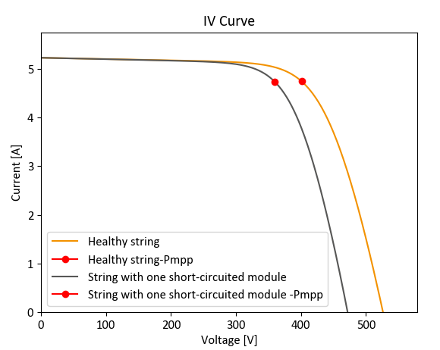
Module short-circuit
Signature
A module short-circuit occurs when the current does not flow through its cells but through another path (such as the bypass diodes).
Potential causes:
Improper manufacturing (soldering error, bus bar misalignment…)
Faulty bypass diodes in short-circuit position
Improper installation (connection error, damaged connectors…)
Situations where the PV module is « intentionally » bypassed thanks to the bypass diodes:
Damaged cells (from hailing, lightning…)
Electrical insulation defect due to moisture ingress
Shading with hotspots
Advanced aging with severe mismatch

Slide 25
Module short-circuit
Signature
A module short-circuit occurs when the current does not flow through its cells but through another path (such as the bypass diodes).
Potential causes:
Improper manufacturing (soldering error, bus bar misalignment…)
Faulty bypass diodes in short-circuit position
Improper installation (connection error, damaged connectors…)
Situations where the PV module is « intentionally » bypassed thanks to the bypass diodes:
Damaged cells (from hailing, lightning…)
Electrical insulation defect due to moisture ingress
Shading with hotspots
Advanced aging with severe mismatch
Detection Hints:
Constant underperformance
Start at a specific date
The power reduction is proportional to the number of short-circuited modules

Slide 26
That’s it

Slide 27
Resources to go further
Modeling guide PVPMC: https://pvpmc.sandia.gov/modeling-guide/
Python / Pvlib tutorial: https://pvsc-python-tutorials.github.io/PVSC48-Python-Tutorial/
To go further:
The Use of Advanced Algorithms in PV Failure Monitoring , IEA PVPS 2021: https://iea-pvps.org/wp-content/uploads/2021/10/Final-Report-IEA-PVPS-T13-19_2021_PV-Failure-Monitoring.pdf
Improving Efficiency of PV Systems Using Statistical Performance Monitoring, IEA PVPS 2017: https://iea-pvps.org/wp-content/uploads/2020/01/Report_IEA-PVPS_T13-07_2017_Improving_Efficiency_of_PV_Systems_Using_Statistical__Performance_Monitoring.pdf

