Slide 1



Operational research for urban solar development
“PV failure detection based on operational time series”
22/12/2023
Alexandre Mathieu

Slide 2
Curriculum
Plan
Day | Time | Duration | Content
Monday 27/11/2023 | 9h45-11h15 12h30-14h | 1h30 + 1h30 | 50% Lecture / 50 % Hands-on
Tuesday 05/12/2023 | 8h-9h30 9h45-11h15 | 1h30 + 1h30 | 50% Lecture / 50 % Hands-on
Thursday 07/12/2023 | 8h-11h 12h45-15h45 | 6h | 25% Lecture / 75 % Project
Monday 11/12/2023 | 8h-11h 12h30-15h30 | 6h | 10% Lecture / 90 % Project
Friday 22/12/2023 | 8h-9h30 | 1h30 | 100 % Project
Today

Slide 3
Agenda
Project – Outputs

Slide 4
Project: some details
Only train your Machine Learning models on January and July
Installation date: Oct-2017

Slide 5
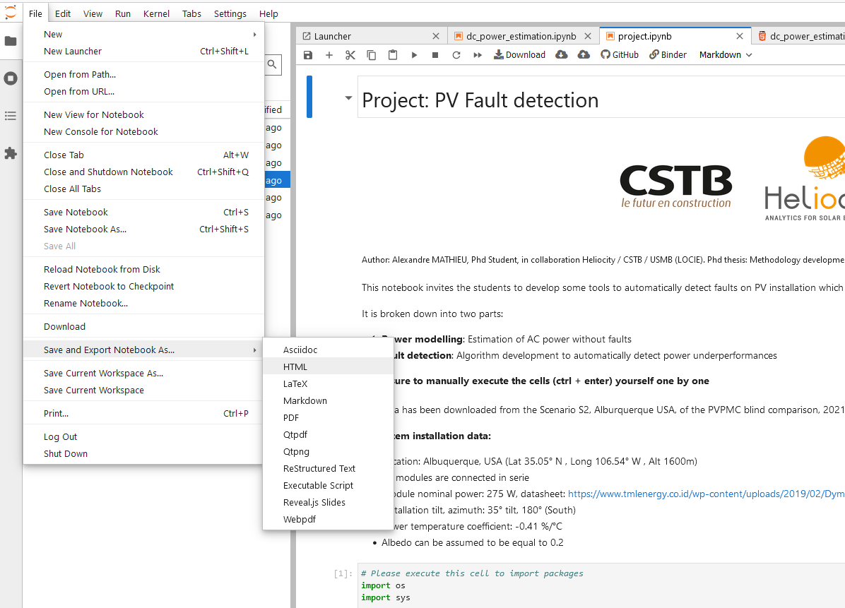
Project outputs
I. HTML export of your notebook: See example to the right
(Make sure to insert your name in it)
II. Four CSV files:
(Python command: dataframe.to_csv(‘initials_estimation.csv’)
One collecting the AC estimation variables with those specific column names:
4 columns [“gpoa_estimated”, “t_mod_estimated”, “dc_power_estimated”, “ac_power_estimated”]
2. Three csv files (one for each failure) with energy loss as values and datetime as index:
Shading
Inverter clipping
Module short-circuit

Slide 6
Project outputs
Send the 5 csv files + Htlm notebook to me by mail alexandre.mathieu@cstb.fr .

Slide 7
That’s it

