Slide 1



Operational research for urban solar development
“PV failure detection based on operational time series”
05/12/2023 - Morning
Alexandre Mathieu

Slide 2
Agenda
Curriculum
PV performance model steps

Slide 3
Curriculum
Plan
Day | Time | Duration | Content
Monday 27/11/2023 | 9h45-11h15 12h30-14h | 1h30 + 1h30 | 50% Lecture / 50 % Hands-on
Tuesday 05/12/2023 | 8h-9h30 9h45-11h15 | 1h30 + 1h30 | 50% Lecture / 50 % Hands-on
Thursday 07/12/2023 | 8h-11h 12h45-15h45 | 6h | 25% Lecture / 75 % Project
Monday 11/11/2023 | 8h-11h 12h30-15h30 | 6h | 10% Lecture / 90 % Project
Friday 22/12/2023 | 8h-9h30 | 1h30 | 100 % Project
Today

Slide 4
Curriculum
Plan
Day | Time | Duration | Content
Monday 27/11/2023 | 9h45-11h15 12h30-14h | 1h30 + 1h30 | 50% Lecture / 50 % Hands-on
Tuesday 05/12/2023 | 8h-9h30 9h45-11h15 | 1h30 + 1h30 | 50% Lecture / 50 % Hands-on
Thursday 07/12/2023 | 8h-11h 12h45-15h45 | 6h | 25% Lecture / 75 % Project
Monday 11/11/2023 | 8h-11h 12h30-15h30 | 6h | 10% Lecture / 90 % Project
Friday 22/12/2023 | 8h-9h30 | 1h30 | 100 % Project
For next time. Make groups of 2 for the project.
Today

Slide 5
Agenda
Curriculum
PV performance model steps

Slide 6

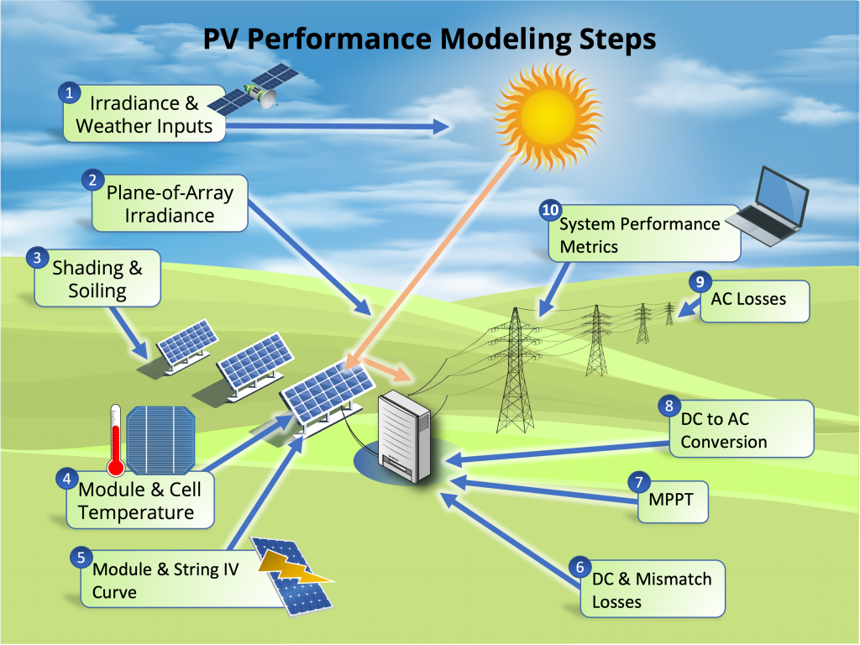
Modeling steps
27/11/2023
*image from: PVSC48 python tutorial

Slide 7
Modeling steps
27/11/2023
Today
*image from: PVSC48 python tutorial

Slide 8
Modeling steps
Notebook recap 27/11/2023
The notebook is now corrected and can be read online: https://github.com/AlexandreHugoMathieu/pvfault_detection_solar_academy/blob/master/notebooks/python_intro_poa.ipynb

Slide 9
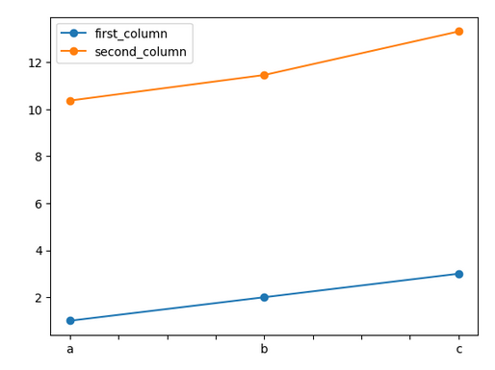
Modeling steps
import numpy as np # import to your python instance the package “numpy” and rename it “np” (helpful for math calculations)
import pandas as pd # import to your python instance the package “pandas” (helpful for data structure and calculations)
ts = pd.Series([1, 2,3], index=['a','b','c']) # Initiate a pandas serie into variable “ts”
ts2 = ts + ts/2 + np.cos(ts) + np.pi # Make calculate with “ts” and store it into “ts2”
print(ts2) # print serie ts
ts.plot(marker="o") # Make a plot of ts with “o” (circle) marker
df = pd.DataFrame() # Initiate an empty dataframe into variable “df”
df["first_column"] = ts # Store “ts” serie in a column labeled “first_column”
df["second_column"] = ts2 * 2 # Store “ts2” serie in another column labeled “second_column”
df.plot(marker="o") # Make a plot of df with “o” (circle) marker
df.loc[“a”, :] # Select the entire row with “a” as index
df.loc[“a”, “first_column”] # Select the value with “a” as index and “first_column” as column
ts
a | 1
b | 2
c | 3
index
values
Notebook recap 27/11/2023
Python commands 1/2
df
a | 1 | 2
b | 2 | 4
c | 3 | 6
index
Pvlib ref *William F. Holmgren, Clifford W. Hansen, and Mark A. Mikofski. “pvlib python: a python package for modeling solar energy systems.” Journal of Open Source Software, 3(29), 884, (2018). https://doi.org/10.21105/joss.00884

Slide 10
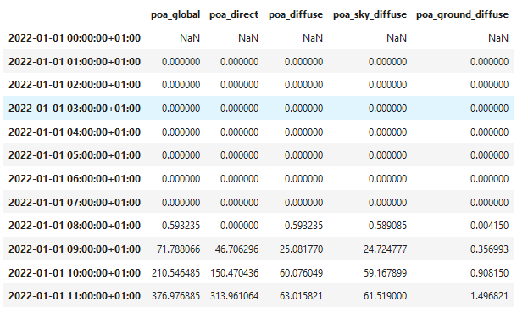
Modeling steps
####### Calculate POA, the lazy way #######
from pvlib.irradiance import get_total_irradiance # import the function “get_total_irradiance from pvlib”
# On another note, pvlib* is a very useful package for PV modeling with plenty of convenient functions, do not hesitate to look it up on the web
beta = 20 # tilt [°]
azimuth = 180 # azimuth [°]
rho = 0.2 # albedo
solar_position = pd.read_csv("solarpos_data.csv") # Import the data file "solarpos_data.csv“ which contains the sun path (azimuth and elevation) with datetime index
weather_data = pd.read_csv(DATA_PATH / "sat_data.csv", index_col=0) # Import the data file “sat_data.csv“ which irradiance (dni, ghi, dhi) with datetime index
data = get_total_irradiance(beta, azimuth, solar_position["zenith"], solar_position["azimuth"], weather_data["dni"], weather_data["ghi"], weather_data["dhi"], albedo=rho) # Directly apply the isotropic models
print(data.head(24)) # Show the first 24 lines of the DataFrame
values
Notebook recap 27/11/2023
Python commands 2/2
Pvlib ref *William F. Holmgren, Clifford W. Hansen, and Mark A. Mikofski. “pvlib python: a python package for modeling solar energy systems.” Journal of Open Source Software, 3(29), 884, (2018). https://doi.org/10.21105/joss.00884

Slide 11

Modeling steps
3. Shading / Terrain horizon mask
PVGIS: Website/Online Tool to estimate power production:
Enables to extract the horizon mask with a Digital Surface Model (DSM).
Go to: https://re.jrc.ec.europa.eu/pvg_tools/en/
Time for some hands-on exercises,
Again !

Slide 12
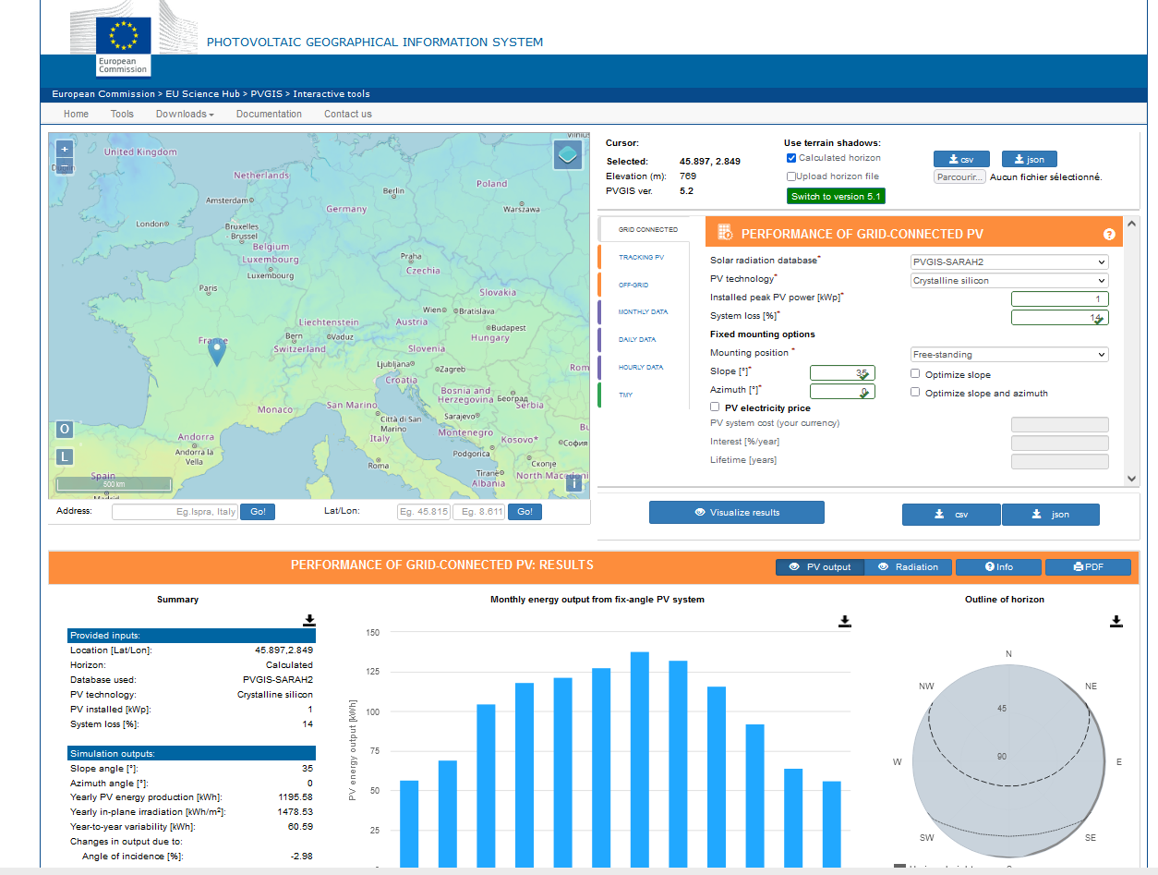
Modeling steps
3. Shading / Terrain horizon mask
PVGIS: Website/Online Tool to estimate power production: https://re.jrc.ec.europa.eu/pvg_tools/en/
Enables to extract the horizon mask with a Digital Surface Model (DSM).
Instructions:
Generate a simulation on PVGIS
Click on the map on Grenoble and select the « Grid connected tab »
Vizualize
Extract the horizon file in csv format
2. Follow the instructions on the jupyter notebook and calculate the modified POA on one year. https://github.com/AlexandreHugoMathieu/pvfault_detection_solar_academy/blob/master/notebooks/python_intro2_horizon_mask.ipynb
Notes:
Show function
Create function to get the API horizon mask
How many hours is the direct component blocked ?

Slide 13
Modeling steps
4. Module and Cell temperature
The hotter a module is, the less efficient it is !

Slide 14
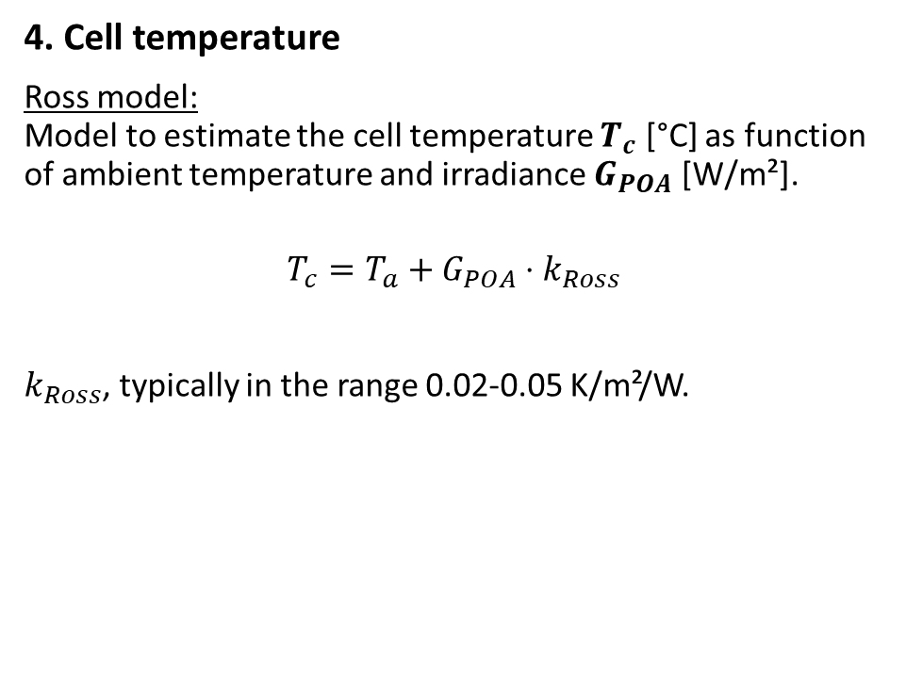
Modeling steps
4. Cell temperature
Ross model: Model to estimate the cell temperature $T_{c}$ [°C] as function of ambient temperature and irradiance $G_{POA}$ [W/m²].
$$T_{c}=T_{a}+G_{POA}⋅k_{Ross}$$
$k_{Ross}$, typically in the range 0.02-0.05 K/m²/W.
Ross, R. G. Jr., (1981). “Design Techniques for Flat-Plate Photovoltaic Arrays”

Slide 15

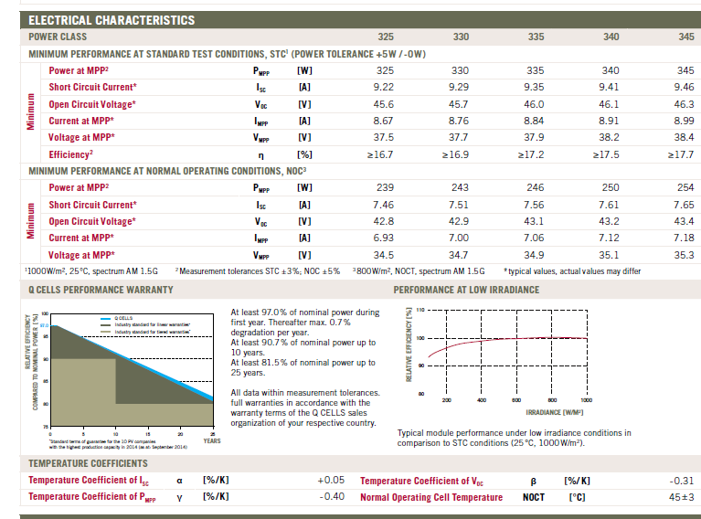
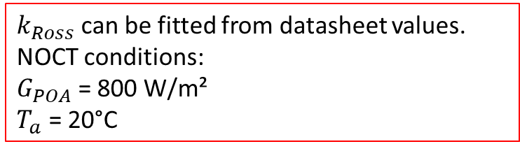
Modeling steps
$k_{Ross}$can be fitted from datasheet values. NOCT conditions: $G_{POA}$= 800 W/m²
$T_{a}$ = 20°C
4. Cell temperature
Ross model: Model to estimate the cell temperature $T_{c}$ [°C] as function of ambient temperature and irradiance $G_{POA}$ [W/m²].
$$T_{c}=T_{a}+G_{POA}⋅k_{Ross}$$
$k_{Ross}$, typically in the range 0.02-0.05 K/m²/W.
Ross, R. G. Jr., (1981). “Design Techniques for Flat-Plate Photovoltaic Arrays”

Slide 16
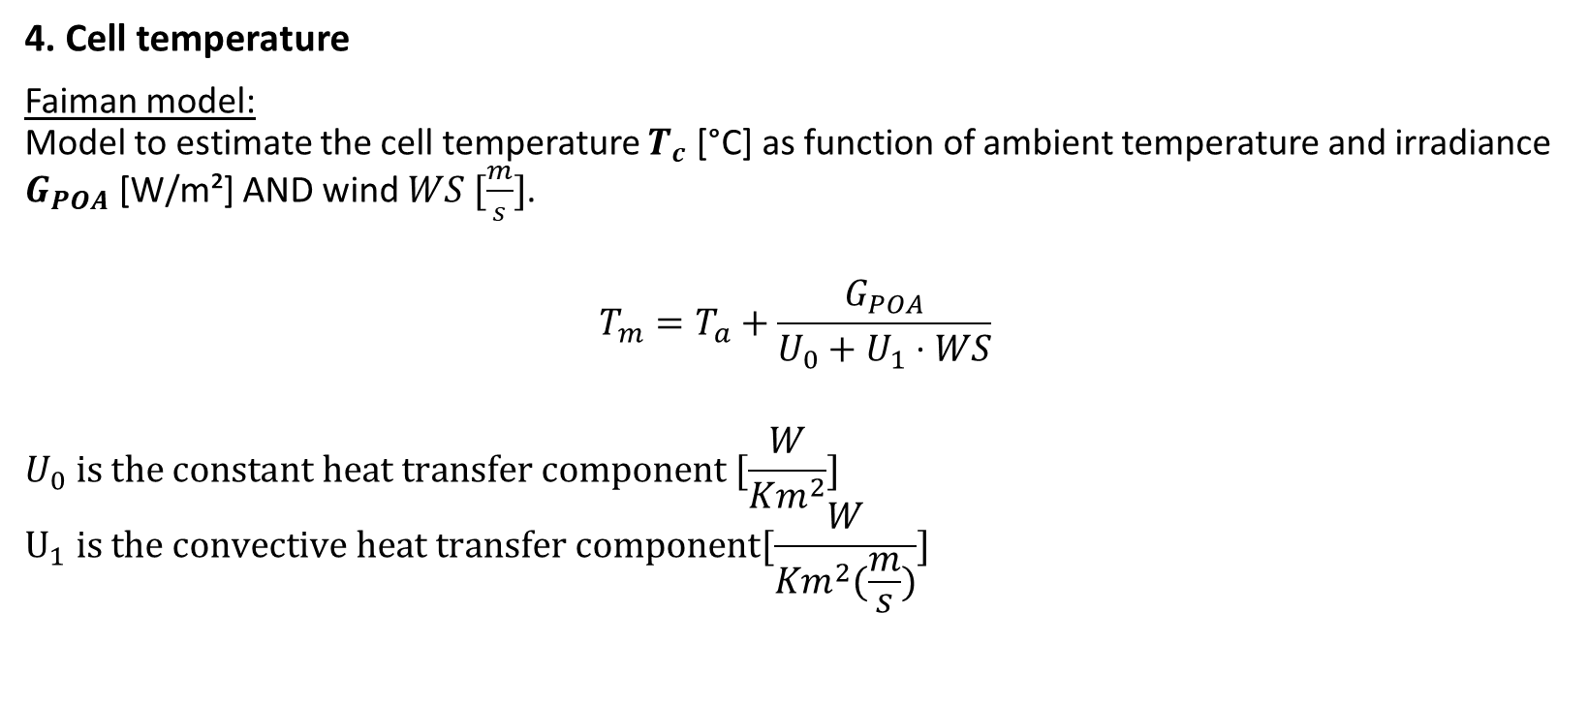
Modeling steps
4. Cell temperature
Faiman model: Model to estimate the cell temperature $T_{c}$ [°C] as function of ambient temperature and irradiance $G_{POA}$ [W/m²] AND wind $WS [\frac{m}{s}]$.
$$T_{m}=T_{a}+\frac{G_{POA}}{U_{0}+U_{1}⋅WS}$$
$$U_{0} is the constant heat transfer component [\frac{W}{Km^{2}}]$$
$$U_{1} is the convective heat transfer component[\frac{W}{Km^{2}(\frac{m}{s})}]$$
Faiman, D. (2008). Assessing the outdoor operating temperature of photovoltaic modules.

Slide 17
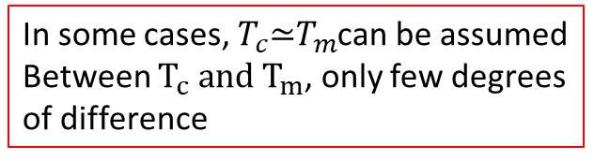
Modeling steps
4. Cell temperature
Faiman model: Model to estimate the cell temperature $T_{c}$ [°C] as function of ambient temperature and irradiance $G_{POA}$ [W/m²] AND wind $WS [\frac{m}{s}]$.
$$T_{m}=T_{a}+\frac{G_{POA}}{U_{0}+U_{1}⋅WS}$$
$$U_{0} is the constant heat transfer component [\frac{W}{Km^{2}}]$$
$$U_{1} is the convective heat transfer component[\frac{W}{Km^{2}(\frac{m}{s})}]$$
In some cases, $T_{c}\text{≃}T_{m}$can be assumed Between $T_{c} and T_{m}$, only few degrees of difference
Faiman, D. (2008). Assessing the outdoor operating temperature of photovoltaic modules.

Slide 18
Modeling steps
Time for some hands-on exercises !
4. Cell temperature
Use the following notebook: https://github.com/AlexandreHugoMathieu/pvfault_detection_solar_academy/blob/master/notebooks/dc_power_estimation.ipynb
Follow the python tutorial and estimate the cell temperature for one year.

Slide 19
Modeling steps
5. Module and String IV Curve

Slide 20
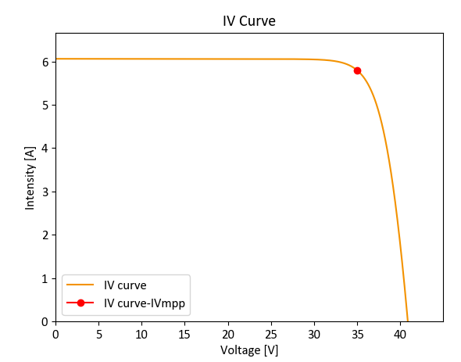
Modeling steps
5. Module and String IV Curve
For a fixed irradiance and module temperature, the PV module has its I, current which depends on V, voltage and it can take many operating points.

Slide 21
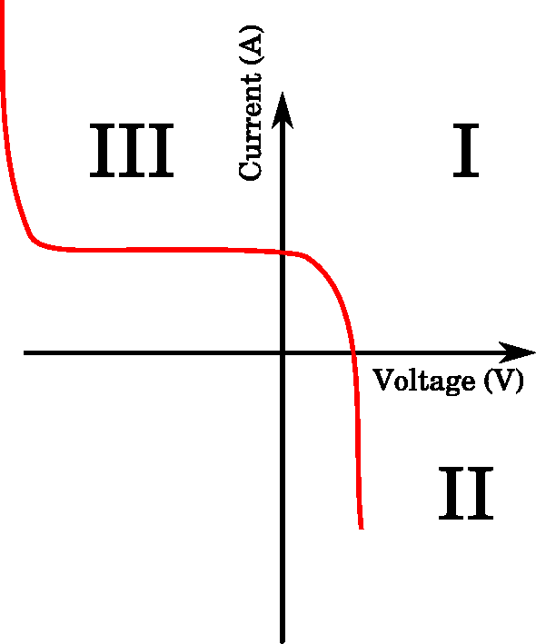
Modeling steps
5. Module and String IV Curve
For a fixed irradiance and module temperature, the PV module has its I, current which depends on V, voltage and it can take many operating points.
In reality, the IV characteristics go out of the 1st quadrant and the module can potentially consume power.

Slide 22
Modeling steps
5. Module and String IV Curve
For a fixed irradiance and module temperature, the PV module has its I, current which depends on V, voltage and it can take many operating points
Then, the inverter is constantly searching for the operating point which maximizes the power MPP: Maximum Power Point.

Slide 23
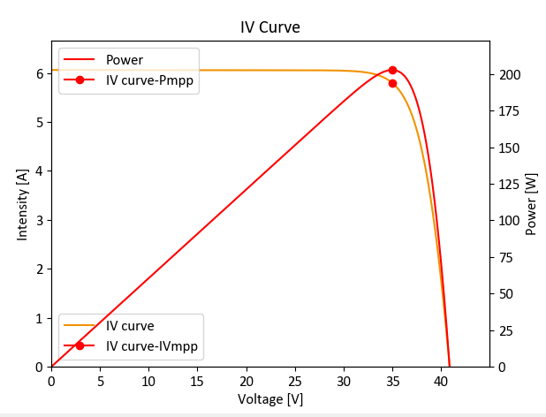
Modeling steps
5. Module and String IV Curve
For a fixed irradiance and module temperature, the PV module has its I, current which depends on V, voltage and it can take many operating points.
Then, the inverter is constantly searching for the operating. point which maximizes the power MPP: Maximum Power Point.
Especially, it changes the voltage with the MPP-Tracker (MPPT) to maximize power.

Slide 24
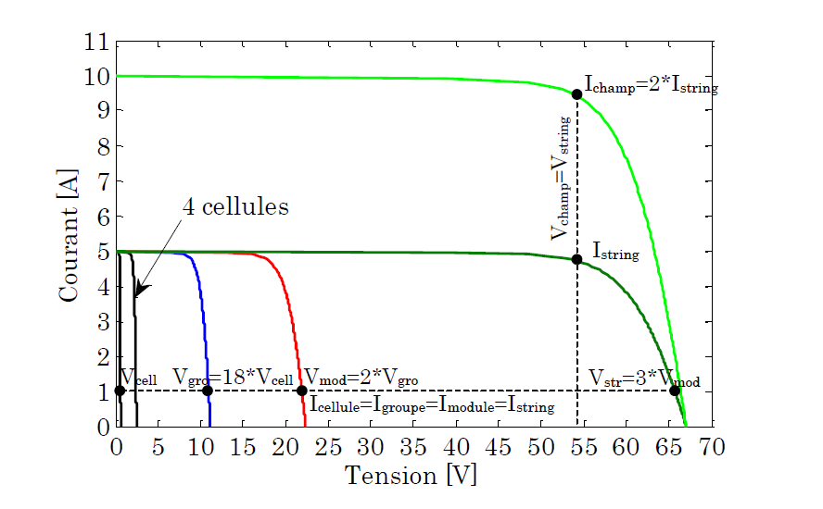
Modeling steps
5. Module and String IV Curve
By the way… the IV curves can be summed up when the modules are connected in series or parallel! The inverter, then, maximizes the power of the PV array IV curve.
Bun, L.. “Détection et localisation de défauts pour un système PV.” (2011).

Slide 25
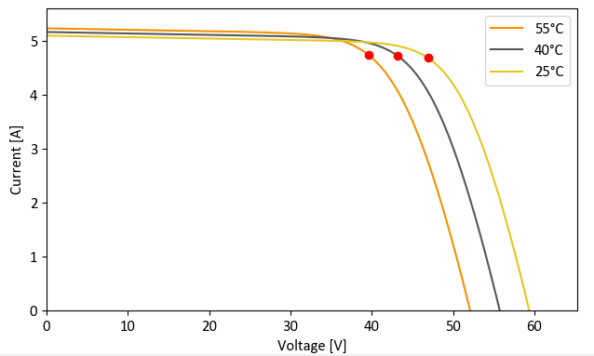
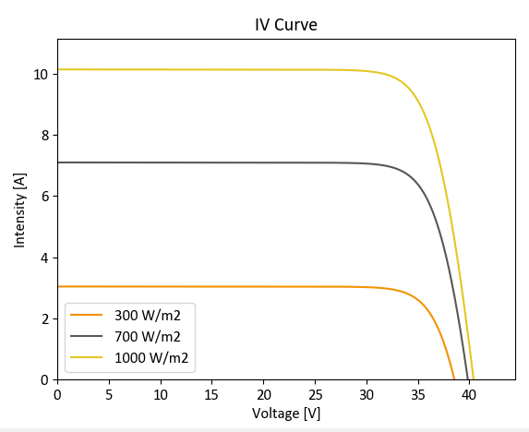
Modeling steps
Example of I-V curves as function of different module temperature
5. Module and String IV Curve
The IV curves' dependencies:
Higher cell temperatures mostly decrease the voltage
Higher irradiance level mostly increase the current
Example of I-V curves as function of different irradiances

Slide 26
Modeling steps
6. DC & Mismatch Losses
Not the focus of this class. However, keep in mind that:
DC wiring losses are around 0.5%-2%.
Mismatch losses refer to the fact that PV modules have different IV curves and this can entail significant losses.

Slide 27
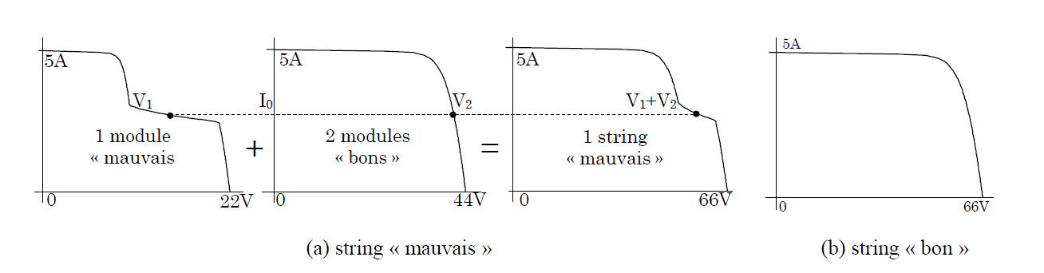
Modeling steps
6. DC & Mismatch Losses
Not the focus of this class. However, keep in mind that:
DC wiring losses are around between 0.5% and 2%.
Mismatch losses refers to the fact that PV modules have different IV curves and this can entail significant losses. For instance, if one of them has a very degraded IV curve (shading or other), it can significantly degrade the IV curve at the array level.
Bun, L.. “Détection et localisation de défauts pour un système PV.” (2011).

Slide 28
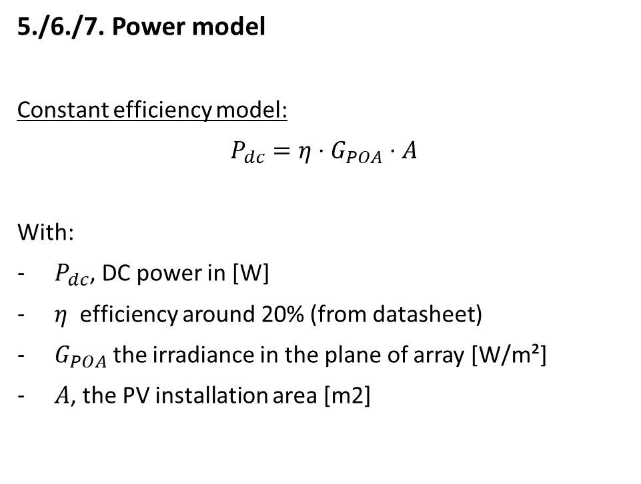
Modeling steps
5./6./7. Power model
Constant efficiency model:
$P_{dc}=η⋅G_{POA}⋅A$
With:
$P_{dc}$, DC power in [W]
$η$ efficiency around 20% (from datasheet)
$G_{POA}$ the irradiance in the plane of array [W/m²]
$A$, the PV installation area [m2]

Slide 29

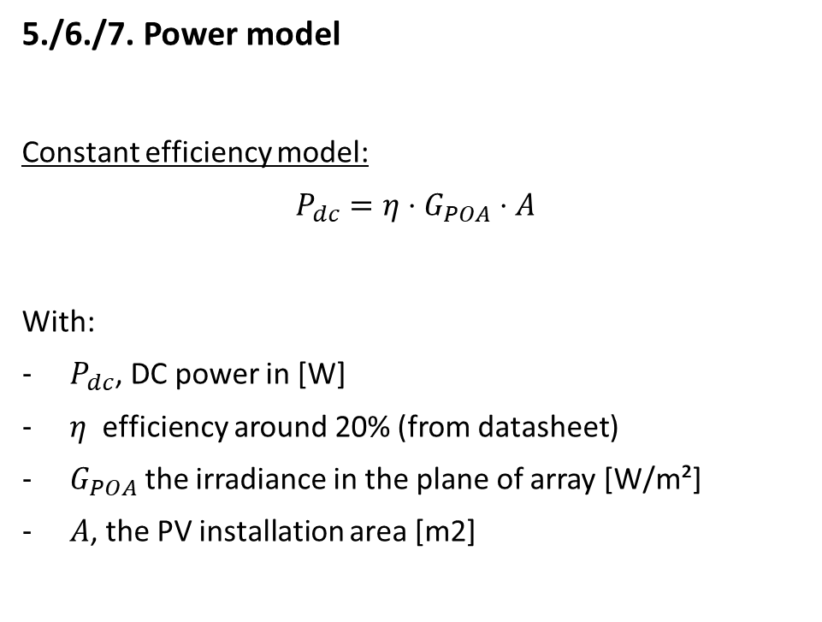
Modeling steps
5./6./7. Power model
Constant efficiency model:
$P_{dc}=η⋅G_{POA}⋅A$
With:
$P_{dc}$, DC power in [W]
$η$ efficiency around 20% (from datasheet)
$G_{POA}$ the irradiance in the plane of array [W/m²]
$A$, the PV installation area [m2]
Not really precise for instantaneous values

Slide 30
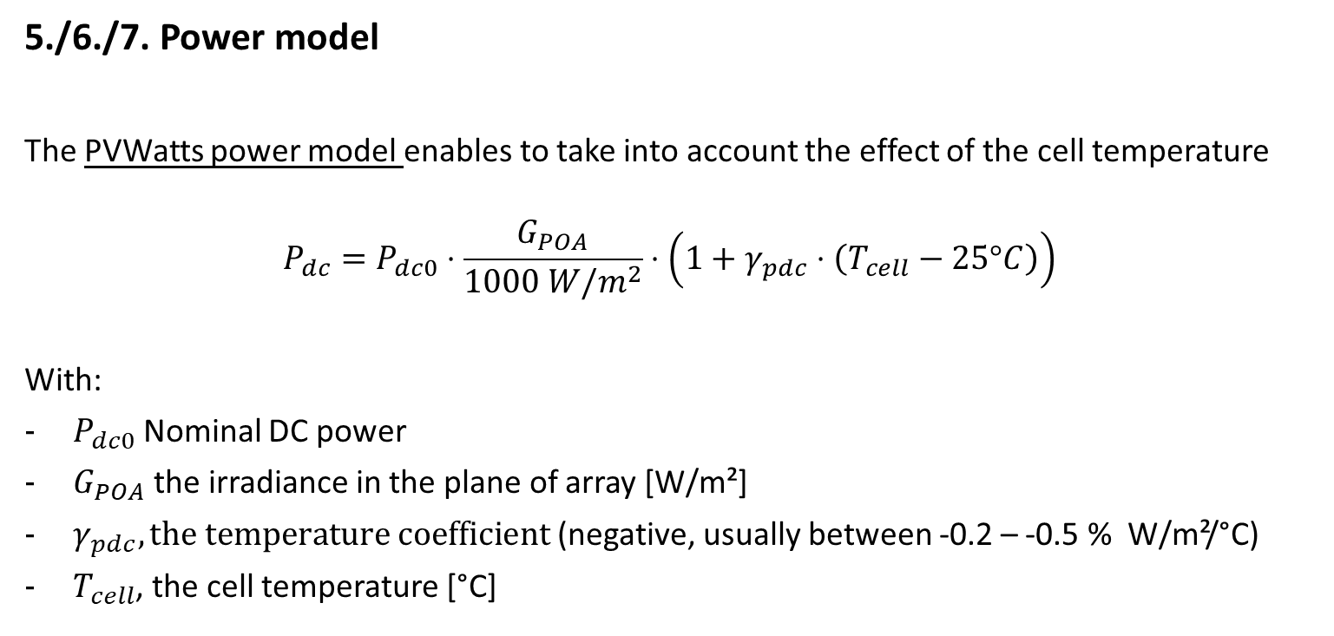
Modeling steps
5./6./7. Power model
The PVWatts power model enables to take into account the effect of the cell temperature
$$P_{dc}=P_{dc0}⋅\frac{G_{POA}}{1000 W/m^{2}}⋅\left(1+γ_{pdc}⋅\left(T_{cell}−25°C\right)\right)$$
With:
$P_{dc0}$ Nominal DC power
$G_{POA}$ the irradiance in the plane of array [W/m²]
$γ_{pdc}, the temperature coefficient$ (negative, usually between -0.2 – -0.5 % W/m²/°C)
$T_{cell}$, the cell temperature [°C]
PVWatts model: A. P. Dobos, “PVWatts Version 5 Manual” (2014).

Slide 31
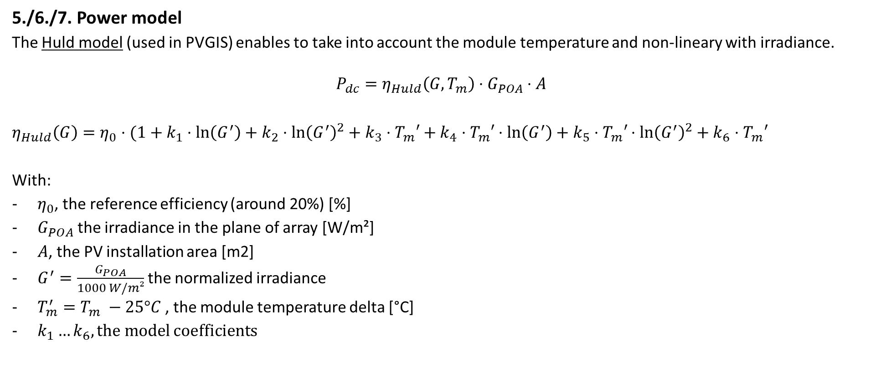
Modeling steps
5./6./7. Power model
The Huld model (used in PVGIS) enables to take into account the module temperature and non-lineary with irradiance.
$$P_{dc}=η_{Huld}\left(G, T_{m}\right)⋅G_{POA}⋅A$$
$η_{Huld}\left(G\right)=η_{0}⋅(1+k_{1}⋅\ln\left(G^{′}\right)+k_{2}$ $⋅\ln{{\left(G^{′}\right)}^{2}+k_{3}⋅T_{m}′+k_{4}⋅T_{m}′⋅\ln\left(G^{′}\right)+k_{5}⋅T_{m}′}$ $⋅\ln{{\left(G^{′}\right)}^{2}+k_{6}⋅T_{m}′}$
With:
$η_{0}$, the reference efficiency (around 20%) [%]
$G_{POA}$ the irradiance in the plane of array [W/m²]
$A$, the PV installation area [m2]
$G^{′}=\frac{G_{POA}}{1000 W/m²}$ the normalized irradiance
$T_{m}^{′}=T_{m} −25°C$ , the module temperature delta [°C]
$k_{1}…k_{6}, the model$coefficients
Huld model: Thomas Huld et al., A power-rating model for crystalline silicon PV modules, 2011,

Slide 32
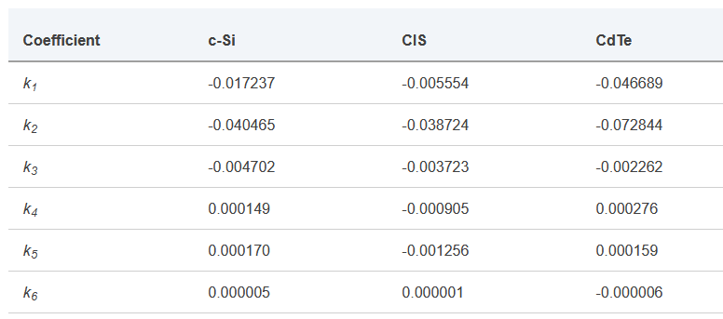
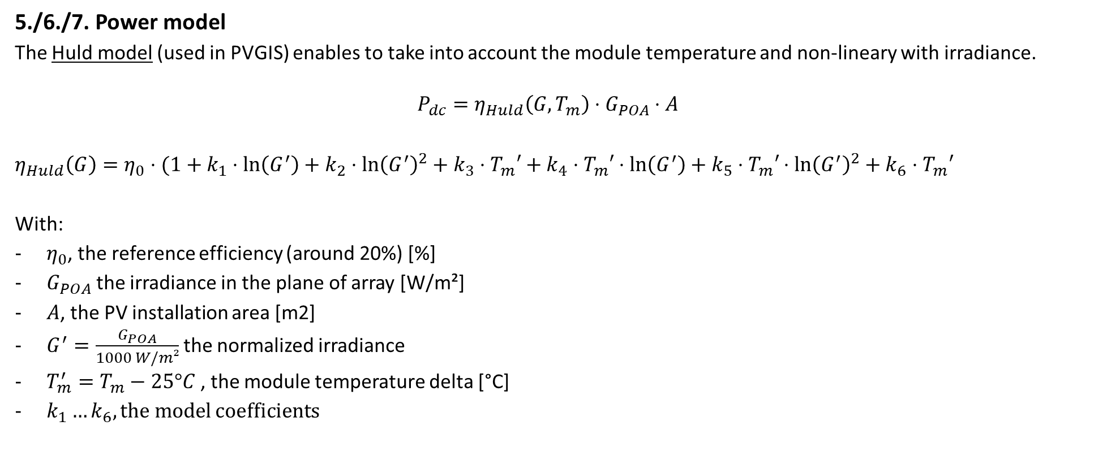
Modeling steps
5./6./7. Power model
The Huld model (used in PVGIS) enables to take into account the module temperature and non-lineary with irradiance.
$$P_{dc}=η_{Huld}\left(G, T_{m}\right)⋅G_{POA}⋅A$$
$η_{Huld}\left(G\right)=η_{0}⋅(1+k_{1}⋅\ln\left(G^{′}\right)+k_{2}$ $⋅\ln{{\left(G^{′}\right)}^{2}+k_{3}⋅T_{m}′+k_{4}⋅T_{m}′⋅\ln\left(G^{′}\right)+k_{5}⋅T_{m}′}$ $⋅\ln{{\left(G^{′}\right)}^{2}+k_{6}⋅T_{m}′}$
With:
$η_{0}$, the reference efficiency (around 20%) [%]
$G_{POA}$ the irradiance in the plane of array [W/m²]
$A$, the PV installation area [m2]
$G^{′}=\frac{G_{POA}}{1000 W/m²}$ the normalized irradiance
$T_{m}^{′}=T_{m}−25°C$ , the module temperature delta [°C]
$k_{1}…k_{6}, the model$coefficients
Reference values from PVGIS
Huld model: Thomas Huld et al., A power-rating model for crystalline silicon PV modules, 2011,

Slide 33
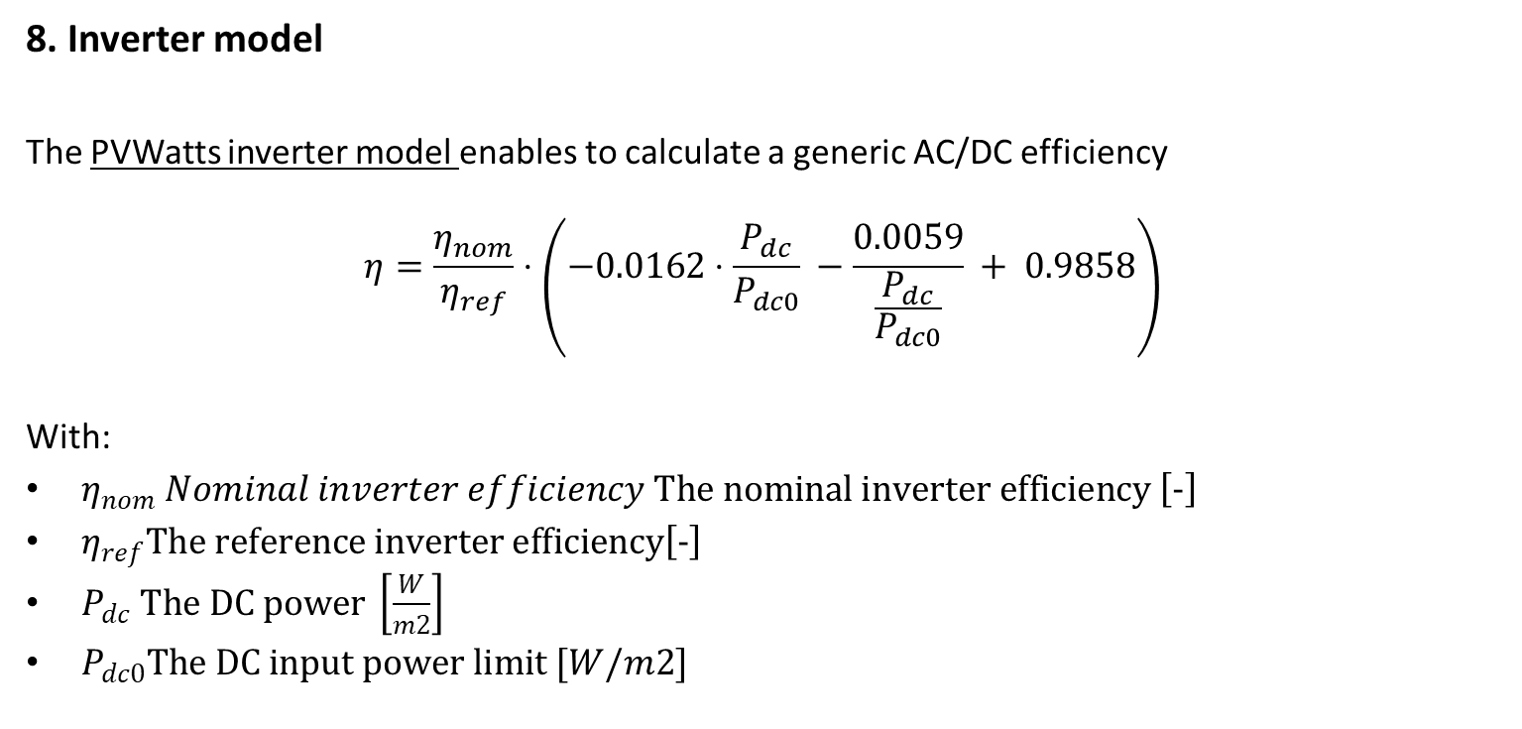
Modeling steps
8. Inverter model
The PVWatts inverter model enables to calculate a generic AC/DC efficiency
$$η=\frac{η_{nom}}{η_{ref}}⋅\left(−0.0162⋅\frac{P_{dc}}{P_{dc0}} −\frac{0.0059}{\frac{P_{dc}}{P_{dc0}}} + 0.9858\right)$$
With:
$η_{nom} Nominal inverter efficiency The nominal inverter efficiency \left[−\right]$
$η_{ref}The reference inverter efficiency\left[−\right]$
$P_{dc} The DC power \left[\frac{W}{m2}\right]$
$P_{dc0}The DC input power limit [W/m2]$
PVWatts model: A. P. Dobos, “PVWatts Version 5 Manual” (2014).

Slide 34

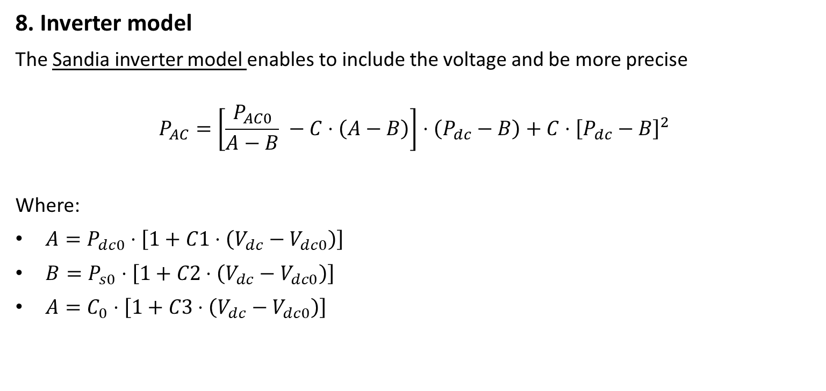
Modeling steps
8. Inverter model
The Sandia inverter model enables to include the voltage and be more precise
$$P_{AC}=\left[\frac{P_{AC0}}{A−B} −C⋅\left(A−B\right)\right]⋅\left(P_{dc}−B\right)+C⋅{\left[P_{dc}−B\right]}^{2}$$
Where:
$A=P_{dc0}⋅\left[1+C1⋅\left(V_{dc}−V_{dc0}\right)\right]$
$B=P_{s0}⋅\left[1+C2⋅\left(V_{dc}−V_{dc0}\right)\right]$
$A=C_{0}⋅\left[1+C3⋅\left(V_{dc}−V_{dc0}\right)\right]$
Parameters:
$V_{dc}:$DC input voltage (V). This is typically assumed to be the array’s maximum power voltage.
$V_{dc0}$: DC voltage level (V) at which the AC power rating is achieved at reference operating conditions.
$P_{AC}$: AC output power (W)
$P_{AC0}$: Maximum AC power rating for inverter at reference conditions (W). Assumed to be an upper limit.
$P_{dc0}$: DC power level (W) at which the AC power rating is achieved at reference operating conditions.
$P_{s0}$: DC power required to start the inversion process (W)
$C_{0}$,$C_{1}$, $C_{2},C_{3}$: Empirical coefficients
D. King, S. Gonzalez, G. Galbraith, W. Boyson, “Performance Model for Grid-Connected Photovoltaic Inverters”, SAND2007-5036, Sandia National Laboratories

Slide 35
Modeling steps
5./6./7. Power model
Use the following notebook: https://github.com/AlexandreHugoMathieu/pvfault_detection_solar_academy/blob/master/notebooks/dc_power_estimation.ipynb
Follow the python tutorial and estimate the DC power for one year.
Time for some hands-on exercises !

Slide 36
Resources
Modeling guide PVPMC: https://pvpmc.sandia.gov/modeling-guide/
Python / Pvlib tutorial: https://pvsc-python-tutorials.github.io/PVSC48-Python-Tutorial/
To go further:
The Use of Advanced Algorithms in PV Failure Monitoring: https://iea-pvps.org/wp-content/uploads/2021/10/Final-Report-IEA-PVPS-T13-19_2021_PV-Failure-Monitoring.pdf

Slide 37
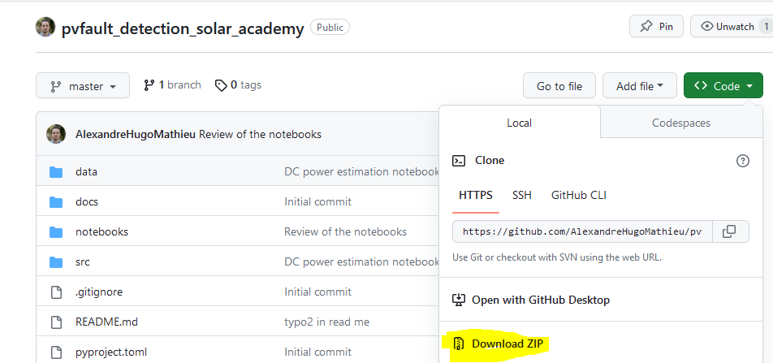
Appendix
How to install Python and import the course repository to use the notebooks on your local PC.
Install python: www.python.org/downloads/, download and install the 3.9.13 “release” (Add python to your Path)
Go to https://github.com/AlexandreHugoMathieu/pvfault_detection_solar_academy, click on the green “Code” button and then download the folder as the zip

Slide 38
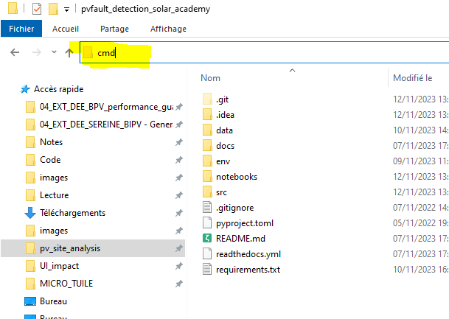
Appendix
How to install Python and import the course repository to use the notebooks on your local PC.
Install python: www.python.org/downloads/, download and install the 3.9.13 “release” (Add python to your Path)
Go to https://github.com/AlexandreHugoMathieu/pvfault_detection_solar_academy, click on the green “Code” button and then download the folder as the zip
Unzip it and put it in adequate location in your PC.
Let’s create a virtual environment where you will find all the functions for this course:
Go in the folder and open the command line from that same folder by writing “cmd” in the path bar (with Windows)

Slide 39
Appendix
How to install Python and import the course repository to use the notebooks on your local PC.
Install python: www.python.org/downloads/, download and install the 3.9.13 “release” (Add python to your Path)
Go to https://github.com/AlexandreHugoMathieu/pvfault_detection_solar_academy, click on the green “Code” button and then download the folder as the zip
Unzip it and put it in adequate location in your PC.
Let’s create a virtual environment where you will find all the functions for this course:
Go in the folder and open the command line from that same folder by writing “cmd” in the path bar (with Windows)
In the command bar: execute the following line to create the “solar_env” environnement that you will use in your notebooks
“pip install virtualenv”
“python –m virtualenv solar_env”
“call solar_env\Scripts\activate” (you should have a ‘solar_env’ on the left of the command at this point)
“pip install –r requirements.txt” (load all the libraries, take a little time, be patient)
“python -m ipykernel install --name=solarkernel” (create a kernel for the notebooks)
It’s ready !

Slide 40
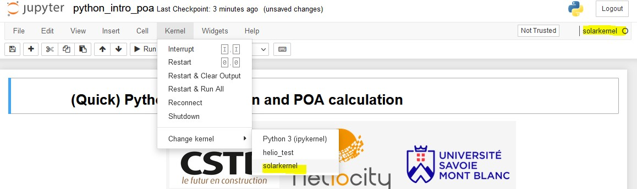
Appendix
How to start a notebook
Go in the folder and open the command line from that same folder by writing “cmd” in the path bar (with Windows)
In the command bar, exexute:
“call solar_env\Scripts\activate” (go in the virtual env)
“jupyter notebook” (open the notebooks browser)
3. Browse to the notebooks folder, choose one and pick the solarkernel when asked.

