Slide 1



Operational research for urban solar development
“PV failure detection based on operational time series”
07/12/2023
Alexandre Mathieu

Slide 2
Agenda
Curriculum
PV performance model steps

Slide 3
Curriculum
Plan
Day | Time | Duration | Content
Monday 27/11/2023 | 9h45-11h15 12h30-14h | 1h30 + 1h30 | 50% Lecture / 50 % Hands-on
Tuesday 05/12/2023 | 8h-9h30 9h45-11h15 | 1h30 + 1h30 | 50% Lecture / 50 % Hands-on
Thursday 07/12/2023 | 8h-11h 12h45-15h45 | 6h | 25% Lecture / 75 % Project
Monday 11/11/2023 | 8h-11h 12h30-15h30 | 6h | 10% Lecture / 90 % Project
Friday 22/12/2023 | 8h-9h30 | 1h30 | 100 % Project
Today
Project: groups of 2 for the project

Slide 4
Agenda
Curriculum
PV performance model steps

Slide 5

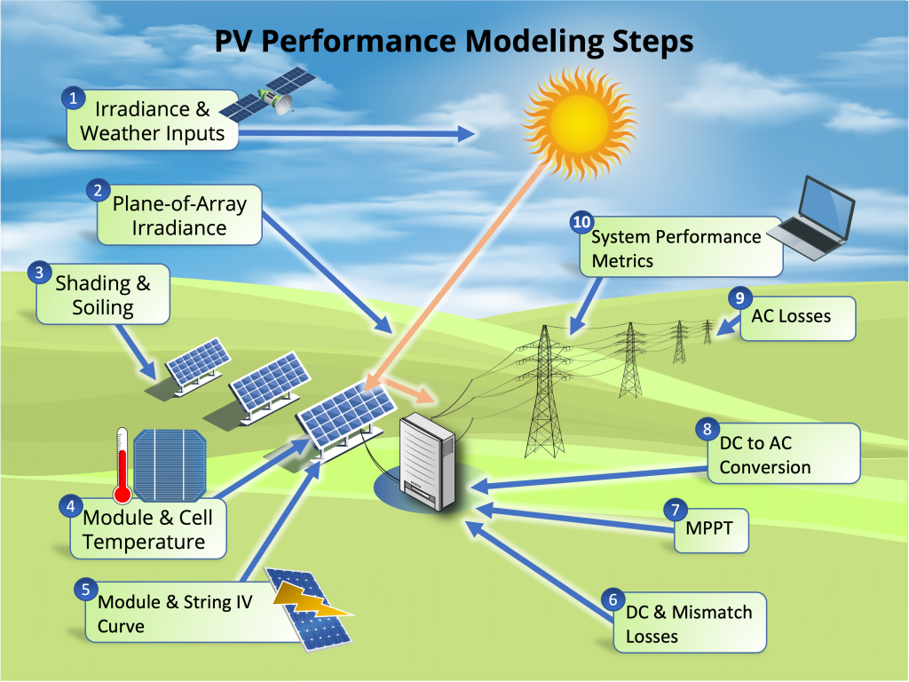
Modeling steps
27/11/2023
& 05/12/2023
*image from: PVSC48 python tutorial

Slide 6
Modeling steps
27/11/2023
& 05/12/2023
Today
*image from: PVSC48 python tutorial

Slide 7
Modeling steps
Notebook recap 05/12/2023
The notebook is now corrected and can be read online: https://github.com/AlexandreHugoMathieu/pvfault_detection_solar_academy/blob/master/notebooks/python_intro2_horizon_mask.ipynb

Slide 8
Modeling steps
import matplotlib.pyplot as plt
# Apply filters
filter_1 = weather_data["ghi"] > 800
filter_2 = (weather_data.index > pd.to_datetime("20220701").tz_localize("CET"))
filter = filter_1 & filter_2 # Combine with a “and” condition
weather_data.loc[filter, "dhi"]
# If statement
a=1
if a<0: # assertion: is "a" under 0 ? Do not forget the “:” at the end of the line
print("a is lower than 0") # Line non-executed since the assertion above is wrong, do not forget the “tab” indendation after a “if”
# Loop over all elements of a list or pd.Series which allow to perform task on each of the element
For element in [“a”,”b”]:
print(element)
for index, row in df.iterrows(): # Loop over all rows and index of the dataframe one by one
print(row["column1"] + row["column2"])
# Plot with matplotlib plt.plot(x, y, linewidth=0, marker="o") # scatter plot with no line in that case
# Function, useful to store few lines of code you want to reuse and apply with different inputs
def my_func_name(argument1, argument2): # Define the function "" with the "def" command and a small increment tab to the right
y = argument1 + argument2
return y
my_func_name(1,2) # Apply the function with two arguments and return 3
my_func_name(1,3) # Return 4
Notebook recap 05/12/2023
Python commands

Slide 9
Modeling steps
4. Module and Cell temperature
The hotter a module is, the less efficient it is !

Slide 10
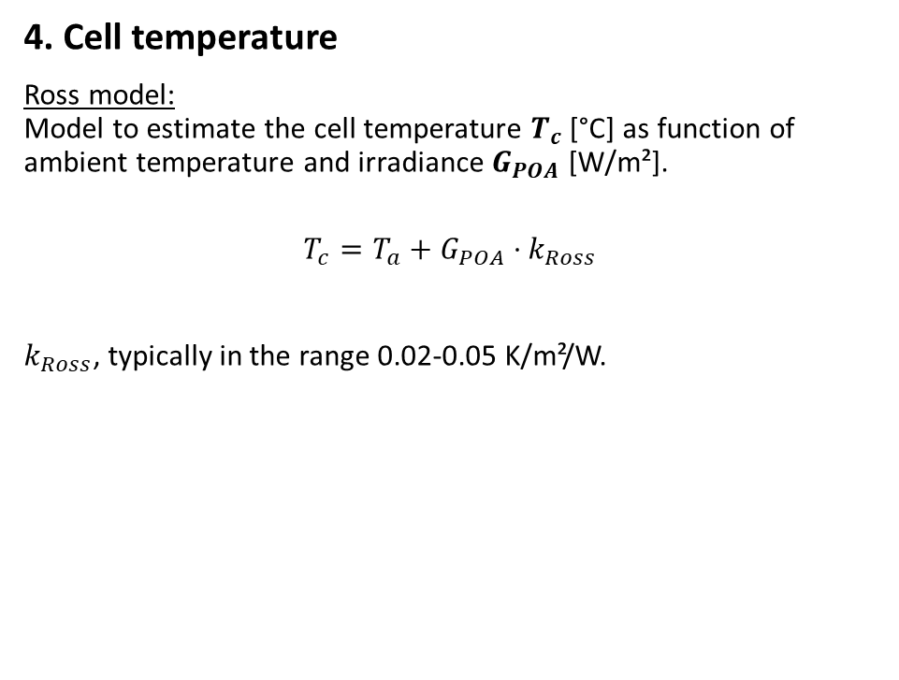
Modeling steps
4. Cell temperature
Ross model: Model to estimate the cell temperature $T_{c}$ [°C] as function of ambient temperature and irradiance $G_{POA}$ [W/m²].
$$T_{c}=T_{a}+G_{POA}⋅k_{Ross}$$
$k_{Ross}$, typically in the range 0.02-0.05 K/m²/W.
Ross, R. G. Jr., (1981). “Design Techniques for Flat-Plate Photovoltaic Arrays”

Slide 11

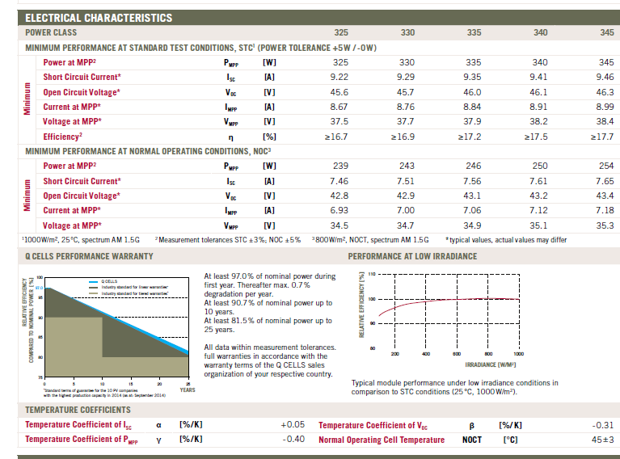
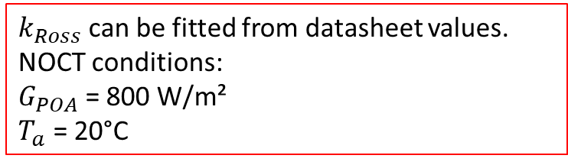
Modeling steps
$k_{Ross}$can be fitted from datasheet values. NOCT conditions: $G_{POA}$= 800 W/m²
$T_{a}$ = 20°C
4. Cell temperature
Ross model: Model to estimate the cell temperature $T_{c}$ [°C] as function of ambient temperature and irradiance $G_{POA}$ [W/m²].
$$T_{c}=T_{a}+G_{POA}⋅k_{Ross}$$
$k_{Ross}$, typically in the range 0.02-0.05 K/m²/W.
Ross, R. G. Jr., (1981). “Design Techniques for Flat-Plate Photovoltaic Arrays”

Slide 12
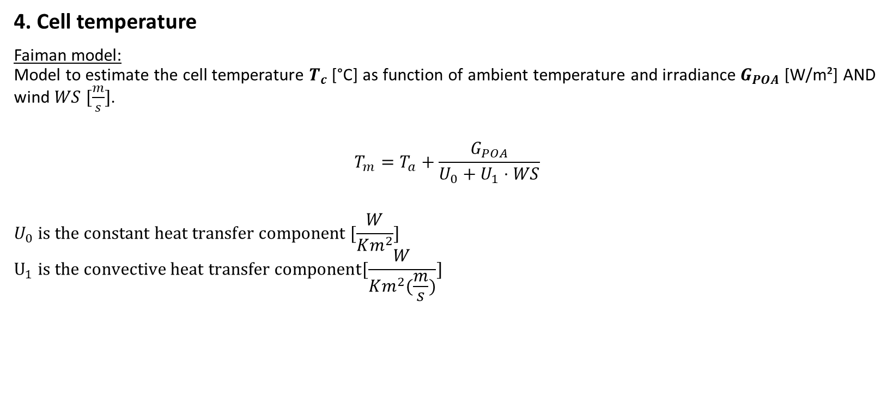
Modeling steps
4. Cell temperature
Faiman model: Model to estimate the cell temperature $T_{c}$ [°C] as function of ambient temperature and irradiance $G_{POA}$ [W/m²] AND wind $WS [\frac{m}{s}]$.
$$T_{m}=T_{a}+\frac{G_{POA}}{U_{0}+U_{1}⋅WS}$$
$$U_{0} is the constant heat transfer component [\frac{W}{Km^{2}}]$$
$$U_{1} is the convective heat transfer component[\frac{W}{Km^{2}(\frac{m}{s})}]$$
Faiman, D. (2008). Assessing the outdoor operating temperature of photovoltaic modules.

Slide 13
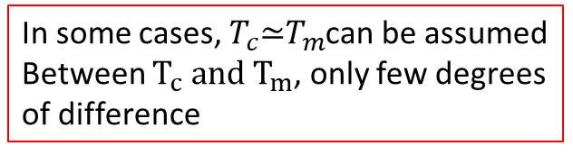
Modeling steps
4. Cell temperature
Faiman model: Model to estimate the cell temperature $T_{c}$ [°C] as function of ambient temperature and irradiance $G_{POA}$ [W/m²] AND wind $WS [\frac{m}{s}]$.
$$T_{m}=T_{a}+\frac{G_{POA}}{U_{0}+U_{1}⋅WS}$$
$$U_{0} is the constant heat transfer component [\frac{W}{Km^{2}}]$$
$$U_{1} is the convective heat transfer component[\frac{W}{Km^{2}(\frac{m}{s})}]$$
In some cases, $T_{c}\text{≃}T_{m}$can be assumed Between $T_{c} and T_{m}$, only few degrees of difference
Faiman, D. (2008). Assessing the outdoor operating temperature of photovoltaic modules.

Slide 14
Modeling steps
5. Module and String IV Curve

Slide 15
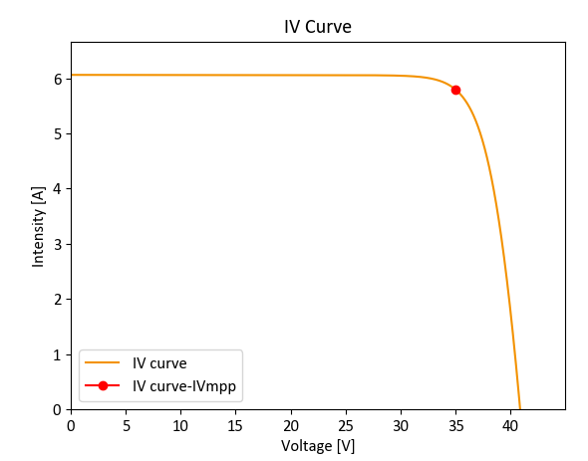
Modeling steps
5. Module and String IV Curve
For a fixed irradiance and module temperature, the PV module has its I, current which depends on V, voltage and it can take many operating points.

Slide 16
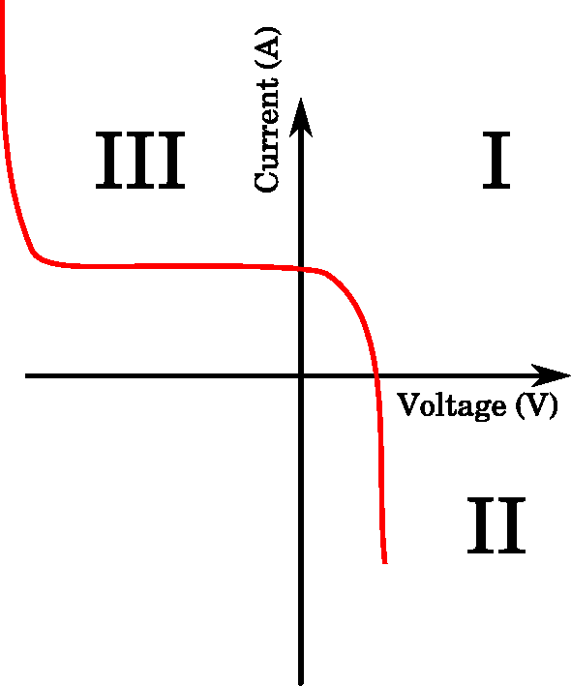
Modeling steps
5. Module and String IV Curve
For a fixed irradiance and module temperature, the PV module has its I, current which depends on V, voltage and it can take many operating points.
In reality, the IV characteristics go out of the 1st quadrant and the module can potentially consume power.

Slide 17
Modeling steps
5. Module and String IV Curve
For a fixed irradiance and module temperature, the PV module has its I, current which depends on V, voltage and it can take many operating points.
Then, the inverter is constantly searching for the operating point which maximizes the power MPP: Maximum Power Point.

Slide 18
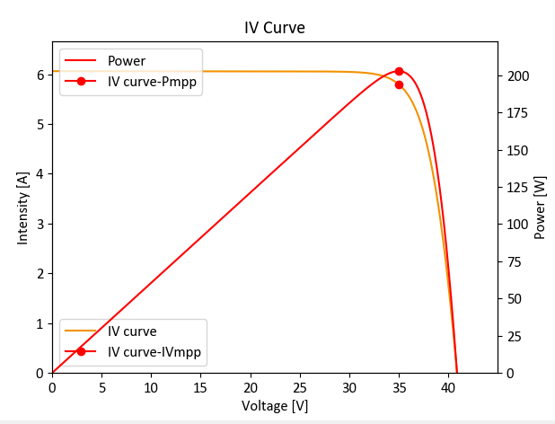
Modeling steps
5. Module and String IV Curve
For a fixed irradiance and module temperature, the PV module has its I, current which depends on V, voltage and it can take many operating points.
Then, the inverter is constantly searching for the operating point which maximizes the power MPP: Maximum Power Point.
Especially, it changes the voltage with the MPP-Tracker (MPPT) to maximize power.

Slide 19
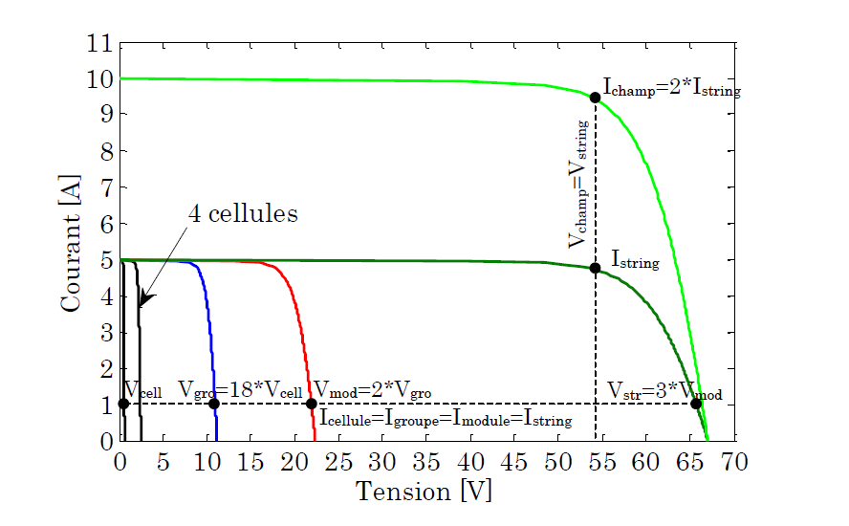
Modeling steps
5. Module and String IV Curve
By the way… the IV curves can be summed up when the modules are connected in series or parallel! The inverter, then, maximizes the power of the PV array IV curve.
Bun, L.. “Détection et localisation de défauts pour un système PV.” (2011).

Slide 20
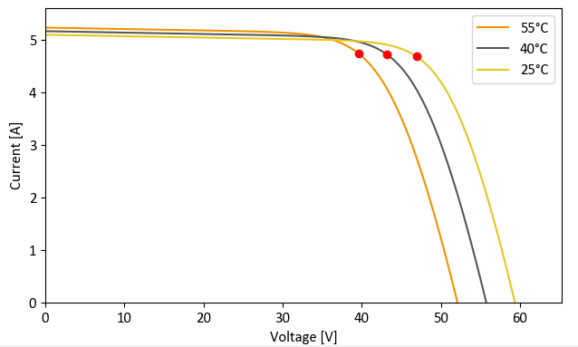
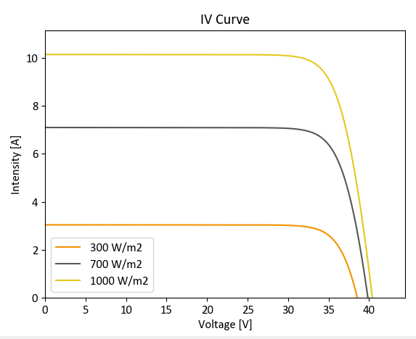
Modeling steps
Example of I-V curves as function of different module temperature
5. Module and String IV Curve
The IV curves' dependencies:
Higher cell temperatures mostly decrease the voltage
Higher irradiance level mostly increase the current
Example of I-V curves as function of different irradiances

Slide 21
Modeling steps
6. DC & Mismatch Losses
Not the focus of this class. However, keep in mind that:
DC wiring losses are around 0.5%-2%.
Mismatch losses refers to the fact that PV modules have different IV curves and this can entail significant losses.

Slide 22
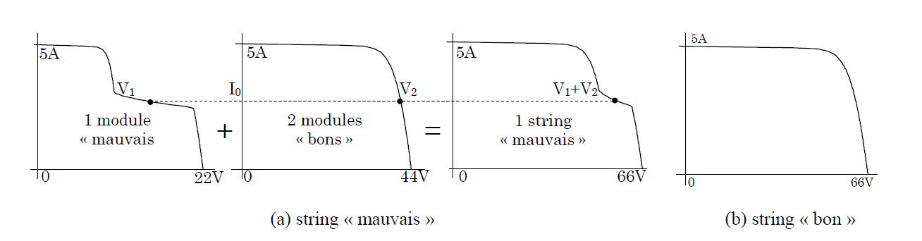
Modeling steps
6. DC & Mismatch Losses
Not the focus of this class. However, keep in mind that:
DC wiring losses are around 0.5%-2%.
Mismatch losses refers to the fact that PV modules have different IV curves and this can entail significant losses. For instance, if one of them has a very degraded IV curve (shading or other), it can significantly degrade the IV curve at the array level.
Bun, L.. “Détection et localisation de défauts pour un système PV.” (2011).

Slide 23
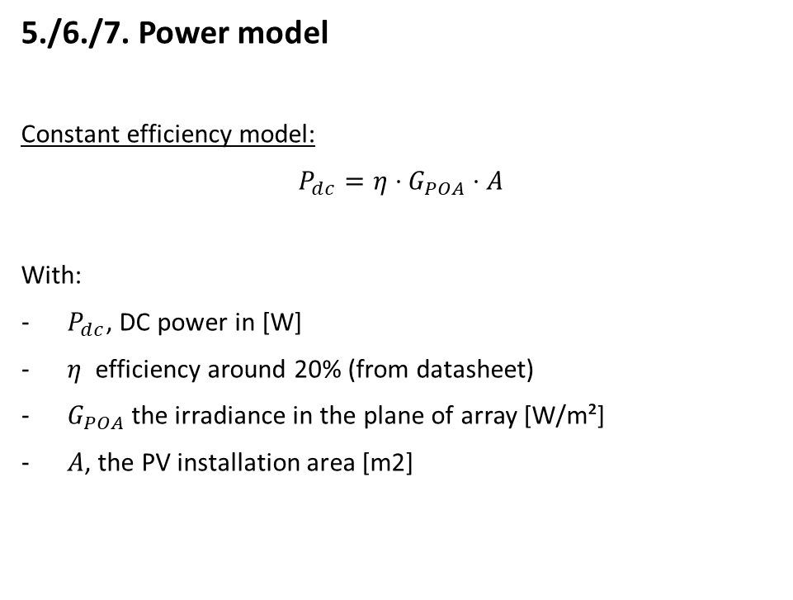
Modeling steps
5./6./7. Power model
Constant efficiency model:
$P_{dc}=η⋅G_{POA}⋅A$
With:
$P_{dc}$, DC power in [W]
$η$ efficiency around 20% (from datasheet)
$G_{POA}$ the irradiance in the plane of array [W/m²]
$A$, the PV installation area [m2]

Slide 24

Modeling steps
5./6./7. Power model
Constant efficiency model:
$P_{dc}=η⋅G_{POA}⋅A$
With:
$P_{dc}$, DC power in [W]
$η$ efficiency around 20% (from datasheet)
$G_{POA}$ the irradiance in the plane of array [W/m²]
$A$, the PV installation area [m2]
Not really precise for instantaneous values

Slide 25
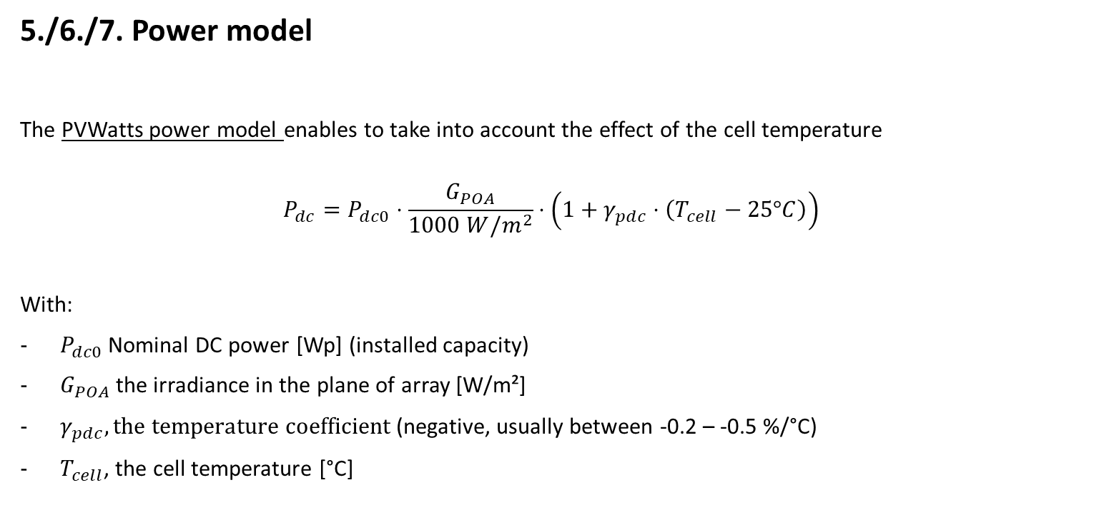
Modeling steps
5./6./7. Power model
The PVWatts power model enables to take into account the effect of the cell temperature
$$P_{dc}=P_{dc0}⋅\frac{G_{POA}}{1000 W/m^{2}}⋅\left(1+γ_{pdc}⋅\left(T_{cell}−25°C\right)\right)$$
With:
$P_{dc0}$ Nominal DC power [Wp] (installed capacity)
$G_{POA}$ the irradiance in the plane of array [W/m²]
$γ_{pdc}, the temperature coefficient$ (negative, usually between -0.2 – -0.5 %/°C)
$T_{cell}$, the cell temperature [°C]
PVWatts model: A. P. Dobos, “PVWatts Version 5 Manual” (2014).

Slide 26
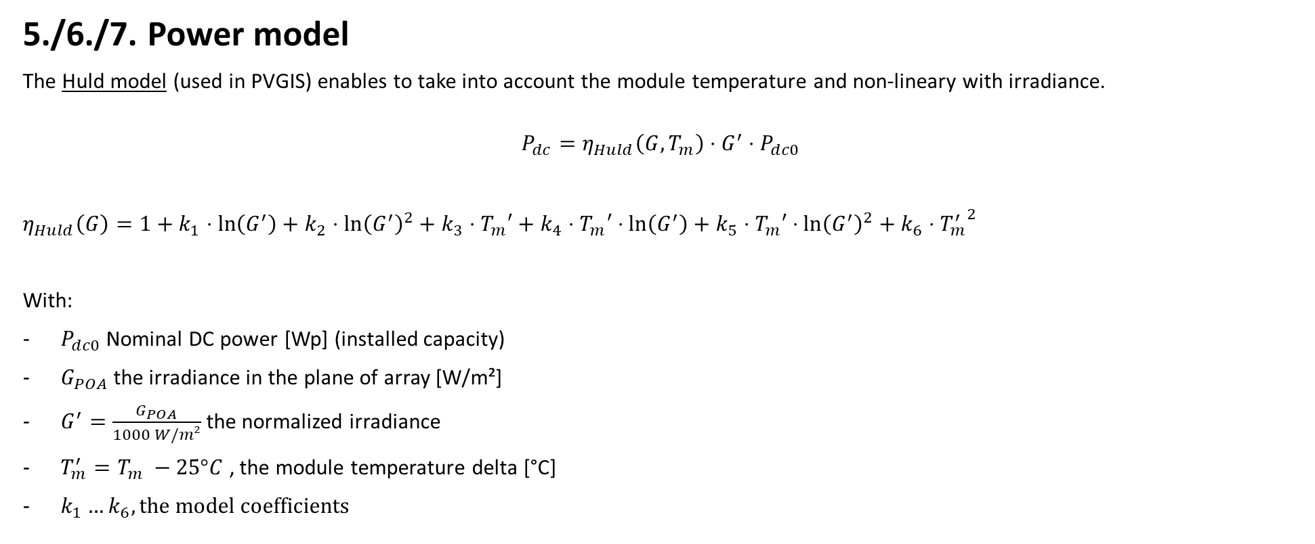
Modeling steps
5./6./7. Power model
The Huld model (used in PVGIS) enables to take into account the module temperature and non-lineary with irradiance.
$$P_{dc}=η_{Huld}\left(G, T_{m}\right)⋅G^{′}⋅P_{dc0}$$
$η_{Huld}\left(G\right)=1+k_{1}⋅\ln\left(G^{′}\right)+k_{2}$ $⋅\ln{{\left(G^{′}\right)}^{2}+k_{3}⋅T_{m}′+k_{4}⋅T_{m}′⋅\ln\left(G^{′}\right)+k_{5}⋅T_{m}′}$ $⋅\ln{{\left(G^{′}\right)}^{2}+k_{6}⋅{T_{m}^{′}}^{2}}$
With:
$P_{dc0}$ Nominal DC power [Wp] (installed capacity)
$G_{POA}$ the irradiance in the plane of array [W/m²]
$G^{′}=\frac{G_{POA}}{1000 W/m²}$ the normalized irradiance
$T_{m}^{′}=T_{m} −25°C$ , the module temperature delta [°C]
$k_{1}…k_{6}, the model$coefficients
Huld model: Thomas Huld et al., A power-rating model for crystalline silicon PV modules, 2011,

Slide 27
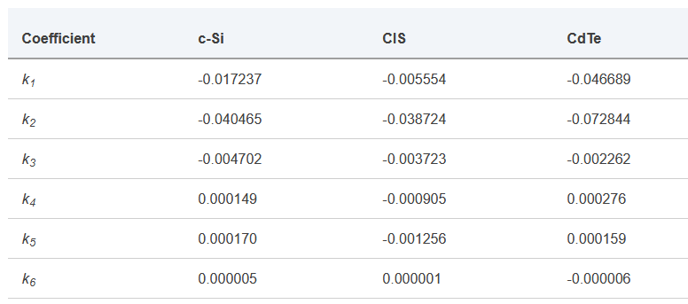
Modeling steps
5./6./7. Power model
The Huld model (used in PVGIS) enables to take into account the module temperature and non-lineary with irradiance.
$$P_{dc}=η_{Huld}\left(G, T_{m}\right)⋅G^{′}⋅P_{dc0}$$
$η_{Huld}\left(G\right)=1+k_{1}⋅\ln\left(G^{′}\right)+k_{2}$ $⋅\ln{{\left(G^{′}\right)}^{2}+k_{3}⋅T_{m}′+k_{4}⋅T_{m}′⋅\ln\left(G^{′}\right)+k_{5}⋅T_{m}′}$ $⋅\ln{{\left(G^{′}\right)}^{2}+k_{6}⋅{T_{m}^{′}}^{2}}$
With:
$P_{dc0}$ Nominal DC power [Wp] (installed capacity)
$G_{POA}$ the irradiance in the plane of array [W/m²]
$G^{′}=\frac{G_{POA}}{1000 W/m²}$ the normalized irradiance
$T_{m}^{′}=T_{m} −25°C$ , the module temperature delta [°C]
$k_{1}…k_{6}, the model$coefficients
Huld model: Thomas Huld et al., A power-rating model for crystalline silicon PV modules, 2011,

Slide 28
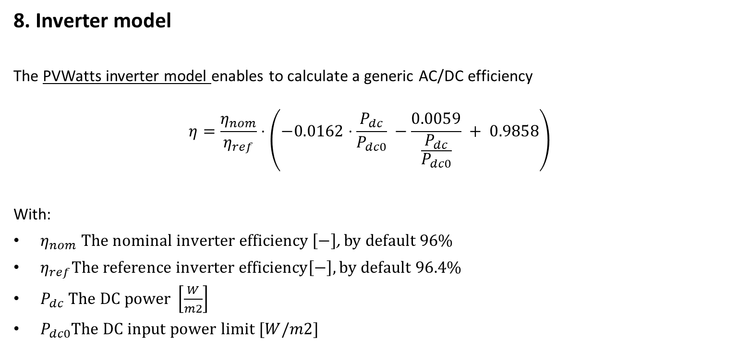
Modeling steps
8. Inverter model
The PVWatts inverter model enables to calculate a generic AC/DC efficiency
$$η=\frac{η_{nom}}{η_{ref}}⋅\left(−0.0162⋅\frac{P_{dc}}{P_{dc0}} −\frac{0.0059}{\frac{P_{dc}}{P_{dc0}}} + 0.9858\right)$$
With:
$η_{nom} The nominal inverter efficiency \left[−\right]$, by default 96%
$η_{ref}The reference inverter efficiency\left[−\right], by default 96.4\%$
$P_{dc} The DC power \left[\frac{W}{m2}\right]$
$P_{dc0}The DC input power limit [W/m2]$
PVWatts model: A. P. Dobos, “PVWatts Version 5 Manual” (2014).

Slide 29
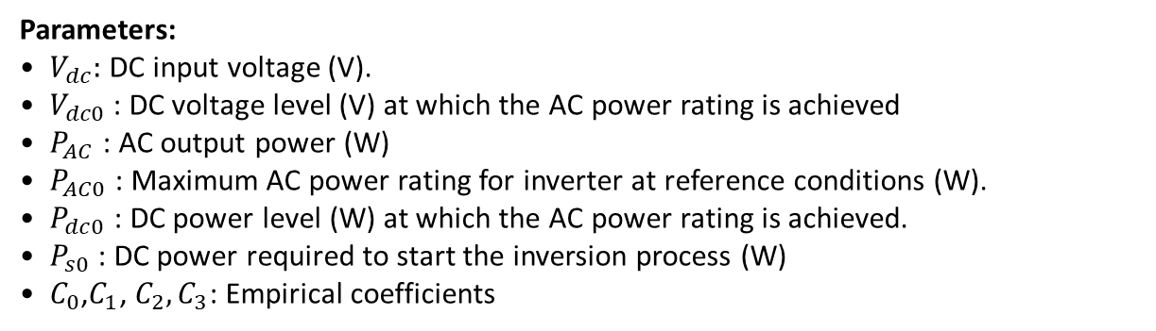

Modeling steps
8. Inverter model
The Sandia inverter model enables to include the voltage and be more precise
$$P_{AC}=\left[\frac{P_{AC0}}{A−B} −C⋅\left(A−B\right)\right]⋅\left(P_{dc}−B\right)+C⋅{\left[P_{dc}−B\right]}^{2}$$
Where:
$A=P_{dc0}⋅\left[1+C1⋅\left(V_{dc}−V_{dc0}\right)\right]$
$B=P_{s0}⋅\left[1+C2⋅\left(V_{dc}−V_{dc0}\right)\right]$
$A=C_{0}⋅\left[1+C3⋅\left(V_{dc}−V_{dc0}\right)\right]$
Parameters:
$V_{dc}:$DC input voltage (V).
$V_{dc0}$: DC voltage level (V) at which the AC power rating is achieved
$P_{AC}$: AC output power (W)
$P_{AC0}$: Maximum AC power rating for inverter at reference conditions (W).
$P_{dc0}$: DC power level (W) at which the AC power rating is achieved.
$P_{s0}$: DC power required to start the inversion process (W)
$C_{0}$,$C_{1}$, $C_{2},C_{3}$: Empirical coefficients
D. King, S. Gonzalez, G. Galbraith, W. Boyson, “Performance Model for Grid-Connected Photovoltaic Inverters”, SAND2007-5036, Sandia National Laboratories

Slide 30
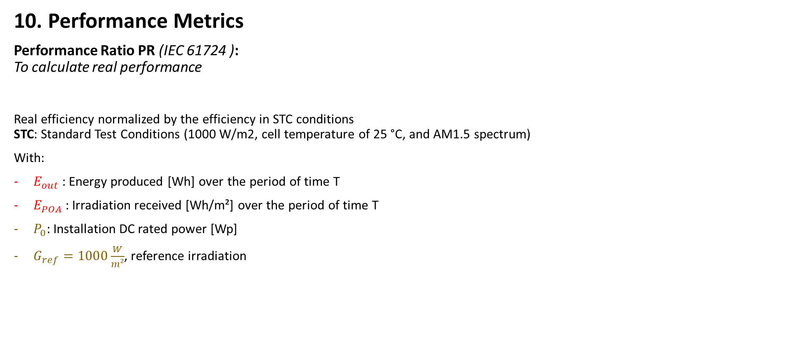

Modeling steps
10. Performance Metrics
Performance Ratio PR (IEC 61724 ): To calculate real performance
Real efficiency normalized by the efficiency in STC conditions STC: Standard Test Conditions (1000 W/m2, cell temperature of 25 °C, and AM1.5 spectrum)
With:
$E_{out}$: Energy produced [Wh] over the period of time T
$E_{POA}$: Irradiation received [Wh/m²] over the period of time T
$P_{0}$: Installation DC rated power [Wp]
$G_{ref}=1000\frac{W}{m²}$, reference irradiation
$$PR= \frac{E_{out}}{E_{POA}}/\frac{P_{0}}{G_{ref}}$$

Slide 31

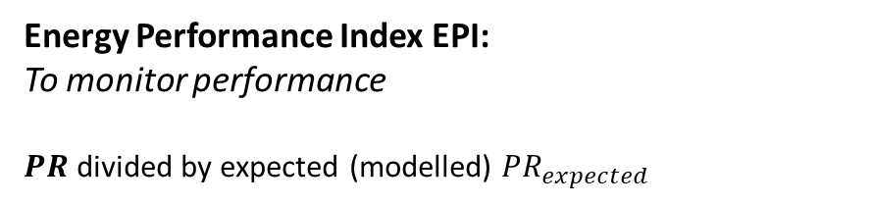

Modeling steps
10. Performance Metrics
Performance Ratio PR (IEC 61724 ): To calculate real performance
Real efficiency normalized by the efficiency in STC conditions STC: Standard Test Conditions (1000 W/m2, cell temperature of 25 °C, and AM1.5 spectrum)
With:
$E_{out}$: Energy produced [Wh] over the period of time T
$E_{POA}$: Irradiation received [Wh/m²] over the period of time T
$P_{0}$: Installation DC rated power [Wp]
$G_{ref}=1000\frac{W}{m²}$, reference irradiation
$$PR= \frac{E_{out}}{E_{POA}}/\frac{P_{0}}{G_{ref}}$$
Energy Performance Index EPI:
To monitor performance
𝑷𝑹 divided by expected (modelled) $PR_{expected}$
$$EPI=\frac{PR}{PR_{expected}}$$

Slide 32

Modeling steps
Time for some hands-on exercises !
Use the following notebook: https://github.com/AlexandreHugoMathieu/pvfault_detection_solar_academy/blob/master/notebooks/dc_power_estimation.ipynb
Follow the python tutorial and estimate the AC power for one year.

Slide 33
Resources
Modeling guide PVPMC: https://pvpmc.sandia.gov/modeling-guide/
Python / Pvlib tutorial: https://pvsc-python-tutorials.github.io/PVSC48-Python-Tutorial/
To go further:
The Use of Advanced Algorithms in PV Failure Monitoring: https://iea-pvps.org/wp-content/uploads/2021/10/Final-Report-IEA-PVPS-T13-19_2021_PV-Failure-Monitoring.pdf

Slide 34
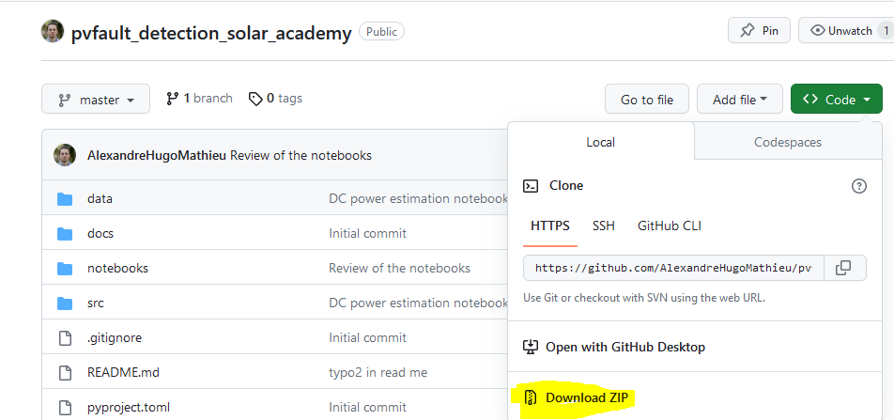
Appendix
How to install Python and import the course repository to use the notebooks on your local PC.
Install python: www.python.org/downloads/, download and install the 3.9.13 “release” (Add python to your Path)
Go to https://github.com/AlexandreHugoMathieu/pvfault_detection_solar_academy, click on the green “Code” button and then download the folder as the zip

Slide 35
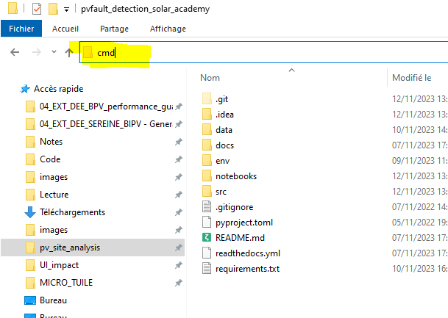
Appendix
How to install Python and import the course repository to use the notebooks on your local PC.
Install python: www.python.org/downloads/, download and install the 3.9.13 “release” (Add python to your Path)
Go to https://github.com/AlexandreHugoMathieu/pvfault_detection_solar_academy, click on the green “Code” button and then download the folder as the zip
Unzip it and put it in adequate location in your PC.
Let’s create a virtual environment where you will find all the functions for this course:
Go in the folder and open the command line from that same folder by writing “cmd” in the path bar (with Windows)

Slide 36
Appendix
How to install Python and import the course repository to use the notebooks on your local PC.
Install python: www.python.org/downloads/, download and install the 3.9.13 “release” (Add python to your Path)
Go to https://github.com/AlexandreHugoMathieu/pvfault_detection_solar_academy, click on the green “Code” button and then download the folder as the zip
Unzip it and put it in adequate location in your PC.
Let’s create a virtual environment where you will find all the functions for this course:
Go in the folder and open the command line from that same folder by writing “cmd” in the path bar (with Windows)
In the command bar: execute the following line to create the “solar_env” environnement that you will use in your notebooks
“pip install virtualenv”
“python –m virtualenv solar_env”
“call solar_env\Scripts\activate” (you should have a ‘solar_env’ on the left of the command at this point)
“pip install –r requirements.txt” (load all the libraries, take a little time, be patient)
“python -m ipykernel install --name=solarkernel” (create a kernel for the notebooks)
It’s ready !

Slide 37
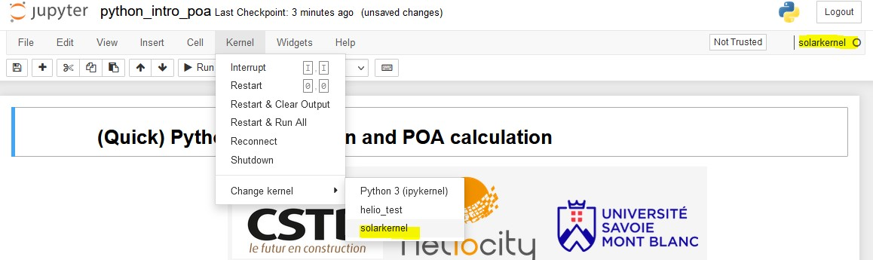
Appendix
How to start a notebook
Go in the folder and open the command line from that same folder by writing “cmd” in the path bar (with Windows)
In the command bar, exexute:
“call solar_env\Scripts\activate” (go in the virtual env)
“jupyter notebook” (open the notebooks browser)
3. Browse to the notebooks folder, choose one and pick the solarkernel when asked.

