Slide 1



Operational research for urban solar development
“PV failure detection based on operational time series”
02/12/2024
Alexandre Mathieu

Slide 2
Curriculum
Day | Time | Duration | Content
Wednesday 13/11/2024 | 11h15-12h45 14h15-15h45 | 1h30 + 1h30 | 50% Lecture / 50 % Hands-on
Tuesday 26/11/2024 | 9h45-13h00 | 1h30 + 1h30 | 25% Lecture / 75 % Hands-on
Monday 02/12/2024 | 13h15-16h15 | 3h | 15% Lecture / 85 % Hands-on
Monday 09/12/2024 | 8h-11h 13h15-16h15 | 6h | 10% Lecture / 90 % Hands-on/Project
Tuesday 10/12/2024 | 8h-11h | 3h | 10% Lecture / 90 % Project
Monday 16/12/2024 | 8-11h | 3h | 10% Lecture / 90 % Project
Thursday 19/12/2024 | 9h45-12h45 | 3h | 10% Lecture / 90 % Project
Monday 06/01/2025 | 13h15-14h45 | 1h30 | 100% Project
Monday 13/01/2025 | 9h45-11h45 | 1h30 | 100% Project
Total |  | 27h
Plan

Slide 3
Agenda
Review notebook last week
PV performance model steps

Slide 4
Agenda
Review notebook last week
PV performance model steps

Slide 5
Review first notebook
Notebook recap 26/11/2024
Google collab link: https://colab.research.google.com/drive/1hB1pmBw-n7RiS99vCHQi2OKicfcQxpcO?usp=sharing
Correction: https://github.com/AlexandreHugoMathieu/pvfault_detection_solar_academy/blob/master/notebooks/python_intro2_horizon_mask.ipynb

Slide 6
Modeling steps
import matplotlib.pyplot as plt
# Apply filters
filter_1 = weather_data["ghi"] > 800
filter_2 = (weather_data.index > pd.to_datetime("20220701").tz_localize("CET"))
filter = (filter_1) & (filter_2) # Combine with a “and” condition
weather_data.loc[filter, "dhi"] # Select only the rows which fulfills the filter condition
and show the DHI column from weather_data
# If statement
a=1
if a<0: # assertion: is "a" under 0 ? Do not forget the “:” at the end of the line
print("a is lower than 0") # Line non-executed since the assertion above is wrong, do not forget the “tab” indentation after a “if”
# Loop over all elements of a list or pd.Series which allow to perform task on each of the element
For element in [“a”,”b”]:
print(element)
for index, row in df.iterrows(): # Loop over all rows and index of the dataframe one by one
print(row["column1"] + row["column2"])
# Plot with matplotlib plt.plot(x, y, linewidth=0, marker="o") # scatter plot with no line in that case
Notebook recap 26/11/2024
Python commands

Slide 7
Agenda
Review notebook last week
PV performance model steps

Slide 8
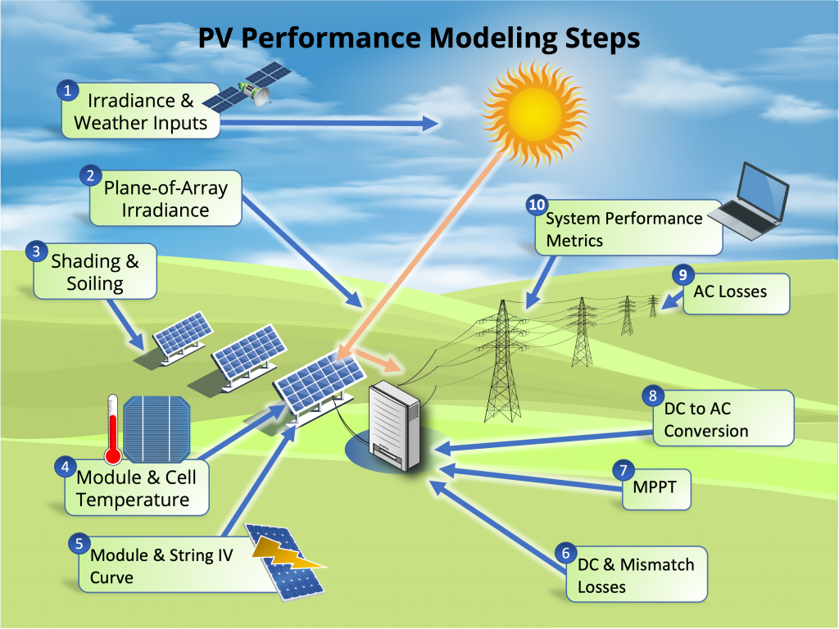
Modeling steps
4. Module and Cell temperature
The hotter a module is, the less efficient it is !

Slide 9
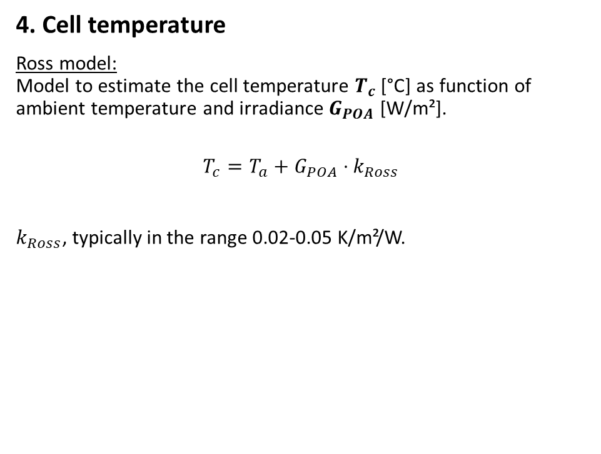
Modeling steps
4. Cell temperature
Ross model: Model to estimate the cell temperature $T_{c}$ [°C] as function of ambient temperature and irradiance $G_{POA}$ [W/m²].
$$T_{c}=T_{a}+G_{POA}⋅k_{Ross}$$
$k_{Ross}$, typically in the range 0.02-0.05 K/m²/W.
Ross, R. G. Jr., (1981). “Design Techniques for Flat-Plate Photovoltaic Arrays”

Slide 10

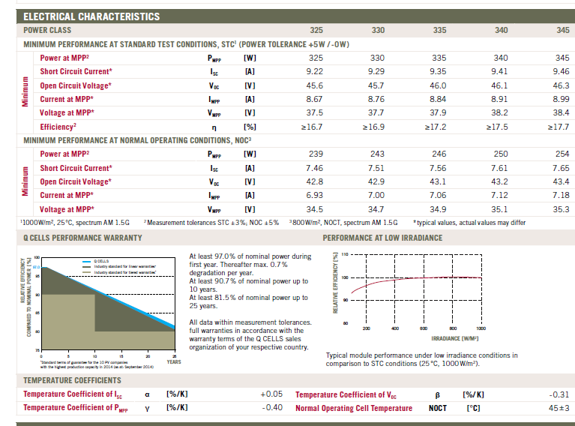
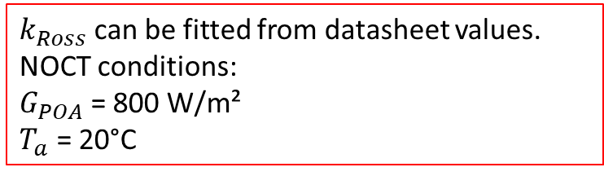
Modeling steps
$k_{Ross}$can be fitted from datasheet values. NOCT conditions: $G_{POA}$= 800 W/m²
$T_{a}$ = 20°C
4. Cell temperature
Ross model: Model to estimate the cell temperature $T_{c}$ [°C] as function of ambient temperature and irradiance $G_{POA}$ [W/m²].
$$T_{c}=T_{a}+G_{POA}⋅k_{Ross}$$
$k_{Ross}$, typically in the range 0.02-0.05 K/m²/W.
Ross, R. G. Jr., (1981). “Design Techniques for Flat-Plate Photovoltaic Arrays”

Slide 11
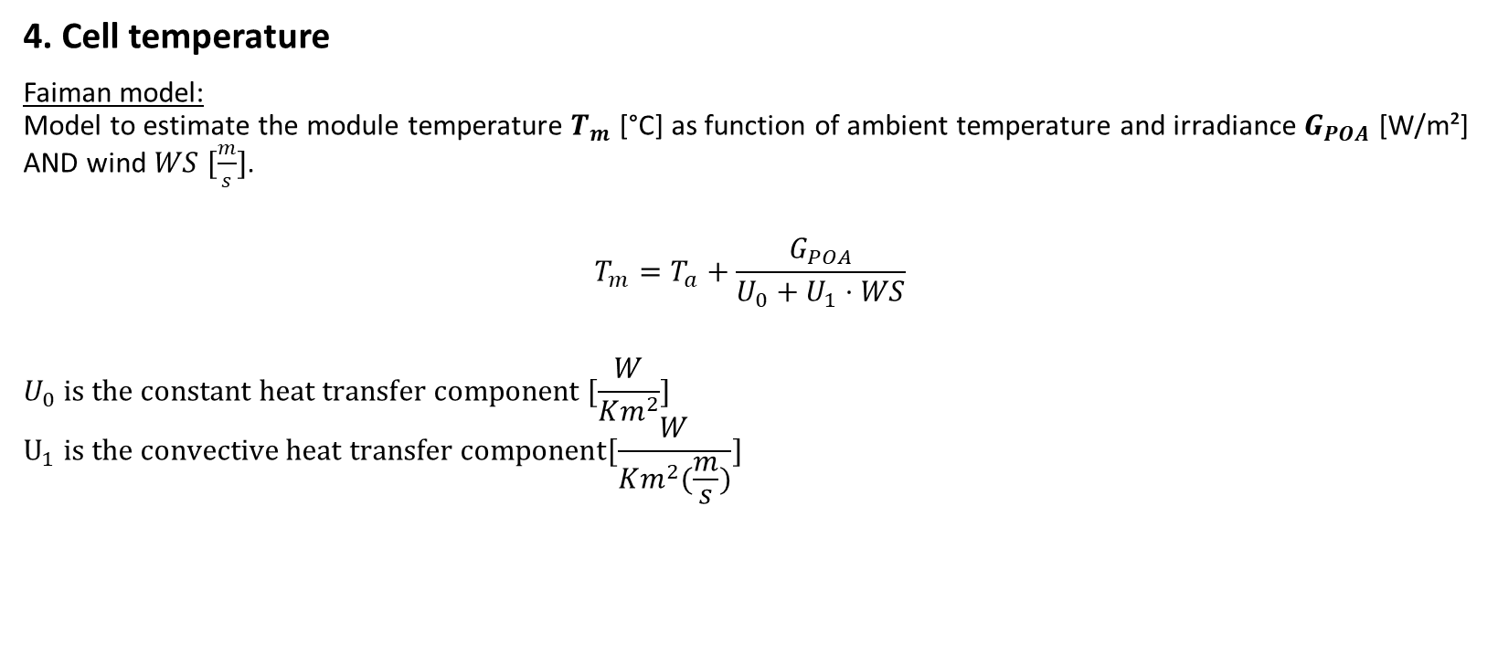
Modeling steps
4. Cell temperature
Faiman model: Model to estimate the module temperature $T_{m}$ [°C] as function of ambient temperature and irradiance $G_{POA}$ [W/m²] AND wind $WS [\frac{m}{s}]$.
$$T_{m}=T_{a}+\frac{G_{POA}}{U_{0}+U_{1}⋅WS}$$
$$U_{0} is the constant heat transfer component [\frac{W}{Km^{2}}]$$
$$U_{1} is the convective heat transfer component[\frac{W}{Km^{2}(\frac{m}{s})}]$$
Faiman, D. (2008). Assessing the outdoor operating temperature of photovoltaic modules.

Slide 12
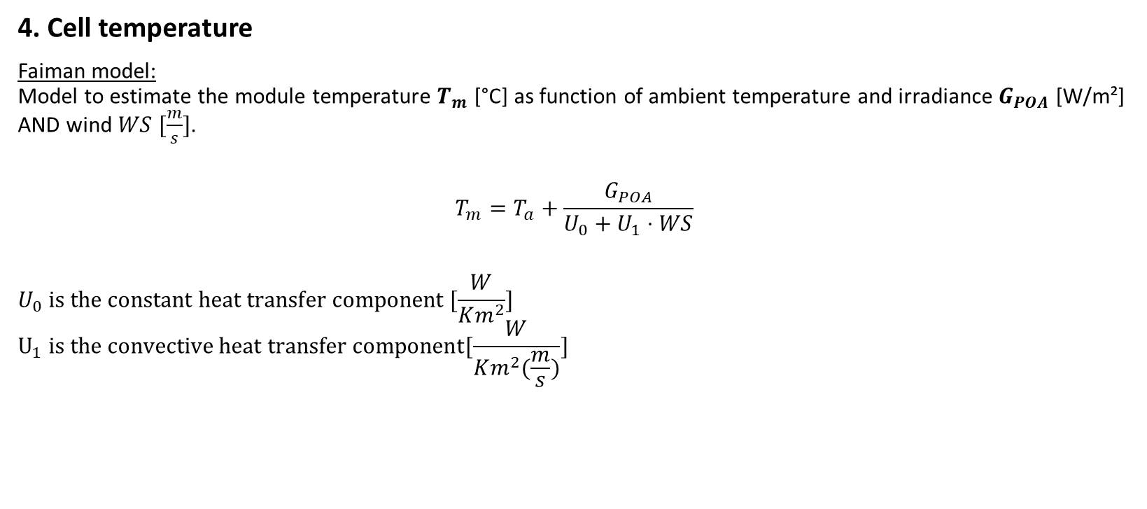
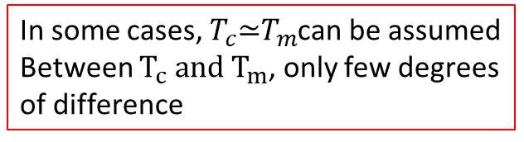
Modeling steps
4. Cell temperature
Faiman model: Model to estimate the module temperature $T_{m}$ [°C] as function of ambient temperature and irradiance $G_{POA}$ [W/m²] AND wind $WS [\frac{m}{s}]$.
$$T_{m}=T_{a}+\frac{G_{POA}}{U_{0}+U_{1}⋅WS}$$
$$U_{0} is the constant heat transfer component [\frac{W}{Km^{2}}]$$
$$U_{1} is the convective heat transfer component[\frac{W}{Km^{2}(\frac{m}{s})}]$$
In some cases, $T_{c}\text{≃}T_{m}$can be assumed Between $T_{c} and T_{m}$, only few degrees of difference
Faiman, D. (2008). Assessing the outdoor operating temperature of photovoltaic modules.

Slide 13
Modeling steps
5. Module and String IV Curve

Slide 14
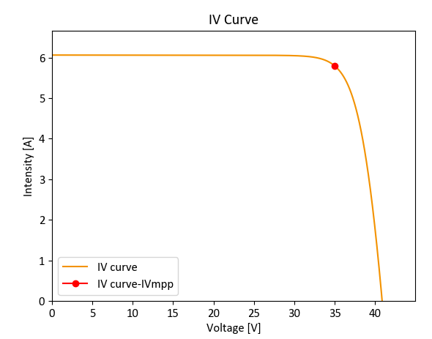
Modeling steps
5. Module and String IV Curve
For a fixed irradiance and module temperature, the PV module has its I, current which depends on V, voltage and it can take many operating points.

Slide 15
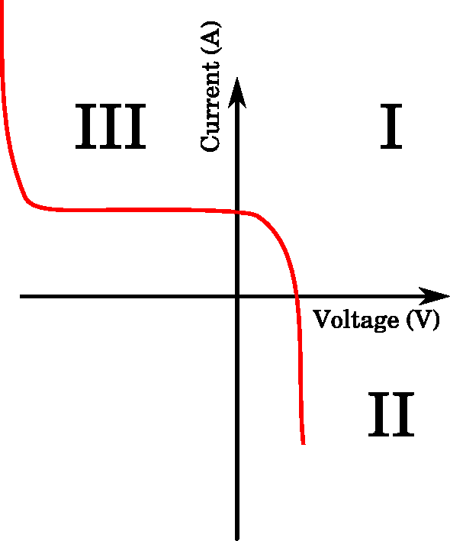
Modeling steps
5. Module and String IV Curve
For a fixed irradiance and module temperature, the PV module has its I, current which depends on V, voltage and it can take many operating points.
In reality, the IV characteristics go out of the 1st quadrant and the module can potentially consume power.

Slide 16
Modeling steps
5. Module and String IV Curve
For a fixed irradiance and module temperature, the PV module has its I, current which depends on V, voltage and it can take many operating points.
Then, the inverter is constantly searching for the operating point which maximizes the power MPP: Maximum Power Point.

Slide 17
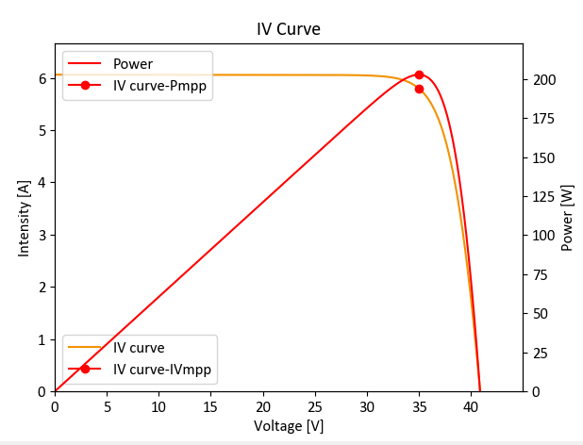
Modeling steps
5. Module and String IV Curve
For a fixed irradiance and module temperature, the PV module has its I, current which depends on V, voltage and it can take many operating points.
Then, the inverter is constantly searching for the operating point which maximizes the power MPP: Maximum Power Point.
Especially, it changes the voltage with the MPP-Tracker (MPPT) to maximize power.

Slide 18
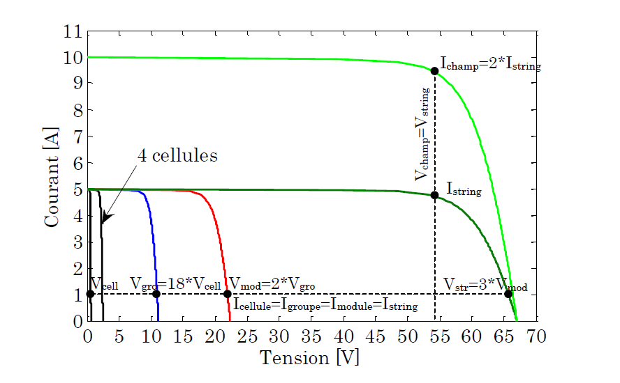
Modeling steps
5. Module and String IV Curve
By the way… the IV curves can be summed up when the modules are connected in series or parallel! The inverter, then, maximizes the power of the PV array IV curve.
Bun, L.. “Détection et localisation de défauts pour un système PV.” (2011).

Slide 19
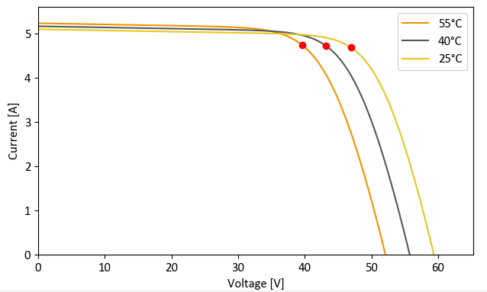
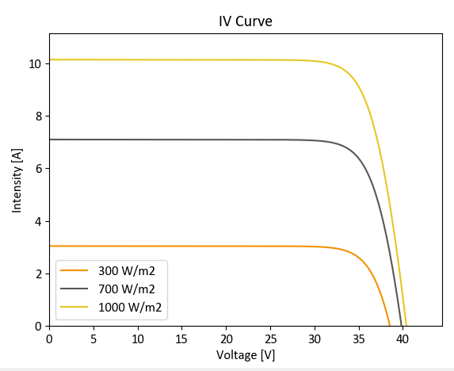
Modeling steps
Example of I-V curves as function of different module temperature
5. Module and String IV Curve
The IV curves' dependencies:
Higher cell temperatures mostly decrease the voltage
Higher irradiance level mostly increase the current
Example of I-V curves as function of different irradiances

Slide 20
Modeling steps
6. DC & Mismatch Losses
Not the focus of this class. However, keep in mind that:
DC wiring losses are around 0.5%-2%.
Mismatch losses refers to the fact that PV modules have different IV curves and this can entail significant losses.

Slide 21
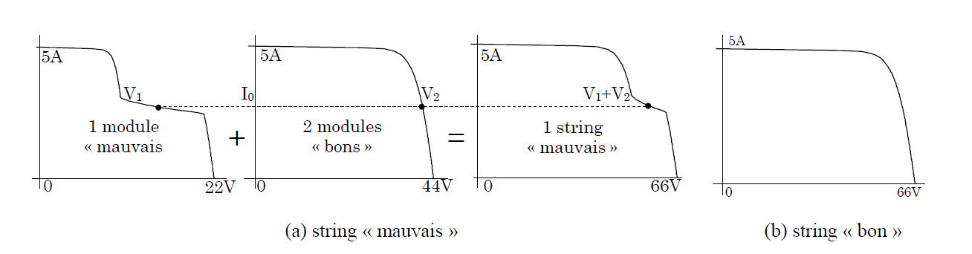
Modeling steps
6. DC & Mismatch Losses
Not the focus of this class. However, keep in mind that:
DC wiring losses are around 0.5%-2%.
Mismatch losses refers to the fact that PV modules have different IV curves and this can entail significant losses. For instance, if one of them has a very degraded IV curve (shading or other), it can significantly degrade the IV curve at the array level.
Bun, L.. “Détection et localisation de défauts pour un système PV.” (2011).

Slide 22
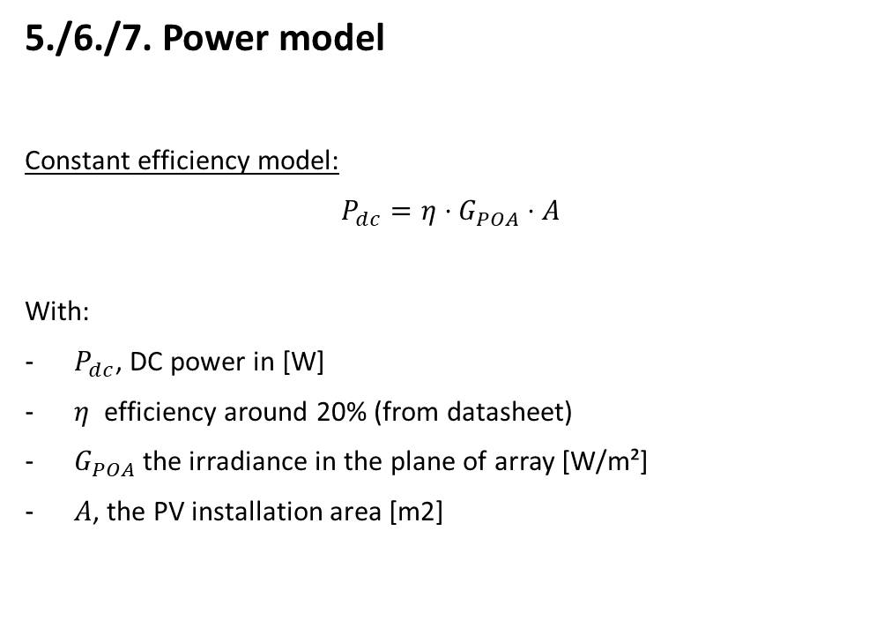
Modeling steps
5./6./7. Power model
Constant efficiency model:
$P_{dc}=η⋅G_{POA}⋅A$
With:
$P_{dc}$, DC power in [W]
$η$ efficiency around 20% (from datasheet)
$G_{POA}$ the irradiance in the plane of array [W/m²]
$A$, the PV installation area [m2]

Slide 23

Modeling steps
5./6./7. Power model
Constant efficiency model:
$P_{dc}=η⋅G_{POA}⋅A$
With:
$P_{dc}$, DC power in [W]
$η$ efficiency around 20% (from datasheet)
$G_{POA}$ the irradiance in the plane of array [W/m²]
$A$, the PV installation area [m2]
Not really precise for instantaneous values

Slide 24
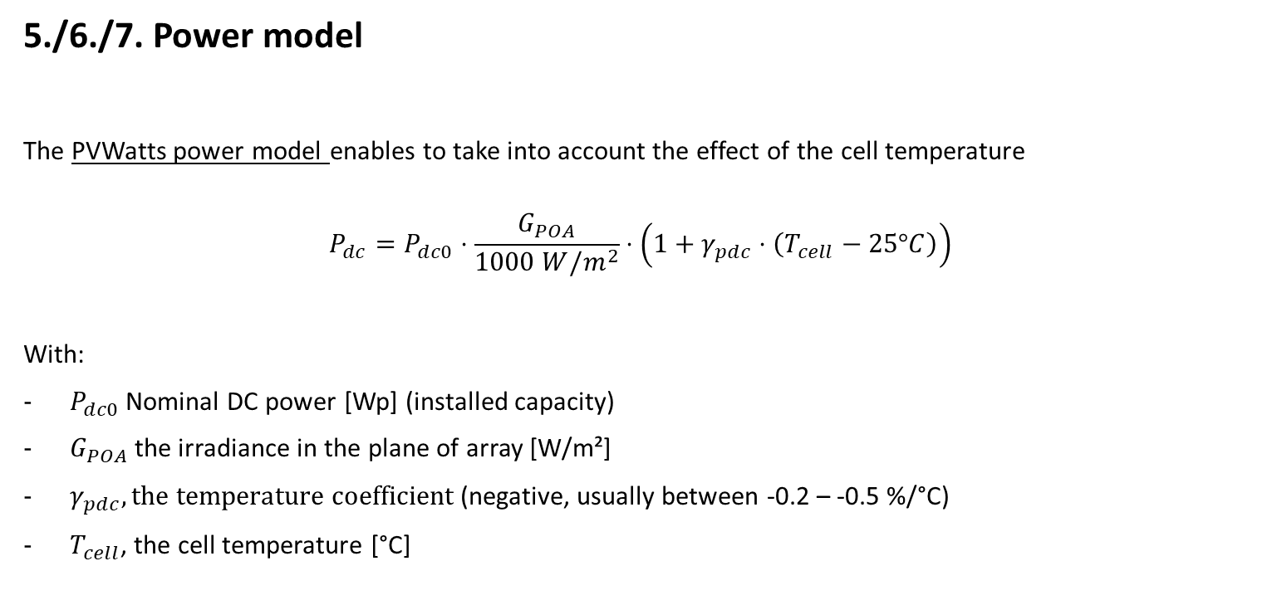
Modeling steps
5./6./7. Power model
The PVWatts power model enables to take into account the effect of the cell temperature
$$P_{dc}=P_{dc0}⋅\frac{G_{POA}}{1000 W/m^{2}}⋅\left(1+γ_{pdc}⋅\left(T_{cell}−25°C\right)\right)$$
With:
$P_{dc0}$ Nominal DC power [Wp] (installed capacity)
$G_{POA}$ the irradiance in the plane of array [W/m²]
$γ_{pdc}, the temperature coefficient$ (negative, usually between -0.2 – -0.5 %/°C)
$T_{cell}$, the cell temperature [°C]
PVWatts model: A. P. Dobos, “PVWatts Version 5 Manual” (2014).

Slide 25
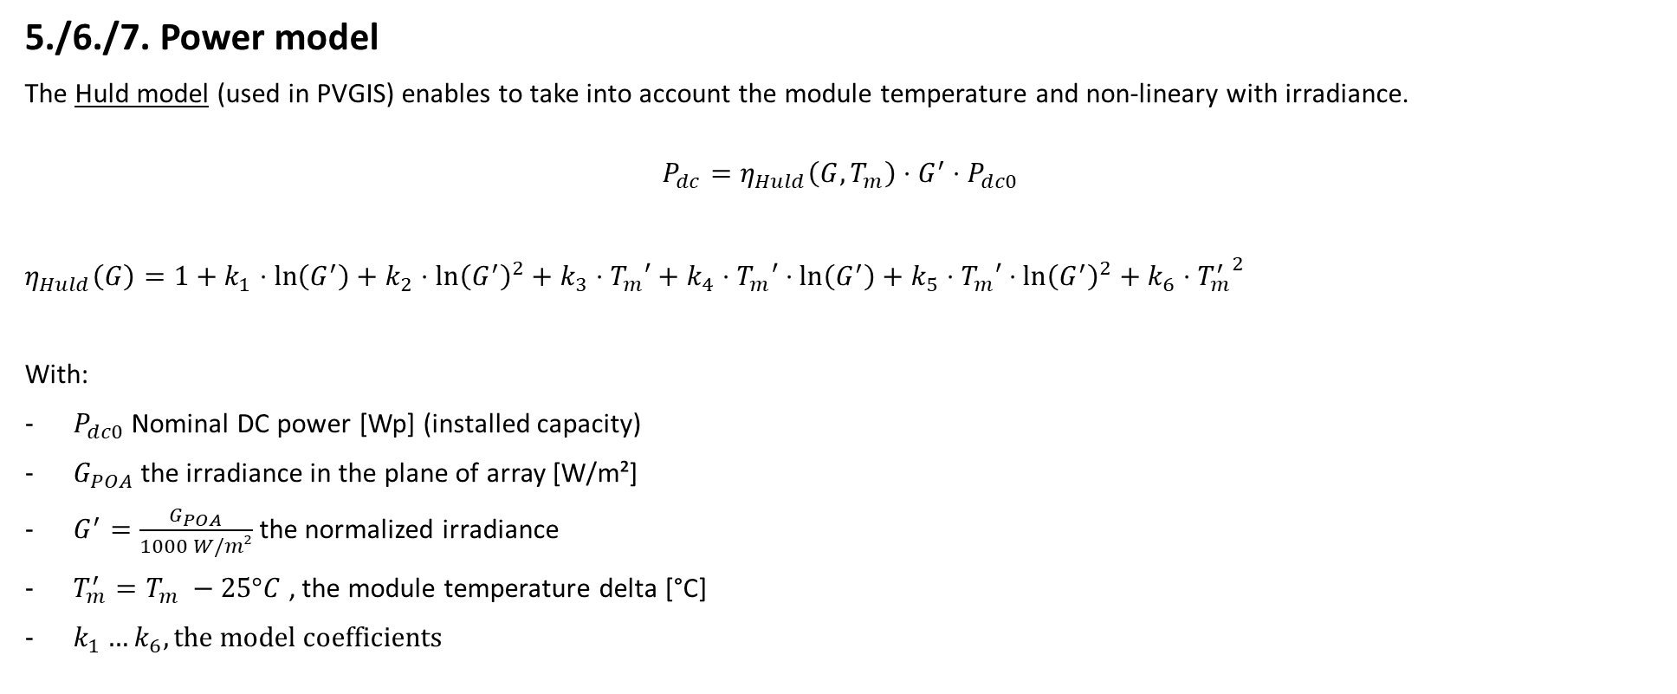
Modeling steps
5./6./7. Power model
The Huld model (used in PVGIS) enables to take into account the module temperature and non-lineary with irradiance.
$$P_{dc}=η_{Huld}\left(G, T_{m}\right)⋅G^{′}⋅P_{dc0}$$
$η_{Huld}\left(G\right)=1+k_{1}⋅\ln\left(G^{′}\right)+k_{2}$ $⋅\ln{{\left(G^{′}\right)}^{2}+k_{3}⋅T_{m}′+k_{4}⋅T_{m}′⋅\ln\left(G^{′}\right)+k_{5}⋅T_{m}′}$ $⋅\ln{{\left(G^{′}\right)}^{2}+k_{6}⋅{T_{m}^{′}}^{2}}$
With:
$P_{dc0}$ Nominal DC power [Wp] (installed capacity)
$G_{POA}$ the irradiance in the plane of array [W/m²]
$G^{′}=\frac{G_{POA}}{1000 W/m²}$ the normalized irradiance
$T_{m}^{′}=T_{m} −25°C$ , the module temperature delta [°C]
$k_{1}…k_{6}, the model$coefficients
Huld model: Thomas Huld et al., A power-rating model for crystalline silicon PV modules, 2011,

Slide 26
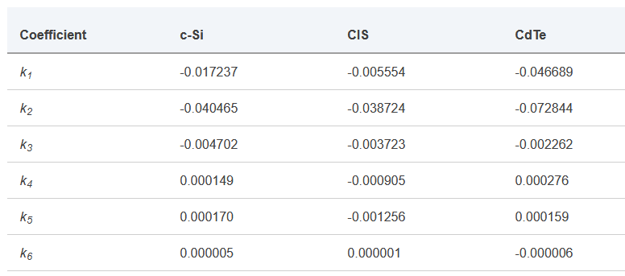
Modeling steps
5./6./7. Power model
The Huld model (used in PVGIS) enables to take into account the module temperature and non-lineary with irradiance.
$$P_{dc}=η_{Huld}\left(G, T_{m}\right)⋅G^{′}⋅P_{dc0}$$
$η_{Huld}\left(G\right)=1+k_{1}⋅\ln\left(G^{′}\right)+k_{2}$ $⋅\ln{{\left(G^{′}\right)}^{2}+k_{3}⋅T_{m}′+k_{4}⋅T_{m}′⋅\ln\left(G^{′}\right)+k_{5}⋅T_{m}′}$ $⋅\ln{{\left(G^{′}\right)}^{2}+k_{6}⋅{T_{m}^{′}}^{2}}$
With:
$P_{dc0}$ Nominal DC power [Wp] (installed capacity)
$G_{POA}$ the irradiance in the plane of array [W/m²]
$G^{′}=\frac{G_{POA}}{1000 W/m²}$ the normalized irradiance
$T_{m}^{′}=T_{m} −25°C$ , the module temperature delta [°C]
$k_{1}…k_{6}, the model$coefficients
PVGIS coefficients
Huld model: Thomas Huld et al., A power-rating model for crystalline silicon PV modules, 2011,

Slide 27
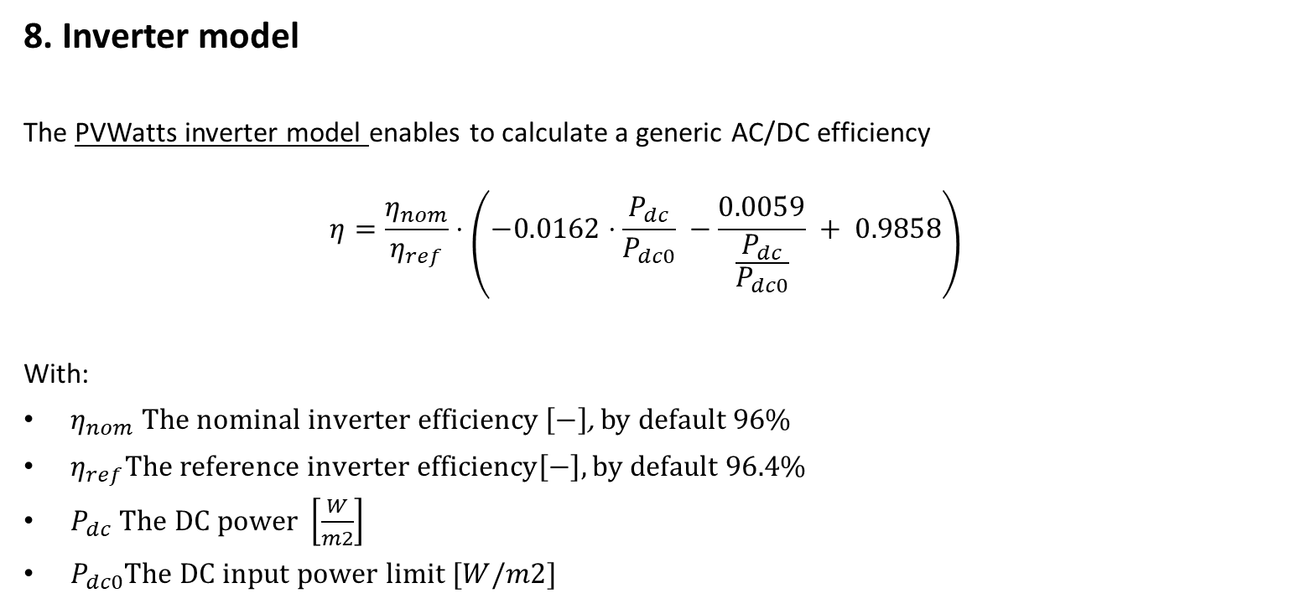
Modeling steps
8. Inverter model
The PVWatts inverter model enables to calculate a generic AC/DC efficiency
$$η=\frac{η_{nom}}{η_{ref}}⋅\left(−0.0162⋅\frac{P_{dc}}{P_{dc0}} −\frac{0.0059}{\frac{P_{dc}}{P_{dc0}}} + 0.9858\right)$$
With:
$η_{nom} The nominal inverter efficiency \left[−\right]$, by default 96%
$η_{ref}The reference inverter efficiency\left[−\right], by default 96.4\%$
$P_{dc} The DC power \left[\frac{W}{m2}\right]$
$P_{dc0}The DC input power limit [W/m2]$
PVWatts model: A. P. Dobos, “PVWatts Version 5 Manual” (2014).

Slide 28
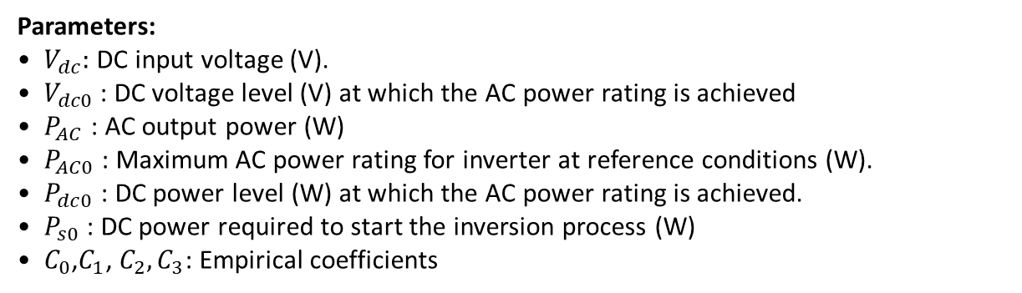

Modeling steps
8. Inverter model
The Sandia inverter model enables to include the voltage and be more precise
$$P_{AC}=\left[\frac{P_{AC0}}{A−B} −C⋅\left(A−B\right)\right]⋅\left(P_{dc}−B\right)+C⋅{\left[P_{dc}−B\right]}^{2}$$
Where:
$A=P_{dc0}⋅\left[1+C1⋅\left(V_{dc}−V_{dc0}\right)\right]$
$B=P_{s0}⋅\left[1+C2⋅\left(V_{dc}−V_{dc0}\right)\right]$
$A=C_{0}⋅\left[1+C3⋅\left(V_{dc}−V_{dc0}\right)\right]$
Parameters:
$V_{dc}:$DC input voltage (V).
$V_{dc0}$: DC voltage level (V) at which the AC power rating is achieved
$P_{AC}$: AC output power (W)
$P_{AC0}$: Maximum AC power rating for inverter at reference conditions (W).
$P_{dc0}$: DC power level (W) at which the AC power rating is achieved.
$P_{s0}$: DC power required to start the inversion process (W)
$C_{0}$,$C_{1}$, $C_{2},C_{3}$: Empirical coefficients
D. King, S. Gonzalez, G. Galbraith, W. Boyson, “Performance Model for Grid-Connected Photovoltaic Inverters”, SAND2007-5036, Sandia National Laboratories

Slide 29
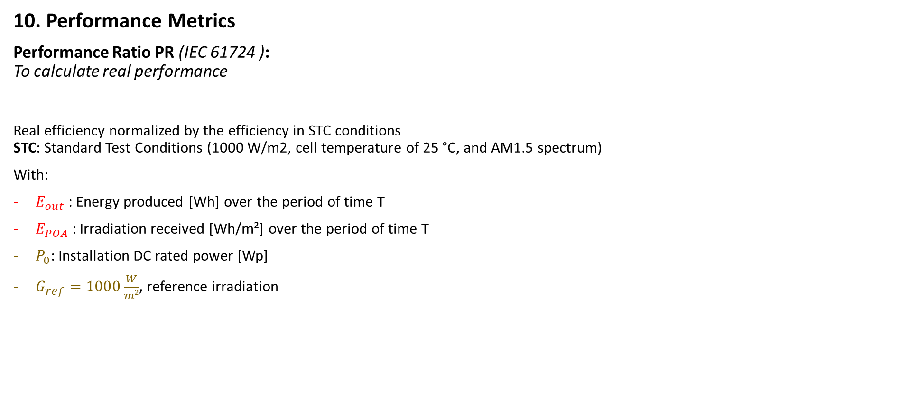

Modeling steps
10. Performance Metrics
Performance Ratio PR (IEC 61724 ): To calculate real performance
Real efficiency normalized by the efficiency in STC conditions STC: Standard Test Conditions (1000 W/m2, cell temperature of 25 °C, and AM1.5 spectrum)
With:
$E_{out}$: Energy produced [Wh] over the period of time T
$E_{POA}$: Irradiation received [Wh/m²] over the period of time T
$P_{0}$: Installation DC rated power [Wp]
$G_{ref}=1000\frac{W}{m²}$, reference irradiation
$$PR= \frac{E_{out}}{E_{POA}}/\frac{P_{0}}{G_{ref}}$$

Slide 30

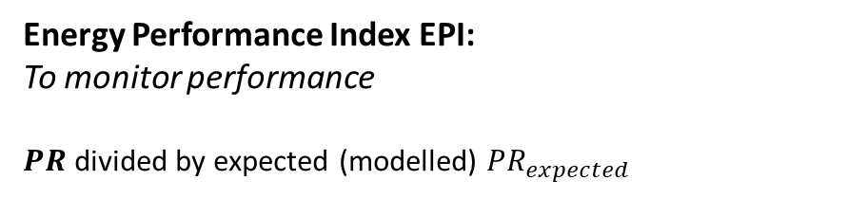

Modeling steps
10. Performance Metrics
Performance Ratio PR (IEC 61724 ): To calculate real performance
Real efficiency normalized by the efficiency in STC conditions STC: Standard Test Conditions (1000 W/m2, cell temperature of 25 °C, and AM1.5 spectrum)
With:
$E_{out}$: Energy produced [Wh] over the period of time T
$E_{POA}$: Irradiation received [Wh/m²] over the period of time T
$P_{0}$: Installation DC rated power [Wp]
$G_{ref}=1000\frac{W}{m²}$, reference irradiation
$$PR= \frac{E_{out}}{E_{POA}}/\frac{P_{0}}{G_{ref}}$$
Energy Performance Index EPI:
To monitor performance
𝑷𝑹 divided by expected (modelled) $PR_{expected}$
$$EPI=\frac{PR}{PR_{expected}}$$

Slide 31

Modeling steps
Time for some hands-on exercises !
Use the following notebook: https://colab.research.google.com/drive/1ncPYAOFvJvU_Tc5goPQL9F9wLNUh1FzQ?usp=sharing
Follow the python tutorial and estimate the AC power for one year.

Slide 32
That’s it

