Slide 1



CONTRAINTES ET IMPLEMENTATION DES SYSTEMES​
WRITE A TITLE IN THIS SECTION
Year-end report
CRUISE
CONTROL
FINAL PRESENTATION
By faith I mean a vision of good one cherishes and the enthusiasm
that pushes one to seek its fulfillment regardless of obstacles.
Designer: DreamsPPT department: Marketing
Team : Ctrl Alt Elite
Notes:
1

Slide 2
1
Introduction
2
Hardware Discription
CONTENTS
3
Software Structure
4
Specifications and Test reviews
5
Problems Encountered
2022/10/26
2
Notes:
2

Slide 3
01
INTRODUCTION
3
Notes:
3

Slide 4
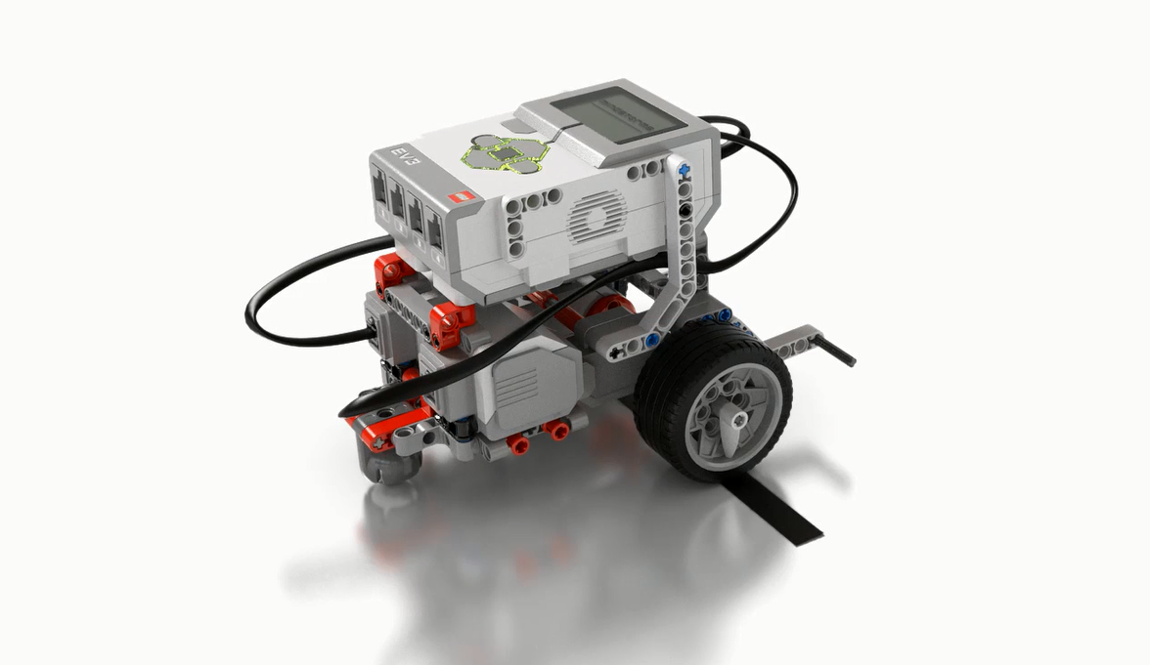
CRUISE CONTROL with Lego EV3
Modular design and manufacture cruise control system.
The bronze goal : enable the car to find its own way and monitor obstacles.
The silver goal : enable the car to navigate more complex routes.
The gold level : the car can detect roadside panels.
4
Notes:
4

Slide 5
02
Hardware Description
5
Notes:
5

Slide 6
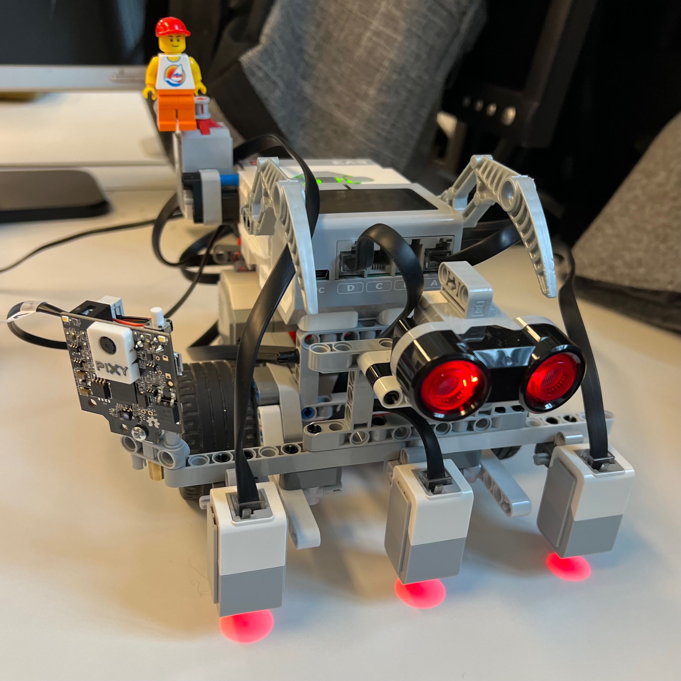
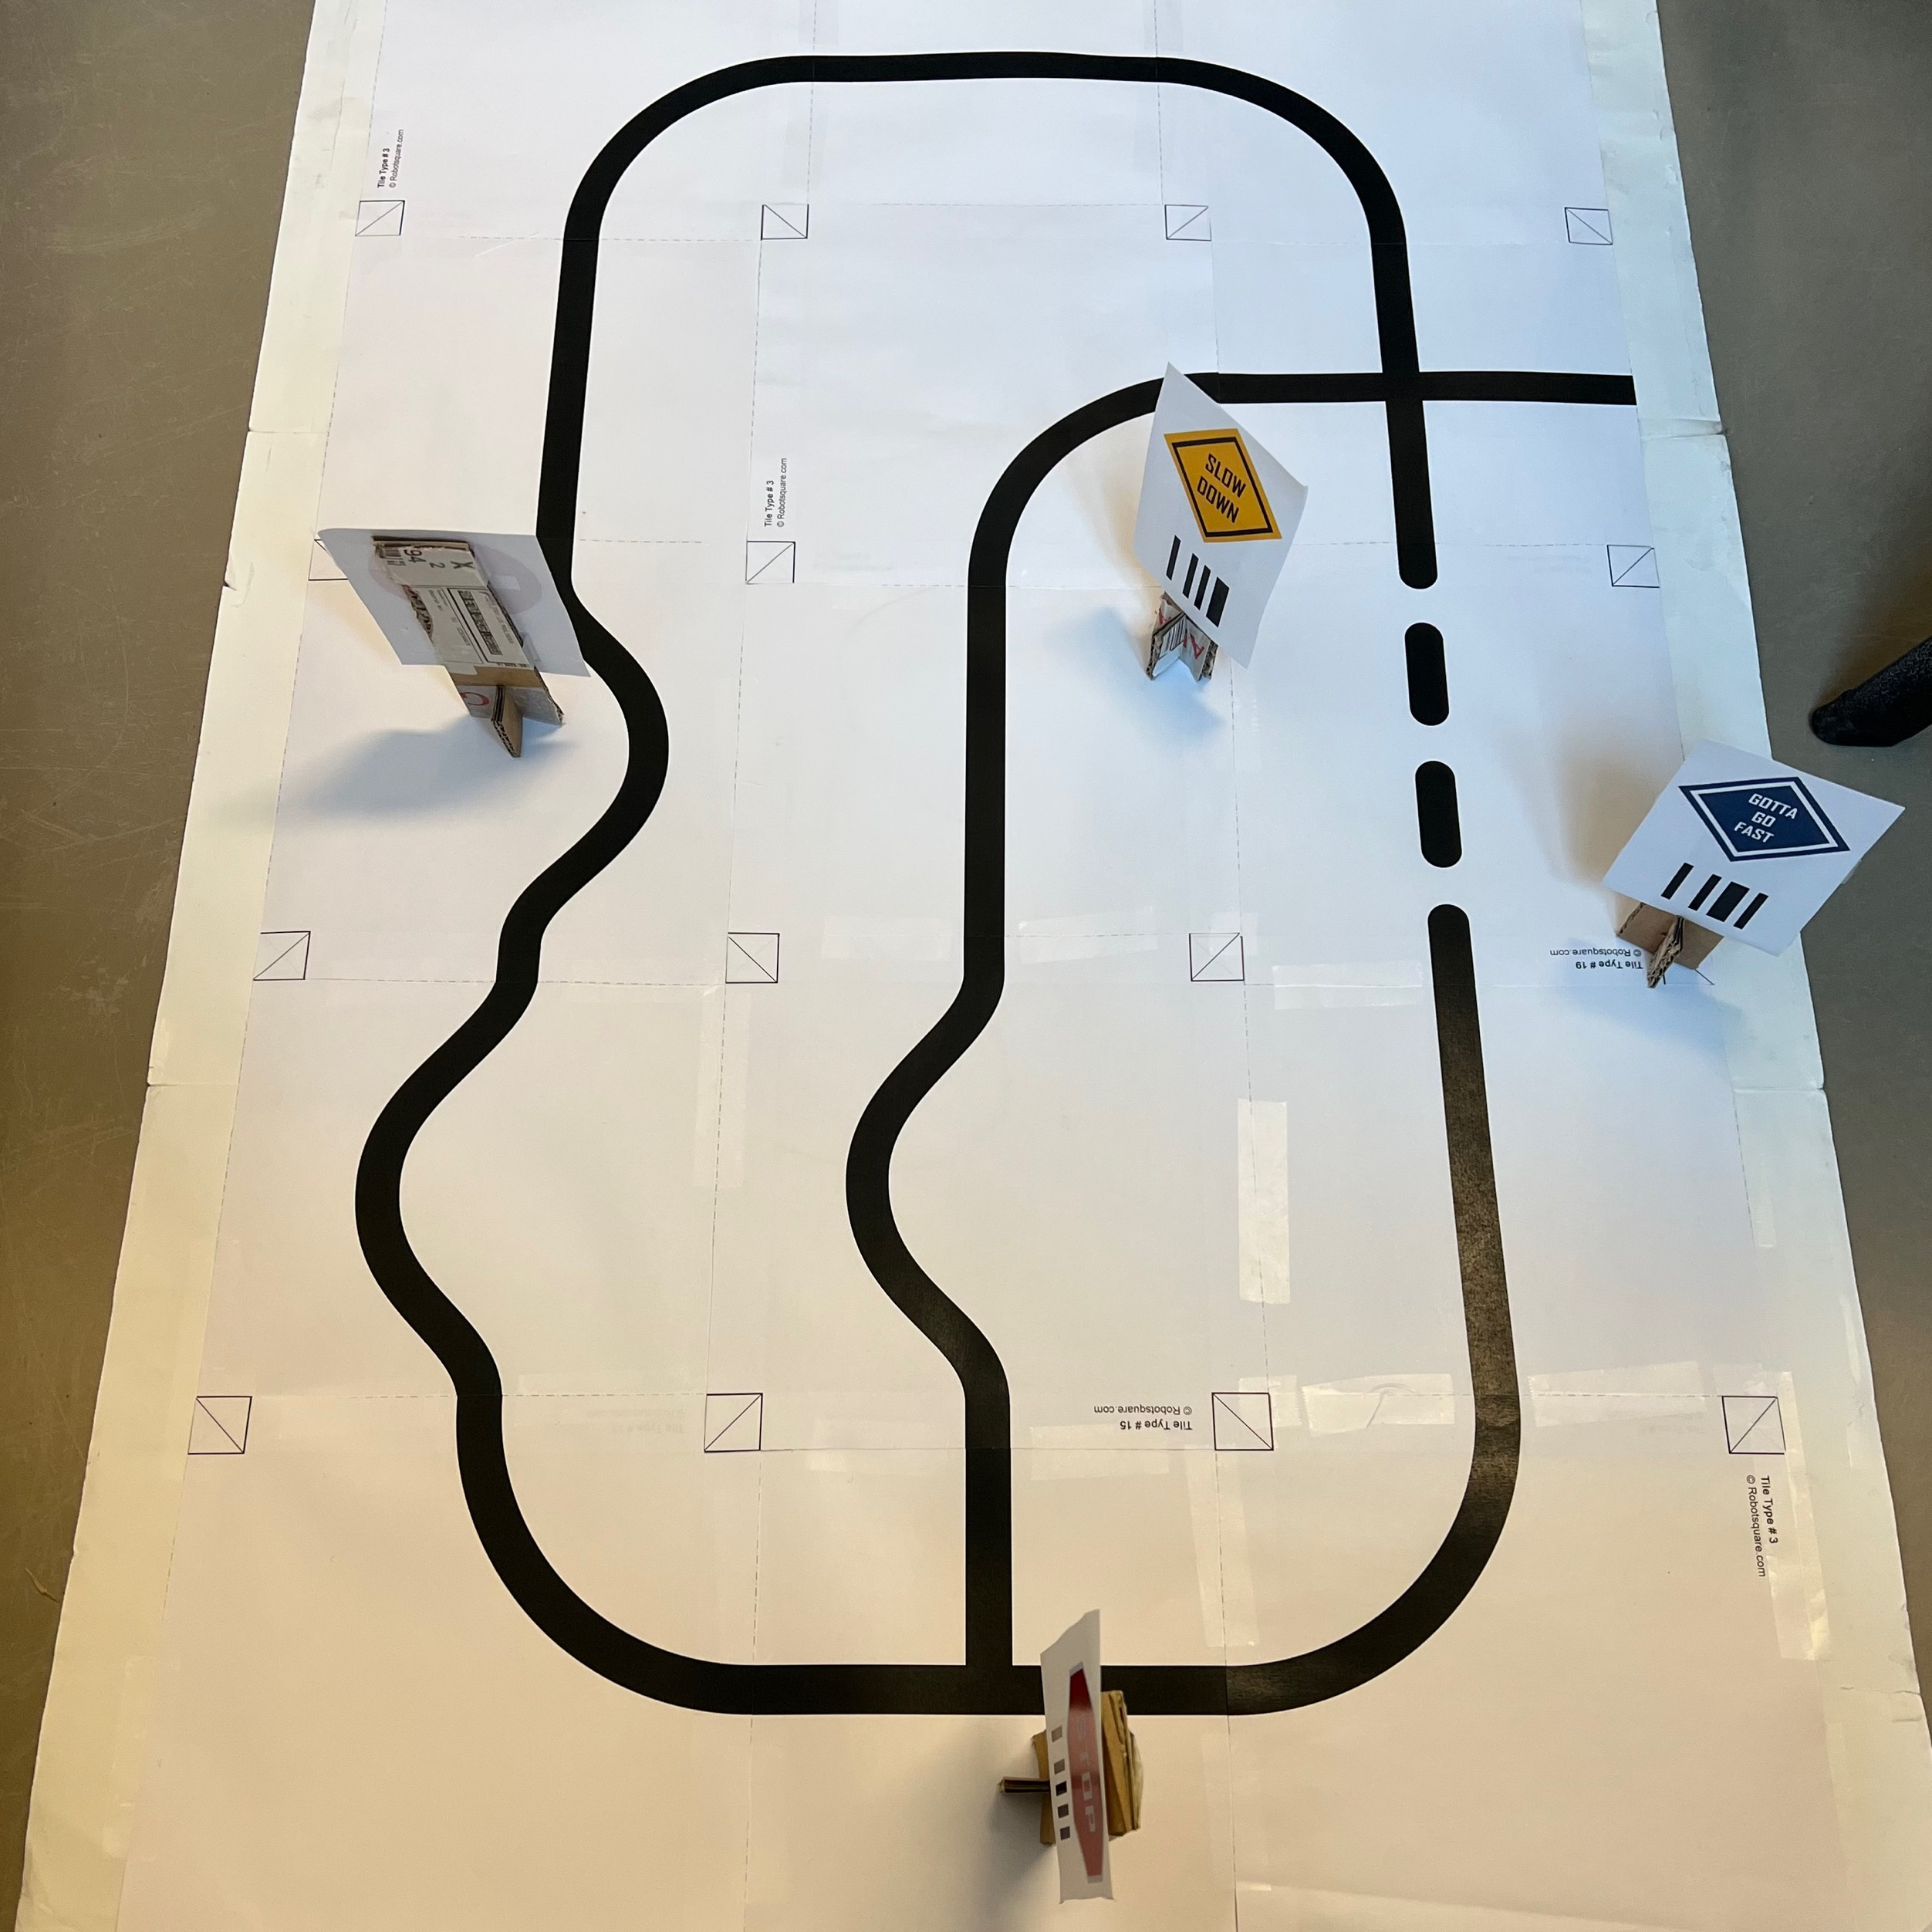
Lego Car and Road Map
Simple and efficient Cruise control car with 2 motors
Consisting colour sensors, ultrasonic sensor and a push sensor.
Include a pixy camera to detect the panels across the journey.
A Lego brick is present at the top for easy accessing and controlling it
6
Notes:
6

Slide 7
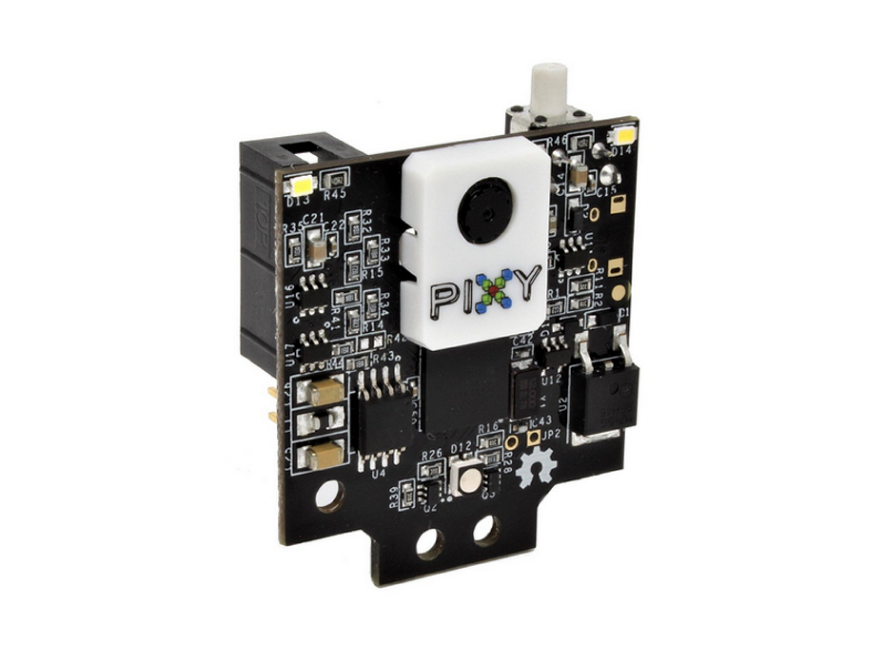
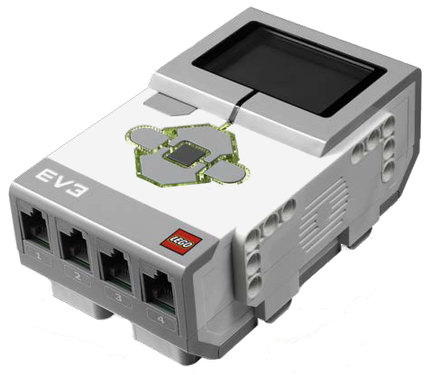
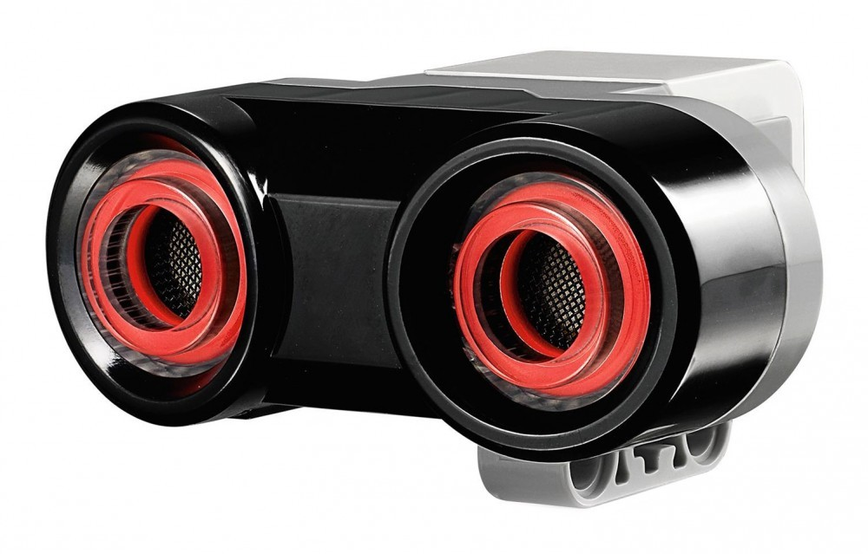
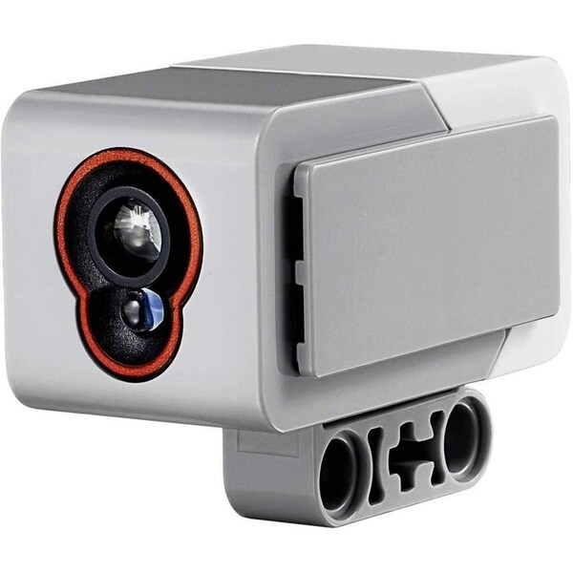
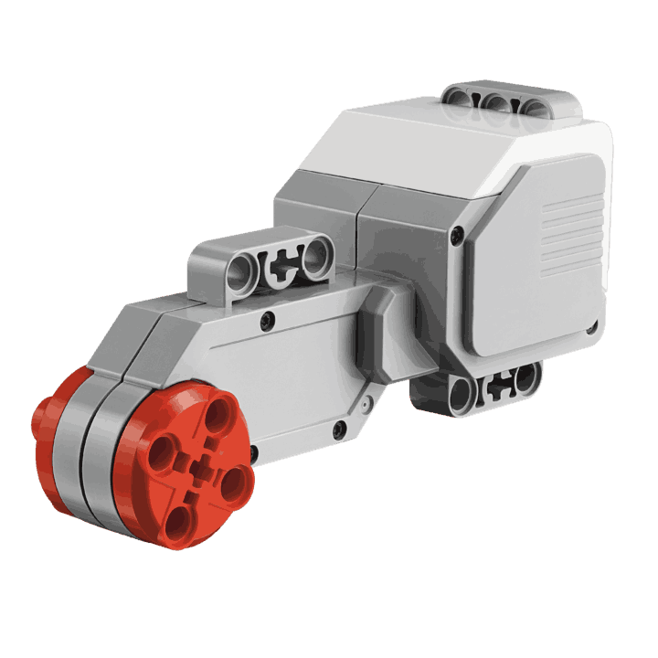
Hardware
Development board
Pixy Camera
Ultrasonic sensor
Color sensor
Electric motor
7
Notes:
Why did we choose these components?
7

Slide 8
The Track
The starting point
Corner
Electric motor
Development board
Color sensor
Intersection
Irregular road pattern
8
Notes:
8

Slide 9




Indication Panels In The Track
STOP
SLOW DOWN
GOTTA GO FAST
The starting point
Corner
Electric motor
Development board
Color sensor
Intersection
Irregular road pattern
9
Notes:
9

Slide 10
03
Software Structure
10
Notes:
10

Slide 11
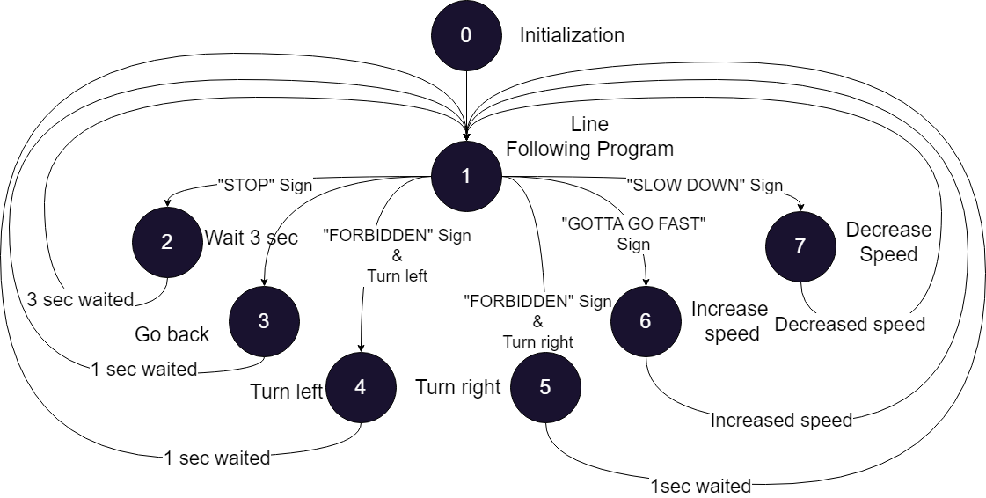
Code structure : State machine
11
Notes:
11

Slide 12
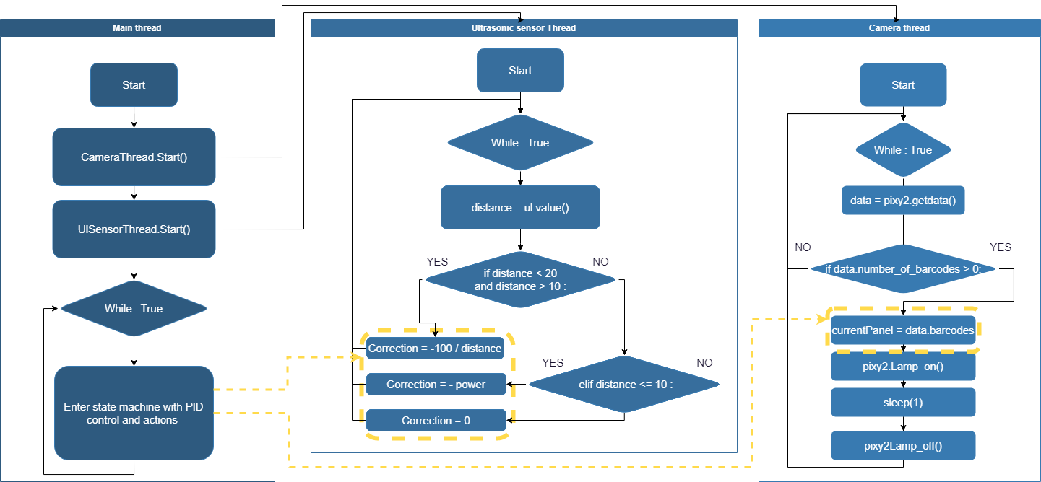
Code structure : Threading
12
Notes:
12

Slide 13
Code structure : Classes
main.py :
Main function
Threads starts
Sensor reading
State Machine :
PID control
Increase speed (called from robot.py)
Decrease speed (called from robot.py)
Stop for 3 seconds (called from robot.py)
Turn Right (called from robot.py)
Turn Left (called from robot.py)
robot.py :
Sensors initialization
Motors initialization
Camera initialization
Global values
Settings
cameraThread class
ulSensorThread class
TurnLeft
TurnRight
IncreaseSpeed
DecreaseSpeed
Stop
Ev3dev (OS):
Sensor/actuators class
pixy2.py :
Pixy2 class
Class
Function
Variables
13
Notes:
13

Slide 14
04
Specifications and Test reviews
14
Notes:
14

Slide 15
Specification and Test reviews – Bronze target
Specifications :
Follow a line
Adapt speed according to obstacles in front the robot
Stop the robot if an obstacle is too close to the front of the robot
What the robot could do :
Follow a line in one direction
Adapt speed when the obstacle is between 10cm to 20cm in front of it
Stop when the obstacle is 10cm or less in front of it
What the robot couldn’t do :
Follow a line in both direction
15
Notes:
15

Slide 16

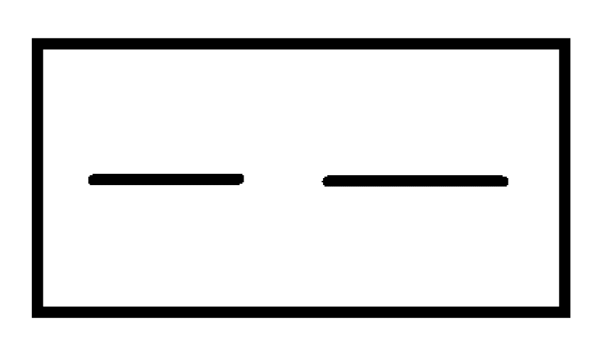
Specification and Test reviews – Silver target
Specifications :
Follow a determined a path on a track
Go through a cross section
Go through an interruption
What the robot could do :
Go through a cross section
Go through an interruption of around 2cm
What the robot couldn’t do :
Follow a determined path on a track
16
Notes:
16

Slide 17
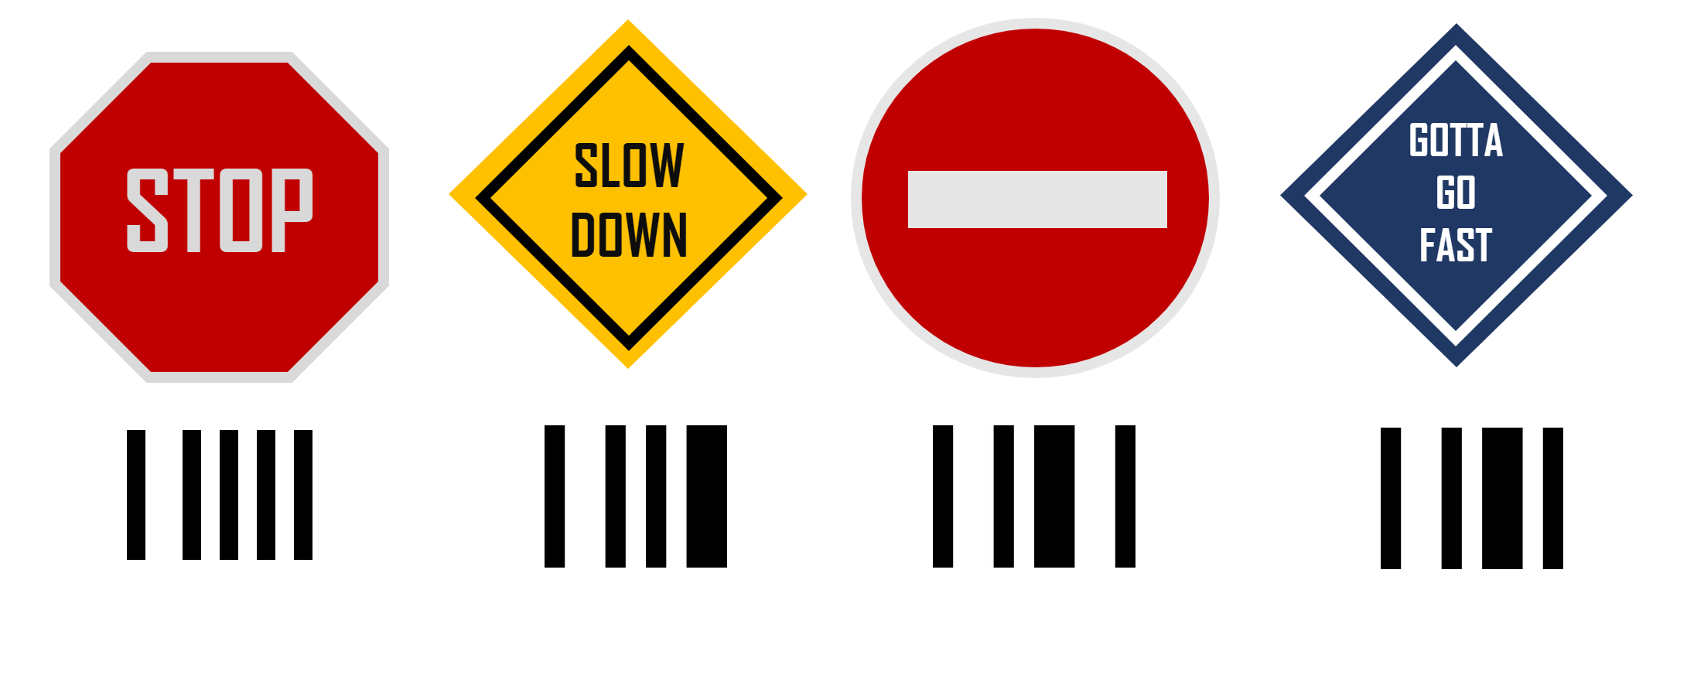
Specification and Test reviews – Gold target
Specifications :
Recognize panels on the side road
React to panels on the side road
Panels used :
Stop : stop the robot for 3s
Slowdown : slow the robot to its minimum speed
No entry : block the path in front of the robot on a cross section
Gotta go fast : accelerate the robot to its top speed
17
Notes:
17

Slide 18
05
Problems Encountered
18
Notes:
18

Slide 19



Problem Encountered
Hardware
Using
Pixy camera
Software
PID controller
accuracy
Problem of Test
Software
Making a classes
In our code
19
Notes:
19

Slide 20
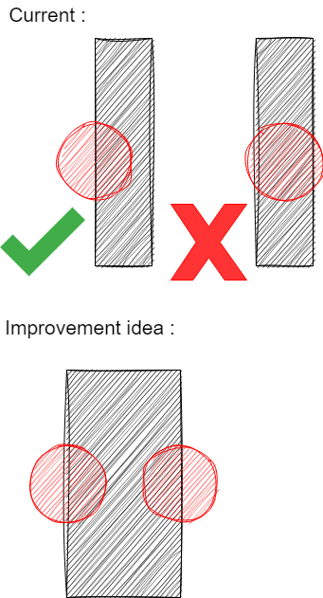
Problem encountered
Operating conditions :
The field must be clean enough
The ambient light may affect the values read by the sensors
The line to follow isn’t large enough (the robot loose the line)
Hardware limits:
Limited system ressources (too many threads causes slowdowns)
The system is very sensitive to the battery state : affecting motor power AND sensor range
Improvement leads :
Larger line so the robot doesn’t loose the track
Adding another sensor to follow the line
20
Notes:
20

Slide 21
WRITE A TITLE IN THIS SECTION
Year-end report
Thank you
By faith I mean a vision of good one cherishes and the enthusiasm
that pushes one to seek its fulfillment regardless of obstacles.
Designer: DreamsPPT department: Marketing
Notes:
21

