Slide 1
COT 4400 Final Project
A project by
Alexandre Miguel Lopes Fernandes Da Silva, Dyllan Britz, Darien Henrie
Notes:
When listing all project collaborators, either use commas or bullets

Slide 2
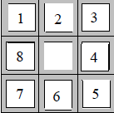
Background of Problem
Find the cheapest solution to the 8-puzzle, given the initial and goal state.
DFS
BFS
Dijkstra
Notes:
What is the name of your colony song?
Write lyrics to the song and, if you are feeling creative, use a computer program or instruments to create the music that goes along with it!
To insert an audio file, click on Recording -> Audio -> Audio on My PC and

Slide 3
Implementation
Step 1
Read the input file
Step 2
Check if puzzle is solvable
Step 3
Run the Implemented algorithms
Step 4
Find the cheapest solution
Notes:
What is the name of your colony song?
Write lyrics to the song and, if you are feeling creative, use a computer program or instruments to create the music that goes along with it!
To insert an audio file, click on Recording -> Audio -> Audio on My PC and

Slide 4
DFS
// Input: A graph G and a vertex v of G
// Output: All vertices reachable from v labeled as discovered
procedure DFS-iterative(G,v) {
let S be a stack
S.push(v)
while S is not empty {
w = S.pop()
if (w is not labeled as discovered) {
label w as discovered
for all vertices x in G.adjacentVertices(w) {
S.push(x)
}
}
}
}
Notes:
What is the name of your colony song?
Write lyrics to the song and, if you are feeling creative, use a computer program or instruments to create the music that goes along with it!
To insert an audio file, click on Recording -> Audio -> Audio on My PC and

Slide 5
BFS
// Input: Graph G and a starting Vertex v
// Output: labeling of the edges and partition of the vertices // of G
procedure BFS(G,v) {
let Q be queue
Q.enqueue(v)
label v as "discovered"
while ( Q is not empty) {
w = Q.dequeue()
for all vertices s of w in G.adjacentVertices(w) {
if (vertex s is not labeled as "discovered") {
Q.enqueue(s)
label s as "discovered"
}
}
}
}
Notes:
What is the name of your colony song?
Write lyrics to the song and, if you are feeling creative, use a computer program or instruments to create the music that goes along with it!
To insert an audio file, click on Recording -> Audio -> Audio on My PC and

Slide 6
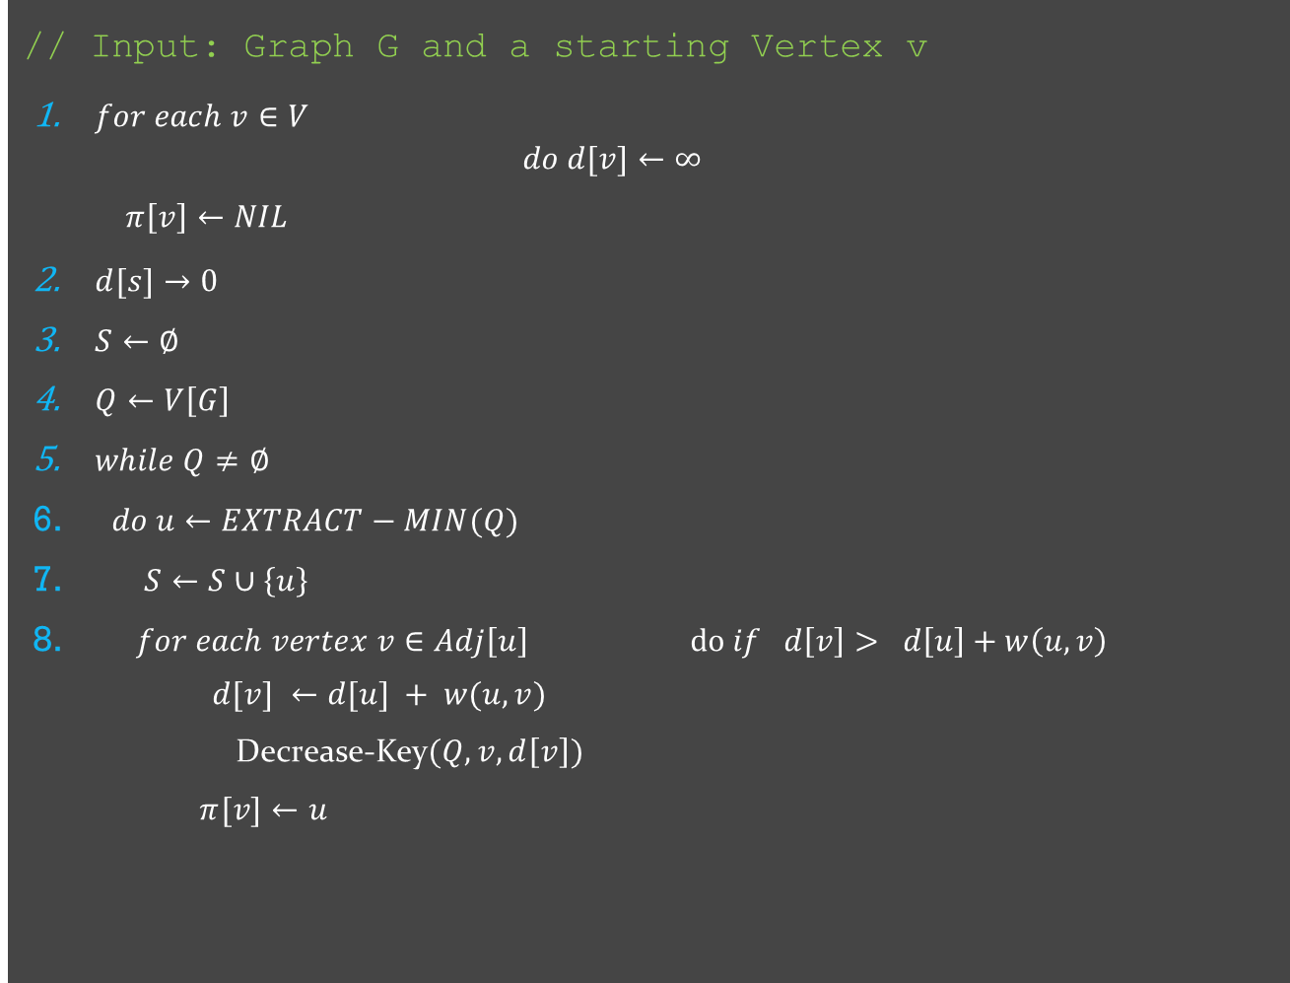
Dijkstra
// Input: Graph G and a starting Vertex v
$for each v∈V$
$$do d[v]←∞$$
$π\left[v\right]←NIL$
$d[s]→0$
$S←∅$
$Q←V\left[G\right]$
$while Q≠∅$
$do u←EXTRACT−MIN(Q)$
$S←S∪\left\{u\right\}$
$for each vertex v∈Adj\left[u\right]$ $do if d\left[v\right]> d\left[u\right]+w\left(u, v\right)$
$d[v] ←d[u] + w(u, v)$
Decrease-Key$(Q,v,d\left[v\right])$
$π[v]←u$
Notes:
What is the name of your colony song?
Write lyrics to the song and, if you are feeling creative, use a computer program or instruments to create the music that goes along with it!
To insert an audio file, click on Recording -> Audio -> Audio on My PC and

Slide 7
Walkthrough
Notes:
What is the name of your colony song?
Write lyrics to the song and, if you are feeling creative, use a computer program or instruments to create the music that goes along with it!
To insert an audio file, click on Recording -> Audio -> Audio on My PC and

Slide 8
Analysis
DFS | BFS | Dijkstra
Stack-based Running time of o(V + E) | Queue-based Running time of O(V+E) | PQ-based Running time of O(V+E*LogV)

Slide 9
Conclusion
Understanding how different algorithms can be applied to solve the same problem
Hands-on experience on implementing BFS, DFS, and Dijkstra algorithm to solve a complex problem
Compared and enhanced knowledge on the given algorithms
Notes:
Insert a map of your colony (draw it, ink it, or create it in PPT- be creative!)
Insert -> Pictures for photos
Draw for digital inking
Insert -> Shapes if you want to create it in PPT
All mountains, towns/villages, bodies of water/waterways, landmarks, etc. should be clearly labeled

Slide 10

Questions?

